Slide 1
2015 History & Social Science Standards of Learning Fall Institute
October 3, 2016 – Abingdon
October 4, 2016 – Danville
October 11, 2016 – Staunton
October 17, 2016 - Herndon
October 18, 2016 – Fredericksburg
October 24, 2016 – Roanoke
November 3, 2016 – Richmond
November 14, 2016 – Newport News

Slide 2
Notes:
Welcome and introduce Betsy and Jill. Ask each to say something.
There will be CHANGE placards on the tables. Ask participants to choose one that they most identify with. Do not discuss why, but just choose the one that speaks to them the most. There should be two of each type on the table.

Slide 3
What’s happening today . . .
Opening Session
Information Sources at Work
Working Lunch
Breakout Sessions

Slide 4
Opening Session
Review and Revision of the History and Social Science Standards of Learning
Literacy Connections
Supporting Documents, Resources, and Professional Development
Notes:
What you will find is that we will be going backwards to move forward. I will show you where we have come from to help you understand why we are where we are today and what you will be doing to move us forward this fall.

Slide 6
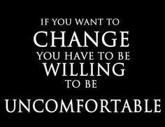
Notes:
Stop! Discussion about the fact that changes have been made and that there will be a level of uncomfortableness that may occur.
Use a personal example as a model.
Have a place where we would like to be when it comes to history and social science education.
Have the person who selected stand and discuss with their table why they choose this placard. Each person has one minute.

Slide 7
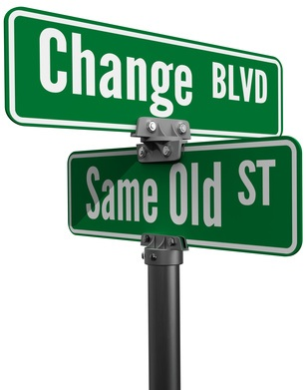
Review and Revision of the History and Social Science Standards of Learning
Notes:
Although it will be uncomfortable, we can remain on Same Old Street or move to Change Blvd

Slide 8
Goal of the History and Social Science Standards of Learning
The study of history and social science is vital in promoting a civic-minded, democratic society.
All students need to know and understand our national heritage in order to become informed participants in shaping our nation’s future.

Slide 9
Code of Virginia
Notes:
Establishing standards for history and social science is written in the Code of Virginia.

Slide 10
Code of Virginia
§ 22.1-253.13:1. Standard 1. Instructional programs supporting the Standards of Learning and other educational objectives.
The Board of Education shall establish educational objectives known as the Standards of Learning, which shall form the core of Virginia's educational program, and other educational objectives, which together are designed to ensure the development of the skills that are necessary for success in school and for preparation for life in the years beyond.

Slide 11
Code of Virginia
§ 22.1-253.13:1. Standard 1. Instructional programs supporting the Standards of Learning and other educational objectives.
The Board of Education shall establish educational objectives known as the Standards of Learning, which shall form the core of Virginia's educational program, and other educational objectives, which together are designed to ensure the development of the skills that are necessary for success in school and for preparation for life in the years beyond.
The Board of Education shall establish educational objectives known as the Standards of Learning
Notes:
The standards therefore belong to the Virginia Board of Education.

Slide 12
Code of Virginia
§ 22.1-253.13:1-2. The Board of Education shall establish a regular schedule, in a manner it deems appropriate, for the review, and revision as may be necessary, of the Standards of Learning in all subject areas. Such review of each subject area shall occur at least once every seven years. Nothing in this section shall be construed to prohibit the board from conducting such review and revision on a more frequent basis.
Notes:
Based upon the Code of Virginia, review and revisions as may be necessary of the Standards of Learning for each subject area, occur every seven years. The Code does allow for the BOE to call for more frequent review and revision if needed.

Slide 13
Review and Revision Schedule

Slide 14
January 2014 – March 2015
Revised the 2008 History and Social Science Standards of Learning
Committees were convened to review and revise the Standards
The proposed History and Social Science Standards of Learning was taken to the Virginia Board of Education for first review
Public comment period followed
March 2015
Virginia Board of Education approved 2015 History and Social Science Standards of Learning
Summer 2015
Committees convened to review and revise the Curriculum Framework
Notes:
Process for reviewing and revising of the history and social science Standards of Learning was a two year process.

Slide 15
Fall 2015
The proposed History and Social Science Standards of Learning Curriculum Framework went to the Virginia Board of Education for first review. Public comment period followed.
Winter 2016
Virginia Board of Education approved 2015 History and Social Science Standards of Learning Curriculum Framework
July 2016
Virginia Department of Education posted 2015 History and Social Science Standards of Learning and Curriculum Framework
Notes:
Review the process verbally- committees, regional representation, over 1100 comments submitted, public hearings, involvement with External Committees: historians, museums, and other entities with history and social science interest

Slide 16
Notes:
The Preface outlines or provides an introduction to the Standards, the process used and an overview as to how the contents within should be used.

Slide 17
Notes:
Mark the text-
Understand
Surprised
Questions about

Slide 18
The History and Social Science Standards of Learning, supported by the History and Social Science
Standards of Learning Curriculum Framework, define essential understandings, knowledge, and skills. The standards and curriculum framework are not intended to encompass the entire curriculum for a given grade level or course nor to prescribe how the content should be taught. School divisions are encouraged to incorporate the standards and curriculum framework into a broader, locally designed curriculum.
Notes:
Although the Standards and the Curriculum Framework is very dense in content, it is the responsibility of the local school division use the standards to develop a broader, locally designed curriculum.

Slide 19
Overview of Revisions
Increased Emphasis on the Skills in the
2015 History and Social Science Standards of Learning
History and social science skills are a key component to understanding historical, geographic, political, and economic events or trends. They are the tools used
to increase student understanding of the history and social science curriculum;
to guide the focus of instruction for each standard;
to indicate what the student should be able to do; and
to be incorporated in all history and social science content instruction.
Notes:
The skills will not be assessed in isolation, rather they will be assessed as part of the content in the History and Social Science Standards of Learning.

Slide 20
It starts with the . . .

Slide 22
Overview of Revisions
Skills have always existed in the K-3 courses and the 2015 review spells out the skills for each of the K-3 courses. The skills define the expectations and will assist teachers as they plan their instruction.

Slide 23
Skills
K.1 The student will demonstrate skills for historical thinking, geographical analysis, economic decision making, and responsible citizenship by
viewing artifacts and primary and secondary sources to develop an understanding of history;
using basic map skills to support an understanding of the community;
gathering and classifying information, sequencing events, and separating fact from fiction to improve understanding of the community;
asking appropriate questions to solve a problem;
comparing and contrasting people, places, or events;
recognizing direct cause-and-effect relationships;
making connections between past and present;
using a decision-making model to make informed decisions;
practicing good citizenship skills while collaborating, compromising, and participating in classroom activities; and
developing fluency in content vocabulary and comprehension of oral, written, and visual sources.
viewing artifacts and primary and secondary sources to develop an understanding of history;
Notes:
Point out that the verb or the “action” changes depending upon the level. Students have opportunity to practice the skill at different levels also.

Slide 24
Skills
VS.1 The student will demonstrate skills for historical thinking, geographical analysis, economic decision making, and responsible citizenship by
analyzing and interpreting artifacts and primary and secondary sources to understand events in Virginia history;
analyzing the impact of geographic features on people, places, and events to support an understanding of events in Virginia history;
interpreting charts, graphs, and pictures to determine characteristics of people, places, or events in Virginia history;
recognizing points of view and historical perspectives;
comparing and contrasting ideas and cultural perspectives in Virginia history;
determining relationships with multiple causes or effects in Virginia history;
explaining connections across time and place;
using a decision-making model to identify costs and benefits of a specific choice made;
practicing good citizenship skills and respect for rules and laws while collaborating, compromising, and participating in classroom activities; and
investigating and researching to develop products orally and in writing.
analyzing and interpreting artifacts and primary and secondary sources to understand events in Virginia history;

Slide 25
Skills
WHII.1 The student will demonstrate skills for historical thinking, geographical analysis, economic decision making, and responsible citizenship by
synthesizing evidence from artifacts and primary and secondary sources to obtain information about events and life in world history;
using geographic information to determine patterns and trends in world history;
interpreting charts, graphs, and pictures to determine characteristics of people, places, or events in world history;
evaluating sources for accuracy, credibility, bias, and propaganda;
comparing and contrasting historical, cultural, economic, and political perspectives in world history;
explaining how indirect cause-and-effect relationships impacted people, places, and events in world history;
analyzing multiple connections across time and place;
using a decision-making model to analyze and explain the incentives for and consequences of a specific choice made;
identifying the rights and responsibilities of citizens and ethical use of materials and intellectual property; and
investigating and researching to develop products orally and in writing.
synthesizing evidence from artifacts and primary and secondary sources to obtain information about events and life in world history;

Slide 26
Skills Progression Chart
Notes:
Discuss the benefits and barriers of a skills progression chart. Develop strategies to overcome barriers.

Slide 27
Skills Progression Chart
Conceptual Understanding
Scaffolding the Understanding
Analyzing the Understanding

Slide 28
Overview of the Revisions
Beginning with USI-
There is now an expectation that students move from “demonstrate knowledge” to “apply social science skills” to the content.
Notes:
This change can be found in the lead-in statements of each standard beginning with the course- United States History to 1865 and continuing through Virginia and United States Government.

Slide 29
Overview of the Revisions
Kindergarten – Grade Three
This reflects widening the student’s sphere of learning. It illustrates a progression from the local community to the Commonwealth of Virginia, moving towards a focus on the United States of America and then expanding to a focus on ancient world cultures.

Slide 30
Overview of the Revisions
Virginia Studies, United States History to 1865, United States History: 1865 to the Present, and Civics and Economics
Updated to reflect current events.

Slide 31
Overview of the Revisions
World Geography
WG.4 (2008) was expanded into separate standards organized by regions.
World History and Geography courses
Content added to explore a global focus.

Slide 32
Overview of the Revisions
Virginia and United States History
Content added to fill gaps and reflect a more diverse history
Virginia and United States Government Content removed that was duplicated in Economics and Personal Finance

Slide 33
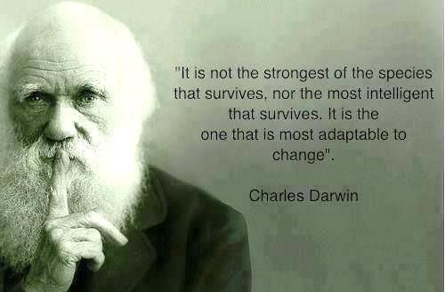

Slide 34
CURRICULUM FRAMEWORK

Slide 35
Curriculum Framework
Four Columns
Notes:
2008 Standards provided for four columns giving teachers specific questions and skills to teach each Standard.

Slide 36
Curriculum Framework
Two Columns
Notes:
Revision Committee members, public comment, and External Committee input suggested eliminating two columns to provide autonomy to develop relevant questions and determine which social science skills best supported making connections and understanding content.

Slide 37
Experiences for Essential Skills
What are Experiences?
Notes:
Bring attention to the Experiences and describe what they are and how they can be used.
Provide teachers with “experiences” and give them an opportunity to:
discuss what they are and how they can be used; and
develop their own to share with the group.

Slide 38
The experiences should be –
engaging,
rigorous with higher level thinking questions,
relevant (connecting time periods, places, and events to the present day).

Slide 39
Experiences
Are . . .
Are NOT. . .
Engaging- promoting discussion, collaboration, and understanding
Opportunities to practice social science skills using various content
Varied throughout the lesson to help students make connections
Worksheets
Specific to one Standard, topic, or course

Slide 40
Just a thought . . .

Slide 41
Resources Strike Through Documents
The strikethrough documents enable teachers, schools, and divisions to compare the revisions and changes to the 2008 and 2015 History and Social Science Standards of Learning.
Final Review of Proposed History and Social Science Standards of Learning
Proposed Curriculum Framework for 2015 History and Social Science Standards of Learning

Slide 42
Crosswalk
Notes:
The Crosswalk replicates the information provided in the Final Review of Proposed History and Social Science Standards of Learning, but in chart form.

Slide 44
Think about . . .
Literacy Connections:
English skills used in teaching
History and Social Science

Slide 45
New
Collaboration and Integration
History and Social Science
Using Informational Sources
Applying Geographic Skills
Organizing Information
Questioning
Comparing and Contrasting
Determining Cause & Effect
Making Connections
Exercising Civic Responsibility
Demonstrating comprehension
Reading
Use text structures such as type, headings, and graphics to predict and categorize information.
Use prior knowledge and background knowledge as context for new learning.
Identify questions to be asked.
Compare/contrast information about a topic in different selections.
Identify cause/effect relationships.
Identify and summarize supporting details.
Compare/contrast viewpoints.
Notes:
This slide shows the connection between the HSS skills and the English Standards of Learning. Students are familiar with the skills addressed in HSS courses because all of their English courses are based on these skills. Consider a partnership with your English teacher across the hall. Collaboration between disciplines will only enhance learning and provide for a deeper understanding of concepts, skills, and content.

Slide 46
Teaching Literacy Through History
Notes:
Several professional resources on teaching literacy through history.

Slide 47
The Connection Between Literacy and History
Notes:
An article on the connection between literacy and history.

Slide 48
NCTE Content Literacy Resources
Notes:
The National Council for Teachers of English resource page for disciplinary literacy. Links will lead to professional development videos, books, and journals for further study on the topic.

Slide 49
Literacy is a shared responsibility.

Slide 50
English SOL Institute Presentations & Lessons
2012: Nonfiction reading, writing, research and media literacy
2013: Using primary sources with the Library of Congress, vocabulary strategies, nonfiction reading, and persuasive writing
2014: Nonfiction and fiction reading, writing, instructional strategies for English Language Learners and Students with Disabilities.
2015: Formative Assessment
Presentations and resources aimed at both elementary and secondary classrooms http://www.doe.virginia.gov/testing/sol/standards_docs/english/index.shtml
Notes:
Follow the links to the English SOL Institute materials from previous years. Each year had a different focus/concentration, but you’ll find materials that will work for your own professional development or for use in your classrooms. 2013 and 2015 will tie very nicely with the new HSS standards and skills.

Slide 51
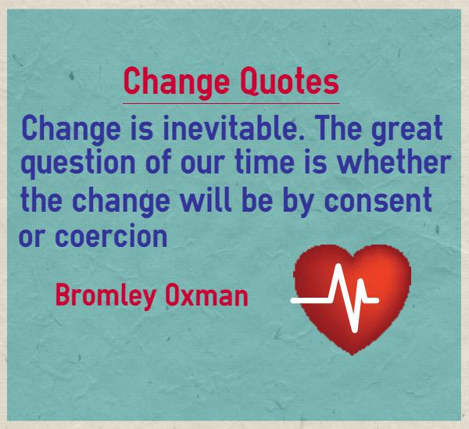
Notes:
Who does this speak to?

Slide 52
Fall
Institutes

Slide 53
Today

Slide 54
As the
2015 History and Social Science Standards of Learning
are implemented, what should be the consistent message?

Slide 55
The addition of social science skills at every course were strengthened to prepare students for their next steps by providing an opportunity for teachers to . . .

Slide 56
. . . develop instructional lessons and activities that engage students with the content using the social science skills
–Active Engagement

Slide 57
. . . teach for understanding rather than memorization
. . . effectively collaborate and integrate

Slide 58
. . . and provide exemplars that demonstrate a deeper understanding and promote historical thinking through the application of knowledge and skills.

Slide 59
Notes:
Encourage teachers to make one small change in order to “change” their instructional delivery.

Slide 60
Your thoughts . . .
Notes:
Ideas that you are square with
Three points to summarize the revisions or the process
Questions still circling

Slide 61
2015 History and Social Science SOL Institute Partners
Virginia Commission on Civics Education
Virginia Council on Economic Education
Virginia Geographic Alliance
Teaching with Primary Sources, Northern Virginia Partnership- A Program of the Library of Congress

Slide 62
2015 History and Social Science
SOL Institute Steering Committee
Name | Division | Region
Alice Reilly | Fairfax | IV
Amy Cummings | Roanoke | VI
Amy Griffin | Cumberland | VIII
Brennan Sigel-Guion | Hanover | I
Bruce Brady | Norfolk | II
Cathy Hix | Alexandria | IV
Ellen Stick | Roanoke City | VI
Janet Stevens | Richmond City | I
Jeff Girvan | Prince William | IV
Jennifer Brown | Fairfax | IV
Jennifer Lopez | Norfolk | II
Katrina Cary | Suffolk | II
Lisa Gibson | Virginia Beach | II
Lynne Bland | Chesterfield | I
Mary-Beverly | Washington | VII
Meredith Rapp | Powhatan | I
Myra Frazier | Campbell | V
Roxanne Edgerton | Chesapeake | II
Sarah Duncan-Hinds | Isle of Wight | II

Slide 63
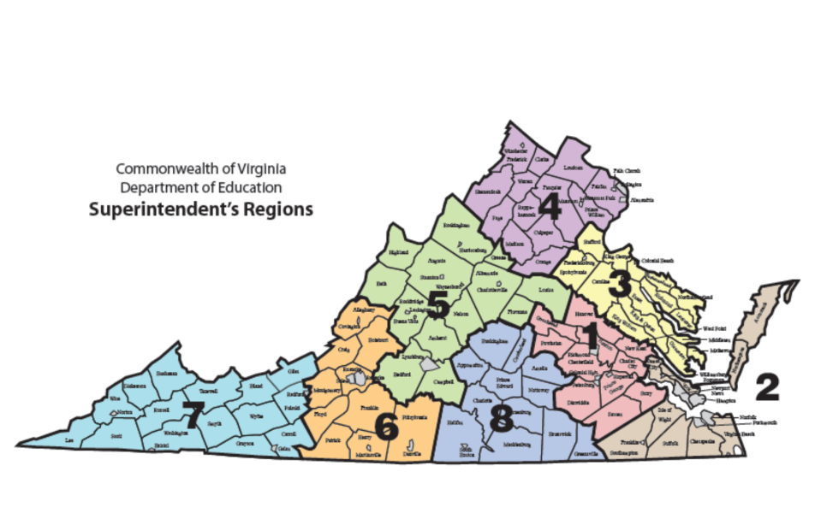
2015 History and Social Science Teacher Trainers
Region I
Name | Course | School Division
Carla Crump | K - 3 | Powhatan County
Apryl-Dawn Julien | K - 3 | Richmond City
Julia Davis | Virginia Studies | Hanover County
Katherine Moore | USI | Richmond City
Sara Kelley | USII | Powhatan County
Tracey Zaval Horvath | Civics and Economics | Chesterfield County
Brennan Sigel-Guion | World Geo | Hanover County
Karen Adam | WHI | Hanover County
Maria Newby | WHII | Powhatan County
Rodney Robinson | VUS | Richmond City
Nakita Lee | GOVT | Chesterfield County
Region II
Name | Course | Division
Quoteshia Hargett | K - 3 | Portsmouth
Melissa Mygas | K - 3 | Newport News
Roberta Branch | Virginia Studies | Suffolk
Melissa Viola-Askey | USI | Prince William
Wendy Burr | USII | Chesapeake
Ferida Cralle | Civics and Economics | Stafford
Kelly Stead | World Geo | Norfolk
Julie Blumenthal | WHI | Norfolk
Candace Schafer-Southard | WHII | Williamsburg-James City
Camille Beliveau | VUS | Chesapeake
Jessica Mitchell | GOVT | Newport News

Slide 64
2015 History and Social Science Teacher Trainers
Region III
Name | Course | Division
Megan Bush | K - 3 | Stafford County
Jennifer Burgin | K - 3 | Arlington
Barbara Giese | Virginia Studies | Stafford County
Beth Davenport | USI | Stafford County
Brenda James | USII | Stafford County
Ferida Cralle | Civics and Economics | Stafford County
Bethany (Beth) Augrom | World Geo | Stafford County
Bradley Kraft | WHI | Montgomery County
Jessica Mitchell | WHII | Newport News
Cathy Nichols-Cocke | VUS | Campbell County
David Wessel | GOVT | Spotsylvania County
Region IV
Name | Course | School Division
Kathy Nealon | K - 3 | Fairfax
Susan Mayo | K - 3 | Manassas City
Anne Walker | Virginia Studies | Prince William
Nicole Bennett | USI | Fairfax
Aaron Cebular | USII | Prince William
Don Brunner | Civics & Economics | Culpepper
Diana Jordan | World Geo | Arlington
Thomas Callahan | WHI & WHII | Culpepper
Elizabeth Glynn | VUS | Loudoun County
Michelle Cottrell-Williams | GOVT | Arlington

Slide 65
2015 History and Social Science Teacher Trainers
Region V
Name | Course | School Division
Jennifer Burgin | K - 3 | Arlington County
Lori Stone | Virginia Studies | Campbell County
Meagan Gilliam | USI | Augusta County
Michelle Holland | USII | Campbell County
Curtis Young | Civics and Economics | Norfolk City
Diana Jordan | World Geo | Arlington County
Marc Hudson | WHI | Campbell County
Michael Nagy | WHII | Campbell County
Cathy Nichols-Cocke | VUS | Campbell County
Michelle Cottrell-Williams | GOVT | Arlington County
Region VI
Name | Course | School Division
Dawn Toole | K - 3 | Martinsville
Dana Campbell | Virginia Studies | Henry County
Jenna Sprinkle | USI | Roanoke County
Beth Simmons | USII | Franklin County
Jack Jagodzinski | Civics and Economics | Roanoke City
Brennan Sigel-Guion | World Geo | Hanover County
Layne Link | WHI | Roanoke County
Beverly Newbern | WHII | Roanoke County
Kelly White | VUS | Roanoke City
Michelle Cottrell-Williams | GOVT | Arlington County

Slide 66
2015 History and Social Science Teacher Trainers
Region VII
Name | Course | School Division
Misty Jeffers | K – 3 | Washington County
Bethany Collins | K - 3 | Tazewell County
Brandi McCracken | Virginia Studies | Washington County
Jessica Zumbrum | USI | Lee County
Debbie Manuel | USII | Wythe County
Christopher Wilson | Civics and Economics | Wise County
Sherry Cole | World Geo | Washington County
Jeremy Beverly | WHI | Washington County
Brianna Rhodes | WHII | Grayson County
Tiffany Jenkins | VUS | Bristol County
Tim Duncan | GOVT | Wise County
Region VIII
Name | Course | School Division
Tamara Green | K - 3 | Buckingham County
Vanessa Mason | K - 3 | Halifax County
Betty Banks | Virginia Studies | Lunenburg County
Meagan Gilliam | USI | Buckingham County
Laura Shaw | USII | Prince William County
Tracey Zaval Horvath | Civics and Economics | Chesterfield County
Jill Pritt | World Geo | Campbell County
Kelly Jones | WHI | Greensville County
Joseph Servis | WHII | Appomattox
Lloyd Page | VUS | Nottoway County
Courtney Kelly | GOVT | Cumberland County

Slide 67
Virginia Department of Education
Christonya Brown, K-12, History and Social Science Coordinator
E-mail: Christonya.Brown@doe.virginia.gov
Betsy Barton, Elementary, History and Social Science Specialist
E-mail: Betsy.Barton@doe.virginia.gov
Jill Nogueras, English and History and Social Science Specialist
E-mail: Jill.Nogueras@doe.virginia.gov

