Slide 1
Journey from Learning Experiences and Performance Tasks to Local Alternative Assessments
Middle School Social Studies

Slide 2


Slide 3
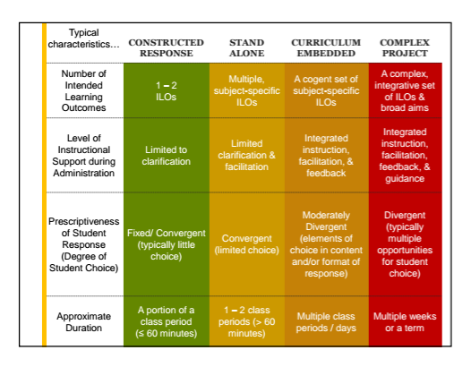
Performance Based Assessments
Dr. Chris Gareis, College of William and Mary

Slide 4
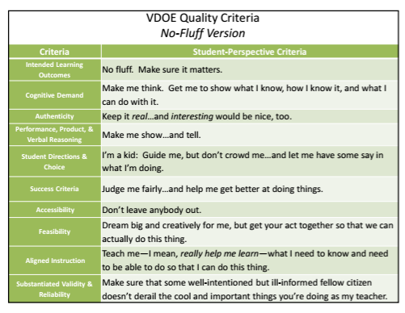
Dr. Chris Gareis, College of William and Mary

Slide 5
Begin with the end in mind...

Slide 6
GQ: How is power divided between the three branches?
Performance Based Assessment
Students will assume the role of a toymaker who is tasked with making a superhero action figure that represents one of the three branches of government. The name and look of the action figure must convey the powers of that branch of government. In addition, students will create any “accessories” needed to carry out the powers AND identify the weaknesses of that superhero as they pertain to the checks and balances system/powers of other branches.

Slide 7
Student Learning Objectives/Targets:
CE.1a) analyzing and interpreting evidence from primary and secondary sources, including charts, graphs, and political cartoons;
CE.1f) determining multiple cause-and-effect relationships that impact political and economic events;
CE.1j) defending conclusions orally and in writing to a wide range of audiences, using evidence from sources.
CE.6a) describing the structure and powers of the national government;
CE.6b) explaining the principle of separation of powers and the operation of checks and balances;
CE.6d) describing the roles and powers of the executive branch.
CE.9b) describing the exercise of judicial review

Slide 8
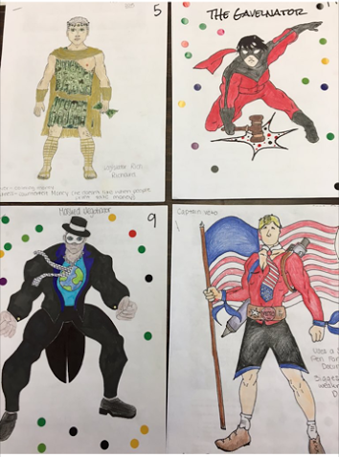

Slide 9
Legislative Branch

Slide 10
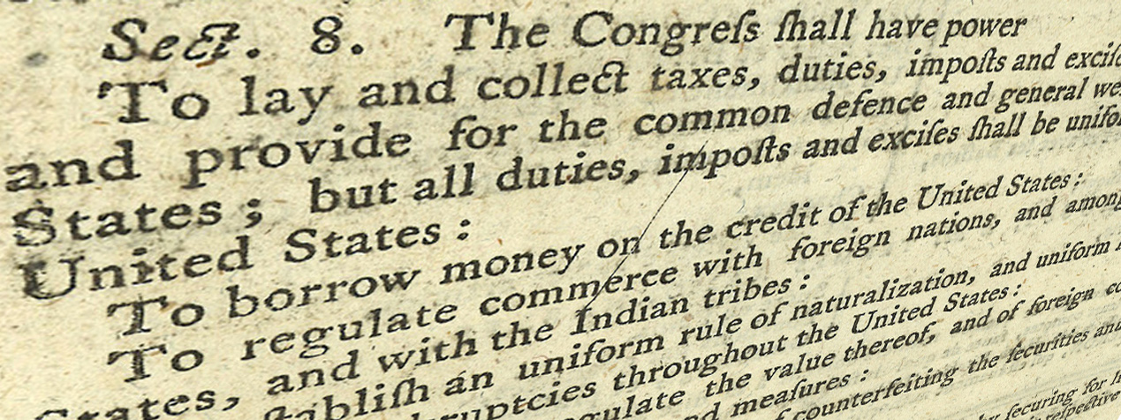
Constitution Coding (Article I Section 8)
Check - confirms what they know
Plus - new information
Minus - contradicts what they thought
Question - question about it
Notes:
Source of photo: http://bbcpersian7.com/images/article-1-section-8-1.jpg

Slide 11

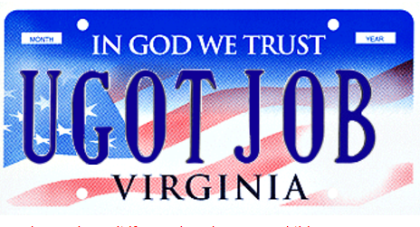
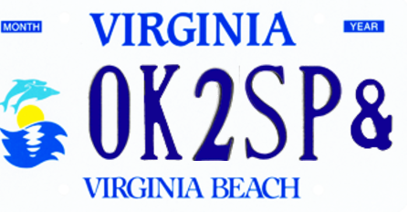
Congressional Vanity License Plates
Students will create a vanity plate for a senator or representative to brag about a power they have in their role in Congress.
Notes:
https://www.dmv.virginia.gov/dmvnet/plate_purchase/select_plate.asp

Slide 12
Executive Branch

Slide 13
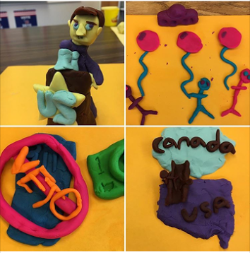
Presidential Roles Playdoh Sculptures and Hosted Gallery Walk
(student-directed instruction)
Notes:
Click on photo for link to see video of hosted gallery walk

Slide 14
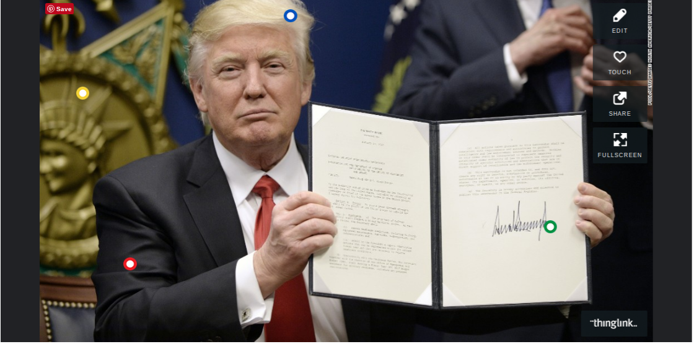
Executive Orders Thinglink DBQ
Notes:
Click on image for link to Thinglink

Slide 15
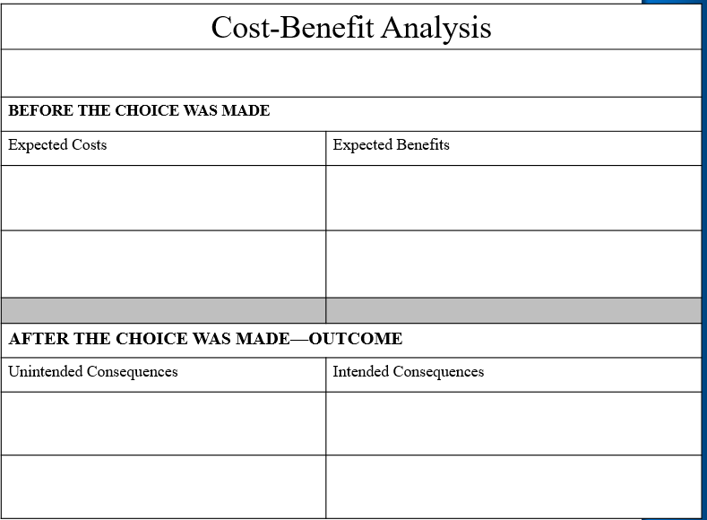
Executive Orders Cost-Benefit Analysis
Students will be given FDR’s Executive Order 9066. They will complete a cost-benefit analysis of that order using the chart below.

Slide 16
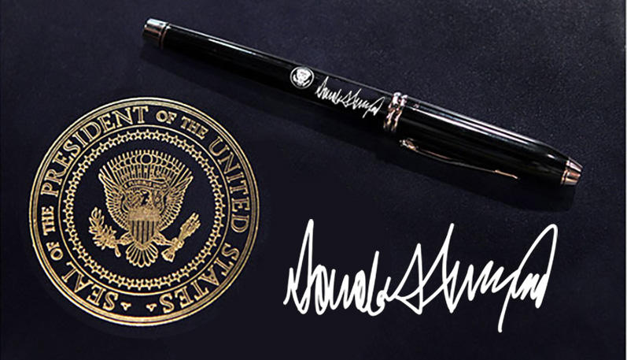
Using their knowledge from the Executive Orders Thinglink DBQ and the cost-benefit analysis of Executive Order 9066, students will synthesize information to write a thesis statement to answer the guiding question:
Should presidents have the power to issue executive orders?
Notes:
Source of photo: http://www.securityorb.com/wp-content/uploads/2017/05/donald_trump_presidential_pen.jpeg

Slide 17
Judicial Branch

Slide 18

Judicial Review Analysis
Students will research one of the Top 10 SCOTUS cases young people should know according to the New York Times Upfront magazine. They will create a poster to teach their classmates about their case.

Slide 19
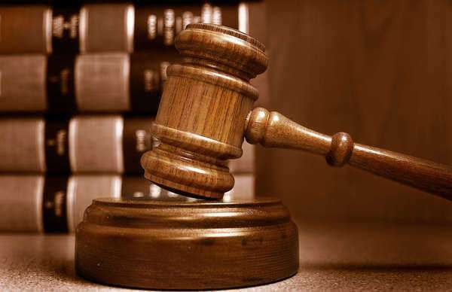
Judicial Review Analysis
Students will read a narrative about Marbury v. Madison from the iCivics website. They will use the information from the reading during a gallery walk of the posters to evaluate the court cases to determine if judicial review was applied in each case.
Notes:
Sample gallery walk recording form (not using all of NYT Upfront cases; uses other cases as well)
NYTUpfront magazine article
Image from: http://constitution.laws.com/marbury-v.-madison

Slide 20
Application

Slide 21
Questions?
Notes:
Clipart

Slide 22
Disclaimer
Reference within this presentation to any specific commercial or non-commercial product, process, or service by trade name, trademark, manufacturer or otherwise does not constitute or imply an endorsement, recommendation, or favoring by the Virginia Department of Education.

Slide 23
Contact Info.
Tracey Zaval-Horvath
Chesterfield County Public Schools
Tracey_Zaval@ccpsnet.nett
Rebecca Burley
Norfolk City
Public Schools
rburley@nps.k12.va.us

