Slide 1
Virginia’s Early Childhood Advisory Committee (ECAC)
December 15, 2022

Slide 2
Agenda
Full Advisory Committee convenes
  Approval of agenda
  Welcome to our new ECAC member, Wendy Lipscomb
Presentation: Update on CDC Licensing Regulations and General Procedures / Background Check Regulations
Presentation: Update on Early Childhood Data Dashboard
Presentation: Update on Virginia Kindergarten Readiness Program (VKRP)
Presentation: Update on Armed Forces Report
Presentation: Update on General Policy for Remote Participation in Committee Meetings and Meetings Conducted Virtually
Questions and discussion

Slide 3
Update on CDC Licensing Regulations and General Procedures/Background Checks

Slide 4
General Procedures/Background Checks
Regulatory action to repeal the current 8VAC20-820 and create a new 8VAC20-821 with background check requirements for child care providers merged into the new regulation was:
  Accepted by the Board on first review on September 15, 2022; and
  Approved by the Board at final review on October 20, 2022.
The approved regulation has been submitted for executive branch review pursuant to the requirements of the Administrative Process Act.
In the final stage of the regulatory process, VDOE staff will take to the Board a fast-track regulatory action to repeal the Fee Requirements.

Slide 5
Implementation
VDOE will work with licensed child day programs, licensed family day systems, and regulated child day programs to support implementation through the following measures:
  Facilitate a statewide webinar providing an overview of the changes;
  Provide in-depth training in each region related to the changes that includes opportunities for Q&A;
  Provide guidance documents summarizing key changes and detailing frequently asked questions; and
  Provide an implementation period during which consultation will be provided related to regulation compliance.

Slide 6
Child Day Center (CDC) Licensing Regulations
Workgroup with diverse stakeholders from child day programs and early childhood experts have met eight times since early 2022 to thoroughly review the standards.
Shared goal was to draft regulations that:
  Are easier to read and understand;
  Improve understanding of the requirements;
  Provide flexibility on how to meet requirements; and
  Improve the health and safety of children receiving care.
Next steps are to 1) finalize the recommendations in January 2023 and 2) bring NOIRA and the drafted regulations to ECAC.

Slide 7
Update on Early Childhood Data Dashboard

Slide 8
Overview of the Data Dashboard
The Virginia data dashboard:
Is an annual data product that showcases the accomplishments of the field through numbers and statistics.
Has been released every December since 2018 as part of the Preschool Development Grant Birth-Five (PDG B-5) activities.
Features five key areas, aligned with the Division’s goals:
  Access and Choice
  Quality Improvement
  Family Engagement
  Health and Safety
  Regional Capacity and Innovation

Slide 9
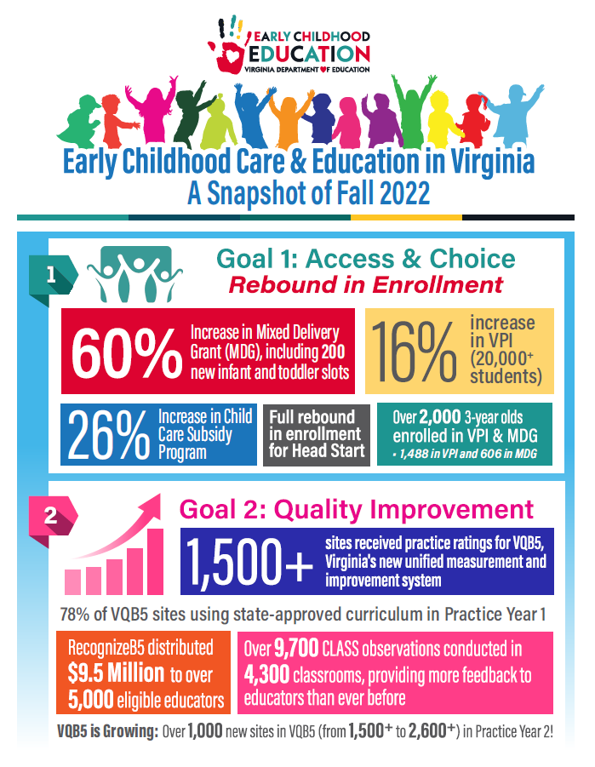
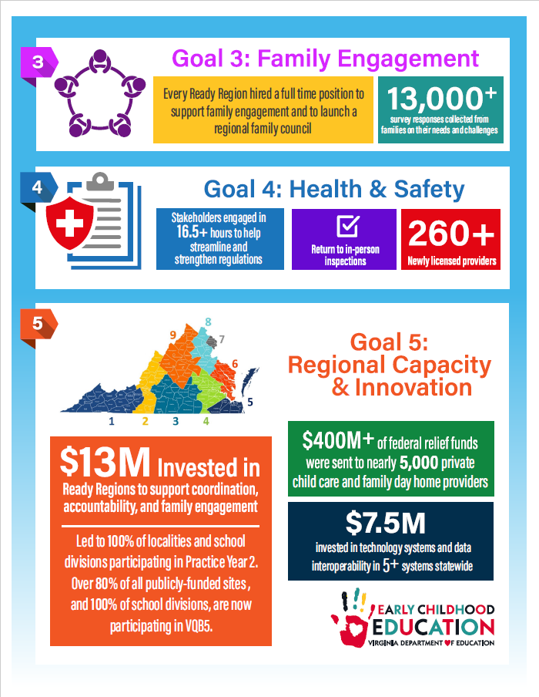
2022 ECCE Data Dashboard

Slide 10
VKRP Update

Slide 11


Slide 12

What we will cover
Background on VKRP
Overview of 2021-22 VKRP Data
Updates for Preschool VKRP
Teacher and Family Supports
Future Directions

Slide 13
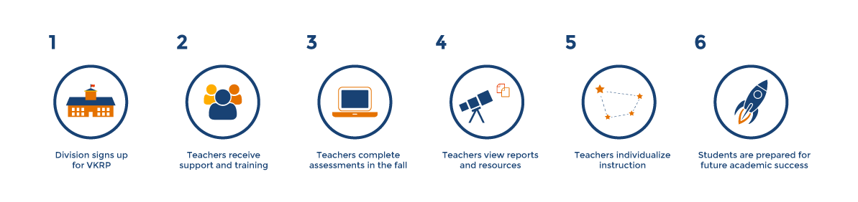


VKRP is a set of coordinated assessments
Literacy (incorporated from VLP), math, self-regulation, and social skills are combined to provide teachers with a more comprehensive picture of students’ skills at the beginning and end of kindergarten.
Readiness is defined as having foundational skills in all areas.
VKRP is a reporting system
Provides detailed and integrated information about students’ skills at the student (for teachers and families), classroom, school, division, and state levels.
VKRP is a set of instructional resources
Supports teachers to understand students’ skill levels and to use instructional practices to support their learning and growth.

Slide 14





VKRP Assessments and Methods
Literacy: Phonological Awareness Literacy Screening (PALS) | Mathematics: Early Mathematics Assessment System (EMAS) | Self-Regulation, and Social Skills | Mental Health Well-Being Note. New items assessing teachers’ report of students’ mental well-being were added in fall of 2020. These items are not part of the overall readiness score.
Notes:
The state of Virginia is making it a priority to assess prekindergarten and kindergarten students’ skills – to provide information to teachers, to school/program leaders and to families – so we can all support students in their early learning and foundational skill development.
The assessments that VKRP uses to measure foundational skills:
The Virginia Literacy Partnerships formally known as the PALS office provides reliable and valid assessments of language and literacy in prekindergarten and kindergarten. The VLP assessments are given by children’s classroom teachers, instructional assistants, and/or other members of school personnel (e.g., math leads, literacy specialists)
The EMAS is a reliable and valid measure of mathematics – teachers work one on one with a child using math manipulatives and materials to assess their skills.
The CBRS is a reliable and valid measure of self-regulation and social skills – a published measure that has been used in other states across the US to measure these skills in prekindergarten, kindergarten, and into elementary school. Teachers observe students for 4-6 weeks before completing the rating scale, which takes about 3 minutes per student within the online assessment system.
Well-being items were added beginning in fall 2020 to ascertain student mental health and teacher overall concern regarding a student’s mental well-being.

Slide 15
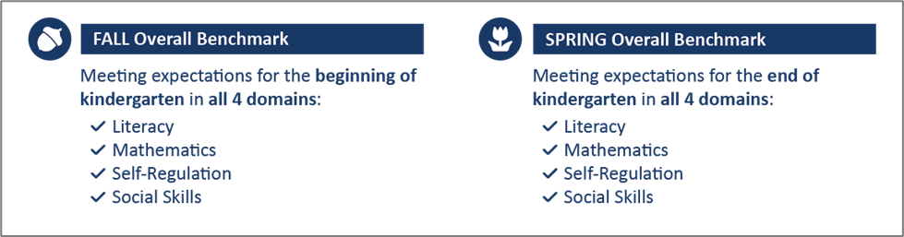
Defining Readiness for Summative Purposes
For summative purposes, kindergarten students are categorized as ready or meeting the overall benchmark (fall) and meeting the overall benchmark (spring) if they demonstrate minimally expected skills for the fall or the spring of kindergarten for literacy, mathematics, self-regulation, and social skills.
If a kindergarten student does not demonstrate the minimally expected skill in one or more areas at the respective timepoint (fall or spring), they are categorized as not ready or below the benchmark (fall) and below the benchmark (spring).
Notes:
What is Kindergarten Readiness?
Kindergarten or school readiness spans multiple domains—language, literacy, math, science, cognition, self-regulation, social skills, physical health, gross motor skills
These skills are not developed in isolation but rather they are developed through children’s early experiences at home, school, and in the community
While not fully comprehensive VKRP provides reliable and valid data across indicators known to predict school success in the short and long term (literacy, social skills, mathematics, and self regulation) – and a purposeful equal emphasis on academics and social-emotional
For purposes of VKRP
Ready = foundational skills in all areas
Not Ready = Lacking foundational skills in one or more areas
Consistent with how readiness is defined in the research

Slide 16




History of VKRP
2013 - 2014
2014 - 2015
2015 - current
2019 - current
2021 and on
Tool selection
Literacy - PALS
Math - Teacher standardized administration
Self-regulation -Teacher report via rating scale
Social-skills -Teacher report via rating scale
Piloted measures
And estimated statewide representative sample of readiness
Voluntary roll out
With expansion to spring time point in 2018-19
Statewide
Kindergarten participation fall and spring
Statewide
Prekindergarten statewide roll-out in VPI classrooms
Notes:
The team at UVA has been working with school divisions for many years to develop the VKRP assessments, reports, and resources for kindergarten and most recently prekindergarten
The 2019-20 school year began the statewide rollout of kindergarten participation in VKRP.
In 2021-22, we started the roll-out of the prekindergarten VKRP statewide for VPI classrooms with the option of Head Start and Mixed Delivery classrooms using the VKRP as well. Additionally, teachers in mixed age classrooms were able to utilize the CBRS for their three-year-old students. Also in the 2021-2022 school year for the first time the majority of kindergarten and participating prekindergarten students had data collected in both the fall and spring allowing for meaningful examination of students’ growth over the school year.

Slide 17
Kindergarten Data
2021-2022

Slide 18
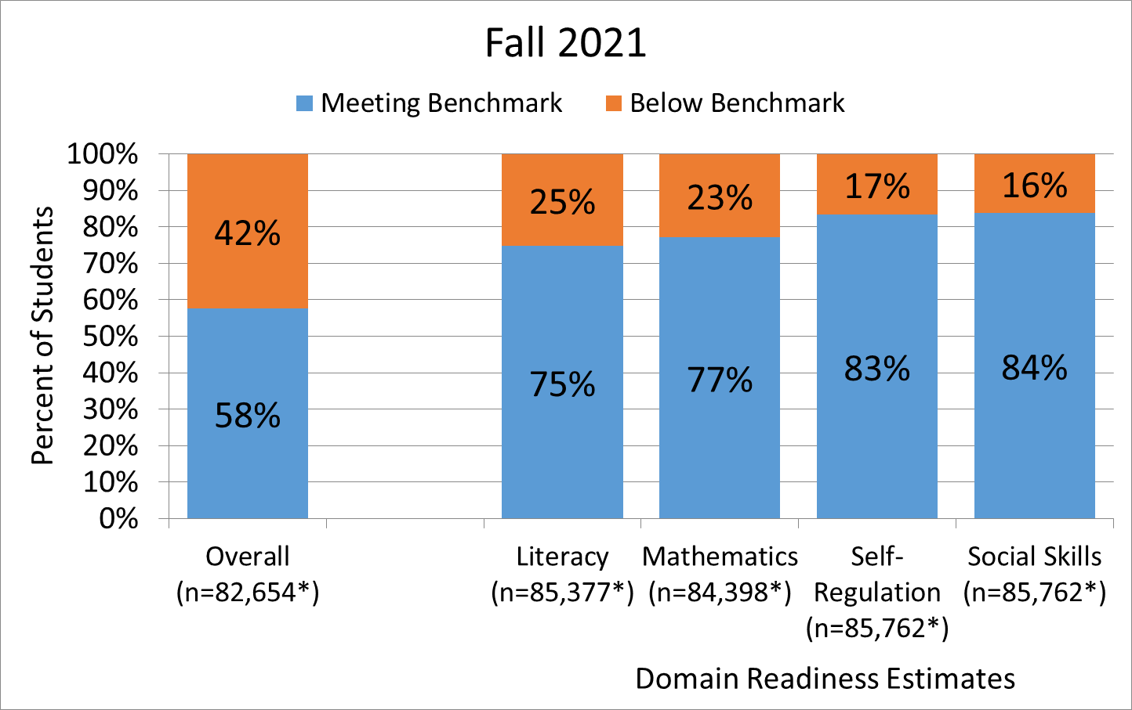
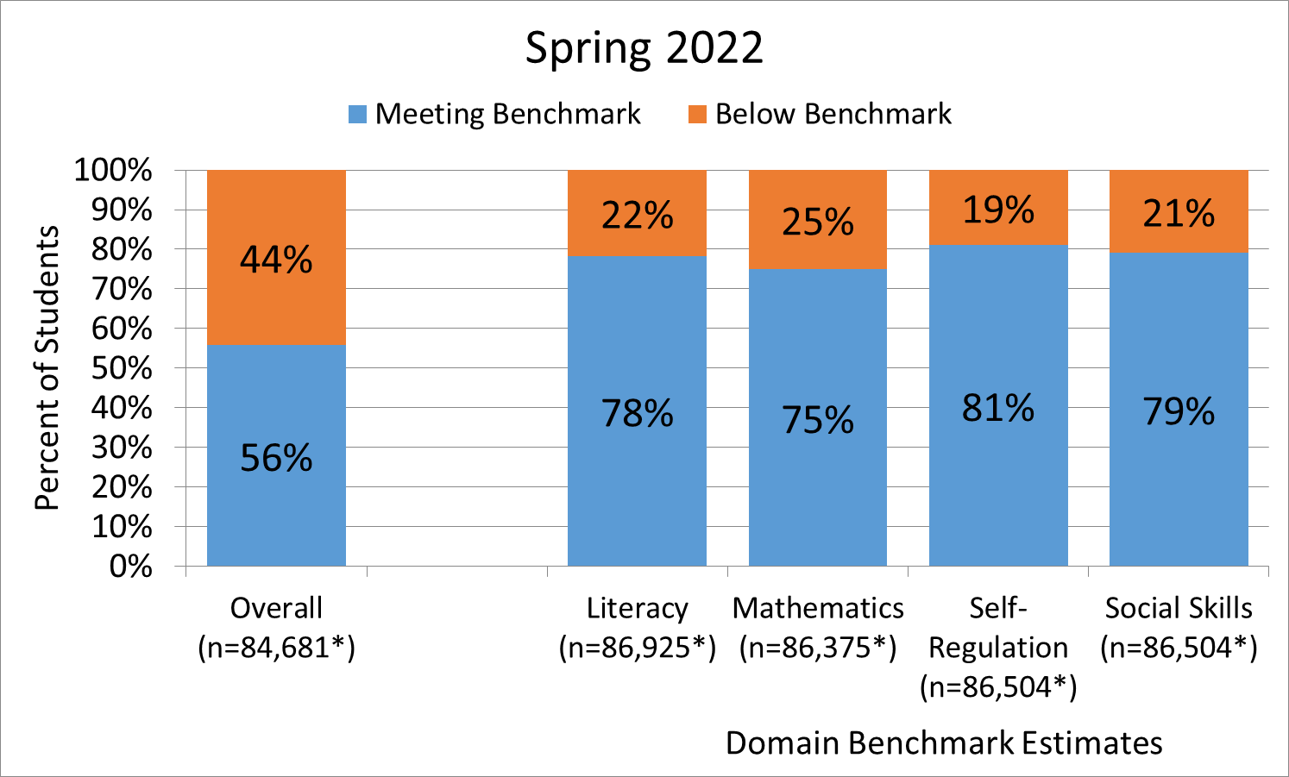
Fall 2021 and Spring 2022
VKRP Kindergarten Overall and Domain Benchmark Estimates
The data from the 2021-2022 academic year indicates that 42% of students fell below the overall VKRP benchmark in the fall of 2021. In the spring of 2022, 44% of students fell below the overall VKRP benchmark.
Notes:
In both the fall and spring, over 50% of students were meeting the overall benchmark at both timepoints. However, 42% were not meeting the overall benchmark in the fall and this increased slightly by 2% of students in the spring, where we saw 44% of students not meeting expectations for the end of the kindergarten year

Slide 19
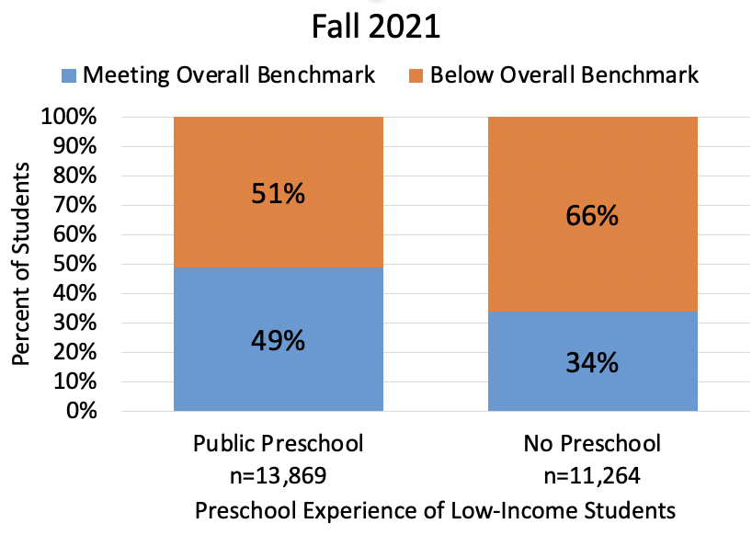
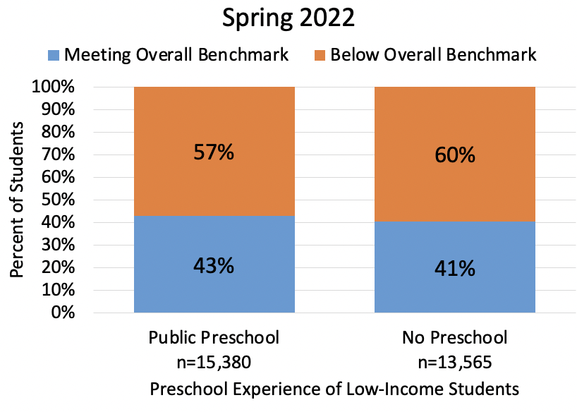
Fall 2021 and Spring 2022
VKRP Kindergarten Overall Benchmark Status
By Preschool Experience for Students From Low-Income Status
In fall of 2021 and spring of 2022, students from low-income backgrounds who attended public pre-kindergarten were more likely to meet or exceed the benchmark compared to students from similar backgrounds who did not attend public pre-kindergarten.
This pattern was true overall and true for all learning domains except social skills for both fall 2021 and spring 2022 .
Notes:
We see that in the fall children from low-income backgrounds who attended public preschool are more likely to meet the fall readiness benchmark compared to children from low-income families without a public preschool experience. By the spring the two groups look more similar in terms of meeting the spring overall benchmark with 43% of those who attended public preschool meeting the spring benchmark and 41% of those who did not attend public preschool meeting the spring benchmark. This is consistent with other samples and research where children who did not attend public preschool often catch up to their peers who did attend public preschool by the end of the kindergarten year.
Of note, this pattern was true overall and true for all learning domains except social skills for both fall 2021 and spring 2022.

Slide 20
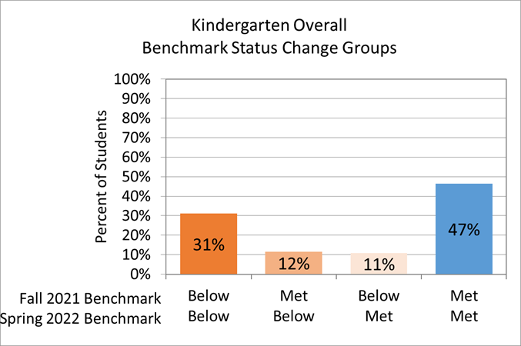
Fall 2021 and Spring 2022
VKRP Kindergarten
Overall Benchmark Status Change
The largest group of kindergarten students (47%) were meeting the overall benchmark in both the fall of 2021 and spring of 2022.
The second largest group of students (31%) were below the overall benchmark in both the fall of 2021 and spring of 2022.
Most students (78%) remained in the same benchmark status group (met/met or below/below) from the fall of 2021 to the spring of 2022.
Notes:
Most students did not shift benchmark status from the fall to the spring, meaning 47% met in the fall and met overall benchmarks in the spring or conversely did not meet in the fall and continued to not meet the overall benchmark in the spring.
A smaller group of students shifted their benchmark status over the year. Specifically, 12% of students met the overall benchmark in the fall and then did not meet the benchmark in the spring. Whereas, 11% of students were below the fall benchmark and then met the spring benchmark.

Slide 21
4-Year-Old Pre-kindergarten Data
VKRP
2021-2022

Slide 22
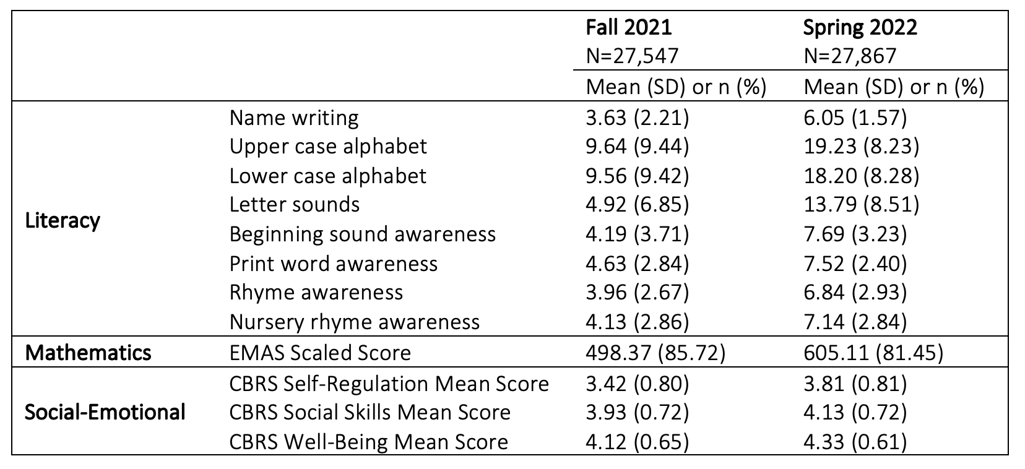
Fall 2021 and Spring 2022
VKRP Pre-kindergarten Assessment Descriptives
Overall, four-year-old children displayed a range of skills in the fall of 2021 and spring of 2022 across each of the domains — literacy, mathematics, self-regulation, and social skills.
Notes:
The PALS PreK measure for literacy does not have a summed score, and therefore in Table 19, we present the mean subtask scores (e.g., name writing, letter sounds etc.) in the screener.

Slide 23
Pre-kindergarten VKRP
Fall 2022

Slide 24
Assessing Pre-kindergarten Classrooms
Classroom Type | Number of Classrooms | Percent of Classrooms | Total Number of Students | Percent of Total Students
3-Year-Old | 341 | 12.3 | 3,323 | 9.2
3-Year-Old/4-Year-Old | 791 | 28.5 | 9,838 | 27.3
4-Year-Old | 1,642 | 59.2 | 22,844 | 63.4
Total | 2,774 | 100.0 | 36,005 | 100.0

Slide 25
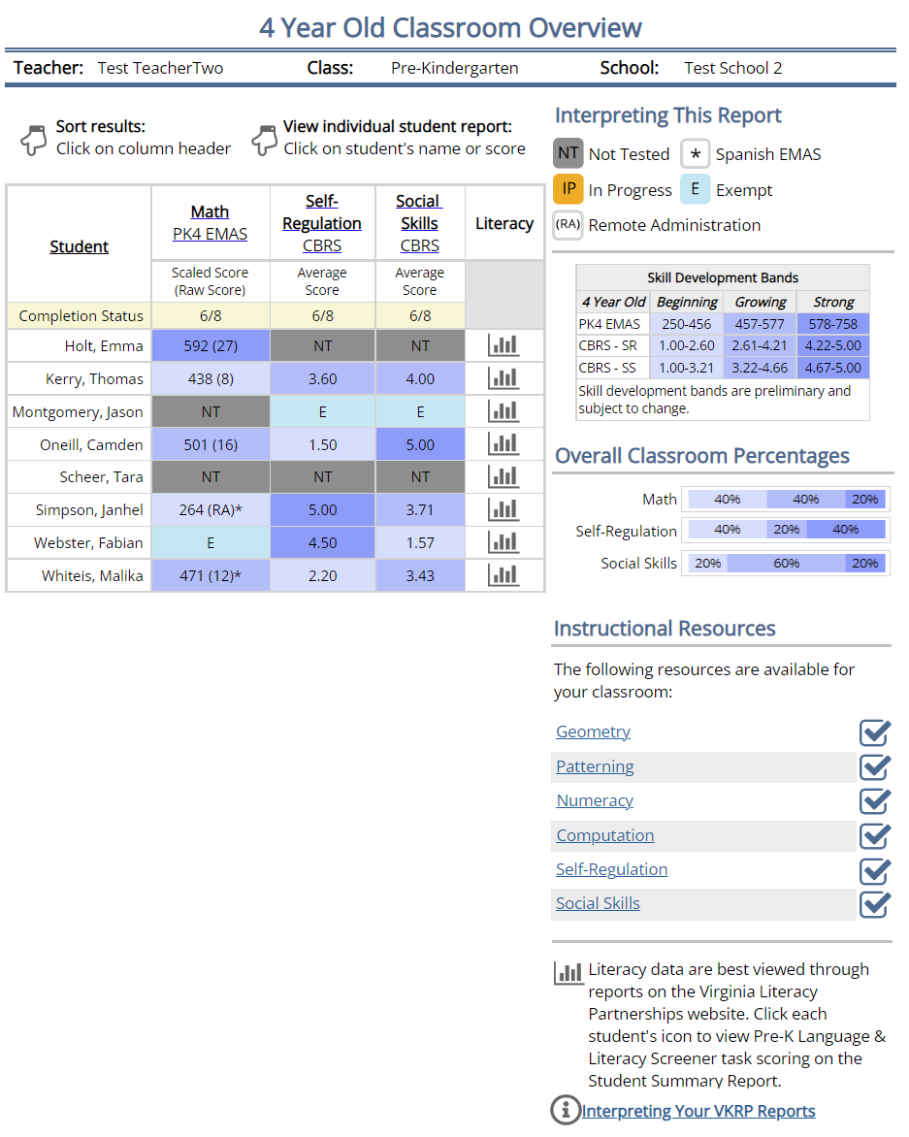
Classroom Overview Report Pre-K 4

Slide 26
Teacher and Family Supports for
Understanding VKRP Data

Slide 27
VKRP Supporting Teachers
Workshops & Webinars:
VKRP continues to support pre-kindergarten and kindergarten teachers’ implementation of VKRP by providing in-person, remote, and online training. In addition, VKRP has assembled resources for promoting teachers’ use of the assessment data and resources to support student skill development.
Resources:
Teachers and administrators may access informational resources within the VKRP web portal (Teacher Manual, Instructional Leader Guide, Interpreting Reports document, Instructional Resources) and the VKRP public website (VKRP blogs, links to websites and resources).
Collaboration:
The VKRP team conducted a series of focus groups with pre-kindergarten administrators and teachers during the Spring/Summer 2022 to learn how educators use their data and received feedback on future report features.
Notes:
Supporting. VKRP will continue to support pre-kindergarten and kindergarten teachers’ implementation of VKRP by providing in-person, remote, and online training, resources, and information for teachers as well as school-level and division-level administrators. VKRP partners with programs, schools, and divisions on how to use their growth data to promote student skill development over time.
Listening and Learning. VKRP has completed a series of focus groups with families to learn more about what school readiness means to families and how to improve the VKRP family reports and resources. Families from a range of backgrounds, including families with children who are English language/multilingual learners (EL) and families with children who have educational disabilities have been intentionally included in the focus groups.

Slide 28
Training and Support for Teachers
Development of Skill Development Bands in pre-kindergarten:
To help teachers interpret and use VKRP data, pre-kindergarten reports now include information about where children fall within skill development bands:
  Beginning: children are beginning to develop skills in this area and may need extra support to reach readiness goals by the beginning of kindergarten.
  Growing: children are building towards readiness in this domain and require developmentally appropriate instruction and monitoring to ensure that they remain on track to meet readiness goals by kindergarten.
  Strong: children have robust early foundational skills in this early learning domain and will benefit from extra challenges.
These score ranges are included to give guidance on where children are in their development of skills so that teachers can provide appropriate support and instruction.
Refinement of Interpreting Reports resources:
Additional guidance incorporated around the skill development bands and the interpretation of the skill development bands.

Slide 29
Training and Support for Teachers
Data Use and Interpretation Sessions:
Requests from pre-kindergarten divisions and programs
  Held virtually and in-person
Sessions intentionally designed to help administrators and teachers to:
  Develop an understanding of what VKRP reports are available and where to find them on the VKRP web portal
  Gain proficiency in locating key data elements (benchmarks, skill development bands)
  Assist in identifying patterns in data
  Understand how to link data to VKRP resources
Next steps include development of interactive modules and enhanced videos to support administrator and teacher data use in kindergarten and pre-kindergarten

Slide 30
VKRP Supporting Families
Report:
At the pre-kindergarten and kindergarten levels, VKRP provides a family information report educators can use to share children's scores with their families.
Resources:
Teachers may access informational resources within the VKRP web portal (Family Information Report link) and the VKRP public website (Family Resources) to share with families in both English and Spanish. These documents include activities families can use with their child to support development in the areas of mathematics, self-regulation, and social skills.
Collaboration:
The VKRP team conducted a series of focus groups with families with pre-kindergarten aged children during the Spring/Summer 2022 to learn their views of readiness and how they would like to be able to see their child’s data in reports. In addition, the team shared the family resources and asked for suggestions for improvement.

Slide 31
Family Focus Groups
Objective:
    To learn from a diverse group of families and family childcare providers about their understanding of VKRP, the program’s usefulness for their family and how to improve family reports and resources
Format:
    Small virtual focus groups held between May-July 2022
Participants:
    Convened three focus groups with diverse families and providers to include:
      Family childcare providers and families (conducted in Spanish)
      Families of children in special education
      Families of pre-kindergarten and kindergarten children without IEPs

Slide 32
Family Focus Groups: Themes
School-Home Communication:
  Consistent communication about VKRP data between schools and families
  Family resources to support children’s development at home
Family Reports:
  More detail about children’s strengths and areas of needed support
Focus on Social-Emotional Mental Health Well-being:
  Families’ desire to how children are doing social-emotionally
  How these skills are specifically being supported in the classroom
Assessment accommodations:
  Better individualized support to meet children’s diverse physical and learning needs

Slide 33
Next Steps for Supporting Families
Refinement and enhancement of Family Information Reports:
  Planned inclusion of more specific strengths and areas of needed support for each child
  Inclusion of individual children’s growth for families
Expanded Family Resources:
  Enhanced activities and strategies for families
  Additional resources for teachers to support communication with families

Slide 34
Future Directions
Early Elementary Pilot
Additional funding was appropriated to develop and pilot an upward extension of mathematics, self-regulation, social skills, and mental health into the first through third grades.
Collaborating
VKRP is closely collaborating with the Virginia Literacy Partnerships (VLP) around the development and launch of VKRP and the new Pre-K Language & Literacy Screener in three and four-year-old pre-kindergarten classrooms.
VKRP is collaborating with the STREAMin3 team to support STREAMin3 teachers to administer the VKRP preschool assessments and use data to improve their curriculum use and instruction in the classroom.

Slide 35
Update on Armed Forces Report

Slide 36
Overview
HB 994/SB 529 directs the Board of Education to determine the feasibility of amending the Child Care Subsidy Program regulations (8VAC20-790) to permit all active duty members of the Armed Forces who serve as caregivers of dependents to apply for the Child Care Subsidy Program.
VDOE is preparing a report on behalf of the Board to submit to the House Committee on Education and Senate Committee on Education and Health.

Slide 37
Military Families in Virginia
As of 2021, 75,000 active duty service members in Virginia were parents to 98,000 children ages 18 and younger.
Nearly 40 percent of children of active duty service members were ages 5 and younger.
Among service members with children, 79 percent (~41,000) were married to a civilian. Half of all civilian spouses were employed.
Over half of all active duty service members in Virginia have incomes over 350 percent of the federal poverty level ($91,125 for a family of 4).
Note: Norfolk, VA and the National Capital Region (including counties in Northern VA) are identified by DoD as regions with the highest concentration of child care need.
Sources: Military OneSource 2021 Demographics; American Community Survey 5-Year Estimates

Slide 38
Child Care Assistance for Military Families
Program | Overview and Eligibility | Funding and Oversight
Military-operated child care programs | All active-duty military families qualify for enrollment in a DoD-operated program. Care is available to eligible families on a sliding fee scale based on household income. | Department of Defense-operated centers and family child care homes are licensed, monitored, and funded by the DoD.
Operation: Military Child Care (OMCC) | Provides child care subsidies to families in which one or more parents or guardians are activated or deployed. In two-parent households, one caregiver must be deployed/activated and the other must be working or enrolled in school. | Funded by the federal Department of Defense. Operated in partnership with Child Care Aware of America
Military Child Care in Your Neighborhood (MCCYN) | Provides fee assistance to eligible families to offset the cost of enrolling in community-based child care programs when military-operated programs are unavailable. Specific eligibility parameters are set by each branch. | Funded by the federal Department of Defense. Administered by each service branch.
Child Care in Your Home (CCYH) | Fee assistance pilot program to help families cover the cost of full-time care in their homes; designed to support military families with nontraditional work schedules. Select Virginia communities included in pilot. Eligible families must include one or more active duty parents with a full-time working spouse or spouse enrolled in school full-time. | Funded by the federal Department of Defense.
For more information, see militarychildcare.com.

Slide 39
Virginia’s Child Care Subsidy Program
Virginia sets eligibility for the Child Care Subsidy Program (CCSP) but is limited by the federal Child Care and Development Block Grant (CCDBG) Act.
Families that do not meet federal criteria must be served with state dollars.
Criteria | Virginia Eligibility | Maximum Eligibility Under Federal Law
Age of child | Children under age 13 or under age 18 if physically or mentally unable to care for himself or herself, or is under a court order | Children under age 13 or under age 18 if physically or mentally unable to care for himself or herself, or is under a court order
Parental activity requirement | All available parents in the household are working, in an education or training program, or searching for work | All available parents in the household are working, in an education or training program, or searching for work
Household income | For families with at least one young child: 85 percent state median income For families with school age children only: income limits established regionally, ranging from 150-250% of the federal poverty guidelines | 85 percent state median income

Slide 40
Serving All Active Duty Service Members
The Board could revise 8VAC20-790 to make all active duty service members eligible for child care assistance through the CCSP by going through the state regulatory process.
Additional state funds would be required to serve military families who are ineligible under federal rules because:
  Their household income exceeds 85% of the state median income ($96,969 for a family of four); and/or
  In two-parent households, one parent or guardian is not working, in school, or searching for work.

Slide 41
Fiscal Impact
VDOE estimates that there are approximately 48,000 children in military families in Virginia that do not meet the federally-established parameters for child care assistance through CCDBG.
Assuming an low-end average per-child cost of $10,000 per year and a high-end average per-child cost of $18,000 per year, serving all 48,000 children in the Virginia CCSP would require between $480 million and $864 million in additional state general funds annually.
  Note these may be overestimates, as there is insufficient data to accurately estimate the number of children served by DoD-funded programs and actual demand for care and education.

Slide 42
Update on General Policy for Remote Participation in Committee Meetings and Meetings Conducted Virtually

Slide 43
Requirements for Meetings of Public Bodies
In general, the following requirements apply to meetings of public bodies according to the Virginia Freedom of Information Act (§ 2.2-37):
Meetings of public bodies should be open to the public;
Meetings should not be conducted electronically except when specifically permitted by law;
Public bodies must give notice of the date, time, and location of meetings;
A quorum of members must be physically present to conduct business; and
Meeting minutes should be recorded in writing and include a list of attendees and their physical location.

Slide 44
New Public Meeting Laws and Proposed Guidance
Here are relevant revisions to public meetings law as of September 1, 2022:
Expands the conditions under which members of a public body can participate in a meeting virtually when business is being conducted in person (§2.2-3708.2); and
Permits public bodies to conduct a limited number of meetings virtually and sets conditions for conducting business virtually (§2.2-3708.3).
These laws pertain to the Board of Education and related committees, including ECAC. We are expected to develop a written policy.
The proposed guidance governs participation of ECAC meetings by the means of electronic communication, including meetings facilitated in a hybrid format and those facilitated virtually.
Notes:
The new policies are established by law in the Code of Virginia and do not offer much flexibility. However, adopting the new public meeting laws will provide a more flexibility to the members of the ECAC to participate virtually when applicable based on the qualifications of the policy.

Slide 45
Electronic Participation in In-Person Meetings
ECAC members may participate in meetings virtually if they cannot attend in-person for one of the following reasons:
The member has a medical condition (temporary or permanent);
The member is required to care for a family member who has a medical condition;
The member’s residence is more than 60 miles from the meeting location; or
The member is unable to attend due to personal reasons.
  A member may participate virtually for a personal reason up to 2 times a year or 25 percent of the meetings, whichever is greater.

Slide 46
Approval of Electronic Participation
Members must notify the Chair and/or the VDOE that they plan to attend virtually and for what reason in advance of the meeting.
The Chair recommends approval of virtual participation, which is then voted on by the ECAC and recorded in the meeting minutes.
A quorum of ECAC members must be physically present to approve virtual participation and to conduct meeting business.
The following information must be reflected in the meeting minutes:
  Whether the member’s virtual participation was approved by the ECAC;
  The location of the remote participant if the location is not open to the public; and
  The reason for the member’s virtual participation.

Slide 47
All-Virtual ECAC Meetings
The new public meeting laws permit public bodies to meet virtually up to two times per year or 25 percent of meetings, whichever is greater.
All-virtual meetings may not be consecutive with another all-virtual meeting.
Example of Meeting Schedule
Meeting 1 | Virtual
Meeting 2 | In-person (quorum is required)
Meeting 3 | Virtual
Meeting 4 | In-person (quorum is required)
Meeting 5 | In-person (quorum is required)

Slide 48
All-Virtual ECAC Meetings
For all-virtual meetings, the following conditions must be met:
VDOE must give public notice of virtual facilitation via Town Hall and website.
The meeting should be conducted on Zoom and streamed on YouTube to provide public access. Members should generally be on video.
The public body must accept written public comment.
No more than 2 members should participate in the meeting from the same remote location, unless the location is open to the public.
VDOE must monitor a designated email inbox or phone line during the meeting so the public can notify staff of any technical issues preventing public access. If technical issues arise, the meeting may not be continued until the issue is resolved and the public can access the meeting.

Slide 49
Questions and Discussion

Slide 50
We are experiencing technical difficulties
The livestream will return momentarily

