Slide 1


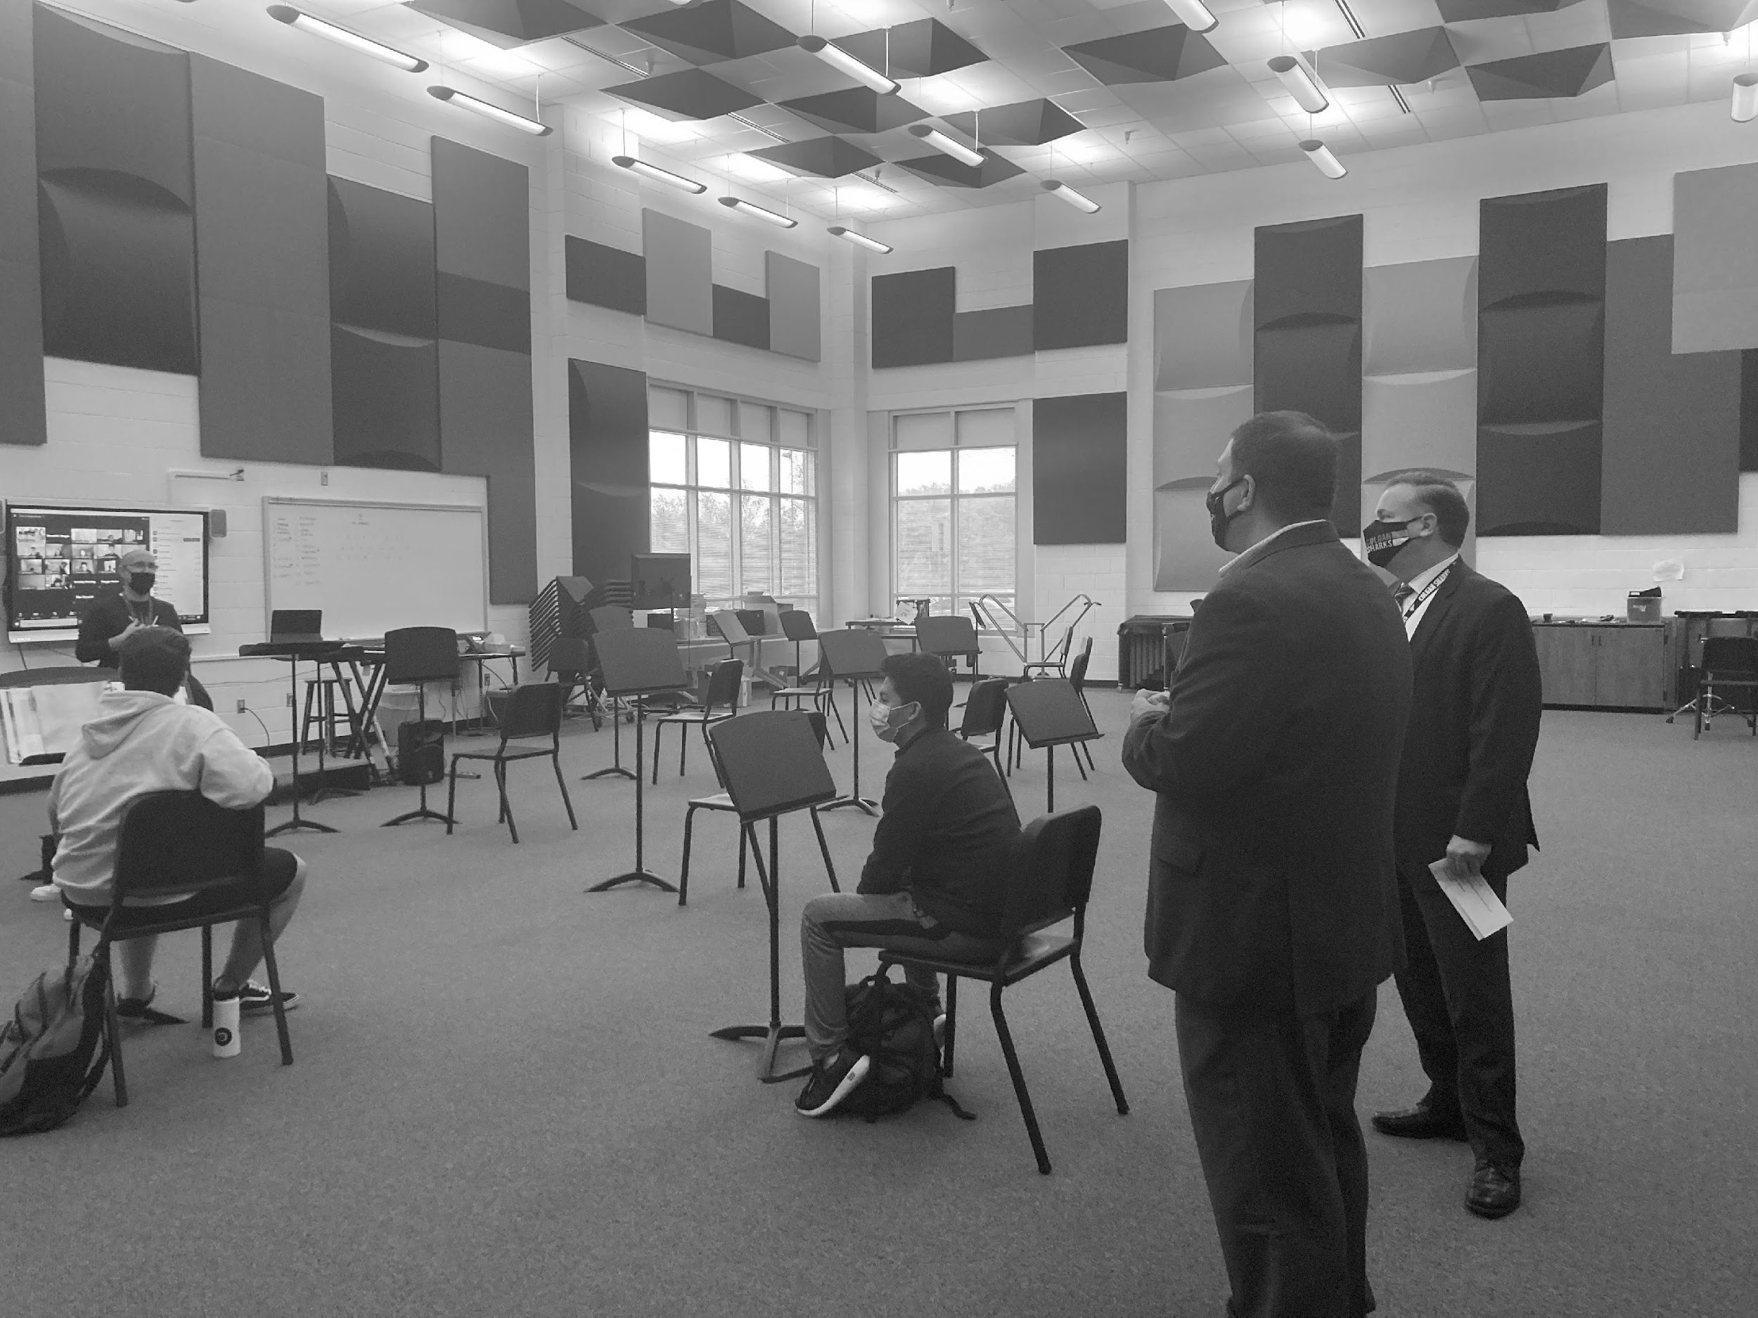



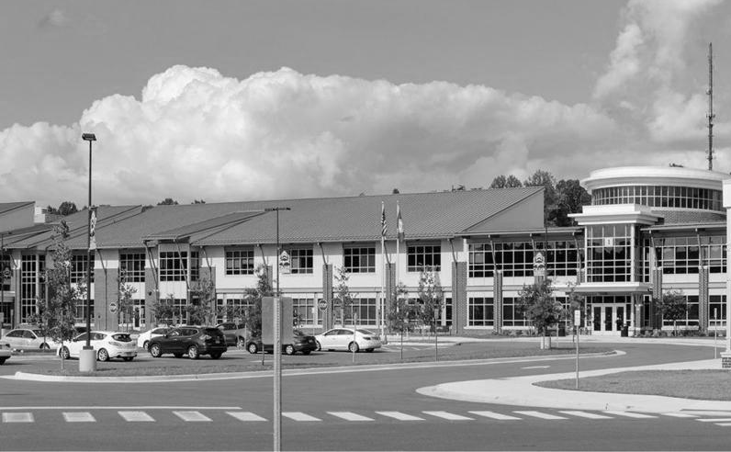
Needs and Conditions of Virginia Public School Buildings and Virginia’s School Facilities Guidelines
Presentation to the Board of Education
Kent Dickey and Vijay Ramnarain
September 22, 2021

Slide 2
Presentation Overview
1. Data and findings from various sources on the current needs and conditions of Virginia’s public school facilities, many of which were presented to the Commission on School Construction and Modernization in June:
  School division enrollment data
  VDOE School/Building Inventory data – Spring ‘21
  School division Capital Improvement Plans (CIP) – Spring ‘21
  Funding and expenditure information
  Other external data sources/reports
  2. VDOE public school facilities guidelines, including recent revisions to the guidelines

Slide 3
Virginia’s Student Enrollment Trend
From 2010-2019, student enrollment increased by 3.6%, but then dropped by that same pct. last year due to the pandemic. Fall ‘21 enrollment available later this fall will indicate degree of enrollment recovery.
Data Source: VDOE Fall Enrollment, 2010 through 2020

Slide 4
5-Year Enrollment Projections by Region
5-year student enrollment projections reported by divisions indicate 4.0% growth in total student enrollment by 2026
  Greatest enrollment growth predicted for Northern Neck (Region 3) and Northern Virginia (Region 4)
  Enrollment losses predicted for Western Virginia (Region 6), Southwest (Region 7) and Southside (Region 8)
Region | Percent Enrollment Change by 2026
1: Central Virginia | 5.84%
2: Tidewater | 1.43%
3: Northern Neck (including Fredericksburg) | 11.08%
4: Northern Virginia | 7.94%
5: Valley | 3.01%
6: Western Virginia | -6.78%
7: Southwest | -10.01%
8: Southside | -7.40%
Virginia | 4.03%
Enrollment projections unlikely to include impacts of COVID-19
Data Source: School Construction Survey, 2021

Slide 5
School Building Inventory
VDOE periodically inventories school buildings in response to studies or legislative inquiries
  Data were collected for the first time in 2013 and updated in 2021 for the Commission on School Construction & Modernization
In Spring 2021, divisions reported 2,005 school buildings*
  128 of 132 divisions reported data for 97% of school buildings
For each building, the inventory collects:
  Student capacity levels, building square footage, and site acreage
  Year building put in service
  Date of last major renovation and associated costs
  Replacement value (new construction)
  American with Disabilities Act (ADA) compliance and associated costs
*School buildings include all elementary, middle, high, and combined schools, as well as alternative centers, career and technical centers, special education centers, and preschools.
Notes:
128 of 132 divisions provided information in 2021
1944 of 2005 buildings were updated; for the remaining schools, 2013 data were used if applicable (year in service, sqr footage, and building usage type information have been used in calculating building age and replacement cost)

Slide 6
Number of Virginia School Buildings by Type
Data Source: VDOE School/Building Inventory, 2021
Notes:
57 percent of all school buildings in the state are elementary schools

Slide 7
School Building Capacity Estimates
Divisions reported 40.5% of school buildings currently at or above capacity and an additional 29.4% nearing capacity
Capacity Level | Number of Schools | Percent of Schools
Above Capacity (100% or more of capacity) | 239 | 13.65%
At Capacity (85 to 99% of capacity) | 469 | 26.80%
Nearing Capacity (70 to 84% capacity) | 515 | 29.42%
Capacity is calculated by dividing the serving student enrollment count with the student building capacity count
Data Source: VDOE School/Building Inventory, 2021

Slide 8
School Building Age by Type
More than half of all school buildings are greater than 50 years old
Number of Buildings
Data Source: VDOE School/Building Inventory, 2021
Notes:
More than half of all school buildings in the state are greater than 50 years old

Slide 9
Age of School Buildings by Region
Regions 6, 7 and 8 have the highest median age of school buildings (58 years), while Region 3 has the lowest age (median 32 years)
Region | Newest (Years) | Oldest (Years) | Median
1: Central Virginia | 0 | 110 | 50
2: Tidewater | 2 | 111 | 50
3: Northern Neck | 2 | 98 | 32
4: Northern Virginia | 0 | 105 | 48
5: Valley | 2 | 184 | 55
6: Western Virginia | 0 | 101 | 58
7: Southwest | 1 | 107 | 58
8: Southside | 13 | 113 | 58
State | 0 | 184 | 52
Data Source: VDOE School/Building Inventory, 2021
Notes:
New London Academy Elementary is Bedford County was built in 1837 (184 years old).

Slide 10
Replacement Costs for School Buildings over 50 Years Old
School Type | Number of Schools over 50 Years Old | Total Square Footage | Total Replacement Cost
Elementary | 619 | 40,286,230 | $10,071,557,500
Middle | 148 | 18,467,374 | $4,616,843,500
High | 144 | 25,225,870 | $7,567,761,000
Combined | 43 | 3,883,406 | $1,165,021,800
Others | 86 | 4,751,318 | $1,369,651,700
Total | 1,040 | 92,614,198 | $24,790,835,500
Note: Replacement costs were estimated at $250 per sq. ft. for schools serving PK-8 students, and $300 per sq. ft. for schools serving 9-12 students, for an average costs of $267 per sq. ft. for the state.
Data Source: VDOE School/Building Inventory, 2021
Notes:
In 2021, divisions reported 1,040 schools more than 50 years old. If all of those schools were replaced, this would result in a total estimated replacement costs of $24.8 billion dollars

Slide 11
Total Construction & Renovation Costs, FY 2011-FY 2021
Over FY11-FY21, divisions reported constructing 119 new schools at a total cost of $4.226 billion and completing 568 addition/renovation projects at a total cost of $3.335 billion
Virginia Public School Construction and Renovation Costs, FY11-FY21
 | Total Number of Schools | Total Costs | Total Square Footage | Costs per Square Foot
New Elementary Schools | 65 | $1,480,215,361 | 6,352,068 | $233.03
New Middle Schools | 18 | $692,678,682 | 2,857,009 | $242.45
New High Schools | 21 | $1,402,309,778 | 5,549,672 | $252.68
New Combined Schools | 15 | $651,025,693 | 2,395,561 | $271.76
Total New Schools | 119 | $4,226,229,514 | 17,154,310 | $246.37
Total Additions/Renovations | 568 | $3,335,120,811 | 25,849,301 | $129.02
Data Source: VDOE School Construction Cost Data

Slide 12
Percent of Buildings with Major Renovation Projects since 2015, by Region
Data Source: VDOE School/Building Inventory, 2021
Notes:
Percent of school buildings with major renovation varies by region. Approximately 15 percent of the state’s school building have experienced major construction in the past 5 years.

Slide 13
Percent of School Buildings Meeting Americans with Disabilities Act (ADA) Requirements
The majority of school buildings (78%) meet ADA requirements.
Regionally, the percentage of bldgs. compliant ranges from 61.5% (Region 1) to 96.6% (Region 5).
Estimated renovation costs for ADA compliance total $205 million.
Data Source: VDOE School/Building Inventory, 2021
Notes:
78 percent of school buildings meet ADA compliance. Divisions estimate nearly $205 million in renovation costs is needed to make the remaining 19% of buildings accessible.

Slide 14
School Division HVAC Projects during COVID-19
As of Spring 2021, 62% of divisions have completed at least one HVAC project since March 2020 in response to COVID-19
12% of responding divisions have no planned HVAC projects in response to COVID-19
HVAC System Projects in Response to COVID-19 | Average Number of Projects per Division | Total Number of Projects, All Divisions
Number completed since March 2020 | 8 | 975
Number begun but not completed since March 2020 | 8 | 942
Number planned but not begun since March 2020 | 12 | 1,527
Total | 26 | 3,444
Note: Total counts include multiple HVAC projects per school if school has no central HVAC or multiple HVAC systems.
Data Source: School Construction Survey, 2021

Slide 15
Prior School Building Inventories or Conditions Surveys
Former VDOE Triennial Facilities Survey, last conducted in 1995-1996:
  More than 50% of divisions reported deferred maintenance in their schools
  45% of schools used temporary classrooms
  Nearly 33% of schools had overcrowded classrooms
  27% of schools reported having classrooms considered obsolete
  Estimated 7,900 new classrooms needed over the next five years
  63% of schools were more than 25 years old and needed major renovation/replacement
In 2002, at the request of Governor Warner:
  Lack of maintenance/repairs most frequently cited driver of construction needs
  65% of schools housed enrollment that was 90% to 115%+ of school capacity
  77% of divisions reported using some type of temporary or portable classroom space (i.e., trailers) to alleviate overcrowding or due to lack of adequate instructional space
  59% of schools were 23 or more years old since originally built or significantly renovated

Slide 16
Review of School Division Capital Improvement Plans (CIPs)
In Spring ‘21, VDOE received 117 current Capital Improvement Plans from school divisions
VDOE staff analyzed plans up to 10 plan years (FY21 to FY30) to determine type, number, and costs of projects by school
State-level summaries include the total number of schools with a given project type and the total project costs
Region-level data summaries were also developed and include the number of schools with a given project type and the average (median) and total costs by project type

Slide 17
Statewide Summary of CIP Review
The typical planning horizon for division CIPs is 5 years
The largest share of CIP estimated costs are for new schools and renovations
  81 new schools planned for a total cost of $3.834B
  566 renovations planned for a total cost of $3.318B
Following renovations, divisions most frequently planned for HVAC repair/replacement, grounds/parking lot, and roof repair/replacement projects
  463 HVAC projects for a total cost of $623M
  353 grounds and parking lot projects for a total cost of $128M
  344 roof repair/replacement projects for a total cost of $468M

Slide 18
School Division CIP Projects by Total Costs
Project Type | Number of Schools with Project Type | Total Costs
New Schools | 81 | $3,834,076,026
Renovations | 566 | $3,318,205,135
HVAC Repair/Replacement | 463 | $623,451,926
School Additions | 48 | $514,763,904
Roof Repair/Replacement | 344 | $467,944,657
Other Items* | 171 | $376,585,276
Technology Upgrades | 132 | $172,340,570
Electrical & Plumbing | 226 | $169,013,619
Sports & Playgrounds | 287 | $161,815,993
Grounds & Parking Lots | 353 | $127,645,348
Safety Upgrades & Lighting | 191 | $50,664,811
*Other most often included transportation-related costs

Slide 19
CIP Costs: New Schools by Region
Region | Number of New Schools | New School Type | Total Costs | Median Costs
1: Central Virginia | 17 | 11 ES; 2 MS; 2 HS; 1 Comb; 1 Pre | $593,967,376 | $32,250,425
2: Tidewater | 16 | 5 ES; 4 MS; 3 HS; 1 Pre; 1 Unspec; 2 Other Div Bldg | $498,484,245 | $22,000,000
3: Northern Neck | 5 | 1 ES; 1 HS; 1 Comb; 1 Alt; 1 Other Div Bldg | $253,122,699 | $54,322,416
4: Northern Virginia | 31 | 19 ES; 4 MS: 6 HS; 1 C&T; 1 Alt | $2,151,449,772 | $62,172,219
5: Valley | 3 | 2 ES; 1 HS | $85,000,000 | $29,000,000
6: Western Virginia | 0 | 0 | $0 | $0
7: Southwest | 2 | 1 ES; 1 MS | $37,391,934 | $18,695,967
8: Southside | 7 | 1 ES; 3 HS; 1 Alt; 2 Other Div Bldg | $214,660,000 | $30,000,000
ES: Elementary School MS: Middle School HS: High School | Comb: Combined School Alt: Alternative School C&T: Career & Technical School | Other Div Bldg: Other Division Building (often Central Office buildings, or School Board buildings) Unspec: School Unspecified
Notes:
Southwest Region – both new schools are proposed for Wythe County

Slide 20
CIP Costs: Renovations by Region
Region | Number of Schools with Renovations | Total Costs | Median Costs
1: Central Virginia | 36 | $399,192,673 | $345,000
2: Tidewater | 99 | $513,973,329 | $650,000
3: Northern Neck | 52 | $111,081,406 | $281,250
4: Northern Virginia | 170 | $1,808,662,674 | $435,833
5: Valley | 61 | $196,616,603 | $367,248
6: Western Virginia | 59 | $182,347,652 | $186,228
7: Southwest | 59 | $61,781,135 | $157,760
8: Southside | 30 | $44,549,663 | $100,000

Slide 21
CIP Costs: HVAC Repair/Replacement by Region
Region | Number of Schools with HVAC Repairs/Replace | Total Costs | Average (Median) Costs
1: Central Virginia | 34 | $52,386,507 | $475,000
2: Tidewater | 91 | $296,016,508 | $1,200,000
3: Northern Neck | 44 | $19,452,900 | $256,500
4: Northern Virginia | 113 | $52,255,045 | $200,000
5: Valley | 49 | $75,511,912 | 4,704,797
6: Western Virginia | 39 | $33,071,010 | 4,492,043.82
7: Southwest | 72 | $78,838,541 | $184,000
8: Southside | 21 | $16,467,002 | $410,000

Slide 22
CIP Costs: School Addition by Region
Region | Number of Schools with School Additions | Total Costs | Average (Median) Costs
1: Central Virginia | 7 | $90,544,000 | $5,631,065
2: Tidewater | 11 | $139,690,277 | $12,000,000
3: Northern Neck | 3 | $10,641,963 | $697,000
4: Northern Virginia | 12 | $140,376,616 | $7,953,300
5: Valley | 8 | $110,236,048 | $14,535,000
6: Western Virginia | 1 | $450,000 | $450,000
7: Southwest | 4 | $22,425,000 | $5,800,000
8: Southside | 1 | $400,000 | $400,000

Slide 23
CIP Costs: Roof Repair/Replacement by Region
Region | Number of Schools with Roof Repairs/ Replacement | Total Costs | Average (Median) Costs
1: Central Virginia | 38 | $29,923,810 | $300,000
2: Tidewater | 64 | $157,071,809 | $1,425,000
3: Northern Neck | 24 | $64,342,254 | $523,500
4: Northern Virginia | 63 | $139,999,837 | $831,900
5: Valley | 51 | $25,539,379 | $321,000
6: Western Virginia | 31 | $26,994,674 | $497,935
7: Southwest | 55 | $20,678,848 | $261,548
8: Southside | 18 | $3,394,046 | $125,000

Slide 24
Division Priorities for CIP Project Funding
School divisions overall rated HVAC repair/replacement, building renovations/additions, and roof repair/replacement higher than new schools as CIP funding priorities - this likely reflects a lack of available funding for new schools in many divisions, requiring funds that are available to go towards upgrades to existing buildings versus new construction that is actually needed. New schools would likely be rated a higher priority if funding sources for new construction were more readily available to divisions statewide.

Slide 25
Planned Renovations not Captured in CIP
Data Source: VDOE School/Building Inventory, 2021

Slide 26
History of State Assistance for School Construction
A 1993 JLARC report (State/Local Relations and Service Responsibilities: A Framework for Change) provides historical information on state support for local school construction:
  Virginia state gov’t. was active in school construction during the early 1900s. However, in the 1930s, responsibility for two major areas of infrastructure was changed - with passage of the Byrd Road Act, the state took over responsibility for county road construction with the understanding that localities would be primarily responsible for school construction.
  Federal funding was available for local school construction. In 1938, the federal government funded 45% of local construction costs. In subsequent decades, federal funding for capital costs significantly decreased to less than 1% of local costs.
  While this level of support was not sustained, at various points during the 1940s and 1950s, the state provided localities with grants for school construction - example: state appropriations of $45M in 1950 (*$516.2M in 2021 $) and $30M in 1952 (*$309.1M in 2021 $) for local school building needs.
  Beginning in the 1960s, the state moved primarily toward providing loans only - through the Literary Fund and the new Virginia Public School Authority (VPSA). As of 1993, state aid for school construction continued to be provided in the form of loans through the Literary Fund and VPSA.
*Estimate of current 2021 dollars based on CPI-All Urban Consumers inflation adjustment.

Slide 27
History of Federal Assistance for School Construction
While historically a state/local responsibility, federal support for school construction has been through both tax policy and some grant support:
  Favorable tax treatment of debt financing, including:
    Federal tax-exemption on bonds issued by state/local governments to finance school construction
    “Tax credit bonds,” in which holders receive a federal tax credit in lieu of interest payments allowing state/local issuers to usually pay no interest (not currently available)
    Tax-exempt “private activity bonds” where private entities build public school facilities financed by tax-exempt bonds
Source: Congressional Research Service, School Construction and Renovation: A Review of Federal Programs and Legislation, August 2020

Slide 28
History of Federal Assistance for School Construction – Grant Assistance (1 of 2)
During the Great Depression, the Works Progress Administration (WPA) financed 4,383 new schools and renovated thousands more in the U.S. from 1935-40.
In 1950, federal legislation authorized funds to assist states in surveying school construction needs and the Impact Aid program was created to fund school construction in areas affected by federal activities and facilities damaged by major disasters.
From 1989 to 2001, in response to Supreme Court rulings regarding equitable services to private school students, school districts received federal assistance for capital expenses.
Since 1992, Federal Emergency Management Agency (FEMA) provides disaster assistance for school reconstruction following disasters.
In 2001, a one-time $1.2B program for emergency school renovation/repair/other activities, with over 75% of the funds designated for school facilities and targeting high poverty and rural districts. VDOE awarded $12.4M to 17 high poverty/rural divisions for renovations in 116 schools, and $4.2M to 14 divisions for educational technology infrastructure.
Source: Congressional Research Service, School Construction and Renovation: A Review of Federal Programs and Legislation, August 2020

Slide 29
History of Federal Assistance for School Construction – Grant Assistance (2 of 2)
In 2001, legislation provided grant support for charter school facilities.
In 2009, the American Recovery and Reinvestment Act (ARRA) provided $54B for the State Fiscal Stabilization Fund (SFSF), with most of the funding allocated for PreK-12 and postsecondary education. Funds could be used for modernization, renovation, or repair of public school facilities, and later guidance allowed SFSF to be used for new K-12 school construction.
Programs providing funds to local governments/school districts to compensate for federal activities reducing local tax revenue, and can be used for school construction/renovation: U.S. DOE Impact Aid programs; Department of Interior “Payments in Lieu of Taxes” (PILT) formula program; and the U.S. Forest Service Secure Rural Schools Payments formula program, which the Code of Virginia requires be allocated to school divisions.
Source: Congressional Research Service, School Construction and Renovation: A Review of Federal Programs and Legislation, August 2020

Slide 30
Use of Federal Funds for School Construction - Existing Grants & Pandemic Funds (1 of 2)
Existing federal education funds cannot be used for large-scaled school construction and renovation. However, minor building and classroom renovations to facilitate delivery of programs (e.g., Title I, IDEA, Head Start) is permitted, and divisions occasionally use these federal funds this way.
The primary source of pandemic federal funds for PreK-12 - ESSER formula funds to divisions - may be used for school construction and renovation, but current federal guidance emphasizes using the funds to modify school facilities to increase social distancing, facilitate cleaning, and improve ventilation/air quality (i.e., HVAC upgrades). VDOE has approved divisions using their ESSER funds for such purposes.

Slide 31
Use of Federal Funds for School Construction - Existing Grants & Pandemic Funds (2 of 2)
May ‘21 guidance from U.S. DOE clarifies that ESSER (& GEER) funds may be used for new school construction under various conditions and with state approval, but is discouraged due to the time involved and since may limit divisions’ more immediate responses to COVID-19 needs.
The guidance says construction with ESSER/GEER funds must meet various requirements - i.e., “to prevent, prepare for, and respond to COVID-19”, that costs be “necessary and reasonable”, and projects meet various federal requirements governing construction expenditures. VDOE has established a pre-approval process for division requests to use ESSER funds for construction that considers their immediate COVID response needs.

Slide 32
Recent State Funding Support for School Facilities
The next several slides summarize more recent sources of state support for school construction/renovation/maintenance in Virginia:
  Standards of Quality (SOQ) funding formula for operations & maintenance and facilities (non-capital costs)
  Previous state Maintenance Supplement grants
  Previous state School Construction grants
  Previous and then Resumed Lottery funding for division “Non-recurring Costs” such as school facilities
  Recent Special Session appropriation of Va’s. ARP relief funds for school ventilation/HVAC upgrades ($250M)

Slide 33
SOQ Funding for Facilities and Operations and Maintenance
The Standards of Quality (SOQ) funding formula does not include support for division capital outlay or debt service costs.
However, the Basic Aid per pupil formula does provide non-capital support for Operations & Maintenance and Facilities.
  Funding is provided on a “prevailing cost” basis in these two areas for staffing and non-capital items such as utilities, insurance, and materials and supplies.
Estimated state share of funding in the FY22 Basic Aid formula is $628.4M for Operations & Maintenance and only $790K for Facilities. SOQ funding changes made during the 2008-10 recession reduced funding provided for the Facilities category.

Slide 34
Previous State Maintenance Supplement Grants
From FY93-FY02, “Maintenance Supplement” funding was appropriated to support public school facilities.
  General funds were provided to divisions on a per pupil basis for ongoing maintenance needs or debt service payments. The funds were distributed using the composite index and required a local match.
This funding was provided through FY02, at approx. $9.5M per year for the last several years it was appropriated.

Slide 35
Previous State School Construction Grants
Beginning in FY99, $55.0M per year GF was appropriated for grants to divisions for public school facilities. Funding reduced to $27.5M per year from FY03-FY09.
  Funding distributed based on a “floor” of $200K per division ($100K FY03 thereafter), with remainder of funds distributed based on the division's proportion of enrollment weighted by the composite index.
  Funds used only for “nonrecurring expenditures” defined as: “school construction, additions and renovations, infrastructure, site acquisition, technology, other expenditures related to modernizing classroom equipment, payments to escrow accounts, school safety equipment or renovations, and debt service payments on projects completed during the last ten years.”
This funding ended after FY09 during the recession.

Slide 36
Previous Lottery Funds for “Non-recurring Costs”
From FY99 to FY10, Lottery proceeds were allocated to divisions, with at least 50 percent to be spent for “non-recurring costs.”
  Non-recurring costs included: “school construction, additions, infrastructure, site acquisition, renovations, technology, and other expenditures related to modernizing classroom equipment and debt service payments on school projects completed in the last 10 years.”
  Funds were distributed on a per pupil basis, adjusted for the division composite index, and required a local match (but not in FY10).
  This funding was discontinued after FY10 during the recession.

Slide 37
Previous Lottery Funds for “Non-recurring Costs”
The funding amounts provided from Lottery from FY99 to FY10 (with at least 50% spent by divisions on “nonrecurring” costs such as construction) were as follows:
FY99 = $123.5M
FY00 = $125.5M
FY01 = $122.3M
FY02 = $144.6M
FY03 = $158.2M
FY04 = $146.2M
FY05 = $156.5M
FY06 = $160.4M
FY07 = $155.4M
FY08 = $149.0M
FY09 = $132.2M
FY10 = $72.4M

Slide 38
Lottery Funds Resumed for “Non-recurring Costs” But Flexible
In FY17, the state resumed allocating per pupil Lottery funds to divisions through a “flexible” funding program.
  Funds were allocated based on ADM and adjusted for the composite index. School divisions were permitted to spend the funds on both recurring and nonrecurring expenses “in a manner that best supported the needs of the divisions.” No local match was required. These provisions were in place from FY17 through FY20.
Total Lottery funding provided under this approach was:
  FY17 = $36.6M
  FY18 = $191.3M
  FY19 = $253.2M
  FY20 = $255.5M

Slide 39
Current 2020-22 Lottery Funds for “Non-recurring Costs”
For 2020-22 (Chp. 552), 40% of Lottery is designated for the per pupil formula allocation to school divisions ($283.3M in FY21 & $276.4M in FY22). Several changes compared to the FY17-FY20 flexible funding, incl. reinstating required pct. for “non-recurring” uses:
  Small divisions receive a minimum of $200K in funding.
  A local match of funding based on the composite index is required beginning in FY22.
  At least 30% in FY21 and 40% in FY22 must be spent on “nonrecurring” costs (i.e., school construction, additions, infrastructure, site acquisition, renovations, school buses, technology, other expenditures for modernizing classroom equipment, and debt service payments on projects completed during the last 10 years).

Slide 40
Special Session Appropriation of ARP Relief Funds for School Ventilation Projects
$250M of Virginia’s $4.3B in American Rescue Plan Act state and local relief funds was appropriated at the recent Special Session for school ventilation/HVAC projects.
Funds are allocated to divisions based on enrollment, with a minimum allocation of $200K per division. Divisions may use their ESSER formula funds for the required 1:1 match.
Divisions apply this fall for their allocation of this one-time funding. Funds must be obligated by Dec. 2024.

Slide 41
Previous Information on School Construction Needs and Debt
From 2002 statewide survey:
  $5.33B in outstanding debt reported for school buildings
  Debt service for school buildings in FY02 was $607M and est. $633M for FY03
  New debt issued for school buildings in FY03 est. at $829M
  Reported $4.76B in school construction needs for FY 2003-08, with $4.07B to be financed by debt and $0.68B by cash/direct appropriation
  Reported an additional $2.60B in unfunded construction needs expected to go unmet

Slide 42
Local Approaches to Financing School Facilities
Local school boards have the responsibility “for erecting, furnishing, equipping, and non-instructional operating of necessary school buildings…” (Sec. 22.1-79, COV). School boards in Virginia do not have taxing power or the ability to issue debt.
Common financing approaches used locally in Virginia for school capital projects are:
  Cash/direct appropriation (current local revenues and/or allowable state/federal funds)
  Literary Fund or Bank Loans
  Bonds

Slide 43
Local Approaches to Financing School Facilities – Bonds/Loans
Types of Bonds or Loans
  General Obligation Bonds - issued directly by locality (voter approval in counties).
  Subject to Appropriation Bonds (through local Economic/Industrial Development Authorities) - IDA/EDA borrows the funds to construct school and leases it to school division; annual division appropriations cover the lease payments.
  Virginia Public School Authority - state authority authorized to issue its own bonds and use the proceeds to buy public school obligations issued by Virginia localities making up the “pool.” The Pooled Bond Program offered each fall/spring offers localities access to the bond market at market rates below what they could achieve on their own credit.
  An interest rate subsidy component provides a direct cash grant to divisions from the Literary Fund as part of the project funding so that the effective interest rate paid on the VPSA loan is equivalent to the interest rate divisions would have paid on a direct Literary Fund loan (subsidy component currently suspended).
  Literary Fund or bank loans

Slide 44
Local Approaches to Financing School Facilities – Literary Fund Loans
Literary Fund - a revolving loan fund administered by the BOE providing low-interest loans for school construction & renovation for projects on the First Priority Waiting List ($7.5M per project loan limit; $20M cap on outstanding loans per division; interest rate from 2%-6% based on division Comp. Index).
When Literary Fund principal is at least $80M, the General Assembly may use additional funds for other public school purposes - the majority of Literary Fund revenue in past years has been used for state’s share of teacher retirement required by the SOQ and for debt service on VPSA notes issued for the ed. tech. and school security equipment grants to divisions - this limits the on-going availability of funds for direct construction loans.
In July, DOE and Va. Treasury staff submitted recommendations to the Gov. and General Assembly to increase the viability of the Literary Fund as a source of school construction financing for school divisions.

Slide 45
State Summary: Debt Financing Mechanisms
While local general obligation bonds are most frequently reported, 32% of divisions indicate that their local government rarely issues debt to finance school construction and renovation
Debt Financing Mechanism | Count of Divisions | Percent of Divisions
Local general obligation bonds issued by the local government on behalf of the school division | 69 | 53.1%
Local general obligation bonds sold to the Virginia Public School Authority (VPSA) via the Pooled Bond Program | 63 | 48.5%
Bank Loans | 15 | 11.5%
Literary Fund Loans | 14 | 10.7%
Bonds issued by the local Economic/Industrial Development Authority (EDA/IDA) for school Construction | 13 | 10.0%
N = 130 responding school divisions
Data Source: School Construction Survey, 2021

Slide 46
Division Spending for O&M, Facilities, & Debt Service, & Outstanding Debt – FY 20
School divisions’ FY20 expenditures for building operations & maintenance, facilities, and debt service were:
  Operations & Maintenance (Buildings)
    Non-capital = $1.292B
    Capital = $29.8M
    Total = $1.321B
  Facilities
    Non-capital (salaries, benefits, supplies, etc.) = 181.5M
    Capital = 1.075B
    Total = 1.257B
  Debt Service
    Total principal/interest payments = $476.1M
Divisions reported outstanding debt at the end of FY20 of $7.158B (i.e., debt attributable to the division on either the books of the division or the locality)
Data Source: FY20 Annual School Report

Slide 47
Amount of Outstanding Locality Debt and Stress on Locality Budget
Outstanding debt for Virginia localities in FY20 for all local government functions (per APA Comparative Cost Report) was:
  Statewide total all localities = $57.774B
  Average per locality = $337.9M
  Average per capita = $6,596
APA also publishes local stress measures related to volume of outstanding locality debt (FY18 data):
  Outstanding debt as a % of local tax base (taxable real estate and personal property) – locality avg. = 1.6%; min. = 0.0%; max. = 8.6%
  Pct. of operating budget used for debt service – locality avg. = 9.2%; min. = 0.0%; max. = 42.1%

Slide 48
Amount of Outstanding Locality Debt and Stress on Locality Budget
The Comm. on Local Gov. publishes a “fiscal stress index” indicating localities’ ability to generate additional local revenues relative to the rest of the state.
  A composite score based on revenue capacity per capita, revenue effort, and median household income.
  State average index value is 100, with greater than 100 above state average fiscal stress and less than 100 below average stress.
  For FY18, the locality values range from 90 to 108, with the county average 99 and the city average 103.

Slide 49
Recent School Facilities Conditions Report Findings for Va.
A recent national report (2021 State of Our Schools: America’s PK-12 Public School Facilities) found in Virginia:
  Annual school division spending for school operations & maintenance and capital outlay falls well below best practice benchmarks, especially for capital spending;
  Operations & maintenance and capital outlay expenditures are lowest in high poverty divisions with larger minority student populations;
  City divisions spend a similar amount as suburban divisions on operations & maintenance, but significantly less on capital improvements; rural divisions spend the least on both; and,
  Over the FY09-FY19 period, local funds paid 87% of school facilities capital outlay and state funds 10% (national avg. state share was 22%).

Slide 50
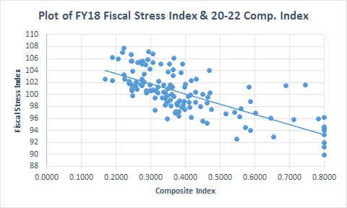
Higher fiscal stress among localities with lower ability to pay (Composite Index)

Slide 51
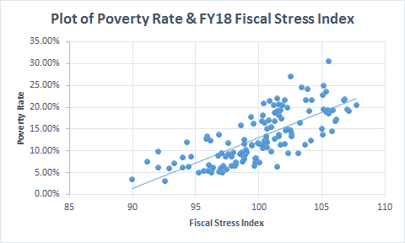
Higher fiscal stress among localities with higher poverty

Slide 52
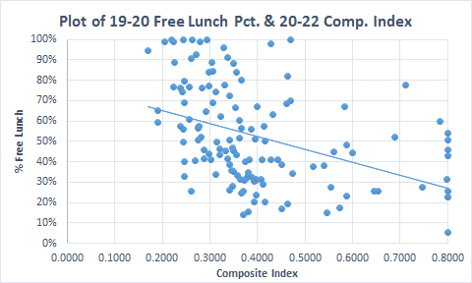
Moderate relationship between ability to pay (Composite Index) and percent of students qualifying for free lunch program

Slide 53
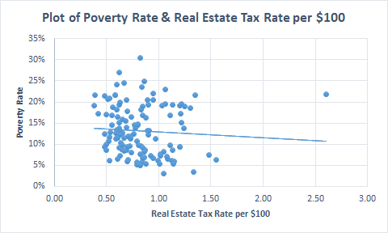
No relationship between community poverty rate and real estate tax rate

Slide 54
Other State Resources: School Division Efficiency Reviews & DGS Facilities Tool
The efficiency review program, begun in 2004 and managed by DPB, identifies ways divisions can realize cost savings in non-instructional operations that can be redirected and best practices replicated. In the Facilities area, examples of best practices identified include: cost/efficiency tracking and benchmarks, energy management, preventive maintenance, prototype school designs, enrollment projections/school capacity reviews, building condition assessments, etc.
Va. Dept. of General Services has developed a facility conditions assessment tool (Maintenance Reserve Facilities Index) that indexes the age, condition, and uses of state facilities and can be used in allocating facilities funding based on facility needs. Such a tool could be used at the state or local levels to assess the condition and needs of public school facilities and inform funding allocation decisions.

Slide 55
Overview of DOE
Guidelines For School Facilities
In Virginia’s Public Schools

Slide 56
Overview of DOE School Facilities Guidelines
The Guidelines for School Facilities in Virginia's Public Schools provides detailed guidance to school planners, architects, and educators for the planning and design of local public school facilities.
The Guidelines are intended to implement the Board of Education’s responsibility to set minimum school facilities standards per § 22.1-138 A.
The Guidelines have recently been revised after the last revisions in 2013. The revision process includes public comment via the Town Hall, as well as input from school division facilities staff and industry representatives.
It is anticipated the latest revision of the Guidelines will be effective on October 1, 2021.

Slide 57
Overview of DOE School Facilities Guidelines
The Guidelines establish best practices and standards in areas such as project planning; school sites; core classrooms; specialty instructional spaces; administrative and support services spaces; circulation space; building mechanical systems; equipment and technology; building environment factors, etc.
The revised Guidelines include new sections on NetZero schools; building safety and security; safe operation of electrical partitions; new CTE space requirements; ASHRAE standards for school HVAC systems; universal waste management; outdoor school facilities; and maintenance/custodial space requirements. All other sections have been updated to reflect current design and technology standards such as use of LED lighting systems, STEM project space requirements, increased room size for science labs, and Pre-K programs.
Staff will provide a brief overview of key content from the document.

