Slide 1
Overview of Special Education Staffing
PRESENTED TO THE VIRGINIA BOARD OF EDUCATION’S COMMITTEE ON THE STANDARDS OF QUALITY
October 20, 2021

Slide 2
Special Education Staffing
Background
Existing regulatory authority and regulations
Previous inquiries in this area
Relevant Factors
Areas for Consideration
Workplan
SESS Resources and Initiatives
Timeline
Initiatives already in action

Slide 3
Special Education Staffing Background (1 of 2)
Regulatory Background, Standards of Quality (Standard 2, § 22.1-253.13:2)
Sets out instructional and staffing ratios for school divisions. These ratios are specific to grade and/or discipline as well as staffing for programs of prevention, intervention, remediation, English language learners, and reading specialists.
Provides authority to the Board to set specific ratios for students with disabilities in its regulations.
"Within its regulations governing special education programs, the Board shall seek to set pupil/teacher ratios for pupils with intellectual disability that do not exceed the pupil/teacher ratios for self-contained classes for pupils with specific learning disabilities."
Standards of Accreditation
8VAC20-131-240 discuss standard loads for teachers which would apply to integrated classrooms. This section also points to the special education regulations for additional staffing requirements.

Slide 4
Special Education Staffing Background (2 of 2)
Regulations Governing Special Education Programs for Children with Disabilities in Virginia
8VAC20-81-40 Special education staffing requirements
Refers to 8VAC20-81-340, IEP services, service levels and removal from general education to provide special education and related services
Personnel assignment, caseload standards, and staffing for other special education programs
8VAC20-81-340 Special education caseload staffing requirements
Include the disability category, level of service, and number of students for maximum caseloads
Notes:
Staffing for early childhood special education, regional and local jails, educational interpreting services

Slide 5
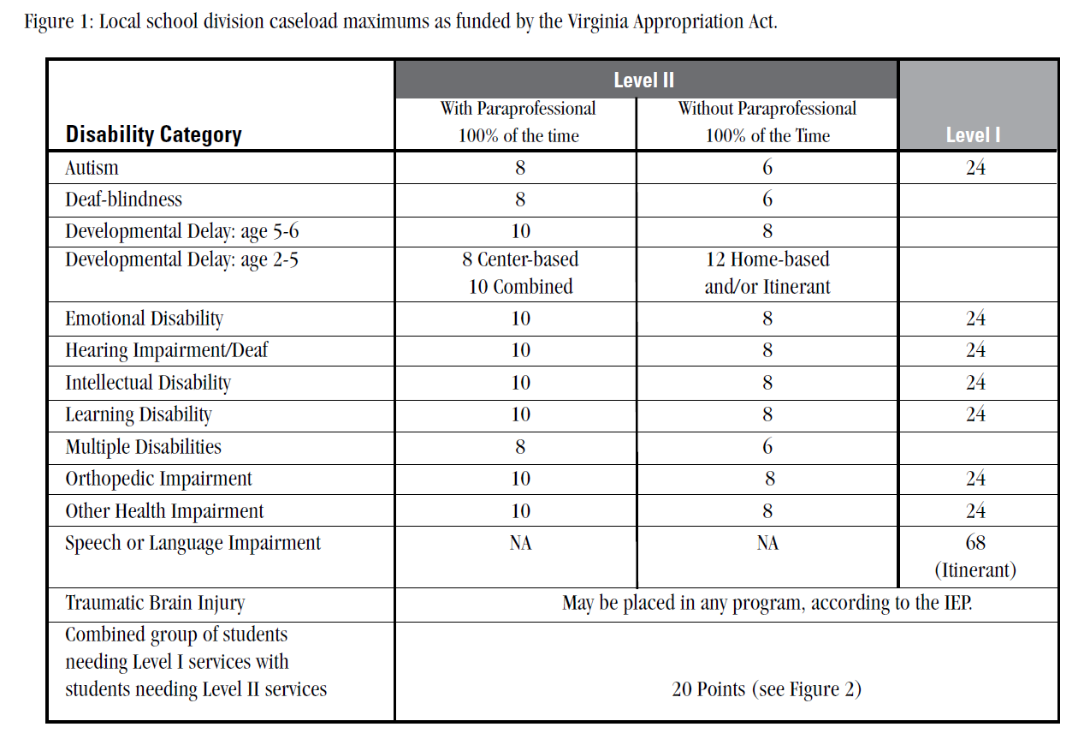

Slide 6
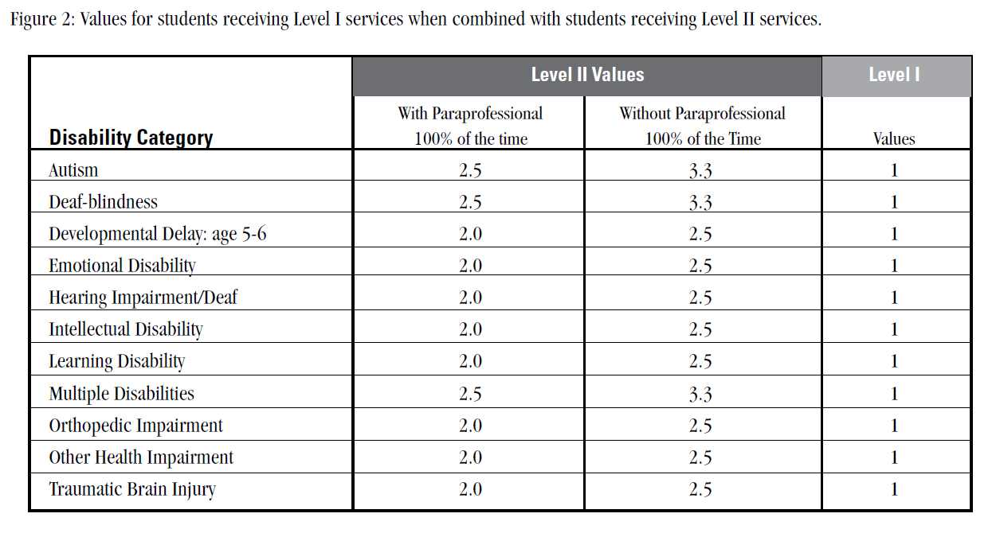

Slide 7
Relevant Factors: Funding
The Board of Education regulations govern minimum staffing requirements for special education
Funding to support special education (including staffing and support positions) comes from
State funding: Virginia’s state Standards of Quality (SOQ) funding
Federal funding: Allocations to local school divisions from the Individuals with Disabilities Education Act (IDEA)
Disparate impact on localities on special education funding
Notes:
SOQ Funding Allocations:
Based on JLARC methodology established in the late 1980’s. SOQ funding provides for the state share of salary, fringe benefits and support costs on instructional positions based on the staffing standards for special education. These staffing standards are applied to the December 1 special education child count data to determine the required instrictional positions for special education. Localities must pay the local schare of these costs based on their composite index.
IDEA Allocations: *NEVER FULLY FUNDED (Feds committed 40% of funding and current level of funding is 14.7%)
The federal funding formula used to allocate funding to school divisions is updated annually. Information for IDEA 611 funding was updated recently with the exception of the ‘base year’ allocated amount (i.e., FFY99-December 1, 1998 child count). The data sources for the FFY2019 (SFY2019-2020) allocation are
· 2017 School Census ages 2-21 published by Weldon Cooper Center; and
· Free/Reduced Lunch counts as of October 2018 published by VDOE Office of School Nutrition Programs.
Please note that these changes are also impacted incrementally, based on changes to total census data and poverty (i.e., % of state total).

Slide 8
Relevant Factors: Data Collection
Data related to special education instructional personnel
December 1 Child Count Table 2 Report of Special Education Teacher Serving Children with Disabilities
Instructional Personnel (IPAL) data collection
Supply and Demand Report for School Personnel (retired)
Positions and Exits Collection (new)
More detailed data
Timeline for collection October-December 2021
Notes:
Dec 1 CC Table 2 20-21: 3-5-537.28, 6-21-10720.21, TOTAL: 11,257.49
IPAL:
Web-based data collection completed by Virginia school divisions is used to collect teaching assignments at the school level and to verify that each teacher meets the licensure requirements for their teaching assignment(s) per the federal No Child Left Behind Act of 2001 (Public Law 1007-110). The data collection reflects a snapshot of the school division's instructional personnel as of October 1 of the reporting school year.
In order to comply with the reporting requirements of Indicators (b)(1), (b)(2), and (b)(3) of the State Fiscal Stabilization Fund (SFSF) Assurances, the No Child Left Behind Act of 2001 (Public Law 107-110), and Title II of the Higher Education Act (HEA), school divisions are required to submit data for the Fall Master Schedule Collection (MSC) that includes the following:
Secondary Enrollment Demographics Form (SEDF);
Instructional Personnel and Verification of Licensure Endorsement Report;
Instructional Personnel Survey Data Report; and
Supply and Demand Report.
Supply and Demand Report for School Personnel (retired):
Web-based data collection is used to collect the number of unfilled positions by administrative and teaching areas as of October 1 of the reporting school year from each Virginia school division.
The Supply and Demand Report has been replaced with the new Positions and Exits Collection. The "IPAL Survey" which was the aggregate collection of paraprofessionals has also been replaced with the new Positions and Exits Collection.

Slide 9
Relevant Factors: Recruitment and Retention
Special Education is the number one area of critical shortage for instructional personnel in the Commonwealth
Significant support from VDOE to speciality and teacher preparation programs using federal state set-aside funds
Network of support across higher education institutions across Virginia
Continuing area of focus for the State Special Education Advisory Committee
Inquiries and requests for technical assistance from local school divisions to VDOE

Slide 10
JLARC SPED Study
JLARC SPED (Appendix D)
Special education staffing models should consider student’s severity of need, scope of teacher responsibilities, and special education service settings
Standards of quality could better reflect resources needed to adequately staff special education
VDOE Response to JLARC
Dr. Lane’s Response and focus on capacity building for school-level staffing and support
Development of staff across educational settings to become more aware of the needs and requirements in servicing students with disabilities

Slide 11
VDOE Workplan
Continued support to institutes of higher education with a focus on special education and specialist preparation programs
Partnership across VDOE to support robust data collection and efficient utilization of funding to support special education staffing
Leveraging of support through external support
Personnel Development Grant from the U. S. Department of Education
Technical Assistance Grant from the Center for Effective Educator Development Accountability and Reform (CEEDAR) at the University of Florida
Innovative approaches to support special education personnel and creating an ideal model for special education staffing

Slide 12
Areas for Consideration
“Attract, Prepare, Retain: Effective Personnel For All”
General and special education teachers, early childhood personnel, and related services providers—who have the knowledge and skills needed to provide effective instruction, interventions, supports, and services to children with disabilities
Training and Technical Assistance
Journey Into Teaching (JITA); professional assessments, competency instruction, support with stipends for participants
Innovative Staffing Models
Other state examples; consideration of severity of need, scope of teacher responsibilities, and service setting. Consideration of “workload analysis model.”
Shift in Special Education
Adapting our approach to serving students with a focus on evidence-based practices and a practical approach for our public school divisions
Notes:
JITA: Regions 1, 8 and Petersburg pilot for 2020-2021 school year
We retained 10 of 11 JITA teachers this year and they are fully staffed. The plan was to follow these 10 for two more years but the SPED director wants his provisional new hires in also and it will work out so we have 15 in this year's cohort.
SPED “staffing”--> SOQ=access, caseload requirements=compliance, staffing models=best practice/implementation

