Slide 1
VDOE OMEGA Training: Fall 2022
804-371-0993 – OMEGA.Support@DOE.Virginia.gov

Slide 2
VDOE OMEGA Training 2022
OMEGA Introduction
Access to OMEGA
  OP-1 Form (Updated with CARES Act information)
Applications
  Original Application
  Revisions
  Amendments
Budget (Object Code) Transfers
Reimbursement Requests
Questions?

Slide 3
What is OMEGA?
OMEGA stands for Online Management of Education Grant Awards
OMEGA is an automated grant reimbursement and application system designed and administered by the Virginia Department of Education. It is used to process grant reimbursements, budget transfers and application requests. OMEGA is accessed through the VDOE’s secure internet portal, the Single Sign-on for Web Systems (SSWS).
https://p1pe.doe.virginia.gov/ssws/login.page.do

Slide 4
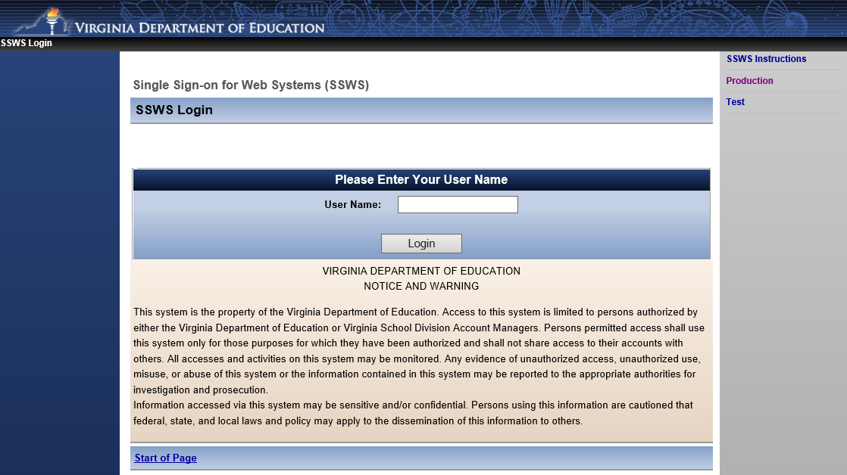
OMEGA Login Page

Slide 5

Access to OMEGA
OP-1 FORM (Levels 1 - 4)
OP-VDOE (Levels 5 – 7)
Forms can be found on the VDOE website at
http://www.doe.virginia.gov/school_finance/budget/grants_acct_reporting/omega/index.shtml

Slide 6
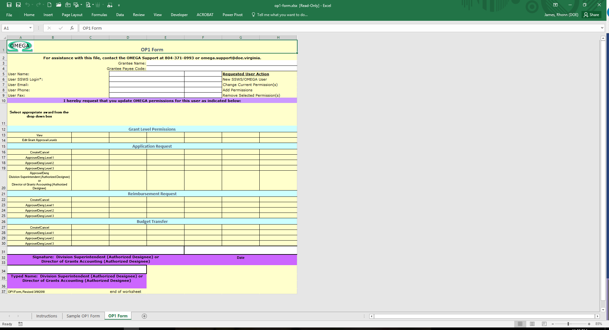
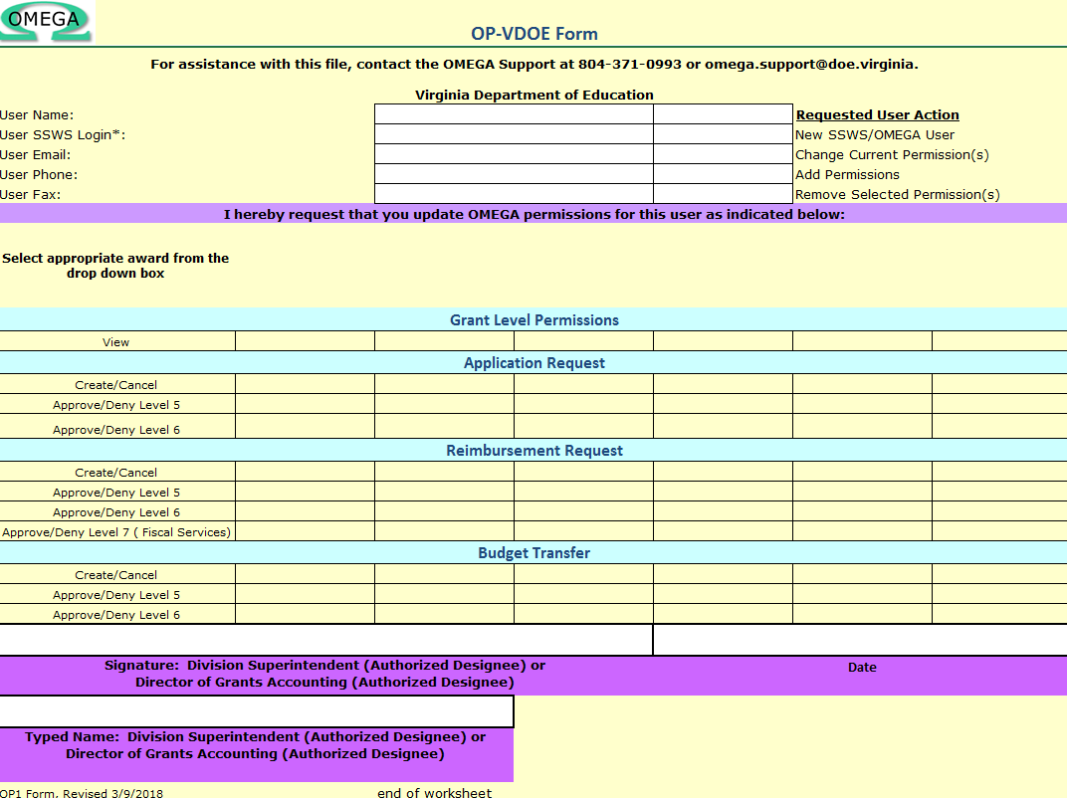
OP-1 & OP-VDOE Forms

Slide 7
Things to remember when completing an OP Form
Use the most up-to-date OP form
  Latest revised on July 22nd
  A person can only be a creator OR an approver (not both)
OP form must be signed
  Supt or Supt’s designee must sign and date
Please submit OP form to OMEGA Support at: omega.support@doe.virginia.gov

Slide 8
Things to remember when completing an OP Form
You need at least one creator and one Level 4 approver (for applications) and one Level 3 approver (for reimbursements and budget transfers) for each award.
You also have the option to have Level 1 and Level 2 approvers as well, but these are not required.
If you do not have a required approver for an award in Omega, your request will stall at the level where the approver is missing.

Slide 9
Submitting an Application
The application process allows school divisions to transmit grant award information electronically to the Department of Education while ensuring appropriate levels of review
The process provides one central repository for award documentation and allows immediate access to users
Grantees may choose to submit an application for one award (non-consolidated) or an application for multiple awards (consolidated)

Slide 10
Important Reminders
Make sure to choose the correct year for your application (even though a new year is showing, it doesn’t mean that is the correct year for submission!)
At least two people at the school division level are required to be involved in the automated process of submitting and approving an application
One of those individuals, the Application Originator/Creator, performs the download of the completed application(s) Excel spreadsheet and submits the application for approval
After the application has been downloaded, saved and submitted by the originator/creator, the division superintendent or superintendent’s designee must approve the application in OMEGA at Level 4

Slide 11

Submitting an Application
On the OMEGA home page, the application Originator/Creator selects Submit an Application.

Slide 12
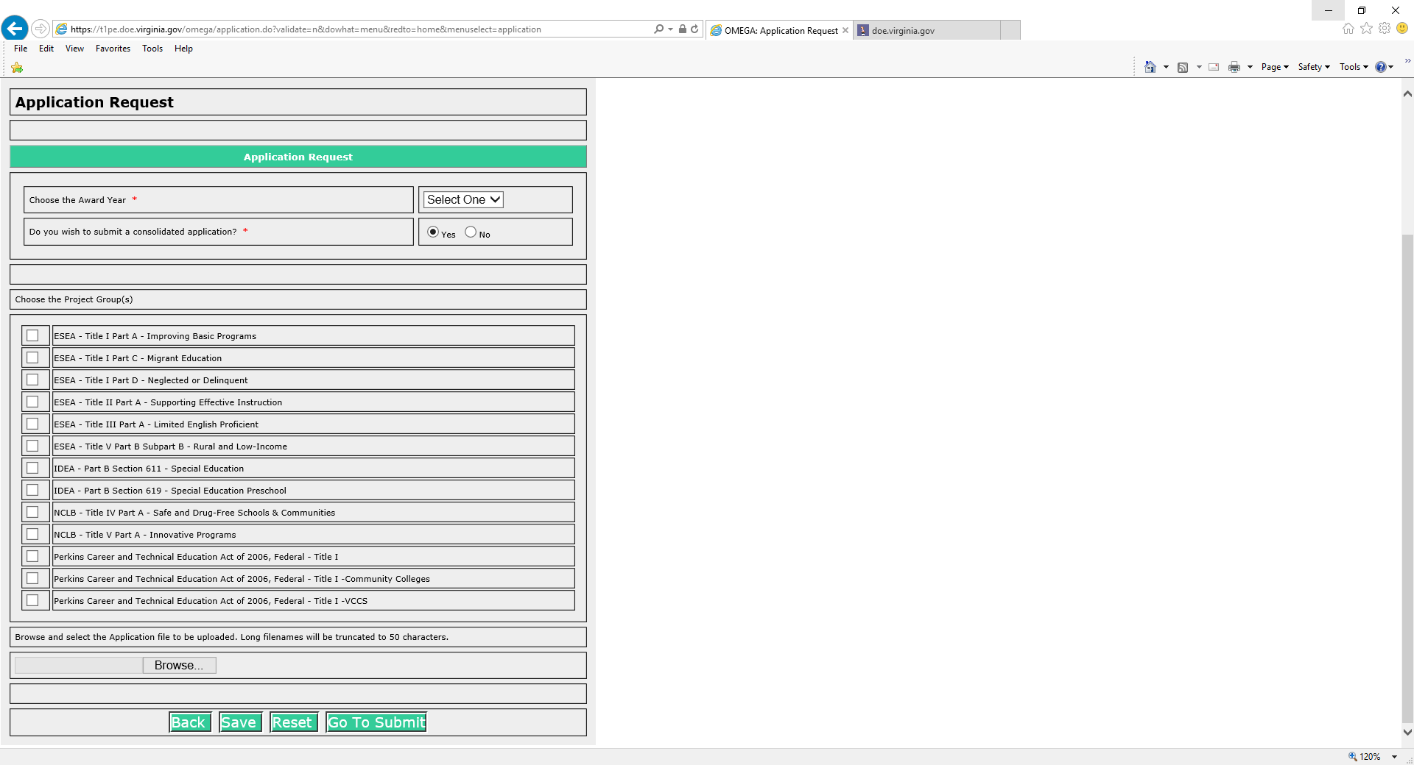
Select:
Year
Type of Application: Consolidated or Non-Consolidated (Yes or No)
Project Group
Indicate the award(s) for which funding is being requested by checking the appropriate box(es).
Then click on Browse.
Find and select (double click the file name or click the file name once and “Open” once) the Excel spreadsheet that contains the application information.

Slide 13
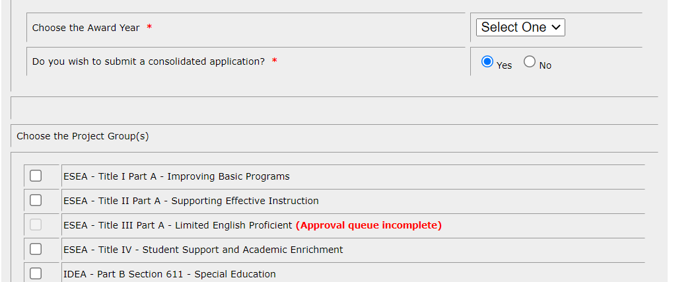
What Does This Mean?
This tells you if your approval queue is missing approvers. It will not let you submit if you are missing approvers.
If you see this, email Omega Support and we can get your queue updated!

Slide 14
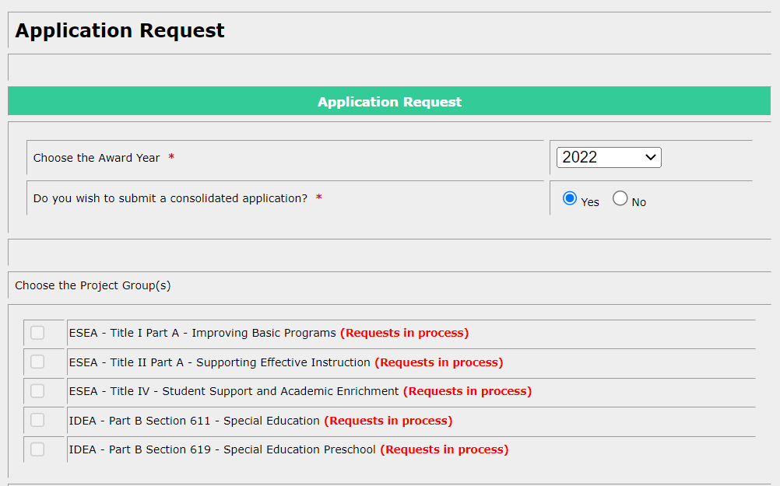
What Does This Mean?
This tells you if you already have an application in process for the year you are trying to work with.
If you see this, check your to-do list to see if the application is there to revise. If not, email Omega Support.

Slide 15
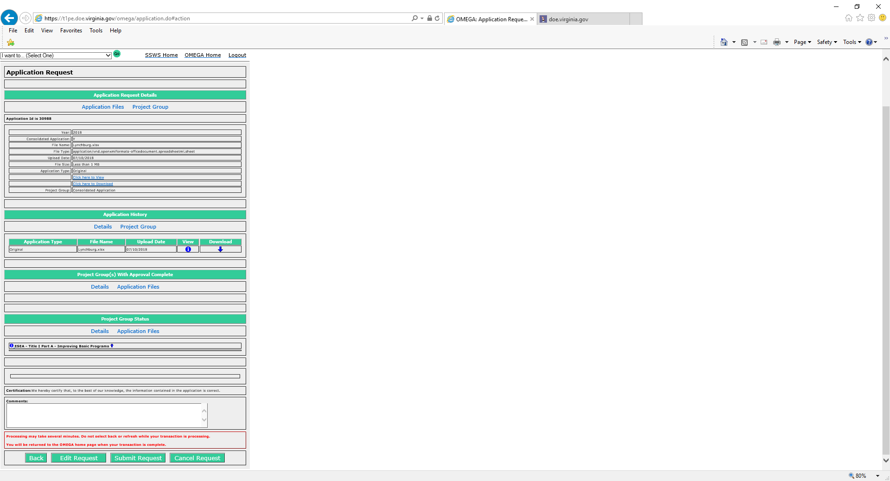
Once the Application is saved, it is staged and ready for an action
Back
Edit Request
Submit the request (Moves to the next Level)
Cancel the request
OMEGA can be finicky – Please be patient after clicking the submit button to avoid “Duplicate Submissions”
When contacting OMEGA Support – We always ask for the Application ID Number
Notes:
When submitting the request please be patient

Slide 16
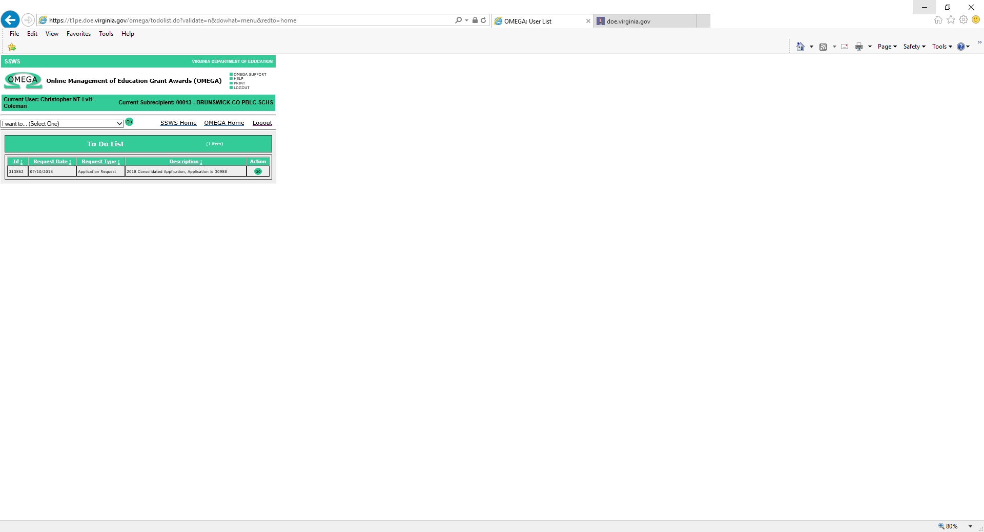
Once Submitted, the Application is routed to the “To Do List” of the next approver in the queue for that award
Take Action:
Select “GO”
Application will open up to 3 Action buttons (review the attached application – Excel Format)
Back
Approve
Deny

Slide 17
Where Does the Application Go?
Normally, the application moves on to the next approver’s “To Do List” Up-Line
    This could be at the LEA or SEA levels
Is it stuck?
    Where is the application in the queue? (click on the arrow under Project Group Status)
    Check that all levels of approval have an approver (click on the info button)
    If you aren’t sure, email Omega Support and we can find out where the application is!

Slide 18
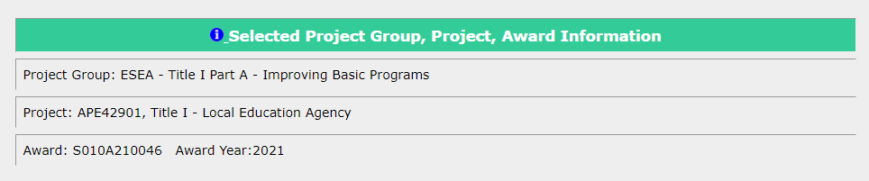

How Can I Tell Who is in the Queue?
You have an Info button on every request that will bring up this queue window (it will appear with the award information).

Slide 19
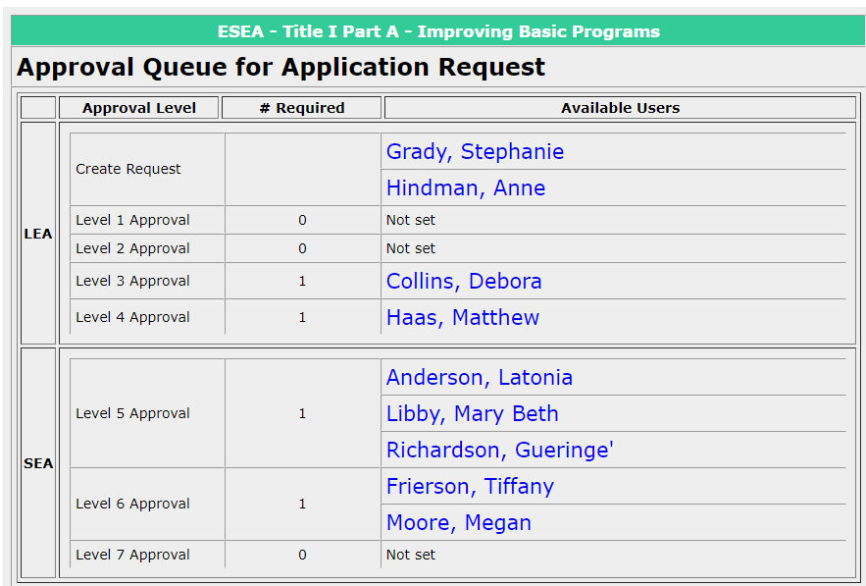
How Can I Tell Who is in the Queue?
Clicking on the info button will open a new window with your queue listed! This can give you insight as to where your request is.

Slide 20
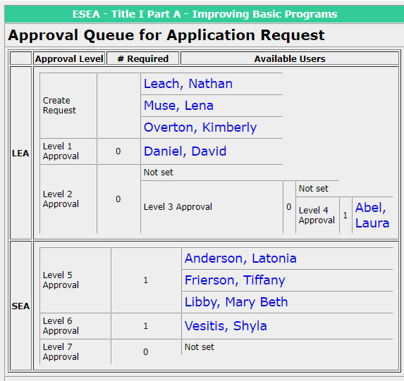
Where Does the Request Go?
In this picture, there is an approver for Level 1, but no required level. This means it will skip your Level 1 approver. We can update your queue using “Edit Grant Approval Levels.”

Slide 21
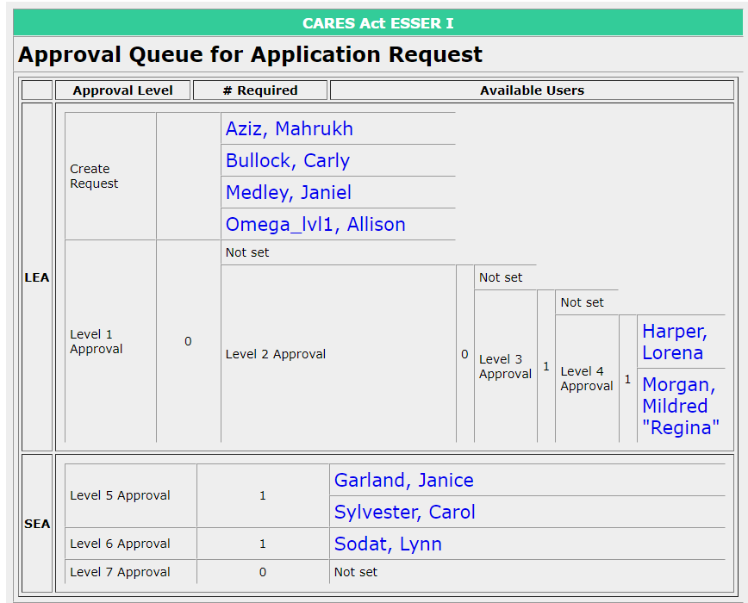
Where Does the Request Go?
In this picture, there is a queue requirement for a Level 3 approver, but no approver. This means it will stop at your Level 3 approver. We will need to add an approver here so the request can continue on.
The queue can not be changed while there are requests in it. We have to wait until it is clear to alter the queue.

Slide 22
Revising a Denied Application
A submitted application can be denied at any LEA or SEA Review Level as it moves through the Approval Queue
Correction of a denial can be done only by an originator/creator and only when the application is available in an originator’s To-Do list
If a non-consolidated (only one award) application is denied, the application immediately returns to the Originator’s To-Do List
If an award in a consolidated (multiple awards) application is denied, the application won’t return to the originator until all awards within the application have a status of either “Denied” or “Approval Completed”

Slide 23
Revising a Denied Application
Revisions to the application are made in EXCEL. Access the spreadsheet that contains the award information, make the required changes, and save the revised spreadsheet
In Omega, access the application from the To-Do list by clicking the Go button:

Slide 24
Revising a Denied Application
Select Edit Request:

Slide 25
Revising a Denied Application

Slide 26
Application Revision is staged and ready for an action
Notes:
When submitting the request please be patient

Slide 27
The following screen allows comments. A brief description of revisions should be entered.
Select
After the application is transmitted, the originator is returned to the Omega Home screen. That indicates the revised application is successfully submitted and has simultaneously moved off of the originator’s To-Do list and onto the To-Do list of the first approver in the queue.

Slide 28
Submitting an Amended Application
An application amendment may only be processed after an Application Request has the status of Approval Completed (through Level 6).
The steps for processing an amended application are similar to processing a revised application
  From the Dropdown – Select “Submit an Application Amendment” instead of going to the to-do list
In a consolidated (multiple awards) application, all individual awards must have the status of Approval Completed.
In a non-consolidated application (one award) the one award must have the status of Approval Completed.

Slide 29
Submitting an Amended Application
What if my application isn’t appearing in the “Submit an Amendment” list?
  This likely means one of two things:
    Your application is not complete. It is still “in process” in the list of applications. If this is the case, you can find the application in your to-do list and revise it from there.
    The funds are currently not in Omega yet. No amendments can take place until the award funds are in Omega for the year. Not all 2022 awards are in yet!

Slide 30
Budget (Object Code) Transfers
Also known as “Budget Transfer,” “Change My Object Code Budget” is the mechanism used to move funds within an award from object line to object line. Transfers do not increase nor decrease the funds available or affect the award’s remaining balance.
From the OMEGA drop down, select “Change my object code budget”

Slide 31
Budget (Object Code) Transfers
The Request for Budget Transfer appears
The object code, its description, and the amount available by object code are shown
The increases and decreases change object code budgets are enter in the “Amount of Change” column. A minus sign (-) is entered where funds are subtracted
The total in the “Amount of Change” (middle) column MUST equal $0.00
An explanation of the object code changes is required before you submit

Slide 32
Budget (Object Code) Transfers
Example:
Note that the “Amt of Change” column total is zero and the required justification has been entered.
Other than the decimal point and minus sign, no special characters are entered i.e., ($ + ,).
Once completed, there are three options:
the Back button returns the user to the home screen without saving the request
Save saves the request, adds it to the user’s To-Do list and Omega assigns a unique request ID number.
Reset changes all amounts entered into the Amt of Change column back to zero
Notes:
Notice the sum total is still Zero.

Slide 33
Budget (Object Code) Transfers
After saving the data, confirmation appears at the top of the page and a request ID is assigned.

Slide 34
Budget (Object Code) Transfers
Clicking on allows another review of the data and another chance to edit

Slide 35
Budget (Object Code) Transfers
After successfully saving, the Status Queue indicates the request is created, shows a tracking number, the status change date, the individual who changed the status, and the level at which the change was made
There are four options:
  “Back” returns the user to the Omega Home page
  “Edit Request” allow further changes to be made
  “Submit Request” begins the processing and puts the request into the approval queue
  “Cancel Request” will remove the request from the To-Do list
*If you cancel, the request cannot be processed further. Cancellation requires a justification.*

Slide 36
Creating a Reimbursement Request
From the Omega drop down , select “Create/Submit a reimbursement”

Slide 37
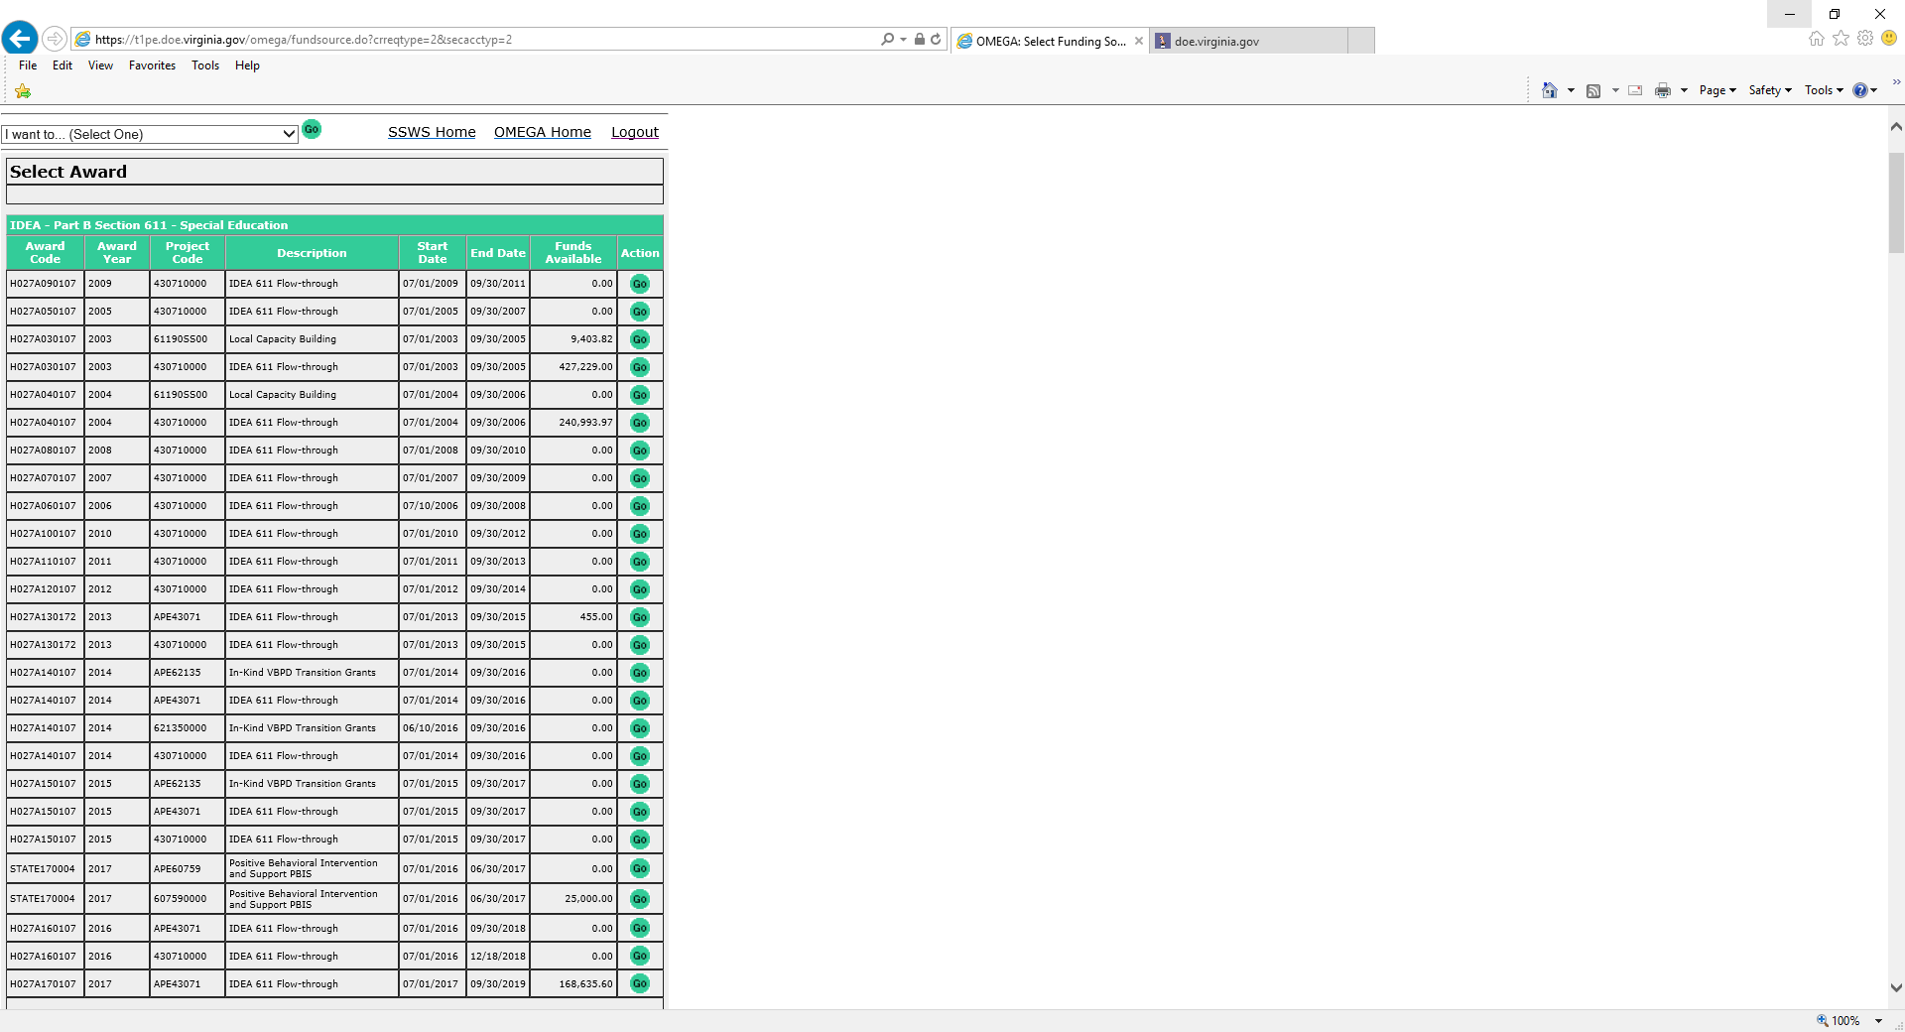
Creating a Reimbursement Request
Choosing the Create/Submit a reimbursement function will access the Select Award page so that the user can select a funding source. This will become the default award.
Select an Award using the button
Note: If, upon selection of the award, the user then tries to Create/Submit a Reimbursement but is denied access, review the user’s OP1 form to ensure that the appropriate permissions have been established. If the OP1 form shows permission is granted for this award, the user should contact OMEGA Support at the Department.

Slide 38
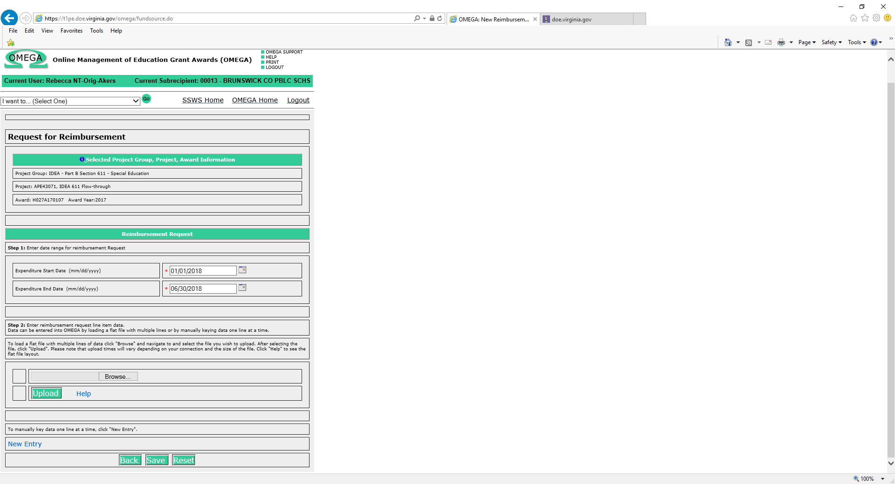
Creating a Reimbursement Request
Enter the expenditure start and end dates first (red arrow). These must be entered to move forward with the request. Expenditure data can be entered manually or uploaded from Excel into OMEGA.
For Manual Entry (yellow arrow):
  Select the New Entry link near the bottom of the request for reimbursement form.
For Electronic Data Entry (green arrow):
  Use the Browse button to locate the file and upload into OMEGA. For details about this feature, see Appendix B: Uploading Data for Reimbursements

Slide 39
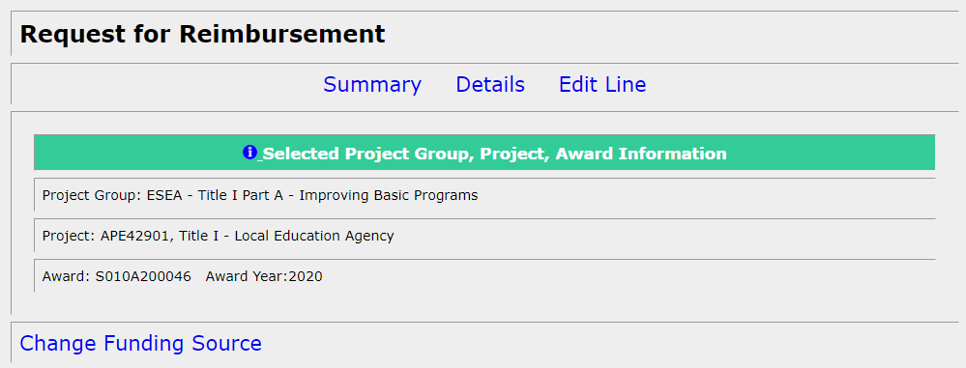
Creating a Reimbursement Request
Entering Expenditure Data Manually:
Upon selection of New Entry, a Reimbursement Request appears, containing 4 sections:
Selected Project Group, Project, Award Information
  This section displays the selected award and related information. Change Funding Source is located here so that you can change the award from this page if necessary.

Slide 40
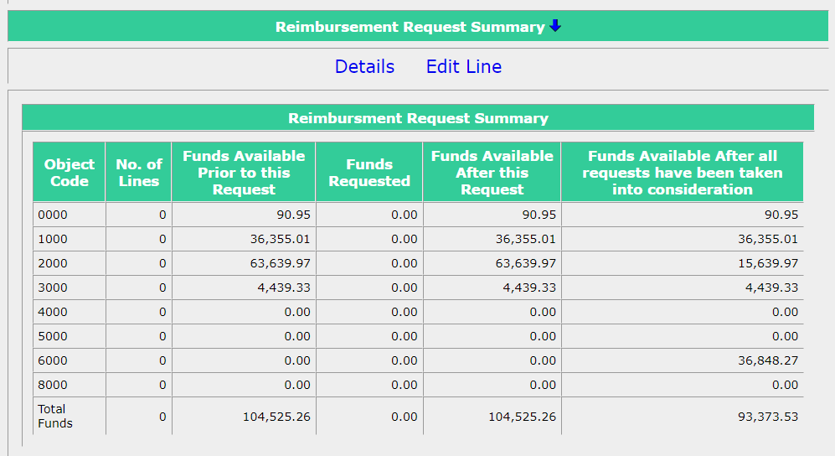
Creating a Reimbursement Request
Entering Expenditure Data Manually:
2. Reimbursement Request Summary
  This section includes columns for:
    Object Code (code used to identify type of expenditure)
    No. of Lines – the value changes as detail lines are added
    Funds Available Prior to this Request (the current balance by object code). (Note that a budget transfer in process will temporarily decrease this amount. Funds are subtracted from donating object lines upon submission of the transfer request. Recipient object lines won’t change until all levels in the queue have been approved and the status is “Transfer Completed”)

Slide 41
Creating a Reimbursement Request
Entering Expenditure Data Manually:
2. Reimbursement Request Summary (continued)
  This section includes columns for:
    Funds Requested (amounts will appear as detail lines are added)
    Funds Available After this Request
    Funds Available After all requests have been taken into consideration (balances after all pending expenditures and budget transfer requests are included).

Slide 42
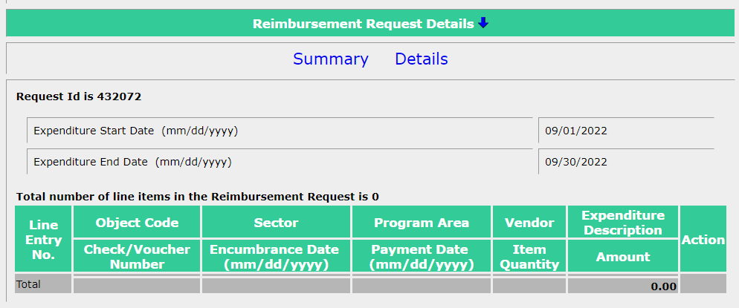
Creating a Reimbursement Request
Entering Expenditure Data Manually:
3. Reimbursement Request Details
  This section includes:
    Request ID – a tracking number automatically assigned by OMEGA
    Expenditure Start and End Dates
    Details of each line in the request appear as lines are added

Slide 43
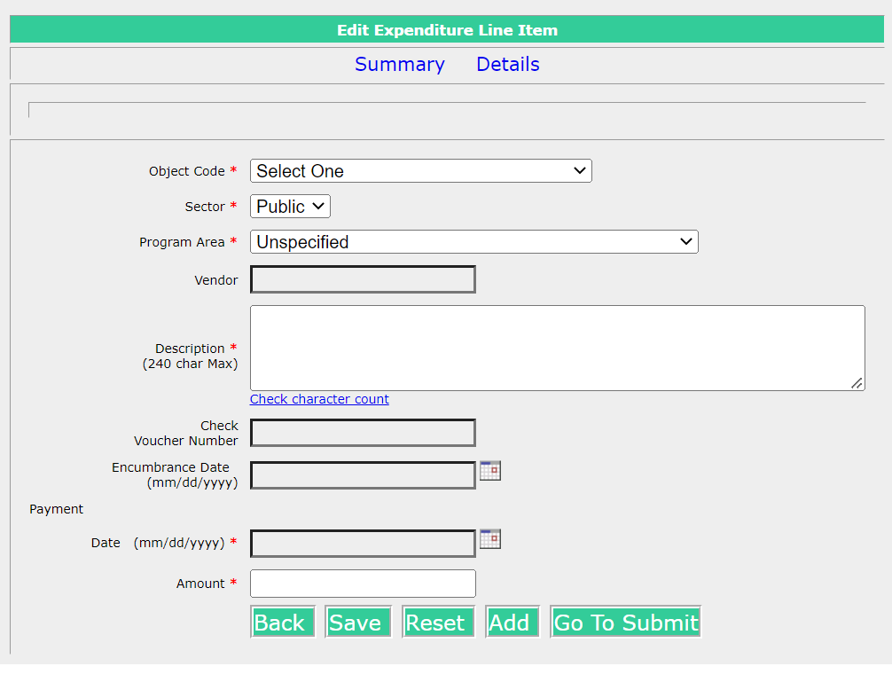
Creating a Reimbursement Request
Entering Expenditure Data Manually:
4. Edit Expenditure Line Item
  This is where you enter your line item information!
  This section includes the fields that are required for reimbursement. Required fields are denoted by an asterisk (*).

Slide 44
Reimbursement Requests
Requirements for Reimbursement Requests:
  All reimbursement requests require the following information:
    Object Code - code established by the Department to classify expenditures
    Sector - identifies whether the cost is associated with a public or private school
    Program Area - additional classifications established by the Department for expenditures
    Vendor Name (100 characters max.)

Slide 45
Reimbursement Requests
Requirements for Reimbursement Requests:
  All reimbursement requests require the following information (continued):
    Description of the Expenditure (240 characters max)
    Check/Voucher Number (10 characters max)
    Payment Date – date payment record was established (date processed in the accounting system or the date the check was cut)
    Payment Amount (do not include commas in this amount)

Slide 46
Reimbursement Requests
Object Codes 1000 & 2000
  For object codes 1000 (Personnel Cost) and 2000 (Fringe Benefits), a Description is now required in the following format:
    Payroll Range or Payroll Cycle Dates
    GL Posting Date
    Pay Date
    Encumbrance date is an optional field
    Expenditure Date is a required field and should be aligned with the Pay Date

Slide 47
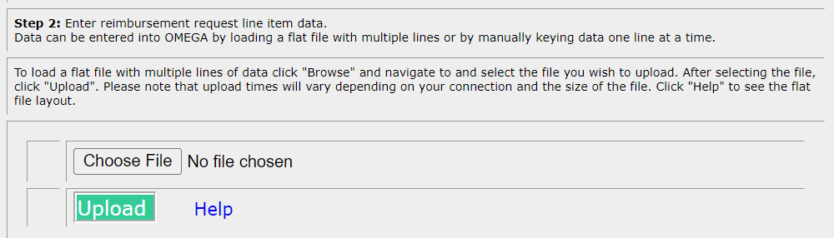
Uploading Reimbursement Requests
If you would like to use the upload process to do your reimbursements requests, a template in Excel is available.
Reimbursement request files must be in .txt format as OMEGA will not take an Excel-formatted file
If you would like more information, please email Omega Support or refer to Appendix B in the Omega User Guide

Slide 48
Creating a Reimbursement Request
Action Buttons
  Returns the user to the previous page .
  Saves the information in OMEGA in a created status, but does not submit the request for approval. The request is saved and can be edited and/or submitted at a later date. The first time the request is saved, Omega assigns a unique ID number to the request and adds the request to the originator’s To-Do list.
    Clears the information previously entered for this line item.
  Opens a blank detail line to add another line item to the request.
  Opens a “locked” version of the request so that the user can review it before submission. The user has options to add a comment, go back to the previous page, edit, submit, or cancel the request.

Slide 49
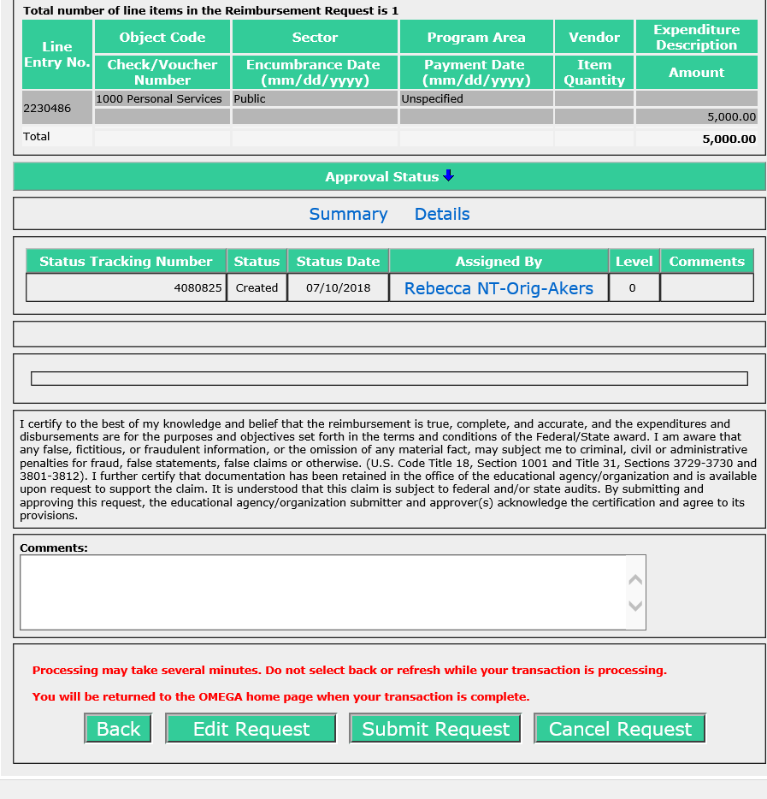
Editing a Reimbursement Request
Edit a Reimbursement Request
To edit a request, select the Action button from the bottom of the request. This will allow editing. The Reimbursement Request Details will show each line item in the request and provide an Action column on the right for each line.
Choose to change information in the selected line.
Choose to copy the line item and add it to the request.
Choose to delete the line item from the request.
Select to save the edited request in the created state.
Its always a good idea to Save after editing.
Select “Go to Submit” to proceed with submission of the request for approval

Slide 50
Creating a Reimbursement Request
NOTE: Once a request is submitted, the Originator/creator cannot edit it. If editing is required after submission, any reviewer in the queue can deny it. A denied request will return to the To-Do list of the Originator and the originator can then edit it.
When the submission has been processed, the originator will be returned to their Omega Home screen and the request will have moved from the originator’s To-Do list to their Pending list. The request will also be in the To-Do list of the first reviewer in the queue and in the Coming Soon list of all subsequent reviewers listed in the queue. As each reviewer processes the request, it will be deleted from that reviewer’s To-Do list and will be added to their Pending list.
An approval level may have more than one reviewer. All individuals at a level have equal access and authority. When a status changes at a level, it changes for all individuals in the queue at that level. A division can require multiple approvals at any level. Due to separation of duties concerns, any one individual should not have permissions at more than one level for any one award.

Slide 51

Questions?

Slide 52
Contact Information
Allison May
(804) 371-0993
Omega.Support@doe.virginia.gov
or
Allison.May@doe.virginia.gov

Slide 53



Connect with VDOE
Twitter: @VDOE_News
Facebook: @VDOENews
#VAis4Learners #EdEquityVA

