Slide 1
The Design and Practice of U.S. Teacher Evaluation
Veronica Katz | Luke C. Miller | Jim Wyckoff
EdPolicyWorks
University of Virginia
Virginia State Board of Education| October 16, 2019
Notes:
Thanks to folks at DCPS for supplying the data and answering our many questions. Jessalynn was instrumental in this work.

Slide 2

Academic Achievement in Virginia
Notes:
Good reason to believe that implementation was a problem given the top down nature of teacher evaluation in most states, the complexity and cost of doing it well

Slide 3
Proposed Agenda
  Why should we care about teacher evaluation?
  How can teacher evaluation improve student outcomes?
  What is teacher evaluation in other states and districts?
  What is teacher evaluation in Virginia?

Slide 4


Slide 5
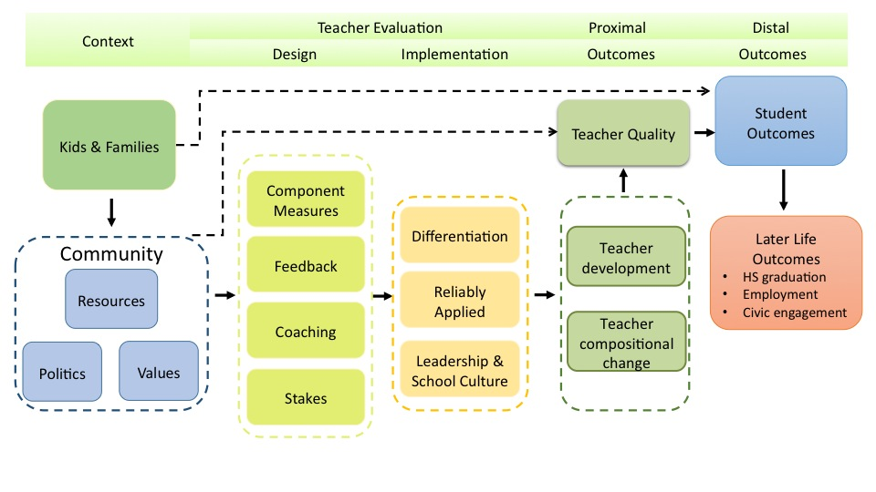
Teacher Evaluation Theory of Change
Notes:
Good reason to believe that implementation was a problem given the top down nature of teacher evaluation in most states, the complexity and cost of doing it well

Slide 6
Teacher Evaluation Theory of Change
Teacher Evaluation |  | Proximal | Distal
Design | Implementation | Outcomes | Outcomes
Student Outcomes
Teacher Quality
Component Measures
Differentiation
Later Life Outcomes
HS graduation
Employment
Civic engagement
Feedback
Teacher development
Reliably
Applied
Coaching
Teacher compositional change
Leadership & School Culture
Stakes

Slide 7

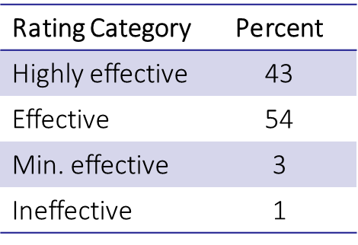
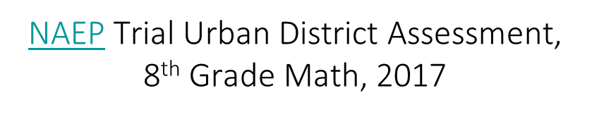
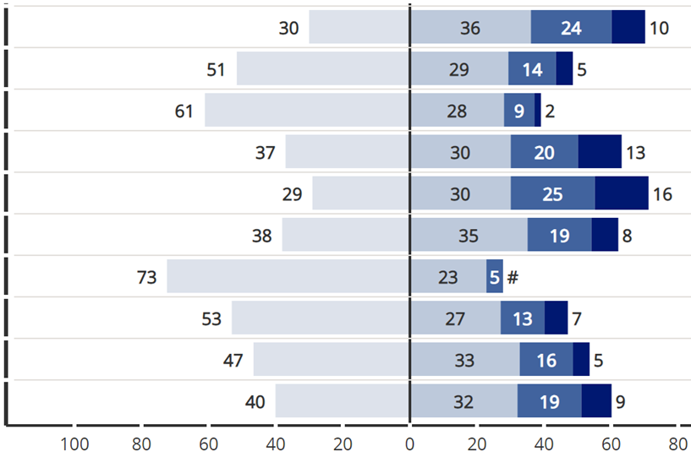

Teacher Evaluation and Teacher Quality
Wait … What?
Notes:
Good reason to believe that implementation was a problem given the top down nature of teacher evaluation in most states, the complexity and cost of doing it well

Slide 8
Effective Teacher Evaluation
Multiple valid and reliable measures
Differentiation among teachers
Formative feedback and support
Summative consequences???
Notes:
Good reason to believe that implementation was a problem given the top down nature of teacher evaluation in most states, the complexity and cost of doing it well

Slide 9
Measuring Teacher Effectiveness
Teaching to test, teacher idiosyncratic material, measurement error
True achievement growth
Rigorous observation
Value added
Test material aligned with policy defined learning goals
Student evaluation

Slide 10
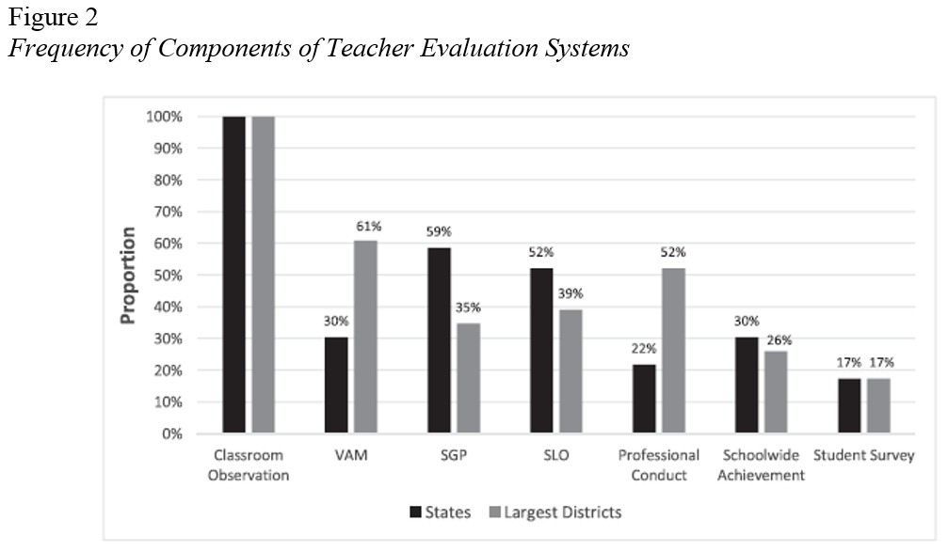
What does typical teacher evaluation look like?
Metric | Weight
Standards based classroom observations | ~65%
Improved in student achievement | ~15%
Student surveys | ~10%
Professional conduct | ~10%
Source: Steinberg & Donaldson, 2016, Figure 3
Notes:
Good reason to believe that implementation was a problem given the top down nature of teacher evaluation in most states, the complexity and cost of doing it well

Slide 11
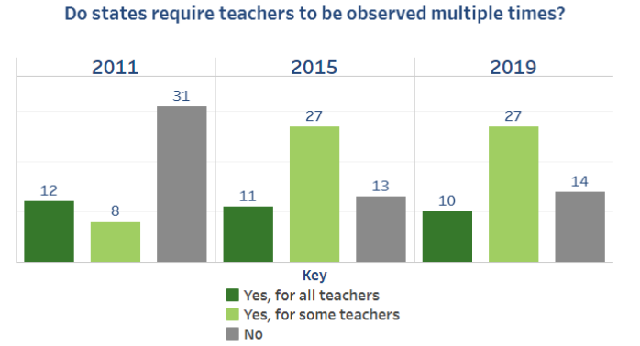
What does typical teacher evaluation look like?
Notes:
Good reason to believe that implementation was a problem given the top down nature of teacher evaluation in most states, the complexity and cost of doing it well

Slide 12
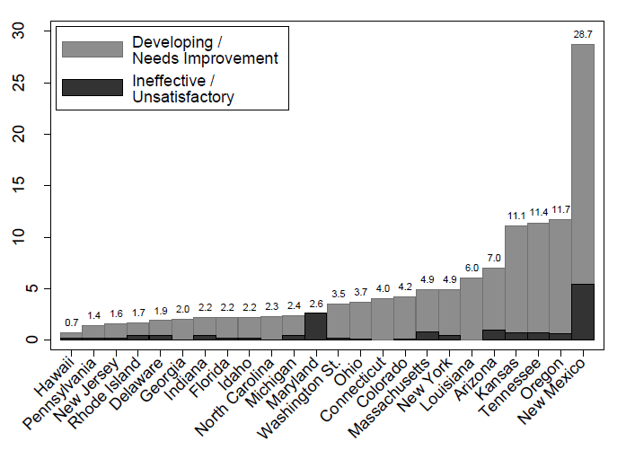
Measuring teacher effectiveness
Figure 5
Percentage of Teachers Rated Below Proficient Across 24 State Evaluation Systems
Source: Kraft & Gilmour, 2017, Figure 1
Notes:
Good reason to believe that implementation was a problem given the top down nature of teacher evaluation in most states, the complexity and cost of doing it well

Slide 13
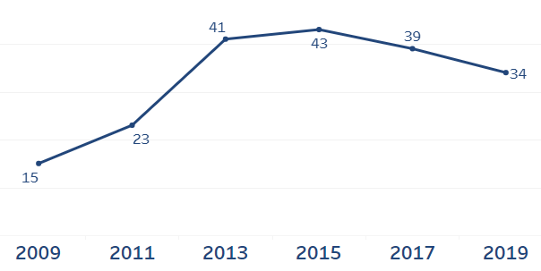
Teacher Evaluation and Teacher Quality
Figure 3
States Requiring Evidence of Student Learning in Teacher Evaluation
Source: Walsh et al., 2019, Figure 2
Notes:
Good reason to believe that implementation was a problem given the top down nature of teacher evaluation in most states, the complexity and cost of doing it well

Slide 14
Characteristics of 7 Evaluation Systems
Table 7
Rigor of SBO Implementation, Seven Teacher Evaluation Systems
 | Denver | DCPS | New Haven | NM | NYC | NC | TN
Use of external observers | None | Discontinued | Targeted | Optional | None | None | None
Annual observer certification | ✔ | ✔ | ✔ | ✔ | ✔ | ✔ | ✔
Ongoing efforts to improve observer reliability | Anually | Annually | No evidence | No evidence | Untargeted observer coaching | No evidence | Targeted observer coaching
Maximum number of formal observations | 1 | 3 | 2 | 3 | 1 | 3 | 6
Table 8
Use of Professional Development, Seven Teacher Evaluation Systems
 | Denver | DCPS | New Haven | NM | NYC | NC | TN
Teacher evaluation informs PD | No evidence | No evidence | Yes, for all teachers | For low-performing teachers | For low-performing teachers | Yes, for all teachers | Yes; limited pilot study
Comprehensive PD plan | No evidence | Yes | Yes | No evidence | No evidence | Yes | No evidence
Notes:
Good reason to believe that implementation was a problem given the top down nature of teacher evaluation in most states, the complexity and cost of doing it well

Slide 15
Consequences associated with evaluation ratings
Table 5
Use of Sanctions and Rewards, Seven Teacher Evaluation Systems
 |  | Denver | DCPS | New Haven | NM | NYC | NC | TN
Sanctions | Performance improvement plan |  |  |  | ✔
 | Salary freeze | ✔ | ✔ | ✔ |  |  |  | ✔
 | Change in probationary status | ✔
 | Dismissal |  | ✔ | ✔ |  |  | ✔
Rewards | Career advancement | ✔ | ✔ | ✔ |  | ✔ | ✔
 | Performance-based salary increase | ✔ | ✔
 | Performance-based bonus |  | ✔ |  | ✔
Notes:
Good reason to believe that implementation was a problem given the top down nature of teacher evaluation in most states, the complexity and cost of doing it well

Slide 16
Implementation
Table 6
Summary of Implementation Process, Seven Teacher Evaluation Systems
 | Denver | DCPS | New Haven | NM | NYC | NC | TN
Efforts to increase buy-in prior to implementation | High | Medium | High | Low | Medium | Medium | Low
Responsiveness after initial implementation | Low | High | Medium | Low | Low | Low | High
District autonomy | Medium | High | Medium | Low | Medium | Low | Low
Notes:
Good reason to believe that implementation was a problem given the top down nature of teacher evaluation in most states, the complexity and cost of doing it well

Slide 17
What is the evaluation of teachers in these and other school divisions?
Notes:
Good reason to believe that implementation was a problem given the top down nature of teacher evaluation in most states, the complexity and cost of doing it well

Slide 18
Teacher evaluation in Virginia
SOQ: Standard 5:
  B. Consistent with the finding that leadership is essential for the advancement of public education in the Commonwealth, teacher, principal, and superintendent evaluations shall be consistent with the performance standards included in the Guidelines for Uniform Performance Standards and Evaluation Criteria for Teachers, Principals, and Superintendents. Evaluations shall include student academic progress as a significant component and an overall summative rating. Teacher evaluations shall include regular observation and evidence that instruction is aligned with the school's curriculum. Evaluations shall include identification of areas of individual strengths and weaknesses and recommendations for appropriate professional activities.
Notes:
Good reason to believe that implementation was a problem given the top down nature of teacher evaluation in most states, the complexity and cost of doing it well

Slide 19
How are teachers evaluated in Virginia?
Guidelines for the Uniform Performance Standards and Evaluation Criteria for Teachers
  Seven standards
  Four ratings categories (expectations for standard 7: student academic progress)
    Exemplary: In addition to meeting the standard, the work of the teacher results in a high level of student achievement with all populations of learners.
    Proficient: The work of the teacher results in acceptable, measurable, and appropriate student academic progress.
Notes:
Good reason to believe that implementation was a problem given the top down nature of teacher evaluation in most states, the complexity and cost of doing it well

Slide 20
Is Virginia realizing the potential of teacher evaluation?
What is the distribution of teacher effectiveness in each division?
Are less-effective teachers receiving targeted development opportunities and realizing performance-based consequences if lack of improvement?
Do Exemplary teachers receive recognition and professional opportunities?
Are teachers and students realizing the benefits of a well-implemented teacher evaluation system?
We simply don’t know
Notes:
Good reason to believe that implementation was a problem given the top down nature of teacher evaluation in most states, the complexity and cost of doing it well

Slide 21
Thank you!
Notes:
Show robustness across tested grades and non-tested grades
Bigger picture: why were HE teachers leaving
She found compelling point about how they are able to replace with better teachers

Slide 22
Teacher assessments in 2009 (Widget Effect)
Infrequent | Many teachers aren’t given feedback every year; often evaluations based on one short observation
Unfocused | Often evaluated on behaviors and practices that have little impact on student learning
Undifferentiated | 99 percent of teachers receive a satisfactory rating
Unhelpful | Disconnected from professional development
Inconsequential | Rarely used to make important decisions about development, compensation, tenure or promotion
Unknown properties | Little evidence of validity and reliability
Overly simplified | Fail to capture complexity of teaching and learning

Slide 23
0.40 SD of student achievement = a year’s worth of learning
Distribution of teacher effectiveness
(NYC 5th grade math, 2009)
Average annual gains in SD effect size from nationally normed tests*
0.4 SD
Grade Level | Reading | Math
4th - 5th | 0.40 | 0.56
5th - 6th | 0.32 | 0.41
6th-7th | 0.23 | 0.30
7th - 8th | 0.26 | 0.32
    Hill, C.J, H.S. Bloom, A, R. Black, and M.W. Lipsey (2007). Empirical Benchmarks for Interpreting Effect Sizes in Research, MDRC Working Papers on Research Methodology, New York, N.Y.: MDRC. Available at: http://onlinelibrary.wiley.com/doi/10.1111/j.1750-8606.2008.00061.x/pdf .

