Slide 1

PROFILES OF A VIRGINIA CLASSROOM, EDUCATOR & EDUCATION LEADER
Presentation to the Virginia Board of Education
June 20, 2019

Slide 2
Profile of a Virginia Graduate
all graduates will
Achieve and apply academic and technical knowledge;
Demonstrate workplace skills, qualities, and behaviors;
Build connections and value interactions with others as a responsible and responsive citizen; and
Align knowledge, skills and personal interests with career opportunities.

Slide 4
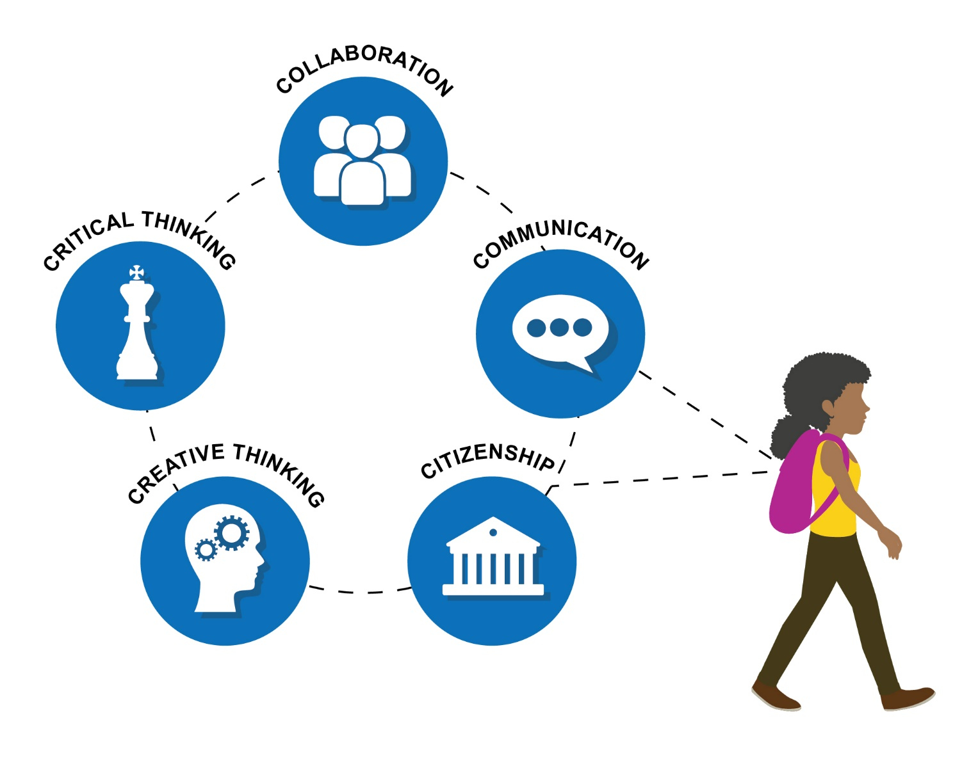
Focus on Deeper Learning

Slide 5
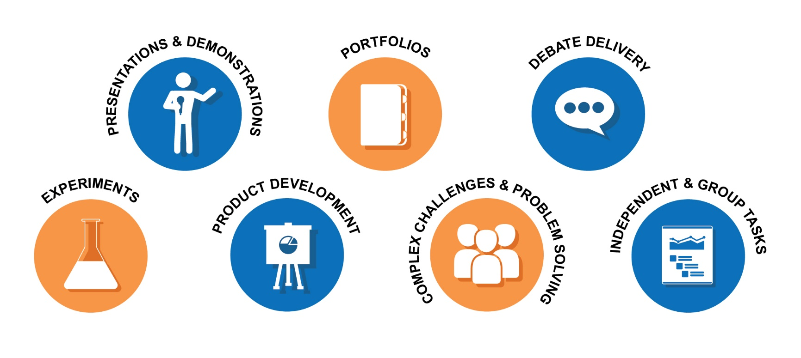
Balanced Assessment System

Slide 6
REALIZING THE PROFILE OF A VIRGINIA GRADUATE
Two years ago, Virginia’s K-12 education vanguard asked:
If the student experience needs to change, then how does the classroom experience need to change?
To get there, how must we change professional practice?
We traveled the state, querying leaders from every corner of the Commonwealth.

Slide 7
Realizing “Virginia is for Learners”
Creating Companion Profiles
Education Leader
Educator
Classroom
Graduate
SOA Changes
Preparing every student to succeed with a future-ready learning experience

Slide 8
VIRGINIA GOVERNMENT OFFICES
Department of Education
Board of Education
Governor’s Office
Secretary of Education’s Office
State Council of Higher Education (SCHEV)
Virginia Tourism Corporation
VIRGINIA STATE EDUCATION GROUPS
Learning Forward Virginia
VACO
VAESP
VASCD
VASCL
VASS
VASSP
VEA
VML
VMSA
VSBA
VSSP
VSUP
Virginia First Cities
Virginia PTA
SCHOOL DIVISIONS
Cumberland County
Chesapeake
Goochland
Hampton
Richmond City
Salem
EMPLOYER GROUPS
ACCE
Virginia Business Council
Virginia Chamber
Virginia Free
NATIONAL EDUCATION GROUPS
2Revs
AFT
AIR
Alliance for Excellence in Education
CASEL
CCSSO
CIE
EdCounsel
EdLeader 21
Envision Learning
iNACOL
Jobs for the Future
Learning Policy Institute
NCIEA
Buck Institute
XQ
COLLEGES & UNIVERSITIES
George Mason University
James Madison University
University of Richmond
University of Virginia
Virginia Commonwealth University
Virginia State University
William & Mary/SURN
BEHIND THE SCENES
COMMUNICATIONS & GOVERNMENT RELATIONS
Capital Results
Education Commission of the States
Hattaway Communications
Hunt Institute
NCSL
NGA
WHRO
OTHER
William and Flora Hewlett Foundation
Virginia Lottery

Slide 9
Shared Beliefs
Virginia Educators and Education Leaders Believe:
Every student in the Commonwealth deserves an excellent education
Every one who works or learns in our schools deserves support and the chance to thrive
Commonwealth graduates have the right to be ready for postsecondary learning and work opportunities
Together, We Commit to:
Strive for equity
Keep learning and growing
Be culturally aware and sensitive
Be responsible risk takers
Show respect
Be agile
Stay curious
Remain coachable
Be self-aware
Stay driven
Lift up strengths and assets
Look for solutions
Hold high standards
Remember that we do our work for our students

Slide 10
FROM DISCOVERY TO DESIGN
FIELD-GENERATED “PROFILES”
PROFILE OF A VIRGINIA CLASSROOM
Led by VASCD
Est. “Pedagogy project”
Engaged master teachers (what/how do we do it)
Engaged WHRO (what does it look like)
PROFILE OF A VIRGINIA EDUCATOR
Led by George Mason/EdPolicy Forward
Held focus groups across the state
Engaged administrators, teachers, academics
Sparking change in educator preparation and professional development
PROFILE OF A VIRGINIA LEADER
Led by William & Mary/SURN
Held focus groups with schools of education & division superintendents
Engaged administrators, teachers, academics
Sparking change leadership development program

Slide 11
PROFILE OF A VIRGINIA CLASSROOM
what does the learning setting need to look like for all students to graduate ready for what comes next?

Slide 12

Profile of a Virginia Classroom
Instructional Design | Student Experience | Learning Community
Focused on essential knowledge, skills and dispositions | Worthwhile and relevant | Safe
Interdisciplinary and relevant | Collaborative | Culturally responsive
Includes purposeful checkpoints | Solutions- and product-oriented | Inclusive
Clearly communicated success criteria | Aligned to the science of learning | Confidence- and skill-building
Responsive to student needs | Encourages productive struggle
 | Tailored to student needs
Five Hallmarks
Plans for deeper learning
Quality Instruction
Positive Relationships
Culture of Respect
Assessment and Feedback

Slide 13
PROFILE OF A VIRGINIA EDUCATOR
what professional knowledge, skills and experiences do educators (including teachers, instructional aides, counselors) need to establish the learning settings and experiences that operationalize the Profile of a Virginia Classroom?

Slide 14
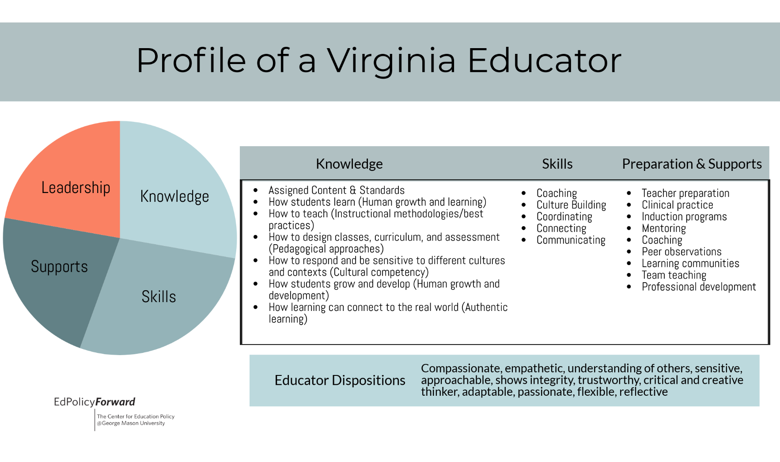

Slide 15
PROFILE OF A VIRGINIA EDUCATION LEADER
what professional knowledge, skills and experiences do education leaders need to support educators and students in operationalizing these profiles?

Slide 16
Profile of a Virginia Education Leader
Vision, Values & Culture Leaders and Vision | Capacity Building Leaders and Others | Shared Responsibility Leadership and Systems
A VA Ed Leader can clearly articulate a vision that prioritizes success for all students. A VA Ed Leader creates organizational structures and cultures that support and advance the vision. A VA Ed Leader models being a risk-taker and innovator. A VA Ed Leader can identify and create buy-in for non-negotiable organization goals to include: equity focus, building learner/leader capacity, and acceptance of habit altering feedback. A VA Ed Leader values and promotes diverse thinking designed to promote student, educator, and community learning. | To ensure deeper learning with an equity lens, a VA Ed Leader maximizes, engages, and empowers educators, students and community, with an emphasis on: Educators- coaching, mentoring, modeling Students- Teaching, learning, growth Families & Community – culture and engagement | A VA Ed Leader will cultivate individual and collective responsibility for equity through partnerships, community and family engagement, and relationships that maximize learning for all. A VA Ed Leader will develop and model continuous improvement and transformation systems that draw upon the research base to leverage the talents of all.
Virginia education leaders work through an equity lens for deeper learning by building the necessary professional skills, growth mindsets, attitudes and values.

Slide 17
NEXT STEPS
Pedagogy Project / Profile of a Virginia Classroom
VASCD
Profile of a Virginia Leader
William and Mary / SURN
Profile of A Virginia Educator
George Mason University
Informs:
  Professional Learning Opportunities – VDOE and Partner Organizations
  Preparation in Higher Ed Institutes and In Service Supports
  Office of Teacher Education and Licensure – Patty Pitts
    Teacher Evaluation
    Teacher Professional Development and Learning

Slide 18
QUESTIONS

