Slide 1
English Learners (ELs) in the Commonwealth
April 2019
Jessica Costa, Ph.D.
Specialist for English Learner Instruction

Slide 2
Who is an EL?*
was not born in the United States or whose native language is a language other than English;
comes from an environment where:
  a language other than English has had a significant impact on the individual’s level of English language proficiency; or
  a language other than English is dominant
difficulties in speaking, reading, writing, or understanding the English language may be sufficient to deny the individual —
  the ability to meet the State’s proficient level of achievement on State assessments
  the ability to successfully achieve in classrooms where the language of instruction is English; or
  the opportunity to participate fully in society.
*Condensed definition Moving toward a More Common Definition of English Learner

Slide 3
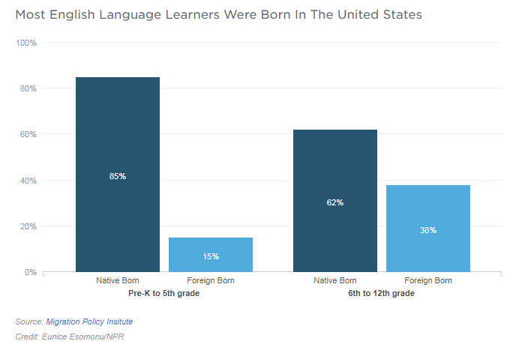
Where are most ELs from?
NPR English Language Learners: How your State is Doing

Slide 4
How do we know who is an EL in need of service?
Divisions should assess identified ELs annually to determine English Language Proficiency Level (ACCESS). Students are scored on the scale of 1.0-6.0.
ELs receive service until they score a 4.4 on the ACCESS
  Reading 35%, Writing 35%, Speaking 15%, Listening 15%
VA ESSA Plan & Title III Guidance

Slide 5
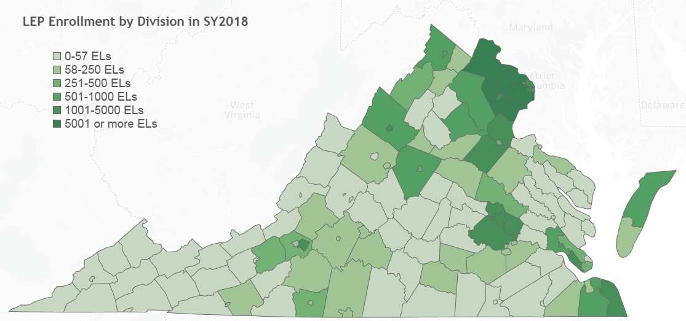
How many ELs do divisions serve?
Source: VDOE Title III LEP Enrollment Report

Slide 6
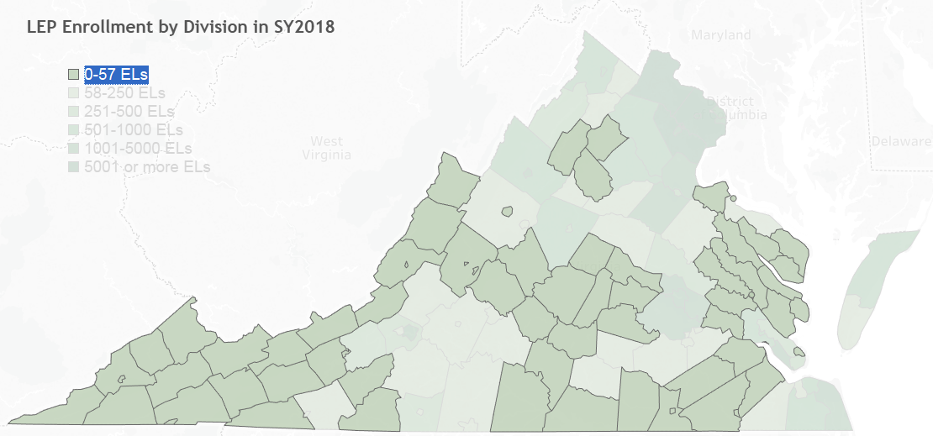
Which divisions does the SOQ limit access to an ESL position?
Source: VDOE Title III LEP Enrollment Report

Slide 7
How many ELs do divisions serve?
Legend color | Number of Divisions | Total Number of ELs
0-57 | 66 | 1333
58-250 | 31 | 3741
251-500 | 9 | 3407
501-1000 | 10 | 7572
1001-5000 | 13 | 31320
5001 and more | 3 | 59766
Total School Divisions | 132 | 107139*
* Count does not include ELs in Virginia School for the Deaf and Blind-Staunton and Department of Juvenile Justice

Slide 8
How do divisions provide service for ELs?
Pulling students out of other classes
Sheltering instruction from a content teacher (special training)
Stand alone ESL class (ELs only, sometimes by levels)
Co-teaching
Dual Language Programming
Newcomer Programs (Sheltered and self-included for a temporary time, where available)
El Toolkit, Chapter 2

Slide 9
How are some EL services organized?
Language Proficiency Levels*
Language Level | Instructional Considerations
1: Entering | Using and understanding short chunks of very common language. Very dependent on supports and teacher modeling.
2: Emerging | Using and understanding repetitive and common language. Dependent on supports and teacher modeling.
3: Developing | Using and understanding more extended language and emerging complexity. Using supports but also starting to use and understand language independently.
4: Expanding | Showing independence in advancing academic language skills and is approaching the more complex linguistic demands necessary to demonstrate English language proficiency in a variety of academic contexts (settings). Needs supports and models at high levels of language proficiency in order to become fully proficient.
5: Bridging | Former EL. No longer serviced through a Language Instruction Program.
*Students language skills vary within levels and by language skill or domain. These descriptions summarize basic considerations.
WIDA English Language Development Standards Framework

Slide 10
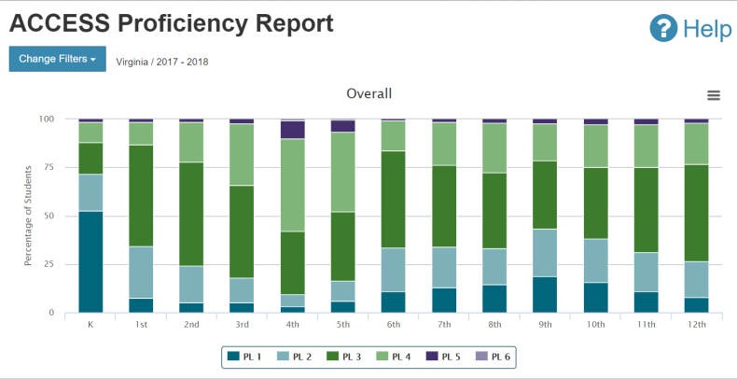
What is the breakdown of levels of VA’s ELs?
WIDA VA Data Dashboard, Retrieved April 2019
Title III Progress and Proficiency Report, 2017-2018

Slide 11
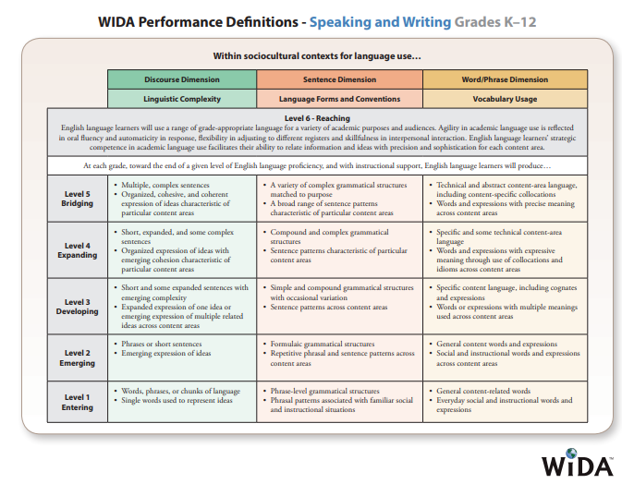
What do you notice?

Slide 12
What are VA’s expectations for EL growth?
Composite Proficiency Level Gains
Proficiency Level | Grades K-2 | Grades 3-5 | Grades 6-12
1.0-2.4 | 1.0 | 0.7 | 0.4
2.5-3.4 | 0.4 | 0.4 | 0.2
3.5-4.4 | 0.2 | 0.2 | 0.1
ELs at lower proficiency levels develop language at faster rates.
ELs in lower grade levels develop language at faster rates.
District Analysis of ELL Growth
Academic Achievement for Language Learners: What can we reasonably expect?

Slide 13
What guidance do we have?
ELs are entitled to appropriate language assistance services to become proficient in English and to participate equally in the standard instructional program within a reasonable period of time.
ELs are entitled to EL programs with sufficient resources to ensure the programs are effectively implemented, including highly qualified teachers, support staff, and appropriate instructional materials.
EL Dear Colleague Letter (2015) from the US Department of Education & DOJ

Slide 14
What are EL equity issues?*
Newcomer ELs: New to the US within the last 12 months
Students with Limited or Interrupted Formal Education (SLIFE)
  Long-Term English Learners: 5+ years of receiving EL services
    VA data: 13,581 reported (does not include LTELs with suspected disabilities); 12.9% ELs
    May require additional supports in order to achieve English language proficiency
US Department of Education webinar (2012); Title III Reports

Slide 15
What are equity issues identified by the US Dept. of Education?
exclude kindergarteners, or EL students with scheduling conflicts, from their EL program;
supplement regular education instruction with only aides who tutor EL students as opposed to teachers adequately trained to deliver the EL program;
fail to offer an EL program to a certain subset of EL students;
stop providing language assistance services when EL students reach higher levels of English proficiency but have not yet met exit criteria; or
fail to address the needs of EL students who have not made expected progress in learning English and have not met exit criteria despite extended enrollment in the EL program.
EL Dear Colleague Letter (2015) from the US Department of Education & DOJ

Slide 16
Questions

Slide 17
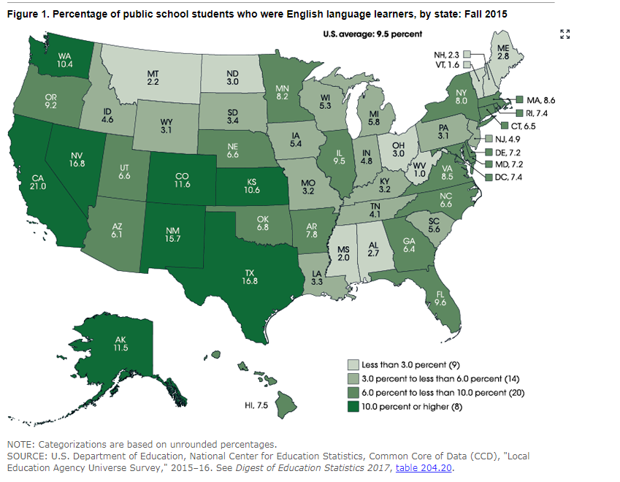
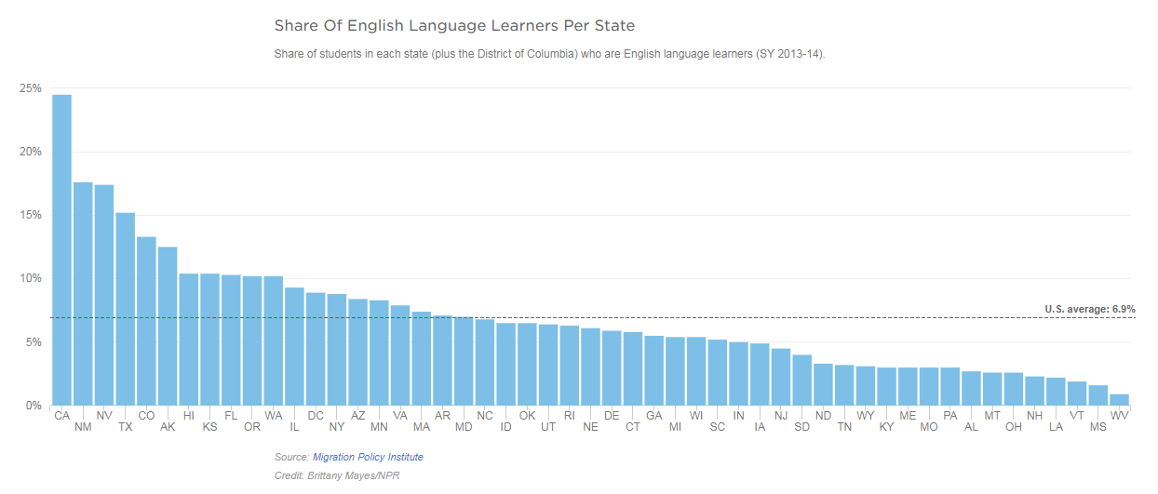
Percent of ELs in VA compared to other states
Text
17th highest EL population
VA 8.5%, US average 9.5% (2015)

Slide 18
More on SLIFE ELs
Newcomers with two or more years of education interrupted in their native country
They have attended school in the U. S., returned to their native country for a period of time, then returned to the U.S again.
They have attended kindergarten in English (L2), 1st and 2nd grade in their first language (L1), then jumped into L2 in 3rd.
They have attended U.S. schools since kindergarten but have language and literacy gaps due to ineffective instruction.
They have attended school in one location for a few months, then moved to another location for a few months, and perhaps had some weeks in between these changes when they does not attend school. (Calderón, 2008.)
Colorin Colorado, EL resource and research database online

Slide 19
What should EL instruction include?
Provide explicit instruction in literacy components.
Develop academic language in the context of content-area instruction.
Provide visual and verbal supports to make core content comprehensible.
Encourage peer-assisted learning opportunities.
Capitalize on students’ home language, knowledge, and cultural assets.
Provide small-group academic support in literacy and English-language development for students.
Jane Echevarria, Author of SIOP strategy materials

Slide 20
What can divisions and schools do?
SMALLER ELL POPULATIONS
Combine levels of English proficiency using skillful differentiation
Train teachers in effective ELL support strategies
Focus resources on ninth and tenth grades to close learning gaps
US Department of Education webinar (2012)

Slide 21
What is best practice?
Create collaboration models across high school academic departments to support simultaneous linguistic and academic development.
A collaborative instructional model reinforces student learning and accelerates SIFEs' academic progress. For secondary-level teachers this may be more challenging and may require a review of the instructional system, curriculum and content, school resources, and teacher planning schedules .
Immigrant Students and Secondary School Reform: Compendium of Best Practices. Written on behalf of The Council of Chief State School Officers (CCSSO).

Slide 22
How does VDOE support teacher capacity and growth ?
Professional Development Trainings on Related Topics; Regionally offered
  (2018-2019) ExC-ELL (Expediting Comprehension for English Language Learners), Scaffolding, Lesson Planning, Long-Term Language Learners, Working with Dually Identified ELs, Working with SLIFE students, etc.
  PRAXIS II Preparation for Add-on ESL Endorsement
  (2019-2020) Repeats of many, Academic Language within Content Areas of Math/English Language Arts, Leadership trainings, Online modules for cohorts: Collaboration, Newcomers, Reading in the elementary grades
Integrated Support during content-specific trainings (2019-2020)

Slide 23
What are some example models and staffing practices?
Students at lower proficiency levels receive more instructional time with an EL certified teacher.
Students at lower proficiency levels receive EL instruction within lower class size maximums.
In the absence of a specific staff ratio, some states use minutes of service or additional funding guidelines to support equitable services for ELs.
References included on handout. Electronic version contains hyperlinks.

Slide 24
