Slide 1


Year-Round Schools at Falling Creek Elementary
Virginia Board of Education, spring 2019

Slide 2

Falling Creek Elementary School YRS
Sum and Substance
Year-round school historical background
Community support
Proposal and implications
Financial Implications
Calendar

Slide 3
Year-Round Schools
Background: Researched Year-round Schools (YRS) due to concerns, such as:
  Summer learning loss, especially for economically-disadvantaged students
  Students may lose access to healthy meals over the summer
  Lack of opportunities for new experiences, camps, travel
Observations, feedback, and takeaways:
  Frequent breaks result in less burnout for teachers and students
  Increased student opportunities for academic support, proper meals, and enrichment
  ESOL students will not have a 10-12 week gap without English instruction

Slide 4
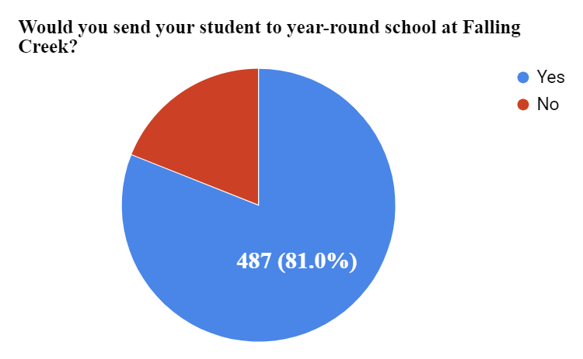
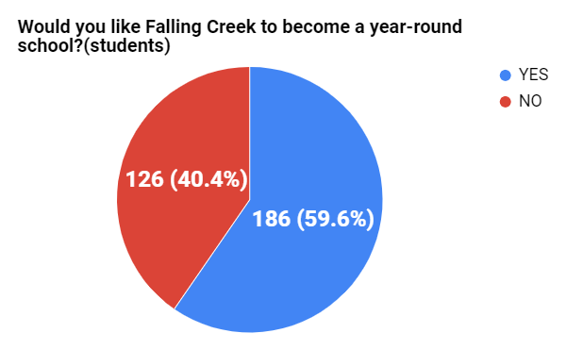
Falling Creek Elementary School YRS
YRS Parent and Student Survey Results - (January 2019)
Parent Responses
Student Responses
Responses = 601
Responses = 312

Slide 5
Falling Creek Elementary School YRS
Proposal for school year 2019-20
During intersessions:
  All interested students may enroll
  CCPS will provide transportation
  Breakfast and lunch will be provided
  Academic support in the A.M.
  Enrichment offered in the afternoons
During period when school is closed:
  Parents register and pay fees for vendors
  70 potential slots with YMCA
  Portions of building are cleaned by CCPS facilities

Slide 6
Falling Creek Elementary School YRS
Students are in school 180 calendar days (Balanced calendar structure)
Roughly 45-15 day schedule: Instruction for 9 weeks/45 days, Intersession for 15 days
Four Intersessions:
Intersession 1: Sept. 30, 2019 - Oct. 17, 2019
  Offer two weeks of intersession; schools closed final week (ex: YMCA)
Intersession 2: Jan. 6, 2020 - Jan. 10, 2020
  Offer one week of intersession
Intersession 3: March 23, 2020 - April 3, 2020
  Offer one week of intersession; schools closed final week (ex: YMCA)
Intersession 4: June 15, 2020 - June 26, 2020
  Offer two weeks of intersession

Slide 7
Falling Creek Elementary School YRS
Implications for Falling Creek parents and community with proposal:
Parents need to create plans for their students for:
  One week during the 1st intersession (fall of 2019)
  One week during 3rd intersession (week before spring break 2020)
  First three weeks in July 2020
Traditional school calendar requires:
  Parents of students not performing in the lower quartile to provide child care for ten weeks; this option requires only five weeks with participation in intersessions
  Parents of students performing in the lower quartile to provide child care for five weeks; this option requires an equivalent amount of time
Proposed partnership with YMCA could reduce costs for parents and provide scholarships for up to 70 students

Slide 8
Falling Creek Elementary School YRS
  Projected additional costs are as follows:
    Staffing (total of $191,855)
      Program Manager - $33,197
      12-month contract for Assistant Principal - $8,375
      12-month contract for Registrar - $4,302
      20 Teachers - $136,177
      3 Instructional Aides - $9,804
    Transportation - $45,737
  CCPS pursuing $300,000 from the VDOE Implementation Grant
  Summer School funds and Title I for remediation and other supplemental needs

Slide 9
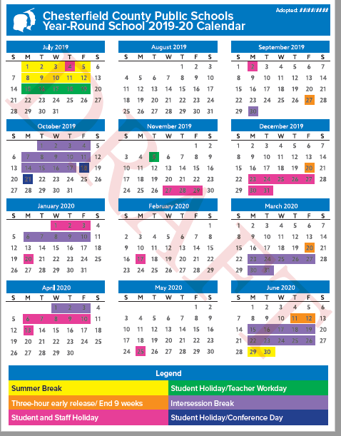
Tentative DRAFT of 2019-20 YRS Calendar
DRAFT
DRAFT
Note: Both Bellwood ES and Falling Creek ES would utilize the same calendar.

Slide 10
Falling Creek Elementary School YRS
Sum and Substance
Year-round school historical background
Community support
Proposal and implications
Financial Implications
Calendar

Slide 11
Year-Round Schools at Falling Creek Elementary
Virginia Board of Education, spring 2019

