Slide 1
Standards of Quality Review:
Levers and Best Practices
January 23, 2019
Zachary Robbins
Director of Policy
Dr. Jennifer Piver-Renna
Director of Research
Notes:
Zack

Slide 2
Overview
Review November 2018 discussion
Compare the SOQ elements against research and best practice literature, and identify potential levers:
  Instructional Quality
  Student Support
  Supporting Vulnerable Populations
Discussion
Notes:
Zack

Slide 3
The Standards of Quality
Standard 1 –
Instructional programs
Standard 6 –
Planning/Public Involvement
Standard 2 –
Personnel/Staffing ratios
Standard 7 –
School Board Policies
Standard 3 – Accreditation/Assessments
Standard 8 –
Compliance
Standard 4 –
Graduation Requirements
Standard 9 –
VIP Incentive Program
Standard 5 –
Professional Development
Standard 10 –
SOL Innovation Committee
Notes:
Zack

Slide 4
2016 SOQ Recommendations
The Board recommended these staffing requirements:
Assistant Principal:
    one full-time asst. principal for every 400 students K-12
School Psychologist:
    one full-time school psychologist for every 1,000 students
Principal:
    one full-time principal in every elementary school
Social Worker:
    one full-time social worker for every 1,000 students
School Counselor:
    one school counselor for every 250 students K-12
School Nurse:
    one full-time school nurse for every 550 students
Board of Education, October 27, 2016 meeting
Notes:
Zack

Slide 5
2016 SOQ Recommendations
Eliminate the “support position cap” to provide state support for support positions based on prevailing practice
Eliminate provisions in the Appropriation Act that waive or override certain SOQ staffing standards
Ensure the availability of data about the local deployment of SOQ positions
Support professional development needs associated with the Profile of a Virginia Graduate implementation
Board of Education, October 27, 2016 meeting
Notes:
Zack

Slide 6
Promoting Equity in Education
Board Comprehensive Plan:
  Establishes a priority to provide “high-quality, effective learning environments for all students.”
  Board to “[d]evelop Standards of Quality, policies, and guidelines to reflect…the diverse nature of the modern student body”
Current Standards of Quality address equality:
  Establishes a minimum standard, based on numbers of students, with little regard to the attributes of the student body
Notes:
Zack

Slide 7
Priority Levers for Equity
Instructional quality
  Class size and class size reduction
  Teacher quality
  School building administration
  Reading specialists
  Technology support
Student support
  Guidance counselors
  Specialized instructional support personnel
Supporting vulnerable populations
  Students in poverty
  English Learner students
  Students with disabilities
Notes:
Jen
Minority students are not specifically identified for additional supports in SOQ

Slide 8
INSTRUCTIONAL QUALITY
Lever One:
Notes:
Jen

Slide 9
Existing SOQ: Maximum Class Size and Student/Teacher Ratios
Grade Span | Max. Student to Teacher ratio | Maximum Class Size
Kindergarten | 24:1 (divisionwide) | 24 (29 if an aide is provided)
Grades 1, 2, and 3 | 24:1 (divisionwide) | 30
Grades 4, 5, and 6 | 25:1 (divisionwide) | 35
Grade 6-12 English Classes | 24:1 (divisionwide) | None
Middle and High Schools | 21:1 (schoolwide) | None
§ 22.1-253.13:2(C), Code of Virginia
Notes:
Zack
Averages out to
1:24.3 in elementary schools
1:21 in middle and high schools
1:22.5 across all grades

Slide 10
Existing K-3 Class Size Reduction Program
Optional $130.5 million (FY19) program available to school divisions with high poverty schools meeting these ratios and class sizes:
Students Eligible for Free Lunch | Max. Schoolwide Student to teacher ratio | Maximum Class Size
30%-45% | 19:1 | 24
45%-55% | 18:1 | 23
55%-65% | 17:1 | 22
65%-70% | 16:1 | 21
70%-75% | 15:1 | 20
75% or more | 14:1 | 19
2018 Appropriation Act, Item 136.C.10
Notes:
Zack

Slide 11
Research on Class Size Reductions
Tennessee’s Student Teacher Achievement Ratio (STAR), 1985^{(1,2)}
Students in small classes significantly outperformed peers and effects were largest for black students, economically disadvantaged students, and boys
California’s K-3 Class Size Reduction Program, 1996⁽³⁾
Positive effects offset by increases in number of new and not-fully-certified teachers
Florida’s Core Class Size Reduction Program, 2002⁽⁴⁾
No impact on test scores in grades 3 through 8 through 2009
Class size reductions are expensive, and other educational interventions have greater returns on investment and larger effects
Data from Tennessee STAR study produced estimates of much larger effects for variation in teacher quality⁽⁵⁾
Notes:
Jen
“Most researched” educational intervention – easy to cherry cherry-pick results
STAR - Average reduction in class size from 22 to 15; small classes outperformed peers by 0.22 SDs (3 months of school); Internal positive rate of return of about 6 percent (Krueger);
California - Reduced class size from 30 students to 20 students; unintended consequence of increase in class sizes in grade 4 (Sims)
FL - Reduced core class size to 18 students through grade 3; 22 students in grade 4-8; and 25 students in grades 9-12
Reducing class size from 24 to 15 in grades K-3 would require a 15% increase in overall school expenditures (Harris)
Engagement, rather than the teaching of specific skills, may be the dominant channel by which small classes influence disadvantaged students (Babcock and Betts)
Differences in classroom quality had long-term effects on the earning power of adults ⁽⁶⁾

Slide 12
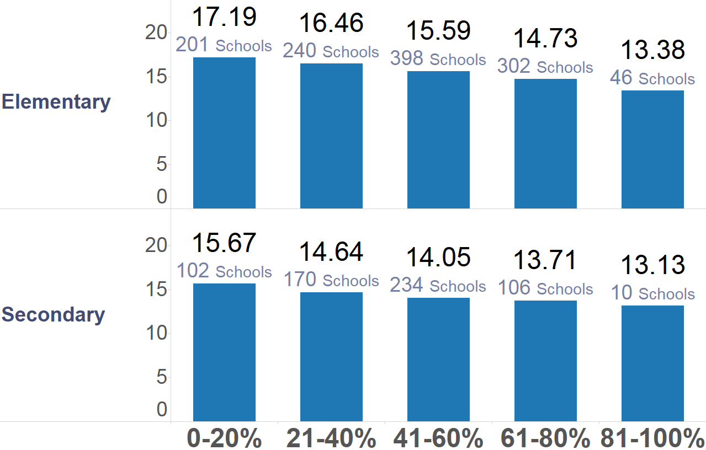
Smaller Average Student-Teacher Ratios in High Poverty Schools
Avg Students/Teacher
Avg Students/Teacher
Percent of Economically Disadvantaged Students
Source: VDOE Fall Membership Reports & IPAL 2017
Notes:
Jen
Data are estimates based on combining school-level teacher data and student enrollment; data collected for funding are at the division-level

Slide 13
Existing SOQ: Teacher Effectiveness and Professional Development
Evaluations must use the Uniform Performance Standards and Evaluation Criteria and include:
Student academic progress
An overall summative rating
Observation
Evidence that instruction is aligned with curriculum
Identification of areas of strengths and weaknesses
Recommendations for appropriate professional activities
§ 22.1-253.13:5(B), Code of Virginia
Notes:
Zack

Slide 14
Existing SOQ: Teacher Effectiveness and Professional Development
Board of Education shall provide guidance on high-quality professional development:
For division- and school-leaders in the evaluation of teacher and principal performance based on student progress and skills and knowledge
For school board members on personnel, curriculum and current issues
For all personnel to ensure proficiency in the use of educational technology
§ 22.1-253.13:5(C), Code of Virginia
Notes:
Zack

Slide 15
Research on Teacher Quality
Single most important factor for student achievement
Differences among teacher quality explain up to 25% of the variance in test scores⁽⁶⁾
Having a teacher in the top quartile of effectiveness four years in a row would eliminate the achievement gap between Black and White students⁽⁷⁾
Average effectiveness of teachers in high poverty schools is less than teachers in other schools and there is significantly greater variation in teacher quality among high poverty schools⁽⁸⁾
Notes:
Jen

Slide 16
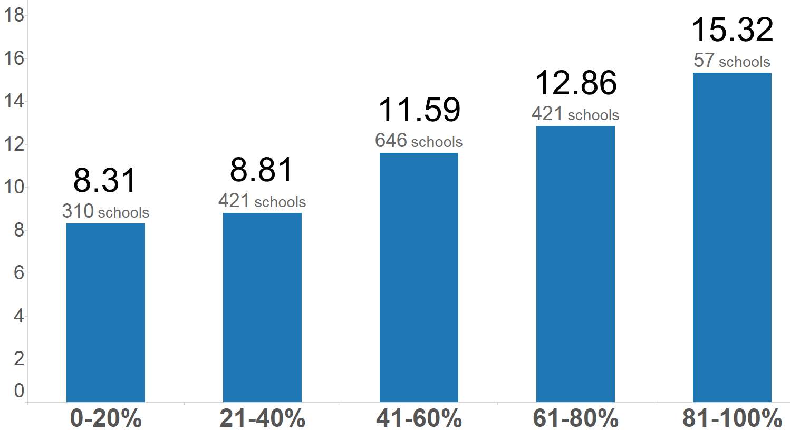
New and Provisionally Licensed Teachers are Concentrated in High Poverty Schools
Avg Percent of New/Provisionally Licensed Teachers
Percent of Economically Disadvantaged Students
Source: VDOE Fall Membership Reports & IPAL 2017
Notes:
Jen

Slide 17
Existing SOQ: Principal and Assistant Principal Ratios
Grade Span | Principals | Assistant Principals
Elementary | 299 or fewer students: One half-time position 300 students: One full-time position | 0-599 students: none 600-899 students: one half-time 900 or more students: one full-time
Middle | One full-time | One full-time position per 600 students
High | One full-time | One full-time position per 600 students
§ 22.1-253.13:2(H), Code of Virginia
Notes:
Zack

Slide 18
Research on School Leadership
In 2016, 88% of Virginia public school principals are partially supported through SOQ funds, compared to 36% of assistant principals
School leaders explain up to 25 percent of the school effects on total student achievement⁽⁹⁾
Teacher retention decisions are sensitive to school leadership⁽¹⁰⁾
School leaders build capacity around how students and families are treated and supported by schools⁽¹¹⁾
Notes:
Jen

Slide 19
Existing SOQ: Reading Specialists
Provided at the discretion of the local school board
Several programs provide funds that may be used to hire reading specialists, funds distributed based on student performance:
  Early Reading Specialists Initiative (1.4 million-FY19)
  Math/Reading Instructional Specialists Initiative (1.8 million- FY19)
  Early Reading Intervention (22.6 million- FY19)
§ 22.1-253.13:2(G), Code of Virginia and 2018 Appropriation Act, Item 136.C.15, 34, and 35
Notes:
Zack

Slide 20
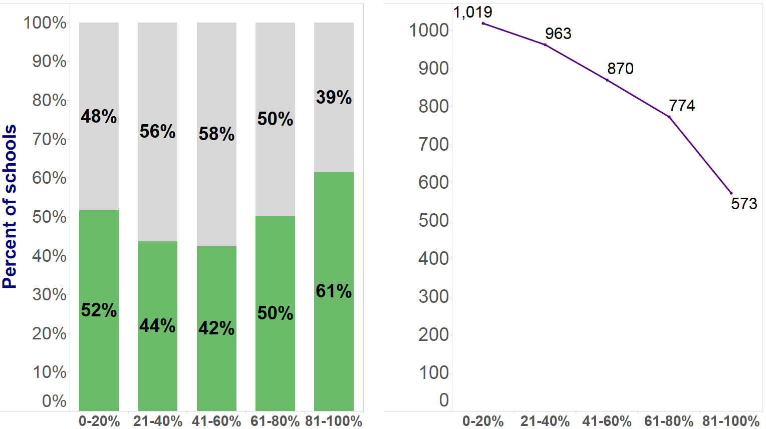
High-Poverty Schools Have Better Access to Reading Specialists
Avg Students/Reading Specialist
Percent of Economically Disadvantaged Students
Access to reading specialist
No access to reading specialist
Source: VDOE Fall Membership Reports & IPAL 2017
Notes:
Jen

Slide 21
Existing SOQ: Technology Support and Data Analysis
One technology support position per 500 students
One data coordinator or instructional technology resource teacher (ITRT) per 500 students
§ 22.1-253.13:2(J), Code of Virginia
Notes:
Zack
The data coordinator position is intended to serve as a resource to principals and classroom teachers in the area of data analysis and interpretation for instructional and school improvement purposes, as well as for overall data management and administration of state assessments.

Slide 22
Research on Technology Support
  In recent surveys of Virginia school divisions^{(12,13)}:
46% of divisions reported not meeting the instructional support position ratio
49% of divisions reported not meeting the ITRT ratio
Divisions identified lack of division technology personnel as the most significant barrier to connectivity
Students in high-poverty schools are less likely than their peers in wealthier schools to have teachers trained in integrating technology in the classroom⁽¹⁴⁾
Notes:
Jen
Survey and staff discussions – not enough positions, hard-to-fill

Slide 23
Policy Considerations: Instructional Quality
Consider smaller classes for inexperienced teachers who need support or for teachers who are responsible for struggling students⁽¹⁵⁾
Consider further defining teacher effectiveness and developing a state-wide, standardized measurement strategy
Consider raising the standards for professional development with additional specificity and more opportune training topics
Consider setting a maximum threshold of new and provisionally licensed teachers in high-poverty schools
Notes:
Jen

Slide 24
Policy Considerations: Instructional Quality
Consider requirements on the development and evaluation of school building leaders, with a focus on attributes that promote positive school climate and enhance student achievement
Consider requiring reading specialists, and adjusting ratios based on student need
Consider updating staffing ratios for technology support positions consistent with current instructional technology needs and future uses
Notes:
Jen

Slide 25
Discussion on Instructional Quality

Slide 26
STUDENT SUPPORT
Lever Two:
Notes:
Zack

Slide 27
Existing SOQ: School Counselor Ratios
Grade Span | School Counselor Ratio
Elementary | One full-time per 500 students
Middle | One full-time per 400 students
High | One full-time per 350 students
For smaller and larger schools, positions are pro-rated accordingly
§ 22.1-253.13:2(H), Code of Virginia
Notes:
Zack

Slide 28
Research on Guidance Counselor Staffing Ratios
American School Counselor Association (ASCA) recommends school counselor-to-student ratio of 1:250
High-poverty schools that met ASCA criteria had better graduation and school attendance rates and lower disciplinary incidents⁽¹⁶⁾
Reducing the student-to-counselor ratio to 1:250 would predict a decrease in the probability of a disciplinary recurrence by:
  9.4% for black students,
  10.8% for black males, and
  9.6% for students eligible for free or reduced price lunch⁽¹⁷⁾
Notes:
Jen

Slide 29
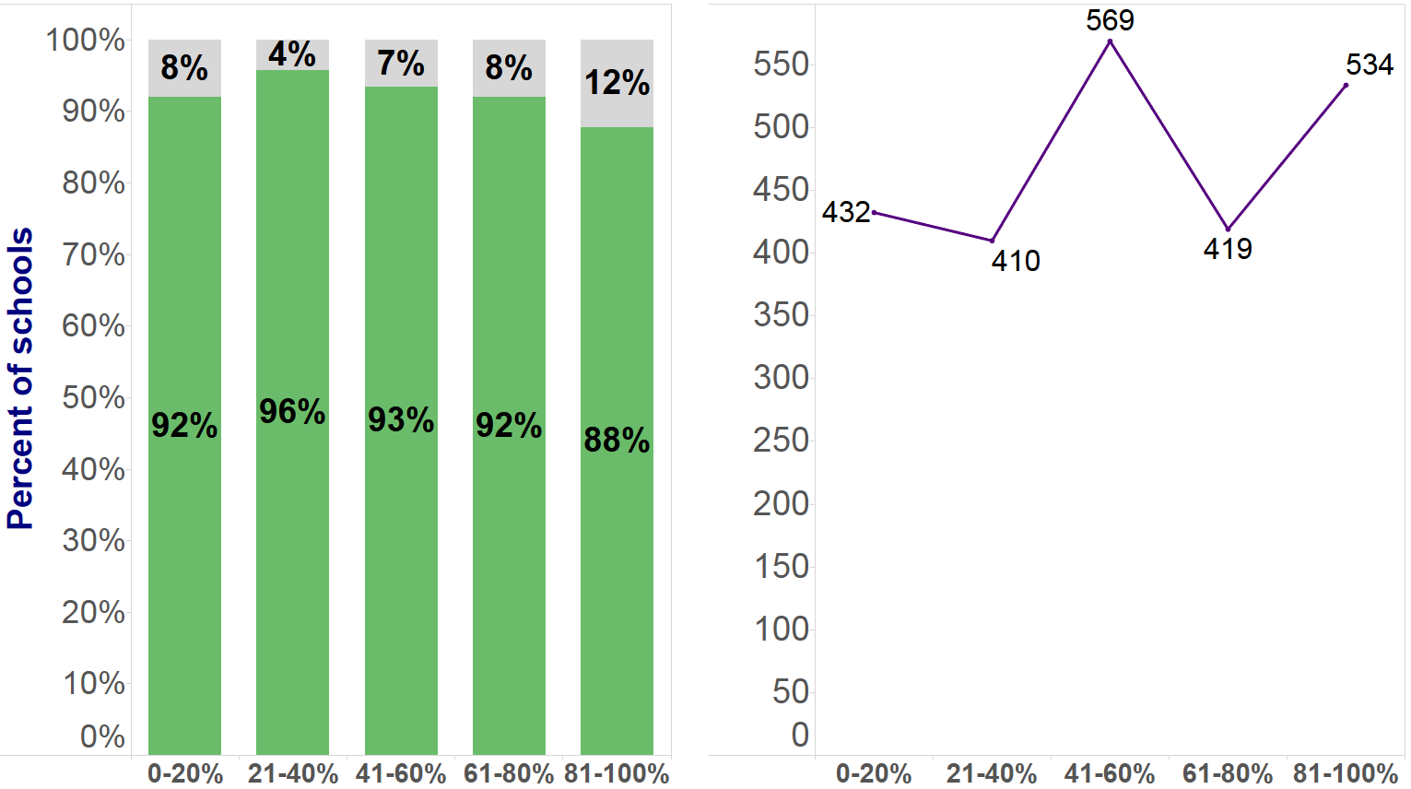
Most Students Have Access to Counselors but Ratios are High
Avg Students/Counselor
Percent of Economically Disadvantaged Students
Access to counselor
No access to counselor
Source: VDOE Fall Membership Reports & IPAL 2017
Notes:
Jen

Slide 30
Existing SOQ: Support Services Positions
Provides funds generally based on prevailing statewide ratios
  The “cap” on support services skews the funding formula, saving the Commonwealth $368.8 million.
No minimum staffing standard, these funds can be used to provide additional instructional positions.
Includes:
  Central office positions
  Administrative and clerical support
  Instructional and tech support
  Operations and maintenance
  Transportation
  Student support positions: social workers, psychologists, nurses
§ 22.1-253.13:2(O), Code of Virginia
Notes:
Zack

Slide 31
Specialized Instructional Support Personnel (ESSA)
The Every Student Succeeds Act defines ‘specialized instructional support personnel’ to include:
school counselors;
school social workers;
school psychologists;
other qualified professional personnel, such as:
  school nurses,
  speech language pathologists,
  school librarians, involved in providing assessment, diagnosis, counseling, educational, therapeutic, and other necessary services
Notes:
Zack

Slide 32
Research on Specialized Instructional Support Personnel
Recommended ratios:
  1:50 to 1:250 social worker-to-student ratio, depending on need
  1:1,000 psychologist-to-student ratio, or lower when more intensive services are needed
  1:750 school nurse-to-student ratio
School-based health programs are effective across diverse cultures and educational models⁽¹⁸⁾
Positive Behavior Interventions and Support (PBIS)
  Effect sizes on academic achievement are large, ranging from 1.08 to 1.71⁽¹⁹⁾
  Program effectiveness is especially strong over time and when the program is implemented with high fidelity⁽²⁰⁾
Notes:
Jen

Slide 33
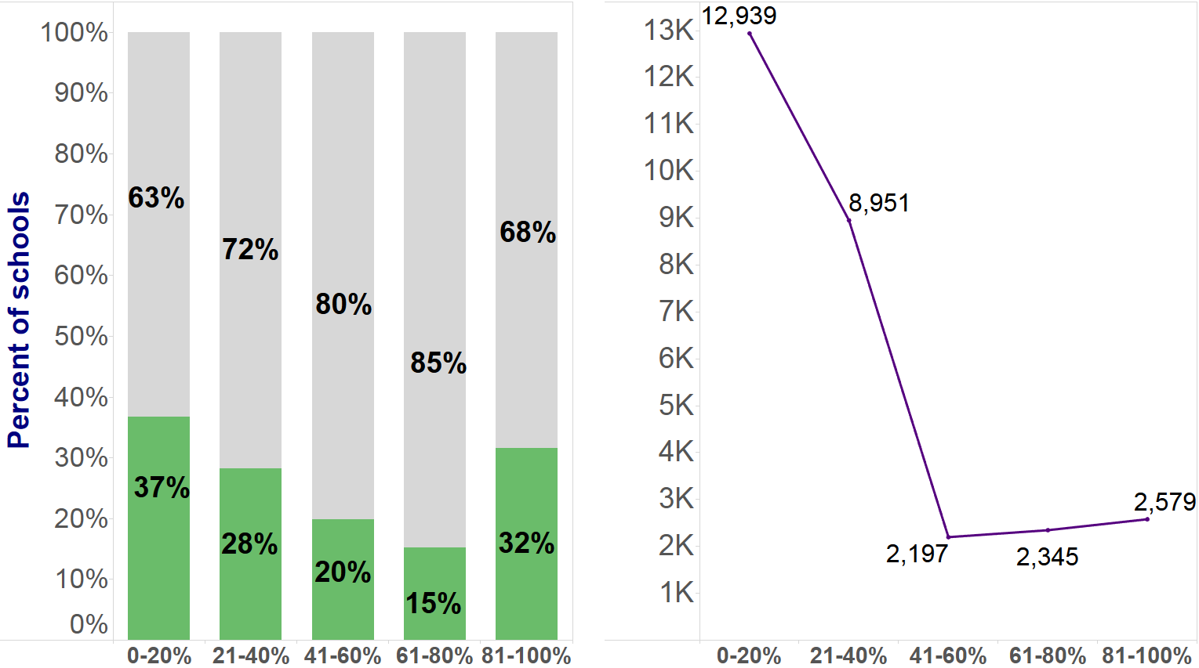
Social Worker Ratios are Lower in High Poverty Schools but Access is Limited
Avg Students/ Social Worker
Percent of Economically Disadvantaged Students
Access to social worker
No access to social worker
Source: VDOE Fall Membership Reports & IPAL 2017
Notes:
Jen

Slide 34
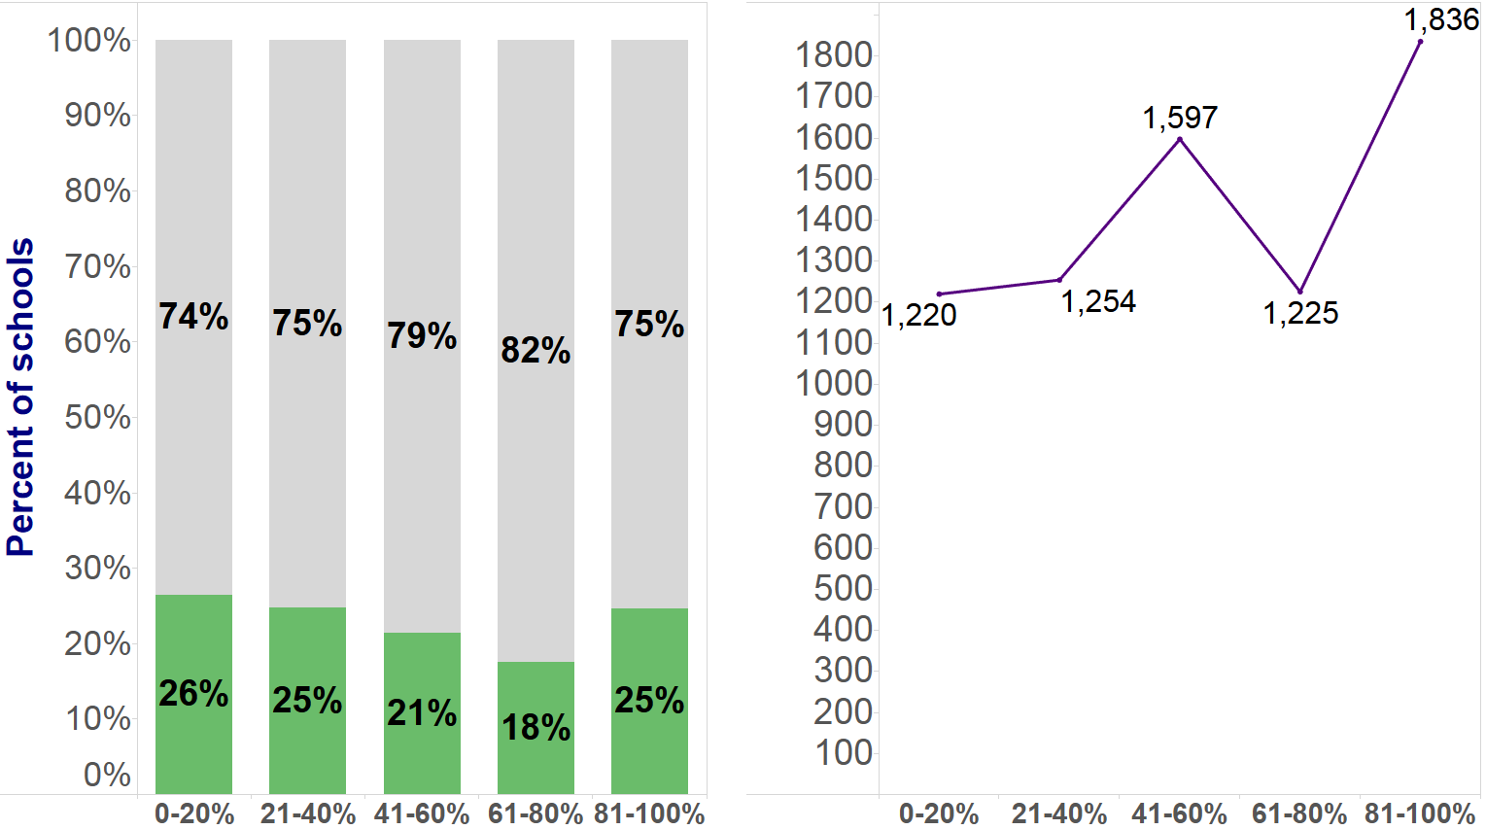
Access to Psychologists is Limited and Ratios are High
Avg Students/Psychologist
Percent of Economically Disadvantaged Students
Access to psychologist
No access to psychologist
Source: VDOE Fall Membership Reports & IPAL 2017
Notes:
Jen

Slide 35
Policy Considerations: Specialized Instructional Support Personnel
Consider 1:250 ratio of school counselors-to-students, with priority staffing for high poverty schools
Remove social workers, psychologists and nurses from support services “bucket” and create new Specialized Instructional Support Personnel staffing category with recommended ratios
Notes:
Zack

Slide 36
Discussion on Student Support

Slide 37
SUPPORTING VULNERABLE STUDENT POPULATIONS
Lever Three:
Notes:
Jen

Slide 38
Research on Students in Poverty
Nationally, the average difference in standardized test scores between students from high and low income families is approximately 1.25 standard deviations⁽²¹⁾
The income achievement gap has narrowed recently but the gap is closing so slowly that it would take at least 60 years for it to disappear completely⁽²¹⁾
In 2018, Virginia’s economically disadvantaged student pass rate on the Grade 3 reading Standards of Learning assessment was 23 points lower than their non-economically disadvantaged peers
Notes:
Jen
CI: In 2003, Virginia had 82 low-income, high-Black/Hispanic schools with 36,061 students; In 2017, Virginia had 168 low-income, high-Black/Hispanic schools with 82,391 students

Slide 39
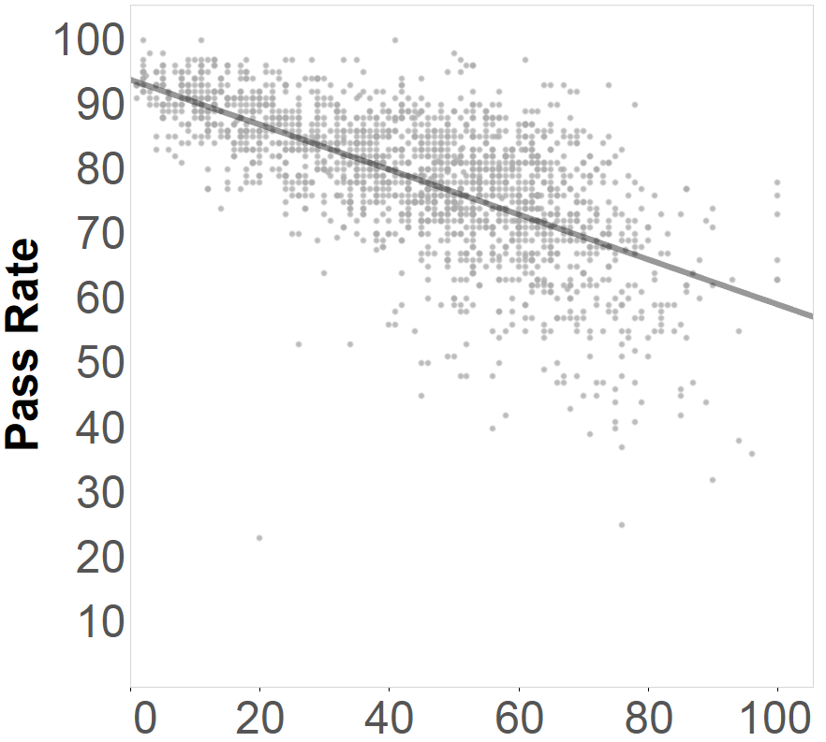
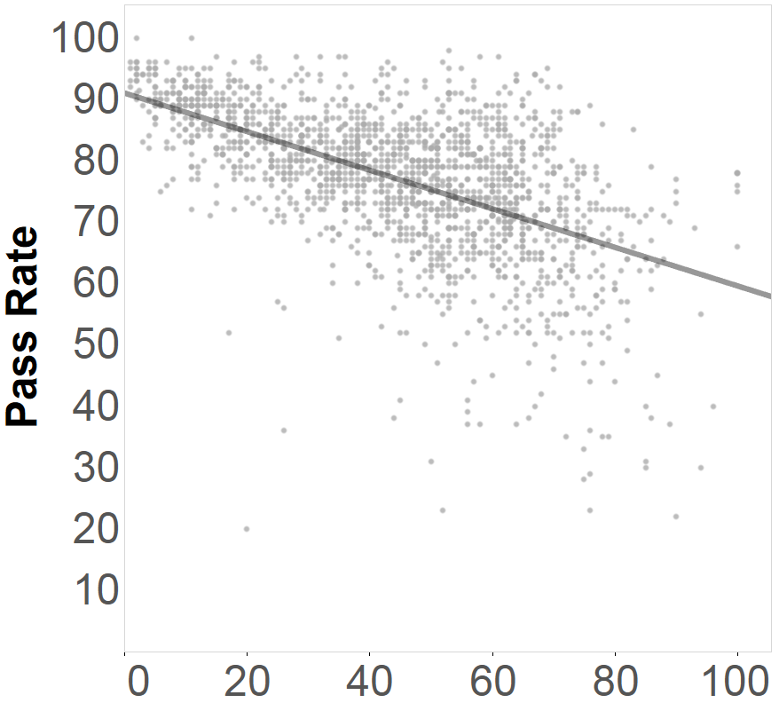
Impact of Concentrated Poverty
English Reading
Mathematics
Benchmark: 75
Benchmark: 70
Schools ≥ 54% ED students are more likely to fall below the reading benchmark.
Schools ≥ 68% ED students are more likely to fall below the math benchmark.
Percent of Economically Disadvantaged Students
Source: VDOE SOL Test Results 2017
Notes:
Jen
English: Χ² (1, N =673214) = 46195.622, p <.001
Math: Χ² (1, N =801531) = 44174.6, p <.001

Slide 40
Existing At-Risk Add-On Fund Program
$100.3 million (FY19) program available to school divisions based on the number of children qualifying for free lunch
Provides a 1% to 14% Add-On to SOQ Basic aid
Typical expenses include:
  Computer programs for remediation
  Remediation and Tutoring
  Dropout Prevention
  English Learner Programs
  Reading and Math Intervention/Resource Teachers
  Dual Enrollment
  Workplace readiness and Credentialing
  Class size reduction
  Truancy Officer Programs
2018 Appropriation Act, Item 136.C.9 and VDOE Report on Planned Uses of At-Risk Add-on Funds
Notes:
Zack

Slide 41
Existing SOQ: Prevention, Intervention and Remediation
$113.1 million (FY19) program to provide positions and programs for educationally at-risk students
Funds an additional hour of instruction per day for students needing services (using free lunch eligibility as a proxy)
Funds are distributed using a sliding scale student/teacher ratio
  10:1 for divisions with most severe English and mathematics failure rates
  18:1 for divisions with lowest English and mathematics failure rates
§ 22.1-253.13:2(D), Code of Virginia and 2018 Appropriation Act, Item 136.C.9
Notes:
Zack

Slide 42
Research on Funding for Low Income Students
Raising per-pupil expenditures for low income students has positive and statistically significant impacts on academic achievement and adult outcomes
A 10% increase in per-pupil spending each year for all 12 years of public school is associated with⁽²²⁾:
  Nearly one-half additional years of completed education
  An increase in graduation rates by nearly 10 percent
  An increase in adult wages by nearly 10 percent
  An increase in family income by 17.1 percent
  A reduction in the incidence of adult poverty by 6.7 percent
  Notable improvements in student-teacher ratios, teacher salary, and instructional time
Notes:
Jen

Slide 43
Existing SOQ: English Learner Staffing Ratios
17 positions per 1000 English Learner students (about 1 position per 59 students)
Not differentiated based upon level of student’s English proficiency
§ 22.1-253.13:2(F), Code of Virginia
Notes:
Zack

Slide 44
Research on English Learner Staffing Ratios
English Learners are significantly less likely to have a fully credentialed teacher than other low- income peers⁽²³⁾
Funding for English Learner staff vary widely based on local context⁽²⁴⁾ :
Ratio model
  Arkansas – 0.4 additional support positions for every 100 English Learners
  Washington - 1 FTE for every 100 English Learners, an additional 0.4 FTE for every 100 English Learners who are also in poverty
Per pupil weighting
  Colorado – per pupil costs multiplied by 0.50 for each English Learner
  New York – per pupil costs multiplied by 2.0 for each English Learner
Needs Index
  California – scaled based on percent of student poverty, English Learners, special education students, and elementary schools per district
Notes:
Jen

Slide 45
Existing SOQ: Special Education Staffing
Fig 1. Caseload maximums
Fig 2. Values for student receiving Level I services when combined with students receiving Level II services
Disability Category | Level II |  | Level I
 | With Paraprofessional 100% of the time | Without Paraprofessional 100% of the Time
Autism | 8 | 6 | 24
Deaf-blindness | 8 | 6
Developmental Delay: age 5-6 | 10 | 8
Developmental Delay: age 2-5 | 8 Center-based 10 Combined | 12 Home-based and/or Itinerant
Emotional Disability | 10 | 8 | 24
Hearing Impairment/Deaf | 10 | 8 | 24
Intellectual Disability | 10 | 8 | 24
Learning Disability | 10 | 8 | 24
Multiple Disabilities | 8 | 6
Orthopedic Impairment | 10 | 8 | 24
Other Health Impairment | 10 | 8 | 24
Speech or Language Impairment | NA | NA | 68 (Itinerant)
Traumatic Brain Injury | May be placed in any program, according to the IEP.
Combined group of students needing Level I services with students needing Level II services | 20 Points (see Figure 2)
Disability Category | Level II Values |  | Level I
 | With Paraprofessional 100% of the time | Without Paraprofessional 100% of the time | Values
Autism | 2.5 | 3.3 | 1
Deaf-blindness | 2.5 | 3.3 | 1
Developmental Delay: age 5-6 | 2.0 | 2.5 | 1
Emotional Disability | 2.0 | 2.5 | 1
Hearing Impairment/Deaf | 2.0 | 2.5 | 1
Intellectual Disability | 2.0 | 2.5 | 1
Learning Disability | 2.0 | 2.5 | 1
Multiple Disabilities | 2.5 | 3.3 | 1
Orthopedic Impairment | 2.0 | 2.5 | 1
Other Health Impairment | 2.0 | 2.5 | 1
Traumatic Brain Injury | 2.0 | 2.5 | 1
Notes:
Zack

Slide 46
Special Education Staffing Research
Current regulations focus on caseloads, without consideration for the intensity of the services needed or the amount of time needed to provide services
Current system is complex combination of locally-, regionally-, and privately-delivered services using a variety of funding sources
Movement towards staffing workload to account for transition to more inclusionary practices and supported instruction in the general education settings⁽²⁵⁾
Notes:
Jen

Slide 47
Policy Considerations: Supporting Vulnerable Student Populations
Consider further refinement of acceptable programs and services for students educationally at-risk
Consider needs-based distribution of English Learner staff, to include poverty and proficiency level
Consider separate, dedicated effort to review Special Education staffing caseloads, following completion of JLARC report
Notes:
Jen
http://jlarc.virginia.gov/pdfs/resolutions/2018_Study_topics2.pdf – page 8

Slide 48
Discussion on Supporting Vulnerable Student Populations

Slide 49
References
Nye, B., Hedges, L. V., & Konstantopoulos, S. (2000). The effects of small classes on academic achievement: The results of the Tennessee Class Size Experiment. American Educational Research Journal, 37(1), 123-151.
Shin, Y. (2012). Do Black children benefit more from small classes? Multivariate instrumental variable estimators with ignorable missing data. Journal of Educational and Behavioral Statistics, 37(4).
Jepsen, C., & Rivkin, S. (2009). Class Size Reduction and Student Achievement: The Potential Tradeoff between Teacher Quality and Class Size. Journal of Human Resources, 44(1), 223–250.
Chingos, M. M. (2011). The False Promise of Class-Size Reduction. Center for American Progress.
Harris, D. N. (2009). Toward Policy-Relevant Benchmarks for Interpreting Effect Sizes: Combining Effects With Costs. Educational Evaluation and Policy Analysis, 31(1), 3–29.
Rockoff, J. E. (2004). The impact of individual teachers on student achievement: Evidence from panel data. American Economic Review, 94(2), 247-252.
Gordon, R., Kane, T. J., & Staiger, D. O. (2006). Identifying effective teachers using performance on the job. Hamilton project discussion paper. Washington, DC: Brookings Institution.
Sass, T. R., Hannaway, J., Xu, Z., Figlio, D., & Feng, L. (2012). Value added of teachers in high-poverty schools and lower poverty schools. Journal of Urban Economics, 72(2–3), 104–122.
Leithwood, K., Seashore Louis, K., Anderson, S. & Wahlstrom, K. (2004). Review of research: How leadership influences student learning. The Wallace Foundation.
Ladd, H. F. (2011). Teachers’ Perceptions of Their Working Conditions: How Predictive of Planned and Actual Teacher Movement? Educational Evaluation and Policy Analysis, 33(2), 235–261.
DeMatthews, D. (2016). Effective Leadership is Not Enough: Critical Approaches to Closing the Racial Discipline Gap. The Clearing House: A Journal of Educational Strategies, Issues and Ideas, 89(1), 7-13.
Virginia Department of Education Technology Usage Survey, 2018.
Virginia Department of Education Broadband Connectivity Capability Survey Report, 2017.
National Assessment of Educational Progress, 2015.

Slide 50
References
Whitehurst, G. J. & Chingos, M. M. (2011). Class size: What research says and what it means for state policy. Brown Center on Education Policy at Brookings.
Lapan, R. T. (2014). Missouri Professional School Counselors: Ratios Matter, Especially in High-Poverty Schools. American School Counselor Associations, Volume 16.
Carrell, S. & Carrell, S. (2006). Do Lower Student-to-Counselor Ratios Reduce School Disciplinary Problems? Contributions to Economic Analysis & Policy, 5(1)
Murphy, J. M. et al. (2017). Scope, scale, and dose of the world’s largest school-based mental health programs. Harvard Review of Psychiatry, 25(5).
Horner R.H., Sugai G., Smolkowski K., et al. (2009). A randomized, waitlist controlled effectiveness trial assessing school-wide positive behavior support in elementary schools. Journal of Positive Behavioral Interventions, (11), 133–44.
Bradshaw C. P., Mitchell M. M., Leaf P.J. (2010). Examining the effects of schoolwide positive behavioral interventions and supports on student outcomes results from a randomized controlled effectiveness trial in elementary schools. Journal of Positive Behavioral Interventions, 133–48.
Reardon, S.F. (2013). The Widening Income Achievement Gap. Educational Leadership.
Jackson, C.K., Johnson, R.C., & Perisco, C. (2016). The effects of school spending on educational and economic outcomes: Evidence from school finance reforms. The Quarterly Journal of Economics, 131 (1), 157-218.
Fry, R. (2008). The role of schools in the English Language Learner Achievement Gap. Pew Hispanic Center.
Jimenez-Castellanos, O. & Topper, A. M. (2012). The cost of providing an adequate education to English Language Learners: A review of the literature. Review of Educational Research, 82, pp. 179-232.
Rumberger, R. W. & Anguino, B. A. (2004). Understanding and addressing the California Latino achievement gap in early elementary school. UC Berkeley Working Papers.

