Slide 1
Profile of a Virginia Educator
Process for the Review of Teacher Professional Development and the Evaluation System
Gena C. Keller, Assistant Superintendent for Learning
Patty Pitts, Assistant Superintendent for Teacher Education and Licensure
January 23, 2019

Slide 2
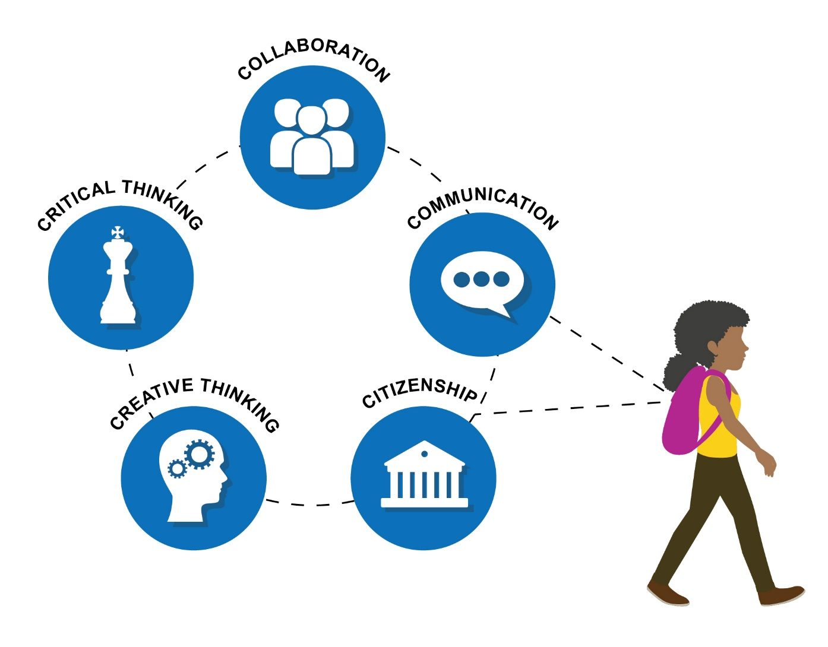
Profile of a Virginia Graduate

Slide 3
Operationalize - Profiles
Profile of a Virginia Educator
Convening of educators from
all regions
Competencies, skill sets and dispositions – linked to standards
Utilized Jobs for the Future and CCSSO’s Crosswalk of Standards to Skill Sets
George Mason University
Profile of a Virginia Education Leader
Convening of educators from
all regions
Competencies, skill sets and dispositions – linked to standards
Utilized Jobs for the Future and CCSSO’s Crosswalk of Standards to Skill Sets
School University Research Network

Slide 4
Operationalize - Profiles
Profile of a Virginia Classroom
  VASCD Pedagogy Project
  Commitment to Lead Professional Learning to Impact Classroom Practice
  Aligns with Best Practice in Instruction

Slide 5
Expected Outcomes
Utilize Profile of a Virginia Classroom to Impact Classroom Instructional Practice
Utilize the Profile of a Virginia Educator to Support Revisions in the Evaluation Process
Utilize the Profile of a Virginia Education Leader to Support Revisions in the Evaluation Process

Slide 6
New Evaluation System
Teacher Evaluation
  Identify Task Force for Input and Design
  Start with Existing Structure and Areas of Focus
  Determine Relevancy for Operationalizing Profile of a Virginia Graduate
  Utilize Required Standards and Profile of a Virginia Educator to Guide Evaluation Process
Professional Development
  Align Professional Development to Support New Evaluation Focus Areas
  Continue to Utilize Partner Organizations to Leverage Aligned PD Opportunities
  Support Potential of Micro-Credentialing As Means of Documenting Skill Sets Aligned with Evaluation Focus Areas – Include in Recertification Process

Slide 7
Guidelines for Uniform Performance Standards and Evaluation Criteria for Teachers
Effective July 1, 2012; revised July 23, 2015
Performance standards define the criteria expected when teachers perform their major duties.
  1. Professional Knowledge
  2. Instructional Planning
  3. Instructional Delivery
  4. Assessment of and for Student Learning
  5. Learning Environment
  6. Professionalism
  7. Student Academic Progress

Slide 8
Code of Virginia
Selected References—Teacher Evaluation
§ 22.1-253.13:5. Standard 5. Quality of classroom instruction and educational leadership.
§ 22.1-303. Probationary terms of service for teachers.
§ 22.1-295. Employment of teachers.
§ 22.1-305. Nonrenewal of contract of probationary teacher.
§ 22.1-307. Dismissal of teacher; grounds.

Slide 9
Professional Development Points for Licensure Renewal
Currently, Eight Options for License Renewal:
    1. College Credit
    2. Professional Conference
    3. Curriculum Development
    4. Publication of Article
    5. Publication of Book
    6. Mentorship/Supervision
    7. Educational Project
    8. Professional Development Activities

Slide 10
Timeline
January – May 2019 Completion of Profiles
  Educator
  Education Leader
  Classroom
June 2019
  Profiles Presented to the Board of Education for Review
July 2019
  Profiles Presented to the Board of Education for Approval
  Profile of a Virginia Educator – Align to New Evaluation System
By July 2019
  New Teacher Evaluation Process Work Begins
By January 2020
  Revision to Professional Development Process and Alignment to the New Evaluation System Begins

