Slide 1
Board of Education Update Early Childhood in Virginia
October 2020

Slide 2
Objectives and Agenda
This update will provide an update on the current situation and the status of the transition of child care and Head Start functions.
Agenda:
Current Early Childhood Situation in the Commonwealth
Supports for the Field
Update on Child Care Transition
Update on Early Learning and Development Standards

Slide 3
Current Early Childhood Situation
As Virginia begins to recover, challenges remain:
The Early Childhood Office is working closely with school divisions in order to support the reopening of VPI and other preschool classrooms this summer and/or fall.
Most VPI and Head Start programs are reopening with virtual learning.
As of 9/28/20, 2,008 child care programs are temporarily closed - a loss in capacity of ~153,000 seats. 908 programs have indicated that they have a reopening date (up from 737 in September).
52% of child care centers and faith-based preschools are open.
86% of family day homes are open.
Half of open providers report making efforts to expand capacity to serve school-age children participating in virtual or hybrid learning
1,510 programs have been approved for round two of the CARES Grant. Yet financial losses experienced far exceed new federal funding available.

Slide 4
Supports for the Field
The expanded Division of School Readiness has worked tirelessly to support the field by:
Coordinating with the Virginia Department of Health and Virginia Department of Social Services to align health and safety expectations, understand challenges faced by the field and deploy federal funding to the field
Producing guidance to support virtual preschool, virtual assessment, classroom observations during a pandemic, and emergency child care during virtual learning
Shifting professional development including training and coaching to virtual for school-based, Head Start and child care leaders and educators
Conducting “Cups and Conversations” and similar interactive events which highlight local solutions and best practices from the field
Participating in community-level webinars and meetings with local coalitions (e.g., Smart Beginnings) and supporting them to identify and address local challenges

Slide 5
Responding to Needs of the Field
Updates to Phase III Guidelines
VDOE was instrumental in efforts to lift group size restrictions for child care providers in COVID guidelines
Child care programs are doing an incredible job of keeping children and staff safe and healthy
Group size restrictions were putting significant financial strain on providers who are already struggling

Slide 6
New Dashboard—Child Care Specific Data
Top
Middle
Bottom
https://www.vdh.virginia.gov/coronavirus/covid-19-in-virginia/

Slide 7
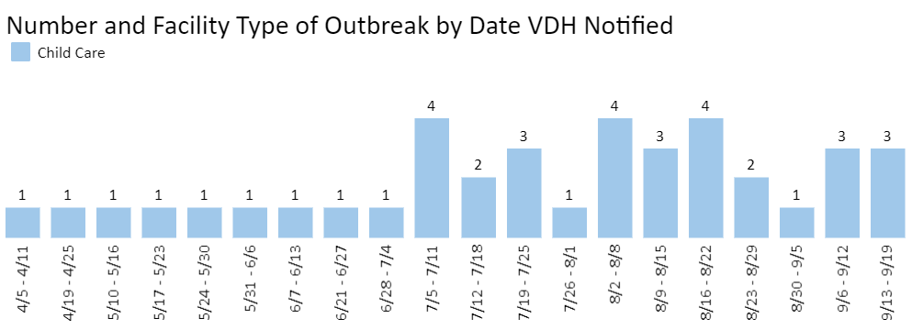
New Dashboard—Child Care Specific Data
Since April, a total of 213 cases associated with 39 outbreaks in child care settings with zero deaths have been reported in Virginia

Slide 8
Child Care Transition: Update
Transition work is ongoing and remains on track for 7/1/21.
VDOE staff are working with VDSS to complete three remaining Memoranda of Agreement before the end of the calendar year:
Child care licensing (target completion: mid-October)
Mid-year hiring (target completion: November 1)
Child care subsidy/CCDBG (target completion: mid-November

Slide 9
Child Care Transition: CCDF Annual Report
The VDOE submitted the first CCDF annual report to the GA with support from VDSS.
Key statistics from SFY 2020:
CCDF expenditures totaled more than $210 million, 70 percent of which went towards child care subsidies
An estimated 29,650 children participated in the Child Care Subsidy Program over the course of the fiscal year, with an average of 20,361 served per month
47 percent of all children served were younger than 5
Over FY20, the number of children on the wait list ranged from a low of 587 to a high of 3,286
Nearly 6,000 providers were licensed, registered, or otherwise tracked through the child care licensing system; 2,444 (41%) accept child care subsidies
FY2020 participation and expenditures were lower than normal due to the COVID-19 pandemic. Similar patterns are expected for 2021. While it is difficult to anticipate how the program will rebound, we expect demand for services to grow significantly in SFY 2022.

Slide 10
Update on ELDS
VDOE is in the final stages of developing revised unified Early Learning and Development Standards (ELDS).
The ELDS are a result of over 10 months of collaboration and engagement with teachers, leaders, and researchers in Virginia
The ELDS show a continuum of learning milestones for children ages birth—five
The first review took place in March 2020. The final draft is now open for public review and feedback through October 22, with a focus on examining the standards for cultural competency and inclusive language.
VDOE will present the Board with a more formal report and review of the ELDS in November, with the goal of statewide usage in the 2021-2022 school year.

Slide 11
Thank You jenna.conway@governor.virginia.gov

