Slide 1
Final Review of Virginia Perkins V State Plan

Slide 2
Authority of the Board
§ 22.1-227. Board designated to carry out provisions of federal act.
The Board of Education is designated as the State Board of Career and Technical Education to carry out the provisions of the federal Vocational Education Act of 1963, as amended, and as such shall promote and administer the provision of agriculture, business, marketing, home economics, health, technology education, trade and industrial education in the public middle and high schools, regional schools established pursuant to § 22.1-26, institutions of higher education, and other eligible institutions for youth and adults.
For the purposes of this section, "promote" shall not be construed to mandate the implementation of any additional career and technical education programs that are not currently offered.
8VAC20-120-10. Authority to Promulgate; Requirements for Compliance with State and Federal Regulations.
These regulations are promulgated by the Board of Education pursuant to § 22.1-16 of the Code of Virginia for career and technical education programs funded in whole or in part with state funds. Federal laws pertaining to such programs permit state regulations in addition to federal requirements (see Carl D. Perkins Act of 2006 (Perkins Act of 2006), § 121 (20 USC § 2341)).
Local education agencies operating career and technical education programs shall comply with these regulations of the Board of Education and requirements of applicable federal legislation, including the Education Department General Administrative Regulations (EDGAR) (34 CFR 74.2) and the Perkins Act of 2006.
Statutory Authority §§ 22.1-16 and 22.1-227 of the Code of Virginia.

Slide 3
Permitted Uses of Reserve Funds
Perkins V permits States to use Reserve Funds to award grants to secondary and postsecondary eligible recipients for CTE activities in—
  rural areas;
  Areas with high percentages of CTE concentrators or CTE participants;
  areas with high numbers of CTE concentrators or CTE participants; and
  areas with disparities or gaps in performance
In order to—
  foster innovation through the identification and promotion of promising and proven CTE programs, practices, and strategies, which may include programs, practices, and strategies that prepare individuals for nontraditional fields; or
  promote the development, implementation, and adoption of programs of study or career pathways aligned with State-identified high-skill, high-wage, or in-demand occupations or industries.

Slide 4
Ten Year Reserve Fund Projections
2% to 4% During Initial Three Years
(As presented at the January 23, 2020, Board Meeting)
Allocation | Projected Perkins Grant | Federal Allocation 85% | Reserve Fund | Secondary 85% | Postsecondary 15% | State Leadership 10% | State Admin 5%
2019-2020 Current | $ 28,310,494.00 | $ 24,063,919.90 |  | $ 20,454,331.92 | $ 3,609,587.98 | $ 2,831,049.40 | $ 1,415,524.70
2020-2021 Projection | $ 29,726,018.71 | $ 25,267,115.90 | $ 505,342.32 (2%) | $ 21,047,507.54 | $ 3,714,266.04 | $ 2,972,601.87 | $ 1,486,300.94
2021-2022 Projection | $ 31,212,319.65 | $ 26,530,471.70 | $ 795,914.15 (3%) | $ 21,874,373.91 | $ 3,860,183.63 | $ 3,121,231.96 | $ 1,560,615.98
2022-2023 Projection | $ 32,772,935.63 | $ 27,856,995.28 | $ 1,114,279.81 (4%) | $ 22,731,308.15 | $ 4,011,407.32 | $ 3,277,293.56 | $ 1,638,646.78
2023-2024 Projection | $ 34,411,582.41 | $ 29,249,845.04 | $ 1,169,993.80 (4%) | $ 23,867,873.56 | $ 4,211,977.69 | $ 3,441,158.24 | $ 1,720,579.12
2024-2025 Projection | $ 36,132,161.53 | $ 30,712,337.30 | $ 1,228,493.49 (4%) | $ 25,061,267.23 | $ 4,422,576.57 | $ 3,613,216.15 | $ 1,806,608.08
2025-2026 Projection | $ 37,938,769.61 | $ 32,247,954.16 | $ 1,289,918.17 (4%) | $ 26,314,330.60 | $ 4,643,705.40 | $ 3,793,876.96 | $ 1,896,938.48
2026-2027 Projection | $ 39,835,708.09 | $ 33,860,351.87 | $ 1,354,414.07 (4%) | $ 27,630,047.13 | $ 4,875,890.67 | $ 3,983,570.81 | $ 1,991,785.40
2027-2028 Projection | $ 41,827,493.49 | $ 35,553,369.46 | $ 1,422,134.78 (4%) | $ 29,011,549.48 | $ 5,119,685.20 | $ 4,182,749.35 | $ 2,091,374.67
2028-2029 Projection | $ 43,918,868.17 | $ 37,331,037.94 | $ 1,493,241.52 (4%) | $ 30,462,126.96 | $ 5,375,669.46 | $ 4,391,886.82 | $ 2,195,943.41
2029-2030 Projection | $ 46,114,811.57 | $ 39,197,589.83 | $ 1,567,903.59 (4%) | $ 31,985,233.30 | $ 5,644,452.94 | $ 4,611,481.16 | $ 2,305,740.58

Slide 5
Ten Year CTE Reserve Fund Projections
4% to 15% During Initial 6 Years Maintaining 85/15 Split
(Superintendent’s Recommendation for the March 19, 2020, Board Meeting)
Allocation | Projected Perkins Grant | Federal Allocation 85% | Reserve Fund | Secondary | Postsecondary | State Leadership 10% | State Admin 5%
2019-2020 Current | $ 28,310,494.00 | $ 24,063,919.90 |  | $ 20,454,331.92 | $ 3,609,587.98 | $ 2,831,049.40 | $ 1,415,524.70
2020-2021 Projection | $ 29,726,018.71 | $ 25,267,115.90 | $ 1,010,684.64 (4%) | $ 20,617,966.57 | $ 3,638,464.69 | $ 2,972,601.87 | $ 1,486,300.94
2021-2022 Projection | $ 31,212,319.65 | $ 26,530,471.70 | $ 1,591,828.30 (6%) | $ 21,197,846.88 | $ 3,740,796.51 | $ 3,121,231.96 | $ 1,560,615.98
2022-2023 Projection | $ 32,772,935.63 | $ 27,856,995.28 | $ 2,367,844.60 (8.5%) | $ 21,665,778.08 | $ 3,823,372.60 | $ 3,277,293.56 | $ 1,638,646.78
2023-2024 Projection | $ 34,411,582.41 | $ 29,249,845.04 | $ 3,363,732.18 (11.5%) | $ 22,003,195.93 | $ 3,882,916.93 | $ 3,441,158.24 | $ 1,720,579.12
2024-2025 Projection | $ 36,132,161.53 | $ 30,712,337.30 | $ 4,146,165.54 (13.5%) | $ 22,581,246.00 | $ 3,984,925.76 | $ 3,613,216.15 | $ 1,806,608.08
2025-2026 Projection | $ 37,938,769.61 | $ 32,247,954.16 | $ 4,837,193.12 (15%) | $ 23,299,146.88 | $ 4,111,614.16 | $ 3,793,876.96 | $ 1,896,938.48
2026-2027 Projection | $ 39,835,708.09 | $ 33,860,351.87 | $ 5,079,052.78 (15%) | $ 24,464,104.23 | $ 4,317,194.86 | $ 3,983,570.81 | $ 1,991,785.40
2027-2028 Projection | $ 41,827,493.49 | $ 35,553,369.46 | $ 5,333,005.42 (15%) | $ 25,687,309.44 | $ 4,533,054.61 | $ 4,182,749.35 | $ 2,091,374.67
2028-2029 Projection | $ 43,918,868.17 | $ 37,331,037.94 | $ 5,599,655.69 (15%) | $ 26,971,674.91 | $ 4,759,707.34 | $ 4,391,886.82 | $ 2,195,943.41
2029-2030 Projection | $ 46,114,811.57 | $ 39,197,589.83 | $ 5,879,638.47 (15%) | $ 28,320,258.65 | $ 4,997,692.70 | $ 4,611,481.16 | $ 2,305,740.58

Slide 6
Secondary Program Quality Indicator(s)
Based on input from the Key Stackholders Group, CTE State Advisory Committee, local administrators and teachers, Virginia will utilize two secondary indicators of quality to measure the percentage of CTE concentrators graduating from high school having:
Recognized postsecondary credential
Work-based learning experiences

Slide 7
Recognized Postsecondary Credential
Recognized postsecondary credential measures the percentage of CTE concentrators graduating from high school with a recognized postsecondary credential.
Note: Perkins V uses the definition of a recognized postsecondary credential from the Workforce Innovation and Opportunity Act (WIOA): “Credential consisting of an industry-recognized certificate or certification, a certificate of completion of an apprenticeship, a license recognized by the State involved or Federal Government, or an associate or baccalaureate degree.”

Slide 8
Work-based Learning
Work-based learning measures the percentage of CTE concentrators graduating from high school in sustained interactions with industry or community professional in real workplace setting, to the extent practicable, or simulated environments at an education institution that foster in-depth, first-hand engagement with tasks required of a given career field, that are aligned to curriculum and instruction.

Slide 9
Secondary State Determined Performance Levels
Core Indicator Code (Code in Perkins IV) | Secondary Perkins Core Indicators of Performance | Perkins V Target Level 2020-2021
1S1 (4S1) | Graduation Rate | 93.50%
1S1 (N/A) | Extended Graduation Rate | N/A
2S1 (1S1) | Academic Attainment- English/Reading | 75.50%
2S2 (1S2) | Academic Attainment- Mathematics (Highest level) | 72.50%
2S3 (New) | Academic Attainment - Science | 70.25%
3S1 (5S1) | Post Program Placement Transition Rate | 93.25%
3S2 (5S1) | Program Completer Survey Response Rate | 28.25%
4S1 (New) (6S1 & 6S2) | Nontraditional Program Concentration | 28.25%
5S1 (New) | Program Quality - Recognized Postsecondary Credential (Option A) | 65.25%
5S2 (New) | Program Quality – Postsecondary Credit (Option B) | N/A
5S3 (New) | Program Quality - Participated in Work-based Learning (Option C) | 10.25%
5S4 A (2S1 A) | Other Program Quality- Technical Skills Attainment/Student Competency Rate | 80.50%
5S4 B (2S1 B) | Completers Participating in Credentialing Tests | 85.00%
5S4 C (2S1 C) | Test Takers (Completers) Passing Credentialing Tests | 85.00%
5S4 D (2S1 D) | Completers Passing Credentialing Tests | 78.00%
5S4 E (2S1 E) | Completers Who Passed a Credentialing Test Plus Completers Who Earned an Advanced Studies Diploma and Did Not Pass a Credentialing Test | 81.00%

Slide 10
Perkins V Required Leadership Activities
State Institutions – (Department of Corrections and Department of Juvenile Justice) | $220,000.00
Nontraditional Research and Training – Services that prepare individuals for nontraditional fields Trailblazers – Provides high quality, current demographic and labor market data together with policy and program analysis. | $150,000.00 $49,996.00
CTE Completer Follow-Up Survey- Perkins V requires a study of program completers following high school graduation. | $251,183.00
CTE Federal Program Monitoring – The USDE requires the grant recipient to conduct local onsite monitoring of sub-recipients. | $123,830.28
TOTAL | $795,009.28

Slide 11
State Leadership Focus Areas of Innovation
(NEW) National Alliance for Partnerships in Equity (NAPE) – Consortium that collaborates to create equitable and diverse classrooms and workplaces. | $10,000.00
(Expanded Services) Academic and Career Plan Portfolio – Includes provisions for each elementary school student to develop a portfolio. | $125,000.00
(Expanded Services) New Teacher Institute – Instruction designed specifically for CTE teachers who are transitioning directly from business and industry to the classroom. | $85,000.00
(Expanded Services) Experience Works – Convening of business, industry and educators that focuses on real-world Work-Based Learning opportunities. | $22,309.31
TOTAL | $222,230.31

Slide 12
Supporting State Leadership Activities
Postsecondary – Allocation to Virginia Community College System | $283,104.94
CTE Resource Center – Serves as Virginia’s career and technical education curriculum unit for the development of instructional competencies for courses offered in middle and high schools across the state. | $719,985.00
Agency Affiliations Southern Regional Education Board (SREB) Career and Technical Education Consortium of States (CTECS) Advance CTE | $65,000.00 $30,000.00 $14,599.00
Career Success Stars – CTE program completer success stories in each of the 17 career clusters | $25,520.00
Virginia Career Wizard – Career information, enrollment in Virginia’s community colleges, college transfer to four-year colleges, college debt and career exploration resources. | $190,000.00
Funds to Support Career Clusters – development and revision for CTE course competencies | $465,521.87
TOTAL | $1,793,730.81

Slide 13
Perkins Allocation Summary
State Leadership
- Perkins V Required Leadership Activities $795,009.28
- State Leadership Focus Areas of Innovation $242,309.31
- Supporting State Leadership Activities $1,793,730.81
TOTAL: $2,831,049.40

Slide 14
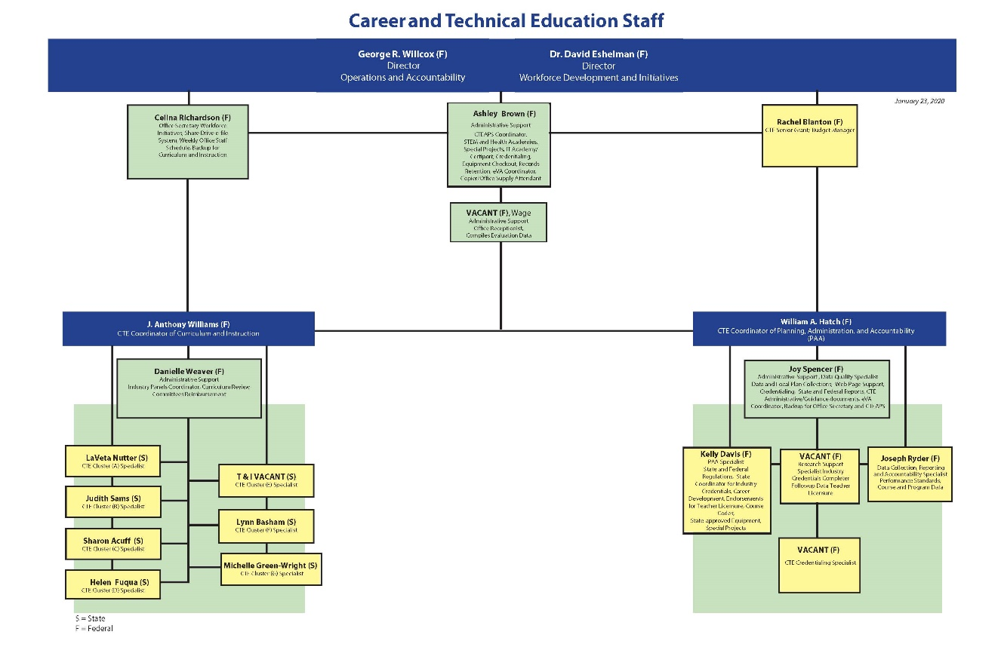
State Administration

Slide 15
Contact Information
Virginia Department of Education
Office of Career, Technical, and Adult Education P.O. Box 2120
Richmond, VA 23218
804 225-2052
cte@doe.Virginia.gov
http://www.doe.virginia.gov/instruction/career_technical/index.shtml

