Slide 1
Office of School Quality’s
Response to the
Joint Legislative Audit Review Committee
Dr. Aurelia Ortiz, Director of the Office of School Quality
Mr. Matt Dreier, Doctoral Resident
Notes:
Lia

Slide 2
Summary of Key Points
The Joint Legislative Audit Review Committee (JLARC) recommended the VDOE develop and implement a plan to guide its transition to a new school improvement model and estimate the additional staffing required to effectively implement the new model
Based on continuous improvement research and state education agency scan, the VDOE is transitioning to a regional, case management approach to school improvement focused on coordinated and differentiated high quality support to the field
Intensive support to MOU, Level II & Level III
Targeted support - Personalized technical assistance, Network Improvement Communities (NIC)
Universal support - webinars, conferences, research-based best practices
Phased transition to Regional Support Teams (RST) over the next 3-4 years
Goal: Improve identified schools so that all children will receive a high quality education in high quality schools
Notes:
Lia
OUR goal is to Improve identified schools so that all children will receive a high quality education in high quality schools

Slide 3
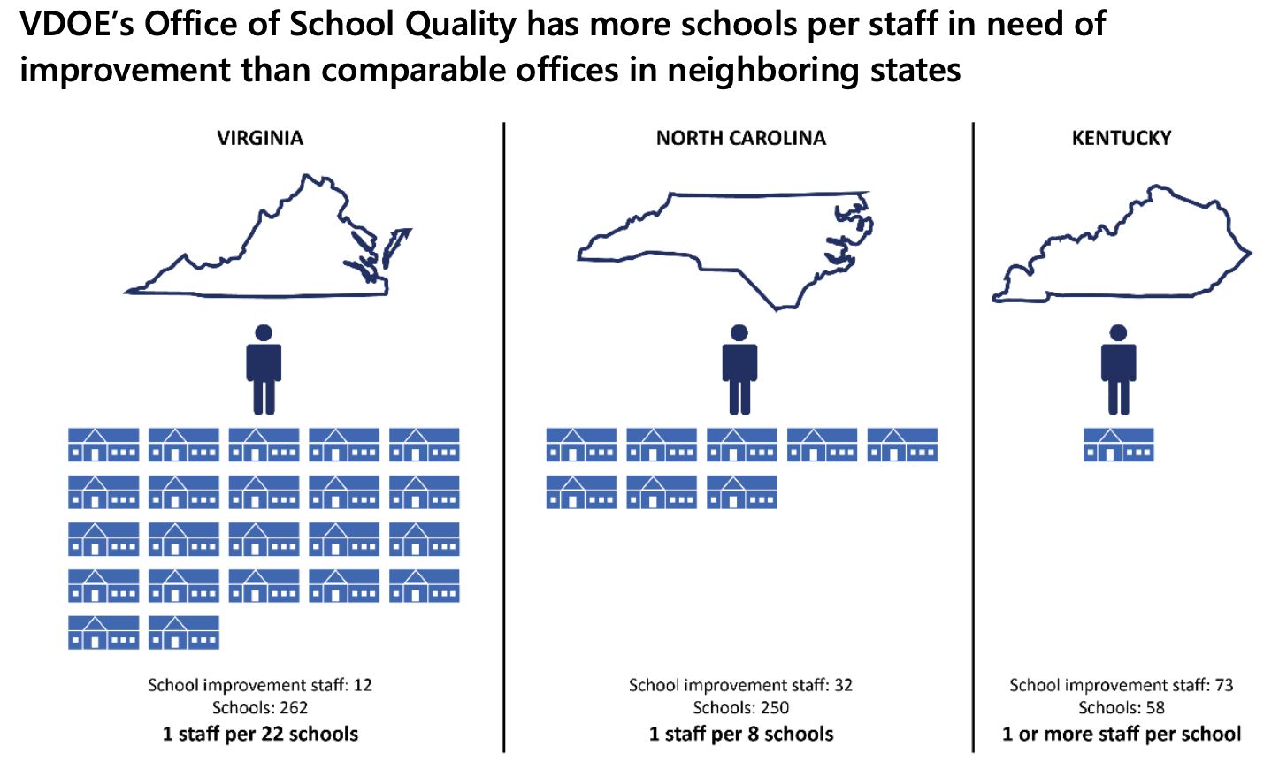
JLARC Findings
OSQ Limited Staff
Compliance centered approach to school improvement
Limited differentiation by need
Limited focus on systemic change
Inhibited trust between schools, divisions and OSQ
Led to increased job dissatisfaction within OSQ
Notes:
Lia
Focused on classroom observations as a lever

Slide 4
JLARC Recommendations
RECOMMENDATION 8 The Virginia Department of Education should develop and implement a plan to guide its transition to a new school improvement model and estimate the additional staffing required to effectively implement the new model. The plan should be presented to the Board of Education and transmitted to the House Education and Appropriations committees and to the Senate Education and Health and Finance and Appropriations committees, no later than June 30, 2021.​
RECOMMENDATION 9 The General Assembly may wish to consider appropriating additional funding for new staff positions in the Virginia Department of Education’s Office of School Quality to strengthen its work with school divisions in the school improvement program.​
RECOMMENDATION 10 The General Assembly may wish to consider amending § 22.1-23 of the Code of Virginia to direct the superintendent of public instruction to (i) develop and implement an effective school improvement program, (ii) identify measures to evaluate the effectiveness of the services the Office of School Quality provides to school divisions, (iii) evaluate and make changes as needed to ensure effectiveness, and (iv) annually report to the Board of Education.
Today’s presentation addresses RECOMMENDATION 8.
Notes:
Matt
The General Assembly has not yet completed this requirement.Budget language "C. The Department of Education shall develop a plan to implement an effective and appropriately-resourced school improvement program. The plan should specify the activities necessary for its Office of School Quality to provide effective support to school divisions in the school improvement program, and the number of state staff and funding required to effectively implement the planned activities. The plan should also define performance measures that will be used to evaluate the effectiveness of the services its Office of School Quality provides to school divisions and how it will evaluate performance compared to those measures and make changes as needed to ensure ongoing effectiveness. The department shall submit the plan for the state's more effective and appropriately-resourced school improvement program to the Board of Education and the Chairs of the House Education and Appropriations committees and Senate Education and Health and Finance and Appropriations committees no later than November 1, 2021."

Slide 5
Current OSQ Structure & Responsibility
OSQ Support/Compliance-State and Federal
Standards of Accreditation
Academic Review Process
MOU /Corrective Action Plans (CAP)
Continuous School Improvement Planning Process to include Continuous Needs Assessment
Monitoring of Level II and Level III schools
Every Students Succeeds Act
School Improvement Grant Processes
Monitoring of Comprehensive Support and Improvement Schools
Opportunities to expand support
Interagency collaboration
Comprehensive Needs Assessment
Professional Learning Networks
Professional Development
Data analytics
Level II division monitoring
Deep collaboration
Evidence Based Practices
Director, Office Of School Quality
Associate Director
*MOU Divisions (5)
(1)Federal and (1)State Coordinators
supporting MOU divisions
Federal (33 schools) /State (45 schools)
(6.5) Specialists supporting
Federal(54 schools)/ State(122schools)
* Memorandum of Understanding (MOU)
Notes:
Lia
Divisions with a Memorandum of Understanding (MOU)
Detailed and intense process that includes...

Slide 6
State and Federal Guidelines
Goal: “The General Assembly shall provide for a system of free public elementary and secondary schools for all children of school age throughout the Commonwealth, and shall seek to ensure that an educational program of high quality is established and continually maintained” Article VIII VA Constitution
Virginia Code 8VAC20-131-400. Application of the School Quality Indicator Performance Levels to Actions defines the requirements for schools based on their School Quality Indicators
All schools receive level 1, level 2, or level 3 designations based on Academic Achievement, Achievement Gaps and Student Engagement and Outcomes data
A school rating of level 3 on any indicator, or level 2 for Academic Achievement indicators in (English, mathematics or science), triggers the need for VDOE’s involvement in implementing school improvement requirements for identified schools
Every Students Succeeds Act is based on state accreditation data that federally identifies schools for School Improvement Grant funding
*Note: the VDOE is not optimally organized and the OSQ is not adequately resourced to meet this goal
Notes:
Matt -- problem of practice slide
For the 2019–20 school year, 262 of the 1,825 public schools in Virginia (14 percent) were required to participate in VDOE’s academic review process. Of these schools, 88 (34 percent) were also identified for federal school improvement funding under ESSA. (JLARC) has the responsibility for providing technical assistance to ensure that all schools are improving and moving towards accreditation

Slide 7
Aligned Strategy
Virginia Board of Education (VBOE) Priority 3: Ensure successful implementation of the Profile of a Virginia Graduate and the accountability system for school quality as embodied in the revisions to the Standards of Accreditation (VBOE Comprehensive Plan: 2018-2023)
VDOE Goal 1: Ensure student success and school quality (VDOE Strategic Plan DRIVE 2025)
OSQ Goals:
Ensure all schools and divisions provide quality instructional and programmatic leadership, with increased support for superintendents, division leaders and principals
Ensure the VDOE provides support and resources to meet school divisions' needs that will result in advancing a culture of continuous improvement
Notes:
Ensure schools and divisions advance a culture of continuous improvement (support and resources)

Slide 8
What the Research says:
Through policy, funding, data and personnel development, the SEA can build capacity for differentiated support throughout the state (Redding, 2009. Framework for an Effective Statewide System of Support)
Technical Assistance providers must be able to move beyond rules based technical assistance and "reach far more deeply into the operations of local schools, as well as to draw upon talent and expertise outside of the SEA's traditional compliance roles" (Jochim, 2016. Measures of Last Resort: Assessing Strategies for State-Initiated Turnarounds. Linking State and Local School Improvement)
To continuously improve the statewide system of support, the system itself needs clear goals, objectives and benchmarks, and a process for monitoring its ongoing operations and for evaluating its effectiveness. (Redding, 2009)
North Carolina transition to regional case management model in 2018
Notes:
Matt
Multiple states have small case management
Also from Redding 2009
Action Principles for Building Local Capacity for Change
1. Conceive of a system of support as a coherent and coordinated means for supporting people in
performing their various roles in children’s education.
2. Build a system of support first from what exists by coordinating components that are extant, adding
missing pieces, and achieving coherence.
3. Move past a review of symptoms (poor test scores) to understand causes (district and school operations) in order to apply remedies.
4. Build the capacity of districts to assume greater responsibility for the continuous improvement of
their schools.
5. Differentiate the necessary roles of personnel within the system of support, including those who
audit/assess district or school operations, those who provide services (training, coaching, consulting),
and those who oversee and manage the process (process managers).
6. Create and refine true “systems” of support rather than providing fragmented services.
7. Coordinate SEA personnel, field staff, intermediate centers, organizational partners, distinguished
educators, support teams, and consultants in one coherent system of support.
8. Make the transition from compliance only to compliance plus support for improvement.
9. Provide a “big picture” view of a system of
support that is coherent and systemic.
10. Bring special education, ELL, Title I, and
career education (structurally separated by
funding streams and departmental organization) within the tent of a unified system of
support.
11. Restructure (redesign) the SEA (and regional
centers) to provide for effective coordination
and administration of the system of support.
12. Assess district/school operations in addition
to examining test scores in order to differentiate and target system of support services.
13. Align the system of support Service Plan
with the district or school Improvement
Plan and with the results of careful assessment of performance and operational data.
14. Assess district/school operations with an
approved set of indicators, procedures, and
instruments.
15. Monitor both the implementation of the
district or school Improvement Plan and the
aligned system of support Service Plan.
16. Evaluate the effectiveness of the system of
support’s procedures and services.
17.Intentionally link systems from the state
to the district to the school and classroom
in order to affect variables that will spawn
improvement.
18. Draw a straight line from every state policy,
program, and service to the intended result
for a student in a classroom.
19. Provide a single, integrated school or district
improvement planning process rather than
separate ones for each categorical program.

Slide 9
Recommendation 1: Establish a School Quality Committee Within the VDOE to Coordinate Our Support to School Divisions Across Agency Units
VDOE Representation
Office of School Quality
Virginia Tiered System of Support
Special Education
Elementary & Secondary Education Act
Innovation and Learning
Budget & Policy
Equity
Assessment & Accountability
Teacher Education (or HR)
Community Engagement
Potential Advisors
Regional Superintendents
MOU Superintendent
Process Coach (through initial operating capability)
Notes:
The technical and adaptive nature of school quality work demands a coherent, "whole of VDOE" strategy which cannot be achieved through siloed, ad hoc tactics. An emerging example occurs during the corrective action plan (CAP) review meetings with MOU divisions. During these monitoring meetings, VDOE representatives from Special Education, Virginia Tiered System of Supports (VTSS), Elementary and Secondary Education Act, and Office of School Quality execute their monitoring and oversight responsibilities with the division leadership, which leads to a more unified — coherent — experience for the division. This concept is not new. Indeed, the VDOE strategic plan identifies the need to "collaborate across VDOE departments and offices to develop a data-based, continuous school and child care improvement planning process encompassing the school and child care quality indicators to build local leadership capacity (VDOE, 2020)." The missing element then, is to actualize this. To build VDOE coherence and capacity, this collaborative body should be composed of leaders below the deputy and assistant superintendent level and chaired by the Office of School Quality director.

Slide 10
Recommendation 2: Provide Resources to Ensure OSQ Meets School Division Needs
Superintendent
Office of School Quality maintains compliance and statewide coordination responsibility. Regional Support Teams (RST) collaborate with divisions, schools, educators, families and regional partners through a continuous improvement process to ensure each child in Virginia has access to a high-quality education. RSTs provide professional learning opportunities and need-based coaching focused on building leadership capacity, team development, and inclusive instruction practices to assist schools in improving educational outcomes.
Div of School Quality, Instruction & Performance
School Quality Committee
Office Of School Quality
Region 1 Support Team
Regional 2 Support Team
Regional 3,6,7,8 Support Team*
Region 4 Support Team
Region 5 Support Team
Direct report
*Regions 3,6,7,8 combined due to number of identified schools
Coordination

Slide 11
Regional Support Team Capabilities
Support Team Lead
Desired Outcomes:
Coordinated and differentiated high quality support to the field
Intensive support to MOU, Level III & Level II
Targeted support - specialized events, Networked Improvement Communities, requested
Universal support - webinars, conferences, research, best practices
Through:
Increased use of data informed decisions
Addressing complex factors
Willing partnership at state-division-school
Each team member will build capacity across schools and divisions in their area of expertise but will be skilled instructional leaders ready to support a variety of needs in their region. Each team member will also be assigned schools to check in and support the principal from time to time.
Continuous Improvement
Curriculum & Instruction
Data Analytics
Special Education
School Readiness
Operations
Human Resources
Literacy
Family Engagement
Principal Development
CTE/Digital

Slide 12
Interim Capacity Until Funding is Available for All Positions in Recommendation 2
Things we will do in depth
Increase Support to MOU, Level III & II
3 visits/yr
Monthly check ins
Increased use of data informed decision making
Lead School Quality Committee
Broaden Technical Assistance Offerings based on need
Director, Office Of School Quality
Data Analytics Specialist
Associate Director, OSQ & MOU Divisions
(5 MOU’s)
(2) Coordinators, Federal/State Lead
& MOU Support
(33 & 45 MOU’s)
(10.5) Specialists
(54 & 122 Monitoring)
Notes:
Increase OSQ staff
Add (4) School Quality Specialists
Add (1) Data Analytics Specialist
Cost
~$720k/year
Reduce Staff to School Ratio to 15 to 1
Increase school contact time by 50%

Slide 13
Personnel
Current OSQ
Director
Associate Director
Admin Assistant
Federal Coordinator
State Coordinator
6.5 Specialists
Total FTE: 11.5
OSQ Staff to Schools in Need of Support Ratio 1:22
Interim OSQ Capability
Director
Associate Director
Admin Assistant
Federal Coordinator
State Coordinator
(1) Data Analytics Specialist
(10.5) Specialists
Total FTE: 16.5
Ratio: 1:13
Full OSQ Capability
Director
Associate Director
Admin Assistant
Federal Coordinator
State Coordinator
(2) Data Analytics Specialist
(10.5) Specialists
(50) RST (10 per region)
Total FTE: 67.5
Ratio: 1:4

Slide 14
Capabilities Comparison
Capability | Interim | Final
Differentiated Support | Limited regional | Full
Approach | Brokering of Services/Coaching | Case Management - increase division and schools’ human, organizational, structural and material capacity
Reach/Depth | MOU, Level II & III | All divisions & schools
Cost | Add $720K/yr in FY23 | Add $5.52M/yr in FY24

Slide 15
Implementation Stages
Exploration
Installation
Initial Implementation
Full Implementation
Assess Needs
Assess Fitness
Examine Recommendations
Consider Implementation Drivers
Acquire resources
Prepare Organization
Prepare Implementation Drivers
Prepare Staff
Adjust Implementation Drivers
Manage Change
Deploy Data Systems
Initiative Improvement Cycles
Monitor & Manage Implementation Drivers
Achieve Fidelity & Outcome Benchmarks
Further Improve Fidelity & Outcomes
2-4 Years
Notes:
There are 3 categories of Implementation Drivers:
Competency Drivers–mechanisms to develop, improve and sustain one’s ability to implement an innovation as intended in order to benefit students.
Organization Drivers–mechanisms to create and sustain hospitable organizational and system environments for effective educational services – that ‘enabling context’ we talked about earlier.
Leadership Drivers– focus on providing the right leadership strategies for different types of leadership challenges. These leadership challenges often emerge as part of the change management process needed to make decisions, provide guidance, and support organization functioning.https://nirn.fpg.unc.edu/module-2/implementation-drivers

Slide 16
A Regional Model Will Allow OSQ to Support School to:
Implement an aligned and culturally relevant curriculum.
Ensure common assessments are aligned to the curriculum to identify academic needs of students on a regular bases
Analyze student achievement data to identify needs of struggling students
Employ tailored, timely,tiered evidenced based interventions
Implement professional learning communities that include a collaborative process by faculty to discuss strategies specific to each student
Employ technology to support, track and monitor data systems to ensure the efficacy of quality instructional programs
Utilize the teacher evaluation system to facilitate solid partnerships between human resources and principals
Notes:
Lia - Facilitate solid partnerships between human resources and principals to ensure the teacher evaluation system effectively develops
and/or when needed to exit ineffective teachers.
Implement professional learning communities that include a collaborative process by faculty to discuss strategies specific to each student (includes strategic scheduling of teachers so students are paired with teachers most likely to enable them to succeed).

Slide 17
The Effectiveness of this Model will:
Build Capacity (superintendents, division leadership and principals)
Strengthen instructional leadership
Utilize data to support division decision making
Provide technical support for aligned quality curriculum and instruction
Integrate continuous improvement strategies
Align division level systems and processes, governance, resources and priorities

Slide 18
Summary of Key Points
The Joint Legislative Audit Review Committee (JLARC) recommended the VDOE develop and implement a plan to guide its transition to a new school improvement model and estimate the additional staffing required to effectively implement the new model
Based on continuous improvement research and state education agency scan, the VDOE is transitioning to a regional, case management approach to school improvement focused on coordinated and differentiated high quality support to the field
Intensive support to MOU, Level II & Level III
Targeted support - Personalized technical assistance, Network Improvement Communities (NIC)
Universal support - webinars, conferences, research-based best practices
Phased transition to Regional Support Teams (RST) over the next 3-4 years
Goal: Improve identified schools so that all children will receive a high quality education in high quality schools
Notes:
Lia
OUR goal is to Improve identified schools so that all children will receive a high quality education in high quality schools

Slide 19
Questions
Notes:
Lia

