Slide 1
Realigning Alternative Accreditation Plans to the 2017 Accreditation Model
Virginia Board of Education Work Session
November 17, 2021

Slide 2
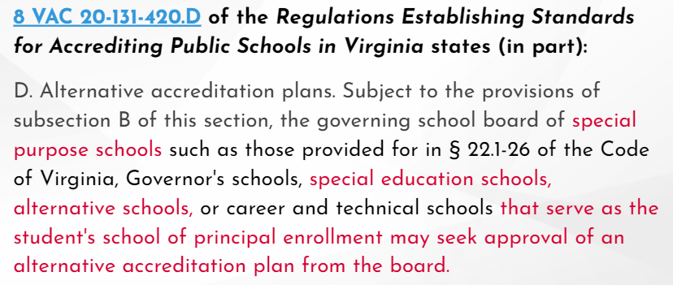
Standards of Accreditation (1 of 2)
(Continued)

Slide 3
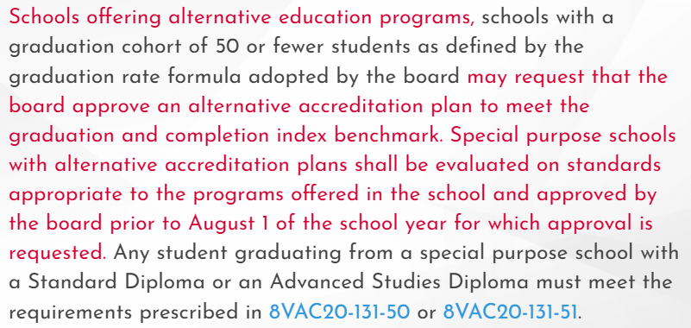
Standards of Accreditation (2 of 2)

Slide 4
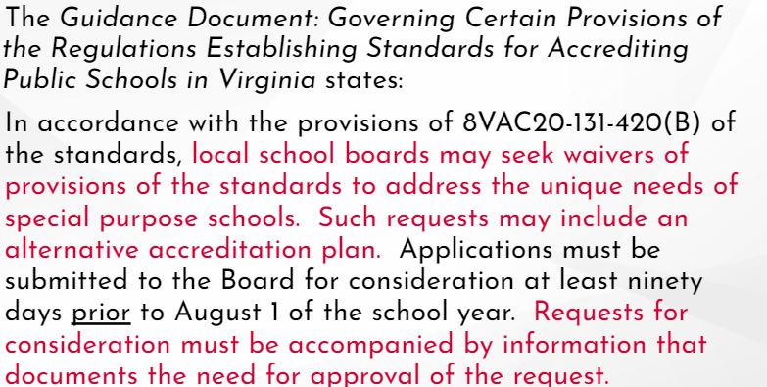
Guidance Document

Slide 5
Use of Alternative Accreditation Plans with Previous Accreditation Model
The previous accreditation model was based primarily on passing Standards of Learning (SOL) tests and on the Graduation and Completion Index (GCI).
Approved alternative accreditation plans under the old model often included:
  measures of growth or weighted “index” models for pass rate calculations; and
  “bonus” points that could be applied to calculations to reach benchmarks.

Slide 6
Alternative Accreditation Plans
On the previous review of Alternative Accreditation plans brought before the Board in November 2019 (first review) and January 2020 (final review), the Board requested that staff take a new look at submitted plans to ascertain that they align with the 2017 Accreditation model.

Slide 7
Established Criteria (1 of 4)
The purpose of the school and the characteristics of the student population served sufficiently justifies the need for an alternative accreditation plan.
The characteristics of the student population are clearly defined.
The rationale for determining which accreditation indicators are not appropriate for the school, or the students served, is sufficient for the indicators that were selected.

Slide 8
Established Criteria (2 of 4)
The rationale includes historical data. Historical data on the school’s performance on each accreditation indicator, when available, must be included in the rationale for determining which indicators are not appropriate for the school or students served. Schools meeting currently established performance levels on an accreditation indicator may not be approved for an alternate process to calculate that indicator.

Slide 9
Established Criteria (3 of 4)
All of the alternate indicators are clearly explained, have an appropriate sample calculation, are objective, measurable, and directly related to the purpose of the school.
The achievement indicators include the use of statewide assessments, which are evaluated separately.

Slide 10
Established Criteria (4 of 4)
The plan sufficiently describes programs and planning activities that allow students to be successful when they return to a regular school setting.
The rationale for requested waivers of accrediting standards is clear and appropriate.

Slide 11
Realignment to 2017 Accreditation Model
Alternative Accreditation plans need to stay true to the main tenets of the accreditation model. The committee looked at the submitted plans with a focus on-
Providing high quality educational programs for all students;
Encouraging continuous appraisal and improvement of the school program for the purpose of raising student achievement; and
Establishing a means of determining the effectiveness of schools.

Slide 12
Allowable Modifications (1 of 3)
Allowable modifications:
Include all students to the greatest extent possible in the alternate model, rather than excluding students to meet established criteria;
  Exception: can exclude students who enrolled in a Virginia Public School for the first time after compulsory attendance age

Slide 13
Allowable Modifications (2 of 3)
Allowable modifications:
Maintain the established benchmarks for Level indicators (i.e., The Level 1 performance level for English must remain greater than or equal to 75%.);
Show improvement in indicator performance with amended rates (i.e., use R5 rather than R10, or use 2% instead of 2.5% for I2);

Slide 14
Allowable Modifications (3 of 3)
Allowable modifications:
Adjust the minimum pass rate (“the floor”) required to use the reduction of the failure rate (i.e., can use R10 when the pass rate is 45% rather than 50%);
Use additional years to calculate a multi-year rate, without excluding any year; and
Maintain chronic absenteeism calculations, but encourage divisions to define “meaningful engagement” to guide absentee policies.

Slide 15
Modifications No Longer Allowed (1 of 2)
General modifications no longer accepted:
Using weighted values for certain outcomes in calculations (i.e., an advanced pass score counts more than a pass proficient score);
  Exception: can use a weighted value for test scores in the 375-399 range

Slide 16
Modifications No Longer Allowed (2 of 2)
General modifications no longer accepted:
Using scenarios to earn “bonus points” (i.e., earn GCI points when 25% of graduates and completers were employed 20 or more hours per week); and
Amending definitions or terms and the calculations involved with them (i.e., broaden the definition of a transfer student).

Slide 17
Submitted Plans (1 of 2)
Feedback will be provided on each submitted plan using the established criteria. This will help ensure, in part, that-
The purpose of the school and the student population does justify the need for an alternative accreditation plan;
Rationales for modifications are thorough and include historical data as part of the justification;
(Continued)

Slide 18
Submitted Plans (2 of 2)
Sample calculations are provided for clarity;
Modified indicators are objective, measurable, and related to the purpose of the school; and
The achievement indicators use the statewide assessments, which are evaluated separately.

Slide 19
Questions?

