Slide 1
Increasing Access and Choice in Publicly-Funded Early Childhood Care and Education in Virginia
Virginia Board of Education Working Session
November 17, 2021

Slide 2
Objective and Agenda
Today’s session will provide an overview of access and choice for Virginia’s early childhood landscape, and identify key priorities.
Virginia’s Early Childhood Landscape
  Eligibility, Funding and Choice Across Programs
Strategies for Increasing Access and Choice
Statewide Data on Access and Enrollment

Slide 3
Our Shared Challenge
All Virginia children are capable of and deserve to enter school ready. Yet too many children enter kindergarten without this opportunity.
According to the 2020 Virginia Kindergarten Readiness Program (VKRP), 45% of Virginia’s Kindergarteners entered school without the key literacy, math, and social-emotional skills needed to be successful.
Our “system” fails to prepare 55% of children from economically disadvantaged families and 66% of children with special needs.
Virginia ranks 33rd in preschool funding and child care funding is at the 70th percentile; nearly 50,000 vulnerable three- and four-year-olds lack access to quality preschool.
Too little is known about the quality of programs that receive public funds.
COVID-19 has negatively impacted providers, educators, families and children.

Slide 4
Our Shared Vision
We envision a Virginia where all children have the opportunity to enter school ready, prepared to fulfill their potential.
All families need affordable access to and support to choose the option that best meets their unique needs.
All early childhood programs that take public funds should benefit from measurement and supports for improvement, ensuring quality choices are available for all families.
Programs are rewarded for continual improvement and educators are adequately compensated.
Overall Virginia’s early childhood system will be more unified, data-driven and resource-effective so families can work, go to school or pursue employment and children have every opportunity to be successful.

Slide 5
A Simplified View
Access + Quality → More Choices for Families → Increased School Readiness Outcomes

Slide 6
Virginia’s Key Publicly-Funded Early Childhood Programs

Slide 7
Why the Complexity?
With at least five types of publicly-funded programs, the Virginia early childhood landscape is complex. Here’s why:
All children are not guaranteed to be served like K-12. Funding is limited. As a result, different eligibility requirements are used to prioritize those in most need or whom may benefit most.
There is no single provider type that serves all birth-to-five children; early childhood is a public-private system defined by 1) diverse providers and 2) diverse family preferences.
Each program has its own historical context. For example, Head Start has invested in the most underserved children and families for 50+ years. The Child Care Subsidy program has helped ensure working families can afford child care and have choice.

Slide 8
Key Publicly-Funded Programs in Virginia
Here are the five key publicly-funded early childhood programs:
Virginia Preschool Initiative (VPI)
Early Childhood Special Education (IDEA Part B, Section 619)
Mixed Delivery Preschool Grant Program
Head Start and Early Head Start
Child Care Subsidy Program
Detail on each program may be found in the Appendices.

Slide 9
Examples of Publicly-Funded Classrooms
Publicly-funded “classrooms” work differently from K-12.
Classroom A in a School:
All children are publicly-funded.
Classroom B in a Family Day Home Business:
Only 1 child is publicly-funded. Other children pay tuition.
Classroom C in a Non-Profit Child Care Center:
Multiple sources of public and private funding.

Slide 10
A Simplified View
Demand = Eligibility Criteria + Options that Meet Family Needs
Demand x Per-Child Funding = Potential Public Investment

Slide 11
Who is Eligible?
 | Virginia Preschool Initiative | Early Childhood Special Education | Mixed Delivery | Head Start/ Early Head Start | Child Care Subsidy
Income Criteria | 200% FPL, or 350% if there is a disability | N/A | 200% FPL, or 350% if there is a disability | 100% FPL, up to 35% may be between 100% and 130% | Varies by region
Age | 3-5 | 2-5 | 3-5 | Birth-3 (EHS) 3-5 (HS) | Birth-12
Child Characteristics | At risk of not being ready | Diagnosed disability or delay |  | At risk of not being ready, 10% must be eligible for special education supports
Other Family Characteristics | Homelessness, high school non-completion | N/A | Homelessness, high school non-completion | In foster care/kinship care, homelessness, or receive public benefits | Employment or school required; job search currently allowed
Local Criteria Allowable? | For 15% | No | For 15% | No | No

Slide 12
What is the Per-Child Funding?
 | Virginia Preschool Initiative | Early Childhood Special Education | Mixed Delivery | Head Start/ Early Head Start | Child Care Subsidy
Funding Source | State General Funds | Federal IDEA Funds | State General Funds and COVID Relief Funding | Federal Head Start Funds | Federal Child Care Development Block Grant (CCDBG) Funds
Set Rate Per Child | $7,655 in FY22 | No set rate | Between $10,000 and $12,000 depending on locality | Between $9,507 and $17,911 for HS/EHS depending on locality | Ranges by locality, based on the market rate, average of $5,586 per year for children younger than 5*
Hours Per Day | 5.5 hours a day | Depending on service, often school day or half day | Full day (based on program schedule) | Annual hours mandated based on the program service option | Based on parent “need” for care (i.e., work or school schedule)
Service Duration | School Year | Depending on service, often school year | 12 months | Depending on Recipient Agency, often school year | Minimum of 12 months
Notes:
just added for 0-5. For all kids its $4936, for 5+ its $4173. SFY21

Slide 13
Insights on Access and Choice

Slide 14
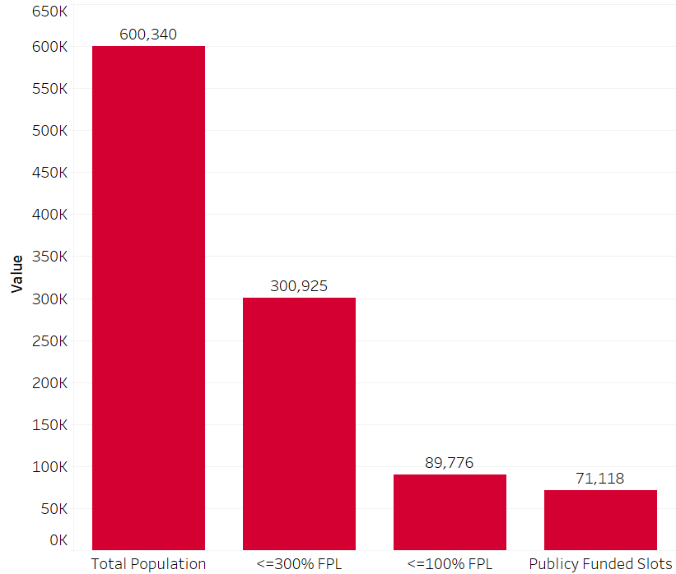
Potential Demand Exceeds Funded Slots
About 15% of children, from birth to age 5, are living at or below 100% FPL.
Roughly 50% of the early childhood population in Virginia live at or below 300% FPL, or $79,500 for a family of 4.
Only 11.8% of the Commonwealth’s early childhood population can be served by the current number of publicly-funded slots through VPI, CCSP, mixed delivery, and EHS/HS.

Slide 15
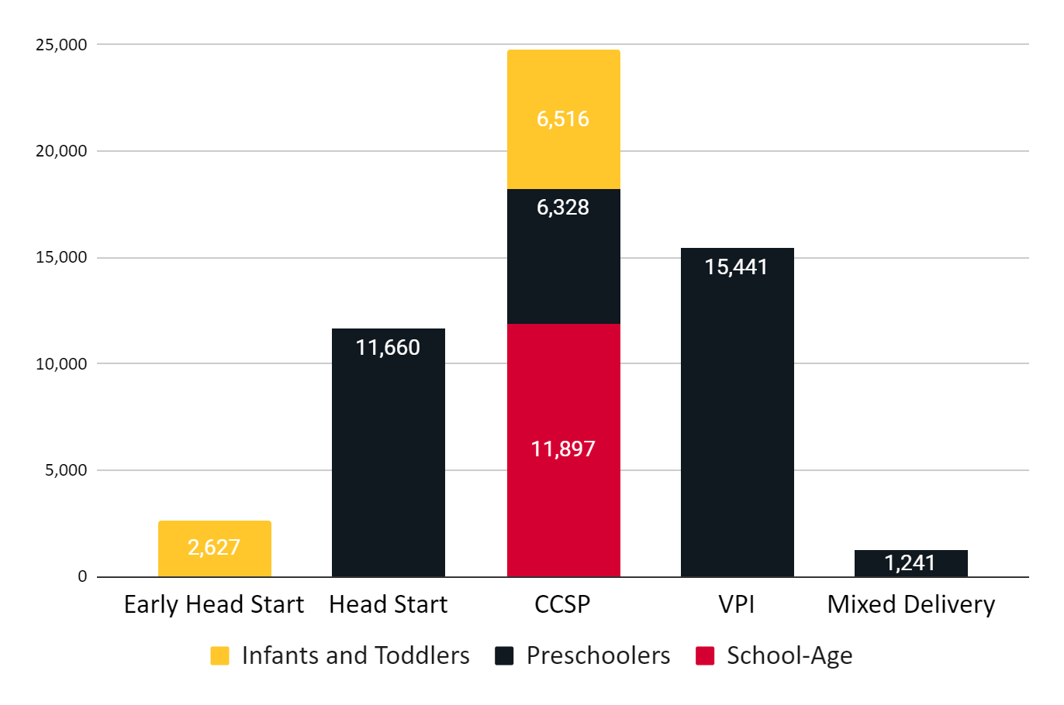
Most Public Funds Support Preschool
Who do publicly-funded early childhood slots support?
16% support infants and toddlers
62% support preschoolers
22% support school-age children

Slide 16
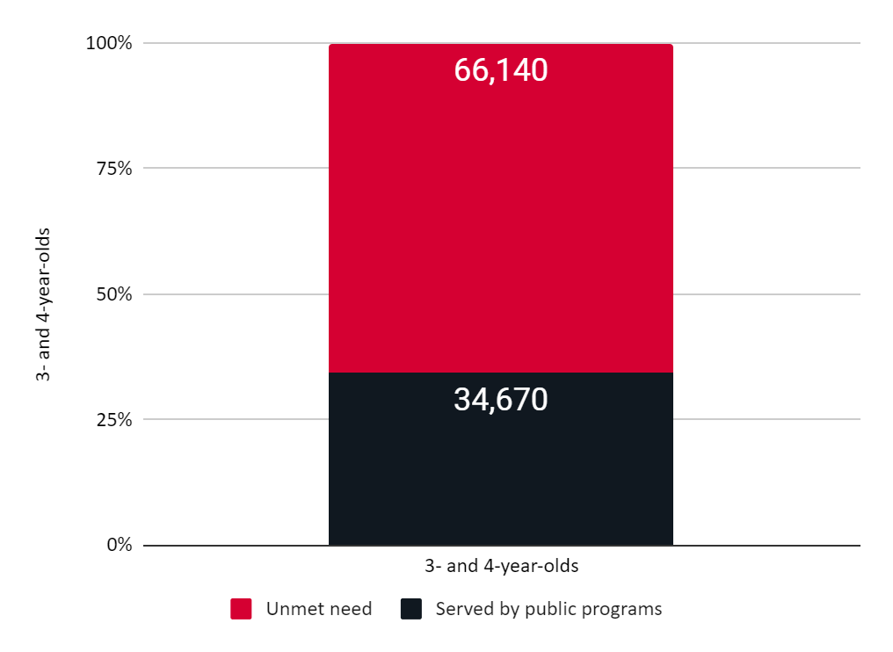
Unmet Need in Preschool
Approximately 1 in 3 preschoolers in Virginia lacks access to publicly-funded early childhood education.
Most are 3 year olds.

Slide 17
Too Few Choices for Infants and Toddlers
Due to low adult-child ratios and other factors, infant and toddler care (up to age 3) is the most costly and least available.
2,682 of nearly 5,600 child care programs (48%) accept children ages 1 year old and younger.
  Infant and toddler classroom sizes are smaller and tend to comprise a smaller share of a program’s licensed capacity.
The Child Care Subsidy program is currently serving 1,166 infants, representing 5% of the program.
Collectively, Early Head Start and the Child Care Subsidy Program serve 9,143 infants and toddlers with public funds, representing 6% of those who may eligible.

Slide 18
Role of School-Age Care
Nearly half of Virginia’s Child Care Subsidy Program participants are school-age children, even pre-pandemic. It is highly likely that this funding helps subsidize birth-to-five classrooms, which are more costly to operate.
Of nearly 5,600 programs, 3,972 programs (71%) report serving school-age children
Roughly 500 (9%) serve only school-age children, with a total licensed capacity of 49,312 (13% of 375,835)
School-age payment rates are closer to actual costs to operate.
Average costs for school-age children in SFY21 were $348 per month
The estimated cost of school-age children ranges from $355-$446, based on cost modeling using current workforce data.

Slide 19
Strategies for Increasing Access and Choice

Slide 20
Expanding Access and Choice in Preschool
To increase school readiness, Virginia should increase funding, flexibility and choice in publicly-funded preschool.
Increase Eligibility and Per-Child Funding - More children must be eligible with more funding per slot in order to build and sustain supply.
Base Funding on the True Cost of Care - Calculate the rate per slot using the actual costs of the experience across settings.
Expand Slots in Community-Based Settings - Community provider settings (e.g., mixed delivery) enable family choice and support diverse providers.
Provide At Least Two Years of Pre-K - Learning is cumulative; children benefit more from 2 consecutive years. Expand pre-K to serve 3-year-olds, and when appropriate, enable 5-year-olds to attend pre-K.
Use Wait Lists Strategically - Quantify wait lists as unmet family demand and focus on eliminating wait lists for all programs as a way to scale growth.

Slide 21
Making the Child Care Subsidy Program More Accessible and Affordable
The Child Care Subsidy Program is the largest source of support for paying for child care, yet many families currently cannot access the program.
Increase Eligibility and Per-Child Funding - More children must be eligible with more funding per slot to build and sustain supply and enable families to work.
Expand Eligibility to Address Need and Encourage Family Self-Sufficiency - Increase income limits and include job search.
Base Funding on the True Cost of Care - Use a methodology based on regional costs of early education. Recognize the significantly higher costs for infants and toddlers.
Fund on Enrollment - Pay programs based on enrollment rather than attendance.
Incent CCSP Participation - Provide multiple incentives to encourage diverse providers to take public funds so families have more options for their vouchers.

Slide 22
Next Steps
Virginia has and can continue to use different means to implement these strategies for increasing access and choice.
Appropriations Language (e.g., Virginia Preschool Initiative)
Legislation (e.g., House Bill 2206)
Regulation (e.g., Child Care Subsidy Program)
COVID-19 Relief Funding (e.g., Subsidy Participation Bonus as part of the Child Care Stabilization Grant Program)

Slide 23
Appendix: Virginia’s Early Childhood Program Requirements

Slide 24
Virginia Preschool Initiative
Eligibility | Income at or below 200% of the FPL, or 350% if the child has a disability Families that are experiencing homelessness, or parents have not completed high school Locally-determined eligibility criteria for up to 15% of students (or more with a waiver)
Ages Served | 4-year-olds, and 3-year-olds for divisions electing to participate pilot A waiver for 2021-2022 allows 5-year-olds to attend if it is the best option for the child
Service Duration | Typical school year calendar (180 days) at either full or half-day.
Location | 126 divisions are offering the program in 2021-2022
Funding Source(s) | State General Funds and local funds
Per-Child Rates | $7,655 per pupil for the full day, with the locality providing a contribution based on LCI (not to exceed 50%). Additional community provider add-on funds available based on regional costs
Typical Participation | In 2019-2020, there were 18,550 four-year-olds enrolled. $115,607,641 dollars were dedicated to the program.

Slide 25
2. Early Childhood Special Education
Eligibility | Children with a disability that falls within one of 13 eligible disability categories (outlined in federal and state regulation)
Ages Served | 2-5 year-olds
Service Duration | Varies by child, and depending on needs identified in IEP. Many services follow that of a traditional school year schedule.
Location | All localities are required to provide services to eligible children
Funding Source(s) | Federal IDEA funds and local funds
Per-Child Rates | Varies significantly depending on locality and service provided
Typical Participation | In 2019-2020, there were 13,060 2-5 year olds receiving services as part of Early Childhood Special Education.

Slide 26
3. Mixed Delivery Preschool Grant Program
Eligibility | Income at or below 200% of the FPL, or 350% if the child has a disability Families that are experiencing homelessness, or have not completed high school Locally-determined eligibility criteria may be used for up to 15% of students.
Ages Served | 3- and 4-year-olds
Service Duration | 12 months
Location | 8 regional grantees that are working with over 80 early childhood providers
Funding Source(s) | In FY22, a combination of State General Funds and COVID relief dollars
Per-Child Rates | Funds range from $12,000-14,000 per slot, depending on a tiered funding formula is calculated based upon jurisdiction.
Current Participation | The 2021-2022 program will enroll up to 1,250 children, with up to $16 Million dedicated to support the program.

Slide 27
4. Head Start and Early Head Start
Eligibility | Based on family income at or below the poverty level according to the federal Guidelines Children in foster care,in kinship care, experiencing homelessness, and children from families receiving public assistance (TANF or SSI) are eligible regardless of income.
Ages Served | Head Start: 3- and 4-year-olds Early Head Start: 0-2 year-olds
Service Duration | Typically Head Start programs operate on the school calendar (180 days), and Early Head Start programs operate year round services.
Location | 52 Recipient Agencies that operate 81 EHS/HS programs across Virginia
Funding Source(s) | Head Start Funds, granted from federal government to the local Recipient Agency. Recipient agencies require a 20% non-federal match for their total budget.
Per-Child Rates | Between $9,507 to $17,911 for Head Start and Early Head Start. Rates vary based on locality and total funded enrollment.
Typical Participation | In 2018-2019 a total of 14,029 children were enrolled with a total of $140,146,070 in federal funding provided for services.

Slide 28
5. Child Care Subsidy Program
Eligibility | Income: ranges by region, temporarily expanded to 85% of the state median income for families with young children Parental activity: parents generally must be working or in school. Under expanded eligibility, parents searching for work are temporarily eligible.
Ages Served | Children up to age 13 (or up to age 18 for children with disabilities)
Service Duration | Families are eligible for a minimum of 12 months of care Amount of care provided each week is based on parents’ work or school schedules
Location | Privately-operated child care programs, typically in centers or family day homes; may be businesses, non-profits or faith-based organizations
Funding Source(s) | Federal Child Care and Development Block Grant (~$190 million annually in a typical year)
Per-Child Rates | Vary by locality based on the prevailing market rate
Typical Participation | In FY19, 18,600 total (10,098 birth-five children; 8,602 school-age children)* participated. In September 2021, over 25,000 children are enrolled

