Slide 1
Data Science Standards of Learning
First Review
Virginia Board of Education
November 18, 2021
Brendon Albon, STEM and Innovation Director
Tina Mazzacane, K-12 Mathematics Coordinator

Slide 2
Data Science Developers
Data Science Standards of Learning Lead Developers
Deb Crawford, Frederick County
Padhu Seshaiyer, George Mason University
Lisa Bussian, Prince William County
Aanand Vasudevan, Fairfax County
Other Counties/Cities/Organizations Developers Represented
Albemarle County
BlackSky Corporation
CodeVA
CodeRVA
Hampton City
Mary Washington University
Old Dominion University, Modeling and Simulation Center
Shenandoah University
Spotsylvania County
Roanoke County
Wythe County

Slide 3
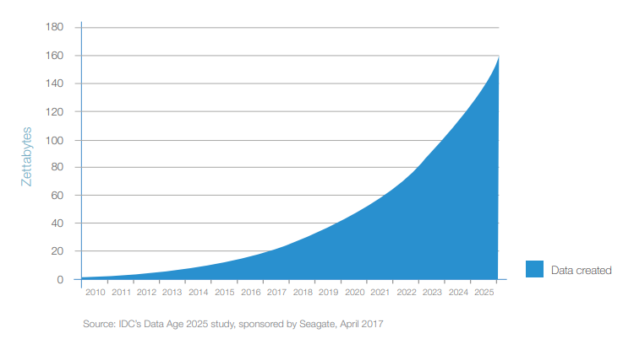
A World Rich with Data
Notes:
“Today’s learners will enter a world rich with data. Data already plays a pivotal role in our homes, our workplaces, an our communities. But, in too many learning experiences and classrooms across the nation, data is not yet playing this crucial role.
This is a tremendous oversight. It is also an incredible opportunity.”
messydata.org

Slide 4
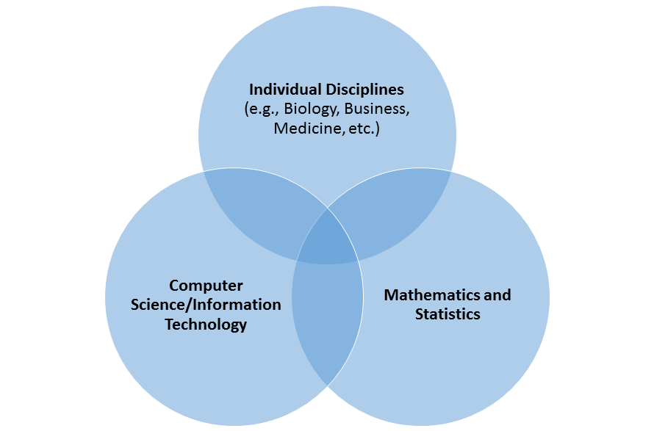
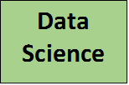
What is Data Science?
Adapted from University of Arizona

Slide 5
VDOE Data Science Standards of Learning
Standards will support local development of a one-semester or year-long course
Big ideas of Data Science
Data Visualization to Communicate Ideas
Prediction Using Data
Ethical Use of Data
Computational Thinking and Problem Solving
Mathematics and Computer Science Endorsed Teachers
Proposed Pilot of Data Science in 2022-2023
Notes:
Data Science Standards of Learning are scheduled to be presented to the Board of Education in November 2021 for first review. The standards will support two one-half credit mathematics courses.

Slide 6
Proposed Timeline
Date | Action
January 2022 – February 2022 | VDOE distributes the proposed Data Science Standards of Learning and Data Science Curriculum Framework for public comment.
March 2022 – April 2022 | VDOE completes edits and revisions to the proposed Data Science Standards of Learning and Data Science Standards of Learning Curriculum Framework based on feedback.
April 2022 | BOE Final Review of Data Science Standards of Learning and Data Science Standards of Learning Curriculum Framework
May 2022 – July 2022 | VDOE plans and provides professional development to a cohort of teachers based on division participation in a pilot implementation.
2022 – 2023 School Year | School divisions selected for pilot implementation offer Data Science courses based on the Data Science Standards of Learning and Data Science Standards of Learning Curriculum Framework.
2023 – 2024 School Year | Full implementation of the Data Science Standards of Learning (SOL) and Data Science Standards of Learning Curriculum Framework (CF).

Slide 7
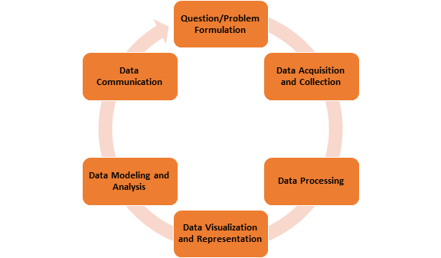
Data Cycle

Slide 8
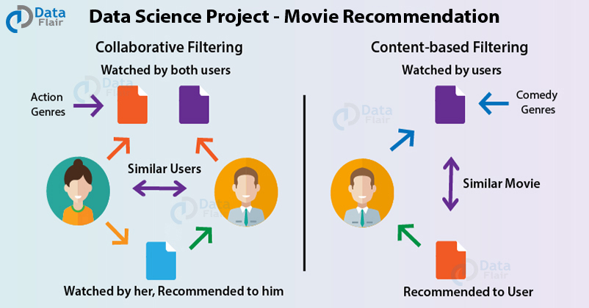
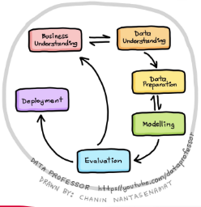
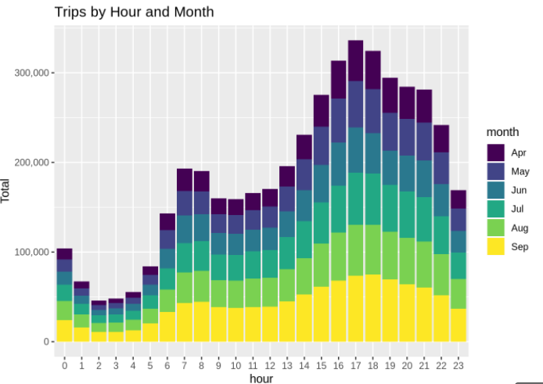
Data Science - Projects
Analyzing Rideshare Data
Data Flair: Data Science Project Ideas
Notes:
https://data-flair.training/blogs/data-science-project-ideas/

Slide 9
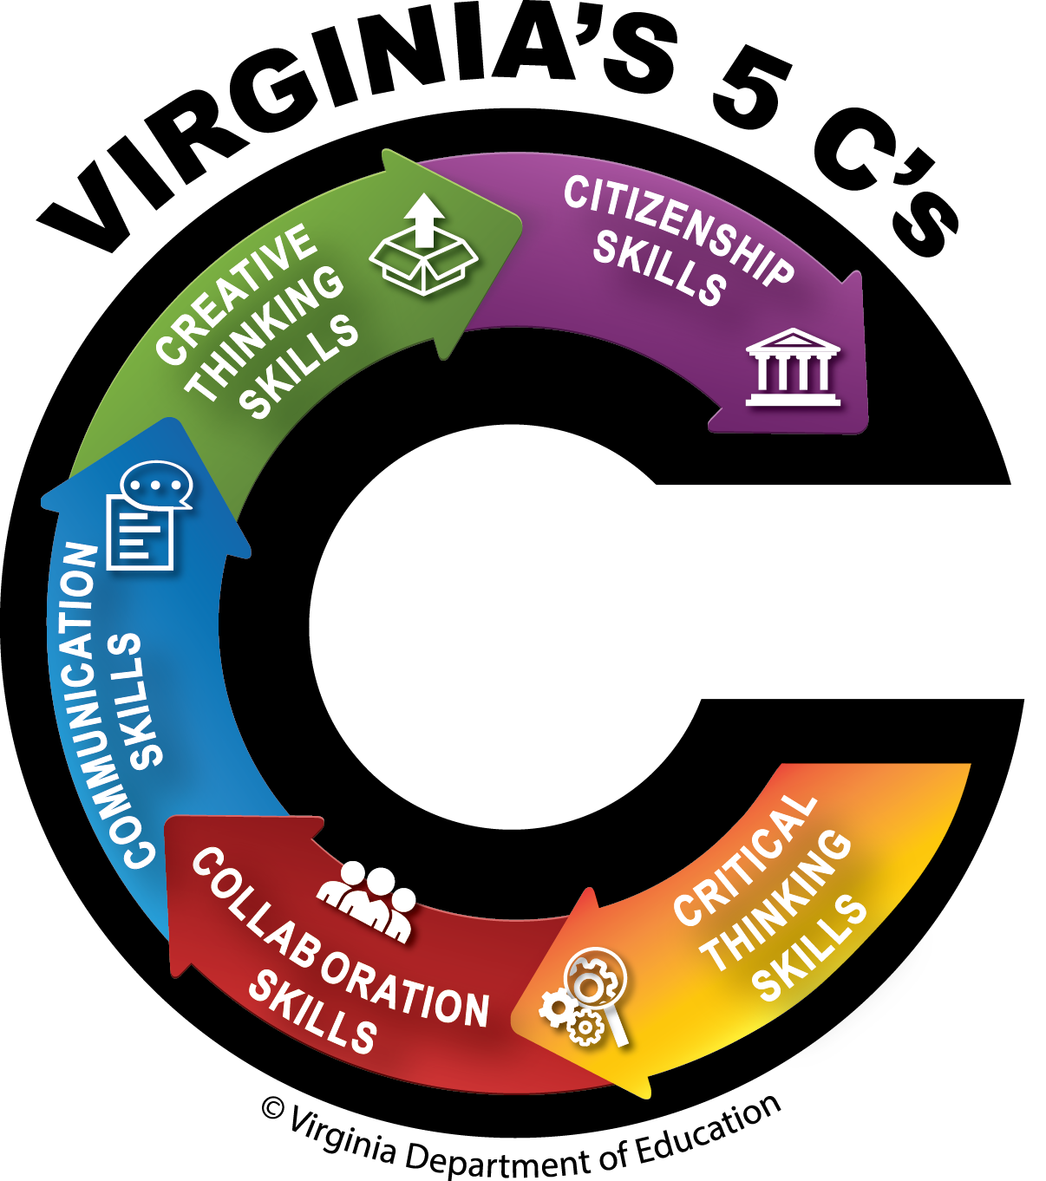
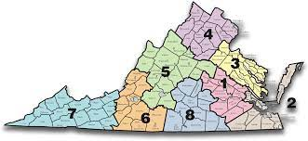
Alignment of the Profile of a Virginia Graduate
and Data Science
Citizenship and Collaboration Authentic Community Contexts- Business, industry and government offer authentic challenges, roles and audiences
Critical and Creative Thinking Data Sources- Local Context & Choice Formulate investigative questions. Use models to predict based on patterns and trends to inform local challenges.
College and Careers- Aligns to Virginia workplace needs for a Data Science skill set
Collaboration and Communication Teachers and learners team up across classrooms/state to teach and learn through unique multi-disciplinary projects. Communication of conclusions to partners for decision-making.
Notes:
Should this be Virginia loves data or Virginia is for Data Lovers :)

Slide 10
Tenets of Data Science
Learners will:
Learn through exploration of data;
Formulate questions through data investigations (tasks/project-based);
Choose data sets from local context and learner-interest;
Follow a data cycle process;
Expose students to many types of data;
Model student’s personal experiences with data structures other than only flat data (row by column);
Choose tools to use for data visualization and analysis;
Communicate through posing questions, collaborating with peers, and tailoring data presentations to specific audiences; and
Build data literacy skills to bring to postsecondary opportunities (college/career).
Notes:
Deb

Slide 11
Modernizing Mathematics Education
What mathematical knowledge and skills are needed for an evolving future?
How can data literacy be embedded across the K-12 mathematics curriculum?
How can we shift mathematical learning experiences to provide students the touchpoints needed to access a 21st century world?
Photo provided by the Science Museum of Virginia (SMV)
Notes:
Tina-Math education should be embraced as one of the major elements needed to best prepare youth for the challenges of not just today, but for tomorrow. Preparing students for an ever evolving future requires that we examine what mathematics knowledge and skills are most important to address a changing, global and more and more digital world. We must provide for deeper learning experiences with more explicit mathematics connections to real world problems. We need to ensure that we more successfully engage youth in the touchpoints that will empower them to be more successful in their future, which requires some rethinking of our methods and models in mathematics education, both in what students learn and how they learn it.

Slide 12
QUESTIONS?

Slide 13
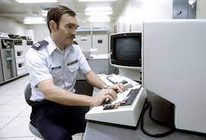
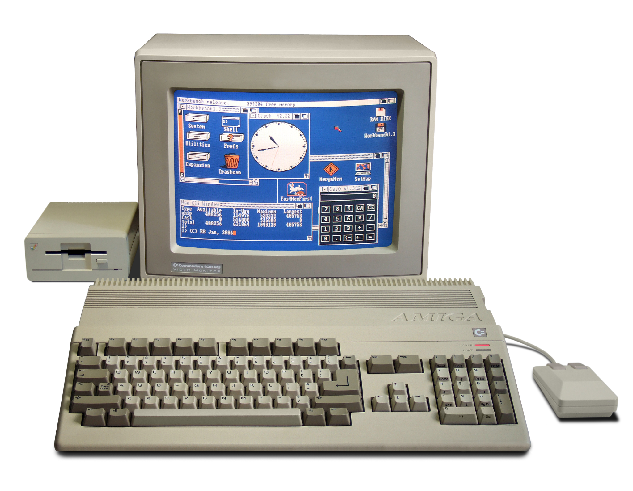
Evolution of Data Storage and Technology
Before 1980
Data stored in warehouses
Accessed by terminals with little to no computing power
Government and business focused
1980 - 2000
Data managed in hubs
Accessed by personal computers
Public use of the Internet
Broader government and business use of data
Expanded use of data for personal use and entertainment
2001 - Present
Data stored in cloud infrastructures
Wireless broadband
Accessed by advanced personal computing devices
Large expansion of data use across business, health care, and other industries
Social media evolution
U.S. National Archives
Wikimedia Commons
Pixabay

