Slide 1



MAKE LITERACY A FAMILY AFFAIR!
Virginia English teachers give pointers on how to create avid readers

Slide 2

VATE - Who we are
Statewide non-profit organization
  English/language arts teachers
    K-12 through college
The Virginia Association of Teachers of English Language Arts (VATE), a state affiliate of the National Council of Teachers of English (NCTE), is dedicated to excellence in the teaching of English and language arts. Membership is open to all Virginia English teachers and anyone in the state dedicated to the advancement of the English and language arts curricula.

Slide 3

Everyone participates!
Set a special time and place free from distractions like TVs and phones
Adults read on their own and with kids
Kids read aloud and independently
Families talk about their reading
Families can write or draw pictures about their reading
Families track their reading

Slide 4
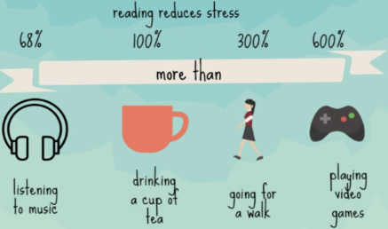
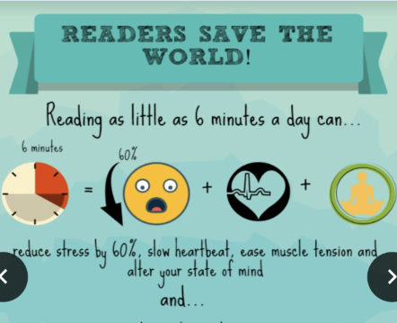
Why should kids read?

Slide 5
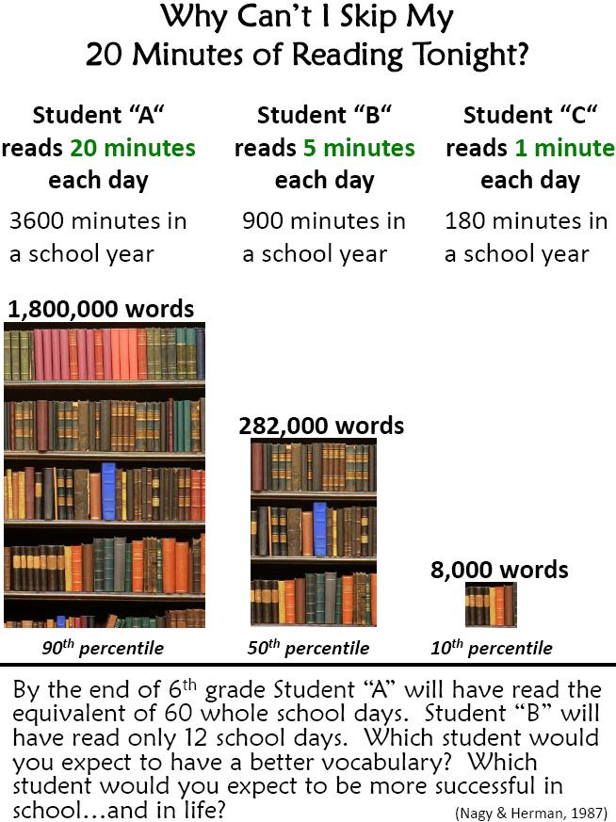
The statistics speak for themselves
1,792,000 reasons why your child needs to read every day

Slide 6

How do I find books for my family?
We Need Diverse Books
  A terrific place to find books on all different types of human experience

Slide 7
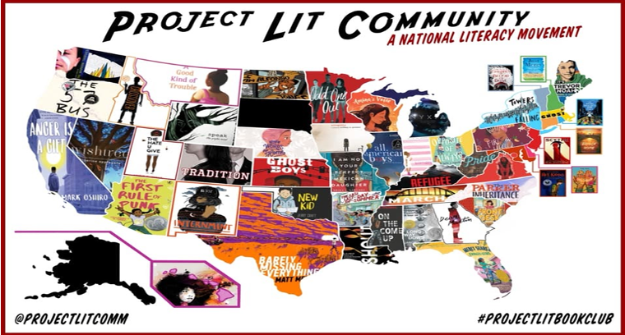
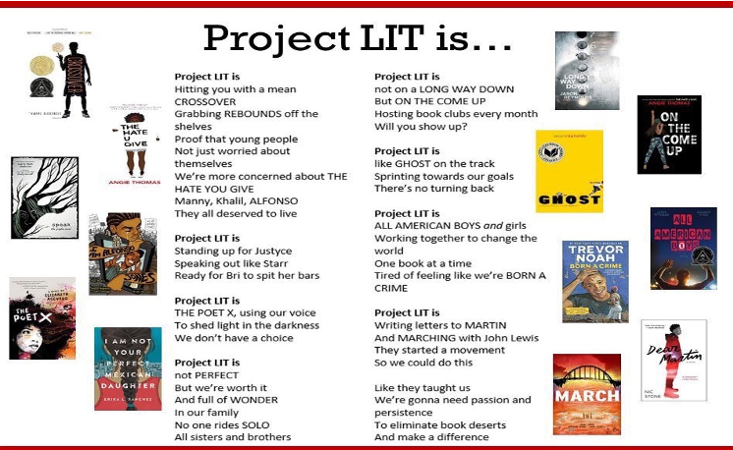
Project Lit
National - look for a chapter or start your own!

Slide 8
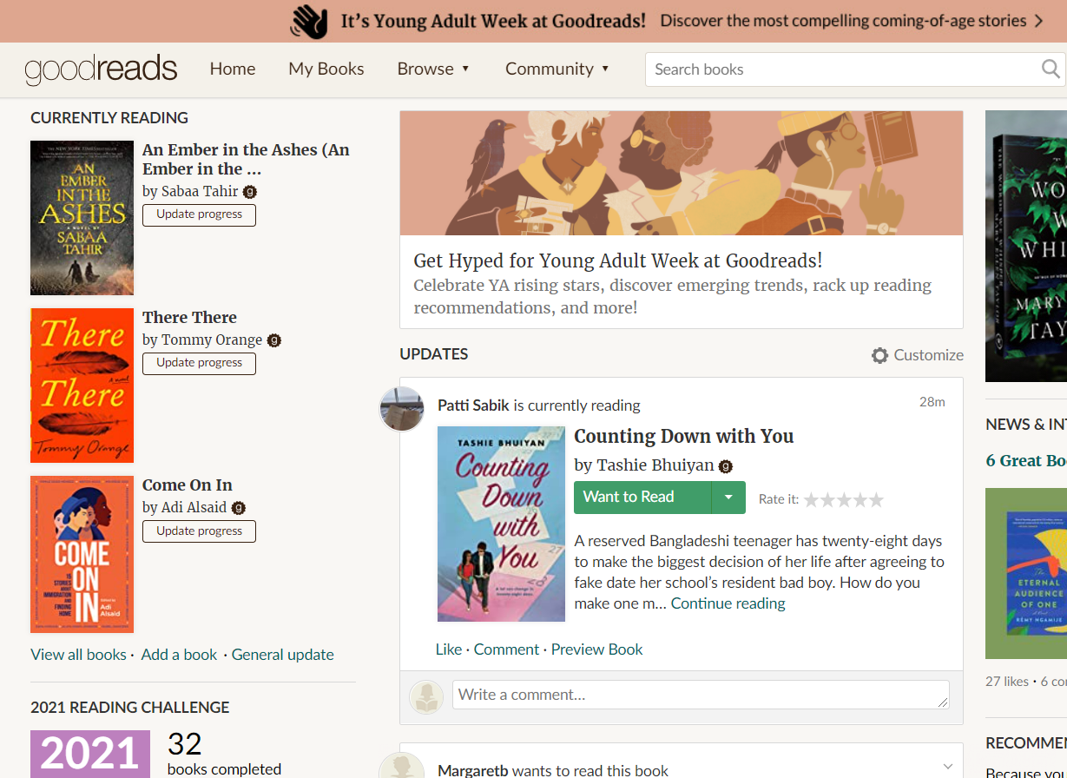
GoodReads
  Keep track of your family’s reading
  Add books you want to read and indicate when you start and finish a book
  Set goals for yourself!

Slide 9

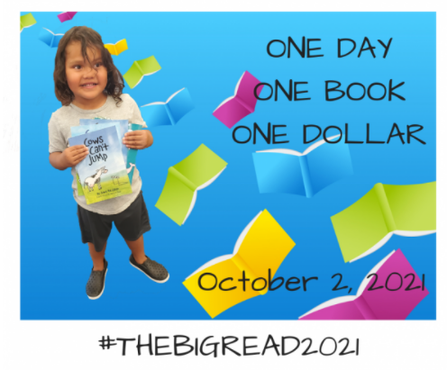
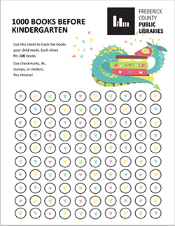
1000 Books Before Kindergarten
Develop your preschooler’s reading habits now by reading books daily.
Track your progress with the app, reading log sheets or social media.
Book list
Programs in Virginia

Slide 10
Don’t judge!
Parents can be quick to remember their own experience or what they like and assume their kids should do the same.
If you want your kids to love reading,
LET THEM PICK THEIR OWN BOOKS!
Graphic novels, comic books
Books about gross stuff
Nonfiction
Books about different peoples and cultures
Audiobooks

Slide 11
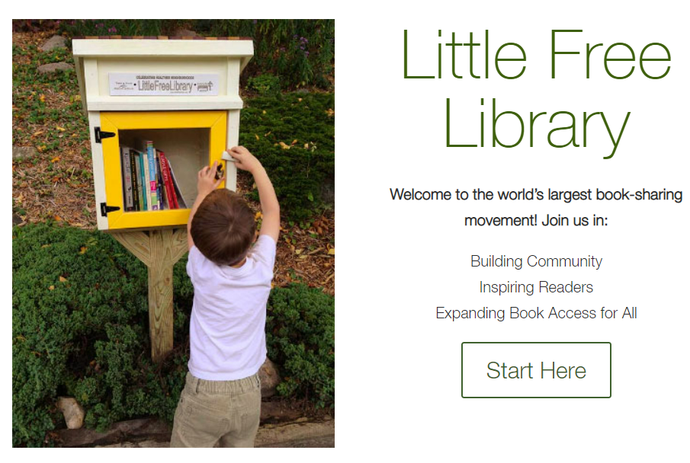

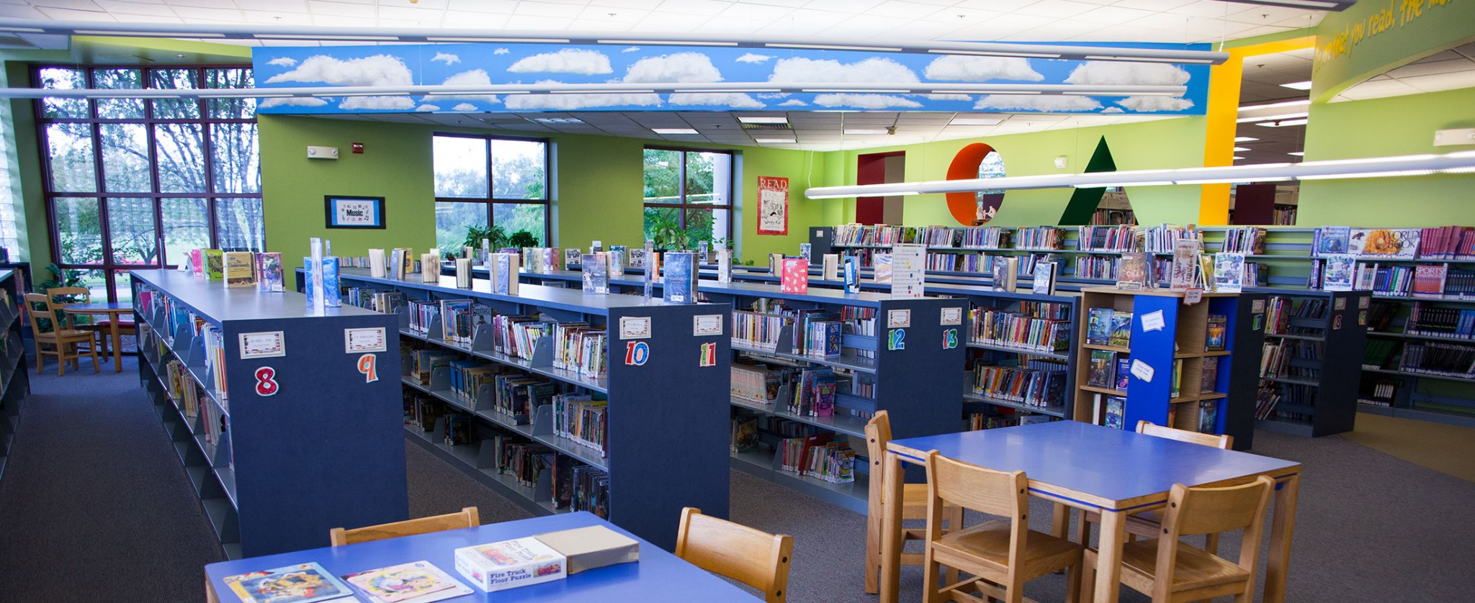
Books are all around us!
Chances are, there is a little free library in your community!
There are lots of cheap ways to buy books, including the Green Valley Book Fair, used book sales, thrift shops, classroom Scholastic orders and more.
Public libraries have EVERYTHING!!! You can check out physical books, ebooks, audiobooks, magazines, and graphic novels for ALL AGES!

Slide 12
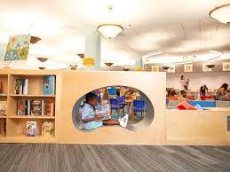
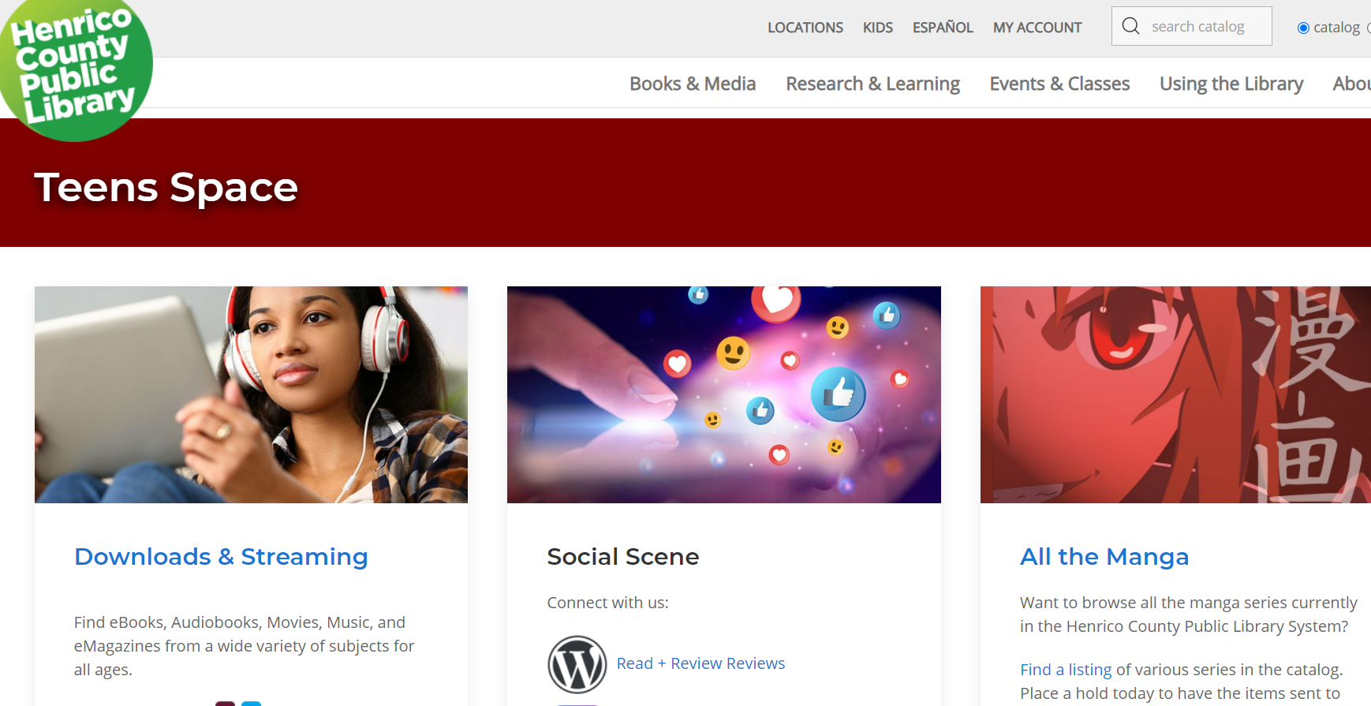
Libraries across the state
Library of Virginia - At-Home Learning
Virginia Public Library Children's Page
Best Libraries in Richmond for Families
Virginia Beach Public Library Kids Page
Check out your area!

Slide 13

Book Festivals
  NOVA
  Charlottesville
  Williamsburg
  George Mason University
  Longwood
  Gaithersburg
  West Virginia
  Click here for the list
National Book Festival Sept. 17-26
Online and in person

Slide 14

Reading is the inhale,
writing is the exhale
  Reading gives kids words, ideas and connections to others
  Writing allows them to express their own ideas in order to connect and communicate

Slide 15
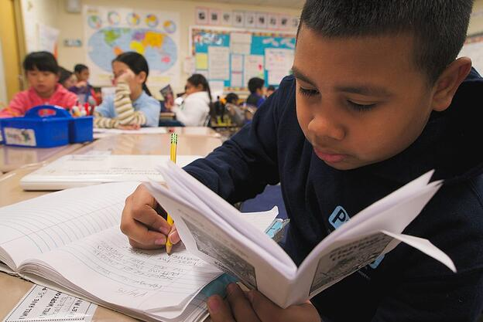
Writing about reading
  Have you ever written a book review or commented on something you’ve read online?
  When we write about what we read, we think more deeply about it → critical thinking!
  Journal
  1-sentence or 6-word summaries
  Review the book
  What did you learn?
There are lots of ideas online!

Slide 16

VATE’s Literacy Explosion
Literacy Explosion
Literacy Explosion is a virtual language arts festival designed to celebrate and promote the integration of literacy and 21st century learning skills. The Literacy Explosion encourages and rewards Virginia students’ excellence in reading, writing, speaking, presenting, filming, drawing, and acting. Categories showcase students’ expression and expertise in their use of language, communication, and digital media: book covers, book trailers, digital posters, photo essays, podcasts, and videos . All Virginia students in grades K-12 are invited to participate in this opportunity to share their language arts talents and abilities.
For more information visit https://vate.org/events/literacy-explosion/

Slide 17
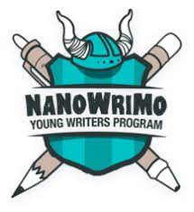
Writing contests
  Contests, more contests and even more contests for kids
  Check your local library
  Contests for adult writers and more
  NaNoWriMo aka National Novel Writing Month for adults and young writers

Slide 18
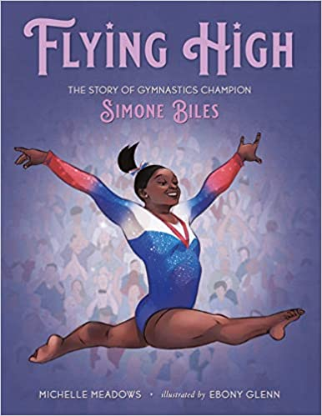
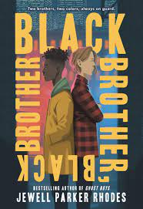

Book talks
  Flying High - elementary
  Black Brother, Black Brother - middle
  I’ll Give You the Sun - high school
Notes:
from Ashley -- My daughter LOVED this book. I love the ease of the reading, the beautiful illustrations, and the rhyme that added rhythm to the text as a read aloud. Also - this book touches on foster care and adoption in a way that children can understand.

Slide 19
Ask a teacher!
Questions about literacy at home and school?

Slide 20
Disclaimer
Reference within this presentation to any specific commercial or non-commercial product, process, or service by trade name, trademark, manufacturer or otherwise does not constitute or imply an endorsement, recommendation, or favoring by the Virginia Department of Education.

