Slide 1

Family Literacy Night
August 31, 2021

Slide 2
Welcome!

Slide 3

Who We Are
Jill Nogueras
K-12 English Coordinator
Colleen Cassada
Middle School English Specialist
Carmen Kurek
Elementary English & Reading Specialist

Slide 4
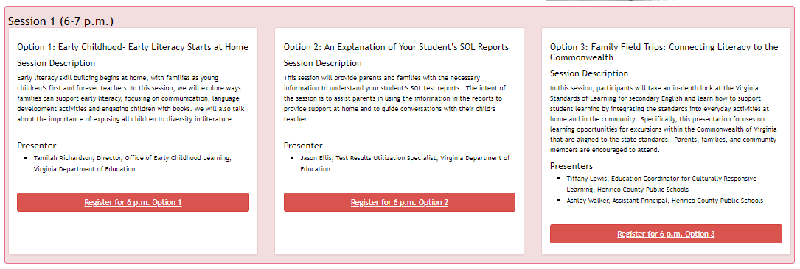
Session One Presentations

Slide 5

Session Two Presentations

Slide 6
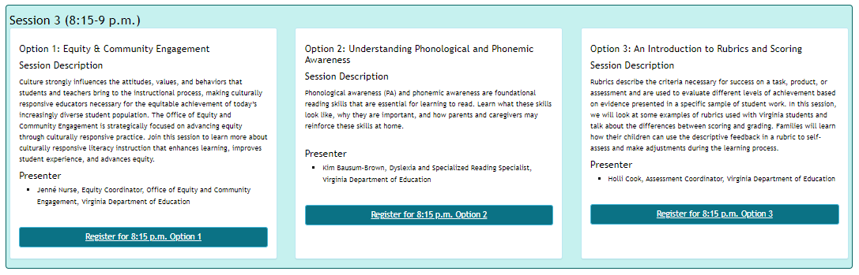
Session Three Presentations

Slide 7



How We Can Support You
Highlight what happens in the classroom
Provide support for connecting learning at home
Share resources and guidance

Slide 8
Literacy in the Classroom

Slide 9
Reading Promotes Deeper Learning and Critical Thinking
Reading Promotes
Deeper Learning
&
Critical Thinking

Slide 10
What Students Need Every Day
Students need opportunities to
read daily
read texts of their choice
read extended pieces of text and grade level material
read grade level text daily, including nonfiction and fiction pieces

Slide 11
How Teachers Support Students
Teachers support students:
  by providing opportunities to read and compare fiction and nonfiction texts
  by modeling how to analyze ideas in two texts and search for evidence to support their conclusions
  by allowing discussion and reflection about ideas based on what students are reading
  by reading to students and/or allowing students to read independently

Slide 12
How Teachers Support Students
Teachers support students:
by providing students with opportunities to study words found in passages from reading materials
by using texts that reflect real-world experiences and situations
by encouraging writing that is intended for an audience & connects to topics and texts of study.
by promoting inquiry through research relates to student interest on topics of study

Slide 13
Connecting Learning
at Home

Slide 14
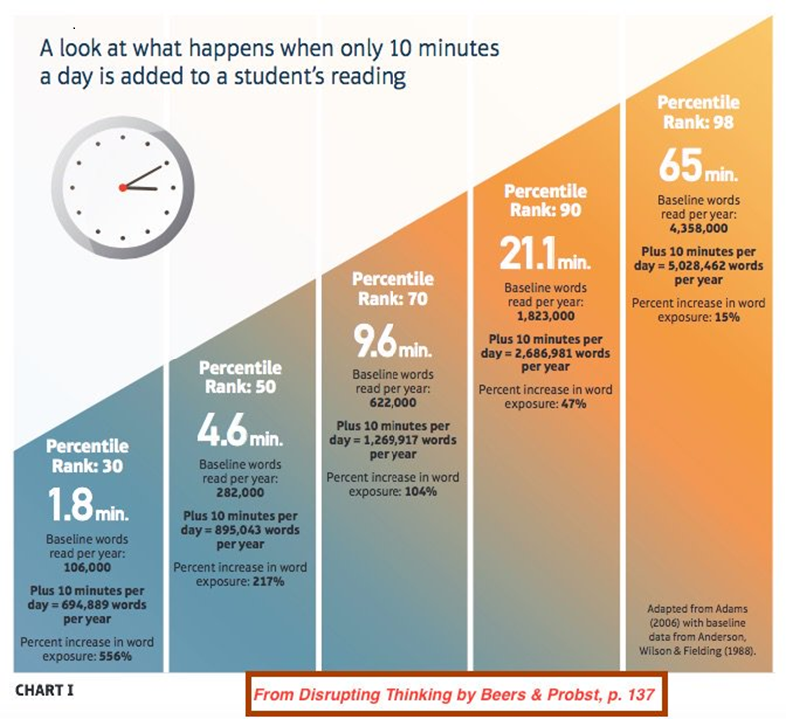
Did You Know?

Slide 15

Did You Know?
“A home filled with reading material is a good way to help kids become excited readers” KidsHealth
Research shows that when a caregiver reads to a child,
Vocabulary expands
Language increases
Cognition develops more rapidly
Creativity & Imagination grow
Ashley Marcin, Reviewed by Dr. Karen Gill, M.D., Healthline

Slide 16
What Can You Do To Support Young Readers?
6 Ways to Fit in Read-Aloud on Busy Days:
Look for time in your family routine
Take 5 minutes before you start the day
Share interesting magazine or news articles
Take advantage of waiting times
Invite older children to read
Read as you ride
Christie Burnett, Scholastic

Slide 17
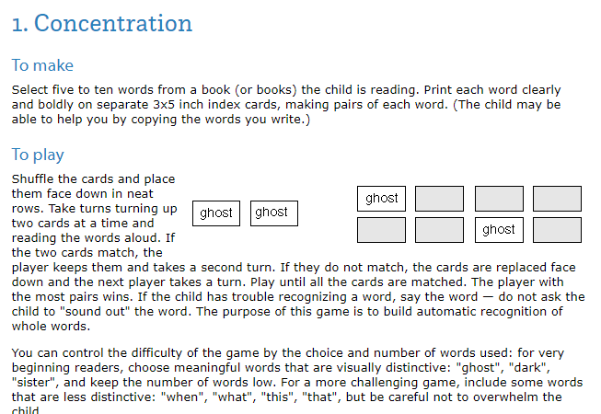
What Can You Do To Support Young Readers?
6 Games for Reading-ReadingRockets.org
Research shows that “playing games is a great way to provide additional practice with early reading skills” ReadingRockets.org

Slide 18
Did You Know?
By the end of 6th grade, in Virginia your student will be expected to:
Describe cause-and-effect relationships and their impact on plot
Explain how an author uses character development to drive conflict and resolution
Draw conclusions and make inferences using the text for support
Compare/contrast details in literary and informational nonfiction texts
(just to name a few)
2017 Virginia Department of Education English Standards of Learning

Slide 19
What You Can Do To Support Middle Grade Readers?
Research suggests that life skills develop in the home.
“In school, your teen will be challenged to read literature, social studies, and science texts. However, students learn about “real-life” text forms mostly at home. Show and discuss cell phone and credit card bills, tax and insurance forms, medicine labels and online user agreements, GPS instructions and car registrations” Zoe Kashner, Scholastic
Play word association games
Read music lyrics together
Review manuals
Discuss labels
Spark a debate and talk about both sides of the issue
https://www.scholastic.com/parents/books-and-reading/books-and-reading-guides/raise-reader-parent-guide-to-reading-ages-11-13.html

Slide 20
Did You Know?
Why are kids struggling to read more today than 50 years ago? It’s a fraught question, and the culprits are probably many...from poverty in some cases, to hours spent scrolling through social media, to kids having less unstructured time to read for pleasure. “The overarching issue is probably that students just read less,” says Spichtig. “With reading less comes less practice. Then with less practice, reading doesn't feel as comfortable. When something doesn't feel comfortable, you don't like to do it.”
Kelly Anderson, ReadingPlus Sponsored by EdSurge.org

Slide 21
Did You Know?
By the end of 12th grade, in Virginia your student will be expected to:
Analyze how authors use key literary elements to contribute to meaning and interpret how themes are connected across texts.
Compare/contrast details in literary and informational nonfiction texts.
Use critical thinking to generate and respond logically to literal, inferential, and evaluative questions about the text(s).
Identify and synthesize resources to make decisions, complete tasks, and solve specific problems.
Analyze multiple texts addressing the same topic to determine how authors reach similar or different conclusions.
Analyze false premises claims, counterclaims, and other evidence in persuasive writing.
(just to name a few)
2017 Virginia Department of Education English Standards of Learning

Slide 22

What Can You Do To Support Teen Readers?
“Rather than demonizing devices or fretting about our current technological landscape, let’s focus instead on the foundational skills of reading, like reading efficiency (the physical act of reading), motivation and self-confidence, and comprehension—which are more important than ever”
Liana Gamber-Thompson, EdSurge

Slide 23
What Can You Do To Support Teen Readers?
7 Ways to Get Teens Reading in a Smartphone Culture (EdSurge.com)
“Keep Panic At Bay”- “teens’ disinterest in longform reading is reasonable cause for concern, it isn’t cause for full blown panic”
“Be a Good Role Model”- “Limit your own screen time, and make room for reading in your daily routine, whether it’s on a phone or on paper”
“Be a Digital Ally”- “You don’t have to stop at behavior modeling. Most parents and mentors know that reading to younger kids regularly has a positive effect on literacy and more, but spending screen time together can also be beneficial”
“Avoid Coercion”-”While it might be tempting to enforce designated reading time for less than eager teens, don’t employ coercion in the process. Don’t force teens to read what you want them to or take away devices until reading occurs”

Slide 24
What Can You Do To Support Teen Readers?
7 Ways to Get Teens Reading in a Smartphone Culture (EdSurge.com)
“Make Good Content Accessible”- “Leave interesting books around the house. Collect old favorites for your students on a school bookshelf”
“Expand Your Reading Repertoire”- “leveraging your teen’s interests to support her or his reading success, even if that means learning about and curating content outside your own comfort zone”
“Celebrate the Positive”- “while teens are reading less, they’re also watching less television these days—an activity that’s long been a source of anxiety for parents”

Slide 25
Did You Know?
“When we speak of literacy and literacy promotion, we need to acknowledge how much literacy encompasses. Yes, it’s a key to success in school, with all that implies about life trajectory, earning power and socioeconomic status. It’s also a key to citizenship and enfranchisement in society, to your ability to understand and take part in all the discourse that shapes your community and your country and your world. It’s the product of a whole range of brain circuits from vocabulary and vision and visual processing to memory and meaning”
Perri Klass, M.D., The New York Times

Slide 26

What We Can Do To Support All Readers
At School
Provide check-ins with families
Read a variety of text
Introduce authors and texts for students to use as models
Promote thoughtful discussions on relevant themes
At Home
Ask questions about skills being learned
Stay connected with the school community
Read together a variety of texts
Model reading and thinking
Find opportunities to discuss various topics

Slide 27
Available Resources

Slide 28

Family Literacy Night Recordings and Resources
Family Literacy Resource Webpage

Slide 29
Additional Resources to Support Literacy at Home
Fine Arts
PALS
Early Literacy
Health and Physical Education
School Counseling
Mathematics

Slide 30
Resources for ELs and Families
Bilingual Glossaries for Subject Areas
English Learner Family Toolkit
Family Connections through Home Languages
Language Learning Everyday: Activities for Families
Language Routines for Multilingual Families
Parent and Family Digital Learning Guide
Reading tips for Parents
Supporting School at Home for English Learners: Presentation and Recording from the VDOE in multiple languages
English Learner Education Programs in Virginia: Presentation and Recording from the VDOE in multiple languages

Slide 31
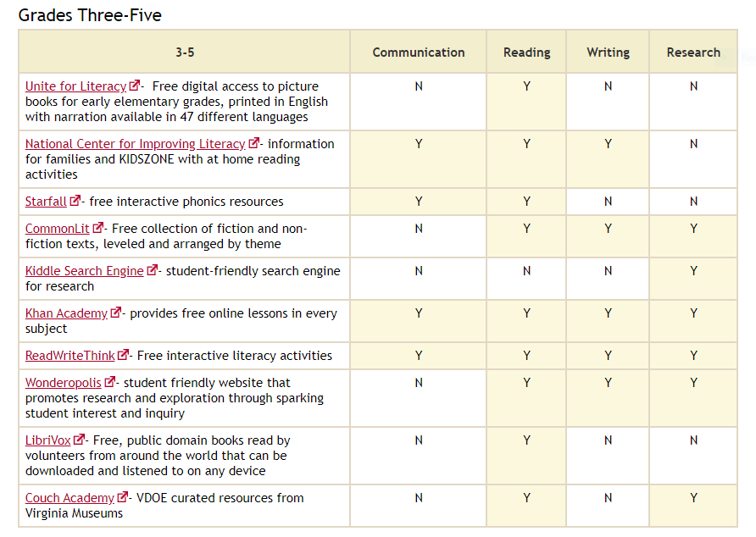
Learning in Place Free Texts and Resources-Elementary

Slide 32
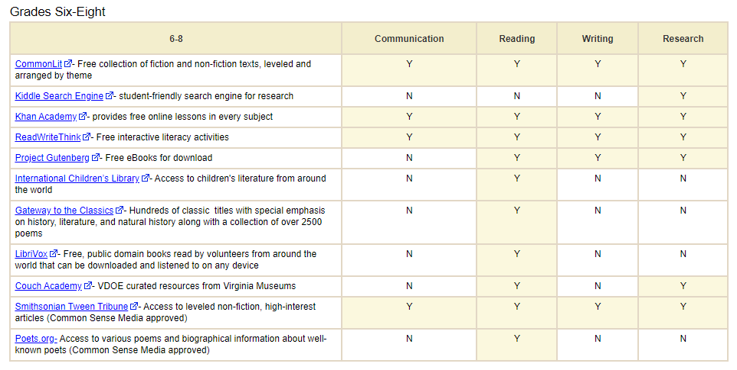
Learning in Place Free Texts and Resources
Middle School

Slide 33
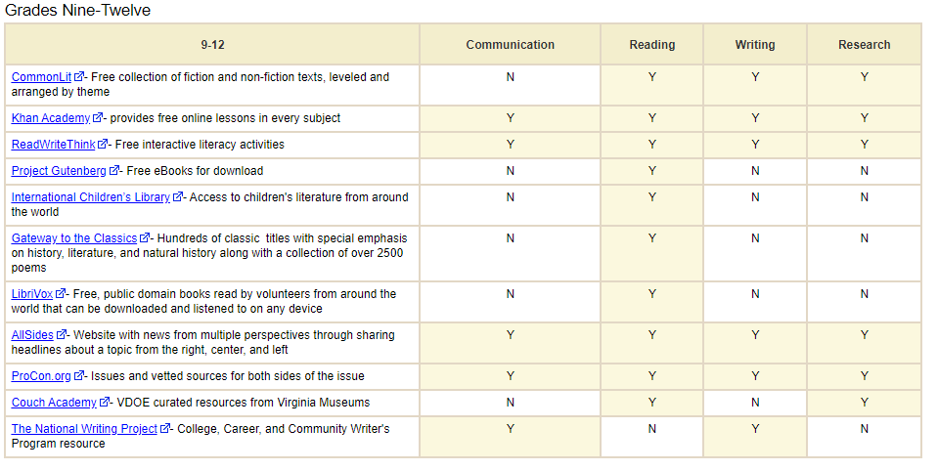
Learning in Place Free Texts and Resources
High School

Slide 34
Thank You!

Slide 35
References
https://www.npr.org/2019/06/20/734494867/the-brighter-side-of-screen-time
https://www.nytimes.com/2017/10/16/well/family/literacy-builds-life-skills-as-well-as-language-skills.html
https://www.edsurge.com/news/2019-09-30-7-ways-to-get-teens-reading-in-a-smartphone-culture
https://www.scholastic.com/parents/books-and-reading/books-and-reading-guides/raise-reader-parent-guide-to-reading-ages-11-13.html
https://www.scholastic.com/parents/books-and-reading/books-and-reading-guides/reading-aloud-at-home.html
https://kidshealth.org/en/parents/reading-home.html
https://pals.virginia.edu/public/resources-home.html

Slide 36
We Are Here to Support You
Jill Nogueras
K-12 English Coordinator
Jill.Nogueras@doe.virginia.gov
Carmen Kurek
Elementary English/Reading Specialist
Carmen.Kurek@doe.virginia.gov
Colleen Cassada
Middle School English Specialist
Colleen.Cassada@doe.Virginia.gov

