Slide 1
Standards-Based Individualized Education Program
Module Seven: Determining the Least
Restrictive Environment (LRE)
Notes:
SBIEP Module Seven: Determining the Least Restrictive Environment (LRE) - In the regulations, LRE is defined as meaning that to the maximum extent appropriate, children with disabilities, including children in public or private institutions or other care facilities, are educated with children who are not disabled, and that special classes, separate schooling or other removal of children with disabilities from the regular educational environment occurs only when the nature or severity of the disability is such that education in regular classes with the use of supplementary aids and services cannot be achieved satisfactorily.
LRE data includes the calculations of the amount of time a student will spend in regular education settings versus time spent in special education settings each day. Schedule of services to be provided, including when the services are to begin, the frequency, duration and location for the provision of services must be included.

Slide 2
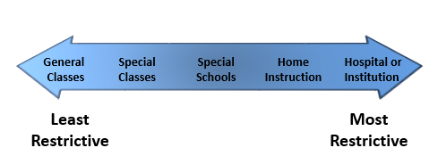
Defining Least Restrictive Environment (LRE):
Continuum of Alternative Placements
Notes:
The regulations also require the IEP team to document in the IEP its review of a continuum of alternative placements, including instruction in regular classes, special classes, special schools, home instruction, and instruction in hospitals and institutions.
No single model for the delivery of services to any specific population or category of children with disabilities is acceptable for meeting this requirement. All placement decisions shall be based on the individual needs of each child. A documented explanation of any time the child will not participate along with nondisabled children is required.

Slide 3
A Documented Explanation of Any Time the Student will not Participate along with Nondisabled Children
Ask:
What is the amount of direct instruction the student needs?
What setting is most likely to help the student achieve his/her goals?
What school facilities are needed to support the student’s learning?
When will the services begin and end?
Notes:
As you document any time the student will not participate with nondisabled children, ask yourself, what is the amount of direct instruction the student needs, what setting is most likely to help the student achieve his/her goals, what school facilities are needed to support the student's learning, and when will the services begin and end?

Slide 4
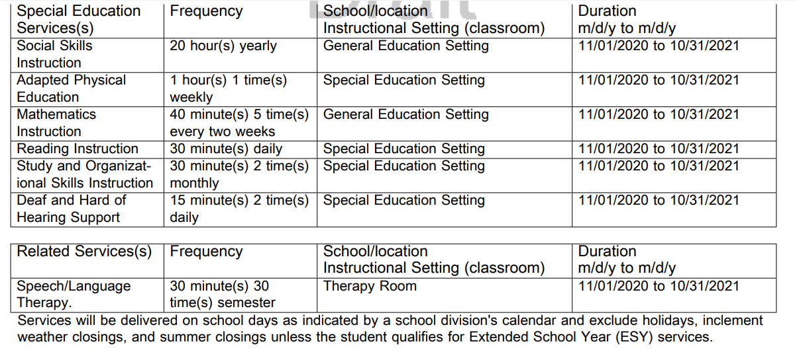
Sample: Service Documentation
Notes:
In this sample Service Documentation - frequency, duration, location, and instructional setting of services that will be provided to, or on behalf of student, are outlined. Based on student’s PLOP and goals, the IEP team has determined that her needs can be met in the general education setting and special education setting. Other special education services, if determined to be necessary, would be listed here including related services, supplementary aids and services, and assistive technology. In this example, Speech/Language Therapy is listed as a related service.
IEP teams are required to identify the specific school site (public or private) when the parent expresses concerns about the location of the services or refuses the proposed site. A listing of more than one anticipated location is permissible, if the parents do not indicate that they will object to any particular school or state that the team identifies.

Slide 5
Quick Check: Determining the Least Restrictive Environment (LRE) (1 of 2)
The IEP Team clearly described the following for each service:
  Frequency and amount (time or conditions)
  Location (general or special education classroom, lunchroom, etc.)
  Duration (generally beginning and ending dates of IEP, unless otherwise specified)
Each statement of service is clear and unambiguous.
Notes:
As you determine LRE Placement, ensure that the IEP team has clearly described the frequency and amount, location, and duration for each service and that each statement of service is clear and unambiguous.

Slide 6
Quick Check: Determining the Least Restrictive Environment (LRE) (2 of 2)
If the student will not participate in the general education environment (age-appropriate and natural settings for preschool children) full time, did the IEP Team describe why full-time participation with nondisabled peers is not appropriate?
The IEP Team considered whether the student will participate with non-disabled peers in extracurricular and nonacademic activities.
Notes:
If the student will not participate in the general education environment full-time, did the IEP team describe why full-time participation with non-disabled peers is not appropriate; and finally, did the IEP team consider whether the student will participate with non-disabled peers in extracurricular and non-academic activities.

Slide 7
Extended School Year Services (ESY)
Regression/recoupment
Degrees of progress
Emerging skills/breakthrough opportunities
Interfering behaviors
The nature and/or severity of the disability
Special circumstances or other factors
Notes:
Extended School Year Services (ESY) are special education and/or related services provided beyond the normal school year, and provide Free Appropriate Public Education (FAPE) to a student with a disability. These services, provided by a local education agency, are distinct from enrichment programs, summer school programs, and compensatory services. They are not simply an extension of time.
To determine if a student should receive ESY services, IEP teams should answer the court articulated question, “will the benefits a disabled student has gained during the regular school year be significantly jeopardized if the student is not provided with the ESY program. Factors of regression, degrees of progress, emerging skills, interfering behaviors, the nature and severity of the disability and special circumstances are considered and if required to receive FAPE, the student must receive ESY services.

Slide 8
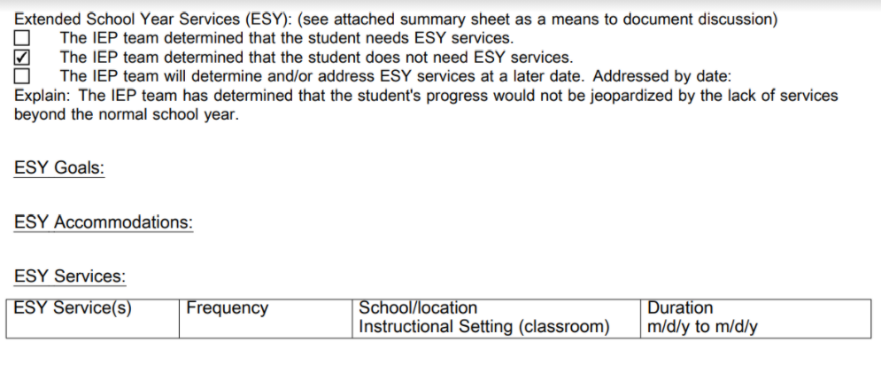
Sample: Extended School Year Services
Notes:
In the ESY sample, the IEP team discussed student’s progress and made a determination that it would not be jeopardized by the lack of services beyond the normal school year. If the IEP team determines that the student qualifies for ESY, then the team would determine goals, accommodations, and amount and frequency of services.

Slide 9
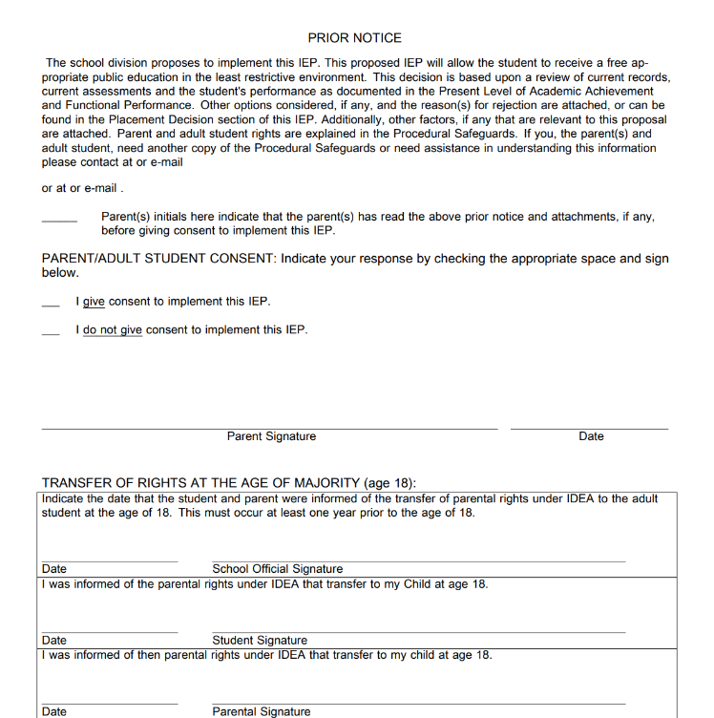
Sample: Prior Notice and Parent Consent Form
Notes:
Written consent is required from the parent before the implementation of special education and related services for the first time; However, it is voluntary on the part of the parent and may be withdrawn at any time. Additional information on the requirements for consent and the IEP process can be found in the Regulations Governing Programs for Students with Disabilities in Virginia on the VDOE website.

Slide 10
Standards-Based Individualized Education Program
Module Seven: Determining the Least Restrictive Environment (LRE)
The resources used during the development of this training module are in the guidance document found on the VDOE Standards-Based IEP webpage.
Notes:
This concludes the seventh of nine training modules on developing Standards-based IEPs. Additional information can be found on the Virginia Department of Education’s website by accessing the link on the screen.

