Slide 1
Standards-Based Individualized Education Program
Module Nine: Developing the Secondary Transition Focused IEP
Notes:
SBIEP Module Nine: Developing the Secondary Transition Focused IEP
This module includes guidance on developing a secondary transition focused IEP.

Slide 2
Writing a Present Level of Academic Achievement and Functional Performance (PLAAFP) for a Transition Focused IEP
The Present Level of Academic Achievement and Functional Performance (PLAAFP) is often referred to as the Present Level of Performance (PLOP).
The PLOP should relate directly to other components of the IEP. (8 VAC 20-80-62)
Notes:
As the IEP team is developing the Present Level of Academic Achievement and Functional Performance (PLAAFP), often referred to as Present Level of Performance (PLOP), for a Secondary Transition Focused IEP, it is important to keep in mind that the PLOP should relate directly to other components of the IEP.

Slide 3
Age-Appropriate Transition Assessment
Document the use of age-appropriate transition assessments to summarize the strengths, preferences, interests, and needs of the student in the present level of performance.
Notes:
Age appropriate transition assessments should be used to summarize the strengths, preferences, interests, and needs of the student in the present level of performance .
Be sure to document the results of age-appropriate transition assessments that were used, as well.
It is also important that the IEP team solicits the student’s input in terms of career goals, postsecondary education, and training.

Slide 4
Sources of Informal and Formal Data
Interests and Preferences
Achievement
Learning Strategies
Adaptive Behavior
Situational Assessment
Behavior/Social Skills
Work Readiness
Work Samples
Adaptive Behavior
Aptitude
Notes:
These are examples of transition assessments that can be both formal and informal. Some assessments might be provided by a vocational evaluator through Department for Aging and Rehabilitative Services (DARS) or a private vendor who is specially trained to do certain assessments and triangulate the results. However, most students will receive assessments through the eligibility/triennial process, the Academic and Career Plan (ACP) developed by the school counselor, and the special education case manager or teacher. A student in a Career and Technical Education (CTE) course might also receive an assessment that is useful as the IEP team determines goals, both annual and postsecondary, as well as transition services for the student.

Slide 5
Transition Assessment Information in the PLOP
(1 of 2)
Career Occupational Survey in Fall 2018 to determine career interests in Consumer Economics and Skilled Services
Career interest inventory on the VA Wizard in Fall 2019 to determine top career pathways:
  Hospitality/Tourism and Lodging
  Human Services
  Art/Audio Visual/Video Technology
Notes:
The next several slides include examples of information found in a PLOP that relates to the development of postsecondary goals, as well as academic and functional goals. Note that the writer has included the assessment and the date it was provided.
“Timothy completed the Career Occupational Survey in Fall, 2018 to determine career interests. His top two areas were in Consumer Economics and Skilled Services. Timothy completed the career interest inventory on the VA Wizard (Fall, 2019) and his top career pathways are Hospitality/Tourism and Lodging, Human Services and Art/Audio Visual/Video Technology.”

Slide 6
Transition Assessment Information in the PLOP
(2 of 2)
In Fall 2020, Timothy observed in the kitchen at a Marriott Resort.
He was attentive and verbally interactive.
He noted the variety of vocabulary used in a kitchen and the color coded calendar to keep staff on track.
He indicated to the school counselor that he wanted to become a chef.
Notes:
“In the Fall, 2020, Timothy observed in the kitchen at a Marriott Resort. He was attentive and verbally interacted with the prep and chef staff. Timothy noted the variety of vocabulary used for foods, knives, bowls, etc. in a kitchen. He also noted the use of a color coded calendar to keep staff on track.
Timothy indicated to the school counselor that he wanted to become a chef.”
It is important for the IEP team to plan with the end in mind when addressing secondary transition. This is often referred to as “backward planning”. Think about packing your bag to go on a vacation. Knowing the destination will help you pack the right gear.
Once the postsecondary goals are developed, the IEP team should begin to think about what can be done in the current year to support the student moving closer to his/her postsecondary goals. What annual goals will be developed for the student? These annual goals might be both academic and functional. Who will provide the services? What activities might the student be involved in during this school year to support postsecondary goals?

Slide 7
Postsecondary Goals (1 of 3)
Postsecondary Employment Goal:
Within six months after completing a postsecondary culinary program (December 2026),Timothy will be competitively employed in an integrated setting as an entry-level cook.
Postsecondary Education Goal:
After graduating from high school, Timothy will complete a culinary program at the community college in his community.
Notes:
Based on information in the PLOP, postsecondary goals can be developed. The Individual with Disabilities Education Act (IDEA) requires that postsecondary employment, education, and training goals are included in the IEP. Consider what annual goals support movement closer to this postsecondary goal. It is not required by IDEA to use dates, as you see in this slide. For some youth and their family, having a timeline mapped out can be helpful.

Slide 8
Postsecondary Goals (2 of 3)
Postsecondary Training Goal:
During Timothy’s postsecondary culinary program, he will complete at least one internship in a restaurant setting in order to earn his degree and prepare for his certification exam.
Notes:
This also lets Timothy and his family understand that there is a training component to his career choice and that he will need to prepare to also earn a certification in order to meet his ultimate employment goal.
Again the IEP team will begin planning annual goals based on his career choice and his academic and functional “needs” documented in the PLOP.

Slide 9
Postsecondary Goals (3 of 3)
The IEP Team will determine the student’s need for a post-school Independent Living goal. This is based on transition assessment information and the needs of the student.
Notes:
The IEP Team will determine the students need for a postsecondary Independent Living goal. This is based on transition assessment information and the needs of the student. Timothy’s IEP team determined that he did not need an independent living goal.
An Independent Living postsecondary goal is not required for every student.

Slide 10
Academic and Functional Achievement:
Annual Goals (1 of 2)
Academic Skills could include:
  Reading
  Written Language
  Mathematics
Notes:
Annual goals will be accomplished within the school year and will support the student’s postsecondary goals. The postsecondary goals are accomplished after the student has left high school, whether that is through graduation, or exceeding the age of eligibility. Progress must be reported on annual goals.
Annual Goals could include academic skills or functional skills.
Academic Skills Include such areas as: reading, written language, and mathematics.

Slide 11
Academic and Functional Achievement:
Annual Goals (2 of 2)
Functional Skills could include:
  Socialization
  Communication
  Behavior
  Personal Management
  Self-Determination
Notes:
Functional Skills Include…
Socialization
Communication
Behavior
Personal Management
Self-Determination
Further information about writing standards-based academic and functional IEP goals can be found in module 3.

Slide 12
From the PLOP to the Annual Goals
  Timothy plans to attend the local community college to become a chef.
  He met with his school counselor in grades 8 and 9 to review his Academic Career Plan (ACP).
  He researched the community college’s culinary program.
Notes:
Here is an example excerpt from Timothy’s PLOP.
“…following high school Timothy plans to attend the local community college to become a chef. He met with his school counselor in grades 8 and 9 to review his ACP, researched options for culinary training and the requirements for acceptance into the community college with a culinary program.”

Slide 13
From the PLOP to the Annual Goals:
Academic Example (1 of 2)
  Timothy struggles with math and failed Algebra I in 9th grade.
  He plans to retake Algebra I in Summer School 2021.
  According to the Occupational NET 2021, the following math skills are needed for a career in culinary arts: knowledge of arithmetic, algebra, geometry, calculus, statistics, and their applications.
Notes:
“Timothy struggles with math and failed Algebra I in 9th grade. He plans to retake Algebra in Summer School 2021. According to the Occupational NET 2021, the following math skills are needed for a career in culinary arts; knowledge of arithmetic, algebra, geometry, calculus, statistics, and their applications (from O NET, 2020)”
These statements from Timothy’s PLOP identifies that math is an academic area of need.

Slide 14
From the PLOP to the Annual Goals:
Academic Example (2 of 2)
Annual Goal: Using manipulatives and algebra tiles, Timothy will solve multi-step equations modeling real-life situations with 80% accuracy by the end of the school year.
Notes:
This may be an appropriate annual goal for Timothy.
Using manipulatives and algebra tiles, Timothy will solve multi-step equations modeling real life situations with 80% accuracy by the end of the school year.

Slide 15
From the PLOP to the Annual Goals:
Functional Example (1 of 2)
According to his parent (May 2020), Timothy requires constant reminders to complete tasks.
In a survey of culinary professionals, 66% note time management of self and others as a required skill (Culinary Survey, 2018).
Notes:
In addition, this excerpt from Timothy’s PLOP shows that he also has a need in the areas of organization and time management.
“According to his parent (May, 2020), Timothy requires constant reminders to complete tasks. Timothy misses his bus several times in a month and arrives to school late. He often forgets to write down assignments and homework is not turned in. In a survey of culinary professionals, 66% note time management of self and others as a required skill. (Culinary Survey, 2018)”

Slide 16
From the PLOP to the Annual Goals:
Functional Example (2 of 2)
Annual Goal: After receiving instruction on using a phone calendar app, Timothy will use the app to enter his daily/monthly schedule to remind him of upcoming events and activities 75% of the time.
Notes:
This may be an appropriate functional goal for Timothy.
After receiving instruction on using a phone calendar app, Timothy will use the app to enter his daily/monthly schedule to remind him of upcoming events and activities 75% of the time.
Note also that both the academic goal and the functional goal will help him be more successful during the current school year. They will also assist him with his stated postsecondary employment goal, as well as his postsecondary education and training goals.

Slide 17
Know the Requirements for Completion Options
Advanced Studies Diploma
Standard Diploma
Applied Studies Diploma
Certificate of Program Completion
Certificate of High School Equivalency Exam
GAD (General Achievement Diploma) (only for those who meet specific requirements)
Not discussed at this time
Notes:
The student’s Diploma and Program Completion candidate status must be discussed at least annually, more often as appropriate. One or more of the following options may be checked: Advanced Studies Diploma; Standard Diploma; Applied Studies Diploma; Certificate of Program Completion; Certificate of High School Equivalency Exam; GAD; or Not discussed at this time. It is essential to consider the student’s need for occupational readiness upon school completion, including consideration of courses to prepare the student as a career and technical education program completer.
*The Modified Standard Diploma (MSD) is no longer an option for students with disabilities who enter the ninth grade for the first time in the 2013-2014 school year and beyond. For those students who may be eligible for the MSD, the team must consider the student’s need for occupational readiness.

Slide 18
Credit Accommodations (1 of 2)
Credit accommodations for students with disabilities may include:
Alternative courses to meet the standard credit requirements
Modifications to the requirements for locally awarded verified credits
Notes:
It is the IEP team’s responsibility to determine if a student is eligible to use credit accommodations to obtain the Standard Diploma. Credit accommodations provide alternatives for students with disabilities in earning the standard and verified credits required to graduate with a Standard Diploma.
Credit accommodations for students with disabilities may include:
Alternative courses to meet the standard credit requirements
Modifications to the requirements for locally awarded verified credits

Slide 19
Credit Accommodations (2 of 2)
Credit accommodations for students with disabilities may include:
Additional tests approved by the Board of Education for earning verified credits
Adjusted cut scores on tests for earning verified credits
Allowance of work-based learning experiences through career and technical education (CTE) courses
Notes:
Credit accommodations for students with disabilities may also include:
Additional tests approved by the Board of Education for earning verified credits
Adjusted cut scores on tests for earning verified credits
Allowance of work-based learning experiences through career and technical education (CTE) courses
More information can be found on VDOE’s Credit Accommodation Page link on the screen.

Slide 20
Transfer of Rights at the Age of Majority
Indicate the date that the student and parent were informed of the transfer of parental rights under IDEA to the
adult student at the age of 18. This must occur at least one year prior to the age of 18.
_____________________ ___________________________________________________
Date School Official Signature
I was informed of the parental rights under IDEA and that these rights transfer to me at age 18.
_____________________ ___________________________________________________
Date Student Signature
I was informed of the parental rights under IDEA that transfer to my student at age 18.
_____________________ ___________________________________________________
Date Parent Signature
Notes:
Beginning not later one year before the child reaches 18 years of age indicate the date that the student and parent were informed of the transfer of parental rights under IDEA to the adult student at the age of 18. This must occur at least one year prior to the age of 18. It is also a good to let the parent know that the VDOE has a document that will provide some information to the parent and student about reaching the age of majority. This booklet will also provide information on what parents can do if their child will not be able to make decisions, and the document also provides information about supported decision making, where the parent and student work together to make decisions.

Slide 21
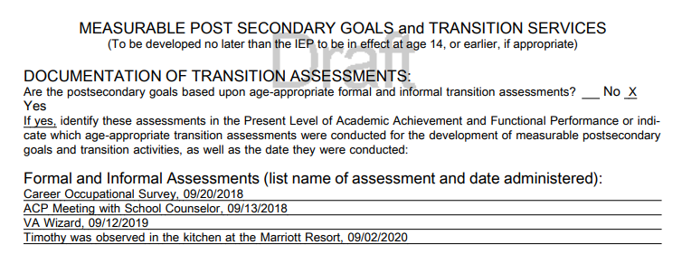
Using Virginia IEP (1 of 2)
Notes:
This slide is only intended to provide you with a sample of what the Goals and Services pages might look like, using the information in the PLOP, for a student..

Slide 22
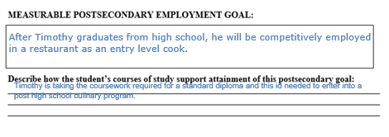
Using Virginia IEP (2 of 2)
Notes:
This slide also provides an example of courses of study that aligns with the students goals.

Slide 23
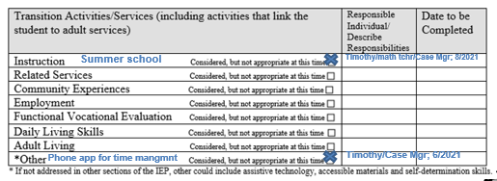
Transition Services and Activities
Notes:
This slide shows how Timothy’s transition activities and services might be documented on the IEP form.

Slide 24
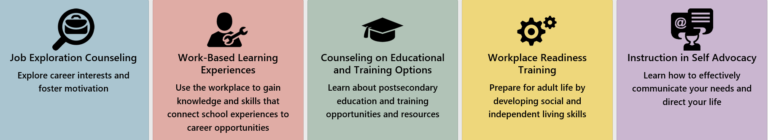
Virginia has Resources! (1 of 5)
Department of Aging and Rehabilitative Services (DARS)
Department for the Blind and Vision Impaired (DBVI)
Notes:
It is also important to know that other agencies might be involved with a student. The information these agencies collect will also help inform the IEP team. Both Virginia DARS and the Department for the Blind and Vision Impaired (DBVI) might be providing Pre Employment Transition Services (ETS)to the student, if the parent provided written consent for their child to be involved with Pre-ETS activities. Information from these activities will assist in the development of the IEP.
Information about DARS and DBVI can be found at the links shown on the screen.

Slide 25
Virginia has Resources! (2 of 5)
Wilson Workforce and Rehabilitation Center
  Comprehensive assessments are given.
  Driving potential, speech and language assessments, academic skills, career interests, vocational evaluations, independent living, education and credentialing are potential areas that could be assessed.
Notes:
VA also has a comprehensive assessment and training/education facility called Wilson Workforce and Training Center. Comprehensive assessments might be completed locally or at the Wilson Workforce and Rehabilitation Center
A student will not go to this center unless the parent provides written consent.
Information about the Wilson Workforce and Rehabilitation Center can be found at the link on the screen.

Slide 26
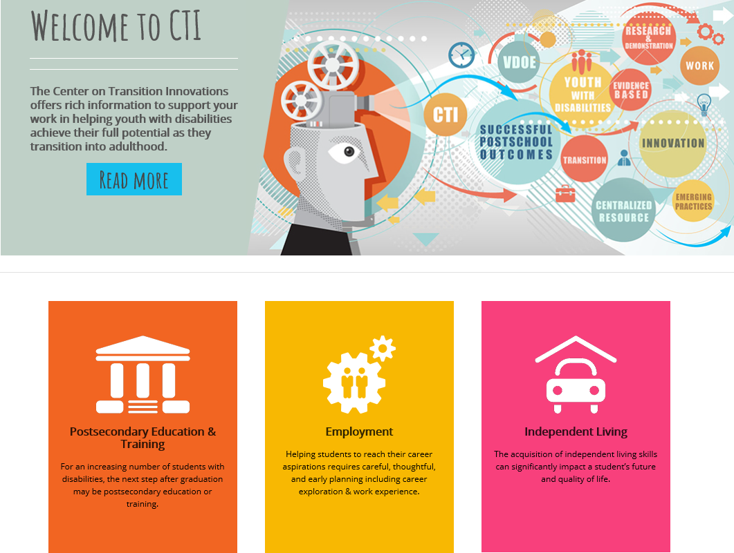
Virginia has Resources! (3 of 5)
VDOE Center on Transition Innovations (CTI)
  Online Classes
  Get Ready for Your Career
  Going to College
  Work Readiness Toolkit
  CTI on YouTube Channel
Notes:
VDOE’s Center on Transition Innovation (CTI) at VCU’s Rehabilitation, Research, and Training Center (RRTC) also provides many resources to teachers, students, and families.

Slide 27
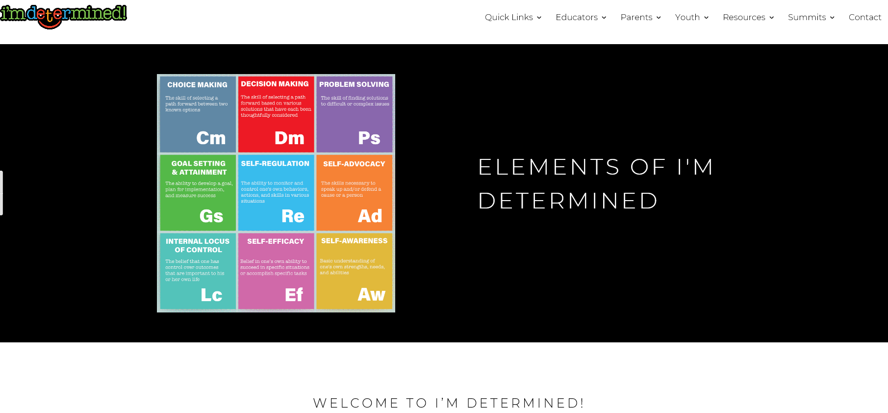
Virginia has Resources! (4 of 5)
I’m Determined
Notes:
The I'm Determined Project has web pages, templates, and videos that will assist the student with making his preferences known as well as what he wants to do after high school.
Information about I’m Determined can be found at the link on the screen.

Slide 28
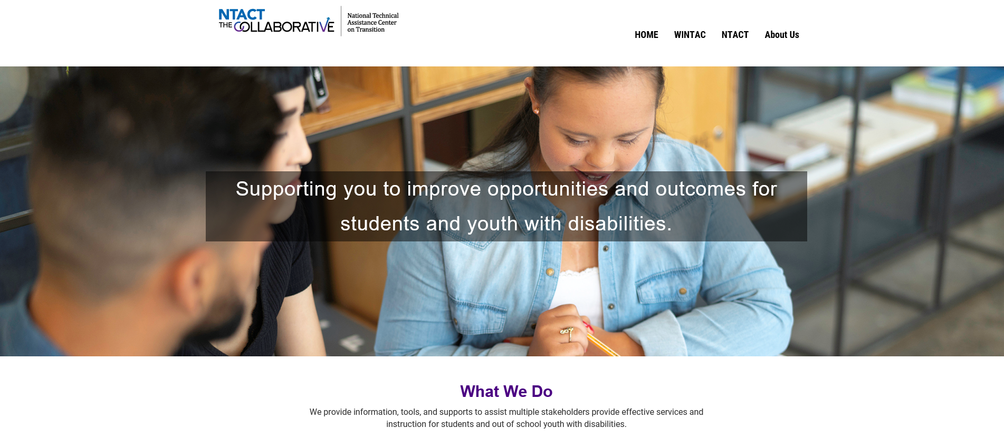
Virginia has Resources! (5 of 5)
National Technical Assistance Center on Transition: The Collaborative
Notes:
The National Technical Assistance Center on Transition: The Collaborative also has resources to help you with transition assessment, planning and writing the IEP.

Slide 29
Standards-Based Individualized Education Program
Module Nine: Developing the Secondary Transition Focused IEP
The resources used during the development of this training module are in the guidance document found on the VDOE Standards-Based IEP webpage.
Notes:
This concludes the ninth of nine training modules on developing Standards-based IEPs. Additional information can be found on the Virginia Department of Education’s website by accessing the link on the screen.

