Slide 1
WRITING IS NOT ONLY FOR THE SOL TESTED YEARS!
We MUST be helping our students build the needed foundation and skills every year!
Melissa Harrell
Mhharrell@shenandoah.k12.va.us
mhh3119@gmail.com
Twitter: @pmelissahh

Slide 2
Standards 5-8
*5.7 The student will write in a variety of forms to include narrative, descriptive, expository, and persuasive.
6.7 The student will write in a variety of forms to include narrative, expository, persuasive, and reflective with an emphasis on narrative and reflective writing.
7.7 The student will write in a variety of forms to include narrative, expository, persuasive, and reflective with an emphasis on expository and persuasive writing.
8.7 The student will write in a variety of forms to include narrative, expository, persuasive, and reflective with an emphasis on expository and persuasive writing.
Notes:
I am including 5th grade to emphasize the importance of looking to where they came from and where they need to be taken. Slide 2 an 3 show the progression of the writing process and foundation needed. Look at the verbage… WILL WRITE.

Slide 3
Standards 9-12
9.6 The student will write in a variety of forms to include expository, persuasive, reflective, and analytic with an emphasis on persuasion and analysis.
10.6 The student will write in a variety of forms to include persuasive, reflective, interpretive, and analytic with an emphasis on persuasion and analysis.
11.6 The student will write in a variety of forms, to include persuasive/argumentative, reflective, interpretive, and analytic with an emphasis on persuasion/argumentation.
12.6 The student will write in a variety of forms to include persuasive/argumentative reflective, interpretive, and analytic with an emphasis on persuasion/argumentation.

Slide 4
Why TEACH writing?
So, you may not have an SOL writing test at the end of grades 6 and 7, but how you prepare your students in these grades will have a huge impact on how well they score on the 8th grade and EoC Writing tests, as well as (and more importantly), how they will succeed in their writing in high school and beyond.
Another GREAT reason to have your students writing is that writing provides a fabulous way for you to assess their comprehension. If students can explain it in writing, then they understand it. Writing can serve as an easy formative assessment tool.
Our students MUST be able to articulate opinions and communicate through writing to be successful in the world.
Being able to write prepares them for jobs we don't even know exist.

Slide 5
3.2.1 Reflection
3 ways you use writing in your instruction.
2 things you are apprehensive about with writing instruction.
1 favorite writing lesson you teach.

Slide 6
How?

Slide 7
Using the Strategies Across grade Levels
We can’t assume that students know how to write, so we must meet them where they are. At any grade level, we as teachers must provide the modeling and scaffolding needed. The amount of modeling or scaffolding required will be determined by the students you teach. These strategies can be used across grade levels as long as the needed support is provided for them to be successful.
Think : I do, We do, You do!

Slide 8
Informal Writing Formats- Reading and Writing Connection
Double Reflective Entry Journals
Perspective Journal
Opinion/Proof (template) (explanation)
BHH ( Book, Head,Heart)BHH Template
Free Write/Guided Free Write
R.A.F.T Explanation Examples
Portfolio Reflection Driving Questions

Slide 9
Formal Writing- Reading and Writing Connection
Narrative Essay
Essay (NO longer the 5 paragraph)Writing in the Wild: Beyond the 5 Paragraph Essay
*persuasive
*argumentative
*expository
*reflective
Research paper/ presentation

Slide 10
My focus with you today: The HOW!
Mentor text
Writing Templates
Mini- lessons (students use their writing)
Modeling

Slide 11
Mentor text
These are two text I recommend and will be referring to.
Writing with Mentors by Allison Marchetti and Rebekah O'Dell
Write Like This by Kelly Gallagher

Slide 12
Why Use It?
Proven to help students to write effectively in that specific discourse.
Writing has become MUCH more than school work activity- cornerstone of a literate life.
Helps support authentic writing instruction and practice to be lifelong writers.

Slide 13
Quote
“ Teach your students real-world writing purposes, add a teacher who models his or her struggles with the writing process, throw in lots of real-world mentor texts for students to emulate, and give our kids the time necessary to enable them to stretch as writers.”
K. Gallagher

Slide 14
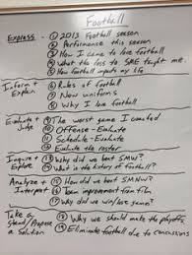
How Can I use it?
Reflective or Expressive Writing
Inform and Explain
Evaluate and Judge
Inquire and Explore
Analyze and Interpret
Take a Stand / Purpose Solution ( SOL)
Notes:
In the photo you can see how ONE topic can be analyzed in all forms of writing. Kelly Gallagher introduces the six pieces at one time with 5 minute quick writes. He chooses the ONE subject and addresses it six different ways. Share this information on pages 16-19.

Slide 15
Reflective VS Expressive
Reflective
moves beyond recounting an experience.
Goal is NOT to share a final thought, but to add insight and discovery of new thoughts.
Expressive
personal writing
first person
sharing of thoughts, feelings, ideas, or questions based on an experience.

Slide 16
Using Mentor text for expressive and reflective writing. Six Word Memoir
First step: Share published pieces Third Step: Students own
All things considered, I am doing well. My plan is to attend college ( Daniela)
The past is forgiven, not forgotten. Failure often leads to great success ( John)
Escaped my mother. trapped by girlfriend. My dream is what I’ll be. ( Jackie)
So the water’s deep. Man up. Letting go means being strong. ( Neida)
You’re never the same person again. (2011) Eat. School. Cheerleading. Work. Sleep. Repeat (Kiki)
Second Step: Teacher’s examples Thinking of six words is hard. ( Dustin)
Up at 4:00; writing is hard.
Started a family, surrounded by girls. Moving on… tweeting, Encyclopedia
Teach, grade, travel, speak, write:tired. of Life, Favorite Mistakes.
Didn't quite work out. I’m glad.
Read a book; smarter than yesterday.

Slide 17
You Try
Mentor text: Student own:
All things considered, I am doing well
The past is forgiven, not forgotten
Escaped my mother. Trapped by girlfriend
Teacher text:
I am smiling on the outside now.
I cringe at the thought. Why?
I see me in her. WOW!

Slide 18
How can I use writing templates?
Can be used as a pre-writing tool.
Functions as a transition to independent writing.
Works well for essay examinations and “sponge” activities.
Writing is a great way to show comprehension.

Slide 19
Structure of A Writing Template
The topic sentence is a general statement or opinion.
Use three to five examples to develop the topic or opinion.
Use transitions when needed. (scaffolding)
Include a summary sentence at the end, if you wish.
Incorporate a variety of sentences: long and short, simple and complex.

Slide 20
Example
Student Example
Weather in Montana is erratic. First . . . Second . . . Then . . . It is hard to believe . . .
Weather in Montana is erratic. First, it doesn’t’ get cold until December. Second, there isn’t any snow for Christmas. Throughout January it changes from warm to cold, and in February it snows more. Then, in March, it is sixty degrees until the last days when it snows. It is hard to believe weather can be so different.

Slide 21
Example based on Nonfiction Article on Woodchucks.
One of the aspects of the
Woodchuck’s is . . . . For
example . . . . In addition . . . .
One of the most amazing aspects of the woodchuck’s life cycle is how quickly they mature. For example, at birth they are blind, naked, and totally helpless. By four weeks, their body is fully furred and they are eating on their own. Then, by the time they are six months old, they have left their parent’s home.

Slide 22
Character Analysis Middle and High
______, a character from the classic
novel_____ by _____ , seems to have been a (an)
__________( adjective) person. An example of this
is was when …Another example was… Finally,…..This character
,___________, always …
*use a “________” only when a word or two needs to be inserted. Use three “…” when more text is needed.

Slide 23
Writing About Literature
In the story___________, I think… In the text it
says… I think
Or
According to the story… It seems to me….The author tells us…. In the end…
*use a “________” only when a word or two needs to be inserted. Use three “…” when more text is needed. THIS NEEDS TO BE EXPLICIT TAUGHT TO THE STUDENTS.

Slide 24
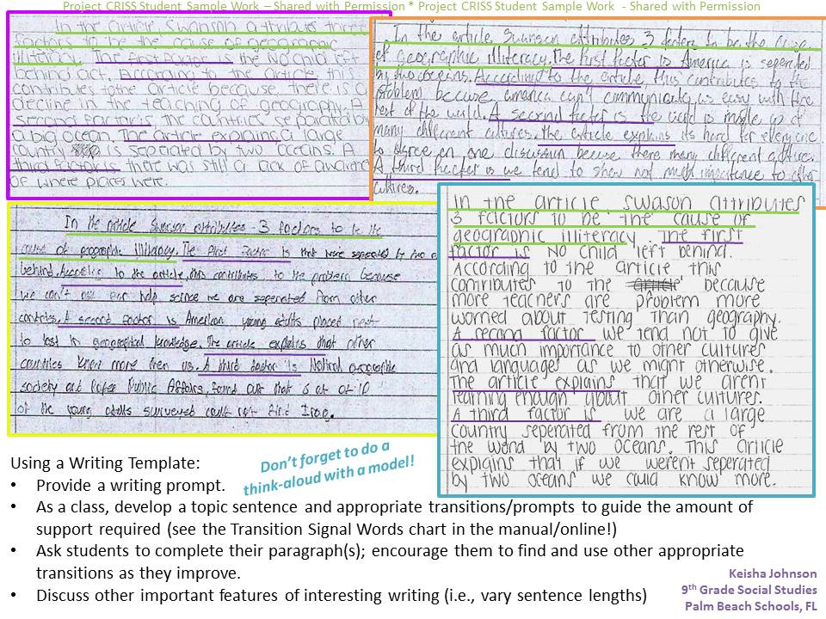
Examples

Slide 25
Modeling in Writing
We need to be drafting in front of our students. It takes courage, but the leap of faith you take will be so well worth it in your writing instruction. It is imperative that they see the struggle, and valuable to watch the teacher write a crummy first draft.

Slide 26
Quote on Modeling
“ In fact, modeling on days when I don’t write well may actually be more valuable than modeling on a day my writing is flowing.” Kelly Gallagher

Slide 27
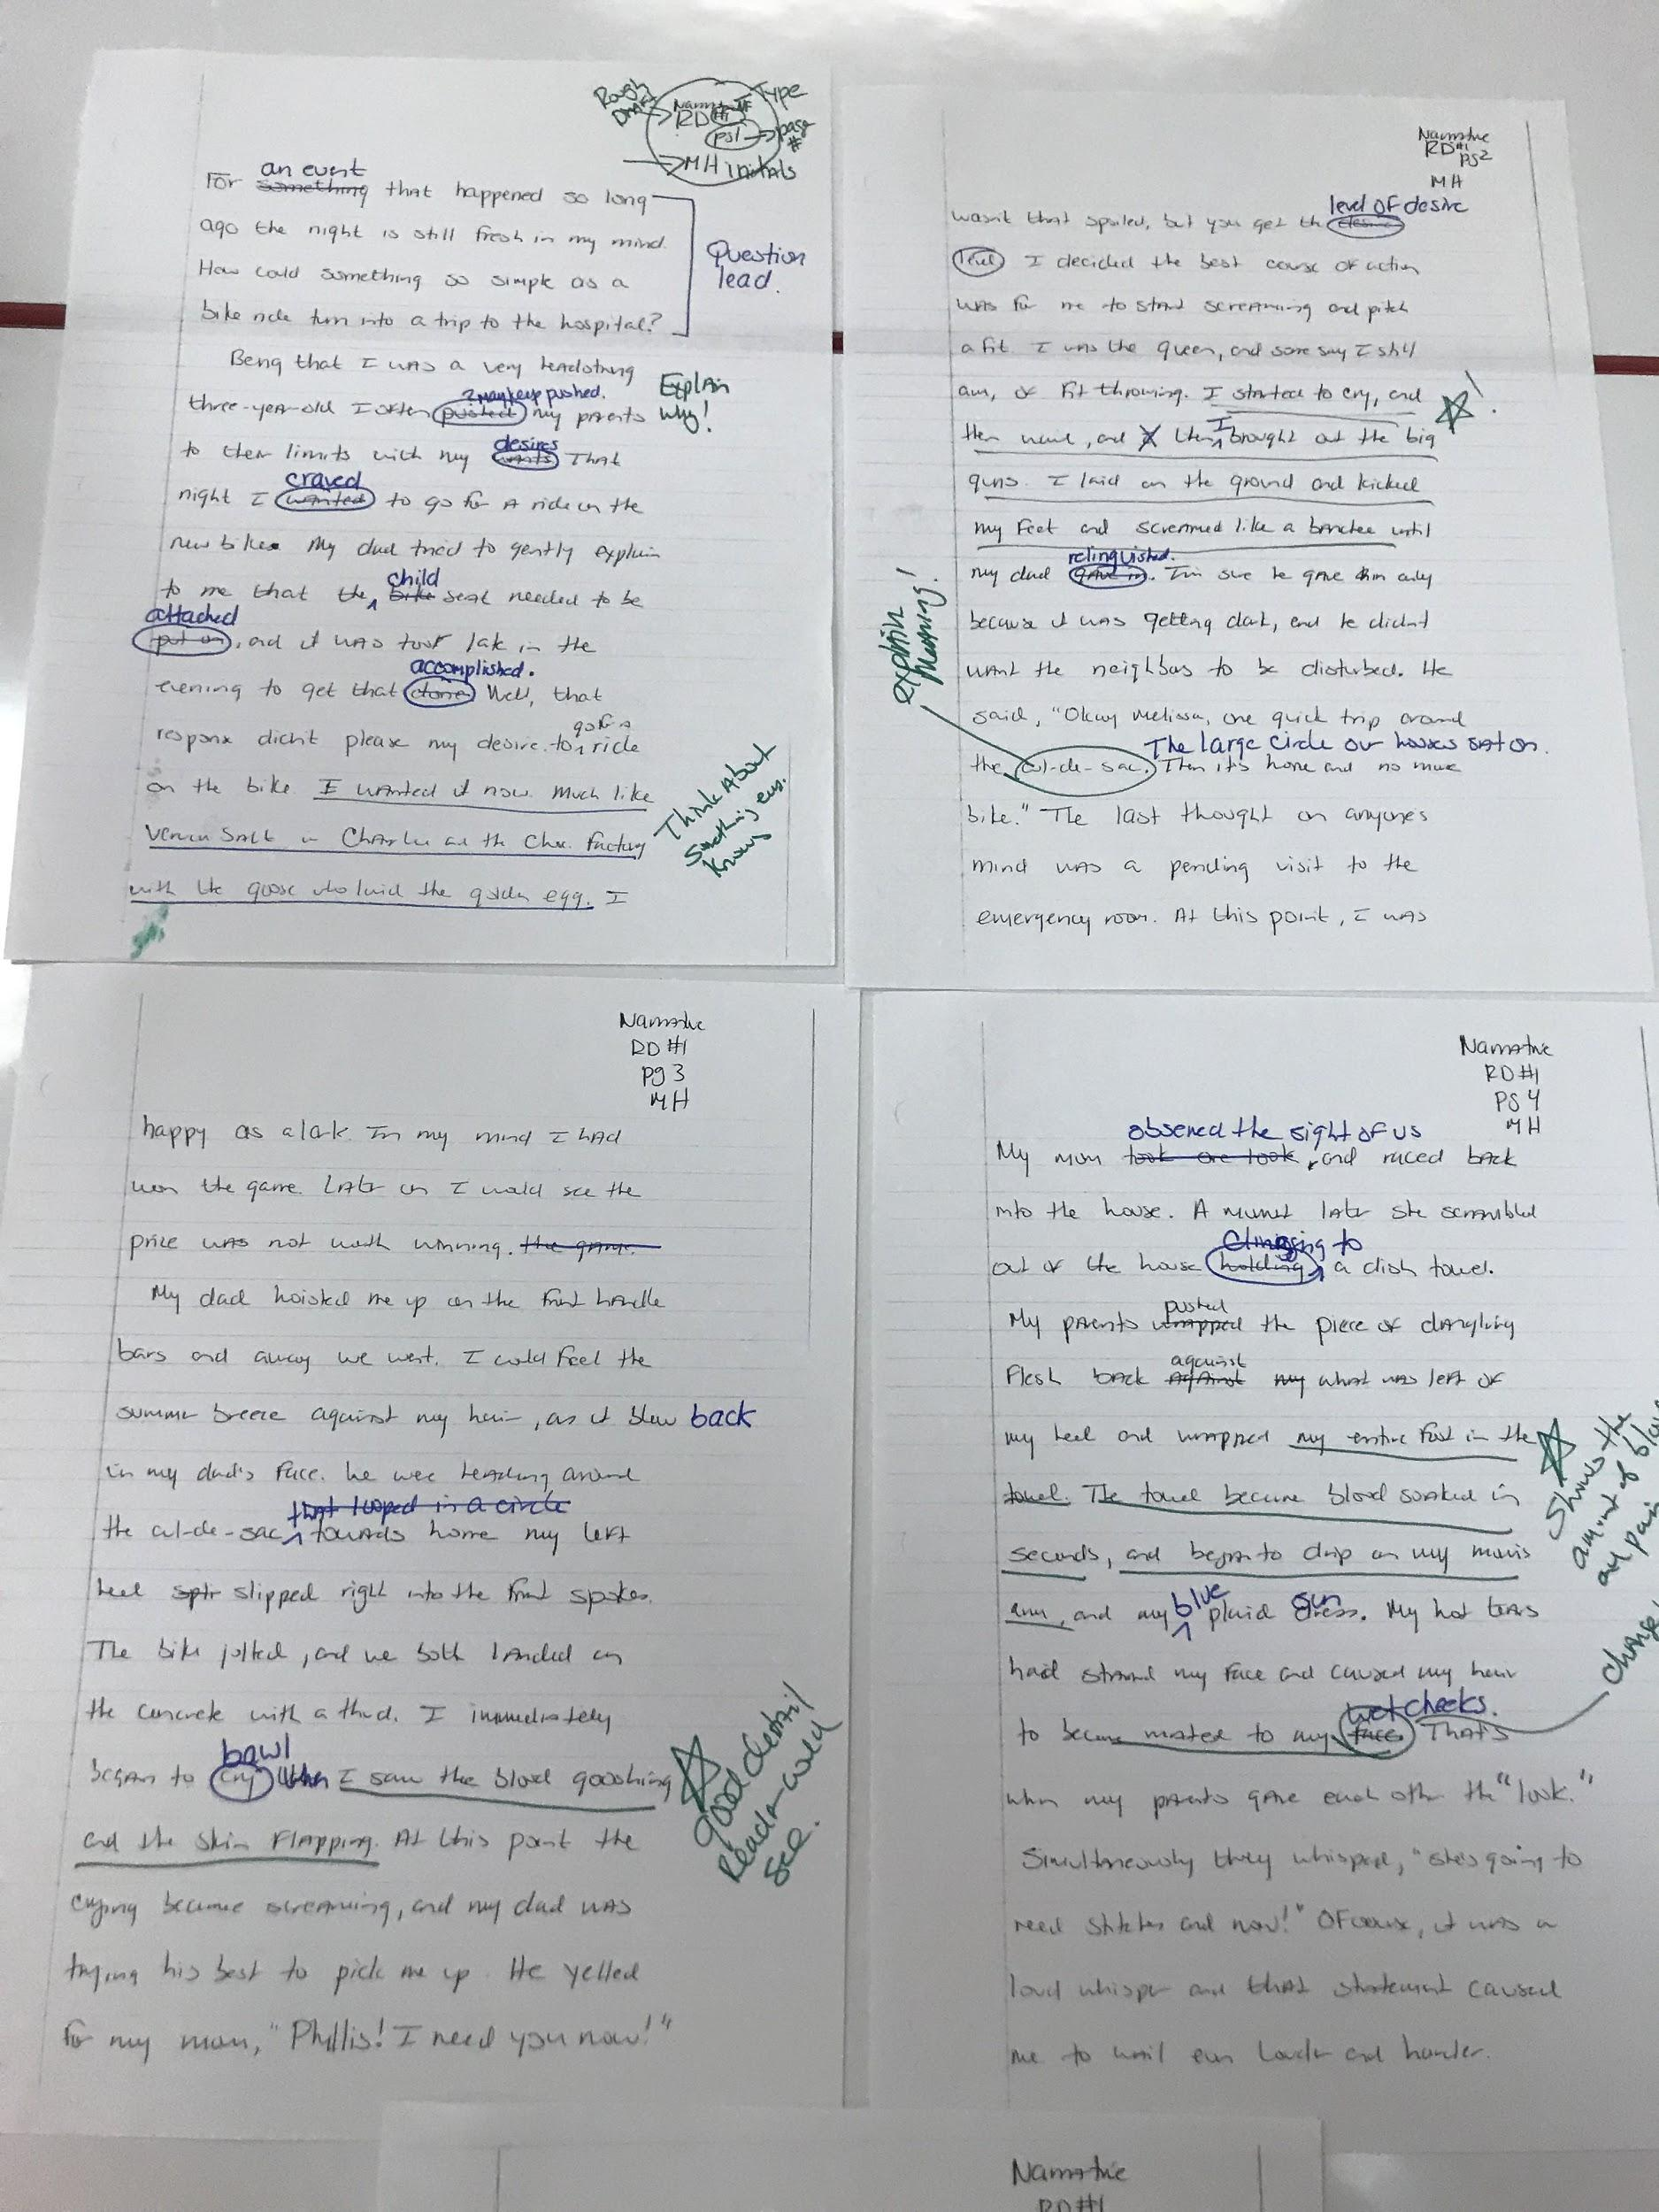
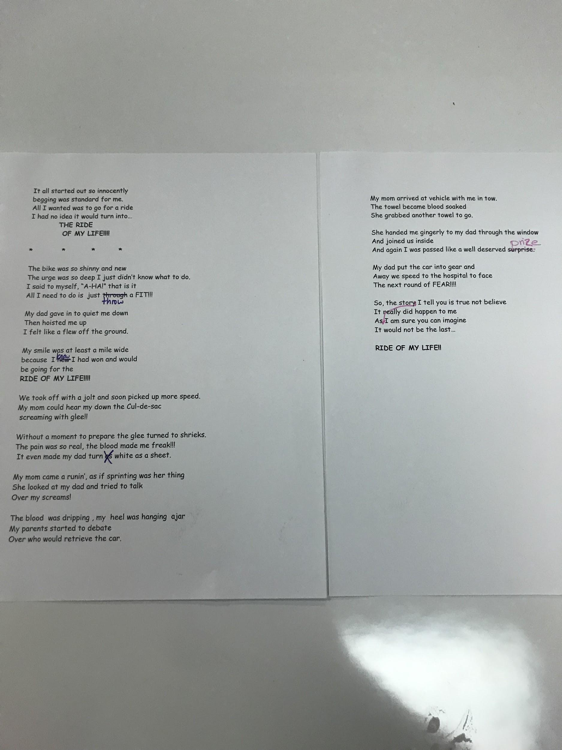
Examples of Student Writing
Narrative NonFiction
Narrative turned into a poem

Slide 28
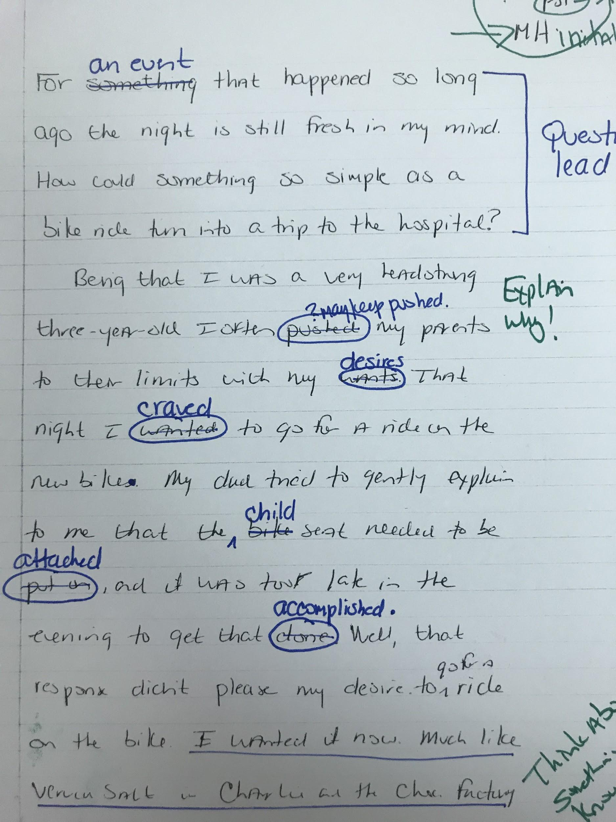
Teacher Draft
Example of my draft being used in a lesson.The changes are suggested by my students.

Slide 29
Ways to Model
Write as they write (Free write time)
As you conference with students, share your writing.
Use your drafts as the text in writing mini lessons.
Bring in the text from the novels, poems, short stories and articles you are using in class.
Use an author whose writing style showcases the mini lesson topic.
It all goes back to I do, We do, You do!

Slide 30
Mini Lessons using Student Writing
Writing lessons should NOT be a lecture. In fact, mini writing lessons should be interactive.
Use your writing or an author's writing to teach. (Connect with reading)
Have students use their writing as the practice text. This not only validates their writing, but it reinforces that writing in NOT one and done.

Slide 31
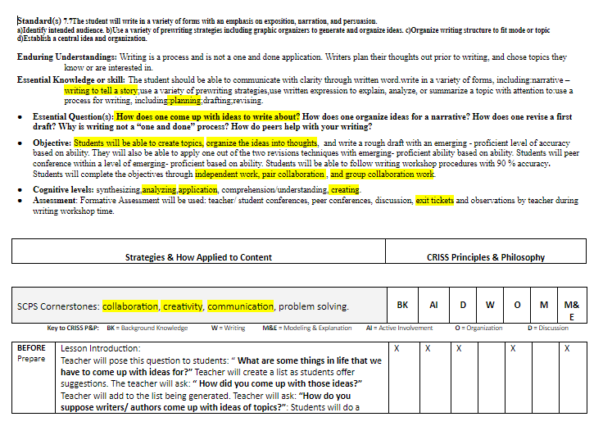
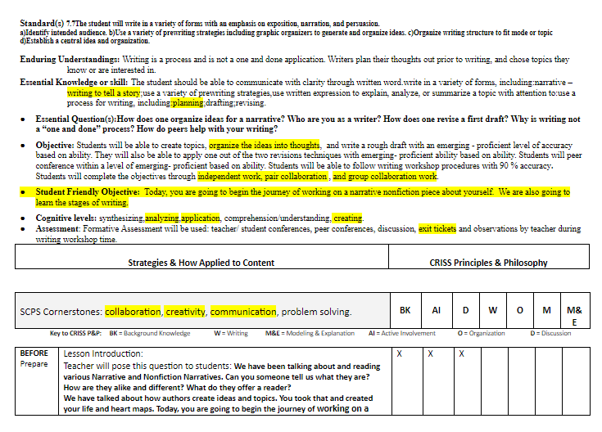
What does a mini lesson look like?
Mini Lesson-Topic
Writing Process Unit

Slide 32
Revision… YES! It is THAT important.
We MUST teach them it is NOT one
and done. Revision and editing are not
worksheet lessons.
Model revision
Use mini lessons for focus
Students should use their text
Turn final drafts into new pieces
I recommend this book! The Revision Toolbox by Georgia Heard

Slide 33
Teaching Revision is IMPERATIVE in Writing Instruction.
Just as equally important students need to see how to take a first draft and move it to revision. This is critical in sharpening their writing skills.
Goes back to revision IS instruction.
Takes MANY modeling sessions to break the
“One and done” mentality.
They need to know the difference between revision and editing.

Slide 34
Revising is NOT editing
Anyone can write, but rewriting is where GOOD writing emerges.
BAD writing has an opportunity to be transformed into good writing.
Second draft goal = IMPROVE “stuff”
NOT GRAMMAR

Slide 35
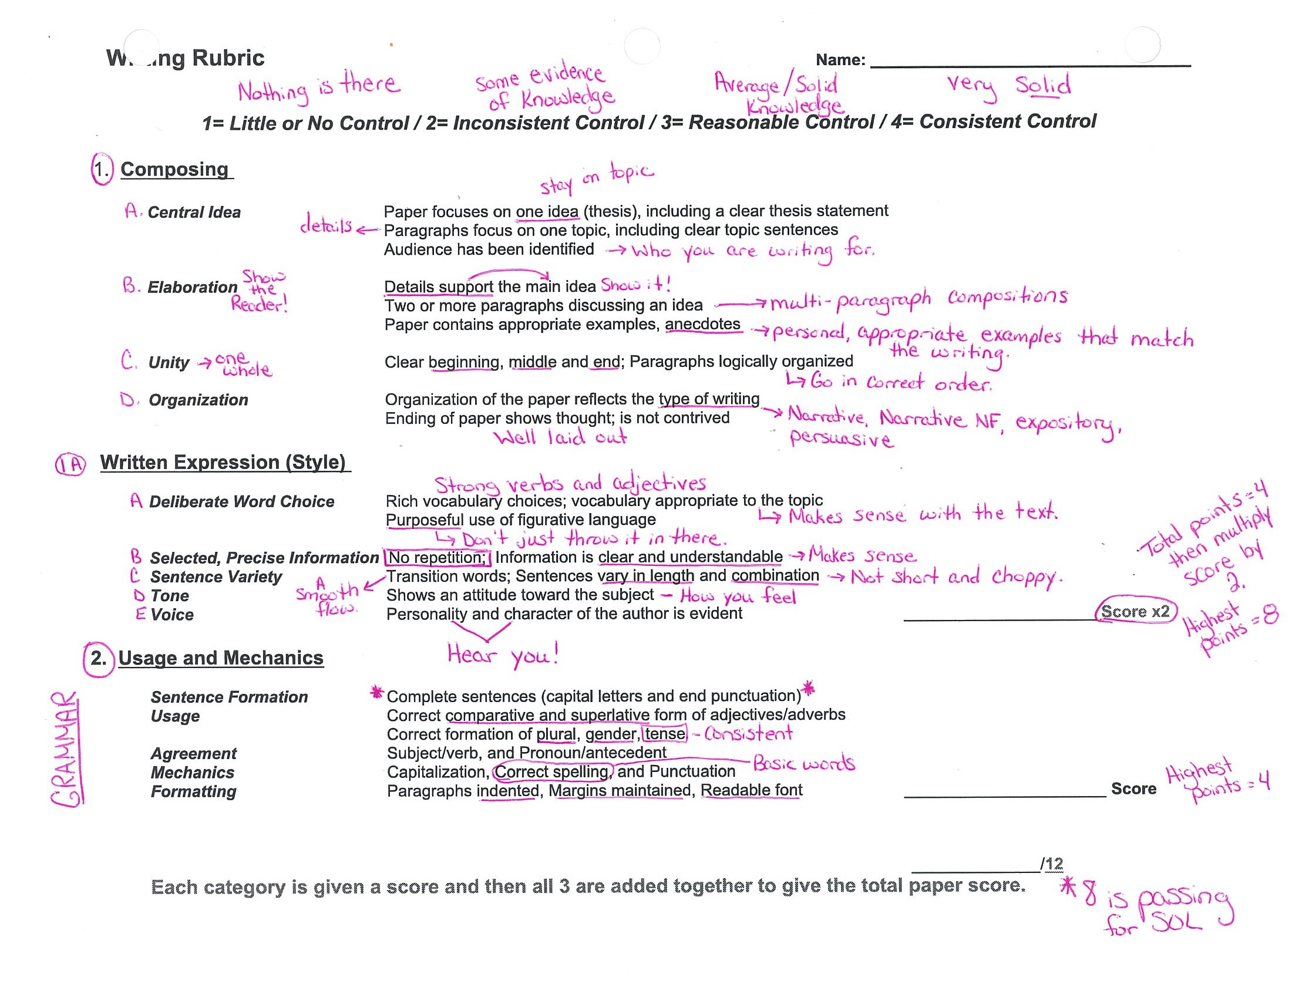
Rubrics
Writing Rubric

Slide 36
Checklist For Writers
______ I planned my paper before writing it.
______ I revised my paper to be sure that
______ the introduction captures the reader's attention;
______ the central idea is supported with specific information and examples that will be interesting to the reader;
______ the content relates to my central idea;
______ ideas are organized in a logical manner;
______ my sentences are varied in length;
______ my sentences are varied in the way that they begin; and
______ the conclusion brings my ideas together.
______ I edited my paper to be sure that
______ correct grammar is used;
______ words are capitalized when appropriate;
______ sentences are punctuated correctly;
______ words are spelled correctly; and ______ paragraphs are clearly indicated.
Printable copy

Slide 37
Writing Checklist
Printable copy With added touches by Mrs. Harrell
CHECKLIST FOR WRITERS
______ I planned my paper before writing it. (brainstorming, outlining) (MADMAN and Architect)
______ I revised my paper to be sure that (made additions and deletions- content) (Architect/Carpenter)
____ the introduction captures the reader’s attention; (hook the reader)
_____ the central idea is supported with specific facts information and (SHOW w/ examples)
examples that will be interesting to the reader; (the reader should be there with you)
_____ the content relates to my central idea; (stay on topic)
______ideas are organized in a logical manner; (stay in chronological order)
______my sentences are varied in length; (not short and choppy)
______my sentences are varied in the way they begin; (don’t start every sentence with “then”)
______the conclusion brings my ideas together. (Tie it all together with a bow- leave with an interesting thought that is RELATED to your topic.)
_____ I edited my paper to be sure that (JUDGE PHASE)
____ correct grammar is used ;( verb tense, correct forms of words)
____ words are capitalized when appropriate; ( start of the sentence, proper nouns)
____ sentences are punctuated correctly; ( commas, ending marks?)
____ words are spelled correctly; and ( you can use a dictionary- so USE it!) Four People
____ paragraphs are clearly indicated. (Indent!!!)
____ I checked my paper (Ask yourself, “Did I REALLY check over this amazing piece I just wrote?)

Slide 38
Class Structure Suggestions
Whether you have 45, 60, or 90 minutes you can be successful teaching writing and reading. You can accomplish it all.

Slide 39
Class break down suggestions
I suggest Writing Workshop.
Monday, Wednesday, Friday= Writing focus Tuesday and Thursday= Reading Focus
Tuesday and Thursday = Writing focus and Monday, Wednesday and Friday = Reading Focus.
Reading and Writing NEED to be integrated. Example

Slide 40
Unit Layout Suggestion to create a flow between reading and Writing.
Reading:
Choose SOL strand, objective, content and assessment.
Choose resources: Novel, short stories, poems, nonfiction. Read aloud text.
Whole group, literature circles, small group, individual choice.
Mini lessons
Writing:
Writing focus that connects with the SOL/objective, content and assessment.
Format of writing: Narrative, expository, informal or formal
Mentor text to use
How will you connect the text from reading?
Mini lessons

Slide 41
Resources to help guide you
VDOE English
Write Like This- Kelly Gallagher Book
Lessons That Change Writers- Nancie Atwell Book
Writing With Mentor Text Book
The Revision Toolbox (second edition)Book
Writing Strategies -Jennifer Serravallo Book
Melissa Harrell email

Slide 42
Questions and Answers
A BIG
THANK YOU
FOR ALL
YOU DO
EVERYDAY
TO MAKE A STUDENT’S DAY BRIGHT!

Slide 43
Using Strategies Across Grade Levels
We can’t assume that students know how to write, so we must meet them where they are. At any grade level, we as teachers must provide the modeling and scaffolding needed. The amount of modeling or scaffolding required will be determined by the students you teach. These strategies can be used across grade levels as long as the needed support is provided for them to be successful.
Think : I do, We do, You do !

Slide 44
Reflection
Take a few minutes to reflect and write about the following:
Based on the information from the presentation and the great things you are already doing how are you going to implement good writing practices in your instruction? What is one thing you will drop? What is one thing you will add? What is one thing you will tweak to make it even better?

Slide 45
Presentation Cite Page (1 of 2)
Ebarvia, T. (2019). Writing in the Wild: Beyond the 5 Paragraph Essay. [Blog] Moving Writers. Available at: https://movingwriters.org/2016/09/27/writing-in-the-wild-beyond-the-5-paragraph-essay/ [Accessed 6 Aug. 2019].
Gallagher, Kelly, and Kelly Gallagher. Write like This: Teaching Real-World Writing Through Modeling & Mentor Texts. Stenhouse Publishers, 2011.
Jones, R. (2019). ReadingQuest | Main Page. [online] Readingquest.org
.

Slide 46
Presentation Cite Page (2 of 2)
Marchetti, Allison, and Rebekah ODell. Writing with Mentors: How to Reach Every Writer in the Room Using Current, Engaging Mentor Texts. Heinemann, 2015.
“Project CRISS: Home.” Project CRISS | Home, Project Criss Website
Ripp, P. (2019). Why Writing Sucks and We Need to Talk About it. [Blog] Pernille Ripp. Available at: https://pernillesripp.com/2019/07/26/why-writing-sucks-and-we-need-to-talk-about-it/ [Accessed 6 Aug. 2019].

