Slide 1
How Can I Teach It All?
How can I teach multiple strands during a whole group reading lesson?
Shawn Geary, Reading Specialist
Franklin City Public Schools
sgeary@fcpsva.org

Slide 2
How Can I Teach It All? (1 of 3)
Purpose: To share ideas and strategies with you to make teaching multiple SOL more efficient and take less time.

Slide 3
How Can I Teach It All? (2 of 3)
Classroom teachers are the most underappreciated and underpaid people on the face of the planet.

Slide 4
How Can I Teach It All? (3 of 3)
What do I do during whole group read aloud that works perfectly?
What do I do during whole group read aloud that needs some tweaking?
What do I do during whole group read aloud that doesn't work at all?

Slide 5
How Do I Plan for it all? (1 of 7)
Goal: To teach multiple strands from the 2018 English SOL
Keep in mind the four strands
Pick a quality trade book
Map out the SOL that you can teach with the book
Collect or design the activities and/or graphic organizers

Slide 6
How Do I Plan for it all? (2 of 7)
What book shall I use?
Works for any grade level
What SOL can I address?
  Communication and Multimodal Literacies
  Reading
  Writing
  Research

Slide 7
How Do I Plan for it all? (3 of 7)
Book: Puff the Magic Dragon
Communication and multimodal literacies
  2.1 c,i,h
  Speak, retell, ask and answer questions
Reading
  2.4b and 2.7a,c,f
  Use knowledge of vowel patterns, make and confirm predictions, ask and answer questions
Writing
  2.10g and 2.11a,c
  Write an opinion with support, use complete sentences and capital I
Research
  2.12b
  Generate questions

Slide 8
How Do I Plan for it all? (4 of 7)
Communication and Multimodal Literacies
  Speak loud enough for everyone to hear
  Listen when others are speaking
Using “equity sticks” and always have someone repeat what is said
Ask questions during lesson
  What are students wondering?
  Have students place questions on question parking lot.

Slide 9
How Do I Plan for it all? (5 of 7)
Reading
  Create a list of words students have a hard time decoding.
  Start decoding the words by looking at the vowel with the students.
  Let them determine if it is long or short
  Theme
  Make predictions and confirm

Slide 10
How Do I Plan for it all? (6 of 7)
Writing
  Use journals
  Sample topic: Write to tell me what the best part of today’s story was in your opinion. Why was this your favorite part?
  As students begin to write, remind them you will be checking for complete sentences and capitalization

Slide 11
How Do I Plan for it all? (7 of 7)
Research
  Questions parking lot
  Let students generate questions on post it notes and add to parking lot
  Each morning answer the questions as the students are getting ready for the day

Slide 12
Two questions to think about
1. How do we ask students to read books, texts, passages, stories?
2. How do we read to students each day?

Slide 13
Turn and Talk

Slide 14
Discussion Question
Can we do this all the time?
If we are deciding that the text we are about to share with our students is vital and worth our instructional time
THEN
Read it all the way through and let students enjoy the story!

Slide 15
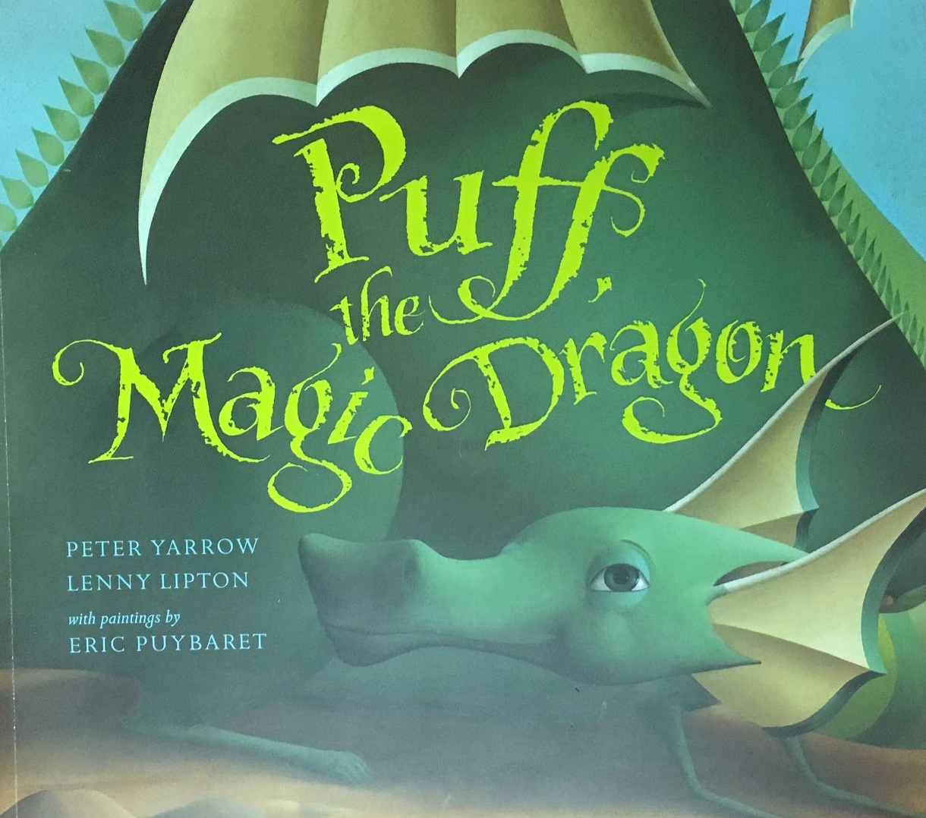
Puff the Magic Dragon

Slide 16
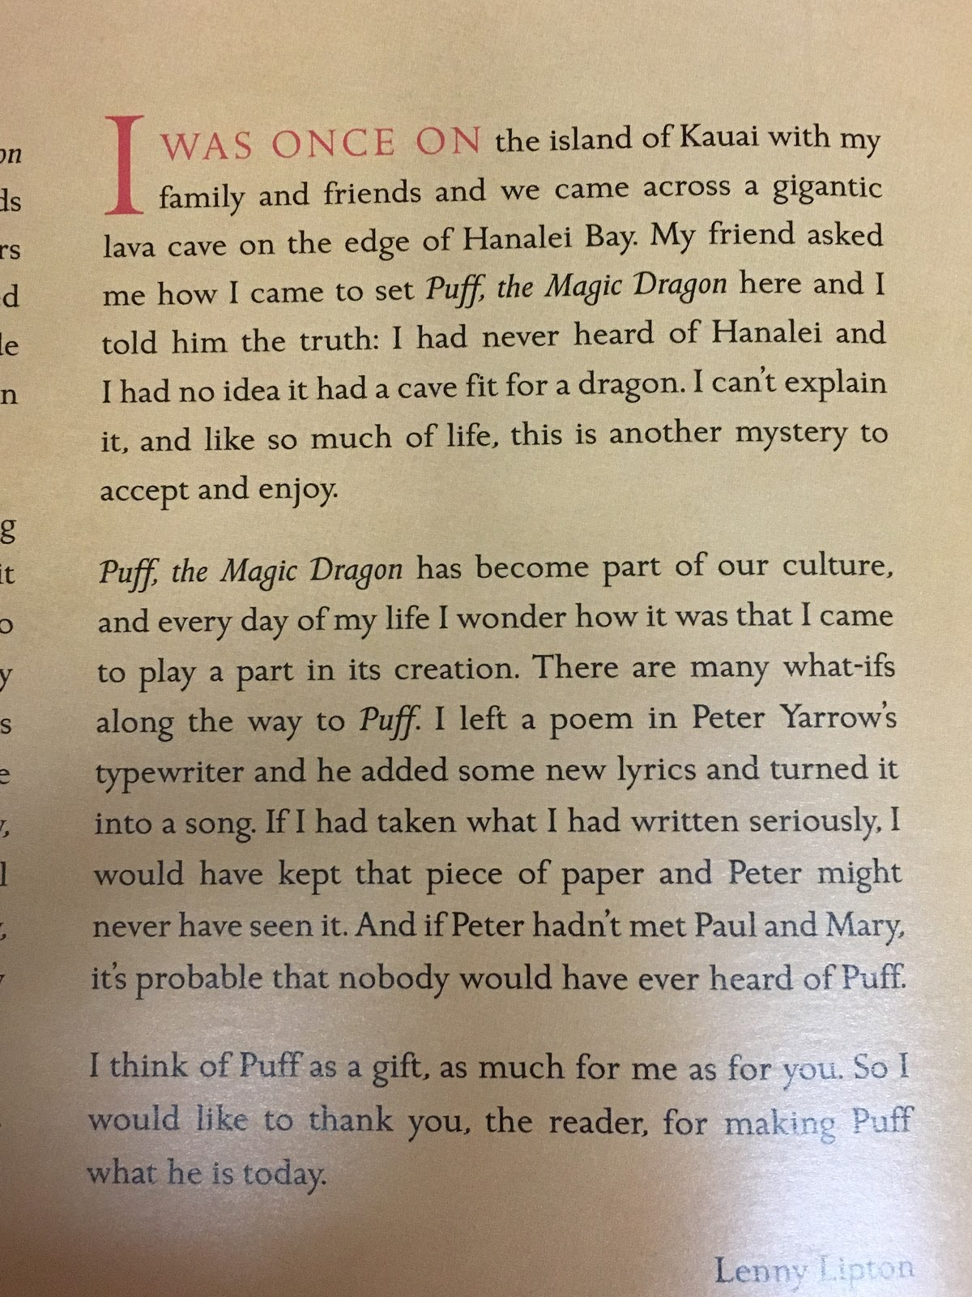
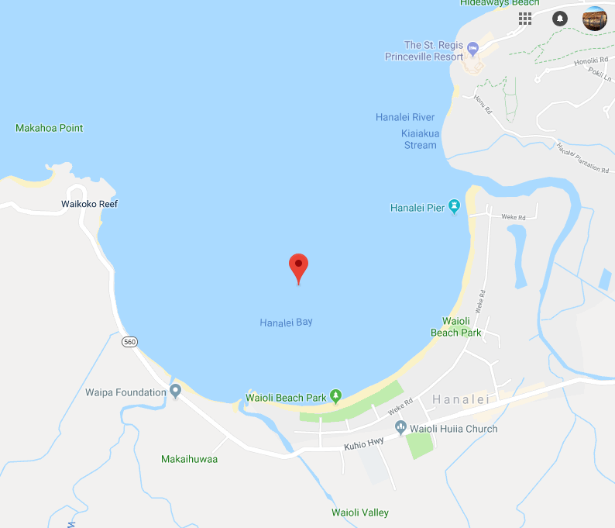
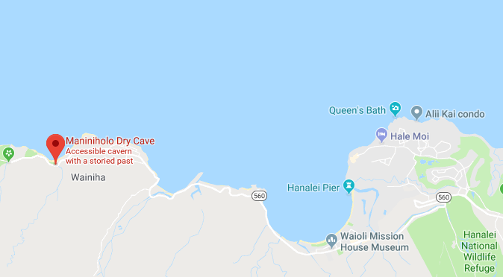
Kauai

Slide 17
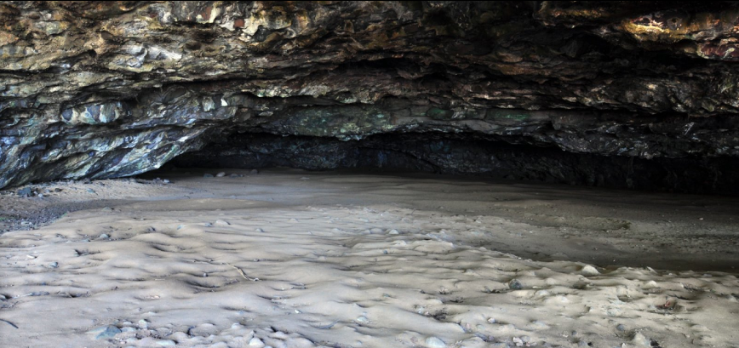
Cave at Hanalei Bay

Slide 18
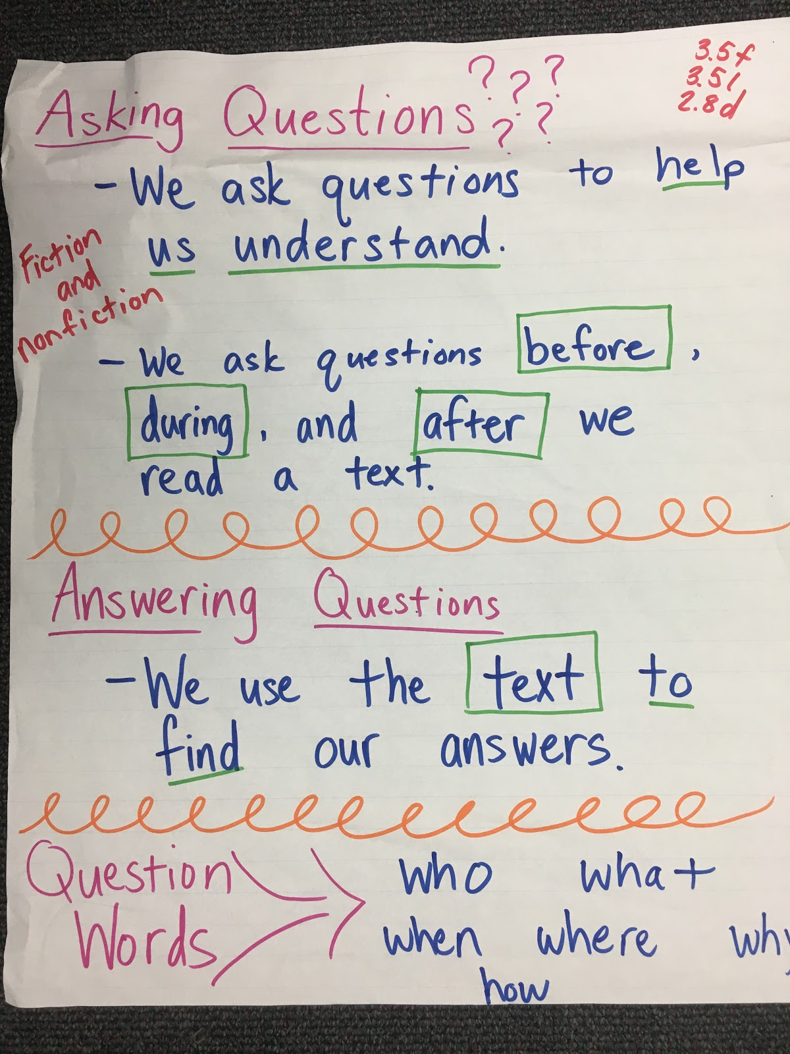
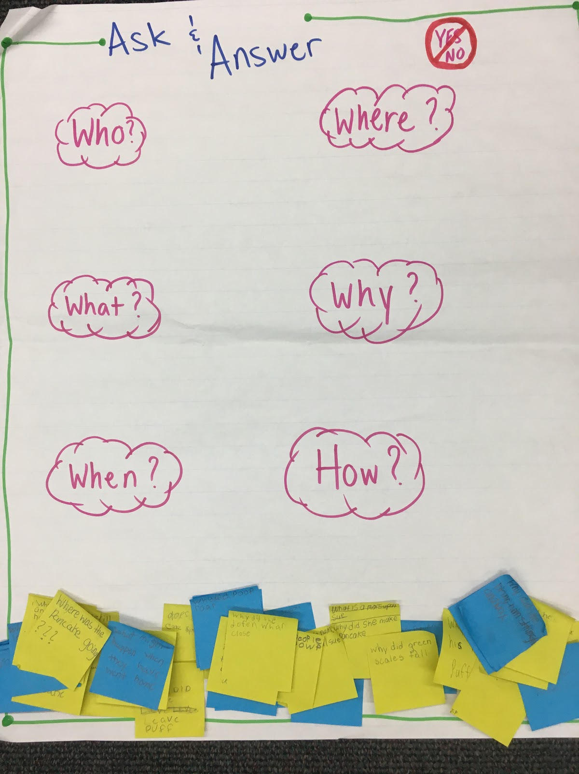
Student Work

Slide 19
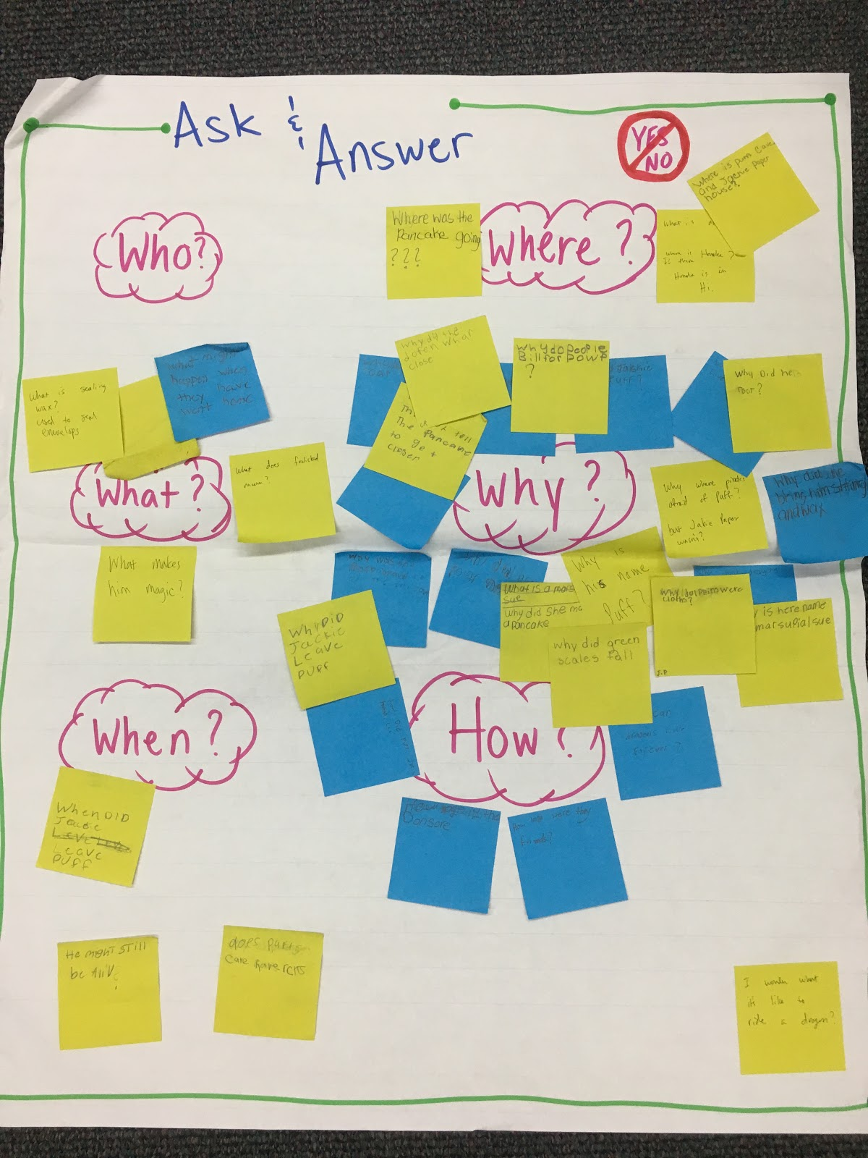
Student Work 2
Students create questions they have as we read the book. It is important to stop and give them a minute or two to record their questions but try not to stop the flow of the text. After you have read the text in its entirety, begin to work through the questions students have generated.

Slide 20

Talking Points
Use post-it notes to mark your talking/stopping points. But remember, keep this to a minimum.

Slide 21
EXTENSION Activity
-Get into groups of 2 or 4.
-Send one of your group members to select a book off the table at the front and get one piece of chart paper.
-Each group member will have a blank SOL map on your table.
-Each table has a copy of the 2018 VDOE SOLs for English K-5. Please share with your table.
-As a team, look through your book. Using the SOL and the trade book develop your SOL map. What SOL could you teach with your book?
-Now take the chart paper and walk us through what your lesson would look like and some of the activities you would use for that book.
-We will share our ideas with each other, as time permits.

Slide 22
Questions?

Slide 23
Bibliography
Yarrow, P., Lipton, L., & Puybaret, E. (2012). Puff, the magic dragon. London: Macmillan Childrens.
Google 2018 retrieved from Google Map Hawaii
Google 2018 retrieved from Google Map Dry Cave

Slide 24
Disclaimer
Reference within this presentation to any specific commercial or non-commercial product, process, or service by trade name, trademark, manufacturer or otherwise does not constitute or imply an endorsement, recommendation, or favoring by the Virginia Department of Education.

