Slide 1
Integrated Language Arts Instruction: K-2 Writing
Emily L. McMillen, Henrico County Public Schools
Dr. Tammy M. Milby, University of Richmond
Dr. Joan A. Rhodes, Virginia Commonwealth University

Slide 2
Session Overview
In this session you will learn how to create writing lessons for K-2 students as part of an integrated unit.
Charlottesville September 16, 2019
Chesapeake September 30, 2019
Springfield October 16, 2019
Roanoke October 21, 2019

Slide 3
I’m Wondering

Slide 4
Let’s Watch for Best Practices in a Writing Classroom

Slide 5
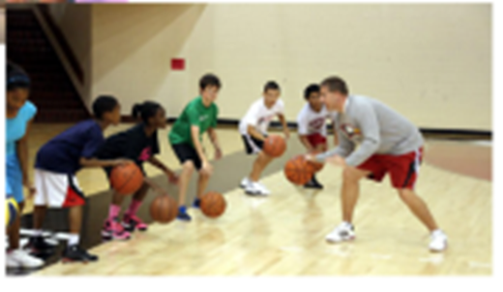
Best Practices
Writing is continuous
Focus on one quick teaching point each day-use this to develop lessons and conferences
Incorporates the Writing Process throughout instruction
Reading like a writer: notice craft & discuss
Model, Model, Model: parts of writing workshop
Establish the writing community

Slide 6
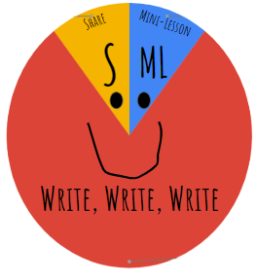
Time Pressure
You need to have a dedicated time every day
Even in SMALL 20 minute blocks, you can structure your writing to include:
mini lesson
independent student writing time
students sharing
Kids need to be writers; writers are readers!

Slide 7
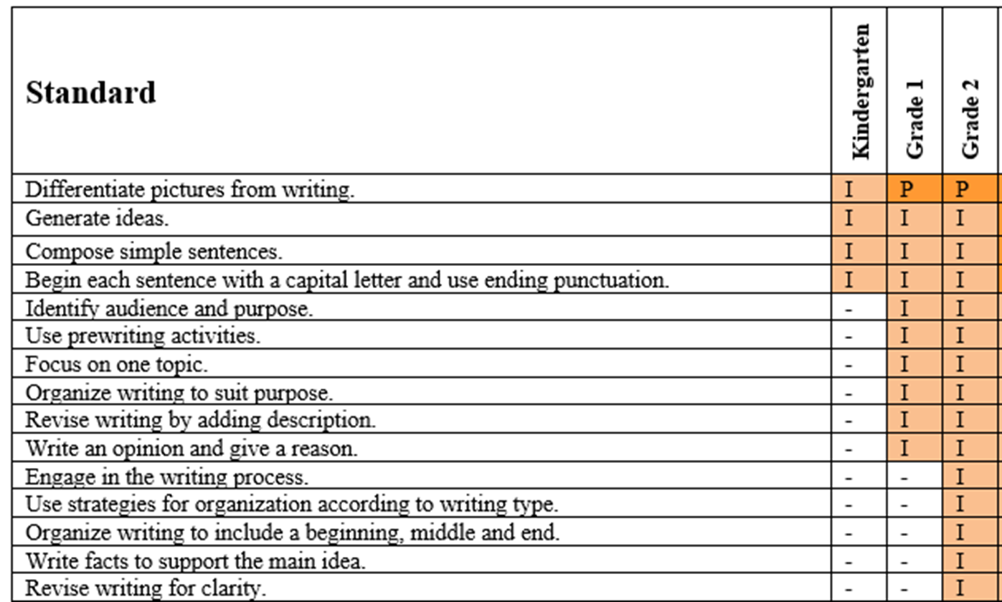
K-2 Writing Standards

Slide 8
Sample Instructional Unit: I Wonder...
I Wonder: How are people the same and different? Why?
Do we all play the same?
Do we all feel the same?
Do we all grow the same?
Do we all look the same?
Do we all live the same?
Book list is available for this “I Wonder” Unit

Slide 9
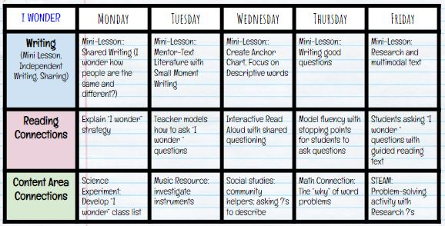
An Integrated Unit Example

Slide 10
Let’s look at some of the days in this unit:
Modeled Writing
Mentor Text
Research and Multimodal Text
- Just a small sampling of what you’ll add into your integrated unit

Slide 11
Modeled Writing Section Begins

Slide 12
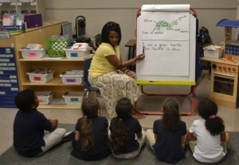
Modeled Writing: What is it?
Teacher models FOR the students
Models writing
Models thinking
Models the writing process
Teacher is WRITING IN FRONT of his/her students!

Slide 13
Modeled Writing: Why do we do it?
Strengthens our students’ knowledge of:
writing behaviors
different types of text
the writing process
story structures
how writing helps us and enriches our everyday life
the vocabulary that writers use to talk about writing.
“Nothing, absolutely nothing you will ever do as a teacher will be more powerful than modeling writing in front of your students.” by Vicki Spandel

Slide 14
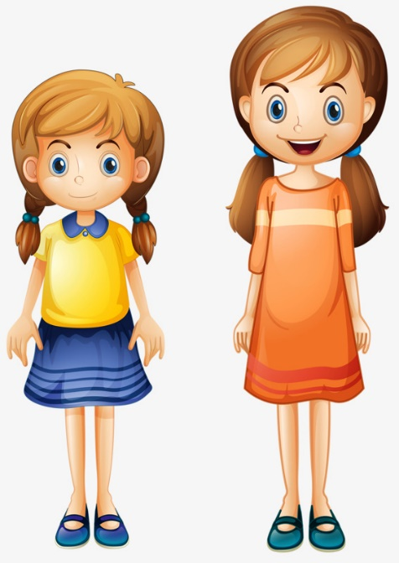
Modeled Writing Why do we do it?
I’m wondering ________ ?
I’m wondering how people look the same?
I’m wondering how people look different?

Slide 15
Mentor Text Section Begins

Slide 16
Mentor Text for Small Moments
Using literature as a mentor text to help students narrow a piece of writing:
Connect: Rereading of Text
Teaching Point: “Small Moment” with inverted pyramid graphic organizer (5-7 minutes)
Engage
Off you go! Think about how to narrow a piece of your own writing from your writing folder...

Slide 17
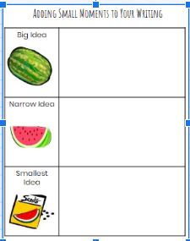
Anchor Charts
Created with students

Slide 18
Multimodal Text Section Begins

Slide 19
Using research to create a multimodal text
I am (color word).
I am (color word) because I ___________.
I would be (color word) because only I can ______________.
My color is (color word) because ___________.
I am unique because _____________.

Slide 20
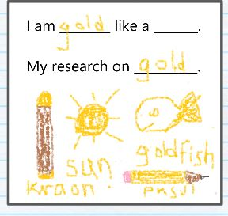
Research for young children
Generate topics of interest. (K-2)
Generate questions to gather information (K-2)
Identify pictures, texts, or people as sources of information (K-2)
Find information from provided sources. (K-2)
Gather and record information (1-2)
I am _____ because ________.
My research on brown.

Slide 21
Using Paint 3D
Image that shows children’s writing.
Image 1: I am green because I like trees.
Image 2: I am gold because I swim like my goldfish.

Slide 22
Now it’s your turn…
Examine the books on your table.
Create a new writing lesson idea where you use the best practices we discussed today.

Slide 23
Reminders
Writing must be taught, practiced, and shared each and every day!
Integrate!

Slide 24
Professional Resources
Write This Way, Kelly Boswell
Craft Lessons: Teaching Writing K-8, Ralph Fletcher & Joann Portalupi
Using Picture Books to Teach Writing With the Traits, Ruth Culham & Raymond Coutu
The Writing Workshop: Working Through the Hard Parts (And They're All Hard Parts). Katie Wood Ray & Lester Laminack
Wondrous Words, Katie Wood Ray

Slide 25
Contact Us
Emily L. McMillen, Henrico County Public Schools: emcmillen@henrico.k12.va.us
Dr. Tammy M. Milby, University of Richmond: tmilby@Richmond.edu
Dr. Joan A. Rhodes, Virginia Commonwealth University: jarhodes2@vcu.edu
What will you push your students to wonder about next week?

Slide 26
Disclaimer
Reference within this presentation to any specific commercial or non-commercial product, process, or service by trade name, trademark, manufacturer or otherwise does not constitute or imply an endorsement, recommendation, or favoring by the Virginia Department of Education.

