Slide 1
Final Review of Proposed Amendment 5 to Virginia’s Consolidated State Plan under the Every Student Succeeds Act of 2015 (ESSA)
Presentation to the Virginia
Board of Education
September 15, 2022

Slide 2
Proposed Change #1: Addition of a Multiple Races Student Group for Reporting
Consistent with ESEA section 1111(c)(2)(B), all major racial and ethnic groups should be included in federal accountability reporting.
The Virginia Department of Education (VDOE) has long defined a major racial or ethnic group as a student group that represents five percent or more of the student population in Virginia.
The multiple races group, which consists of student records that are marked with two or more races, currently represents more than five percent of the student population in Virginia.
The student group multiple races was approved as a component of the state accreditation system in April, 2019.

Slide 3
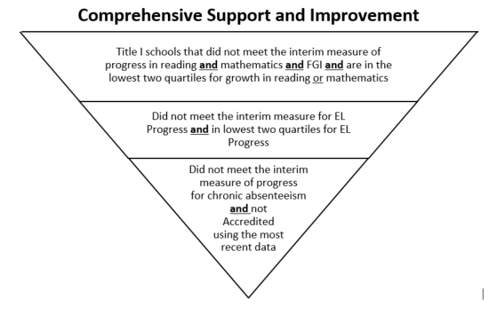
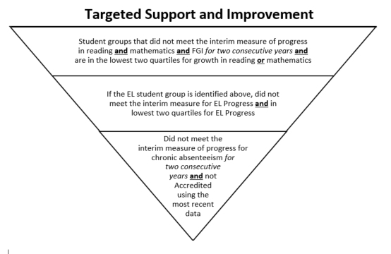
Proposed Change #2: Technical Edit to Step 3 of CSI and TSI Identification
There are three steps, or three sets of criteria, that are used to identify Comprehensive Support and Improvement (CSI) and Targeted Support and Improvement (TSI) schools.
Technical edit: Necessary so that a school which is Accredited because it is in a triennial accreditation period can still be considered for improvement if its most recent school year data does not indicate that the school met accreditation benchmarks.

Slide 4
Proposed Change #3: Revising Growth Methodology for 2022-2023 Federal Accountability Year
In the current Consolidated State Plan, Growth English Reading and Growth Mathematics includes students who passed the current year’s SOL test, and those who showed growth from the previous year SOL test to the current year SOL test.
However, Virginia administered growth assessments for the first time in fall 2021, and it is being proposed to incorporate those assessments into the growth methodology for federal accountability.
Virginia will use the same methodology to determine growth that is used for state accreditation: The spring 2022 SOL test score is compared to the spring 2021 SOL test score first to determine whether growth is shown. If this does not show growth, then the spring 2022 SOL test will be compared to the fall 2021 growth assessment to determine whether growth is shown. If either comparison shows growth, then the student will have met the growth criteria.
Another amendment will be submitted for accountability year 2023-2024 and beyond when further changes to our growth methodology occur.

Slide 5
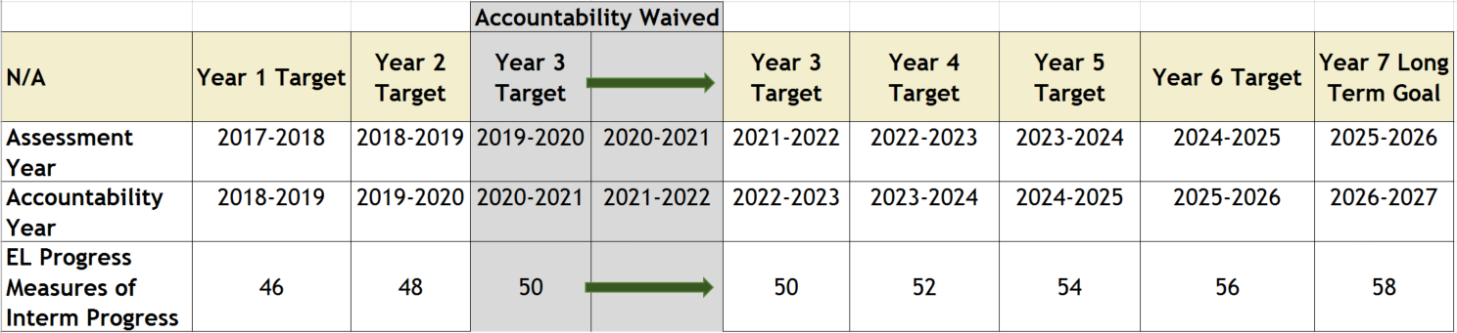
Proposed Change #4: Shift Measures of Interim Progress Forward Two Years
The proposed change shifts measures of interim progress (“targets”) forward two years for Chronic Absenteeism, the Federal four-year graduation Index (FGI), and English Learner Progress.
Example:

Slide 6
Proposed Change #5: New Measures of Interim Progress and Long Term Goals: Reading and Mathematics
ESEA section 1111(c)(4)(A)(i)(I)(aa) requires that measures of interim progress and long-term goals be based on student performance on the State’s current annual assessments.
A new reading assessment was administered for the first time to a fully representative student population during the 2021-2022 school year.
New mathematics and reading Virginia Alternate Assessment Program (VAAP) tests were administered for the first time during the 2021-2022 school year.

Slide 7
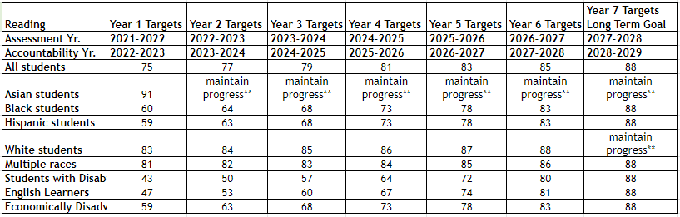

Proposed Measures of Interim Progress and Long Term Goal for Reading
** indicates the rate must meet or exceed the rate from the previous year
The long term goal is based on All Students and closes the difference between the baseline and 100% proficiency by 50%.

Slide 8
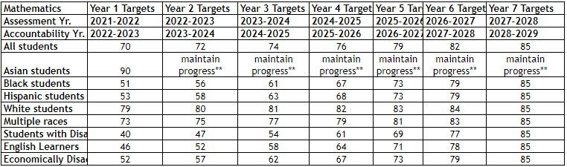
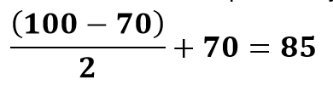
Proposed Measures of Interim Progress and Long Term Goal for Mathematics
** indicates the rate must meet or exceed the rate from the previous year
The long term goal is based on All Students and closes the difference between the baseline and 100% proficiency by 50%.

Slide 9
Proposed Change #6: Edit a Reference Year
As approved in the COVID-19 Addendum, schools that were initially identified as Additional Targeted Support and Improvement (ATSI) in 2018-2019 would enter Comprehensive Support and Improvement status if they did not exit ATSI by fall 2024.
The current Consolidated State Plan references 2021-2022 (this year was determined pre-pandemic) and should be changed to 2024-2025 to reflect the change approved in the COVID-19 Addendum.

Slide 10
Proposed Change #7: Add Detail to Accreditation System Description
Upon an initial review, USED asked for additional information to be placed in the School Quality or Student Success Indicator section of the Consolidated State Plan:
Virginia’s accreditation system is an indicator of School Quality or Student Success;
USED asked for additional details so that it was evident that Virginia’s accreditation system allowed for meaningful differentiation of school quality.

