Slide 1
Update on the Process to Review and Revise the History and Social Science Standards of Learning
Board Work Session
September 14, 2022
September 2022
VDOE History and Social Science Program

Slide 2
Overview
Proposed Update of the Timeline
Proposed “decoupling” of the Standards Document

Slide 3
Proposed Update of the Timeline

Slide 4
Proposed Update of the Timeline
September 2022
Staff are working internally and with consultants to:
“decouple” Standards document creating a Standards document;
create the Curriculum Frameworks for each course; and
ensure documents are clean, concise, understandable, and accessible.
Public comment period closes September 25th
Staff are working closely with Department Senior Leadership to review Standards and Curriculum Frameworks.

Slide 5
Proposed Update of the Timeline
October 2022
Staff will continue to work internally to:
“decouple” Standards document creating a Standards document;
create the Curriculum Frameworks for each course; and
ensure documents are clean, concise, understandable, and accessible.
Staff will continue to work closely with Department Senior Leadership to review Standards and Curriculum Frameworks.
Staff will conduct three (3) Community Engagement Sessions:
All will be conducted in-person.
Process will be communicated through Superintendent’s Memo and outreach to parents.

Slide 6
Proposed Update of the Timeline
November 2022
Staff will continue to work internally to:
“decouple” Standards document creating a Standards document;
create the Curriculum Frameworks for each course;
ensure documents are clean, concise, understandable, and accessible; and
review public comment.
Staff will conduct two (2) Community Engagement Sessions:
All will be conducted in-person.
Process will be communicated through Superintendent’s Memo and outreach to parents.
Department staff prepares documents for First Review at the Board’s November meeting.

Slide 7
Proposed Update of the Timeline
December 2022
The Board hosts public hearings: December 5 – 9, 2022
Staff will continue to work internally to:
Reconcile the input and feedback from the Community Engagement Roundtable Session and Public Hearings; and
ensure documents are clean, concise, understandable, and accessible.
Staff will conduct one (1) virtual Community Engagement Sessions:
Process will be communicated through Superintendent’s Memo and outreach to parents.
Department Staff will meet with Historian Steering Committee for final review of the Standards Document and Curriculum Frameworks.

Slide 8
Proposed Update of the Timeline
January 2023
VDOE finalizes standards and curriculum framework.
Department Staff will prepare documents for Final Approval at the January 2023 Board meeting.

Slide 9
Proposed “decoupling” of the Standards Document

Slide 10
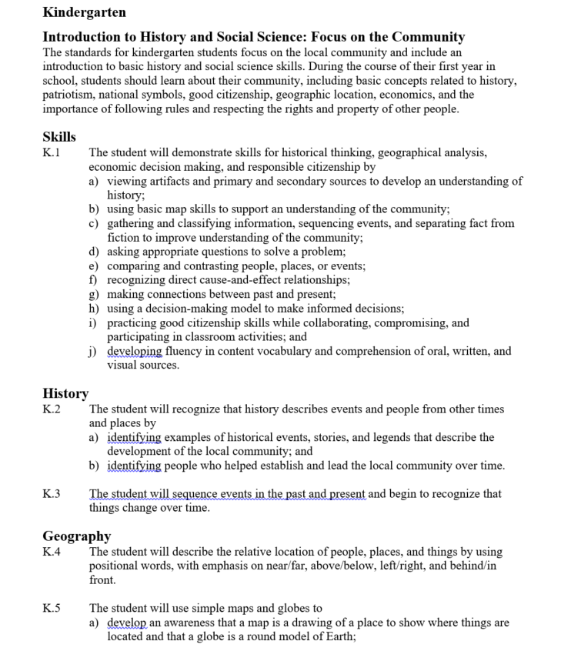
Proposed “decoupling” of the Standards Document
2015 Standards Document
Format of the
Standards Document:
Just the Standards

Slide 11
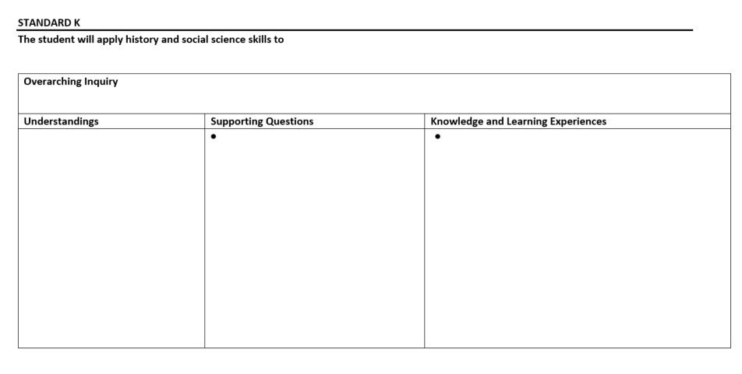
Proposed “decoupling” of the Standards Document
Format for the Curriculum Frameworks:
Content divided into columns and organized by Understandings, Supporting Questions, and Knowledge and Learning Experiences

Slide 12
Summary
Close Public Comment Period at the end of September 2022
Conduct Community Engagement Roundtable Sessions between October – November 2022
Present Standards and Curriculum Frameworks for Board First Review in November
Board Public Hearings in early December 2022
Anticipate Final Approval by the Board in January 2023

