Slide 1
COLLEGE PARTNERSHIP LABORATORY SCHOOLS
Implementation Update​
Planning Grant Guidelines​
Start-up and Per-pupil Operating Funds Guidelines
Presented to the Virginia Board of Education
August 17, 2022

Slide 2
1. IMPLEMENTATION UPDATE

Slide 3
LAB SCHOOLS IN VIRGINIA: BACKGROUND
Lab schools are tuition-free, public, nonsectarian, nonreligious schools approved by the Board. They are responsible for their own operations, including budget preparation, contracts for services, and personnel matters.
There have been numerous lab school models implemented in Virginia since the 1950s, but the formal statutory framework for lab schools was established through legislation in 2010.
The original authorizing legislation only allowed public institutions of higher education or private institutions of higher education that operate a teacher education program approved by the Board to establish lab schools.
Prior to 2022, the General Assembly had not had not made appropriations into the established College Partnership Laboratory School Fund (Fund).
There are no lab schools under the 2010 statutory framework.

Slide 4
LAB SCHOOLS IN VIRGINIA: PURPOSE
The statutory purpose of lab schools is to:
  stimulate the development of innovative education programs for preschool through grade 12 students.
  provide opportunities for innovative instruction and assessment.
  provide teachers with a vehicle for establishing schools with alternative innovative instruction and school scheduling, management, and structure.
  encourage the use of performance-based educational programs.
  establish high standards for both teachers and administrators.
  encourage greater collaboration between education providers from preschool to the postsecondary level.
  develop models for replication in other public schools. § 22.1-349.1

Slide 5
LAB SCHOOLS IN VIRGINIA: REQUIREMENTS
The governing body for an approved school, as selected by the eligible entity, enters into an executing contract with the Board. The governing body is also responsible for administering, managing, and operating the lab school.
The BOE and the governing board for an approved school contract must clearly sets forth the academic and operational performance expectations and measures by which the college partnership laboratory school will be judged.
Lab schools are subject to all state and federal laws related to discrimination as well as laws applicable to public schools in Virginia.
  This includes the Standards of Quality, Standards of Learning, and Standards of Accreditation.

Slide 6
2022 GENERAL ASSEMBLY ACTIVITY
The General Assembly included an $100M disbursement into the College Partnership Laboratory School Fund during its 2022 Session to support the following:
  Planning grants for aspiring new lab schools ($5M)
  Initial start-up grants for newly-approved lab schools ($20M)
  Per-pupil operating grants for approved and launched lab schools ($75M or balance)
An enactment clause in the Appropriation Act amends the statutory definition of a lab school to include public institutions of higher education; higher education centers, institutes, or authorities; and private institutions eligible for Tuition Assistance Grant funds as eligible to apply to open a lab school.
  Community Colleges and Higher Education Centers became eligible entities.
  Eligible entities are no longer required to have a Board-approved Educator Preparation Program.

Slide 7
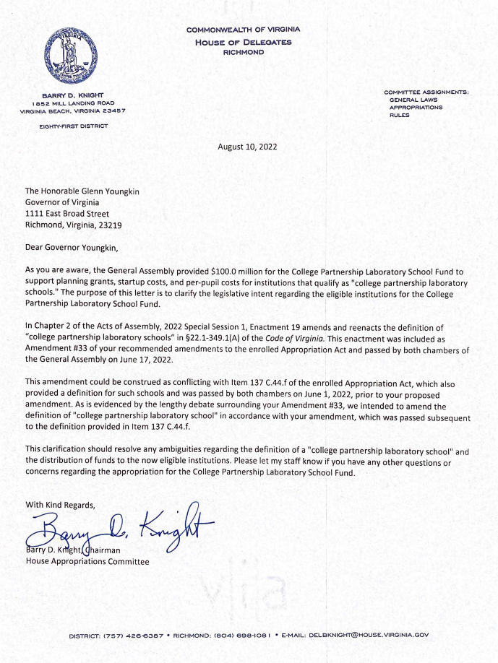

Slide 8
Timeline
Aug. 17, 2022: BOE considers Planning Grant Guidelines; BOE first review of Start-Up and Per-Pupil Grant Guidelines*
Early Sept. 2022: VDOE disseminates Application for Approval of Lab School (approved by BOE and issued in Jan. 2012; no BOE action needed); BOE and BOE Standing Committee begins accepting and reviewing submissions on a rolling basis
Late Aug. 2022: VDOE publishes Planning Grant Application form based on BOE-approved guidelines; VDOE begins accepting and reviewing planning submissions on a rolling basis; BOE convenes its Committee on College Partnership Laboratory Schools (BOE Standing Committee)
Late Sept. 2022: VDOE publishes Start-Up and Per-Pupil Grant Application form based on BOE-approved guidelines; VDOE begins accepting and reviewing start-up and per-pupil submissions on a rolling basis
Winter 2022: BOE Standing Committee and VDOE begins reviewing Applications for Approval of Lab Schools
Sept. 15, 2022: BOE final review of Start-Up and Per-Pupil Grant Guidelines*
Spring 2023: Approved Lab Schools begin hiring teachers and recruiting students
Winter 2022: BOE begins reviewing Applications for Approval of Lab Schools
Fall 2023: Approved Lab Schools welcome their first class!
*Planning Grant and Start-Up and Per-Pupil Grant guidelines delegate authority to administer and award grants to VDOE to ensure submissions are processed and addressed in a timely manner.

Slide 9
2. PLANNING GRANT GUIDELINES

Slide 10
PLANNING GRANT GUIDELINES:
Application Required Components
Entities eligible to apply to open a lab school may apply for a one-time planning grant for up to $200K and a term of no more than 12 months.
  Additional funding will be considered on a case-by-case basis and in accordance with available funds.
Application Required Components include:
  General information about the proposed Lab School, including school governance and structure; facilities; mission and pedagogy; methods of assessment; and prospective student population;
  A description of the school’s proposed instructional model, including how it will improve student academic proficiency, mastery, college- and career-readiness, and long-term outcome goals;
  A description of a plan for involvement of teachers, parents, community, organizations, employers, etc., in the planning, development, and implementation of the program; and
  A description of how the Lab School will secure and maintain community-based partnerships (i.e. businesses, organizations, local school boards and divisions, etc.) to ensure programmatic, financial, and operational success and sustainability of the Lab School.

Slide 11
PLANNING GRANT GUIDELINES:
Timeline and Benchmarks/Deliverables
TIMELINE | BENCHMARKS AND DELIVERABLES
On or before the end of the first quarter of the grant term | Awardee must present a proposed list of milestones, measures of success, and deliverables.
On or before the end of the second quarter of the grant term | Awardee must submit a progress report in order to be eligible for drawing down reimbursements on the second installment of the award.
On or before the end of the third quarter of the grant term | Awardee must present progress on milestones and deliverables, including submission to the Board of an application for approval to launch a Lab School.
On or before the end of the grant term | Awardee is expected to have attained approval by the Board to launch a Lab School.

Slide 12
PLANNING GRANT GUIDELINES:
Evaluating Submissions
The funding evaluation committee convened by the Department will evaluate applications according to a weighted rubric utilizing the following factors:
  Targeted Student Population and Relevant Research: Intention to serve at-risk students and/or offer a new, innovative model grounded in evidence-based practices to improve student academic proficiency, mastery, college- and career-readiness, and long-term outcomes;
  Clarity of Program Description, Goal, and Timeline: Indication of programmatic, operational, and infrastructural capacity to advance an application for approval to launch a Lab School and to launch a Lab School no later than the 2024-2025 school year, with preference for launch in the 2023-2024 school year;
  Sustainability: Evidence of institutional commitment to the viability of the Lab School;
  Collaboration: Collaboration with local school divisions, community-based organizations, and employers, as well as teachers and parents, in manner that promotes quality, innovation, and program results and sustainability;
  Regional and Applicant Diversity: New awards will be made with preference to regional diversity and with preference to new applicants should an applicant have previously received a planning grant during the current fiscal year application period.

Slide 13
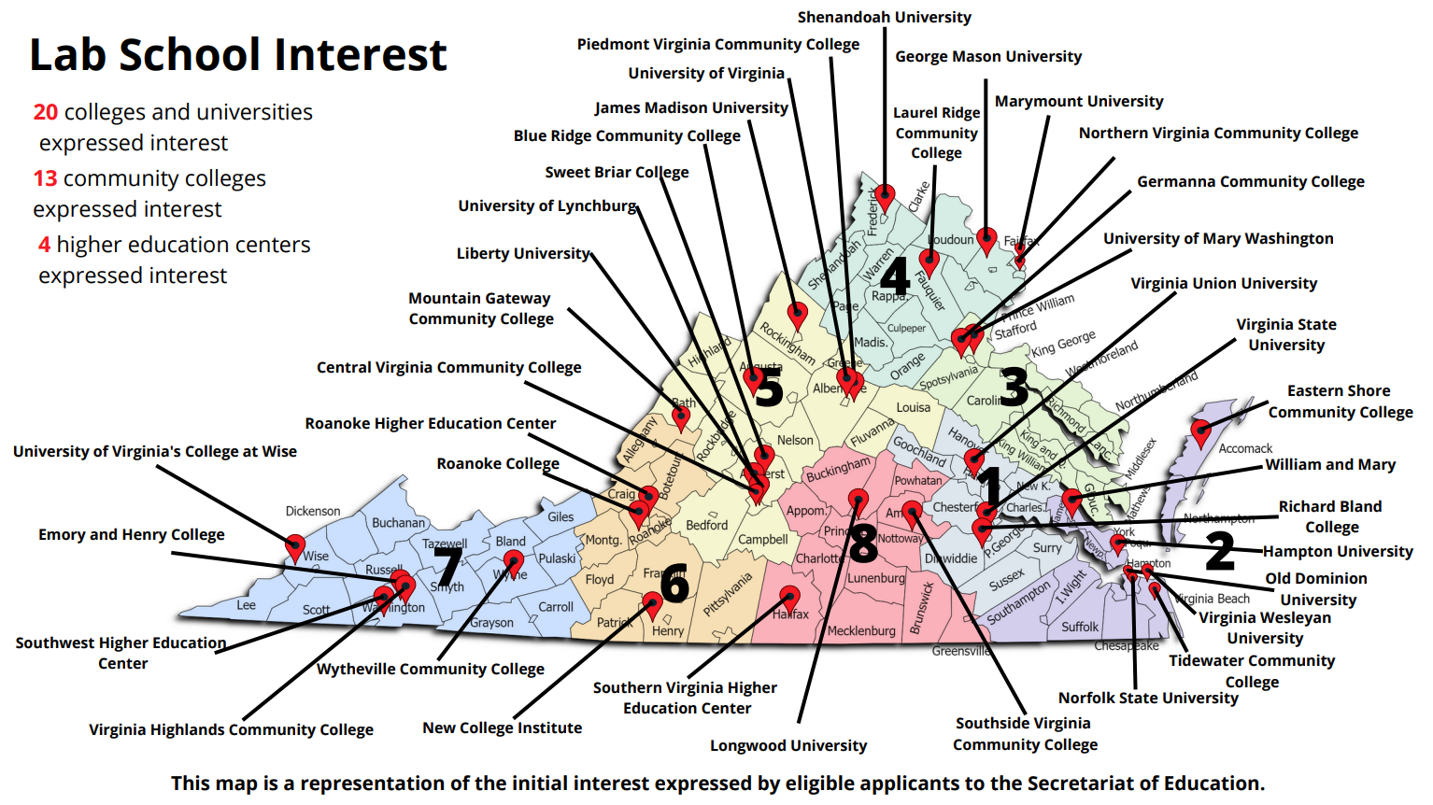

Slide 14
PLANNING GRANT GUIDELINES:
QUESTIONS AND DISCUSSION
Suggested topics:
  1. Board’s outreach recommendations
  2. Board’s plans to establish Board’s Committee on College Partnership Laboratory Schools (Lab School Standing Committee)

Slide 15
3. START-UP AND PER-PUPIL
GRANT GUIDELINES

Slide 16
OBTAINING APPROVAL FOR A LAB SCHOOL
Once an eligible entity is prepared to launch a lab school, it must submit an application for approval to the Board of Education.
Details of what must be included in a application for approval are set out in § 22.1-349.5 of the Code of Virginia and can also be found on the Virginia Department of Education’s (VDOE) webpage on lab schools.
  Application for approval components include items such as mission and vision, instructional program, assessment plan, details about facilities and operations, governance structure, administrative and staffing structure, and more.
An application for approval will go through an initial VDOE-led review process and complete applications for approval will advance to the Board.
The Board’s Committee on College Partnership Laboratory Schools (BOE Standing Committee) will be convened to review the application for approval and make a recommendation to the Board.
The Board will receive the Committee’s recommendations and determine approval status of applicant.
Once approved, the governing body of the new lab school will enter into an executing contract with the Board.

Slide 17
START-UP GRANT GUIDELINES
Approved lab schools can apply for initial start-up grants to support one-time (not recurring) costs up to $1M.
  Additional funding will be considered on a case-by-case basis and in accordance with available funds.
Common allowable expenditures include short-term staffing during start-up and implementation, consultants, contracted services, materials and supplies, technology devices, meeting costs, necessary travel and per diems.
  Start-up grant funds may be used for limited, one-time renovation or alteration of instructional spaces to prepare them for classroom instruction, as well as purchase of classroom materials, equipment, and furnishings.
  Major capital expenditures for land acquisition, new construction, or building-wide renovations are not permitted.
Building from its application for approval, the approved lab school will have already prepared necessary request components including a financial plan, benchmarks and deliverables, and community-based partnerships to ensure sustainability.

Slide 18
PER-PUPIL GRANT GUIDELINES
“Such [per-pupil grant] guidelines shall consider and be consistent with the distribution of state funds for Standards of Quality, Categorical, Incentive and Lottery program per-pupil costs.”
  A per-pupil operating funding grant request amount cannot exceed the average per pupil state-projected funding to educate a student, meaning the statewide average per-pupil funding, including state and local shares, for the fiscal year based on those Standards of Quality (SOQ), Categorical, Incentive and Lottery line-items designated in the current state budget for distribution on a per-pupil cost basis using March 31 average daily membership.
Common allowable expenditures include salaries and benefits of Lab School instructional and support staff, leased facilities that include the Lab School instruction spaces, consultants, contracted services, materials and supplies, technology devices, meeting costs, necessary travel and per diems.
  Major capital expenditures for land acquisition, new construction, or building-wide renovations are not permitted.
  Initial limited renovation/alteration of classroom spaces to prepare for Lab School opening should be supported with start-up grant funds.
Again, building from its application for approval, the approved lab school will have already prepared necessary request components including a financial plan, benchmarks and deliverables, and community-based partnerships to ensure sustainability.
  The lab school will also need to provide details of enrollment numbers to finalize award amount. The per-pupil operating funding grant amount will not decrease if, as of March 31, enrollment decreases by 20 percent or less than the awardee’s initial pupil enrollment estimate.

Slide 19
START-UP AND PER-PUPIL GRANT GUIDELINES: SUSTAINBILITY IS A KEY PRIORITY
Initial start-up and per-pupil grant funding are available to help mitigate the costs of launching a lab school. However, the success of a lab school and these grant programs rely on the long-term programmatic, operational, and financial sustainability of new lab schools.
  Lab school applicants must demonstrate strong community and local partnerships which help to guarantee the sustainability of a lab school. This can include collaboration with community partners, local school boards and divisions, employers, and local businesses, among others.

Slide 20
START-UP AND PER-PUPIL GRANT GUIDELINES:
QUESTIONS AND DISCUSSION

