Slide 1
First Review of Proposed Amendment 5 to Virginia’s Consolidated State Plan under the Every Student Succeeds Act of 2015 (ESSA)
Presentation to the Virginia
Board of Education
August 17, 2022

Slide 2
Proposed Change #1: Addition of a Multiple Races Student Group for Reporting
Consistent with ESEA section 1111(c)(2)(B), all major racial and ethnic groups should be included in federal accountability reporting.
The Virginia Department of Education (VDOE) has long defined a major racial or ethnic group as a student group that represents five percent or more of the student population in Virginia.
The multiple races group, which consists of student records that are marked with two or more races, currently represents more than five percent of the student population in Virginia.
The student group multiple races was approved as a component of the state accreditation system in April, 2019.

Slide 3
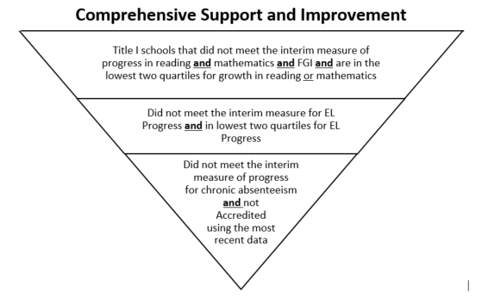
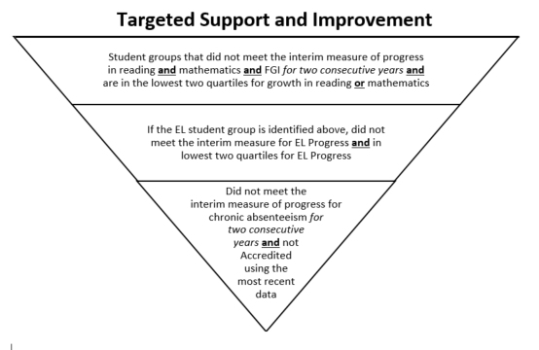
Proposed Change #2: Technical Edit to Step 3 of CSI and TSI Identification
There are three steps, or three sets of criteria, that are used to identify Comprehensive Support and Improvement (CSI) and Targeted Support and Improvement (TSI) schools.
Technical edit: Necessary so that a school which is Accredited because it is in a triennial accreditation period can still be considered for improvement if its most recent school year data does not indicate that the school met accreditation benchmarks.

Slide 4
Proposed Change #3: Revising Growth Methodology for 2022-2023 Federal Accountability Year
In the current Consolidated State Plan, Growth English Reading and Growth Mathematics includes students who passed the current year’s SOL test, and those who showed growth from the previous year SOL test to the current year SOL test.
However, Virginia administered growth assessments for the first time in fall 2021, and it is being proposed to incorporate those assessments into the growth methodology for federal accountability.
USED recommends that Virginia define the methodology so that the growth portion of the rate is determined by measuring student growth from spring 2021 to spring 2022 when a spring 2021 SOL test score for a student is available, and from the fall 2021 growth assessment score when a spring 2021 SOL test score is not available.
Another amendment will need to be submitted for accountability year 2023-2024 and beyond when further changes to our growth methodology are likely to occur.

Slide 5
Proposed Change #4: Shift Measures of Interim Progress Forward Two Years
The proposed change shifts measures of interim progress (“targets”) forward two years for Chronic Absenteeism, the Federal four-year graduation Index (FGI), and English Learner Progress.
This change was previously approved by the Board in March 2022 and then submitted to and approved by the U.S. Department of Education (USED) in the COVID-19 Addendum. However, since the shift forward is a long-term change, USED has stated that it is necessary to update the Consolidated State Plan.

Slide 6
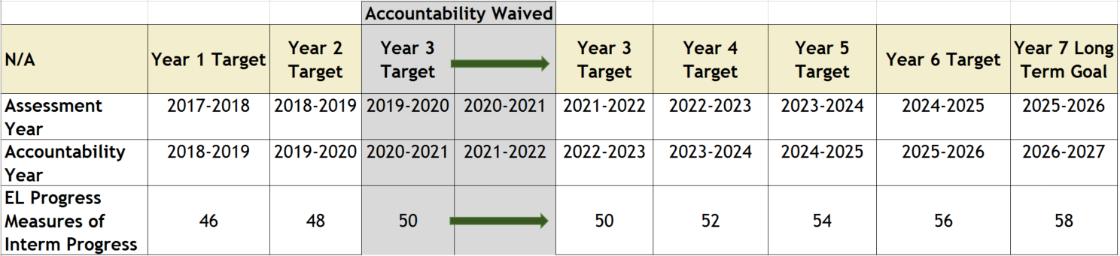
Proposed Change #4: Illustration of Measures of Interim Progress Shift

Slide 7
Proposed Change #5: New Measures of Interim Progress and Long Term Goals: Reading and Mathematics
ESEA section 1111(c)(4)(A)(i)(I)(aa) requires that measures of interim progress and long-term goals be based on student performance on the State’s current annual assessments.
A new reading assessment was administered for the first time to a fully representative student population during the 2021-2022 school year.
New mathematics and reading Virginia Alternate Assessment Program (VAAP) tests were administered for the first time during the 2021-2022 school year.

Slide 8
Proposed Measures of Interim Progress and Long Term Goals
Raises expectations for ALL student groups and places increased focus on closing achievement gaps;
Baseline measures of interim progress are set at the pass rate of the school at the 50th percentile of enrollment using the 2021-2022 school year data, rather than at the pass rate of the school at the 20th percentile of enrollment used in the past;
Increases the long-term goals for both reading and mathematics for all student groups:
  Reading: from 75% to 88%
  Mathematics: from 70% to 85%
Increases the intensity and urgency of closing the achievement gaps since lower performing student groups have greater overall increases to make towards the same long-term goal than higher performing groups, within the same time frame.

Slide 9
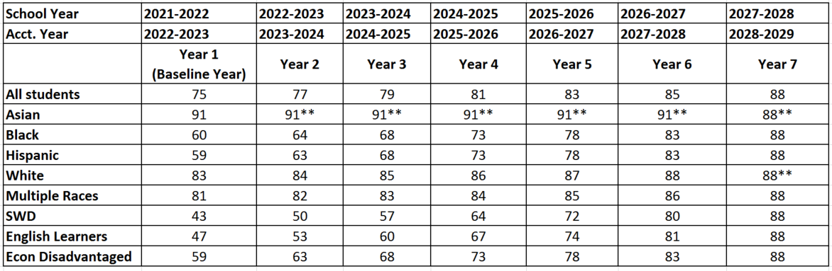

Proposed Measures of Interim Progress and Long Term Goal for Reading
** indicates the rate must meet or exceed the rate from the previous year
The long term goal is based on All Students and closes the difference between the baseline and 100% proficiency by 50%.

Slide 10
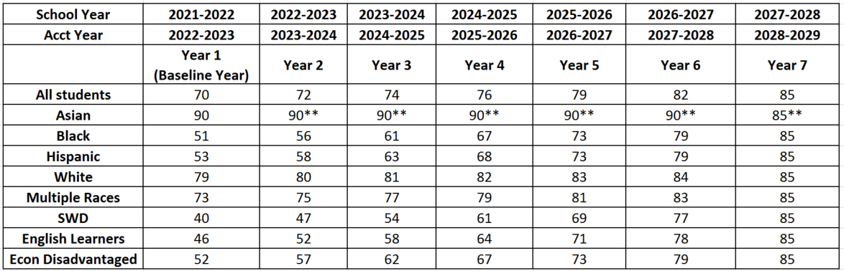
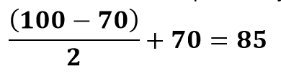
Proposed Measures of Interim Progress and Long Term Goal for Mathematics
** indicates the rate must meet or exceed the rate from the previous year
The long term goal is based on All Students and closes the difference between the baseline and 100% proficiency by 50%.

Slide 11
Proposed Change #6: Edit a Reference Year
As approved in the COVID-19 Addendum, schools that were initially identified as Additional Targeted Support and Improvement (ATSI) in 2018-2019 would enter Comprehensive Support and Improvement status if they did not exit ATSI by fall 2024.
The current Consolidated State Plan references 2021-2022 (this year was determined pre-pandemic) and should be changed to 2024-2025 to reflect the change approved in the COVID-19 Addendum.

