Slide 1

Review and Revision of the History and Social Science Standards of Learning
August 2022
VDOE History and Social Science Program

Slide 2
Overview
The Standards of Learning
Review and Revision Process
  Public Comment
  Review Committees
Developing the Standards Document
  Progression of the Curriculum Framework
  New Structure
Reviewing and Revising the Content
Next steps

Slide 3
Code of Virginia
§ 22.1-253.13:1. Standard 1. Instructional programs supporting the Standards of Learning and other educational objectives.
B. The Board of Education shall establish educational objectives known as the Standards of Learning, which shall form the core of Virginia's educational program, and other educational objectives, which together are designed to ensure the development of the skills that are necessary for success in school and for preparation for life in the years beyond.
...The Board of Education shall include in the Standards of Learning for history and social science the study of contributions to society of diverse people. For the purposes of this subsection, "diverse" includes consideration of disability, ethnicity, race, and gender.

Slide 4
Code of Virginia
§ 22.1-253.13:1. Standard 1. Instructional programs supporting the Standards of Learning and other educational objectives.
C. Local school boards shall develop and implement a program of instruction for grades K through 12 that is aligned to the Standards of Learning and meets or exceeds the requirements of the Board of Education.

Slide 5
Vision
Change history and social science instruction in the Commonwealth of Virginia
The Standards are NOT a means to an end: Passing a Test;
but they are a base of knowledge, understanding, and confidence to:
honor our collective history;
make informed decisions and take informed action; and
respond and engage in ways that benefit our communities, state, nation, and the world

Slide 6
Goals of the Review and Revision
Develop Standards that focus on the study of contributions to society of diverse people and multiple perspectives (22.1-253.13:1)
Continue the emphasis on the social science skills to indicate what students should know, understand, and be able to do.
Establish a structure that promotes inquiry and coaches teachers to shift their practice to focus on compelling questions, the use of valid information sources, and opportunities to link instruction and assessment.
Frame the Standards Document with the incorporation of themes or concepts which can thread both horizontally and vertically throughout the grade levels/courses.

Slide 7
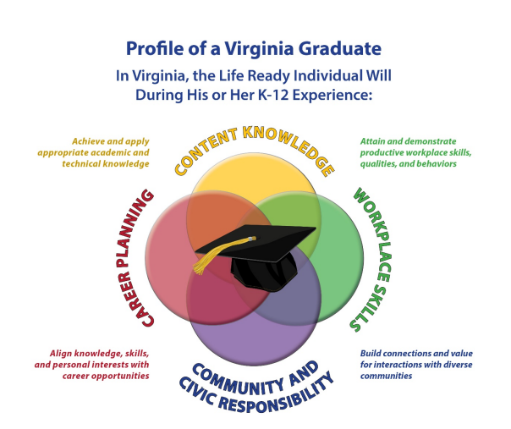
Goals of the Review and Revision

Slide 8
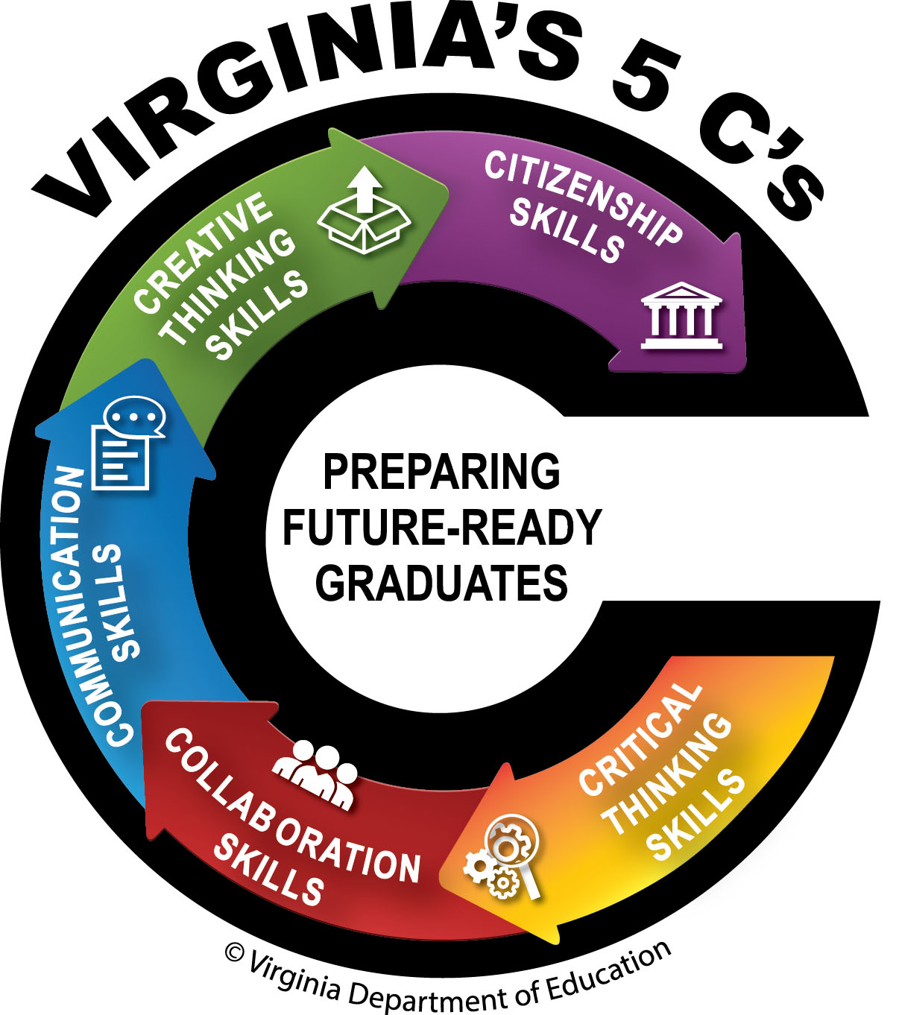
Goals of the Review and Revision

Slide 9
The Standards of Learning

Slide 10
Defined as . . .
The Standards of Learning (SOL) describe the commonwealth's expectations for student learning and achievement in grades K-12 in English, mathematics, science, history/social science, technology, the fine arts, foreign language, health and physical education, and driver education.

Slide 11
Standards vs. Instruction
The Standards are used by school divisions to design their local core instructional program for all students known as Tier 1. Tier 1 is implementing well researched programs and practices that have produced good outcomes for students. (VTSS VDOE)

Slide 12
Standards vs. Instruction
The work during the Review and Revision of the Standards of Learning for history and social science focused on reviewing and revising the Standards and not the work done at the local level to design curriculum to meet the exceptional needs of students (English Language Learners, Gifted, and Students with Disabilities).

Slide 13
Standards vs. Curriculum
Standards | Curriculum
Establish a statewide baseline of what students should know and be able to do at the conclusion of a course | Outlines the instructional program and should emphasize the development of students' abilities to acquire and apply the standards
Are vertically aligned and represents a goal or outcome of an educational program | Must ensure that appropriate accommodations are made for diverse populations of students and indicate the decisions on how best to help students meet these program goals.

Slide 14
Standards vs. Curriculum
Standards | Curriculum
Do not dictate the design of a lesson plan or how units should be organized | Created by school leaders and teachers based on their decisions for pacing, funding allocations, selection of books and resources, data, student needs, and approved by their local school board
Are statements of what students should be able to do after instruction and are not a narrative or a set of instructional or assessment tasks | Includes the vast array of instructional materials, readings, learning experiences and local mechanisms of assessment, including the full body of content knowledge to be covered, all of which are to be selected at the local level

Slide 15
Review & Revision Process

Slide 16


Something different. . .
The 2022 Review Process for HSS:
Develop a one Standards Document and
Review and Revise the Standards and the Curriculum Frameworks at the same time.

Slide 17
HSS Review and Revision Timeline
2021
2021
2021
2022
2022
2022
Winter/Spring
Summer
Fall
Winter/Spring
Summer
Fall
Educators develop a proposed document
External Committees review proposed documents
Compile the input for the Standards Document
Update the Virginia Board of Education
Collaborating and Compile the Standards Document
Draft reviewed by Agency
Consider Public Comments from the Public Hearings
Prepare Standards Document for Final Review
Seek Final Approval from the Board of Education
First Review by the Virginia Board of Education
Public Hearings and Community Engagement Roundtable Discussions across the Commonwealth
Collect Public Comments
Call for Educators to serve
Practitioner Steering Committees review proposed documents
Historian Steering Committee proposed edits to documents
Notes:
As you are aware, we are almost to the finish line and making great progress. For additional details please visit: timeline: https://www.doe.virginia.gov/boe/meetings/2021/01-jan/item-t.docx

Slide 18
Public Comment
Initial Public Feedback on the 2015 Standards of Learning

Slide 19
Public Comments
Public Comments Submitted by Google Forms:
Course | Google Forms Submitted | Total Responses
Kindergarten | 57 | 291
Grade One | 46 | 268
Grade Two | 38 | 291
Grade Three | 39 | 215
Virginia Studies | 33 | 198
United States History to 1865 | 29 | 164
United States History 1865 to Present | 97 | 315
Civics & Economics | 25 | 151
World Geography | 71 | 325
World History and Geography to 1500 | 420 | 1,134
World History and Geography 1500 to Present | 443 | 1,267
Virginia and United States History | 42 | 291
Virginia and United States Government | 26 | 255
Google Forms Submitted: | 1366
Total Public Comments |  | 5,165
Notes:
As you can see History and Social Science instruction is import to Virginia teachers, families and professionals.

Slide 20
Review Committees

Slide 21
Committees
Practitioners Steering - Division-level specialist/coordinators responsible for history and social science instruction at the local division level
Historian Steering - Historians invited to review the Standards and CF and provide preliminary feedback and input
External Student Advisory Council - Students invited to provide input and feedback
Educators Committee - Division teachers and administrators selected through an application process

Slide 22
Committees
External Museums and Organizations - Educators, faculty, or representatives of a history and social science museum or organization with a specific area of focus or specialty
External Historians and Professors - Staff of Institutions of Higher Education invited to check the accuracy of the feedback provided by all previous committees and to ensure there are opportunities for exploration of diverse perspectives and balance
External Parent Advisory & CTE/Business Leader Advisory - Regional representatives provided input

Slide 23
Committees
Committee | Invited | In Attendance
Historian Steering Committee | 6 | 6
Practitioner Steering Committee | 34 | 34
Educator Committee | 63 | 48
Museum and Other Organizations | 45 | 34
Student Committee | 16 | 10
CTE and Business Leaders | 8 | 5
Parent Advisory Committee | 38 | 25
Historian and Professors | 39 | 33
Transition Steering Committee | 16 | 16
Totals: | 265 | 211

Slide 24
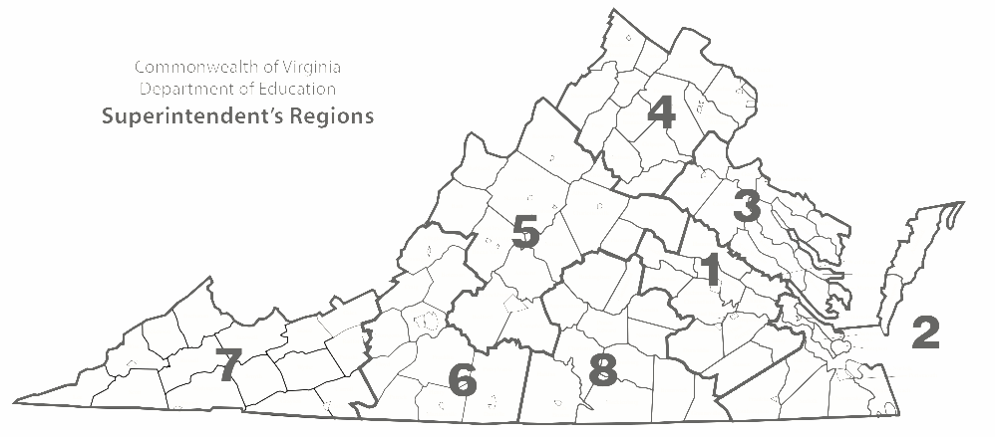
Standards Review Regional Representation
Practitioner and Educator Committees
Practitioner and Educator Committees

Slide 25
Standards Review Regional Representation
Practitioner and Educator Committees
Museums, Organizations, Professors, and Historians Committees

Slide 26
Standards Review Regional Representation
Practitioner and Educator Committees
Committees
Museums, Organizations, Professors, and Historians Committees
VA Parent Advisory, CTE &
Business Leaders

Slide 27
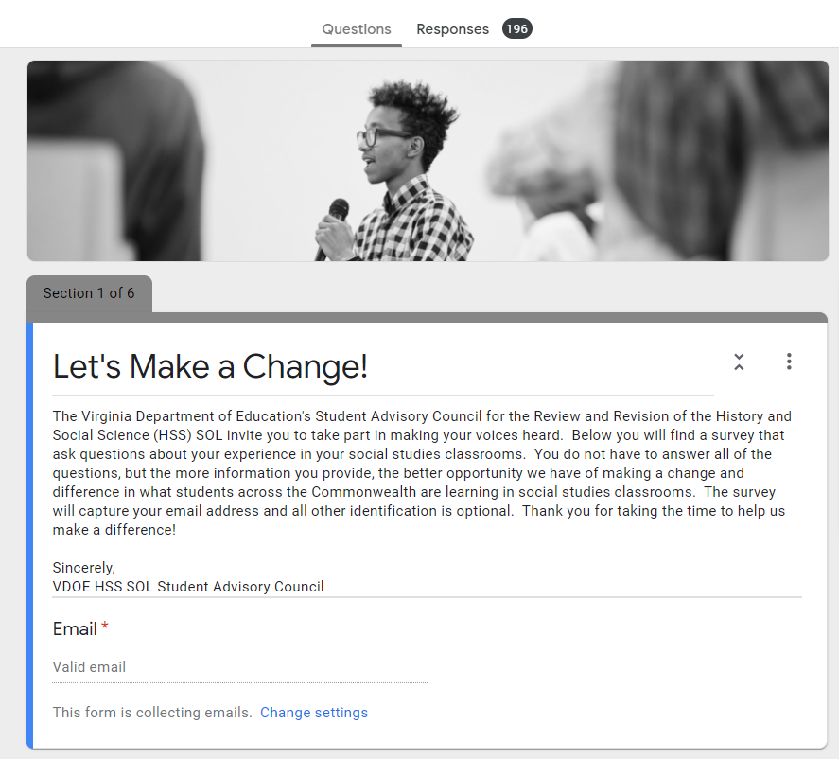
Student Advisory Committee
Student Advisory Committee (SAC) consisted of juniors and seniors selected by Regional Superintendent’s representatives
SAC developed a questionnaire:
Met in May 2021
Questions were developed by the students
25 questions asking about their opinions about the coverage of content, the skills they may have gained, and the instruction they felt they have received.

Slide 28
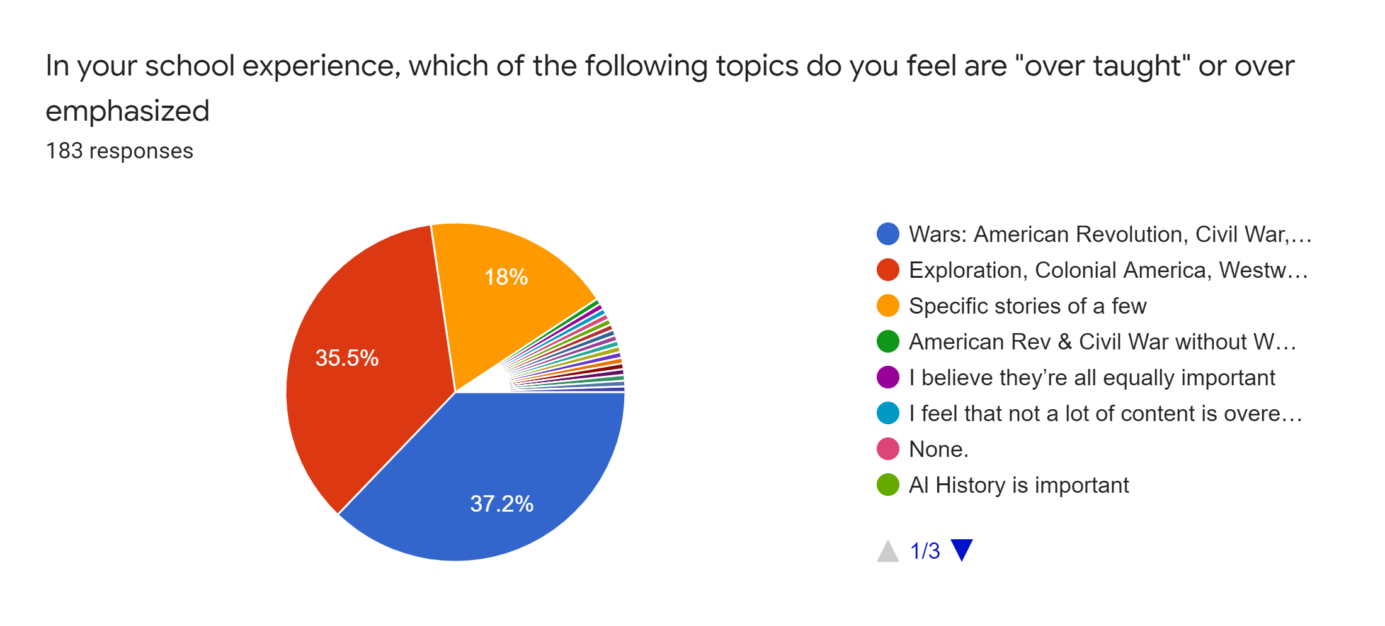
Student Advisory Committee

Slide 29
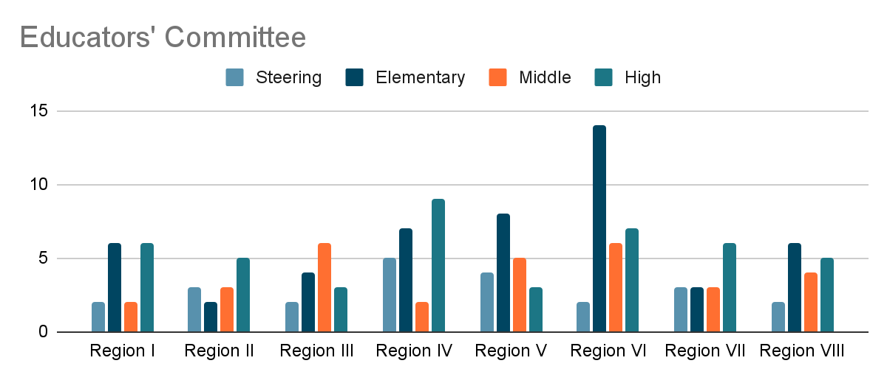
Educator’s Committee
Committees met virtually July 12 - 23, 2021

Slide 30
Educator’s Committee
Please review and/or complete the items below prior to Educator Committee Meetings.
Task and Link(s): |  | Due Date:
Complete Contact Information Google Form to ensure proper processing of incentive payments following committee work. |  | Friday, July 9th
Review the following documents: C3 Framework: College, Career, and Civic Life (2015) The State of State Standards for Civics and U.S. History in 2021 (Fordham Institute) Educating for American Democracy (2021) 2015 History and Social Science Standards 2015 History and Social Science Skills Progression Chart Final Report of the Virginia Commission on African American History Education in the Commonwealth |  | Prior to Monday, July 12, 2021
Review Examples of National Standards: Voluntary National Content Standards for Economics National Curriculum Standards for Social Studies National Geography Standards United States History Content Standards Educating for American Democracy (2021) |  | Prior to Monday, July 12, 2021

Slide 31
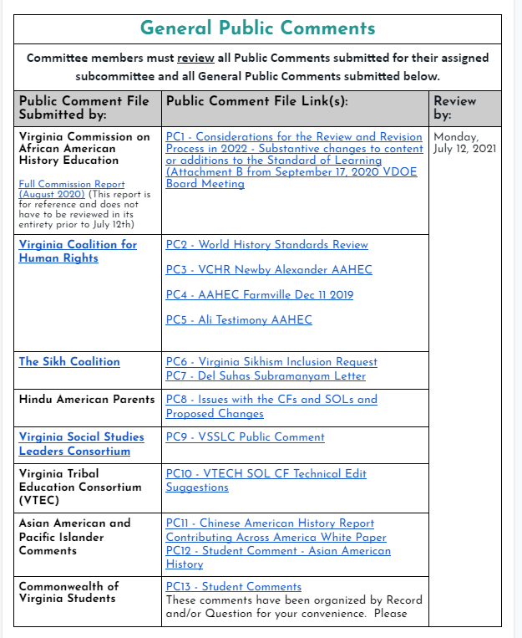
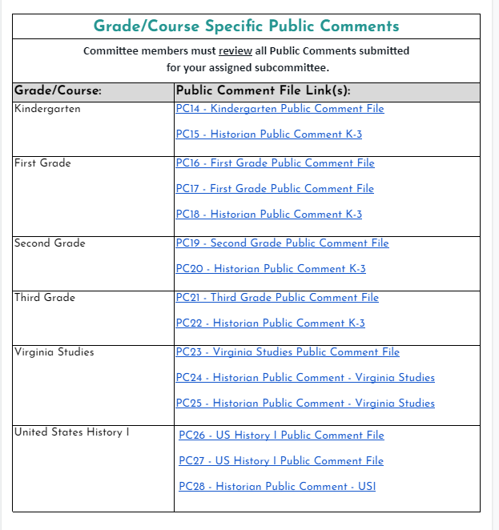
Educator’s Committee
Public Comments were organized by organization and grade/course

Slide 32
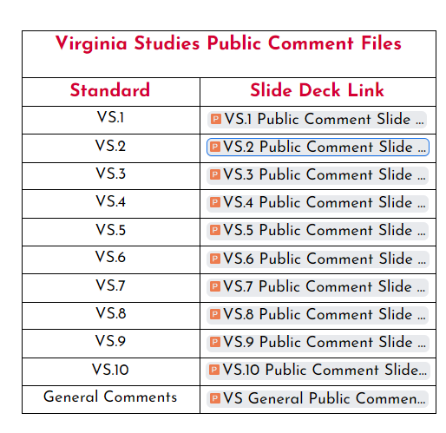
Educator’s Committee
Slide deck of the Public Comments for Virginia Studies

Slide 33
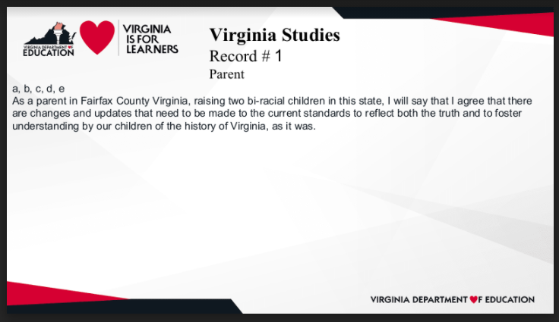
Educator’s Committee
Public Comments were organized by organization and grade/course

Slide 34
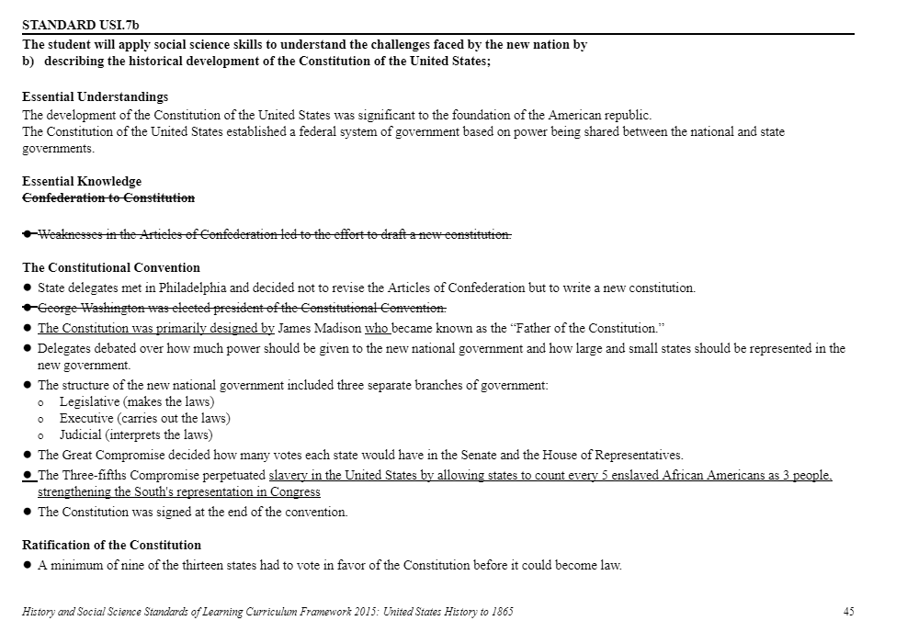
Educator’s Committee
Educators Committee developed a Strikethrough Document based upon consideration of public comment and instructional experience

Slide 35
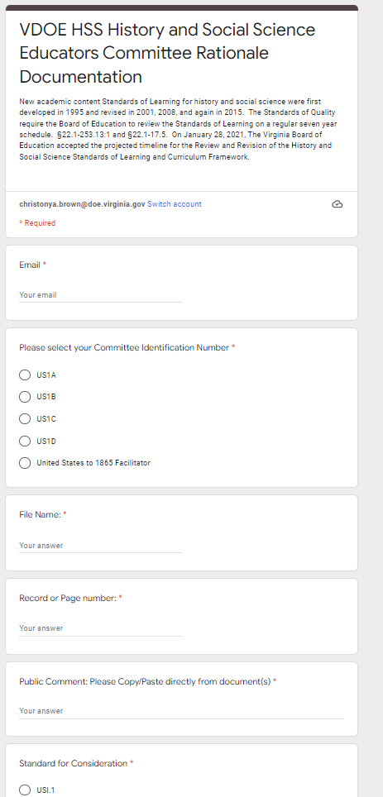
Educator’s Committee
Educators Committee completed a Rationale Form for any changes made in the Strikethrough Document as justification for the change

Slide 36
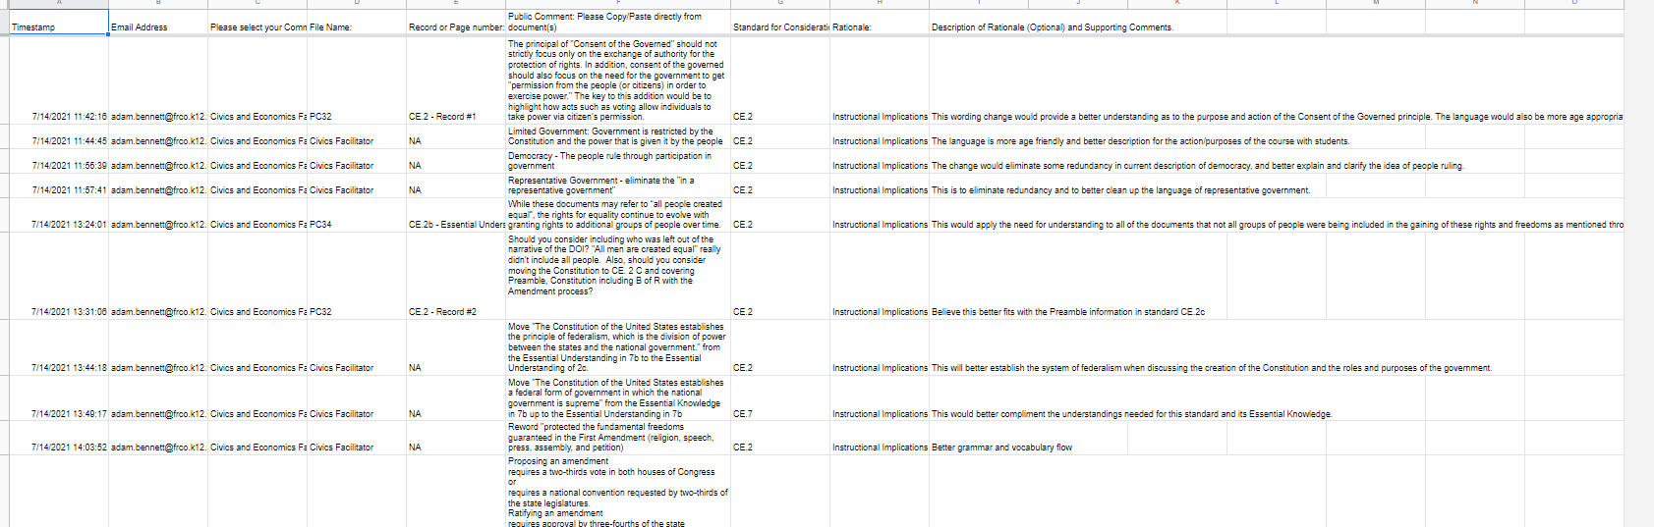
Educator’s Committee
Rationale Form Data
Course
Change
Rationale

Slide 37
Strikethrough Document moved from
Practitioners and
Educator Committee:
Developed the Strikethrough Document
Museums and Organizations:
Provided feedback and content

Slide 38
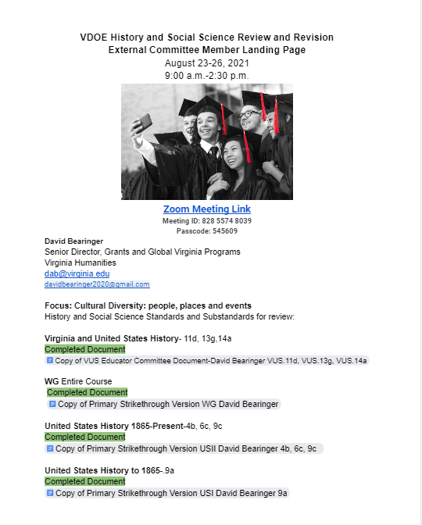
External Committees –
Museums and Organizations
Committees met virtually
August 23 - 26, 2021
Landing Page
Meeting Dates and Time
Committee Member and contact information
Area of focus
Courses and Standards to review
Notations were made on the Strikethrough Document

Slide 39
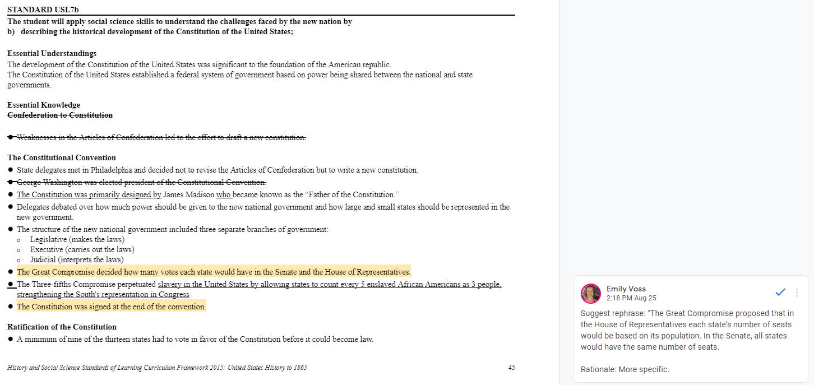
External Committees –
Museums and Organizations
External Committee provided comments on the Strikethrough Document developed by the Educators Committee

Slide 40
Strikethrough Document moved from
Historians and Professors: Provided feedback.
Checked document for historical accuracy
Museums and Organizations:
Provided feedback and content

Slide 41
External Committees –
Historians and Professors
Committees met virtually
September 22 - October 8, 2021
Landing Page
Meeting Dates and Time
Committee Member and contact information
Area of focus
Courses and Standards to review
Notations were made on the Strikethrough Document

Slide 42
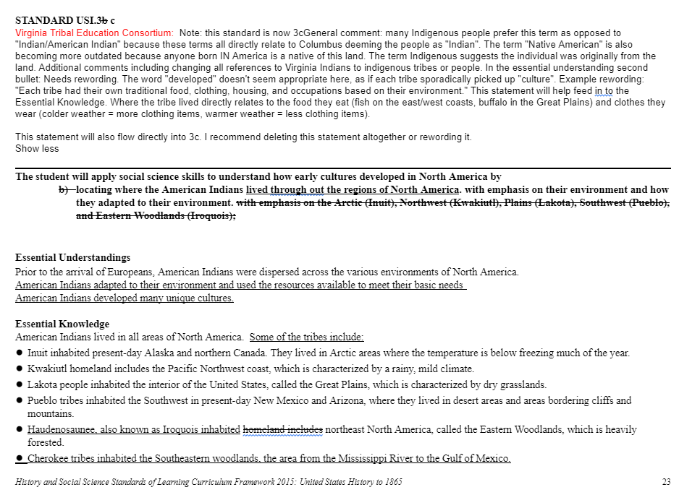
External Committees –
Museums and Organizations
Strikethrough Document
Work from the Educator Committee
Input from the Museums and Organizations
Access to public comments
Notations were made on the Strikethrough Document

Slide 43
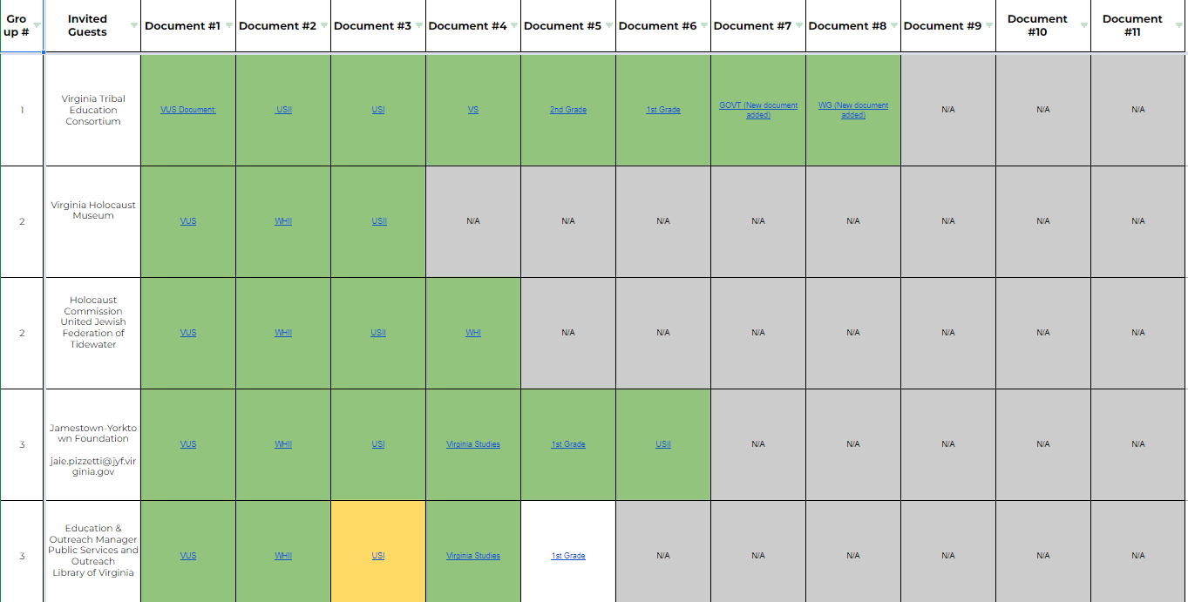
External Committees – Tracking
HSS Program
Facilitated the meetings and
Tracked the progress and input of all committee members

Slide 44
Strikethrough Document moved from
Historians and Professors: Provided feedback.
Checked document for historical accuracy
Practitioner’s Committee:
Reconcile the Strikethrough Document into the New Structure

Slide 45
Strikethrough Document moved from
Collected feedback from the External Parent Advisory & CTE/Business Leader Advisory - Regional representatives provided input

Slide 46
Combine into one
Standards Document

Slide 47
Reconvened Practitioner’s Committee February - April 2022
Provided a template for the structure
Read through all of the comments and input
Transferred Standards, Sub standards, and Understandings to new structure
Developed Overarching Questions, Supporting Questions, and Knowledge and Learning Experiences based upon comments and input

Slide 48
Practitioners and
Educator Committee
Public Comment
Historian Steering Committee
Student Advisory
Review and Revision Cycle
Museums and Organizations
External Parent Advisory & CTE/Business Leader Advisory
Practitioner’s Committee
Historians and Professors

Slide 49
Developing the Standards Document

Slide 50
Development of the History and Social Science SOL
In 1995, the Virginia Board of Education published Standards of Learning in English, mathematics, science, and history and social science for kindergarten through grade 12. Subsequently, Standards of Learning were developed for all academic content areas. The Standards of Learning provide a framework for instructional programs designed to raise the academic achievement of all students in Virginia. School divisions and teachers work to align the local curriculum and classroom instruction with the Standards of Learning.
Pursuant to legislation from the 2000 Virginia General Assembly, the Board of Education established a seven-year cycle for review of the Standards of Learning. Thus, the 1995 History and Social Science Standards of Learning were reviewed in 2001, 2008, and 2015. The Virginia Department of Education convened review committees to review and revise the 2015 History and Social Science Standards of Learning and the results of those reviews are contained in this document.

Slide 51
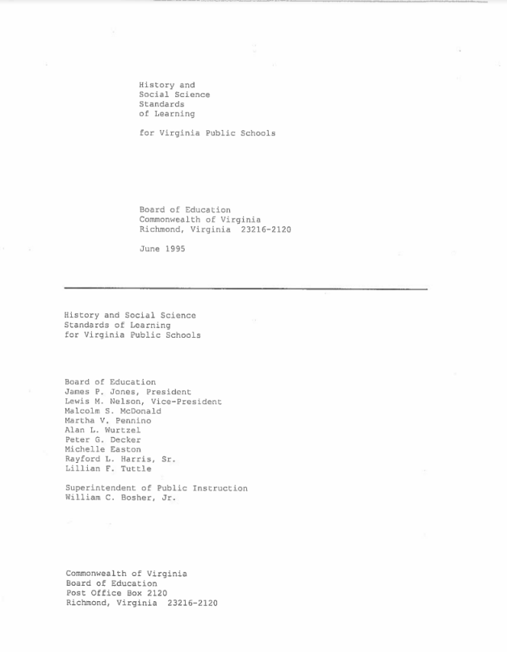
1995
Virginia Studies: 1607 to Present
4.1 The student will explain the impact of geographic factors in the expansion and development of Virginia, with emphasis on the location of American Indians, various European settlers, and African slaves; and the location and growth of cities in relation to the Atlantic Ocean, the Chesapeake Bay, major rivers, the fall line/fall zone, and the Shenandoah Valley.

Slide 52
2001
Resolution Number 2001-35
July 26, 2001
WHEREAS, in March 2001, the Board of Education approved the revised History and Social Science Standards of Learning and requested a review of the companion 1999 History and Social Science Teacher Resource Guide; and
WHEREAS, the History and Social Science Teacher Resource Guide was revised primarily in two specific areas: (a) sequencing for effective instruction and assessment and (b) quantity of material for effective teaching within available instructional time; and
WHEREAS, the History and Social Science Teacher Resource Guide has been supplemented to recognize additional contributions and experiences of men and women of diverse racial, ethnic, cultural and religious groups in the history of Virginia, the United States and the world; and
WHEREAS, the Board has conducted public hearings on the revised Teacher Resource Guide for the History and Social Science Standards of Learning and comments from those hearings have been incorporated into the final document; and
WHEREAS, the name for the Guide has been changed to Curriculum Framework to reflect the intended use of the document for school divisions; and
NOW, THEREFORE, BE IT RESOLVED by the Board of Education that the revised Curriculum Framework for the History and Social Science Standards of Learning will be approved for implementation in Virginia’s public schools.

Slide 53

2001
Virginia: The Land and Its First Inhabitants
VS.2 The student will demonstrate knowledge of the geography and early inhabitants of Virginia by
locating Virginia and its bordering states on maps of the United States;
locating and describing Virginia’s Coastal Plain (Tidewater), Piedmont, Blue Ridge Mountains, Valley and Ridge, and Appalachian Plateau;
locating and identifying water features important to the early history of Virginia (Atlantic Ocean, Chesapeake Bay, James River, York River, Potomac River, and Rappahannock River);
locating three American Indian (First American) language groups (the Algonquian, the Siouan, and the Iroquoian) on a map of Virginia;
describing how American Indians (First Americans) adapted to the climate and their environment to secure food, clothing, and shelter.

Slide 54
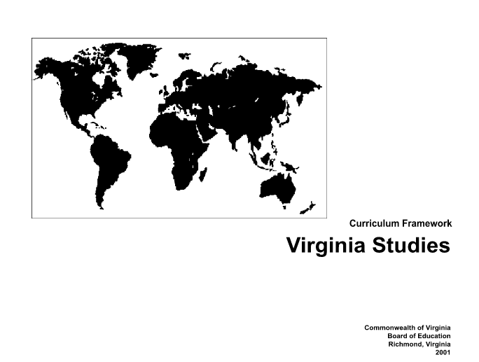
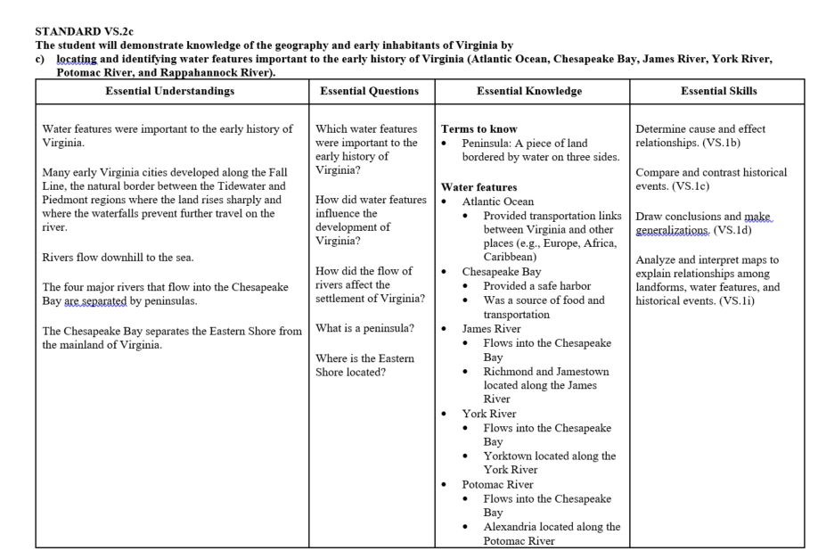
2001

Slide 55

2008
Virginia: The Physical Geography and Native Peoples
VS.2 The student will demonstrate knowledge of the physical geography and native peoples, past and present, of Virginia by
a) locating Virginia and its bordering states on maps of the United States;
b) locating and describing Virginia’s Coastal Plain (Tidewater), Piedmont, Blue Ridge Mountains, Valley and Ridge, and Appalachian Plateau;
c) locating and identifying water features important to the early history of Virginia (Atlantic Ocean, Chesapeake Bay, James River, York River, Potomac River, Rappahannock River, and Lake Drummond and the Dismal Swamp);
d) locating three American Indian language groups (the Algonquian, the Siouan, and the Iroquoian) on a map of Virginia;
e) describing how American Indians related to the climate and their environment to secure food, clothing, and shelter;
f) describing how archaeologists have recovered new material evidence at sites including Werowocomoco and Jamestown;
g) identifying and locating the current state-recognized tribes.

Slide 56
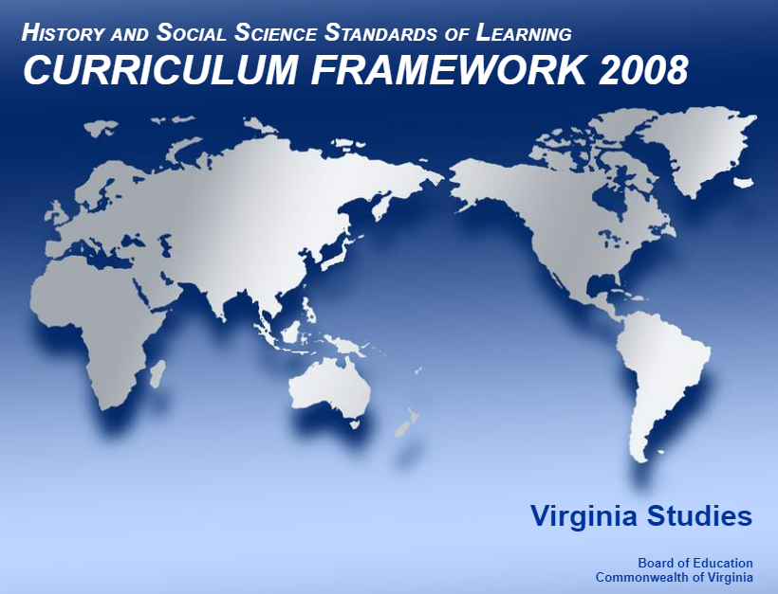
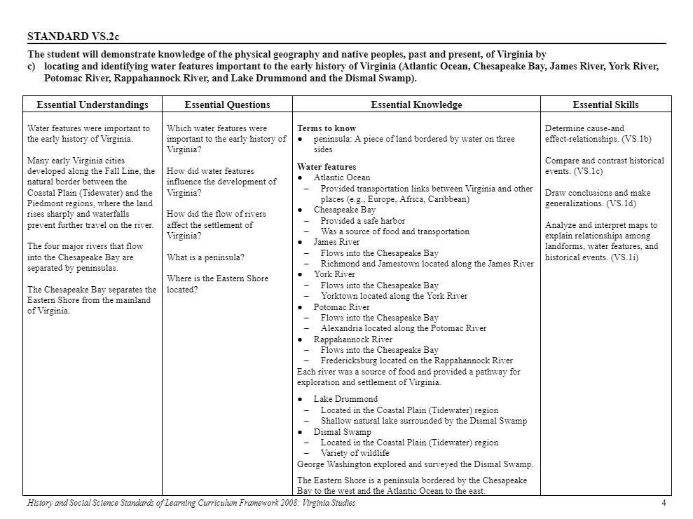
2008

Slide 57
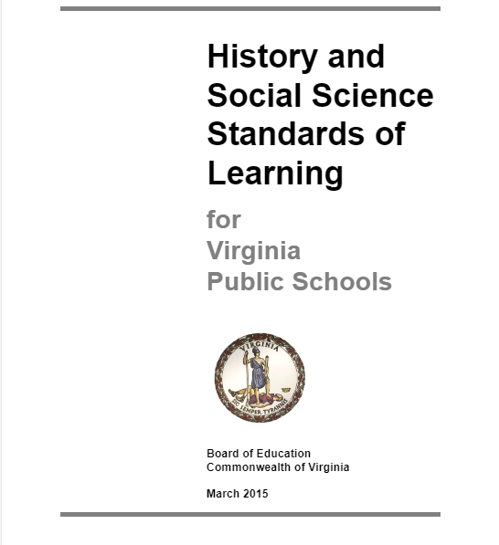
2015
Virginia: The Physical Geography and Native Peoples
VS.2 The student will demonstrate an understanding of the relationship between physical geography and the lives of the native peoples, past and present, of Virginia by
a) locating Virginia and its bordering states on maps of the United States;
b) locating and describing Virginia’s Coastal Plain (Tidewater), Piedmont, Blue Ridge Mountains, Valley and Ridge, and Appalachian Plateau;
c) locating and identifying water features important to the early history of Virginia (Atlantic Ocean, Chesapeake Bay, James River, York River, Potomac River, Rappahannock River, and Lake Drummond and the Dismal Swamp);
d) locating three American Indian language groups (the Algonquian, the Siouan, and the Iroquoian) on a map of Virginia;
e) describing how American Indians related to the climate and their environment to secure food, clothing, and shelter;
f) describing how archaeologists have recovered new material evidence at sites including Werowocomoco and Jamestown; and
g) describing the lives of American Indians in Virginia today.

Slide 58

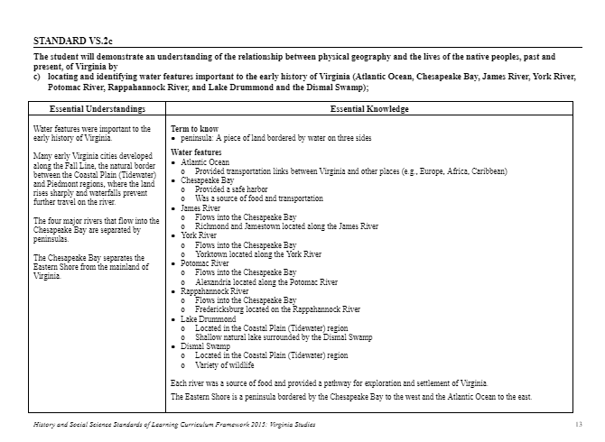
2015

Slide 59
Consideration of:
Over 5,000 Comments received from over 200 Committee members
Incorporation of:
  Inquiry-based practices
  History and Social Science Skills
  Literacy and STEM connection opportunities
  Workplace readiness skills
Reality:
  Greater focus on memorization versus understanding and connections
  Support to educators with curriculum development, content resources and professional development to consider.
  180 Days of school

Slide 60
What Changed?

Slide 61
Review and Revision Cycle
Practitioner’s Committee

Slide 62
Combine into one
Standards Document

Slide 63
New Structure
Increased the information in the Front Matter for greater transparency and opportunities to understand the Standards
Literacy and Workplace Readiness Skills
Reorganization to allow for Inquiry-based learning
Macro-concepts for K-12 and identify how we can expand to micro-concepts each grade level
Identification of Overarching and Supporting questions, sources, and tasks
Teacher guidance
Making sure something from the framework feels familiar to anchor their new learning

Slide 64
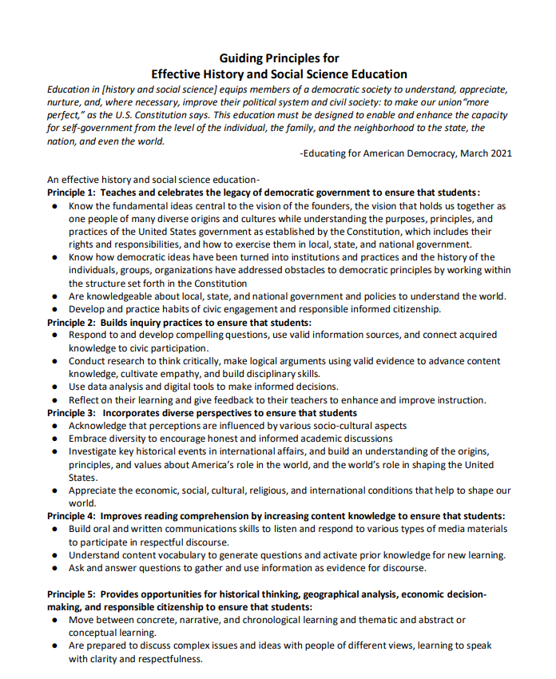
New Structure – Guiding Principles

Slide 65
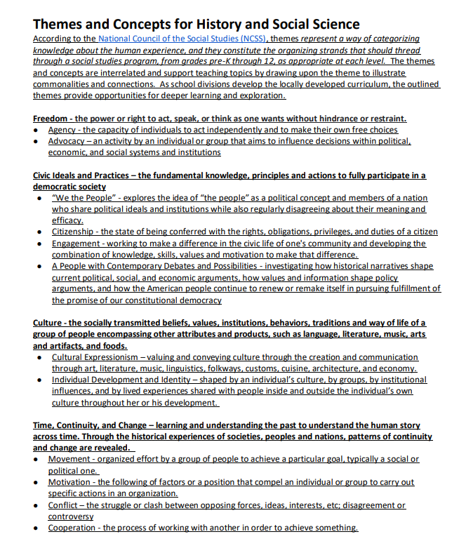
New Structure – Themes and Concepts

Slide 66
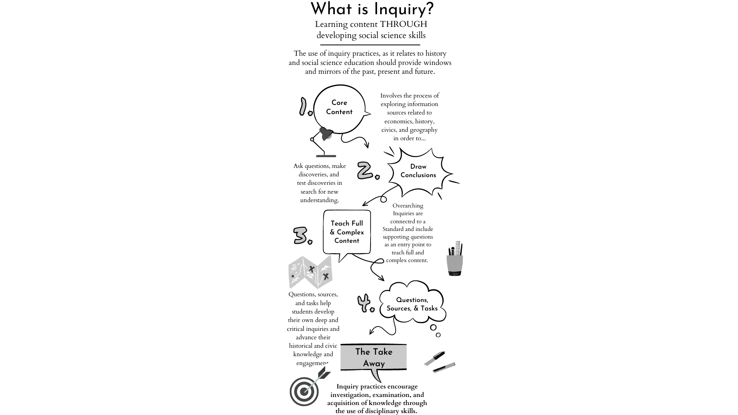
New Structure – Inquiry Based Practices
Use of questions, sources, and tasks to learn

Slide 67
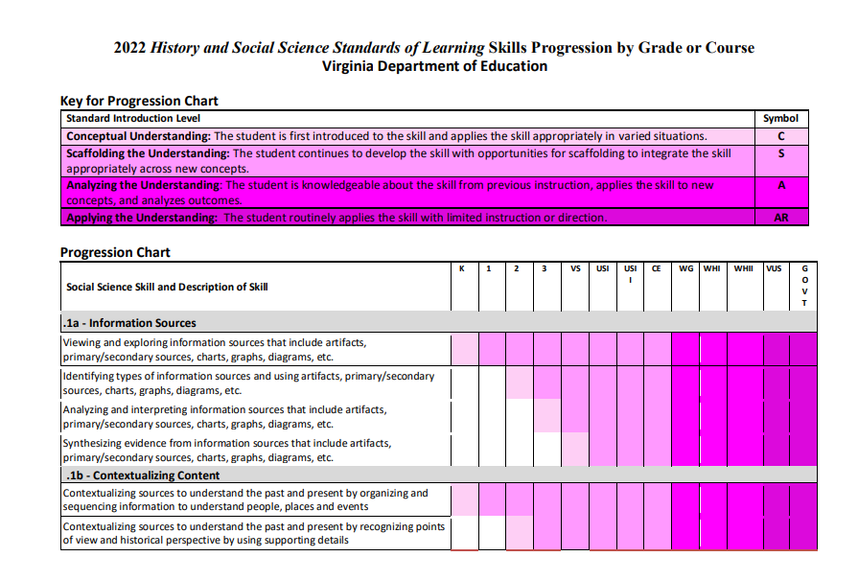
New Structure – Skills Progression

Slide 68
New Structure – Course Introduction
Virginia Studies
The standards for first-grade students include an introduction to the lives of leaders in the history of Virginia and their contributions to the Commonwealth. Students should develop basic map skills. They should study the economic concepts of goods and services, consumers and producers, and making economic choices. Students should learn to apply the traits of a good citizen and recognize that communities in Virginia have local governments. They should learn that communities include people who have diverse ethnic origins, customs, and traditions, who make contributions to their communities, and who are united as Americans by common principles. The Standards for Virginia Studies develop student understanding of Virginia from the Indigenous Peoples who first inhabited the region to present day Virginia with emphasis on the diverse perspectives of the various people who have been part of Virginia’s story. During the course of study, students will explore the basic features of the region and how Indigenous Peoples, the impact of English colonization, the arrival of Africans, and the development of a colonial society. Students will also examine the role Virginia played during Revolutionary War and the development of the first United States government. They will be able to connect those ideas and history to the expansion of Virginia and its role in the Civil War, and how Virginia grew through the 21st century and the challenges and opportunities that Virginia has faced throughout its development. Lastly, students will examine the contributions of change-makers, innovative ideas, and technological, economic and political advancements to the nation and world.
Looking Back, Looking Ahead, and Literacy Connections Students will apply foundational knowledge and skills from previous Social Science Standards of Learning to study the development of Virginia, focusing on the reasons for the settlement of Virginia and the impact on the diverse people who are part of Virginia’s story. The fundamental skills and content introduced in the Kindergarten – Grade Three Standards provided a foundation of skill application and content knowledge. The skills and content are instructionally vital for deeper learning and understanding of Virginia Studies. Each standard, introduced with an Overarching Inquiry Question, encourage student exploration of concepts and themes. Key Knowledge and Learning Experiences, integrated to help students use artifacts, primary and secondary sources to summarize ideas and support with evidence, determine cause and effect, sequence events, recognize multiple perspectives, ask questions, and make connections over time and place. Workplace Readiness Skills of RESPECT FOR DIVERSITY by valuing individual differences and working collaboratively with people of diverse backgrounds, viewpoints, and experiences and TEAMWORK by learning to share the responsibility for collaborative work and respects the thoughts, opinions, and contributions of other students. Building upon those skills, students will have opportunities to continue to develop skills of INITIATIVE AND SELF-DIRECTION to look independently for ways to accomplish tasks. As students were learning to read, they are now transitioning to reading to learn and will apply reading, writing, and communication skills to the Standards for Virginia Studies. This will support their understanding of Virginia’s geography, economic choices, and the responsibilities that citizens have in the larger community.

Slide 69
Proposed 2022
New Structure – The Standards
VS.2 The student will demonstrate an understanding of the relationship between physical geography and the lives of the native peoples, past and present, of Virginia by
c) locating and identifying water features important to the early history of Virginia (Atlantic Ocean, Chesapeake Bay, James River, York River, Potomac River, Rappahannock River, and Lake Drummond and the Dismal Swamp);

Slide 70
Proposed 2022
New Structure – The Standards
Virginia’s Geography
VS.2 The student will apply history and social science skills to demonstrate an understanding of the relationship between physical geography and the lives of the native Virginia’s peoples, past and present of Virginia by locating Virginia, and its bordering states on maps of the United States and North America; locating and describing the relative location and physical characteristics of Virginia's five geographic regions on a map Virginia's Coastal Plain, Piedmont, Blue Ridge Mountains, Valley and Ridge, and Appalachian Plateau; locating, and identifying and describing the impact of water features important to the early history of Virginia (Atlantic Ocean, Chesapeake Bay, James River, York River, Potomac River, Rappahannock River, and Lake Drummond and the Dismal Swamp);. locating three American Indian language groups (the Algonquian, the Siouan, and the Iroquoian) on a map of Virginia; [moved to VS.3a] e) describing how American Indians related to the climate and their environment to secure food, clothing, and shelter; [moved to VS.3b] f) describing how archeologists have recovered new material evidence at sites including Werowocomoco and Jamestown; [moved to VS.3a] g) describing the lives of American Indians in Virginia today. [moved to VS.3c]
c) locating, and identifying and describing the impact of water features important to the early history of Virginia (Atlantic Ocean, Chesapeake Bay, James River, York River, Potomac River, Rappahannock River, and Lake Drummond and the Dismal Swamp);.

Slide 71
2022
VS.2c The student will apply history and social science skills to demonstrate an understanding of the relationship between physical geography and the lives of the native Virginia’s peoples, past and present of Virginia by locating, and identifying, and describing the impact of water features important to the early history of Virginia (Atlantic Ocean, Chesapeake Bay, James River, York River, Potomac River, Rappahannock River, and Lake Drummond and the Dismal Swamp);.
Understandings ● Water features are important to Virginia’s people, past and present. ● Many early Virginia People made decisions about where to create settlements, in part, based on access to water sources. ● Water features create opportunities and barriers for people living in Virginia. Supporting Questions ● How do water features in Virginia influence the lives of Virginians? ● What is a peninsula and how does it influence the lives of those that live on and near it? ● How does the Chesapeake Bay provide a safe harbor, serve as a source of food, recreation, and transportation to both past and present? ● What factors may have influenced the Powhatan Nation to build Werowocomoco along the York River? ● What influence did water features have on the movement and location of Virginia’s capital? ● How are cities located along rivers different from cities located in mountain regions or other parts of Virginia? ● Why are so many naval and armed forces personnel stationed in the Coastal Plain (Tidewater) geographic region of Virginia? ● How can decisions made by various communities along a water feature impact others relying on the same water source? Knowledge and Learning Experiences ● Use various information sources and map tools to identify and locate the water features important to Virginia history, including but not limited to the Atlantic Ocean, Chesapeake Bay, James River, York River, Potomac River, and Rappahannock River. ● Use various map tools and previous knowledge to create a map that is representative of the topography and distinctive characteristics of Virginia’s geographic regions. ● Compare and describe how the geographic regions and their distinctive characteristics influence various communities within them. ● Analyze the impact of geographic regions on the lives of Virginia’s peoples, both past and present utilizing data comparison tools and skills. ● Investigate and describe how the use of Virginia’s water sources have changed over time. Content, Sources, and Resources for Consideration VS.2
Broader focus and opportunity to make connections to local area and history
Overarching statements, but connected to the course, local area and history
Supporting Inquiry-based practices with Content- focused Questions
Learning Experiences from the 2015 CF with the history and social science skills
Additional support for teachers, schools, and school divisions

Slide 72
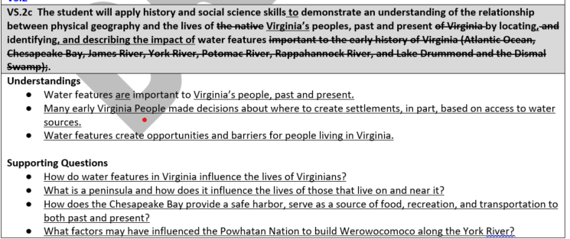
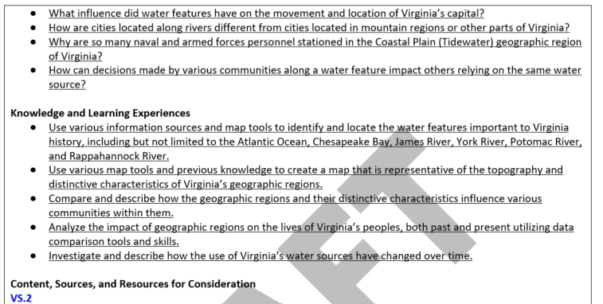
New Structure – The Standards

Slide 73
How did we make decisions during the Review?

Slide 74
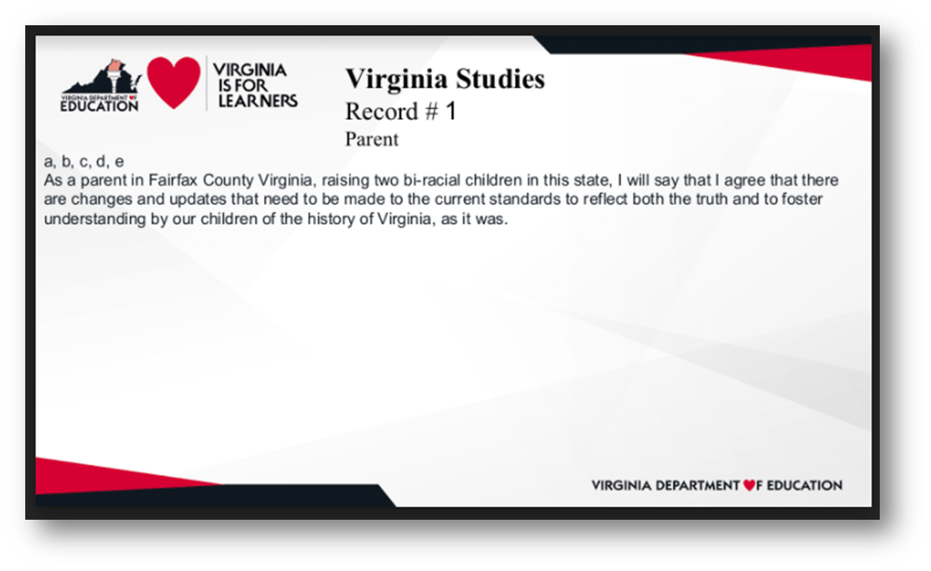
Public Comment
Record # 14
Teacher, Parent
General Comment for Consideration:
This is extraneous information that is not grade level appropriate. However, more time needs to be spent on exploring the state and the map. Major cities, population history and breakdown of population by race or native group to show the growth, information on the other rivers that a major to Virginia - the Dan, the Roanoke so that the whole state is mentioned. This unit should be more involved and is age aprpropriate.

Slide 75
Educator Committee
The group decided to change the language of the standard to reflect that students should also be able to describe the water features in addition to identifying and locating. We also decided to add explicit language about making connections to local river and water features that connect to the major features listed in the Essential knowledge. We feel that by providing a prompt for teachers to make these local geography connections, students will have opportunities to increase their connection to the content which can increase motivation and students' sense of empowerment. Lastly, we decided to add to the Essential Knowledge of the Dismal Swamp that it served as a refuge for numerous groups of peoples.

Slide 76
External Committees
Committee members were asked to site their input whenever possible:
Virginia Geographic Alliance: Comment related to removing the words "impact of" from the standard: strikethrough Comment related to replacement for last statement of standard: Replace: “These islands have and continue to” with “Virginia’s coastal geography includes a number of smaller islands located along and near the Chesape…” Important to include these as they are an often overlooked population but also serve many ties to history, ecology/science for cross-curricular studies of climate change and watersheds, as well as economics w/ tourism, fishing.

Slide 77
New Structure – The Standards
What did we do with all of the input from the various committees?

Slide 78
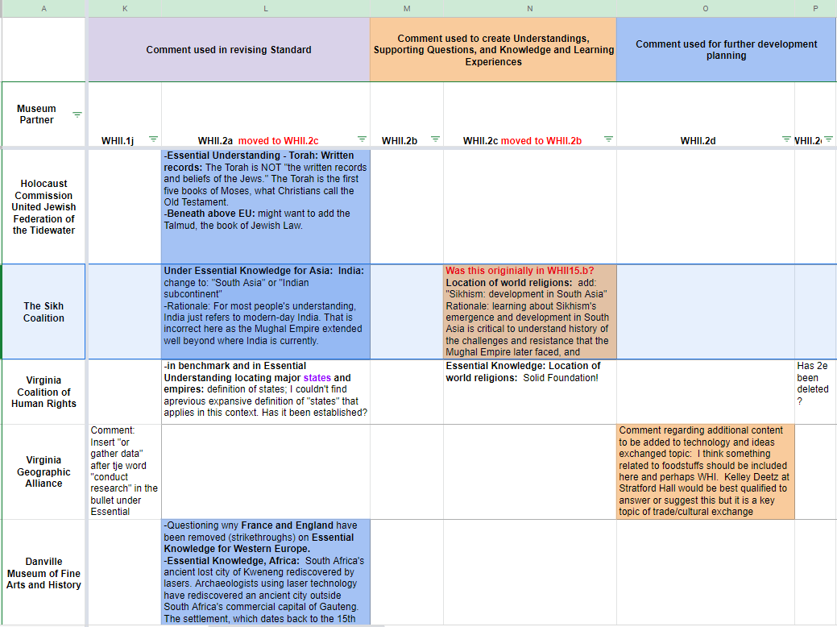
New Structure – Action
The HSS Program captured all of the public comments and committee input in a spreadsheet to determine the best way forward to use the information
Directly in the new structure
Further develop as a resource for teachers to support building content knowledge
Further develop as a resource for teachers to use with students

Slide 79
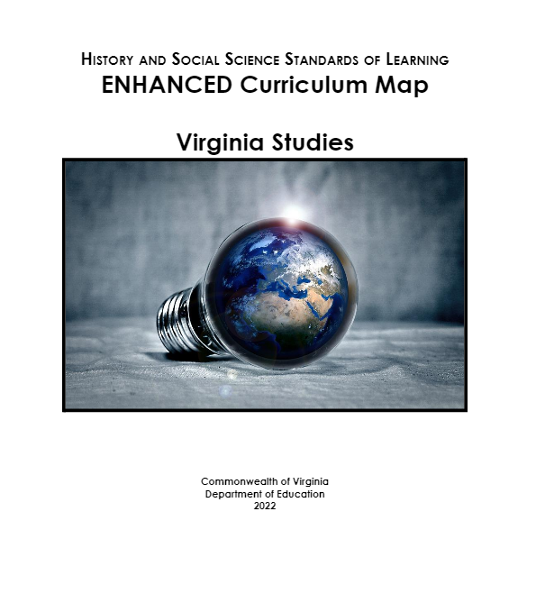
New Structure – Resources to consider and Professional Development
Teacher guidance
Connecting the Overarching Questions, Supporting Questions, Understandings, and Learning Experiences
Disciplinary Skills and Cross Curricula Opportunities to Consider
Vertical Alignment Opportunities and Prior Knowledge Connections to Consider
Literacy and Workplace Readiness Skills
Opportunities for Inquiry-based learning
Notes:
Although the format is not finalized, we are envisioning a linked document similar to this one that offers supports for learning utilizing all the amazing resources and content knowledge shared with us through this process. A linked document that can be updated when new resources and sources are available allows us to support educators to incorporate current events and enhance student learning.

Slide 80
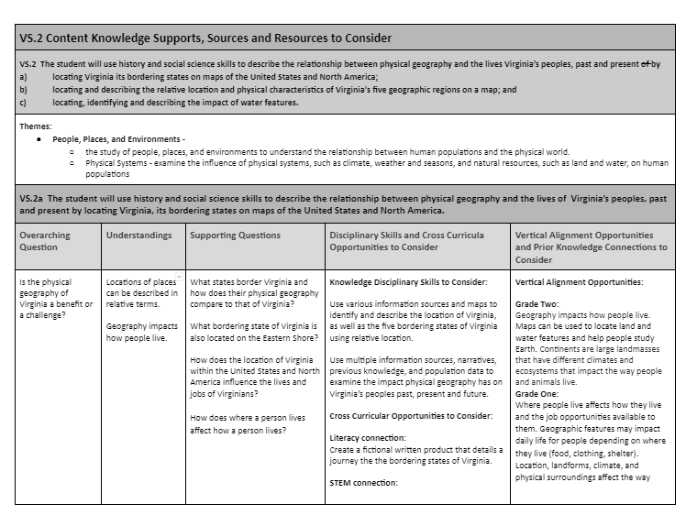
New Structure – Resources to consider and Professional Development
Teacher guidance
Disciplinary Skills and Cross Curricula Opportunities to Consider
Vertical Alignment Opportunities and Prior Knowledge Connections to Consider
Notes:
Although the format is not finalized, we are envisioning a linked document similar to this one that offers supports for learning utilizing all the amazing resources and content knowledge shared with us through this process. A linked document that can be updated when new resources and sources are available allows us to support educators to incorporate current events and enhance student learning.

Slide 81
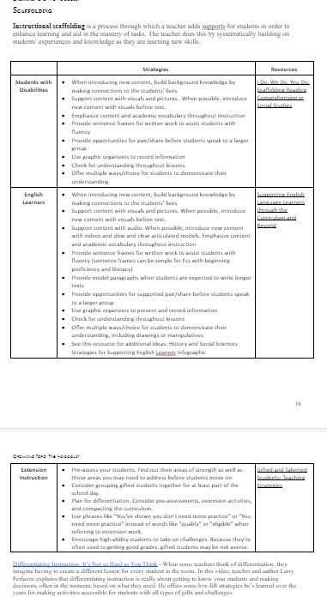
New Structure – Resources to consider and Professional Development
Teacher guidance
Scaffolding for Students with Disabilities, English Language Learners, and Gifted Students
Strategies and links that can be updated as research-based practices are available
Notes:
Although the format is not finalized, we are envisioning a linked document similar to this one that offers supports for learning utilizing all the amazing resources and content knowledge shared with us through this process. A linked document that can be updated when new resources and sources are available allows us to support educators to incorporate current events and enhance student learning.

Slide 82
Revision of the Content

Slide 83
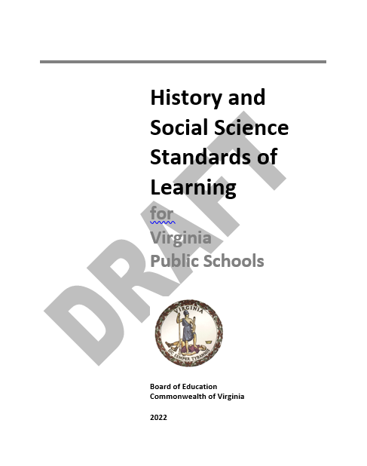
Revision of the Content
General Revisions
Language consistency
Introduction of terms carried throughout the document
Heavy focus on the use of information sources to make specific literacy connections
  K – 3 Standards support “learning to read”
  Virginia Studies – Government support “reading to learn”
Supporting Questions, Knowledge and Learning Experiences provide opportunities for research, investigation, writing, and oral communication
Scaffolding content to build content knowledge and higher-order thinking skills rather than repeating

Slide 84
Revision of the Content
Skills Progression
Added skill – Contextualization
Combined skills to reduce redundancy
Raised the expectations of the skills by moving the concept of synthesizing evidence from sources to the middle school level with the expectation of supporting literacy instruction and reading comprehension

Slide 85
Revision of the Content
K - 3
Focus on Civics at the beginning of each course by broadening the description of a citizen
  a member of a group or people of a community
  belonging to various communities at the same time
  focusing on the characteristics of a “responsible” citizen
  grouped similar content together such as Communities, Citizenship, Traditions, and Symbols
Greater number of Supporting Questions and Knowledge and Learning Experiences to support building foundational knowledge
Content spirals – Community, State, Nation, and World
Enhanced Literacy integration
Opportunities to incorporate local community history and traditions.

Slide 86
Revision of the Content
Virginia Studies
Standard specific to Virginia’s Indigenous Peoples
Opportunity to introduce the life and culture of Africans prior to Colonial Virginia
Expanded the content and opportunities to explore Virginia’s role in the American Revolution and the formation of the new nation
Greater focus on the development of the Constitution of the United States connected to the present with the celebration of Constitution Day (also known as Citizenship Day)
Increased opportunities to connect local history - Use local history and other information sources to investigate and explain the impact of the Civil War battles on the local community, including the changes in population, devastation, migration, and the local economy and government.

Slide 87
Revision of the Content
United States History – Middle School
Standard specific to Indigenous Peoples across the nation
Expanded the content describing the life and culture of Africans prior to Colonial America
Greater focus on comparing people, places, and events and the use of varied graphic organizers for research and investigation
Greater focus on providing evidence to demonstrate understanding and make connections
Expanded the focus on the development of the US Constitution
Added the arrival of various people and cultures such as the Chinese and Irish due to push and pull factors
Greater focus on opportunities for students to investigate the benefits and consequences of technology, innovations, and actions of the local, state, and federal governments
Greater opportunities to connect the actions of the past to the present

Slide 88
Revision of the Content
United States History – Middle School
Retained the people, places, and events from the 2015 Standards through the Supporting Questions and Knowledge and Learning Experiences
Greater focus on the use of data through charts, graphs, and diagrams to analyze trends and patterns and draw conclusions
Greater focus on the impacts of the decisions and perspectives various
Increased opportunities to use previous knowledge, data, and other evidence to make informed arguments about the past, present and future
Introduced and connected contemporary social, legal, political, and cultural changes for all Americans to the blue print of the Civil Rights Movement

Slide 89
Revision of the Content
Civics and Economics – Middle School
Increased focus on civic concepts, citizenship, and engagement
Continued the concept of a “responsible” citizen
Expanded the content for investigation of the fundamental political principles, founding documents, and development of the Constitution of the United States
Expanded the concept of citizenship focusing on individual interests, public good, and civic engagement
Increased focus on connecting historical events to impacts and changes in local, state, and federal policies
Increased focus on civic duties and civic engagement to the local community to serve the common good
Opportunities for students to devise an informed plan and apply content for civic engagement projects

Slide 90
Revision of the Content
World Geography – High School
Overhauled the entire course to align with National Geography Standards, College Board, and IB programs
Retained the awareness of location, spatial concepts, regional identification
Increased the concepts of human interactions with others, the environment, and influences on patterns and trends
Increased the opportunities for students to use the tools and thinking processes of geographers
Increased opportunities to make connections to the past and the immediate present – current events

Slide 91
Revision of the Content
World Geography – High School
Reorganized the content into seven distinct topics to explore and investigate regional examples through similarities and differences, changes and sustainability, and patterns and trends, rather than the memorization of regional factoids
  Introduction to Geography
  Classifying and Identifying Regions
  Population and Migration
  Culture
  Political Geography
  Resources and Environment
  Globalization
Increased the use of data from maps, charts, graphs, diagrams, and other information sources to draw conclusions

Slide 92
Revision of the Content
World History and Geography – High School
World History I course serves as an introduction of the benefits, costs, and interactions of early societies, nations, and states with one another
World History II course continues with the focus on the benefits, costs, and interactions of modern societies, nations, and states with one another
Changed the focus of the initial Standards to emphasize on the geography, culture, political, religious, and social development of the region
Increased focus on the impact of geography, culture, political, religious, and social development of the region
Increased opportunities to explore, research, and investigate the social, cultural, political, and economic patterns that emerged across societies

Slide 93
Revision of the Content
World History and Geography – High School
Attempted to create a balance of content through regional exploration of the geography, culture, political, religious, and social development of various societies
Knowledge and Learning Experiences have a greater focus on the benefits and costs of cross-cultural interactions
Introduced Sikhism as a major world religion, an increased number of regions from Africa and South America, and the impact of global interactions in World History II
Expanded the historical content of 19th and 20th century revolutions and their direct impact on contemporary collaborations and conflicts
Increased the opportunities to research and investigate various perspectives of global events

Slide 94
Revision of the Content
Virginia and United States History – High School
Reorganized the first few Standards to focus on three cultures in the development of Early America – Indigenous Peoples, European Explorers and colonists, and Africans
Building upon knowledge and content introduced in middle school United States History courses
Fewer questions and Learning Experiences for previously introduced content with an opportunity to delve deeper into the topics through the use of data, research and investigation
Introduction of various federal policies and Supreme Court cases with opportunities to explore the impacts on citizens

Slide 95
Revision of the Content
Virginia and United States History – High School
Increased opportunities to use various information sources such as Washington’s Farwell address, text of the Gettysburg Address, how the U.S. v. Wong Kim Ark (1898) impacted the 14th Amendment, or the exploring sources used to during World War II for accuracy, credibility, bias, and propaganda
Expanded the content of the Holocaust, Civil Rights Movement, the Cold War, and reorganized the various social, political, and cultural issues and events in contemporary American history after WWII

Slide 96
Revision of the Content
Virginia and United States Government – High School
Reorganized and reworded the Standards and language of the foundations of American constitutional government raising the expectations, increased opportunities for document analysis, and their impacts on individual liberties
Greater emphasis on understanding the concept of federalism, balance of power between the three branches, and balance of power between the state and national government
Reorganized and reworded the Standards and language for elections at each level, connecting to the Amendments specific to voting and elections, voter turnout, election process, influence of various media types and coverage, and reapportionment and redistricting.

Slide 97
Revision of the Content
Virginia and United States Government – High School
Reorganized and reworded the Standards and language of the branches of government at the national level
Restructured the Standards and language for state and local government
Greater emphasis on the role of the government in the economy
Reorganized and reworded the Standards and language of the branches of government at the national level

Slide 98
Approach history and social science instruction differently.
Rather than memorizing the facts, connect the content.

Slide 99
Next Steps

Slide 100
Board Review
First Review
Virginia Board of Education will hear from Department Staff the process used, input provided, and the revisions proposed
Public hearings will be held in accordance with Virginia Code to gain feedback from the public
Final Review
Virginia Board of Education will hear from Department Staff changes made due to additional input from the public

Slide 101
Community Engagement Roundtable Sessions
Additional input from parents, community, business, educators, and the community at large.
Community Engagement Roundtable Discussions:
  Proposed Document will be publicly available
  Opportunity for participants to ask questions and share comments
  VDOE staff will facilitate the discussions
  All comments will be considered

Slide 102
Pathway to Full Implementation
Anticipating
Creation of a Crosswalk Document to support educators
Content and Resources to Consider linked documents within the new structure document will be created and shared with divisions
Professional learning opportunities throughout the Commonwealth and virtually after final review of the Standards

Slide 103
The Standards of Learning in all subject areas shall be subject to regular review and revision to maintain rigor and to reflect a balance between content knowledge and the application of knowledge in preparation for eventual employment and lifelong learning.
§ 22.1-253.13:1

Slide 104

Andrea Emerson,
History and Social Science Secondary Specialist
Andrea.Emerson@doe.virginia.gov
Brandi McCracken,
History and Social Science Elementary Specialist
Brandi.McCracken@doe.Virginia.gov
Christonya Brown,
History and Social Science Coordinator
Christonya.Brown@doe.Virginia.gov

