Slide 1

Considerations for Updating Virginia’s
School Accountability System
Anne Hyslop
Director of Policy Development, All4Ed
Virginia State Board of Education Work Session
November 16, 2022

Slide 2


Same goals.
Same vision.
New name.
www.all4ed.org

Slide 3

Key Goals of an Accountability System
Public transparency about school quality
Identify and incentivize state priorities for students’ learning and success
Inform school improvement and resource allocation (e.g., funding, technical assistance)

Slide 4
Key Components of an Accountability System
System for differentiating school quality based on federally required and state-selected indicators
  Which indicators should be used?
  How should indicators be calculated and reported?
  Should the system provide an overall school rating/score based on all of the indicators? If so, how should indicators be weighted or combined to produce an overall rating/score?
Inclusion of individual student groups
  Can a school earn high ratings overall if it has a struggling group of students?
  Which indicators are disaggregated by student groups for accountability purposes?
  How many students must be enrolled in a group to “count” (i.e., n-size)?

Slide 5
Accountability Indicator Considerations
Which indicators should be used?
How should indicators be calculated and reported?

Slide 6
Four Federally Required Accountability Indicators
Academic achievement* in math and ELA, 95%+ of students must be included in the denominator (may include growth in math and ELA for high schools)
Varies by grade-span
  K-8 schools: Another academic indicator* (e.g., academic growth in math and ELA)
  HS: 4-Year adjusted cohort graduation rate* (may also use extended-year rates)
Progress toward English language proficiency (ELP)* for English learners
School quality or student success (SQSS): must be valid, reliable, statewide, comparable, and meaningfully differentiate schools (ESEA section 1111(c)(4)(B)(v))
* Must receive “substantial weight” individually and “much greater weight” in the aggregate than SQSS indicators (ESEA section 1111(c)(4)(C)(ii))

Slide 7
Four Questions to Ask About Indicators
Is the measure valid, reliable, comparable, and measured in the same way across schools and districts, and available statewide?
Can the measure be disaggregated for each student subgroup?
Does the measure allow for “meaningful differentiation ”between schools by detecting significant differences in school performance across the state?
Is progress on this measure related to improvements in student learning?

Slide 8
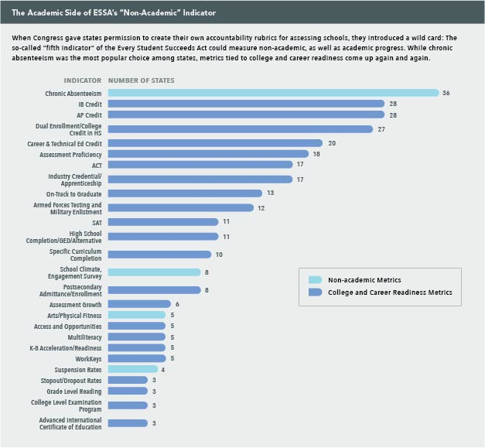
Most Common State-Selected Indicators
College- and career-ready measures are the most popular SQSS indicators (e.g., ACT/SAT, AP/IB and dual credit)
Career-ready measures
Non-CCR measures include: (1) chronic absenteeism, (2) school climate or student engagement survey, (3) arts or PE, (4) suspension rates, and (5) early literacy/reading
Source: https://www.future-ed.org/how-did-essas-non-academic-indicator-get-so-academic/

Slide 9
Virginia Accreditation Indicators
Federal Indicators Met
Overall proficiency and growth in English reading/writing achievement (including progress of English learners toward English-language proficiency)
Overall proficiency and growth in mathematics
Overall proficiency in science
English achievement gaps among student groups
Mathematics achievement gaps among student groups
Absenteeism
Academic Achievement Indicator
Other Academic Indicator
Progress in Achieving ELP Indicator
SQSS Indicators
Current Indicators: K-8

Slide 10
Virginia Accreditation Indicators
Federal Indicators Met
Overall proficiency in English reading/ writing and progress of English learners toward English-language proficiency
Overall proficiency in mathematics
Graduation and completion
Overall proficiency in science
English achievement gaps among student groups
Mathematics achievement gaps among student groups
Dropout rate
Absenteeism
College, career and civic readiness*
Academic Achievement Indicator
Progress in Achieving ELP Indicator
Graduation Rate Indicator
SQSS Indicators
*will be implemented for 2023-24 school year
Current Indicators: HS

Slide 11
Considerations to Improve Virginia’s Indicators
Separate the combined rate into three, standalone indicators
  Achievement: index approach that recognizes advanced students vs. simple proficiency rates
  Growth: consider more nuanced measures (e.g., student growth percentiles) that measure growth for all students
  English learners: fully include in achievement, growth, and ELP indicators
Streamline HS indicators to focus on measures with most value
  Consider removing or deemphasizing dropout rates and HS completion metrics to focus on graduation with a standard or advanced diploma
  Update and implement college, career, and civic readiness index

Slide 12
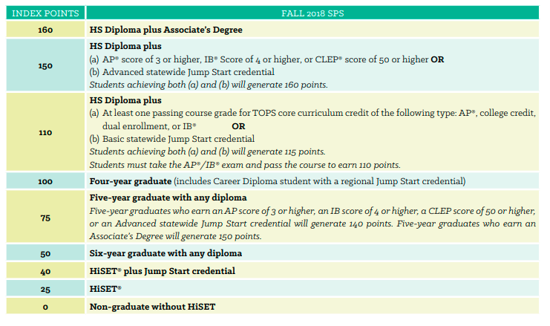
College, Career, and Civic Readiness Index Ideas
LOUISIANA: Strength of Diploma Index
Consider using index to incentivize college and career pathways with greater value beyond high school
Source: https://files.eric.ed.gov/fulltext/ED594219.pdf

Slide 13
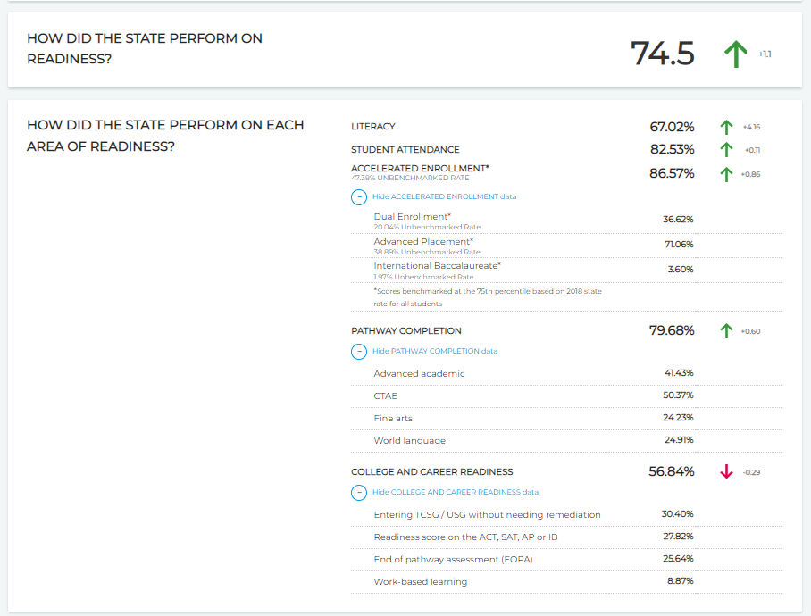
College, Career, and Civic Readiness Index Ideas
Consider reporting on each readiness option separately, as well as an overall rate
Consider using measures that include postsecondary outcomes beyond high school, such as enrolling in credit-bearing coursework in college
GEORGIA
Source: https://ccrpi.gadoe.org/Reports/Views/Shared/_Layout.html

Slide 14
Accountability Ratings Considerations
Should the system provide an overall school rating/score?
If so, how should indicators be weighted or combined to produce it?

Slide 15
Federal Requirements for Differentiation of Schools
ESSA does not require states to issue overall school ratings, like A-F grades, 1-5 star ratings, or an index score (e.g., 85 out of 100 points).
  ESSA requires states to report school performance on each indicator on school and district report cards.
  ESSA requires states to identify three categories of low-performing schools needing extra support from the state and/or district.
When differentiating schools (either for overall ratings, if given, or school identification), non-SQSS indicators must receive “substantial weight” individually and “much greater weight” in the aggregate.

Slide 16

Federal Requirements for School Identification
1
2
3
Targeted Support and Improvement (TSI)
Schools with “consistently underperforming” (defined by the state) groups of students
Identified annually
Additional Targeted Support and Improvement (ATSI)
Schools with a group of students performing similarly to the level of the lowest-performing 5% of Title I schools in CSI
Comprehensive Support and Improvement (CSI)
Lowest-performing 5% of Title I schools
Any high school with graduation rates below 67%
Title I ATSI schools that have not improved within a state-set timeline
can be identified once every three years
For a refresher on ESSA, check out All4Ed’s “ESSA Explained:” https://all4ed.org/publication/essa-explained/

Slide 17
Arguments For and Against School Ratings
PRO (prefer ratings)
Transparent, clear, and user-friendly for parents and the public
Ability to emphasize certain indicators over others by weighting them more
CON (prefer dashboards)
Overly simplified and may not capture nuance of multi-measure accountability systems
Low ratings stigmatize and demoralize school leaders, educators, and the community

Slide 18
The best systems do both: provide overall ratings that are clear and user-friendly, while also providing specific information on each indicator and group of students.
Key Takeaway

Slide 19
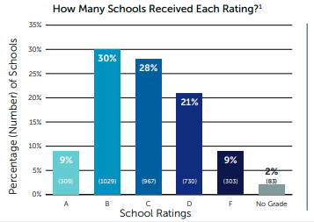
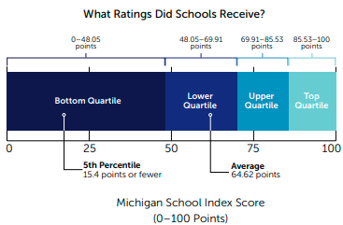
Virginia’s “Ratings” vs. Other States
OHIO
Virginia’s accreditation system does a poor job of differentiating between schools.
MICHIGAN
Sources: https://doe.virginia.gov/statistics_reports/accreditation_federal_reports/accreditation/index.shtml
https://all4ed.org/wp-content/uploads/2020/01/Ohio-State-Chart-FINAL.pdf
https://all4ed.org/wp-content/uploads/2020/01/Michigan-State-Chart-FINAL.pdf

Slide 20
Considerations to Improve Virginia’s “Ratings”
Use more than three levels to better differentiate between schools
Consider user-friendly categories that are intuitive to understand (A-F grades, 1-5 stars, points) for overall grades and ratings on each indicator
Adopt weighting for achievement and growth indicators to differentiate:
  schools where students are meeting grade-level standards and making substantial progress from year to year
  schools where students are meeting grade-level standards but not making substantial progress from year to year
  schools where students are not meeting grade-level standards but are catching up by making substantial progress from year to year
  schools where students are not meeting grade-level standards and are not catching up

Slide 21
Weighting Growth vs. Proficiency
PRO GROWTH
Sophisticated growth measures (like SGP) are less correlated to student demographics that most other accountability measures—meaning they provide relatively more information about schools’ contributions to student learning than about the geographic area or demographics a school serves.
PRO PROFICIENCY
Even if students are making progress toward grade-level standards, the ultimate goal of the K-12 system is to ensure students graduate ready for college and careers; a school cannot be considered high-quality if its students never meet grade-level expectations.

Slide 22
The best systems do both, recognizing that low-proficiency, high-growth schools need different supports than low-proficiency, low-growth schools.
Key Takeaway

Slide 23
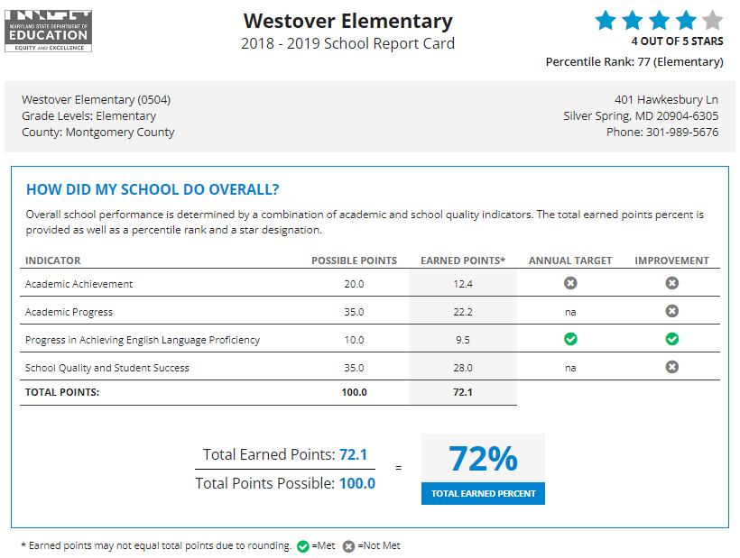
Maryland: overall ratings (stars) AND detailed point breakdown by indicator
Source: https://reportcard.msde.maryland.gov/Graphs/#/ReportCards/ReportCardSchool/1/E/1/15/0504/0

Slide 24
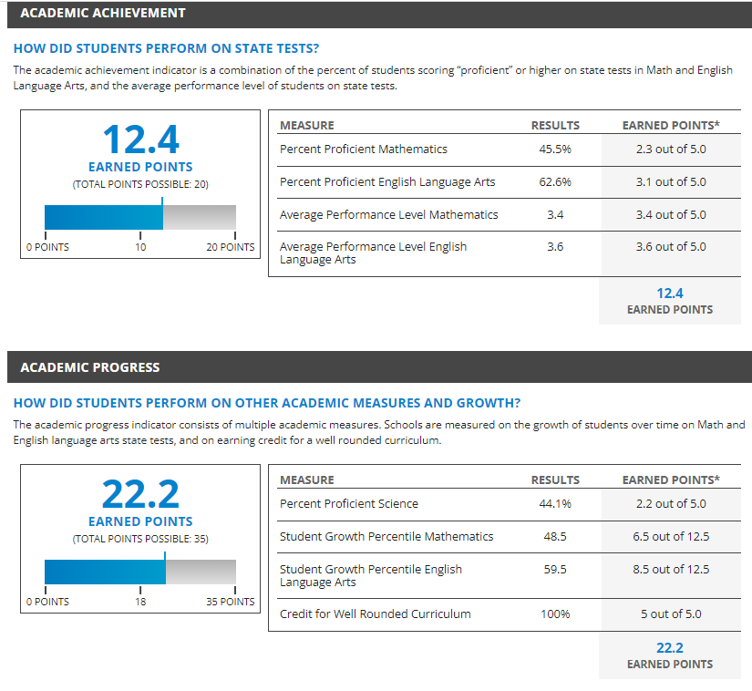
Maryland: dashboard showing points earned for each indicator, with results for each measure within each indicator displayed
Source: https://reportcard.msde.maryland.gov/Graphs/#/ReportCards/ReportCardSchool/1/E/1/15/0504/0

Slide 25
Student Group Considerations
Can a school earn high ratings if it has a struggling group of students?
Which indicators are disaggregated for accountability purposes?
How many students must be enrolled in a school to “count”?

Slide 26
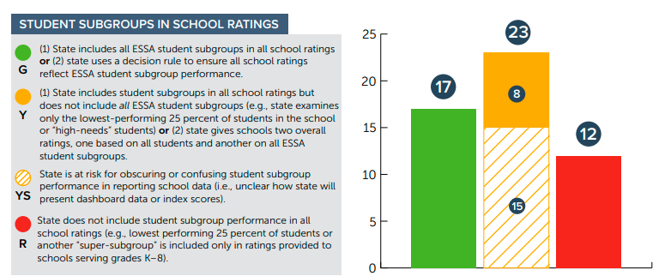
Overall School Performance vs.
Individual Group Performance
While states report disaggregated data on each indicator, most states do not fully include disaggregated data in each indicator when calculating school ratings.
  Some states calculate separate ratings for subgroups (and use those ratings to identify targeted and additional targeted support schools). States may – or may not – report these ratings for specific groups publicly.
  Some states include disaggregated data within a single indicator, but not all indicators.
Source: https://all4ed.org/publication/too-many-states-minimize-student-subgroup-performance-in-essa-accountability-systems/

Slide 27
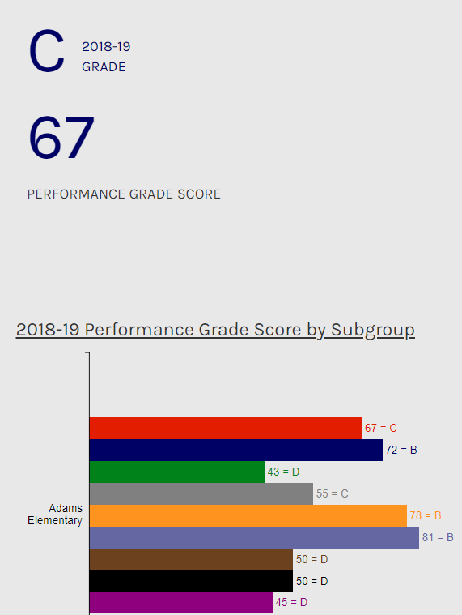
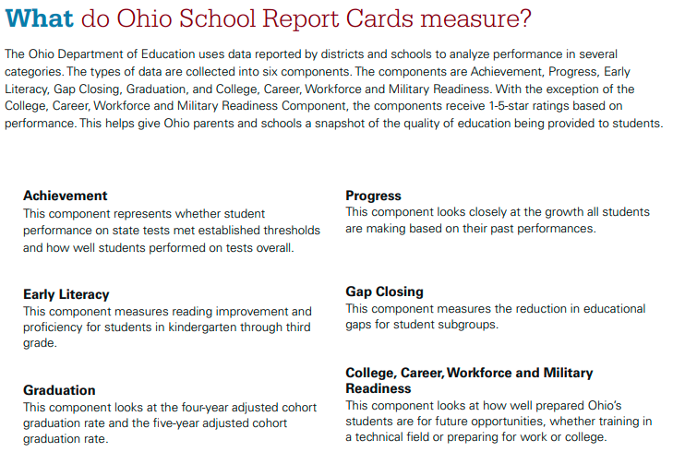
Overall School Performance vs.
Individual Group Performance
NORTH CAROLINA
Sources: https://education.ohio.gov/getattachment/Topics/Data/Report-Card-Resources/2022-Report-Card-Guide.pdf.aspx?lang=en-US
https://ncreports.ondemand.sas.com/src/

Slide 28
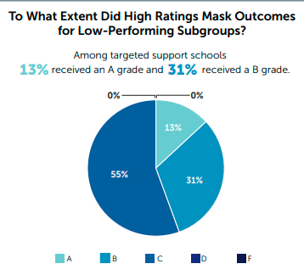
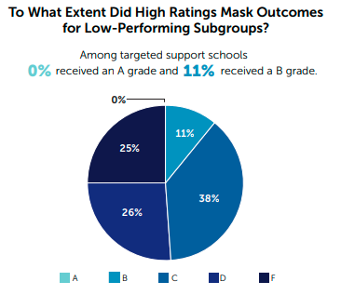
Do School Ratings Mask Performance of Individual Student Groups?
FLORIDA
Business rules and methods for identifying schools can help ensure alignment between overall ratings and school identification.
Florida identified all D and F schools for comprehensive support, meaning (by default) targeted support schools would receive at least a C grade.
Louisiana used a business rule to cap the grade a targeted support school could receive at a B.
LOUISIANA
Sources: https://all4ed.org/wp-content/uploads/2020/01/Florida-State-Chart_FINAL.pdf
https://all4ed.org/wp-content/uploads/2020/01/Louisiana-State-Chart-FINAL.pdf

Slide 29
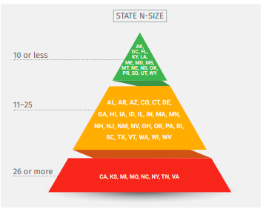
States Are Selecting Lower N-Sizes
Virginia is one of only 8 states using an n-size above 25 students for school accountability.
  Virginia uses an n-size of 10 students for reporting data on school and district report cards.
Source: https://all4ed.org/wp-content/uploads/2018/11/N-Size-Fact-Sheet-NOV-2018.pdf

Slide 30
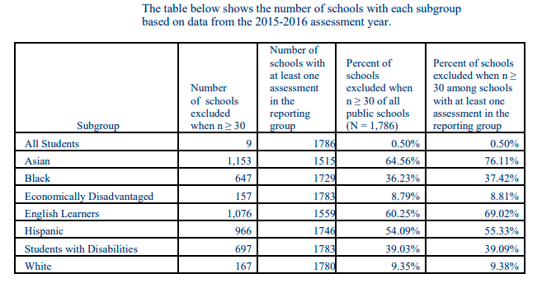
The Impact of N-Size in Virginia
More than half of schools cannot be held accountable for the performance of
  English learners
  Hispanic students
  Asian students
More than one-third of schools cannot be held accountable for the performance of
  Black students
  Students with disabilities
Source: https://oese.ed.gov/files/2021/07/Virginia-Final-Consolidated-State-Plan-PDF_Redacted.pdf

Slide 31
Inclusion of English Learners
VIRGINIA ACCREDITATION
English learners’ scores on state academic assessments can be excluded for accreditation purposes if the student has been enrolled in a Virginia public school for 10 semesters (5 years) or less.
FEDERAL ACCOUNTABILITY
Recently arrived English learners’ scores on state academic assessments can be excluded for accountability purposes for 1-2 years (depending on the option a state selects); recently arrived ELs have been enrolled in US schools for 1 year or less.
Source: https://law.lis.virginia.gov/admincode/title8/agency20/chapter131/section380/

Slide 32
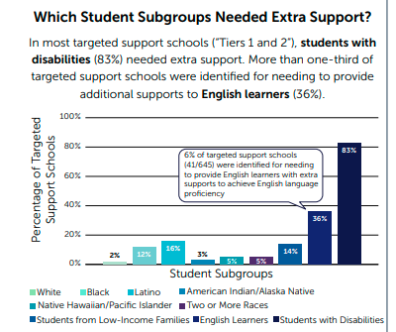
Inclusion of English Learners
WASHINGTON
Unique business rules can support the full inclusion of English learners in the accountability system, in addition to including ELs in every indicator and weighting the ELP indicator (when applicable) appropriately.
  Washington places identified schools into support tiers: “Tier 1” (TSI schools with 1-2 consistently underperforming subgroups), “Tier 2” (TSI schools with 3+ consistently underperforming subgroups or with consistently low ELP progress for English learners), and “Tier 3” (CSI schools).
Source: https://all4ed.org/wp-content/uploads/2020/01/Washington-State-Chart-FINAL.pdf

Slide 33
Considerations to Improve Inclusion of All Students
If school ratings are adopted, utilize a business rule to ensure schools with the highest ratings are not identified for improvement
Lower the n-size for school accountability
Include English learners consistent with federal requirements (in addition to changes to fully include them within indicators measuring proficiency and growth)

Slide 34

Thank you!
Contact us:
Anne Hyslop, Director of Policy Development
ahyslop@all4ed.org
web: all4ed.org
twitter: @all4ed and @afhyslop

