Slide 1
Proposal to Adopt Special Provisions Regarding the Use of the Chronic Absenteeism Indicator for Accreditation Year 2022-2023
Presentation to the Virginia Board of Education
April 21, 2022 - Work Session

Slide 2
What is Chronic Absenteeism?
Chronically absent students miss 10% or more of the school year for any reason (excused or unexcused absences).
It is based on the number of days a student is enrolled in school.
  Example: To be chronically absent, a student enrolled 180 days must miss 18 or more school days.
  This is approximately 2 days per month or more than 3 weeks per school year.

Slide 3
Importance of Monitoring and Controlling Chronic Absenteeism
Chronic absenteeism is an important and reliable indicator of student engagement, and research demonstrates that chronic absenteeism is a strong predictor of academic success.
Research indicates that chronic absenteeism can translate into third-graders unable to master reading, middle-schoolers failing courses and ultimately, teens dropping out of high school.

Slide 4
Chronic Absenteeism in School Accreditation
(1 of 3)
Under the 2017 revisions to the Standards for Accrediting Public Schools in Virginia (SOA), the school accreditation model uses a variety of indicators to provide a comprehensive picture of school quality.
One of nine indicators selected as part of the accreditation system is chronic absenteeism. Based on the relationship between school attendance and student achievement, chronic absenteeism was selected as a measure of student engagement.
The chronic absenteeism rate used in the accreditation model is the percentage of students in a school who are chronically absent.

Slide 5
Chronic Absenteeism in School Accreditation
(2 of 3)
Each of the nine indicators receives a performance level designation based on the indicator rate, and the combination of each indicator’s performance level determines a school’s accreditation status.
Performance Levels descriptions are as following:
  Level One: Indicator rate meets or exceeds state benchmark or shows sufficient improvement from the previous year.
  Level Two: Indicator rate is near the state standard or shows sufficient improvement from the previous year.
  Level Three: Indicator rate is below standard and does not meet the criteria for Level One or Level Two.

Slide 6
Chronic Absenteeism in School Accreditation
(3 of 3)
Accreditation Status:
Accredited: All indicators receive a Level One or Level Two performance level
Accredited with Conditions: One or more indicators receive a Level Three performance level
Accreditation Denied: A school that fails to adopt or fully implement required corrective actions to address Level Three school-quality indicators will receive a status of Accreditation Denied.

Slide 7
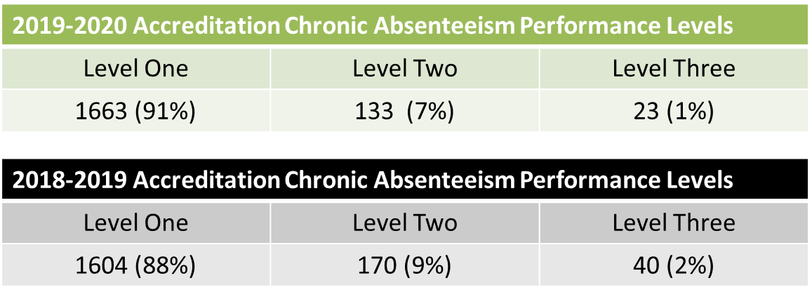
Previous Chronic Absenteeism Performance Levels for Schools

Slide 8
Chronic Absenteeism in School Year 2021-2022
(1 of 2)
School division leaders have reported increased absenteeism in schools during school year 2021-2022 due to recommended quarantine guidelines for “close-contacts” (someone exposed to a person infected with COVID-19), isolation guidelines for those with illness, and students being kept at home because of symptoms that could not be easily distinguished from COVID-19. Through the beginning of January 2022, quarantine and isolation periods were up to 10 days, and currently remain at 5 days in some situations.

Slide 9
Chronic Absenteeism in School Year 2021-2022 (2 of 2)
Under normal circumstances, school divisions have control of the programs, school-level policies, processes, and practices they put in place to engage students in school.
However, student absences due to COVID-19 were not necessarily a result of the lack of school-level policies and practices put in place to engage students and curb absenteeism, and as such, it could be argued that the chronic absenteeism data for 2021-2022 may not accurately reflect school efforts to engage students.

Slide 10
Guidance to School Divisions (1 of 2)
Supt's Memo #230-21, stated, in part:
“...divisions should also be prepared to transition individual students in and out of in-person learning for quarantine related to COVID-19. In cases of quarantine, a student who is not ill and is able to participate in remote instruction should be offered meaningful opportunities to do so. Students should be counted as present or absent per that division’s policy on attendance tracking and monitoring for any remote learning day. If a division does not offer remote learning to a quarantined student, the student should be counted as absent. This circumstance should be extremely rare, as divisions should be prepared to support students who are healthy enough to participate in remote learning during quarantine.”

Slide 11
Guidance to School Divisions (2 of 2)
While these guidelines were communicated in August 2021, they may not have been implemented with fidelity across the state due to —
  staffing shortages;
  numbers of students being quarantined at one time;
  lack of reliable internet connectivity; and/or
  lack of understanding of the flexibilities afforded to schools.
In addition, due to this unprecedented situation, student records may not accurately represent the status of students who were indeed absent or receiving remote instruction.
Notes:
The Department does not finalize chronic absenteeism data until after the final end-of-year Student Record Collection (SRC) submission is completed by school divisions near the end of July.

Slide 12
Use of Chronic Absenteeism in 2022-2023 Accreditation (1 of 4)
Because of the circumstances surrounding chronic absenteeism in 2021-2022, the Department is asking the Board to consider flexibility surrounding the use of this indicator in the determination of the accreditation status of schools in accreditation year 2022-2023.

Slide 13
Use of Chronic Absenteeism in 2022-2023 Accreditation (2 of 4)
The Standards for Accrediting Public Schools in Virginia (SOA) (8VAC20-131-380 F3) provide the Virginia Board of Education with the authority to adopt special provisions related to the use of a school quality indicator in determining the accreditation status of schools. Specifically, the language states:
  “The board may adopt special provisions related to the measurement and use of a school quality indicator as prescribed by the board. The board may also alter the inclusions and exclusions from the performance level calculations by providing adequate notice to local school boards.”

Slide 14
Use of Chronic Absenteeism in 2022-2023 Accreditation (3 of 4)
The Board is being asked to consider the adoption of special provisions to remove the chronic absenteeism indicator from the determination of school accreditation status for 2022-2023 only.
In doing so, the earned performance level and chronic absenteeism rate will still be assigned to, and reported for schools, according to provisions in the SOA.

Slide 15
Use of Chronic Absenteeism in 2022-2023 Accreditation (4 of 4)
Data will be available to school divisions as they prepare for the 2022-2023 school year, and will be available publicly to ensure transparency to all stakeholders in the community.
Divisions will be notified that chronic absenteeism remains a valued metric for school quality and its use in determination of accreditation status will resume with 2022-2023 school year data.

Slide 16
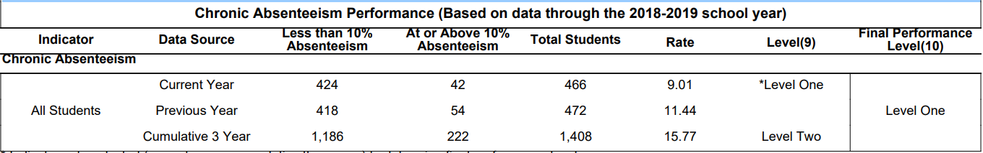
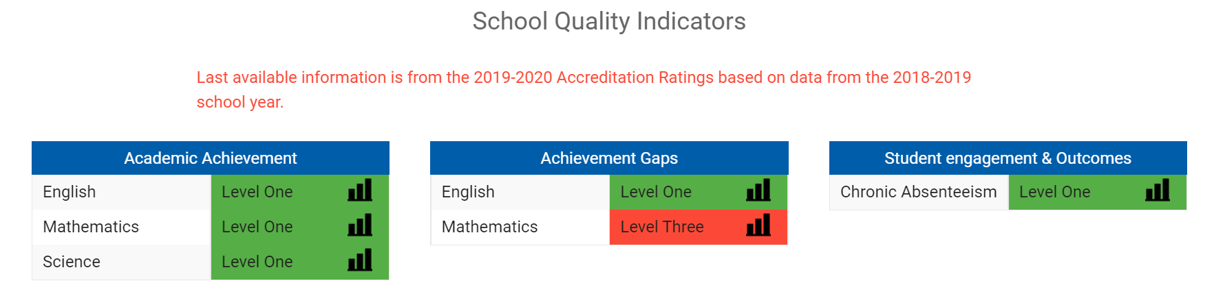
Reporting Requirements Remain the Same

Slide 17
Next Steps
At the April 21, 2022 business meeting, the Board is requested to waive first review and adopt special revisions that will remove the use of chronic absenteeism from the determination of school accreditation status in 2022-2023.
Since the Board does not meet in May, and preliminary accreditation information typically begins to report in July, it is being requested that the Board take action on this item at this meeting so that school divisions can be provided advanced notification of the change, and Department of Education data services staff has time to make the necessary changes to the programs and reports surrounding accreditation data.

