Slide 1
Overview of
Virtual Virginia
Virginia Board of Education • Work Session
Wednesday, April 20, 2022

Slide 2


Slide 3
The Virginia Department of Education’s Virtual Virginia (VVA) program offers K–12 online instruction, summer instruction, a statewide LMS with digital content, and professional learning opportunities to schools, students, and educators across the Commonwealth.
Virginia public school divisions & Virtual Virginia partner together to ensure learners have access and opportunity that complement those available in the physical school.

Slide 4





Slide 6
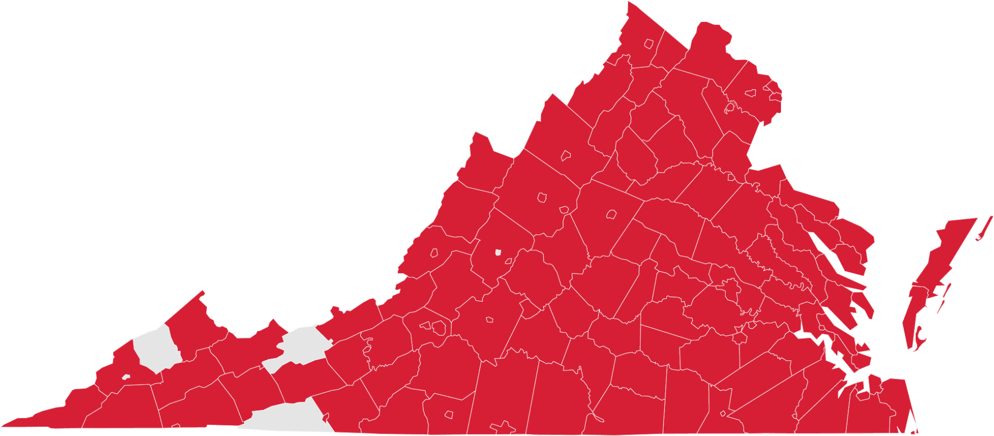
K–12 Instruction Participation, 2021–2022

Slide 7
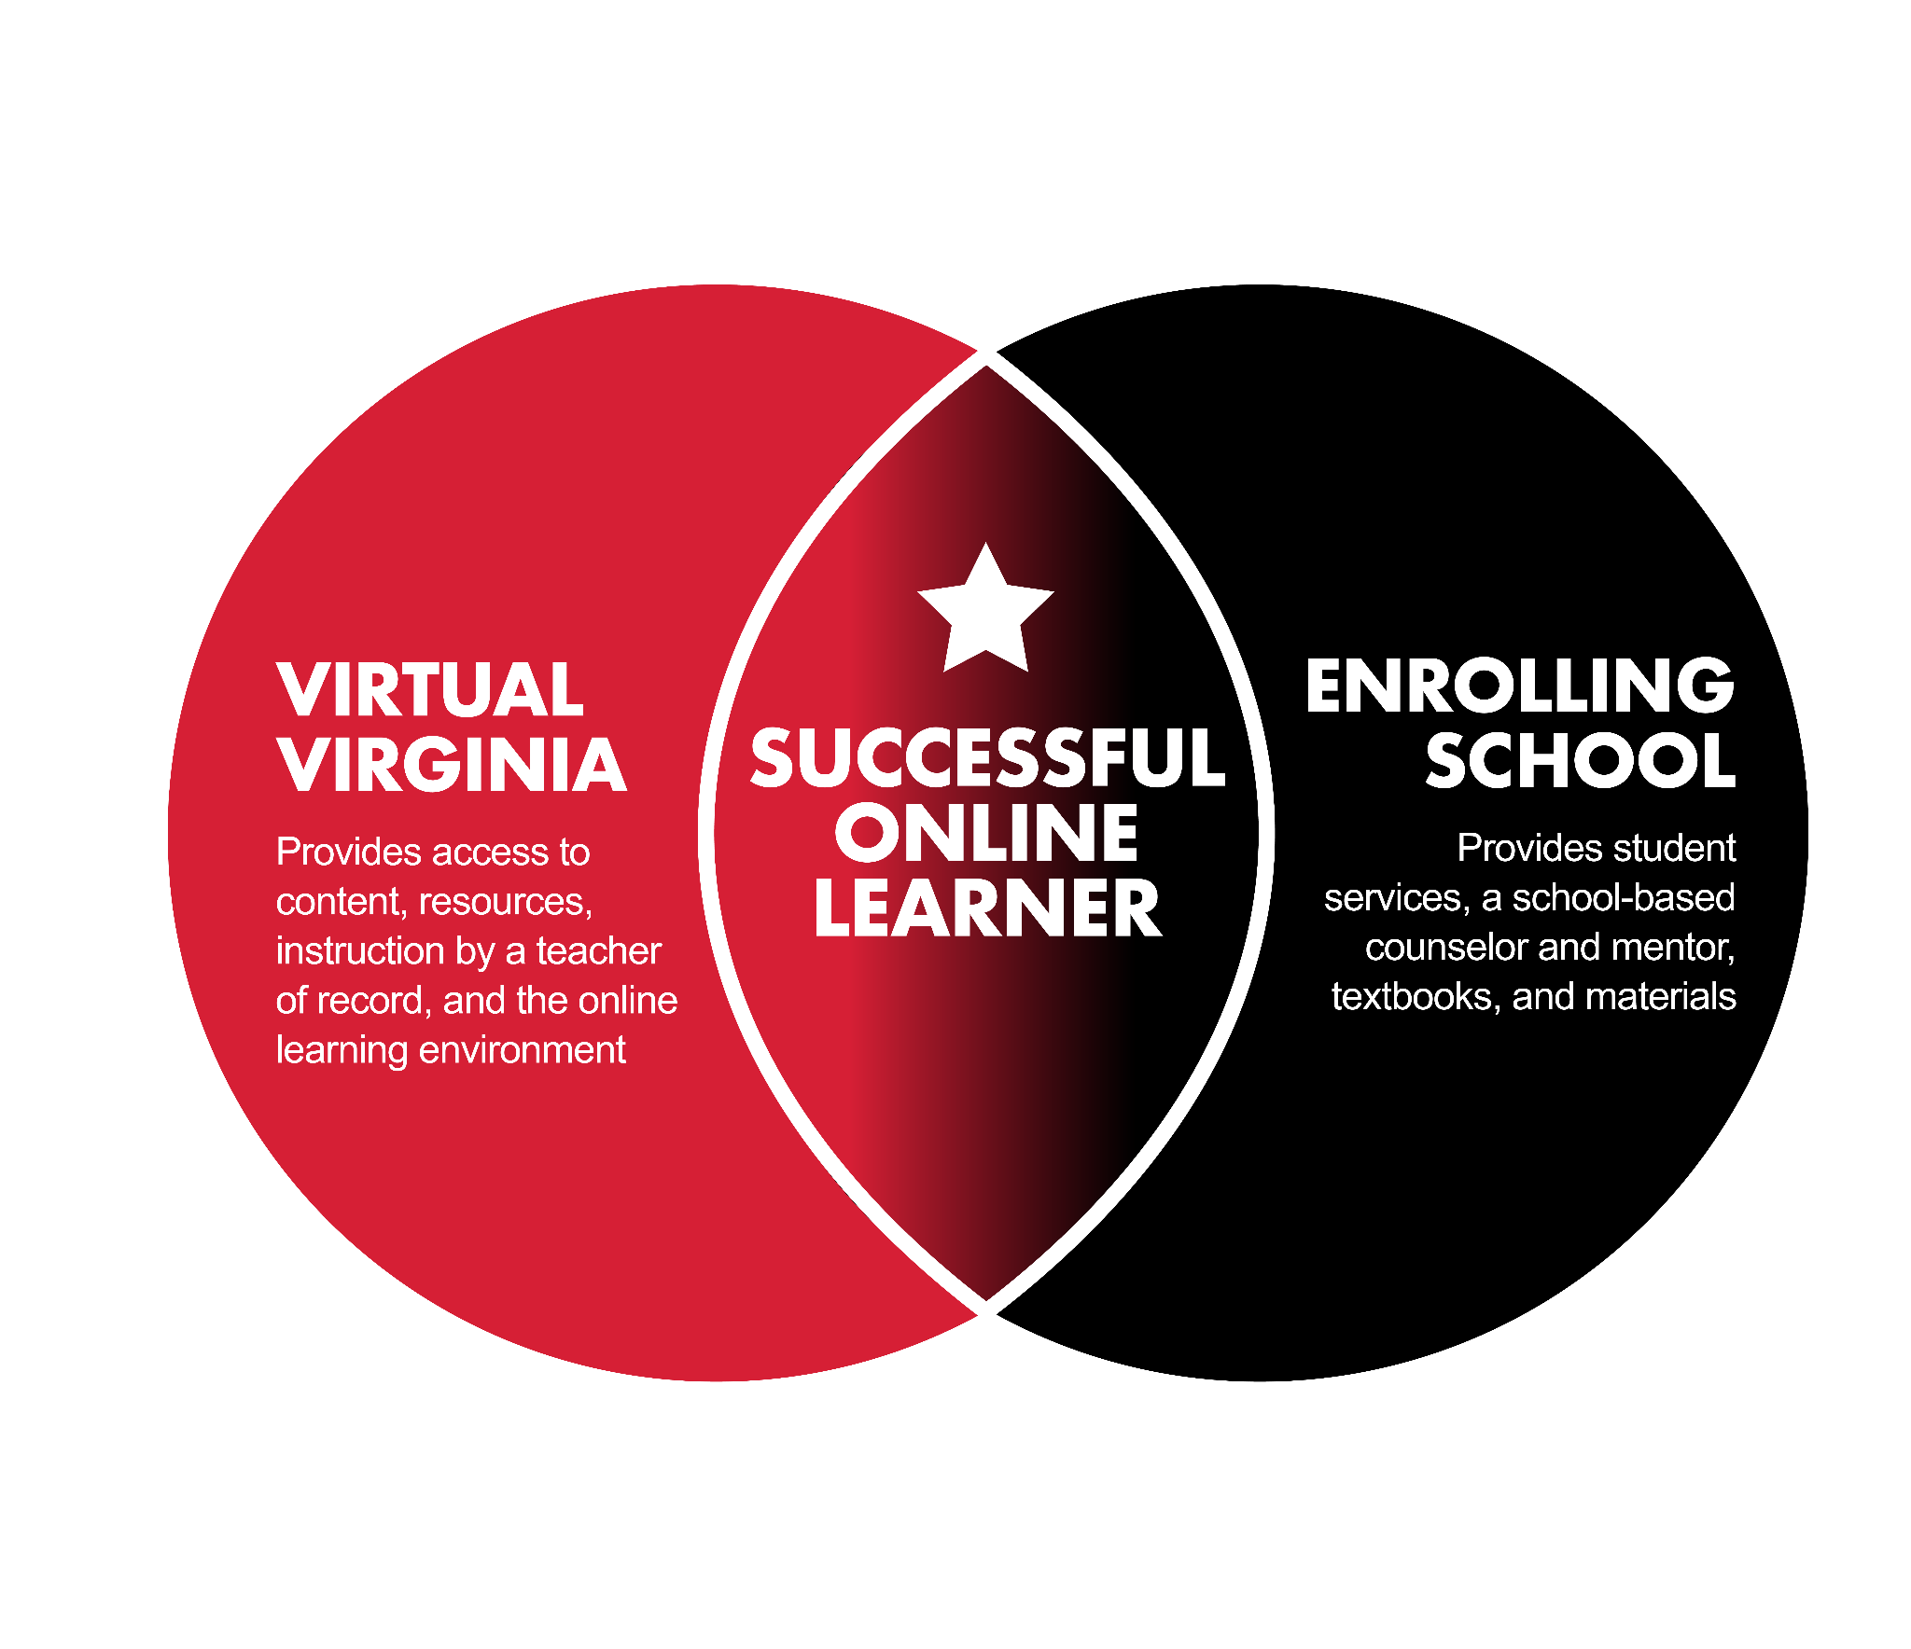

Slide 8




Virtual Virginia (VVA) Over Time
Established in 1984 as the Virginia Satellite Educational Network (VSEN) and later added Virginia Virtual AP School (VVAPS) to the program
VSEN and VVAPS combined to form Virtual Virginia (VVA) in 2006
Complement to local school offerings
  Priority on providing opportunities
  Moving from fixed to flexible
Full-time program launched in 2015–2016
K–5 program established in 2020–2021
Annual growth, especially as Virtual Virginia moved from part-time to full-time and expanded grade level offerings
  Enrollment/Performance Data: self-reported prior to 2021–2022
  VVA now reports via MSC

Slide 9

K–12 Instruction
Asynchronous course content developed and reviewed by Virginia-certified educators
Daily synchronous instruction by Virginia-certified teachers
  Whole-group instruction
  1:1 & small-group instructional time
  Opportunities for remediation & enrichment
Office hours for student and parent/guardian communication
Grades K–5
  Core Subjects
  Specials: Art, Computer Science, Dance, Health & PE, Music, STEM, & World Languages
Grades 6–12
  Personalized schedule from 120+ courses

Slide 10
Reasons for VVA Participation: K–12
 | Student Responses |  | Parent/Guardian Responses
Reason for Participation | 2020–2021 | 2019–2020 | 2020–2021 | 2019–2020
To get ahead | 44% | 73% | 32% | 61%
Prefer/interest in virtual courses | 31% | 25% | 23% | 18%
Scheduling conflict | 28% | 25% | 26% | 25%
Course not offered at school | 39% | 16% | 49% | 31%
To catch up | 8% | 13% | 6% | 8%
To raise a previous grade | 3% | 2% | 3% | 4%

Slide 11
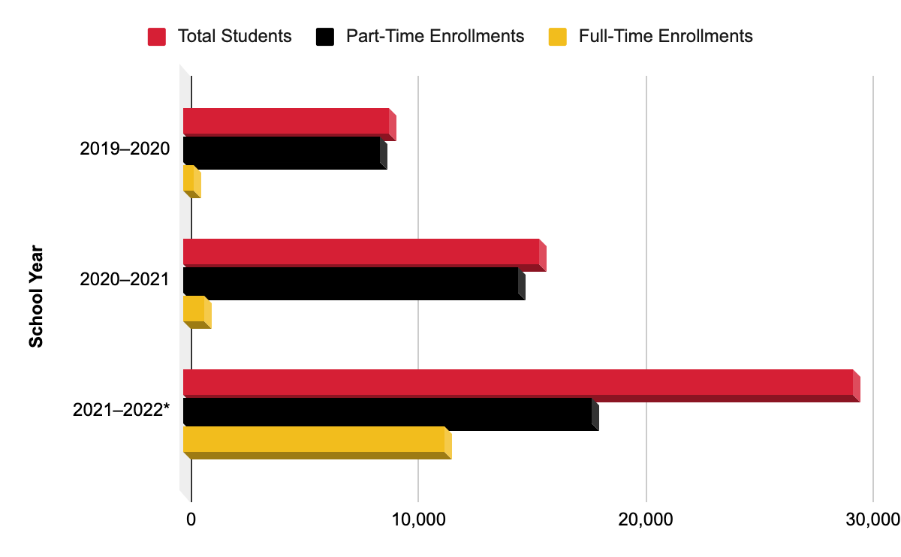
Student Enrollments, 2019–2022
* As of March 30, 2022

Slide 12
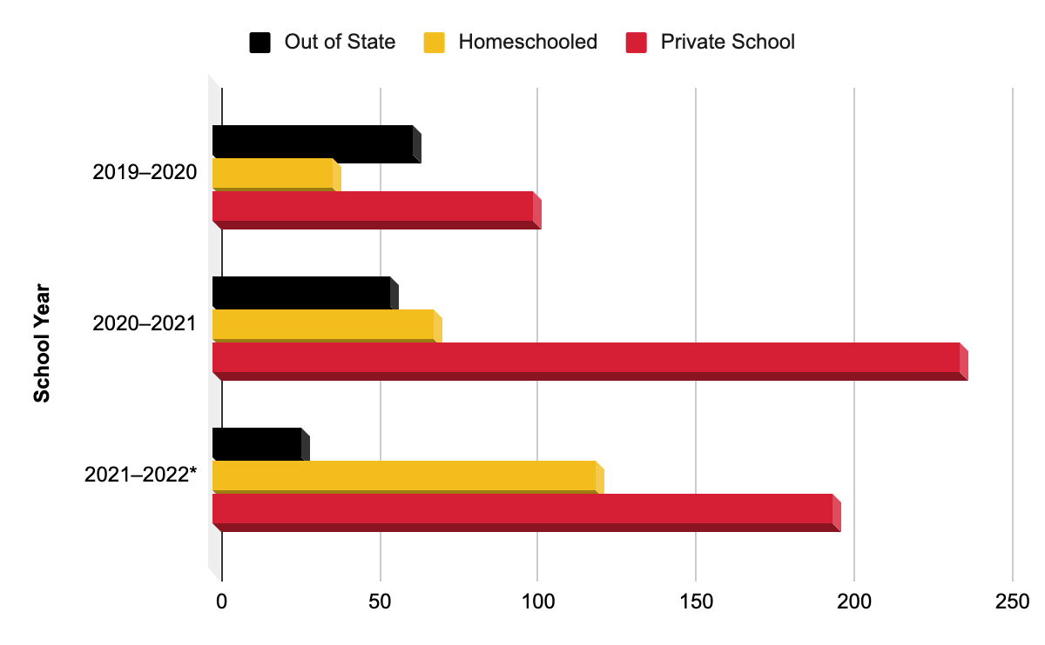
Non-Public Enrollments, 2019–2022
* As of March 30, 2022

Slide 13
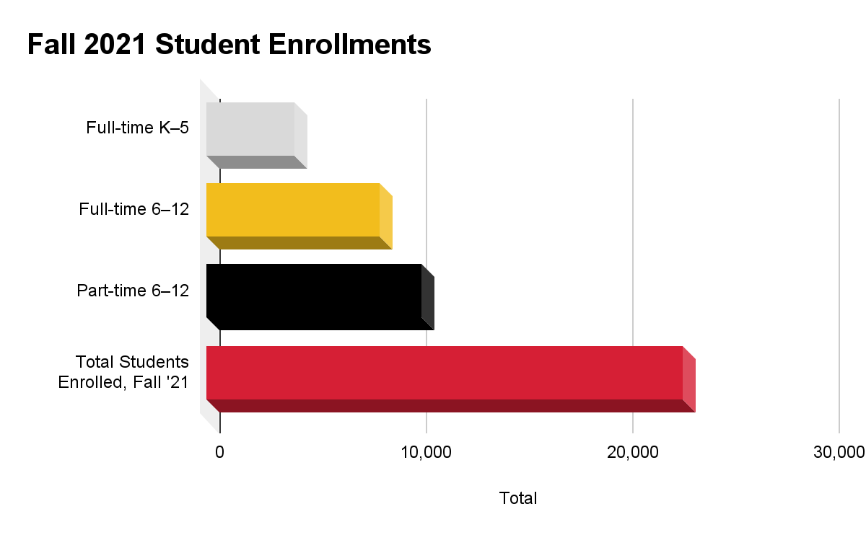
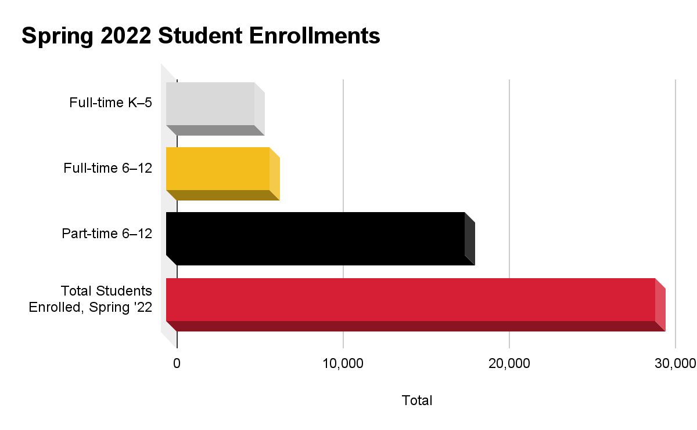

Slide 14
Satisfaction with VVA K–12 Program
88%
92%
STUDENTS
comfortable taking another online course
85%
SCHOOL PERSONNEL
moderately or completely satisfied with VVA program
90%
PARENTS/
GUARDIANS
would enroll their child in a VVA course again
SCHOOL PERSONNEL
believed students’ VVA experience created positive view of virtual learning

Slide 15
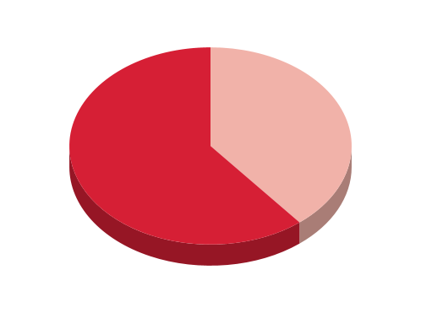
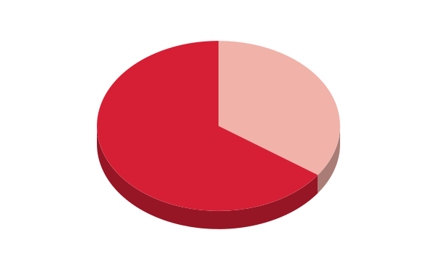
Student Achievement: 2020 AP Exam Scores
61%
65%
PERCENTAGE OF VVA'S AP COURSES
in which VVA students' 2020 AP Exam pass rate (score 3–5) was higher than the Virginia pass rate
PERCENTAGE OF VVA'S AP COURSES
in which VVA students' 2020 AP Exam pass rate (Score 3–5) was higher than the global pass rate

Slide 16
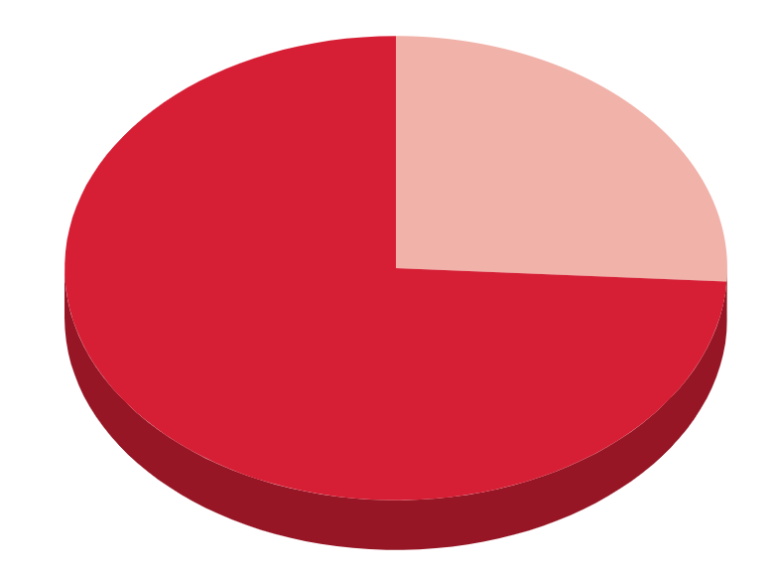
Student Achievement: 2021 AP Exam Scores
74%
74%
PERCENTAGE OF VVA'S AP COURSES
in which VVA students' 2021 AP Exam pass rate (score 3–5) was higher than the Virginia pass rate
PERCENTAGE OF VVA'S AP COURSES
in which VVA students' 2021 AP Exam pass rate (Score 3–5) was higher than the global pass rate

Slide 17
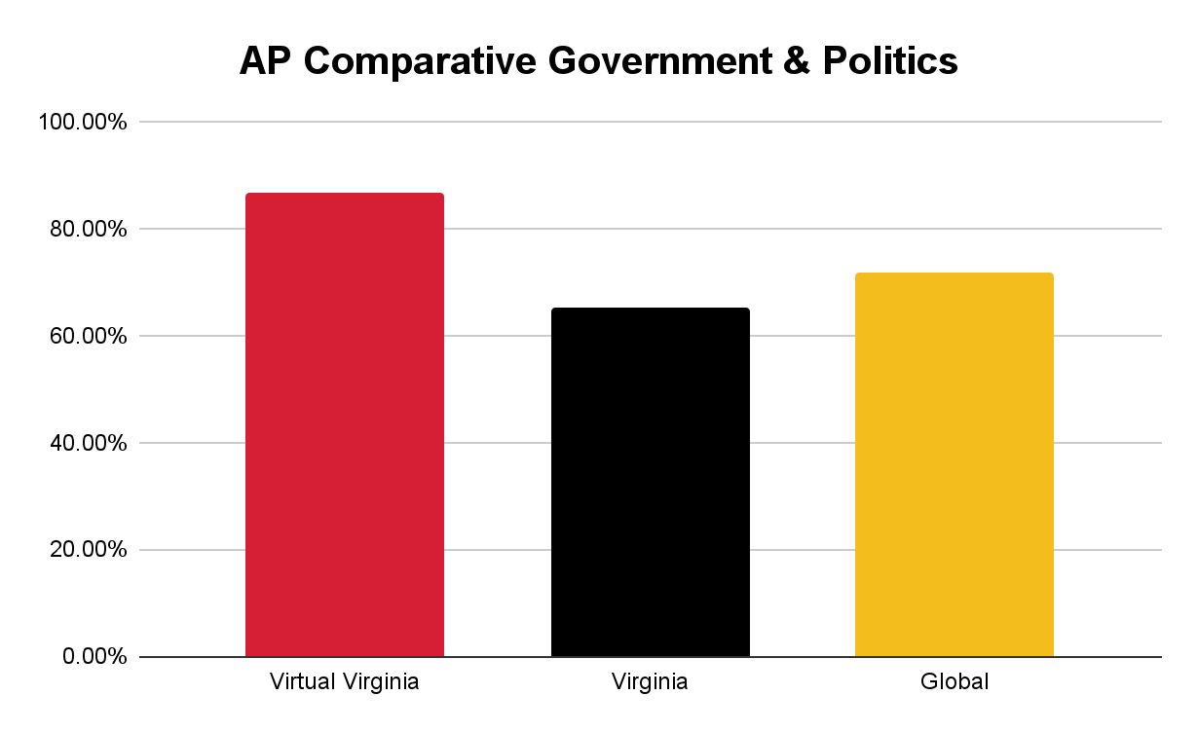
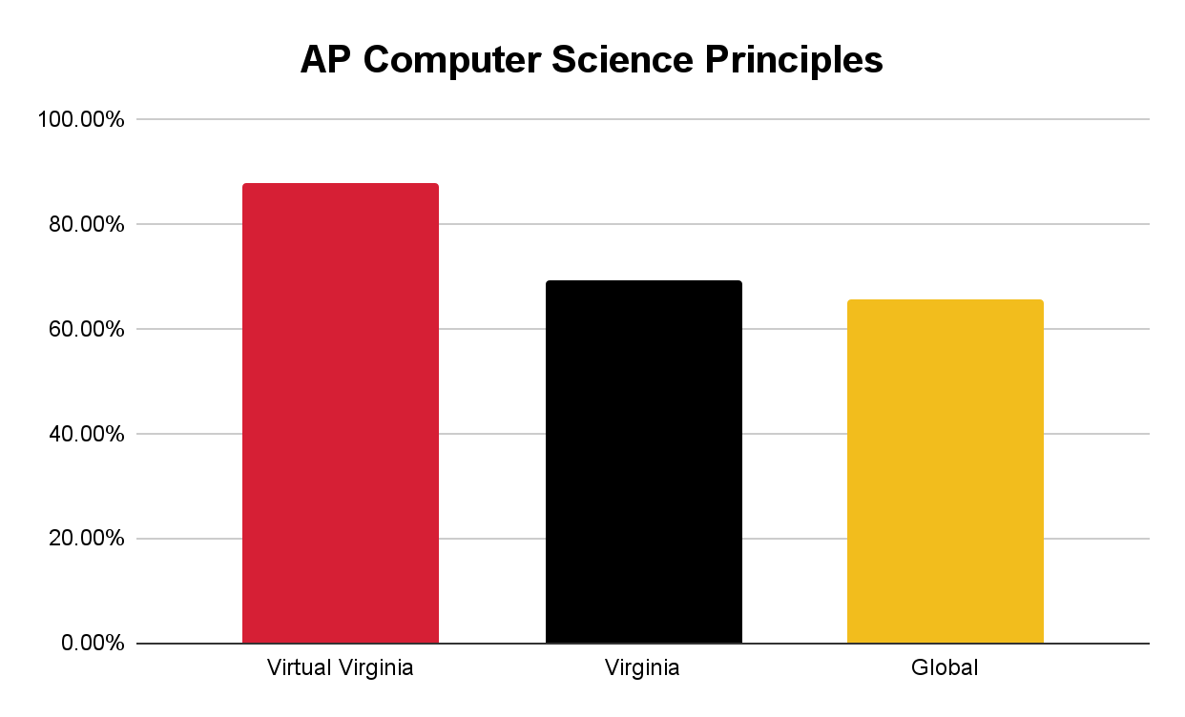

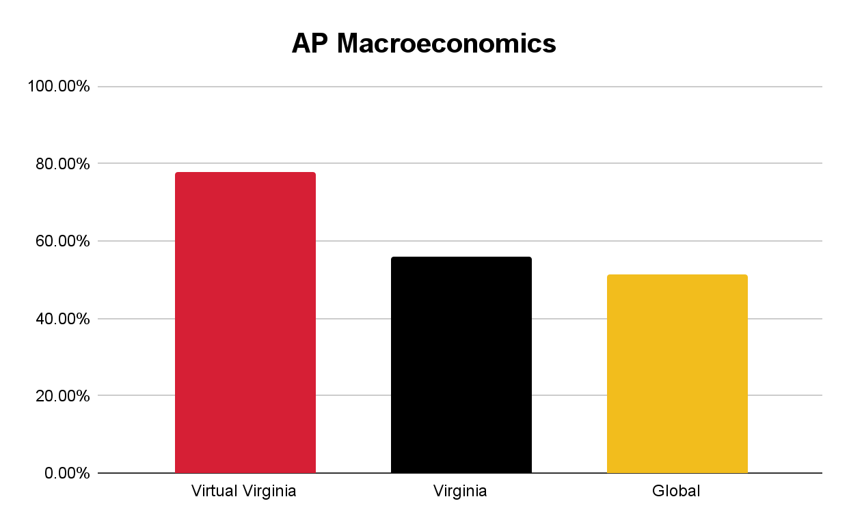
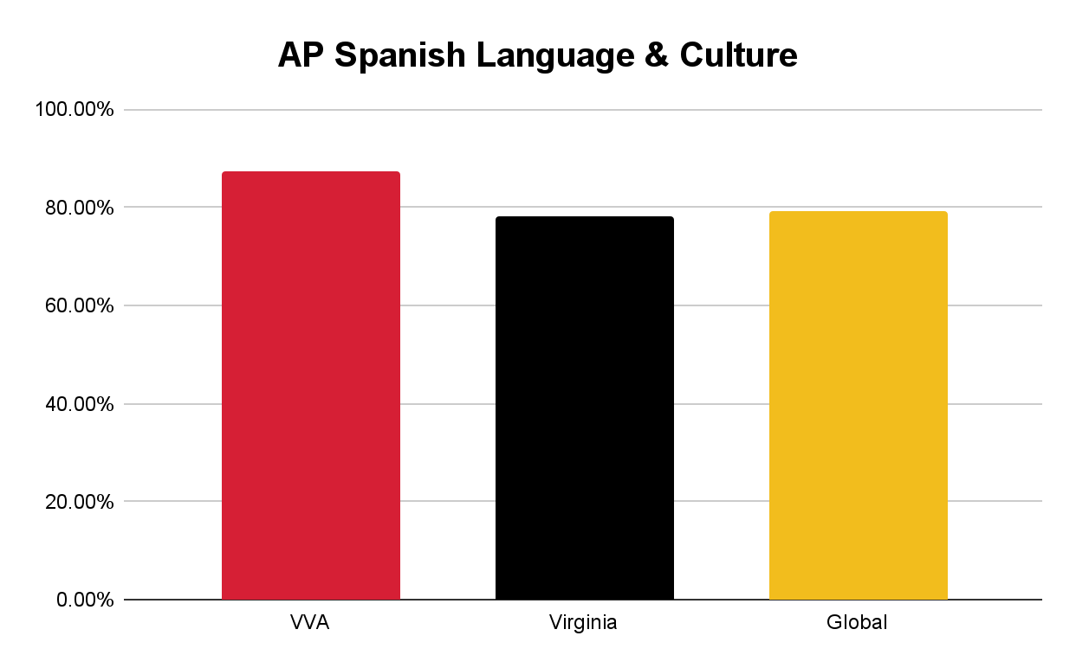
Student Achievement (2021)

Slide 18

VVA Instructors
Full-time and part-time K–12 educators
Possess a valid Virginia teaching license
Recruit in the Commonwealth and across the country
All new VVA instructors:
  Complete Teaching with Virtual Virginia course (during recruitment process)
    Required demonstration and practice
  Must not be under contract with a public school division
  Participate in VVA Professional Development
Follow SOQ and SOA teacher ratios and class sizes

Slide 19
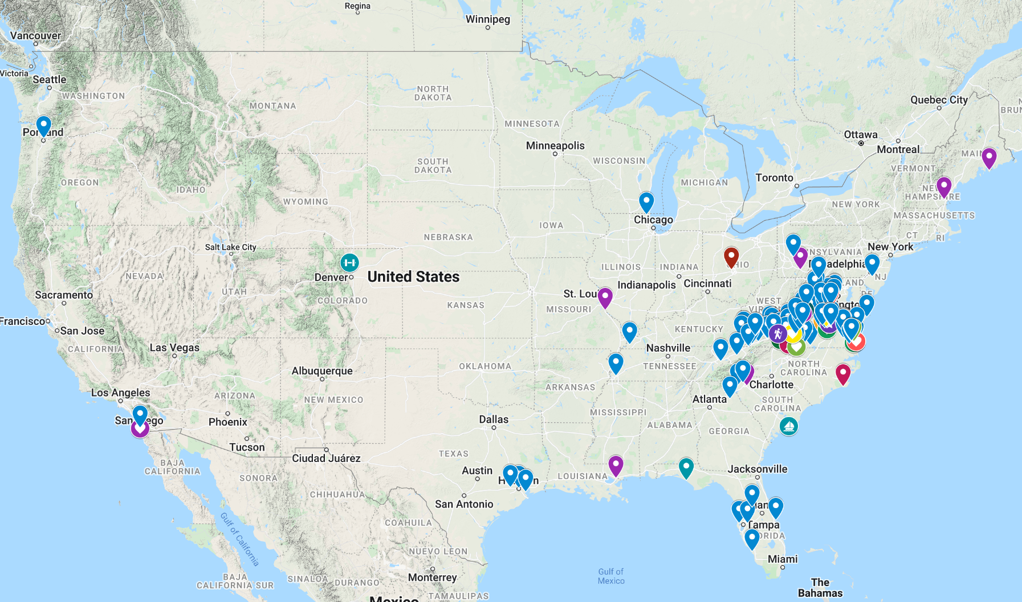
VVA Faculty & Staff
Plus:
Costa Rica (1)
Germany (2)
Spain (1)
Source: Google Maps

Slide 20

Professional Development for VVA Teachers
Internal Opportunities
  Annual "EdCamp" training to start the school year
  Weekly "Lunch & Learn" workshops
  Monthly PL activities aligned with National Standards for
  Quality (NSQ) Online Teaching
  Participation in Professional Learning Communities
Quality Matters training
  Applying the QM K–12 Rubric Workshop
  QM K–12 Reviewer Course
  Addressing Accessibility & Usability Workshop
  QM webinars
  Additional QM courses/workshops as needed/requested
Professional Organizations

Slide 21
2022–2023: K–12 Expansion
Virtual Virginia (VVA) expanded in over the last several years by offering more courses to more learners.
In 2022–2023, VVA is poised to add growth in:
Students enrolled in VVA as part-time in person or full-time online learners
Support for in-person learning needs
Highly qualified Virginia-certified instructors
Core and supplemental opportunities for K–5 learners
Course offerings for learners in grades 6–12
Opportunities for synchronous instruction in whole group, small group, and 1:1 settings

Slide 23
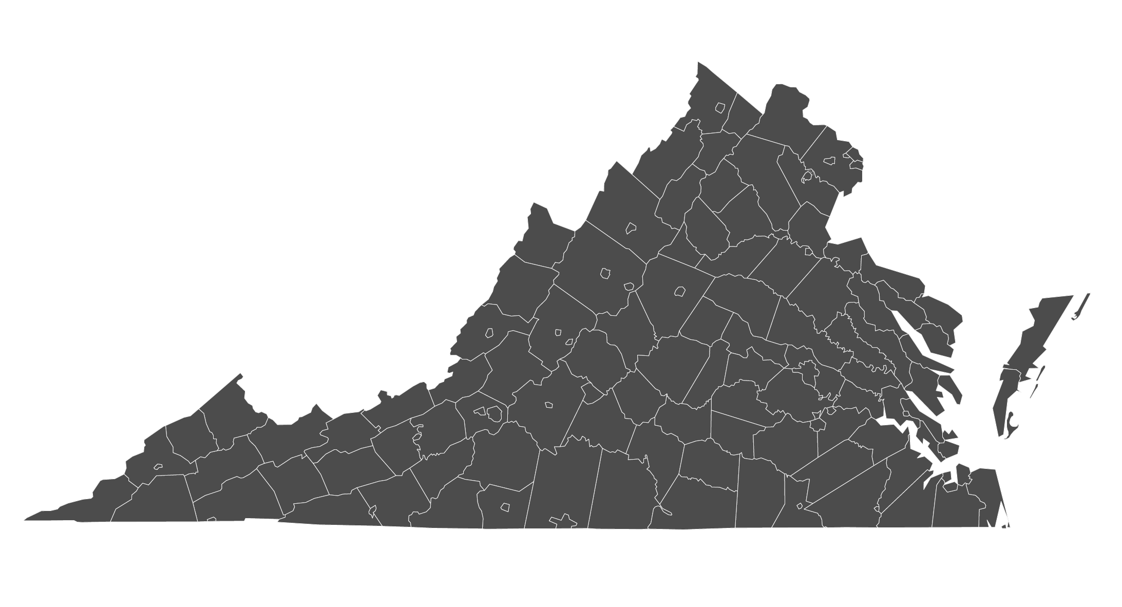
Statewide LMS Participation, 2021–2022

Slide 24

Outreach Program
Established in 2012, the Virtual Virginia Outreach Program provides a statewide LMS and K–12 course content to Virginia public school divisions at no cost.
Why an LMS?
Automation
Interoperability
Organization & security, all in one place
Unlimited (24x7) access for learners
Actionable data: track progress & performance
Cost savings: printing, travel, professional learning, etc.
Expands the division profile: more options for learners and educators
Division’s digital ecosystem: a 2022 solution to a 2022 problem
Blended learning & personalized education
Transparency for parents/guardians

Slide 25

K–12 Content Available (via Statewide LMS)
Grades K–5
Reading
Writing
Math
Social Studies
Science
STEM
Grades 6–12
Core
Advanced Placement
World Languages
Computer Science
HPE
Credit Recovery
2022–2023 Expansion (K–12)
Core Academic & Elective
World Languages
Health & PE
CTE
Fine & Performing Arts
Computer Science
English Language Supports
Career Exploration

Slide 27

Professional Learning
Free training for all Virginia public school educators at no cost.
VVA's PL Catalog of offerings is available 24/7, 365.
Developed by a variety of educators and partners, including:
  VDOE
  VVA
  Canvas
  Virginia Society for Technology in Education (VSTE)
  VASCD
  Virginia Museum of Fine Arts
  School division leaders
  Virginia Colleges and Universities
Microcredentials, Credentials & Badging

Slide 28

Statewide Professional Learning Network (PLN)
Community of Virginia public educators
Access to subject-area peer discussions, workshops, and statewide PL offerings
VDOE professional learning integrated to the PLN
The PLN appears automatically on educator LMS dashboards
24 unique PLN user groups (grade-level teaching, content areas, etc.)
Synchronous & asynchronous professional learning opportunities

Slide 30

VVA Summer Session 2022
Grades K–12
Enrichment Camps (K–5)
  World Languages: Chinese, Spanish & French
  STEM & Core Academics
90 Courses (Grades 6–12)
Cohort 1
Early June to Mid-July
Courses & Enrichment
Credit Recovery
Cohort 2
Mid-June to Late July
Courses & Enrichment
Credit Recovery

Slide 31

Lessons Learned
VVA K–12 instructional (synchronous) model is unique among statewide programs
The needs of K–12 learners in the Commonwealth are evolving (PT & FT)
The investment in VVA K–12 teacher recruitment, training, and support is critical
Statewide LMS - the need for a school division LMS is growing
Connecting professional learning to larger systems is helpful in meeting the evolving needs
We are just getting started…

Slide 32

Challenges
Enrollment flexibility may present (staffing) challenges to meeting the SOQ/SOA
Misconceptions:
screen time
teachers are exhausted/tired of technology
online learning doesn’t work
K–12 Synchronous and Asynchronous requirements
Quality
Continue to support:
data reporting
K–12 research
blended learning

