Slide 1
The New Virginia Alternate Assessment Program
Preparation for Standard Setting

Slide 2
Background
The original Virginia Alternate Assessment Program (VAAP), implemented in the 2000-2001 school year, was designed as a portfolio-based state assessment for students with significant cognitive disabilities. While the design of VAAP changed somewhat over the years, it remained a portfolio-based assessment until the implementation of the Every Student Succeeds Act (ESSA).
On February 5, 2019, the United States Department of Education (USDOE) notified Virginia that the portfolio design of the VAAP did not meet the requirements of ESSA.
USDOE advised Virginia to:
  Redesign or replace the VAAP
  Implement a “new VAAP” by the 2021-22 school year

Slide 3
Virginia Department of Education (VDOE) Response
FALL 2019
Created an internal VDOE team from Assessment and Special Education
Conferred with National Center for Educational Outcomes and USDOE
Developed a workplan to meet USDOE deadlines
WINTER and SPRING 2020
Reviewed alternate assessments for students with significant cognitive disabilities from national assessment consortia and other states
Conferred with state assessment staff from across the country
Selected assessment partners: Behavioral Research & Teaching (BRT) at the University of Oregon and the Oregon Department of Education

Slide 4
Virginia Essentialized Standards of Learning (VESOL)

Slide 5
Essentialization of Standards of Learning into VESOL
In 2020, BRT and VDOE personnel worked with Virginia special educators to use the essentialization process, developed by BRT, to create new academic standards for the VAAP referred to as the Virginia Essentialized Standards of Learning (VESOL).
As allowed by the United States Department of Education, SOL in Reading, Math, and Science were essentialized by reduction in depth, breadth, and complexity to identify academic content which is relevant, accessible, and appropriate for students with significant cognitive disabilities.

Slide 6
Example from Grade 3 - Math
SOL
3.3a The student will estimate and determine the sum or difference of two whole numbers.
VESOL
Add and subtract whole numbers up to 20.

Slide 7
Test Design Overview

Slide 8
New VAAP: Design Basics (1 of 2)
The new VAAP test is available to eligible students with significant cognitive disabilities in Grades 3 through 8 and high school in the areas of reading, mathematics, and science.
Test items will be based on the VESOL and will include three answer options. Test items are presented online but students may also be provided with a paper copy of the items if needed.
Test items may be read to the student or the text-to-speech option may used.

Slide 9
New VAAP: Design Basics (2 of 2)
Offers multiple and diverse ways for students to respond:
Students may choose answer selections on computer or paper.
Students may make answer selections with the support of assistive technology.
Teachers/Examiners may enter answers selected by students based on their preferred response modality (based on their IEP), for example:
    Verbal response
    Pointing
    Head Movement
    Eye gaze

Slide 10
Sample
Grade 3 - Mathematics
SOL
3.3a The student will estimate and determine the sum or difference of two whole numbers.
VESOL
Add and subtract whole numbers up to 20.

Slide 11
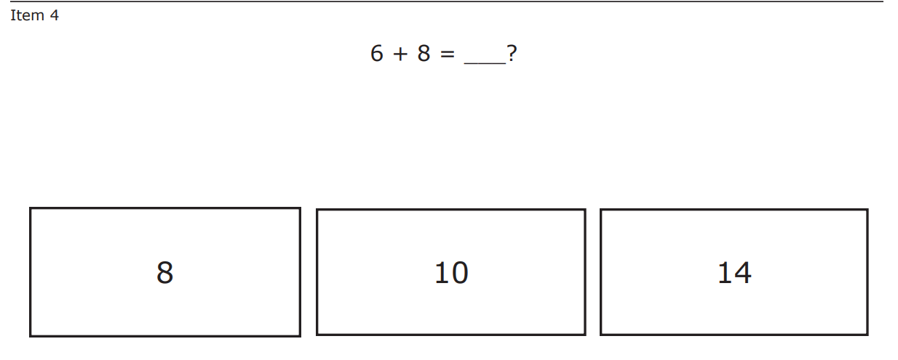
Sample Grade 3 Math Item

Slide 12
VAAP Standard Setting

Slide 13
Need for Standard Setting
The new VAAP tests are being administered for the first time in spring 2022. Since the tests are new, the Board will need to establish minimum scores (cut scores) for the performance levels of proficient and advanced.
Committees of educators are being convened in April and May to review the tests and to make recommendations to the Board regarding the cut scores.
Because the Board does not meet in May, the Board will be asked to waive first review and adopt cut scores for the new VAAP test at the June 2022 Board meeting. To allow the Board and the public time to review the recommended cut scores prior to the June Board meeting, VDOE staff will provide information about the recommended cut scores for the new VAAP tests to the board and the public in May.
An overview of the new VAAP test and a discussion of the process used to establish cut scores is being provided to the Board in this work session to facilitate the Board’s review of the cut score information prior to the June Board meeting.

Slide 14
Standard Setting
Standard setting is a systematic way of making a professional judgment on the level of achievement required to signify that a student’s performance is at a particular performance level (e.g., proficient or advanced).
For the VAAP tests, three performance levels have been established:
  Advanced Attainment of the Standards (Pass)
  Proficient in the Standards (Pass)
  Does Not Meet Proficiency (Fail)

Slide 15
Standard Setting Procedure (1 of 7)
Virginia utilizes the Angoff procedure
  Widely used for setting standards on tests for a number of years
  Used in Virginia with the Standards of Learning tests since 1998
For VAAP standard setting, the procedure was used with committees of Virginia educators who have
  knowledge of the Virginia Essentialized Standards of Learning (VESOL)
  experience teaching students with significant cognitive disabilities

Slide 16
Standard Setting Procedure (2 of 7)
The Angoff procedure includes the following steps:
Committee members receive training in the standard-setting process.
Committee members discuss the performance level description for each achievement level (i.e., Does Not Meet Proficiency, Proficient, and Advanced for the VAAP assessments).
  An example of a performance level descriptor for the “Proficient” achievement level for the VAAP Grade 3 Reading test follows:

Slide 17
Standard Setting Procedure (3 of 7)
VAAP Grade 3 Reading Test Performance Level Descriptor
For a student performing at the “Proficient” level, when given sentences that are read to the student or that the student reads, the student should be able to:
    identify and understand the meaning of some words,
    answer some comprehension questions,
    identify some elements such as events, ideas, or steps,
    identify some characters, and
    identify some settings.

Slide 18
Standard Setting Procedure (4 of 7)
Discussion of Performance Level Descriptors (continued)
The committee members discuss the Performance Level Descriptor for each achievement level.
Then they discuss the characteristics of students who just make it into an achievement level or those who are “just proficient” and “just advanced,” to further define the particular knowledge and skills that separate those students in one achievement level from those in the others.

Slide 19
Standard Setting Procedure (5 of 7)
Round 1 Ratings
Committee member independently examine each question on the test, thinking of students who are “just” proficient and estimating whether 2 out of 3 students would answer each item correctly MOST of the time.
Committee members use the same procedure for the advanced category.
When Round 1 is completed, each committee members has recorded “yes” or “no” for each question on the test for “proficient” and “advanced.” Each committee member’s ratings on the questions are converted to a cut score. A cut score is defined as the number of questions that a student must answer correctly to be classified in a particular performance category.

Slide 20
Standard Setting Procedure (6 of 7)
Round 2 Ratings
Committee members are provided with a table of each person’s ratings from Round 1.
They discuss the results, refine the definitions and descriptors, and repeat the process used in Round 1:
  Committee members again independently examine each question on the test, thinking of students who are “just” proficient and estimating whether 2 out of 3 students would answer each item correctly MOST of the time.

Slide 21
Standard Setting Procedure (7 of 7)
Round 3 Ratings
Committee member are provided with a table of each person’s ratings from Round 2.
They discuss the results and then make any changes to their recommended cut scores.

Slide 22
Articulation Committee (1 of 2)
After the work of the standard setting committees has been completed, a smaller group of educators composed of two or three members from each of the standard setting committees is convened to review the results of Round 3 for each test (i.e., Grades 3-8 and high school reading and mathematics, Grades 5, 8, and high school science).
For the reading tests, for example, the purpose of the “articulation committee” is to review the Round 3 results for the Grade 3-8 and high school reading tests to determine the reasonableness of the recommended cut scores in light of the performance level descriptors and estimated impact data.

Slide 23
Articulation Committee (2 of 2)
The articulation committee repeats this review for the Grades 3-8 and high school mathematics tests and then the Grades 5, 8, and high school science tests.
Impact data is reviewed by the articulation committee and provides estimates of the number of students who would fall into each achievement level if the recommended cut scores were adopted.
Based on their review, the articulation committee may recommend adjustments to the cut scores for some of the tests.

Slide 24
Recommendation to the Board
Details are presented as recommendations to the Board of Education
  The Round 3 results of the standard setting committees for each test are presented.
  The results of the articulation committee are presented.
  The superintendent’s recommendation for the cut scores for each test is provided.
The Board of Education is asked to consider this information and to adopt cut scores for each VAAP test.

