Slide 1

Strengthening Quality in Early Childhood Classrooms:
Update on Practice Year 1
Virginia Board of Education – Work Session
April 20, 2022
Notes:
JENNA

Slide 2
Objectives and Agenda
This presentation will review current research related to measuring and supporting quality in birth-to-five classrooms, along with an update on Virginia’s Unified Measurement and Improvement System (VQB5).
Virginia’s School Readiness Data and Why School Readiness Matters
Measuring and Improving Quality in Early Childhood in Virginia
Progress Update on Practice Year 1 of Virginia’s Unified Measurement and Improvement System (VQB5)

Slide 3
School Readiness in Virginia

Slide 4
Our Shared Vision
Four out of ten Virginia children enter school without the key literacy, math, and social-emotional skills needed. We envision a Virginia where all children have the opportunity to enter school ready.
All families have affordable access to and support to choose the option that meets their unique needs.
All early childhood programs that take public funds benefit from measurement and supports for improvement, ensuring quality choices are available for all families.
Programs are rewarded for continual improvement and educators are adequately compensated.
Overall Virginia’s early childhood system is unified, data-driven and resource-effective so families can work, go to school or pursue employment and children have every opportunity to be successful.

Slide 5
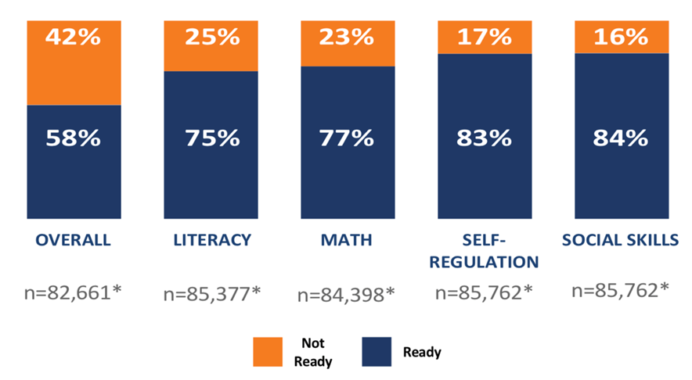
School Readiness in 2021-2022
Fall 2021 VKRP data show that 4 out of 10 young learners do have the opportunity to enter kindergarten ready. More than 21,000 Virginia kindergarteners are at serious risk of reading failure, in the absence of intervention.
VKRP Fall 2021-22 Kindergarten Readiness Results

Slide 6
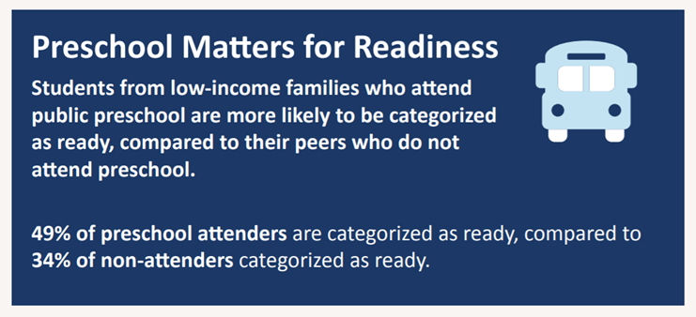
Persistent Disparities in Opportunity
Greater percentages of historically underrepresented children began the school year below the overall readiness benchmark including:
52% of Black students, and 60% of Hispanic students
56% of students from low-income backgrounds
67% of English language/Multilingual learners
64% of students identified as having a disability

Slide 7
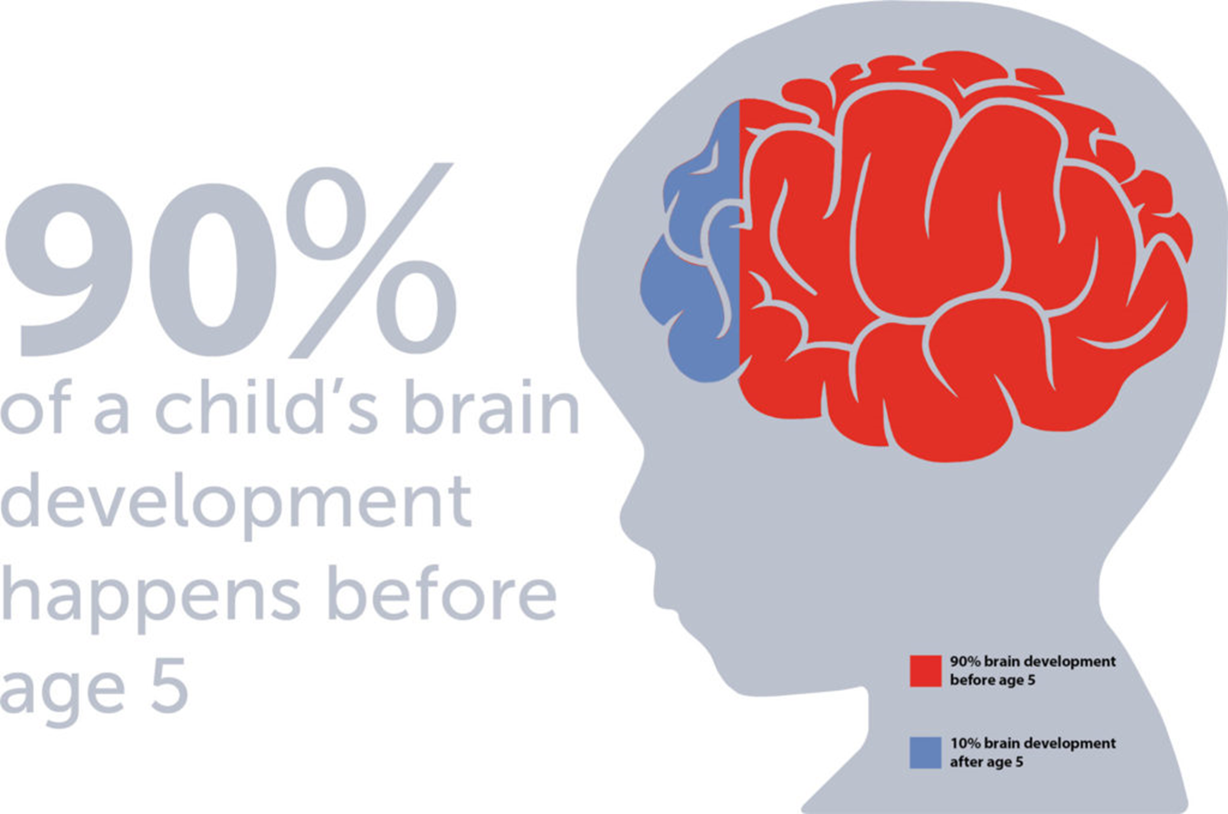
Brain Development and School Readiness

Slide 8
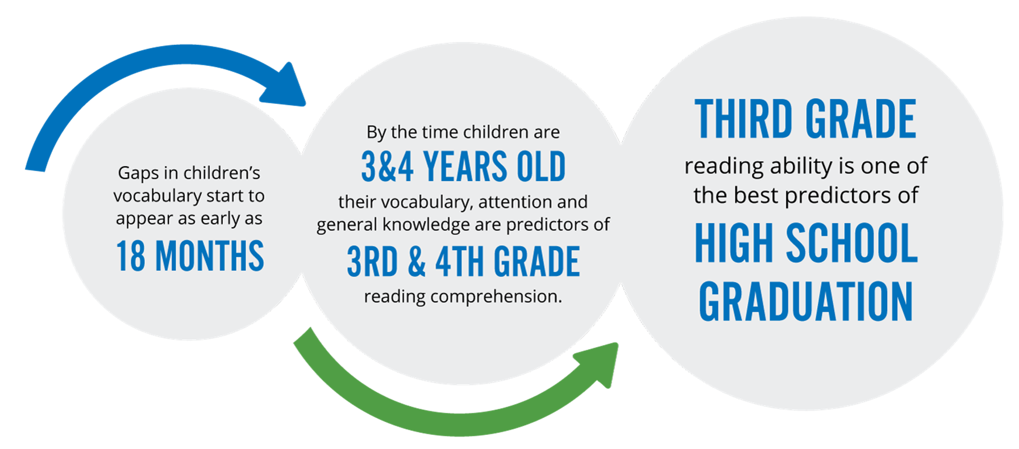
Early Childhood is the Foundation for Learning
https://www.firstthingsfirst.org/early-childhood-matters/early-literacy/
Notes:
https://www.firstthingsfirst.org/early-childhood-matters/early-literacy/

Slide 9
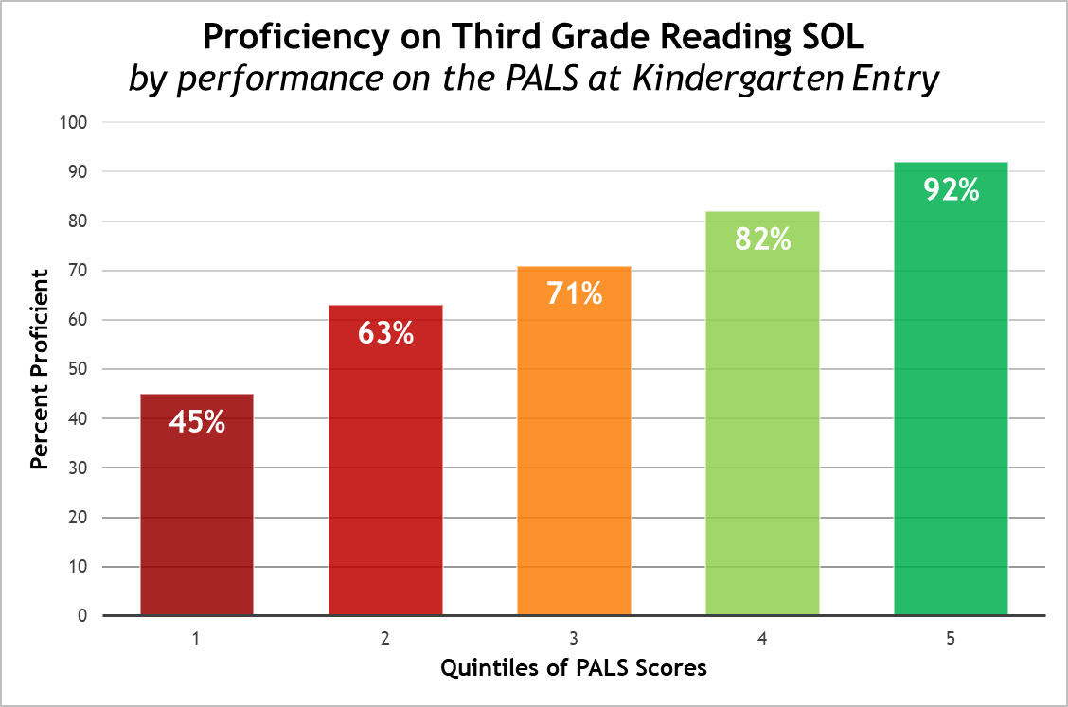
Linking Readiness to 3rd Grade Outcomes

Slide 10
Both Access and Quality Matter
Access + Quality
More Choices for More Families
Improved School Readiness Outcomes

Slide 11
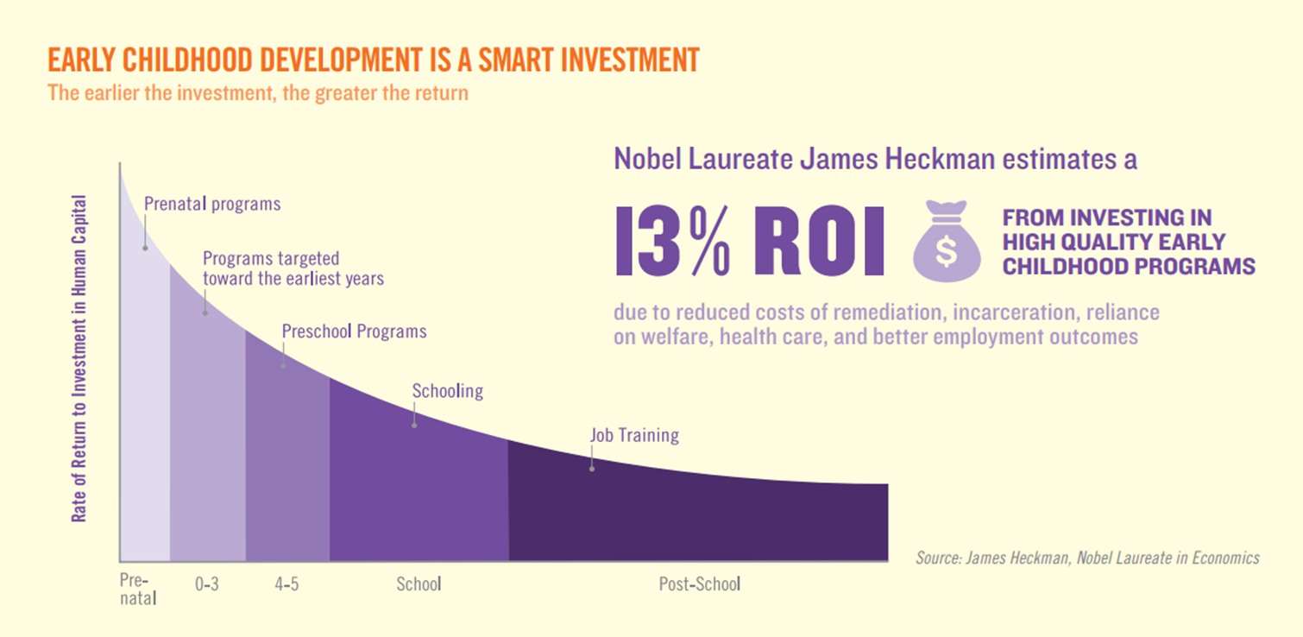
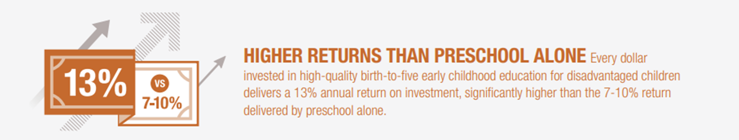
Quality Early Childhood as an Investment

Slide 12
Why Economists Care about EC Quality
According to Federal Reserve Economist James Heckman:
Investing early in education produces better economic, health and social outcomes in childhood and adulthood.
Policymakers who invest in high-quality early learning programs from birth can permanently boost IQ and social-emotional skills that create productive, independent adults.
Child care functions as early learning in the real world—child care without high quality learning is a huge missed opportunity.
Attaching quality to child care provides two generations of benefits—it helps parents grow their income and children grow smarter.
Investing in high-quality child care quickly pays for itself in income gains among parents in the first five years and beyond.
https://heckmanequation.org/

Slide 13
Measuring and Improving Quality in Early Childhood

Slide 14
Virginia’s Path to a Unified Quality System
Virginia Quality (VQ), Head Start and VPI+
Virginia Quality, Head Start and VPI + use teacher-child interactions as a key component of classroom quality in a variety of birth-five settings, including in family day homes.
Preschool Development Grant (PBG B-5)
Virginia received funding to develop a unified strategy, increase equity and build infrastructure at the community level, focusing on relationships, quality, enrollment and family engagement, across PreK, ECSE, Head Start, child care centers and family day homes.
2016
2020
2015
2018
JLARC Early Childhood Study
Study found that Virginia has insufficient evidence about how well publicly-funded early childhood programs are preparing children for school
Recommendations included more comprehensive assessments of K readiness; improving the design, quality, and performance data of programs.
Executive Directive 4 and New State Law
ED4 called for improving school readiness through a plan to ensure that all at-risk 3 and 4-year-olds have access to publicly-funded care and education and that all publicly-funded birth to five programs are measured as part of a uniform quality rating system. HB 1012/SB 578 into law in July 2020, officially unifying birth to five programs under the VDOE as of July 1, 2021; establishing the Early Childhood Advisory Council; and requiring the Board to adopt a uniform quality rating system by July 1, 2021.

Slide 15
Continual Quality Improvement at Scale
Virginia will help drive continual, system-wide improvement in early childhood care and education at scale by:
Defining quality in a way that is (1) linked to child outcomes; (2) makes sense to early educators; (3) is under their control;
Committing to quality measurement as a tool for tracking improvement and targeting supports;
Focusing on improvement and growth, coupled with the necessary investments needed (e.g., professional development, compensation); and
Prioritizing and providing targeted supports for sites with greatest need

Slide 16
How Virginia Measures Quality
VQB5 measures the quality of infant, toddler and preschool teaching and learning based on two nationally-recognized quality indicators. All publicly-funded birth-to-five programs will must participate by Fall 2023.
Interactions | Curriculum
Measure teacher-child interactions and instruction in a developmentally-appropriate way using the Classroom Assessment Scoring System (CLASS) | Measure the use of approved curricula that are aligned with Virginia’s Early Learning and Development Standards
Research shows that stimulating and supportive interactions between teachers and children and effective use of quality curricula promote children’s holistic learning and development, resulting in improved school readiness.
Details can be found on the Quality Measurement and Improvement (VQB5) website

Slide 17
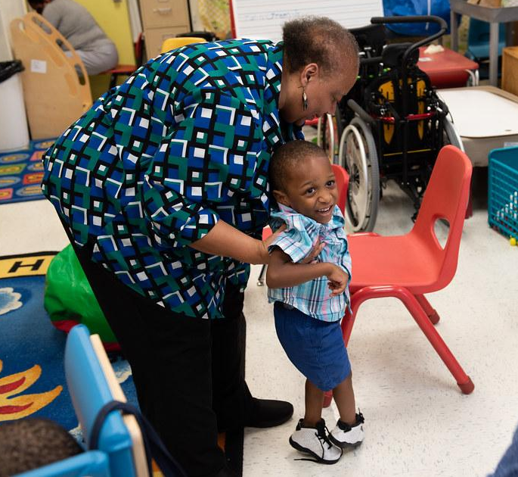
Adult-Child Interactions Promote Learning
Interactions are defined as ongoing back-and-forth exchanges between a child and “significant others” (parents, siblings, peers, and teachers) and are central in supporting children’s learning and development.
  Responsive interactions with teachers help infants, toddlers, and preschool-aged children by providing a secure base (e.g., reliable source of comfort and safety) from which to explore their environments.
  Scaffolded interactions with teachers help children master increasingly difficult tasks that extend their learning and development.
Bowlby, 1979; Bronfenbrenner & Morris, 2006; Vygotsky, 1978

Slide 18
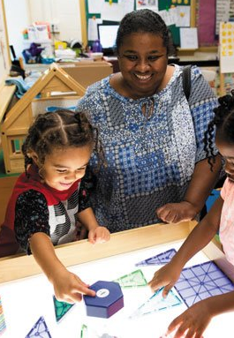
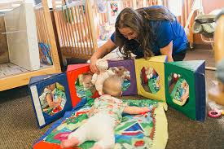
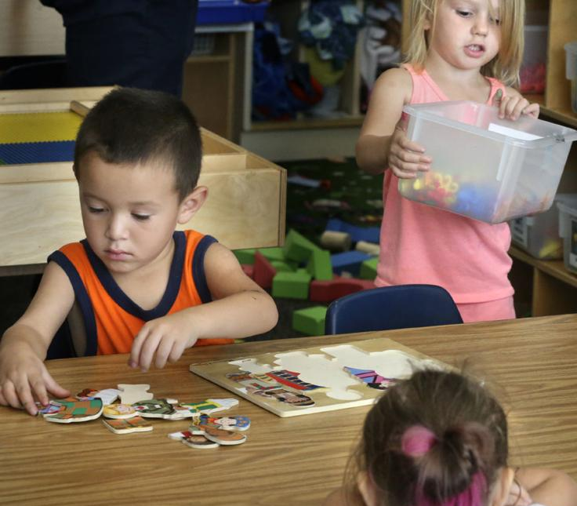
Quality Interactions Across Settings
Research shows that children in classrooms with high quality interactions benefit academically, socially, and behaviorally – across diverse settings:
State-funded PreK
Head Start
Child care
Family day homes
Infant/toddlers
Rural settings
Notes:
State-funded PreK: Johnson et al 2016; Cash et al 2019; Carr et al 2019; Vitiello et al 2018; Mashburn et al 2008; Burchinal et al 2012; Downer et al 2011
Head Start: Hindman & Wasik 2013; Vitiello et al 2018; Aikens et al 2015 (Early Head Start); Hamre et al 2014; Moiduddin et al 2012
Child-care: Vitiello et al 2018; Hatfield et al 2013; Ruzek et al, 2014
Family day homes: Clarke-Stewart et al 2002; Bassok et al 2016
Infant/Toddlers: Ruzek et al, 2014
Rural settings: Justice et al 2017
Measured through statewide QRIS system: Markowitz et al 2020; Sabol et al 2013; Vitiello et al 2018

Slide 19
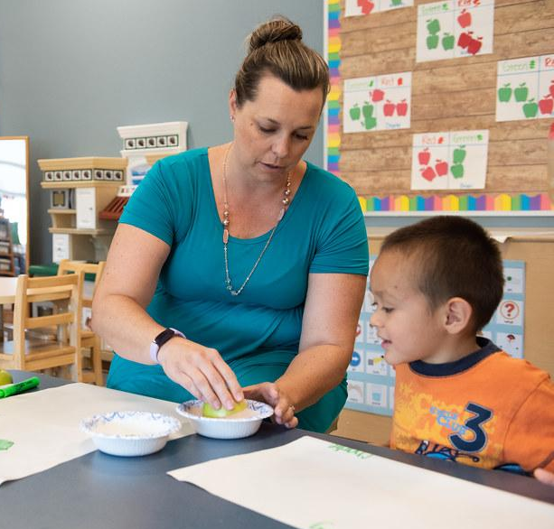
Curriculum Support High-Quality Interactions
Curriculum consists of the “plans for the learning experiences through which children acquire knowledge, skills, abilities, and understanding.” Curriculum helps teachers provide quality interactions that promote learning by:
Defining specific, sequenced learning goals
Providing structure, routines
Suggesting activities promote children’s engagement
Offering scripts help teachers scaffold children’s learning (i.e., how to explain concepts)
Promoting consistency across classrooms
NAEYC -- Developmentally Appropriate Practice Position Statement (adopted April 2020)
Notes:
NAEYC -- Developmentally Appropriate Practice Position Statement (adopted April 2020)
https://www.naeyc.org/sites/default/files/globally-shared/downloads/PDFs/resources/position-statements/dap-statement_0.pdf

Slide 20
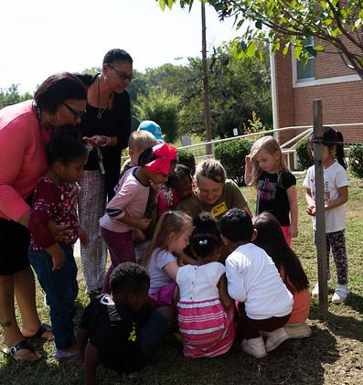
Impact of Curriculum on Children
Research shows that curriculum use, when paired with ongoing support for teachers’ implementation, yields strong impacts on children’s school readiness skills.
Classrooms using the same curriculum vary in their frequency of learning activities and overall quality.
Teachers need to be supported through professional development to implement curricula with high levels of fidelity and quality.
Mattera & Morris, 2013; Morris et al., 2014; Weiland & Yoshikawa, 2013; Weiland et al, 2018

Slide 21
Summary of Rationale for Virginia’s Approach
Why Interactions? | Why Curriculum?
✔ Responsive and effective teacher-child interactions form the foundation for all social and cognitive learning. ✔ 200+ studies show that children in classrooms with more effective teacher-child interactions, as measured by CLASS®, have better academic and social outcomes. ✔ Improvements in interactions are associated with improvements in children’s outcomes. ✔ All children, including those from diverse backgrounds, dual language learners (DLLs) and with special needs, benefit from high quality interactions as measured by CLASS®. ✔ Virginia has used the CLASS® in early care and education settings for 10+ years. | ✔ Using effective curricula helps support learning and development in all settings. ✔ Curricula that are aligned with Virginia’s Early Learning Standards help ensure educators address all areas of children's learning and development. ✔ Quality curricula support cultural and linguistic diversity, and help individualize instruction based on children’s needs. ✔ Studies suggest that “intensive, developmentally-focused curricula with integrated professional development and monitoring of children’s progress offer the strongest hope for improving classroom quality and child outcomes.”

Slide 22
Continuous Quality Improvement
PREPARE
Leaders and educators understand what is being measured and why
RECOGNIZE, REFLECT AND ADJUST
Leaders and educators use data to recognize growth, reflect on what works and make adjustments to address challenges and gaps
MEASURE AND IMPROVE
All infant, toddler and preschool classrooms are observed and consistent information is collected to understand the experience of all children
SUPPORT
Leaders and educators receive professional development that addresses their unique classrooms
GIVE FEEDBACK
Leaders provide educators with individualized feedback on their classroom’s strengths and opportunities for growth

Slide 23
How It All Fits Together
VQB5 measures classroom experiences most strongly linked to children’s outcomes
Adult-child interactions
Curriculum
VQB5 includes all publicly-funded birth-five classrooms and settings
Infants, toddlers, preschoolers
VPI, ECSE, Head Start/Early Head Start, Title I, center-based care, family day homes
VQB5 link children’s experiences to their school readiness outcomes
LinkB5 data collection portal
VKRP assessments (preschool and kindergarten)

Slide 24
Purpose of the Practice Years
Programs can practice collecting information and receiving supportive feedback, with targeted supports for interactions and curriculum. Practice years inform future guidelines and procedures.
VQB5 Practice Year 1 (Currently underway in 1450+ sites)
Participation available through PDG communities (about 85% of the state)
Practice Year 1 ratings shared with site leaders in fall of 2022
2021-2022
VQB5 Practice Year 2
Participation available statewide through Ready Regions to 100% of programs
Practice Year 2 ratings shared with site leaders in fall of 2023
2022-2023
VQB5 Year 1
All publicly funded programs required to participate
Quality Ratings from Year 1 publicly shared in the fall 2024
2023-2024

Slide 25
Progress Update on Practice Year 1
A detailed Practice Year 1 Progress Report is also provided in Appendix A of the Guidelines for Practice Year 2 document

Slide 26
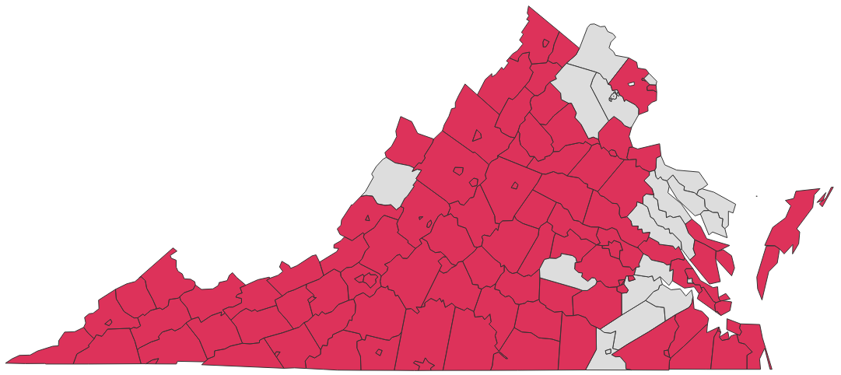

Thousands of Sites are Participating
During Aug/Sept 2021, 1450+ sites registered to participate in VQB5 Practice Year 1, representing different types of early childhood settings in Virginia.
Among sites participating:
More than 650 centers
Over 500 public schools
250+ family day homes

Slide 27
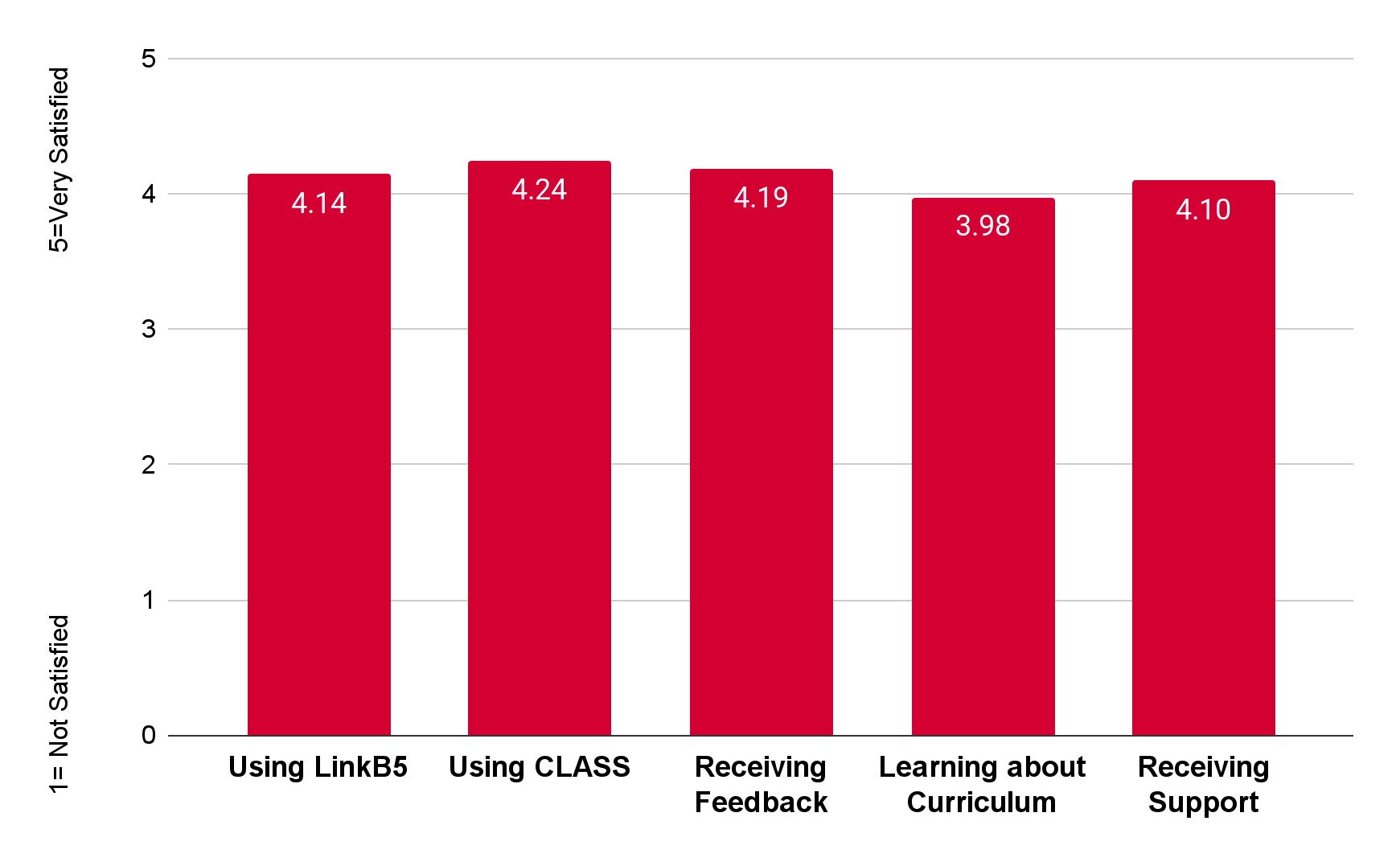
Data Snapshot - Participant Experience
The majority of VQB5 Practice Year 1 participants are satisfied.
VQB5 Fall 2021 Participant Feedback Survey

Slide 28
Programs are Positive about VQB5
I have been enlightened to know how the CLASS tool works and the indicators teachers should be focusing on during their interactions with students. (Center Director/Fairfax)
I have received new ideas and have better ways of doing things (FDH/Charlottesville)
I have been able to take my classroom to a whole new level with the tools from CLASS (PreK teacher/Giles)
I appreciate all of the help and quick response when I had questions (FDH/Fairfax)
I loved the observations. It’s always good to have someone from the outside to give your program a fresh look. (Owner Childcare Center/Suffolk)
I appreciate that "we" are all talking the same language and have comparable results.
(VPI Program/Isle of Wight)
It’s great to see teachers excited about their new curriculum (Center Director/Roanoke)
My teachers saw how good they are doing with their class from an outside source (Center Director/Caroline County)
From Fall 2021 Participant Feedback Survey

Slide 29
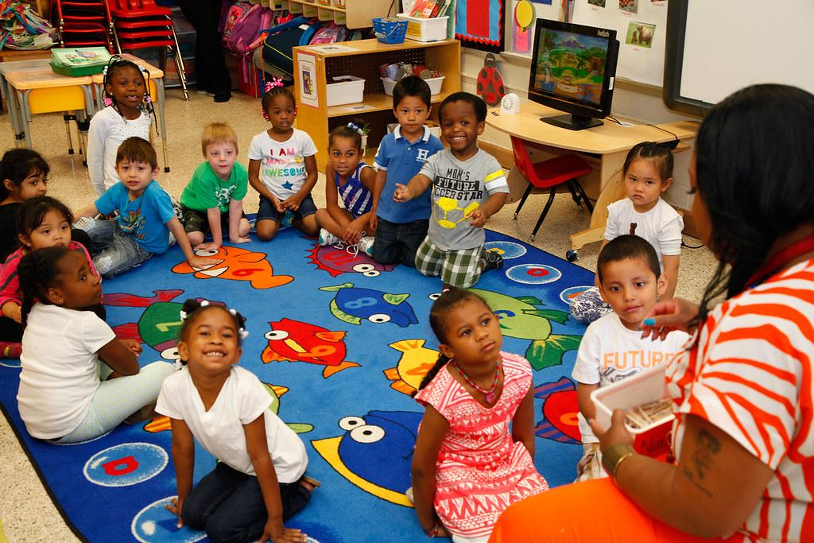
Communities Completed 4200+ Observations this Fall
Accomplishments as of March 2022:
Over 4000+ Local CLASS Observations have been completed (with another 4200+ expected to be completed by June)
  Program leaders and teachers are receiving individualized feedback on their strengths and needs, as well as targeted resources for improvement
Over 200 External Observations have been completed (with another 600+ expected to be completed by June)
  State and community leaders have information to help support local observers

Slide 30
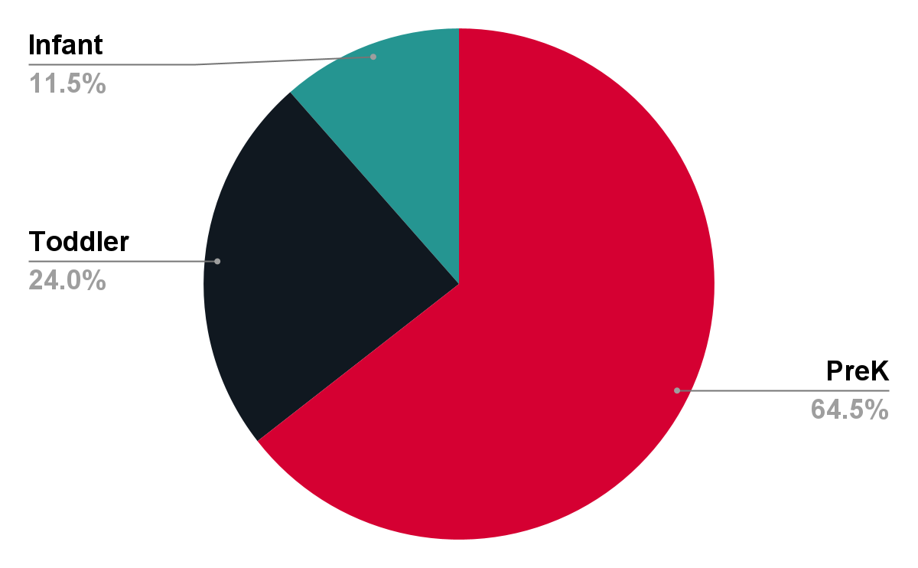
Fall Data Snapshot - Teacher-Child Interactions
All classroom types are receiving CLASS observations and feedback.
VQB5 Fall 2021

Slide 31
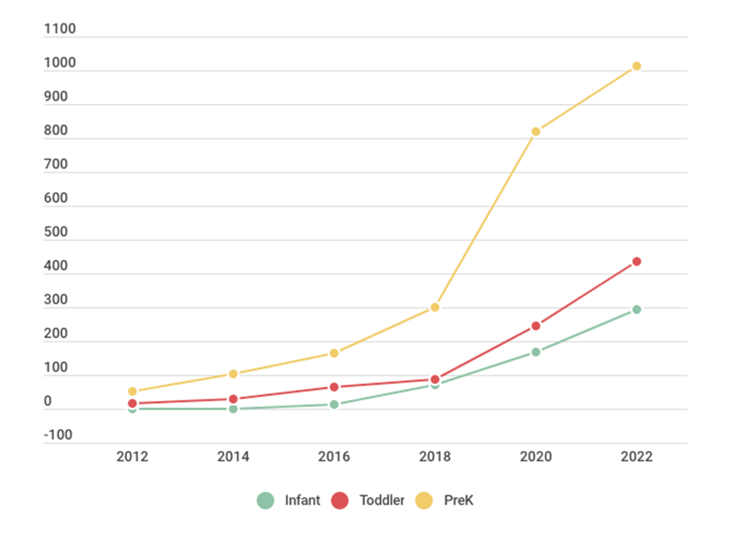
Data Snapshot - CLASS Growth 2012-2022
Growth in CLASS observers has increased greatly across all age levels.
64% of all certified Virginia observers are currently conducting local observations for PY1
Updated March 8, 2022

Slide 32

More Programs are Using Quality Curriculum
Accomplishments as of March 2022
Launched a new birth-five curriculum review process.
  32 curricula currently approved, including 9 infant/toddler and family day home curricula
Launched no-to-low cost birth to five curriculum option, STREAMin3
Information gathered on curriculum use from 4700+ classrooms participating in Practice Year 1 (updated curriculum information being gathered this spring)
  Data on curriculum use is being used to prioritize support for programs who do not yet have access to an approved curriculum

Slide 33
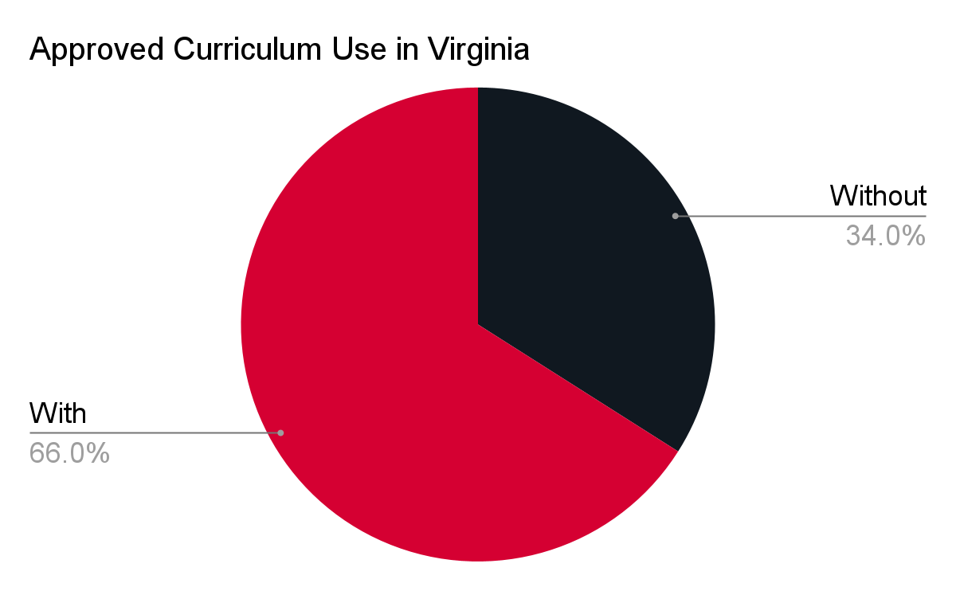
Fall Data Snapshot - Curriculum Use
Two-thirds of programs in VQB5 have an approved curriculum...
VQB5 Fall 2021

Slide 34
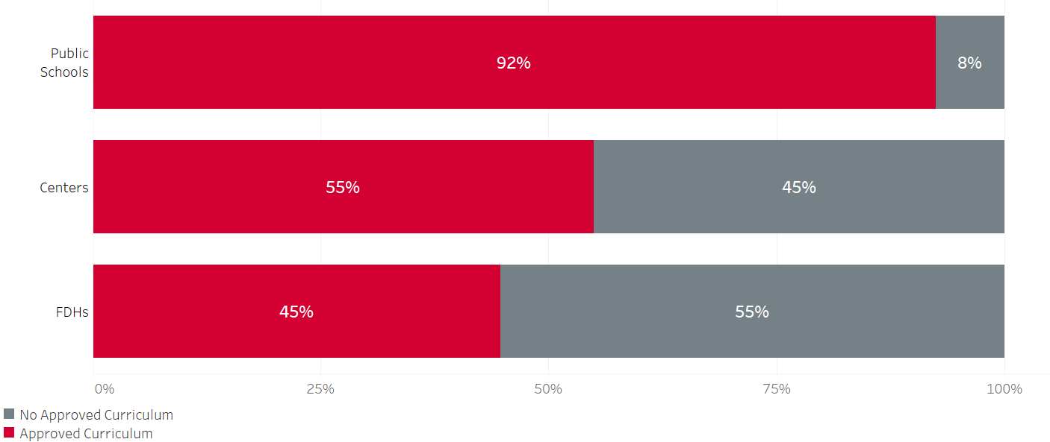
Fall Data Snapshot - Curriculum Use
…Yet use of an approved curriculum varies across program types.
VQB5 Fall 2021

Slide 35
Data-Driven Innovation: RecognizeB5
The Teacher Recognition Program, now called “RecognizeB5”, awards a financial incentive to eligible teachers in child care and family day homes.
Awards financial incentives of at least $2000 to eligible teachers in VQB5;
Is an innovative strategy for supporting, retaining, and rewarding early educators in non-school early-learning settings;
Helps reduce turnover which can positively impact children, improve classroom quality and reduce stress for programs;
Can help address the staffing crisis; and
Enables Virginia to lead with compensation as it builds its statewide measurement and improvement system.
Report: The Effects of Financial Incentives on Teacher Turnover in Early Childhood Education Settings: Experimental Evidence from Virginia.

Slide 36
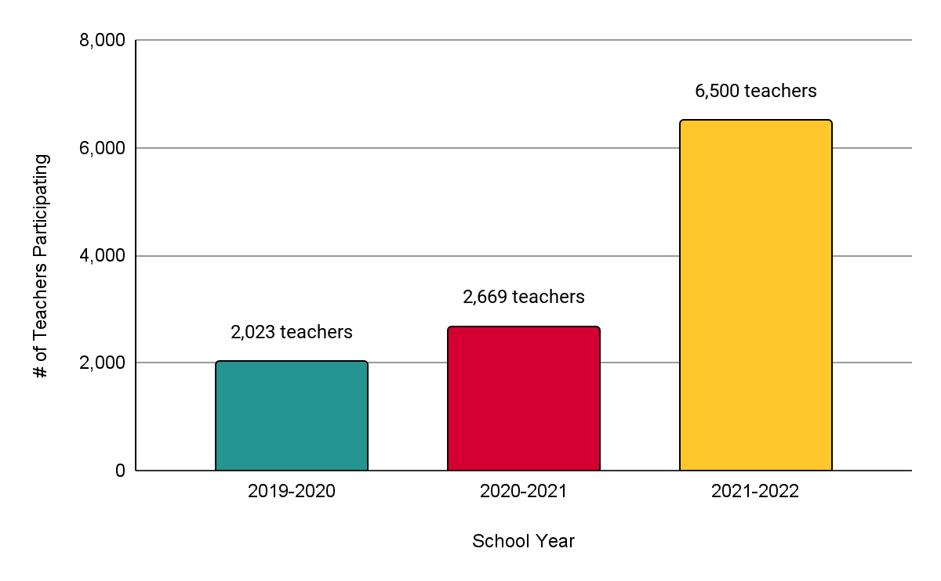
Reach and Impact of RecognizeB5
Participation in RecognizeB5 has increased significantly each year, with more teachers in child care centers and family day homes benefiting in Practice Year 1.
$12.5M* investment
$5M investment
$2.9M investment
*$12.5M is an estimate based on current participation in the program

Slide 37
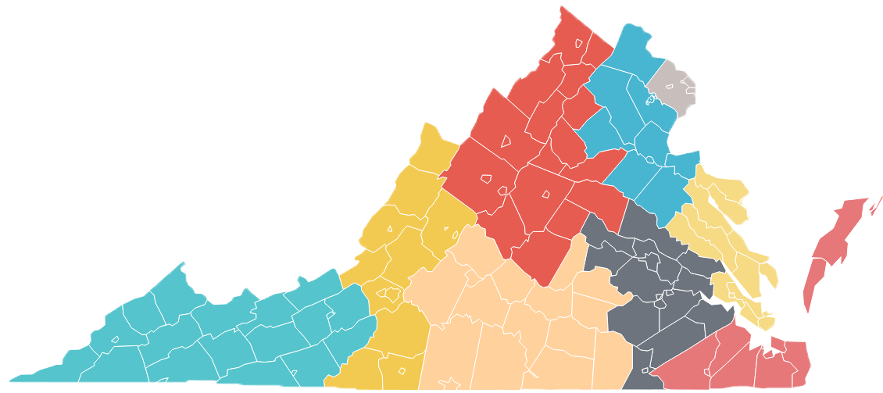
RecognizeB5: Words from Educators
“I spent it on things I needed and wanted for my class.”
Region 8 - North Central
“Because of this grant, I was able to keep a roof over my children's head. My youngest was hospitalized and I didn't have enough PTO left to use.”
Region 7 - Capital Area
“It truly made me feel appreciated and valued. Money is not why I do what I do and has little to do with the rewarding feeling I get for doing my job. However, working tirelessly in a notoriously underpaid profession can weigh on my heart and mind at times when I feel like my paycheck doesn't even closely reflect the quality of my work and the effort I put in.”
Region 2 - West
“Being an educator can, at times, feel overwhelming and undervalued. We do more than just educate children, and we do not exactly do it for the salary we get paid. The money we received through the grant made me feel more valued for what I do, and hopeful that our government can work towards seeing educators as real professionals who hold an important position in our society.”
Region 9 - Blue Ridge
“I’m a single mom of 3, and when I found myself completely struggling to make ends meet, the payments showed up and helped me get through that financially insecure time.”
Region 4 - Central
“It is sometimes easy to be overlooked or considered as babysitters and not true educators. This recognition allowed me to feel extra appreciated and valued for the work I do.”
Region 1 - Southwest

Slide 38
Engagement with the Field
During Practice Year 1, the VDOE has continually engaged the field.
Implementation Guide and Video for Program Leaders (843 views)
Curriculum Review Process Webinar (396 views)
Local CLASS Observations Webinar (752 views)
Presentations to a variety of stakeholder groups (35 presentations)
Improvement Partner Quarterly Webinars (avg of 200 views each)
Fall VQB5 Participant Feedback Survey (465 Responses)
Ongoing engagement with the field through…
  Weekly office hours with PDG Communities
  LinkB5 TA Hotline Support
Ongoing consultation with data and content experts
Quality Matters: Update Webinar (600+ views) and Spring Feedback Survey
VQB5 information has also been shared broadly through weekly Readiness Connections e-newsletter and webinar recordings are available on the Quality Measurement and Improvement (VQB5) webpage.

Slide 39
Stakeholder Feedback
Here are the themes from the stakeholder feedback, noting that key questions and concerns will be addressed through enhancements to the Practice Year 2 Guidelines:
Positive Experiences with VQB5 | Questions/Concerns
Unified approach across all birth-to-five programs Individualized feedback, that included strengths and specific areas to work on Understanding the importance of interactions by using the CLASS tool Helpful ideas and strategies for improvement Support and resources provided from local and state partners when assistance was needed Financial incentive for childcare and family day home teachers (RecognizeB5) | Clarity on participation requirements Clarity about CLASS observation requirements and protocols More information about curriculum options LinkB5 data entry expectations/timeline Staffing shortages and eligibility for RecognizeB5 Educator stress Increased mental health needs and challenging behaviors in the classroom

Slide 40
Questions and Discussion

