Slide 1
Comprehensive Overview of Literacy in Virginia
Board Work Session
March 16, 2022

Slide 2
Introduction and Purpose
The purpose of this presentation is to provide a comprehensive overview of the guidance and instructional support for Tier I literacy instruction in Virginia. Tier I instruction refers to core quality evidence-based practices that support all students. The English Program in the Office of Humanities in the Department of Learning and Innovation works closely with other Virginia Department of Education offices (Assessment, Special Education, Early Childhood, English Language Instruction, Gifted, the Office of School Quality, Teacher Licensure) to address the specific needs of school divisions in the Commonwealth.

Slide 3
Comprehensive Literacy in Virginia: K-12 Approach
The VDOE English Program utilizes the term Comprehensive Literacy to demonstrate the instructional approach of integrating the four strands of the 2017 English Standards of Learning, the 2017 English Standards of Learning Curriculum Framework, the context of real-world application, and the inclusion of interdisciplinary content and scientific-based research in K-12 English language arts.

Slide 4
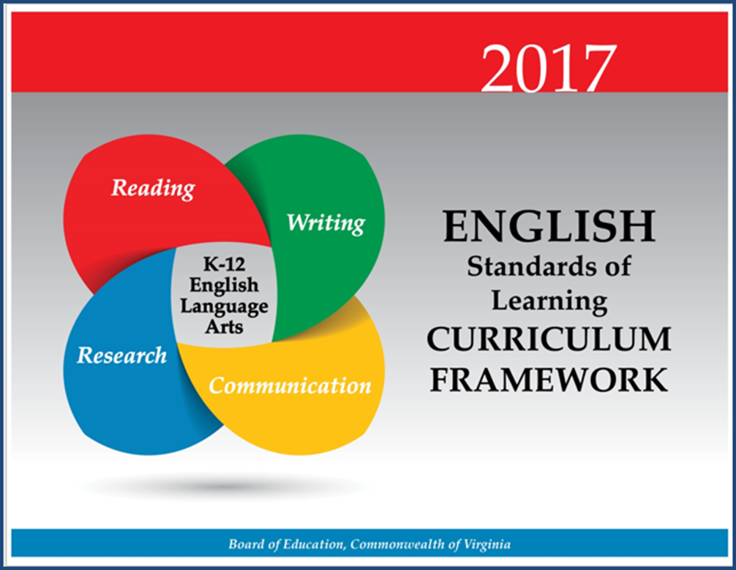
Standards of Learning

Slide 5
English Skills Spiral
The concepts, skills, and content in English Language Arts spiral; teachers should note each grade level builds skills that carry to the following grades. Each grade level within the English Curriculum Framework builds from kindergarten through grade 12, creating a comprehensive instructional tool, which prepares students for success in future postsecondary education and the workplace. Teachers should review the Curriculum Framework for the scope of learning in each of the strands in previous grades and in the grades to follow.

Slide 6
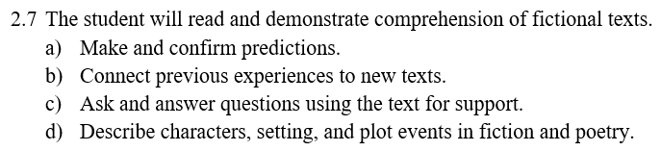
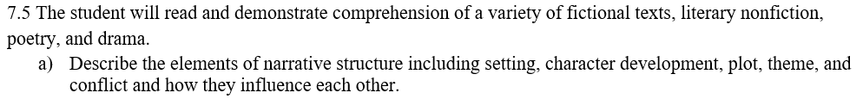
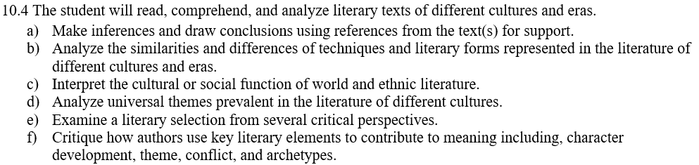
Setting Example

Slide 7

Comprehensive Literacy:
Successful English Instruction-Integrates the Strands
Vocabulary Development
Specific vocabulary from authentic text
Content vocabulary from math, science, and social studies
Reading
Both fiction & nonfiction text
Text-rich environment with variety of text and media
Student choice whenever possible
Writing
Writing as a process for a variety of authentic purposes
Regular writing conferences
Use of Writing Portfolios
Research
Ongoing and embedded in the learning process (when applicable)
Communication/Multimodal Literacies
Opportunities to communicate, collaborate and engage critically with peers and a variety of texts.

Slide 8
English Instruction
Effective Practices
  Paired texts
  Use of text-dependent questions
  Use of inference questions
  Use of text-based vocabulary
  Writing components in every lesson
  Frequent research components

Slide 9
English Standards of Learning Revision & Implementation
Proposed Implementation Year
The 2017 Standards are fully implemented in classrooms. Teachers and students expect to be assessed on the new standards. Schools close. There is no assessment for 2019-2020
Virginia Board of Education Approves the 2010 English Standards of Learning
Virginia Board of Education Approves the English Curriculum Framework based on the 2017 English Standards of Learning
2017
2018-2019
2020-2021
2010
2018
2019-2020
Virginia Board of Education Approves the 2017 English Standards of Learning
Crosswalk Year
Virginia teachers teach the 2017 English Standards of Learning, but the student scores are based on items measuring the 2010 SOL. New assessment items based on the 2017 SOL are field tested.
2017 Standards Implementation Year
Students (who take the SOL) are assessed on the new standards.

Slide 10
Literacy Movements in the United States
Whole Language Instruction
a method of teaching children to read at an early age that allows students to select their own reading matter and that emphasizes the use and recognition of words in everyday contexts.
Phonics-Based Instruction
An approach to teaching reading that emphasizes the systematic relationship between the sounds of language and the graphemes (i.e., letters or letter combinations) that represent those sounds. Learners apply this knowledge to decode printed words.
No Child Left Behind Act
1983
2000
2000s-Present
1960s-1980s
1980s-1990s
2001
Balanced Literacy Instruction
includes both foundational and language comprehension instructional features, such as phonemic awareness and phonics (understanding the relationships between sounds and their written representations), fluency, guided oral reading, vocabulary development, and comprehension. An alternative interpretation of balanced literacy is that it mixes features of whole language and basic skills instruction.
“A Nation At Risk”
National Reading Panel Report

Slide 11
The Science of Reading

Slide 12
What is the Science of Reading?
There is over 50 years of research from a variety of career fields that support how the brain learns to read and speak and how we should be taught. More recently the connection between these fields of research has become more apparent and talked about in educational settings.
Science of reading. A term that refers to a corpus of objective investigation and accumulation of reliable evidence about how humans learn to read and how reading should be taught.
(International Literacy Association)

Slide 13
What Research Says
Kindergarten through Grade 3
Teach students academic language skills, including the use of inferential and narrative language, and vocabulary knowledge.
Develop awareness of the segments of sounds in speech and how they link to letters.
Teach students to decode words, analyze word parts, and write and recognize words.
Ensure that each student reads connected text everyday to support reading accuracy, fluency, and comprehension.
https://ies.ed.gov/ncee/wwc/PracticeGuide/21

Slide 14
Science-Based Phonics Instruction
Effective Phonics Instruction
Explicit and systematic
Readiness Skills
Scope and Sequence
Blending
Dictation
Word Awareness
High-Frequency Words
Reading Connected Text
Building vocabulary and background knowledge
ILA Literacy Leadership Brief

Slide 15
What Research Says About Writing
Writing Instruction
Provide daily time for students to write.
Teach students to use the writing process for a variety of purposes.
Teach students to become fluent with handwriting, spelling, sentence construction, typing, and word processing.
Create an engaged community of writers.
https://ies.ed.gov/ncee/wwc/PracticeGuide/17

Slide 16
Essential Components of Teaching Reading
As reported in the National Reading Panel and later recognized in CCSSO’s A Nation of Readers report, additional research has shown the significant impact of instruction that explicitly addresses all five pillars of reading.
Phonemic Awareness
Phonological Awareness
Fluency
Vocabulary
Comprehension

Slide 17
The Five Pillars of Reading in the
Standards of Learning
Phonemic Awareness | Phonics Instruction | Fluency Instruction | Vocabulary Instruction | Comprehension Instruction
K.3- The student will orally identify, segment and blend various phonemes to develop phonological and phonemic awareness 1.3- The student will orally identify, produce, and manipulate various phonemes within words to develop phonological and phonemic awareness. 2.3- The student will orally identify, produce, and manipulate various phonemes within words to develop phonemic awareness. | K.6- The student will develop an understanding of basic phonetic principles. 1.5- The student will apply phonetic principles to read and spell. 2.4- The student will use phonetic strategies when reading and spelling. 3.3 The student will use knowledge of regular and irregular vowel patterns and decode regular multisyllabic words. | 1.9 i) Read and reread familiar stories and poems with fluency, accuracy and meaningful expression. 1.10 h) Read and reread familiar texts with fluency, accuracy and meaningful expression 2.7 i) Read and reread familiar stories and poems with fluency, accuracy, and meaningful expression. 2.8 h) Read and reread familiar texts with fluency, accuracy, and meaningful expression. 3.5 m) Read with fluency, accuracy, and meaningful expression. 3.6 m) Read with fluency, accuracy, and meaningful expression. | K.7- The student will expand vocabulary and use of word meanings. 1.7- The student will expand vocabulary and use of word meanings. 2.5-The student will use semantic clues and syntax to expand vocabulary when reading. 2.6- The student will expand vocabulary and use of word meanings. 3.4 The student will expand vocabulary when reading | K.8-The student will demonstrate comprehension of fictional text. K.9- The student will demonstrate comprehension of nonfiction text. 1.9, 2.7, 3.6- The student will read and demonstrate comprehension of a variety of fictional texts. 1.10, 2.8, 3.7- The student will read and demonstrate comprehension of a variety of nonfiction texts.

Slide 18
The Simple View
The Science of Reading
Decoding
Language Comprehension
Reading Comprehension
0 X 1 = 0
1 X 0 = 0
.5 X 1 = .5
Grough & Tunmer, 1986

Slide 19
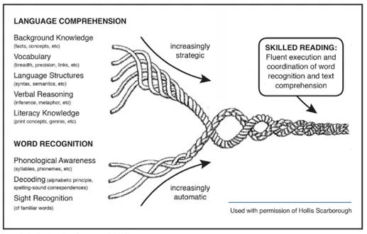
Scarborough’s Reading Rope
Scarborough, 2001
Language Comprehension
The Science of Reading
Reading Comprehension
Decoding

Slide 20
Science of Reading and Instructional Practices
Key practices that demonstrate research and evidence-based instruction:
Direct instruction of decoding, encoding, comprehension, and wide reading of literature
Specific focus on phoneme awareness instruction as well as its connection to encoding and decoding
Systematic, explicit, and intentional instruction on the spoken and written form of the English language (sound, syllable, morpheme, word)
Direct and incidental vocabulary instruction using texts to explore word meanings and sentence structure
Emphasis and intention on building background knowledge and listening comprehension through texts, multimedia, and other print resources that will lead to independent reading comprehension (Moats, 2020).

Slide 21
Extending Comprehension Beyond Early Literacy
“In addition to teaching explicit word-reading skills, literacy instruction requires the teaching of text analysis, discussion, and writing about reading” (Duke, et al. 2021).
Communication & Multimodal Literacies
Reading
Writing
Research

Slide 22
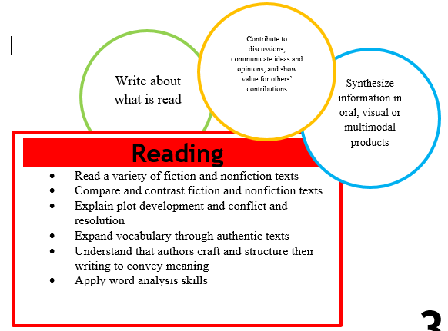
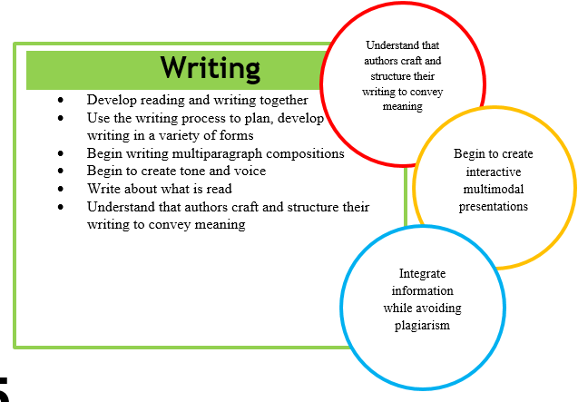
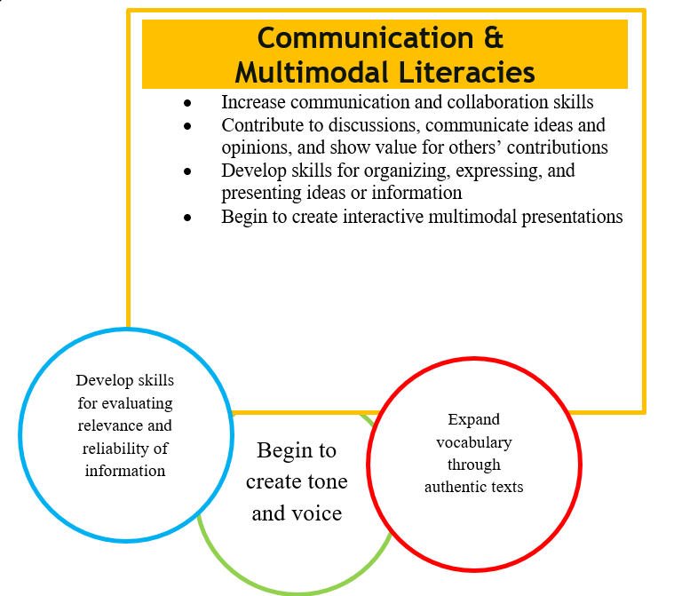
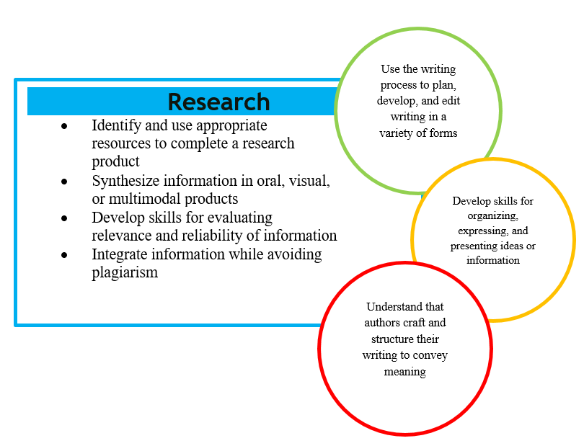
3-5
Virginia Learns- Language Arts Essentials

Slide 23
Literacy: What Research Says
Adolescent Literacy Instruction
1.Incorporation of Disciplinary Literacy Instruction
2.Integration of Multiple and Social Literacies
3.Orchestration of Engagement and Motivation
4.Appreciation of Multicultural Perspectives and Cultures
A Call to Action: What We Know About Adolescent Literacy Instruction. (2018, July 17). Retrieved January 8, 2020, from https://ncte.org/statement/adolescentliteracy/.

Slide 24
Literacy: What Research Says
Adolescent Literacy Instruction:
Practice thinking critically about how they engage with texts to include
•application of metacognitive strategies.
•recognition of bias and high-quality sources.
•argumentation with evidence.
Critical examination of texts that helps them to
•recognize the purpose of text structure and how the writer uses it to create effect.
•infer beyond literal interpretations.
•question and investigate various social, political, and historical context.
understand multiple meanings and richness of texts and layers of complexity
A Call to Action: What We Know About Adolescent Literacy Instruction. (2018, July 17). Retrieved January 8, 2020, from https://ncte.org/statement/adolescentliteracy/.

Slide 25
Literacy: What Research Says
Adolescent Literacy Instruction:
Assessment that helps them to focus on
•the larger purpose and big ideas of the curriculum, and on metacognitive strategies for thinking during literacy acts (Smith, 1991; Darling-Hammond & Falk, 1997; Langer, 2000).
•preparation for assessment (from ongoing classroom measures to high-stakes tests) that should focus on the critical components of multicultural perspectives, motivation, multiple and social literacies, and shifting literacy demands.
Choice and volume of reading
•Opportunities to read often from books of their own choosing
•Access to a vast library of books and texts that vary in levels and text structures (Miller, 2009)
•Dedicated time to read every day (Allington, 2009)
A Call to Action: What We Know About Adolescent Literacy Instruction. (2018, July 17). Retrieved January 8, 2020, from https://ncte.org/statement/adolescentliteracy/.

Slide 26
Science of Reading and Students with Disabilities
Research available that 1 in 5 students, or 15-20 percent of the population, has a language-based learning disability, such as dyslexia
In Virginia, students identified with specific learning disabilities are one of the largest disability categories at approximately 54,136 students
A comprehensive reading program would include:
  An explicit systemic approach to teaching students to read
  Focus on the 5 components of reading - phonics, phonemic awareness, fluency, vocabulary, and comprehension
  Phonics instruction is a practice that is part of a comprehensive reading program in grades K-2
Notes:
These components need to extend past K-2 in order to meet the needs we see in the field. Early years focus on VDOE report. Providing phonics instruction or support in foundational reading skills may go beyond 2nd grade for many identified students, but that would be a part of their specially designed instruction.

Slide 27
Initiatives in Special Education and Student Services
Collaboration with higher education to ensure alignment in teacher preparation programs with the Science of Reading
Focus on professional development to build capacity of local school divisions in practices and courses of study grounded in the Science of Reading
  Multisensory Structured Literacy Initiative began in 2015 and has trained 1,027 teachers across 126 school divisions (75 teachers certified as Classroom Educators through the Academy of Orton Gillingham Educators and Practitioners)
  74/132 school divisions are engaged with LETRS through SESS sponsored training, 1,575 LETRS Volume I licenses have been purchased by VDOE with an additional 3,000 purchased by divisions (since project began in 2018), 97 teachers are enrolled in facilitator training
  Strategic Instructional Teams Initiative (SITI), began in January 2022, is using research-based practices from the University of Kansas for grades 4-12; currently 110 participants representing 28 divisions; the use of these strategies builds upon ongoing practice in SESS for the last 20 years
Notes:
LETRS
Language Essentials for Teachers of Reading and Spelling (LTRS)
LETRS is coursework is supported by the 290,000 state funding and matching federal funding to support multisensory structured language training and matching federal funding; carryover funding has also been used to support the LETRS project
1,300 Virginia teachers participating in LETRS pre and post test scores were analyzed; 18% of teachers earned a passing score (above 80%) on the pre-test while 91% received above an 80% on the post test. Average pre-test score is 66%; average post-test is 91%
Multisensory Structured Literacy Initiative
Initiative began in 2015-present
GMU offers an additional cohort of training every summer (24 for last 3 summers)
William and Mary has hosted an additional cohort of training (29 people)
We have had 74 teachers complete Classroom Educator Practicum (50 additional hours of supervision by OG fellow)
TTAC provides direct support to participates during first year of implementation
There are several divisions that have provided structured literacy training in their divisions using a variety of approaches (OG, IMSE) and Programs (OG Online, S.P.I.R.E)
Multisensory Structured Literacy Training Initiative is supported by the 290,000 state funding and matching federal funding to support multisensory structured language training and matching federal funding; carryover funding has also been used to support this project

Slide 28
Implementation Plan
Build off of success with professional development and support to utilize trained teachers and staff in implementation of practices, support of teachers and data-based evaluation of student learning and skill acquisition
Leveraging implementation science and the Virginia Tiered Systems of Support framework to focus on reading instruction based on the science of reading impacting students with disabilities (partnership with the State Implementation and Scaling-up of Evidence-based Practices (SISEP) center)
Notes:
Importance of going beyond education, training and professional development and into implementation. Nadine Gaab, an associate professor and reading expert at the Harvard Graduate School of Education, “We need to move from a reactive model to a proactive model, where we are trying to find the people who will most likely develop problems and help them before they struggle so much.” Partnership with School Quality and Teaching and Innovation.

Slide 29
Literacy: What Research Says (Early Childhood)
After extensive review of preschool studies, researchers found strong evidence of effectiveness for interventions in each of the 5 language and literacy domains studied:
Domain | Key Findings
Language: ability to comprehend or use spoken language | Language interventions classified as instructional practices generated effect sizes equivalent to a 17 percentile point increase in the performance of the intervention group. Language instruction with one-on-one or small groups was more effective than large group.
Phonological Awareness: awareness of sound units of spoken language | Phonological awareness intervention generated effect sizes equivalent to a 13 percentile point increase. Including multiple types of phonological awareness (e.g., identification, matching, blending, counting, segmenting, and production) was more likely to improve performance.
Print Knowledge: knowledge of the names and sounds of letters | Print knowledge interventions generated effect sizes equivalent to a 9 percentile point increase. Interventions that taught print knowledge without teaching phonological awareness were not effective.
Decoding: ability to translate a word from print to speech | Interventions teaching phonological awareness and print knowledge improved performance in decoding without specific decoding instruction but there was a stronger effect size when all three concepts– phonological awareness, print knowledge, and decoding– were taught together.
Early writing: knowledge of letter or name writing and spelling | Interventions teaching phonological awareness and print knowledge improved performance in early writing without specific early writing instruction but a stronger effect size was noted when all three concepts– phonological awareness, print knowledge, and early writing– were taught together
https://ies.ed.gov/ncee/edlabs/regions/southeast/pdf/REL_2021084.pdf
https://ies.ed.gov/ncee/edlabs/regions/southeast/pdf/REL_2021084.pdf

Slide 30
Building the Foundation for Literacy: Early Childhood
Virginia is working to strengthen all publicly-funded early childhood programs to ensure all children have the opportunity to enter kindergarten ready, including in language and literacy. Key aspects:
Virginia Kindergarten Readiness Program (VKRP)
  Statewide assessment for all K students in fall/spring on literacy (PALS), math, self-regulation and social skills, offers educator resources and provides reporting
  Currently expanding to preschool (3 and 4 year olds in publicly-funded classrooms)
Early Learning and Development Standards (ELDS)
  BOE approved standards in 2020 that include Communication, Language and Literacy Development
VQB5 and LinkB5
  VQB5 is the new statewide measurement and improvement system for all publicly-funded B-5 programs
  Seeks to improve child outcomes by improving teacher-child interactions and curriculum use
  LinkB5 is the data system that will track quality improvement as well as children’s learning and development across classrooms and then link to longitudinal outcomes, enabling the VDOE to better inform and support policy makers, leaders and families; efforts are currently underway to integrate PALS, VKRP and LinkB5 to improve access, usability and impact

Slide 31
Alignment with Early Learning Standards
Language | Phonological Awareness | Print Knowledge | Decoding | Early Writing
CLLD1. Communication CLLD1.1. Understanding verbal and nonverbal cues CLLD1.2. Using vocabulary and nonverbal cues to communicate CLLD1.3. Learning and engaging in conversational interactions CLLD2. Foundations of Reading CLLD2.2. Understanding ideas, vocabulary, and information | CLLD2. Foundations of Reading CLLD2.3. Learning spoken language is composed of smaller segments of sound CLLD2.4. Learning how letters and print work to create words and meaning | CLLD2. Foundations of Reading CLLD2.1. Paying attention to print as meaningful CLLD2.4. Learning how letters and print work to create words and meaning | CLLD2. Foundations of Reading CLLD2.4. Learning how letters and print work to create words and meaning | CLLD3. Foundations of Writing CLLD3.1. Drawing, scribbling, and writing to communicate CLLD3.2. Developing writing habits and skills CLLD3.3. Handling writing tools
https://www.doe.virginia.gov/early-childhood/curriculum/va-elds-birth-5.pdf
Notes:
The Pillars of Literacy highlighted by the National Reading Panel echo throughout Virginia Standards of Learning for K-2.
Our presentation today is going to show how wer have redefined our approach to teaching theses standards. We are now very intentional, explicit, systematic.
In 2010 our instruction was more incidental with some of these standards. What we are proposing today is a more deliberate purposeful approach to teaching these standards.
Tammy

Slide 32
Teacher-Child Interactions & Early Literacy Outcomes
Key Findings
All three Pre-K CLASS domains are related to children’s language and literacy outcomes. Emotionally supportive, well-organized classrooms were linked to stronger performance on measures of phonological awareness, print awareness, letter-word recognition, alphabet knowledge, particularly when scores are in the high range. In contrast, students in classrooms that lacked these relationships had lower receptive language skills.
Instructional Support is an important lever. The CLASS measures Language Modeling which is positively related to children’s language and literacy outcomes, especially for children from less privileged backgrounds.
Dual-language learners stand to benefit from CLASS-based interactions in multiple languages. Children who are DLLs showed growth in their English expressive and receptive language skills in classrooms with higher levels of Emotional Support and Instructional Support. In fact, DLL students who scored lowest on vocabulary assessments at the beginning of the year benefited the most from stronger Instructional Support.
Children continue to benefit from supportive Pre-K classrooms into elementary school, but more is better. The language and literacy advantages from having a warm, organized, and appropriately challenging pre-K classroom can extend at least through 3rd grade. Having multiple consecutive years of strong instruction compounded these effects.
https://tinyurl.com/nm5xf6nz

Slide 33
Promoting Use of Quality Curriculum
In addition to measuring teacher-child interactions, the VDOE will measure curriculum use in order to encourage all publicly-funded classrooms to use an approved curriculum. The VDOE:
Implemented a curriculum review process for birth to five curricula that is based on early education research for effective, comprehensive curricula, and aligned with the ELDS.
Launched new, Virginia-developed curriculum option, Streamin3, that includes Reading as a key skill and focuses on providing emotionally and instructionally supportive interactions to students within a well-organized context to support children’s critical school readiness skills in literacy, math, self-regulation and social skills.
Is using data to prioritize support for programs who don’t yet have access to an approved curriculum.
Option 1: Seek approval for a curriculum the site already has in place | Option 2: Choose and use one of the 25 VDOE-approved curriculum options | Option 3: Access StreamIn3 as Virginia’s open-source option, with low-or-no cost training and resources

Slide 34
Literacy Supports

Slide 35
Early Intervention Reading Initiative

Slide 36
Early Intervention Reading Initiative
History
1997: Early Intervention Reading Initiative Established
Established by the Virginia Acts of Assembly to reduce the number of Kindergarten and first graders with reading problems through early diagnosis and intervention.
2000: Requiring a diagnostic screener
Funding was expanded to include 25% of grade 3 students. A diagnostic screener was also required at this time, Also began the partnership between UVA and PALS
Present
2021: HB 1865
Added language to require intervention to be explicit, systematic, and grounded in the science of reading
2022: PALS 2.0
The VDOE will continue to collaborate with the University of Virginia and PALS on the revision process for the state-provided early literacy screener to ensure teachers are able to gain the most relevant information about their students that align with evidence-based instructional practices.

Slide 37
Early Intervention Reading Initiative
Early Intervention Reading Initiative Established
Established by the Virginia Acts of Assembly to reduce the number of Kindergarten and first graders with reading problems through early diagnosis and intervention.
HB 1181 Required identified grade 3 students to receive intervention before being promoted to grade 4. Funding expanded to include 100% of students in grade 3 needing intervention
HB 410 Parental Notification
Parental Notification of screening and intervention services
2000
2013
2022
1997
2012
2020
Requiring a diagnostic screener
Funding was expanded to include 25% of grade 3 students. A diagnostic screener was also required at this time, Also began the partnership between UVA and PALS
HB 2068 Added first and second graders
Language added on reporting the results of the diagnostic tests to the Department of Education annually and students receiving reading intervention will be assessed again at the end of each year
HB 1865
Added language to require intervention to be explicit, systematic, and grounded in the science of reading

Slide 38
Literacy Professionals

Slide 39
Virginia Literacy Professionals
State literacy interventions often include the use of reading specialists and literacy coaches. Reading specialists work directly with students, while literacy coaches train teachers, educators, or administrators. Reading specialists are most often utilized for tier two intervention and small group instruction.
Currently in Virginia, the Reading Specialist endorsement requires the completion of a Master’s program, or if a Master’s program has been completed in a different area, the candidate must complete specific graduate-level coursework in reading.
Virginia licensure regulations do not currently include an endorsement in literacy coaching.
(International Literacy Association, 2015)

Slide 40
Assessment Data

Slide 41
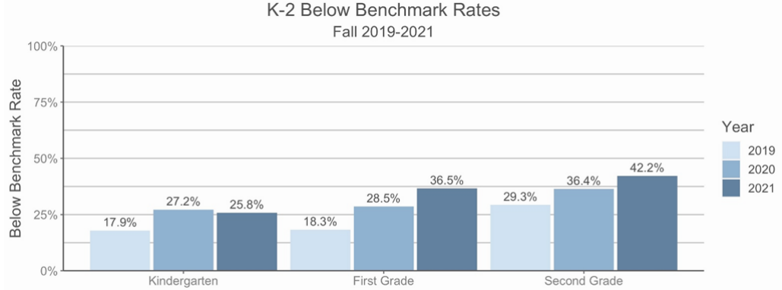
Examining the Impact of COVID-19 on the Identification of At-Risk Students: Fall 2021 Literacy Screening Findings

Slide 42
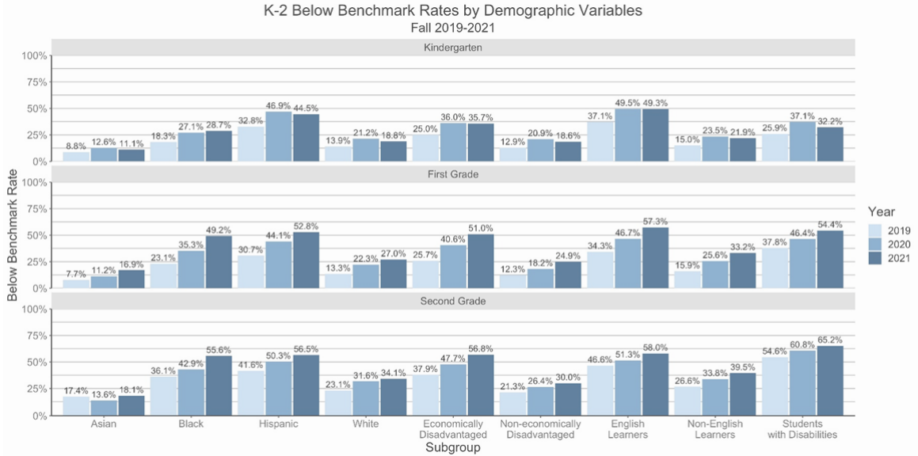
Examining the Impact of COVID-19 on the Identification of At-Risk Students: Fall 2021 Literacy Screening Findings

Slide 43
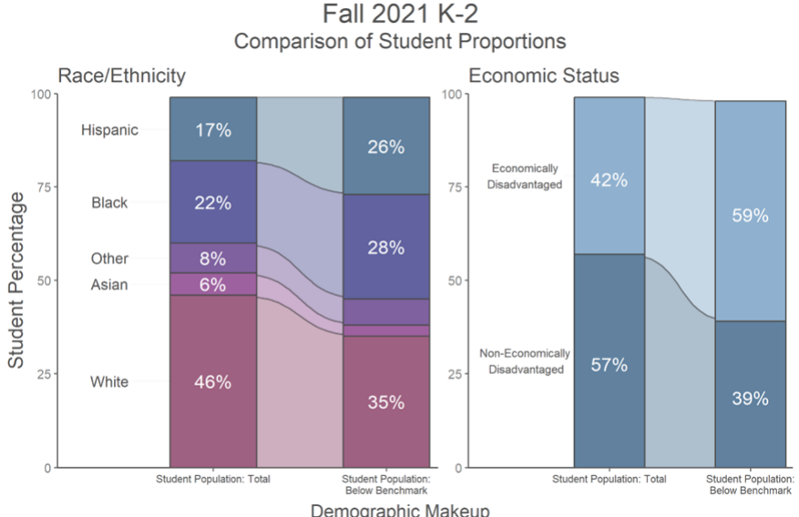
Examining the Impact of COVID-19 on the Identification of At-Risk Students: Fall 2021 Literacy Screening Findings

Slide 44
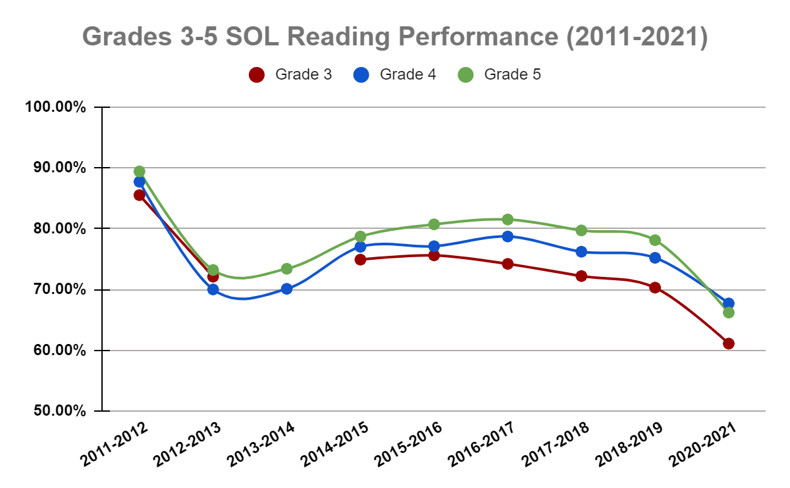
SOL Reading Performance by Grade Level
2010 Standards and Technology Enhanced Items Tested for the first time
Computer Adaptive Testing used for the first time
2017 Standards Tested for the first time

Slide 45
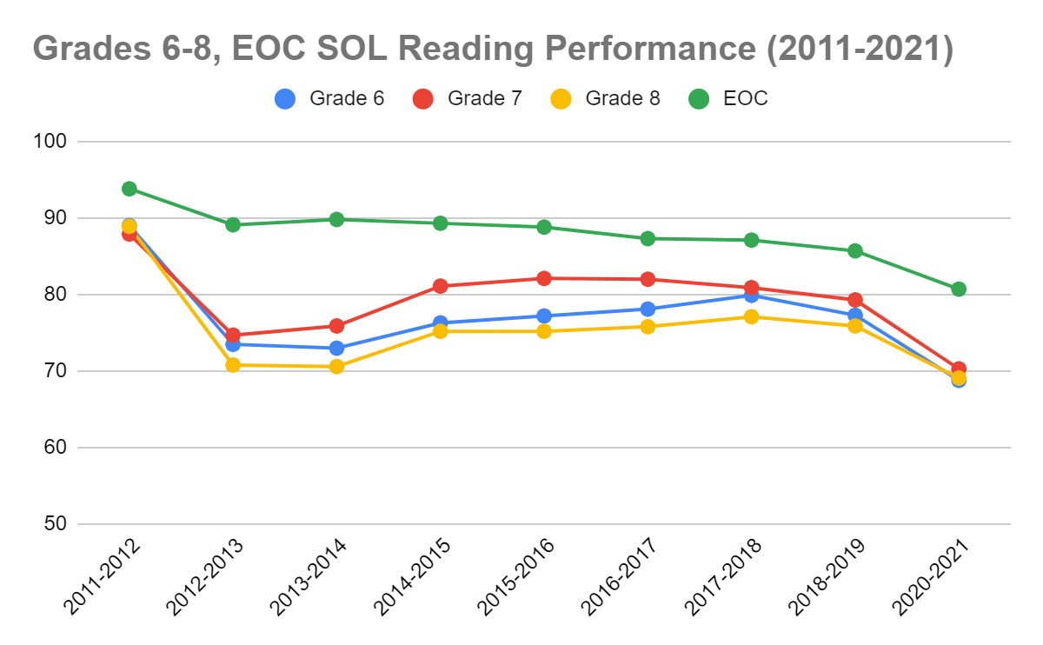
SOL Performance by Grade Level
2010 Standards and Technology Enhanced Items Tested for the first time
2017 Standards Tested for the first time
Computer Adaptive Testing used for the first time Grade 8-Fall 2017 and Grade 6 and 7 Spring 2018

Slide 46
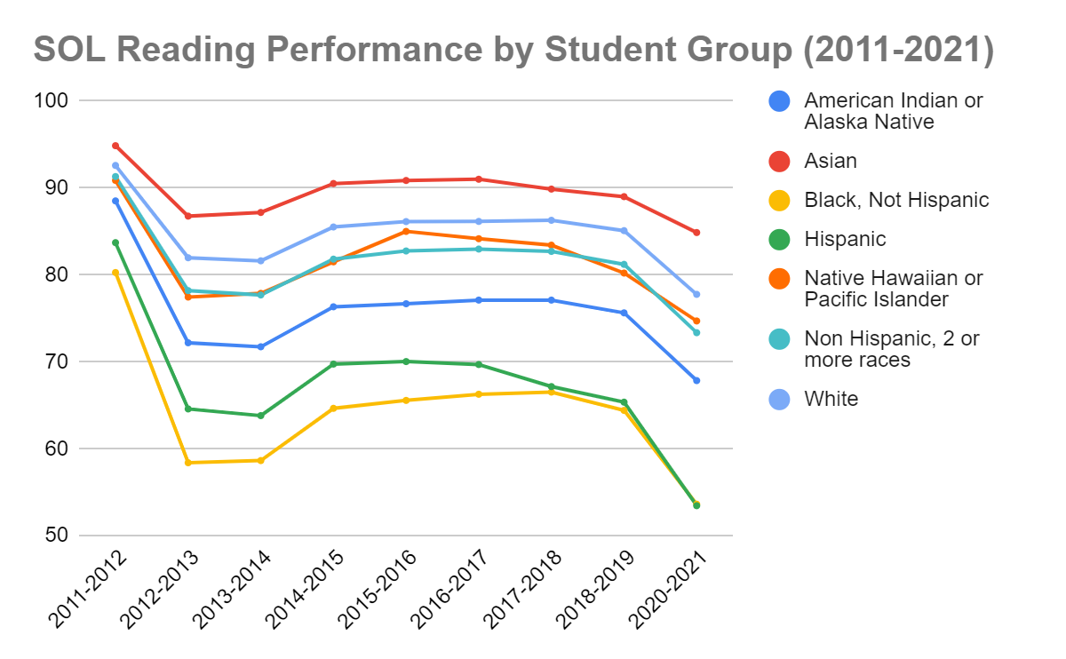
SOL Performance by Student Group
2010 Standards and Technology Enhanced Items Tested for the first time
2017 Standards Tested for the first time

Slide 47
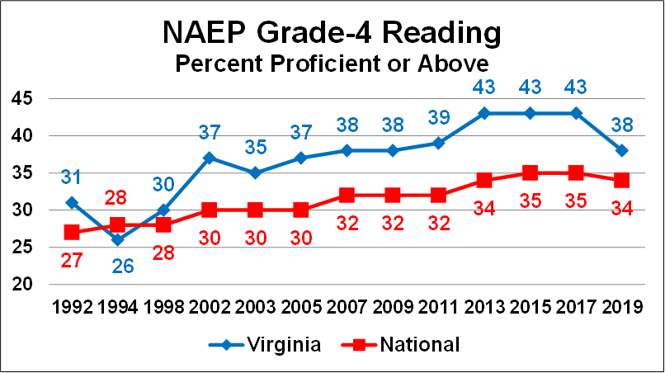

National Assessment of Educational Progress
Notes:
James

Slide 48
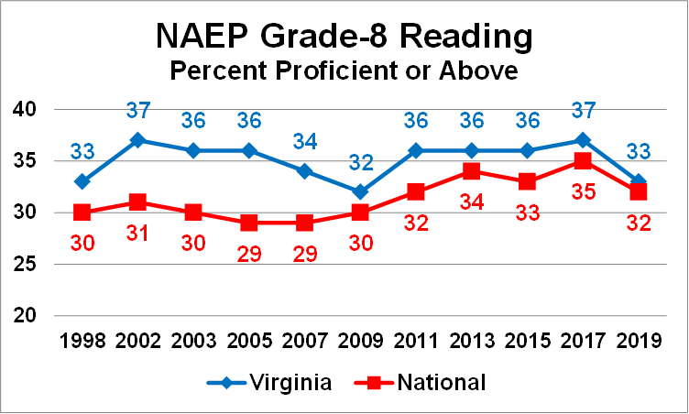
National Assessment of Educational Progress
Notes:
James

Slide 49
2019 NAEP to Now
VDOE Comprehensive Literacy Webinar Series
The VDOE English Program hosts a series of webinars in collaboration with institutes of higher education, school divisions, and the offices of Assessment, Special Education, and English Learner Instruction to support literacy instruction in the field.
Comprehensive Literacy Webinar Series & Assessment Supports Webinar Series
VDOE English Program hosts an additional series of webinars specific to literacy instruction featuring sessions on virtual instruction, hybrid instruction, etc. Collaboration with Assessment Office on series to support instruction leading up to new SOL assessment.
Virginia’s 2019 NAEP Scores are Released
Virginia is one of 17 states that saw declines in performance in fourth-grade reading and one of 31 states that saw declines in eighth grade. Reading performance nationwide was also down in both grades.
October 2019
February 2020
August 2021
Fall 2019
January-February 2020
Fall 2020
Resources to Support Implementation of 2017 Standards/SOL Conferences
Superintendent’s Memo 249-19 is shared with divisions. Divisions participate in the 2019 Deeper Learning Conferences (featuring K-2 sessions for the first time).
VDOE Literacy Summit
Superintendent of Public Instruction invites school divisions to statewide Literacy Summit in Charlottesville, VA.
VDOE English SOL Conferences & Inaugural Family Literacy Night
VDOE hosts evening summer virtual conferences for K-12 English/Reading teachers. Agency collaborates to host Family Literacy Night featuring presentations from multiple offices and state organizations to support community stakeholders and families

Slide 50
Ongoing Support

Slide 51
2019 NAEP to Now Action Steps (1 of 3)
Fall 2019: Virginia’s 2019 NAEP Scores are Released Virginia was one of 17 states that saw declines in performance in fourth-grade reading and one of 31 states that saw declines in eighth grade. Reading performance nationwide was also down in both grades.
October 2019: Resources to Support Implementation of 2017 Standards/SOL Conferences Superintendent’s Memo #249-19 is shared with divisions. Divisions participate in the 2019 Deeper Learning Conferences (featuring K-2 sessions for the first time).
January 2020: Virginia attends CCSSO’s National Summit on Literacy in Washington, D.C. Panel of national level experts share ways to address literacy challenges at the state level.
January- February 2020: VDOE Comprehensive Literacy Webinar Series
The VDOE English Program hosts a series of webinars in collaboration with institutes of higher education, school divisions, and the offices of Assessment, Special Education, and English Learner Instruction to support literacy instruction in the field.

Slide 52
2019 NAEP to Now Action Steps (2 of 3)
February 2020: VDOE Literacy Summit Superintendent of Public Instruction invites school divisions to statewide Literacy Summit in Charlottesville, VA.
Summer 2020: VDOE English Program & Assessment teams collaborate to review and provide feedback/public comment on the 2025 NAEP Reading Framework.
Fall 2020: Comprehensive Literacy Webinar Series & Assessment Supports Webinar Series VDOE English Program hosts an additional series of webinars specific to literacy instruction featuring sessions on virtual instruction, hybrid instruction, etc. Collaboration with Assessment Office on series to support instruction leading up to new SOL assessment.

Slide 53
2019 NAEP to Now Action Steps (3 of 3)
Spring 2021: Professional Development on Demand The VDOE English Professional Development Packages focus on best practices in K-12 literacy instruction aligned to the 2017 English Standards of Learning (SOL). Packages are bundled and sorted by topic for ease of use and focused professional learning.
August 2021: VDOE English SOL Conferences & Inaugural Family Literacy Night VDOE hosts evening summer virtual conferences for K-12 English/Reading teachers. Agency collaborates to host Family Literacy Night featuring presentations from multiple offices and state organizations to support community stakeholders and families.
Fall 2021: Utilizing Data to Maximize Literacy Instruction in 2021-2022 VDOE English staff and Assessment staff to explore using SDBQ data from the Fall 2021 Growth Assessments and formative and summative classroom data to support literacy instruction in K-12 classrooms.

Slide 54
Next Steps
Continued Initiatives
The VDOE English Program will continue to provide guidance on scientific research and evidence-based practices to support K-12 literacy by creating professional development and resources that align to current legislation and initiatives set forth by the Board of Education and the agency.
Teacher Support through PALS 2.0
The VDOE English Program will continue to collaborate with the University of Virginia and PALS on the revision process for the state-provided early literacy screener to ensure teachers are able to gain the most relevant information about their students that align with evidence-based instructional practices.
Microcredentialing
The VDOE English Program will work with partnering offices to develop microcredentials in support of current legislation. These modules will provide coursework and training to enhance teacher knowledge of scientific research-based instructional practices. Additionally, this work will enhance leaders’ understanding of how to support teachers in the development of sound literacy instruction that meets the needs of all learners in Virginia.

Slide 55


PALS Revision
The Big Picture
Bringing PALS-PreK, PALS-K, and PALS 1-3 into alignment with research of science of reading
  Adding language tasks
  Revising existing tasks
  Expanding to include español
Expanding downward to 3-year-olds
Adding vertical alignment so that growth can be measured
Piloting began Fall 2021
Expected in classrooms by Fall 2024
Notes:
Piloting will begin this fall (2021) and we expect the revised assessments to be in classrooms by Fall 2024.

Slide 56
PALS Revision Model
3- and 4-year-olds
Kindergarten
Print Concepts
Alphabet Knowledge
Phonological Awareness
Rapid Automatized Naming (4’s)
Emergent Writing
Oral Language
First Grade-Third Grade
Alphabet Knowledge
Phonological Awareness
Rapid Automatized Naming
Decoding and Encoding
Vocabulary and Language
Phonological Awareness
Rapid Automatized Naming
Decoding and Encoding
Oral Reading Fluency
Vocabulary and Language

Slide 57
Working Together to Strengthen Literacy in the Commonwealth
General Assembly
Board of Education
Department of Education

Slide 58
References (1 of 2)
CCSSO (2021). A Nation of Readers: How State Chiefs Can Help Every Child Learn To Read. Retrieved from: https://753a0706.flowpaper.com/CCSSOReadingResource/#page=1
‌Clark, J. (2021). Science-based reading in Virginia. Building a policy foundation for effective instruction. Technical Report. University of Virginia.
Duke, N., Ward, A., & Pearson, D. (2021). The science of reading comprehension. International Literacy Association. https://ila.onlinelibrary.wiley.com/doi/epdf/10.1002/trtr.1993
Foorman, B., Beyler, N., Borradaile, K., Coyne, M., Denton, C. A., Dimino, J., Furgeson, J., Hayes, L., Henke, J., Justice, L., Keating, B., Lewis, W., Sattar, S., Streke, A., Wagner, R., & Wissel, S. (2016). Foundational skills to support reading for understanding in kindergarten through 3rd grade (NCEE 2016-4008). Washington, DC: National Center for Education Evaluation and Regional Assistance (NCEE), Institute of Education Sciences, U.S. Department of Education. Retrieved from the NCEE website: https://ies.ed.gov/ncee/wwc/Docs/PracticeGuide/wwc_foundationalreading_040717.pdf.
International Literacy Association (2019). Literacy leadership: meeting the challenges of early literacy phonics instruction. Retrieved from Literacy Worldwide (2019). https://www.literacyworldwide.org/docs/default-source/where-we-stand/ila-meeting-challenges-early-literacy-phonics-instruction.pdf
I

Slide 59
References (2 of 2)
International Literacy Association (2015). Multiple roles of school-based specialized literacy professionals. https://www.literacyworldwide.org/docs/default-source/where-we-stand/literacy-professionals-research-brief.pdf
Moats, L. (2020). Teaching reading is rocket science. Retrieved from American Federation of Teachers (AFT). https://www.aft.org/sites/default/files/moats.pdf
National Council of Teachers of English (2018). A call to action: what we know about adolescent literacy instruction. https://ncte.org/statement/adolescentliteracy/.
National Reading Panel. (2000). Teaching children to read: an evidence-based assessment of the scientific research literature on reading and its implications for reading instruction. Retrieved from https://www.nichd.nih.gov/sites/default/files/publications/pubs/nrp/Documents/report.pdf
United States Department of Education. (2021.). WWC: Teaching elementary school students to be effective writers. WWC | Teaching Elementary School Students to Be Effective Writers. Retrieved from https://ies.ed.gov/ncee/wwc/PracticeGuide/17

Slide 60
Contact Information
Jill Nogueras
K-12 English Coordinator
Jill.Nogueras@doe.virginia.gov
Carmen Kurek
Elementary English/Reading Specialist
Carmen.Kurek@doe.virginia.gov
Colleen Cassada
Middle School English Specialist
Colleen.Cassada@doe.Virginia.gov
Tamilah Richardson
Director of Early Childhood Learning
Tamilah.Richardson@doe.virginia.gov
Dr. Samantha Hollins, Assistant Superintendent
Special Education and Student Services
Samantha.Hollins@doe.virginia.gov
Assessment Office
Student_Assessment@doe.virginia.gov

