Slide 1
VDOE Spring 2017 Mathematics Institute
Algebra I/Geometry/Algebra II

Slide 2
Welcome and Introductions

Slide 3
Agenda
Revisions to Standards and Purpose
Emphasis on Specific Content
  Transformations
  Graphing Linear Equations
  Quadrilaterals and Proofs
  Multiple Representations of Functions
Support for Implementation

Slide 4
Revisions to Standards and Purpose

Slide 5
Essential Question
What are the new 2016 Standards of Learning and how might the VDOE documents support understanding of these standards?

Slide 6
Mathematics Process Goals for Students
“The content of the mathematics standards is intended to support the five process goals for students”
- 2009 and 2016 Mathematics Standards of Learning
Mathematical Understanding
Problem Solving
Connections
Communication
Representations
Reasoning

Slide 7

NCTM Principles to Actions
Ensuring Mathematical Success for All
High Leverage Mathematics Teaching Practices
1. Establish mathematics goals to focus learning.
2. Implement tasks that promote reasoning and problem solving.
3. Use and connect mathematical representations.
4. Facilitate meaningful mathematical discourse.
5. Pose purposeful questions.
6. Build procedural fluency from conceptual understanding.
7. Support productive struggle in learning mathematics.
8. Elicit and use evidence of student thinking.
Adapted from Leinwand, S. et al. (2014) Principles to Actions – Ensuring Mathematical Success for All, National Council of Teachers of Mathematics. https://www.nctm.org/uploadedFiles/Standards_and_Positions/PtAExecutiveSummary.pdf

Slide 8
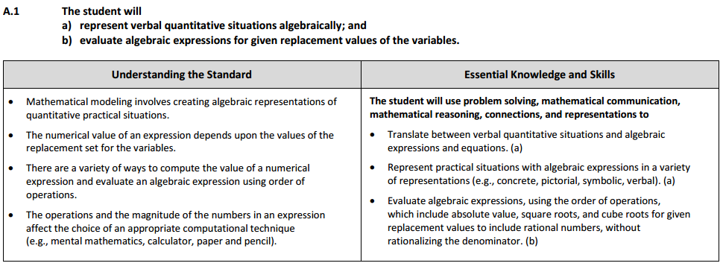
Changes to the Curriculum Framework
Indicators of SOL sub-bullet added to each bullet within the Essential Knowledge and Skills
Notes:
.

Slide 9
Overview of Crosswalk Documents
By grade level/course
Includes:
  Additions
  Deletions
  Parameter changes/
  clarifications (2016 SOL)
  Moves within the grade level
  (2009 SOL to 2016 SOL)
Additions (2016) | Deletions (2009)
Parameter Changes (2016) | Moves (2009 to 2016)

Slide 10
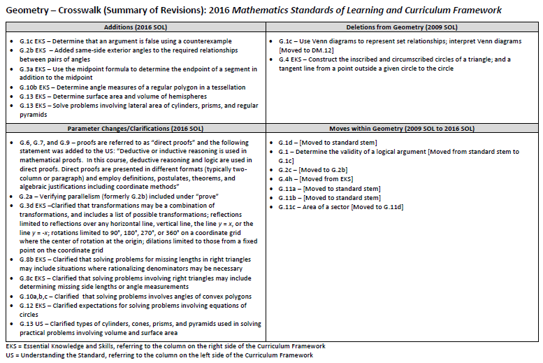
Grade Level Crosswalk
(Summary of Revisions)

Slide 11

2016 Mathematics
Standards of Learning
Algebra I
Overview of Revisions from 2009 to 2016
Related documents available on VDOE Mathematics 2016 webpage
Notes:
Lead: Welcome to the Algebra I overview of revisions to the Mathematics Standards of Learning from 2009 to 2016. It would be helpful to have a copy of the Algebra I – Crosswalk (Summary of Revisions) and a copy of the 2016 Algebra I Curriculum Framework to reference during this presentation. These documents are available electronically on the VDOE Mathematics 2016 webpage under Standards of Learning and Testing.

Slide 12
Purpose
Overview of the 2016 Mathematics Standards of Learning and the Curriculum Framework
Highlight information included in the Essential Knowledge and Skills and the Understanding the Standard sections of the Curriculum Framework

Slide 13
2009 SOL | 2016 SOL
A.7 The student will investigate and analyze function (linear and quadratic) families and their characteristics both algebraically and graphically, including determining whether a relation is a function; domain and range; zeros of a function; x- and y-intercepts; finding the values of a function for elements in its domain; and making connections between and among multiple representations of functions including concrete, verbal, numeric, graphic, and algebraic. | A.7 The student will investigate and analyze linear and quadratic function families and their characteristics both algebraically and graphically, including determining whether a relation is a function; domain and range; zeros; intercepts; values of a function for elements in its domain; and connections between and among multiple representations of functions using verbal descriptions, tables, equations, and graphs.
Revisions:
A.7 EKS no longer includes detect patterns in data and represent arithmetic and geometric patterns algebraically [Included in AFDA.1 and AII.5]
A.7 EKS includes investigate and analyze characteristics and multiple representations of linear and quadratic functions using a graphing utility
A.7a EKS includes determine whether a relation represented by a mapping is a function
A.7d EKS includes the use the x-intercepts from the graphical representation of a quadratic function to determine and confirm its factors

Slide 14
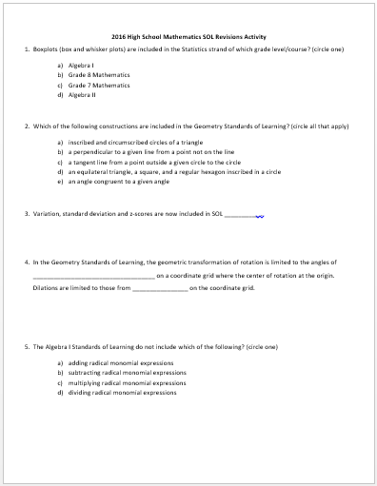
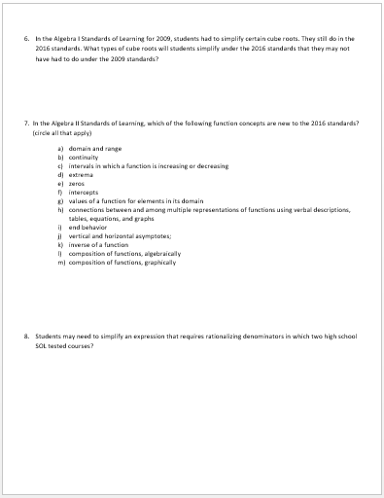
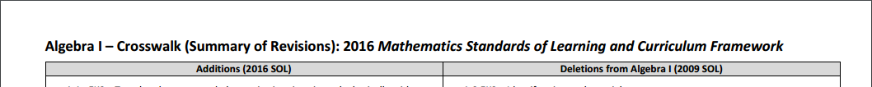
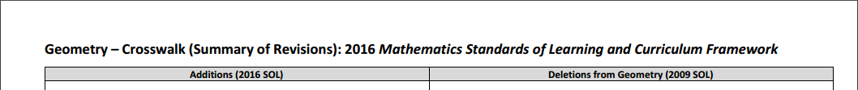
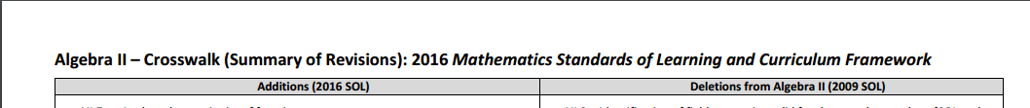
HS SOL Revision Activity - Scavenger Hunt

Slide 15
HS SOL Revision Activity - Scavenger Hunt KEY
b
b, d, e
AFDA.7, AII.11
90°, 180°, 270°, or 360°; a fixed point
d
2009: Whole numbers; 2016: integers
a, c, f, g, k
Geometry and Algebra II

Slide 16
Properties of Real Numbers and Equality/Inequality
Algebra I:
2009. A.4: Justify steps used in simplifying expressions and solving equations using field properties
2016. A.4 EKS: Apply the properties of real numbers...to simplify expressions and solve equations
Algebra II:
2009. A.II.3: Identify field properties that are valid for complex numbers.
2016: N/A

Slide 17
Linear Equations and Inequalities
6.13: One-step linear equations
6.14: One-step linear inequality (addition/subtraction only)
7.12: Two-step linear equations
7.13: One- and two-step linear inequalities
8.17: Multi-step linear equations
8.18: Multi-step linear inequalities
A.4: Multi-step linear equations
A.5: Multi-step linear inequalities

Slide 18
Linear Equations and Inequalities
From Grade 8 Essential Knowledge and Skills:
Variable on one or both sides of the equation
Coefficients and numeric terms will be rational
May contain expressions that need to be expanded using the distributive property
May require collecting like terms to solve
Up to four steps

Slide 19
Course Introductions
Create homogeneous groups of Algebra I, Geometry, and Algebra II teachers.
Read your course description. Discuss the following and be ready to share your thoughts:
What surprises you in the descriptions?
What in these descriptions is already a component of your course? What will need to change?
Which of these things is the hardest/easiest to implement?

Slide 20
Global Changes
Turn and Talk
Now that you have examined the summary documents, what did you find out?
Why do you think the changes were made?

Slide 21
Essential Question Recap
What are the new 2016 Standards of Learning and how might the VDOE documents support understanding of these standards?

Slide 22
2a. Transformations

Slide 23
Essential Questions
What instructional strategies promote students’ understanding of transformations using technology?

Slide 24
Transformations - Vocabulary Sort Activity
With a partner:
When a vocabulary word is shown, raise the card for the course where the word is introduced for the first time.

Slide 25
Transformations
In which course is the word
introduced for the first time?
REFLECTION (and dilation)
(function context)
DILATION (geometry context)
TRANSLATE (function context)
TRANSFORMATION (function context)
TRANSFORMATIONS
(geometry context)
TRANSLATE (and reflect and rotate)
(geometry context)
SIMILAR
CONGRUENT
PARENT FUNCTION
MATH 8
MATH 5
MATH 5
ALGEBRA I
ALGEBRA I
MATH 7
ALGEBRA I
MATH 3
ALGEBRA I
Notes:
Lead: (Words and answers animated as follows…)
Congruent: Third…SOL 3.13: The student will identify congruent and noncongruent figures.
Similar: Math 7…SOL 7.5: solve problems involving similar quadrilaterals and triangles.
Transformations (Geo): Math 5…SOL 5.14: recognize and apply transformations.
Translate (rotate, reflect; Geo): Math 5…5.14: Apply transformations to polygons in order to determine congruence.
Dilation: Math 8…SOL 8.7: Apply transformations to include dilations.
NOTE: 5th grade transformations are in space; 8th grade are on the coordinate plane. 8th also includes isometric transformations. Geometry includes each of those transformations with additional parameters.
Transformations (Function context): Algebra I…SOL A.6: Describe transformations (of a linear function) defined by changes in the slope or y-intercept.
Parent Function: Algebra I…SOL A.6: Use the parent function y = x.
Translate (Function context): Algebra I…SOL A.6: Changes in the y-intercept may be described by transformations.
Reflect (and dilate): Algebra I…SOL A.6: Changes in the slope may be described by dilations.
NOTES: AFDA.2—Use knowledge of transformations (horizontal and vertical translation; reflect over x- and y-axis; dilate by stretch and compress) to write an equation.
Algebra II—AII.6: Identify the transformation of a function—absolute value, square root, cube root, rational, polynomial, exponential, and logarithmic

Slide 26
Transformations Progression
Grade 3: Congruent figures
Grade 5: Isometric Transformations, Geometry context
Grade 7: Similar figures
Grade 8: Dilations
Algebra I: Parent functions, transformations of linear functions

Slide 27
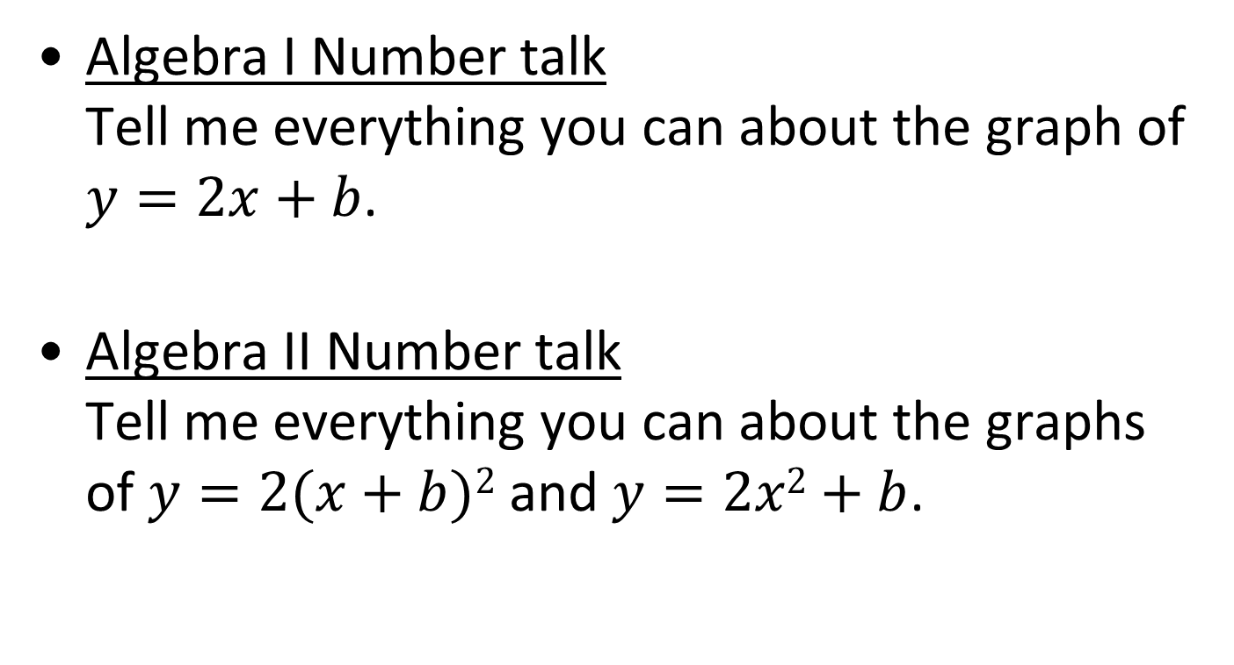
Transformations
Algebra I Number talk
Tell me everything you can about the graph of $y=2x+b$.
Algebra II Number talk
Tell me everything you can about the graphs of $y=2(x+b)2$ and $y=2x2+b$.

Slide 28
Transformations
Desmos Demonstration -- Function Transformation: Practice with Symbols
Teacher page

Slide 29
NCTM Principles to Actions
Ensuring Mathematical Success for All
High Leverage Mathematics Teaching Practices
1. Establish mathematics goals to focus learning.
2. Implement tasks that promote reasoning and problem solving.
3. Use and connect mathematical representations.
4. Facilitate meaningful mathematical discourse.
5. Pose purposeful questions.
6. Build procedural fluency from conceptual understanding.
7. Support productive struggle in learning mathematics.
8. Elicit and use evidence of student thinking.
Adapted from Leinwand, S. et al. (2014) Principles to Actions – Ensuring Mathematical Success for All, National Council of Teachers of Mathematics. https://www.nctm.org/uploadedFiles/Standards_and_Positions/PtAExecutiveSummary.pdf

Slide 30
Essential Questions Recap
What instructional strategies promote students’ understanding of transformations using technology?

Slide 31
2b. Graphing Linear Functions
Notes:
Facilitator:

Slide 32
Essential Question
How does the 2016 progression (grades 5 – 8) of developing linear functions and graphing linear equations impact instruction in the Algebra I classroom?

Slide 33
Sort Activity
With a partner:
Each slip has one of the Essential Knowledge and Skills for the 2016 PFA progression from Grade 5 – Geometry.
Place each skill with the grade level where you think it belongs.
Share your answers with another group.
Are there any discrepancies?

Slide 34
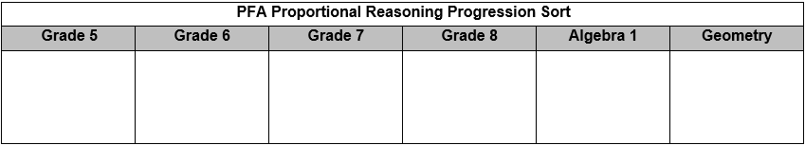
Sort Activity

Slide 35

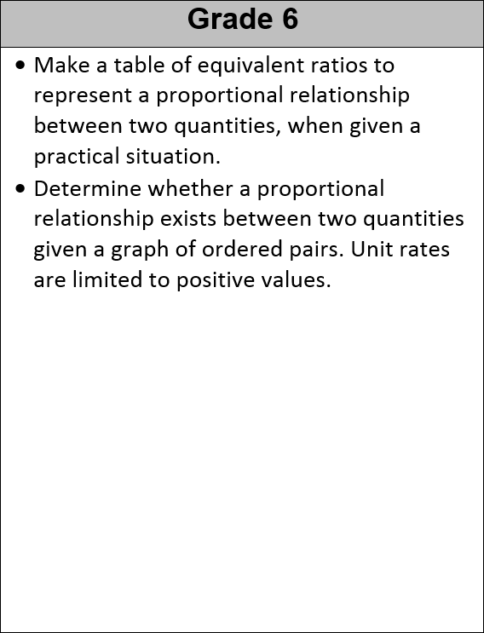
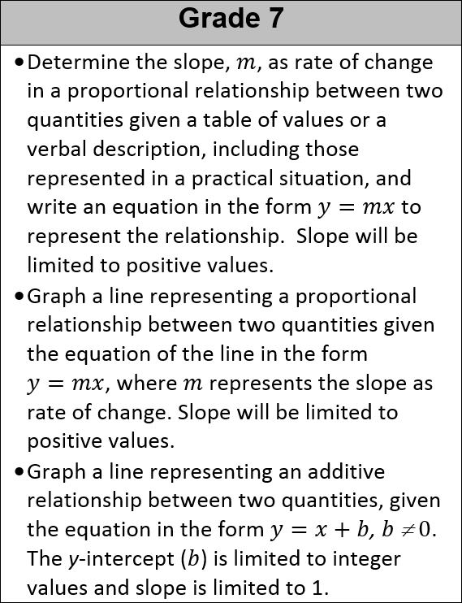
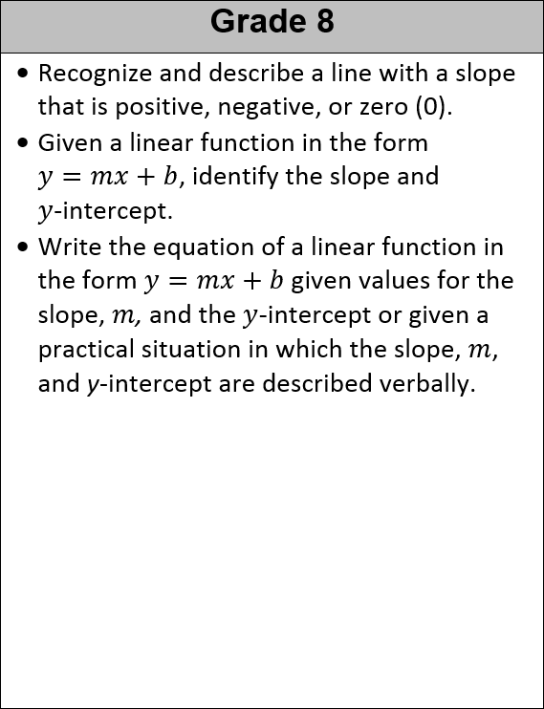
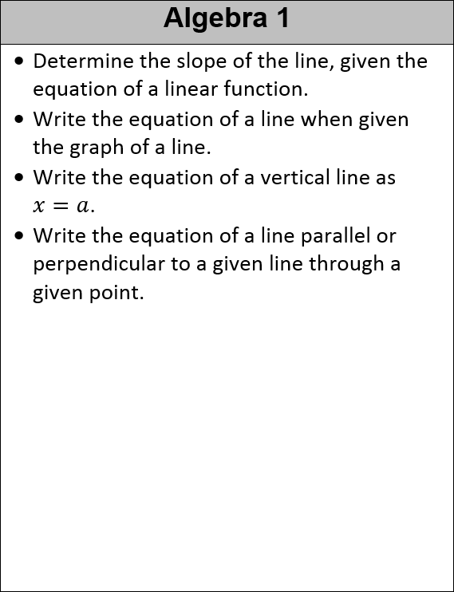
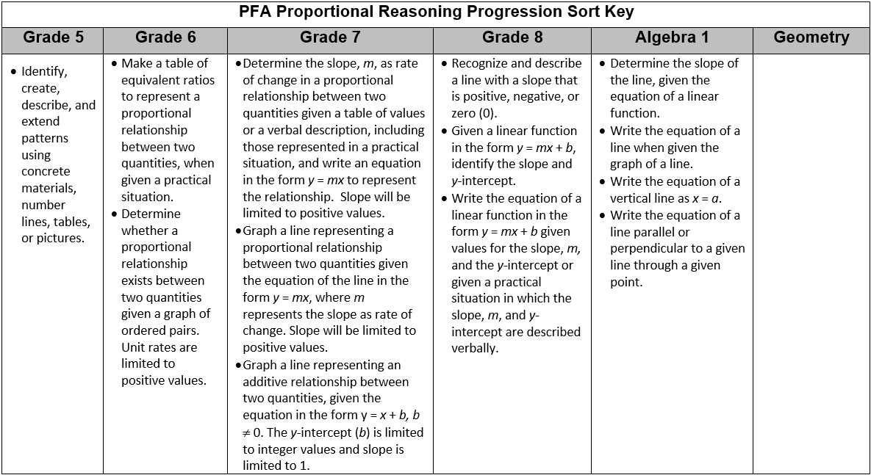
Sort Activity

Slide 36
Algebra (Proportional Reasoning) Progression
SOL 6.12 | SOL 7.10 | SOL 8.16
Essential Knowledge and Skills | Essential Knowledge and Skills | Essential Knowledge and Skills
The student will use problem solving, mathematical communication, mathematical reasoning, connections, and representations to Make a table of equivalent ratios to represent a proportional relationship between two quantities, when given a ratio. (a) Make a table of equivalent ratios to represent a proportional relationship between two quantities, when given a practical situation. (a) Identify the unit rate of a proportional relationship represented by a table of values or a verbal description, including those represented in a practical situation. Unit rates are limited to positive values. (b) Determine a missing value in a ratio table that represents a proportional relationship between two quantities using a unit rate. Unit rates are limited to positive values. (b) Determine whether a proportional relationship exists between two quantities, when given a table of values or a verbal description, including those represented in a practical situation. Unit rates are limited to positive values. (c) Determine whether a proportional relationship exists between two quantities given a graph of ordered pairs. Unit rates are limited to positive values. (c) Make connections between and among multiple representations of the same proportional relationship using verbal descriptions, ratio tables, and graphs. Unit rates are limited to positive values. (d) | The student will use problem solving, mathematical communication, mathematical reasoning, connections, and representations to Determine the slope, m, as rate of change in a proportional relationship between two quantities given a table of values or a verbal description, including those represented in a practical situation, and write an equation in the form y = mx to represent the relationship. Slope will be limited to positive values. (a) Graph a line representing a proportional relationship, between two quantities given an ordered pair on the line and the slope, m, as rate of change. Slope will be limited to positive values. (b) Graph a line representing a proportional relationship between two quantities given the equation of the line in the form y = mx, where m represents the slope as rate of change. Slope will be limited to positive values. (b) Determine the y-intercept, b, in an additive relationship between two quantities given a table of values or a verbal description, including those represented in a practical situation, and write an equation in the form y = x + b, b ≠ 0, to represent the relationship. (c) Graph a line representing an additive relationship (y = x + b, b ≠ 0) between two quantities, given an ordered pair on the line and the y-intercept (b). The y-intercept (b) is limited to integer values and slope is limited to 1. (d) Graph a line representing an additive relationship between two quantities, given the equation in the form y = x + b, b ≠ 0. The y-intercept (b) is limited to integer values and slope is limited to 1. (d) Make connections between and among representations of a proportional or additive relationship between two quantities using verbal descriptions, tables, equations, and graphs. (e) | The student will use problem solving, mathematical communication, mathematical reasoning, connections, and representations to Recognize and describe a line with a slope that is positive, negative, or zero (0). (a) Given a table of values for a linear function, identify the slope and y-intercept. The table will include the coordinate of the y-intercept. (b) Given a linear function in the form y = mx + b, identify the slope and y-intercept. (b) Given the graph of a linear function, identify the slope and y-intercept. The value of the y-intercept will be limited to integers. The coordinates of the ordered pairs shown in the graph will be limited to integers. (b) Identify the dependent and independent variable, given a practical situation modeled by a linear function. (c) Given the equation of a linear function in the form y = mx + b, graph the function. The value of the y-intercept will be limited to integers. (d) Write the equation of a linear function in the form y = mx + b given values for the slope, m, and the y-intercept or given a practical situation in which the slope, m, and y-intercept are described verbally. (e) Make connections between and among representations of a linear function using verbal descriptions, tables, equations, and graphs. (e).
PROPORTIONAL RELATIONSHIPS
NON-PROPORTIONAL /ADDITIVE RELATIONSHIPS
LINEAR FUNCTIONS

Slide 37
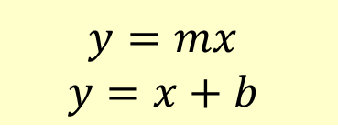

Algebra (Proportional Reasoning) Progression
SOL 6.12 | SOL 7.10 | SOL 8.16
Essential Knowledge and Skills | Essential Knowledge and Skills | Essential Knowledge and Skills
The student will use problem solving, mathematical communication, mathematical reasoning, connections, and representations to Make a table of equivalent ratios to represent a proportional relationship between two quantities, when given a ratio. (a) Make a table of equivalent ratios to represent a proportional relationship between two quantities, when given a practical situation. (a) Identify the unit rate of a proportional relationship represented by a table of values or a verbal description, including those represented in a practical situation. Unit rates are limited to positive values. (b) Determine a missing value in a ratio table that represents a proportional relationship between two quantities using a unit rate. Unit rates are limited to positive values. (b) Determine whether a proportional relationship exists between two quantities, when given a table of values or a verbal description, including those represented in a practical situation. Unit rates are limited to positive values. (c) Determine whether a proportional relationship exists between two quantities given a graph of ordered pairs. Unit rates are limited to positive values. (c) Make connections between and among multiple representations of the same proportional relationship using verbal descriptions, ratio tables, and graphs. Unit rates are limited to positive values. (d) | The student will use problem solving, mathematical communication, mathematical reasoning, connections, and representations to Determine the slope, m, as rate of change in a proportional relationship between two quantities given a table of values or a verbal description, including those represented in a practical situation, and write an equation in the form y = mx to represent the relationship. Slope will be limited to positive values. (a) Graph a line representing a proportional relationship, between two quantities given an ordered pair on the line and the slope, m, as rate of change. Slope will be limited to positive values. (b) Graph a line representing a proportional relationship between two quantities given the equation of the line in the form y = mx, where m represents the slope as rate of change. Slope will be limited to positive values. (b) Determine the y-intercept, b, in an additive relationship between two quantities given a table of values or a verbal description, including those represented in a practical situation, and write an equation in the form y = x + b, b ≠ 0, to represent the relationship. (c) Graph a line representing an additive relationship (y = x + b, b ≠ 0) between two quantities, given an ordered pair on the line and the y-intercept (b). The y-intercept (b) is limited to integer values and slope is limited to 1. (d) Graph a line representing an additive relationship between two quantities, given the equation in the form y = x + b, b ≠ 0. The y-intercept (b) is limited to integer values and slope is limited to 1. (d) Make connections between and among representations of a proportional or additive relationship between two quantities using verbal descriptions, tables, equations, and graphs. (e) | The student will use problem solving, mathematical communication, mathematical reasoning, connections, and representations to Recognize and describe a line with a slope that is positive, negative, or zero (0). (a) Given a table of values for a linear function, identify the slope and y-intercept. The table will include the coordinate of the y-intercept. (b) Given a linear function in the form y = mx + b, identify the slope and y-intercept. (b) Given the graph of a linear function, identify the slope and y-intercept. The value of the y-intercept will be limited to integers. The coordinates of the ordered pairs shown in the graph will be limited to integers. (b) Identify the dependent and independent variable, given a practical situation modeled by a linear function. (c) Given the equation of a linear function in the form y = mx + b, graph the function. The value of the y-intercept will be limited to integers. (d) Write the equation of a linear function in the form y = mx + b given values for the slope, m, and the y-intercept or given a practical situation in which the slope, m, and y-intercept are described verbally. (e) Make connections between and among representations of a linear function using verbal descriptions, tables, equations, and graphs. (e).
RATIO TABLES
UNIT RATES
SLOPE as RATE of CHANGE
SLOPE and y-INTERCEPT
$$y=mx$$
$$y=x+b$$
$$y=mx+b$$

Slide 38
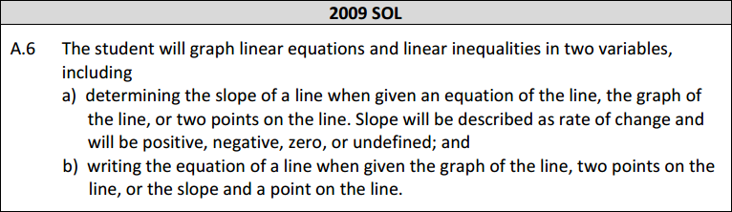
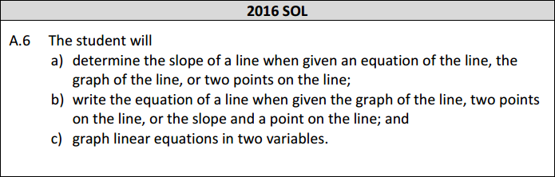
Linear Functions
Compare the 2009 and 2016 A.6 standards. What do you notice?

Slide 39
Linear Functions
Review the Grade 5 – Algebra I progression document.
Discussion:
Algebra I expectations are the same but students are coming with very different experiences. How does our instruction need to be adapted?

Slide 40
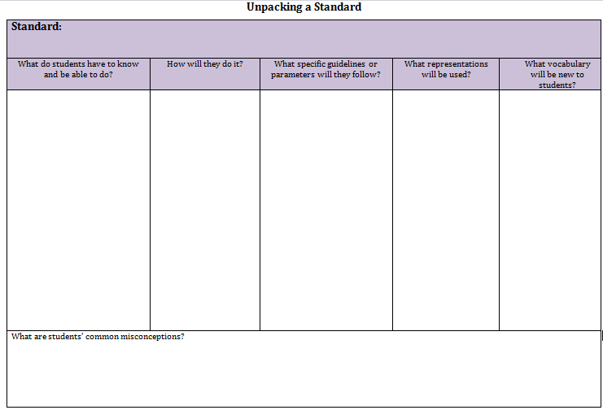
Unpacking Standards – Overview of Structure

Slide 41
NCTM Principles to Actions
Ensuring Mathematical Success for All
High Leverage Mathematics Teaching Practices
1. Establish mathematics goals to focus learning.
2. Implement tasks that promote reasoning and problem solving.
3. Use and connect mathematical representations.
4. Facilitate meaningful mathematical discourse.
5. Pose purposeful questions.
6. Build procedural fluency from conceptual understanding.
7. Support productive struggle in learning mathematics.
8. Elicit and use evidence of student thinking.
Adapted from Leinwand, S. et al. (2014) Principles to Actions – Ensuring Mathematical Success for All, National Council of Teachers of Mathematics. https://www.nctm.org/uploadedFiles/Standards_and_Positions/PtAExecutiveSummary.pdf

Slide 42
Essential Question Recap
How does the 2016 progression (grades 5 – 8) of developing linear functions and graphing linear equations impact instruction in the Algebra I classroom?
Notes:
Facilitator: Briefly revisit as closure.

Slide 43
2c. Quadrilaterals and Proofs
Notes:
Facilitator:

Slide 44
Essential Questions
What instructional strategies promote students’ understanding of quadrilaterals?
What is the role of proof in the Geometry curriculum?

Slide 45
Brainstorming Activity
What Essential Knowledge and Skills regarding quadrilaterals do you think are taught in:
  Grade 4
  Grade 7
  Geometry
Consider types of quadrilaterals, vocabulary, angles, properties, and proofs.
Write your answers on chart paper.

Slide 46
Gallery Walk
Post your charts around the room. Include your table number on your chart.
After seeing the other charts, revise your poster if you would like.
Notes:
Lead:

Slide 47
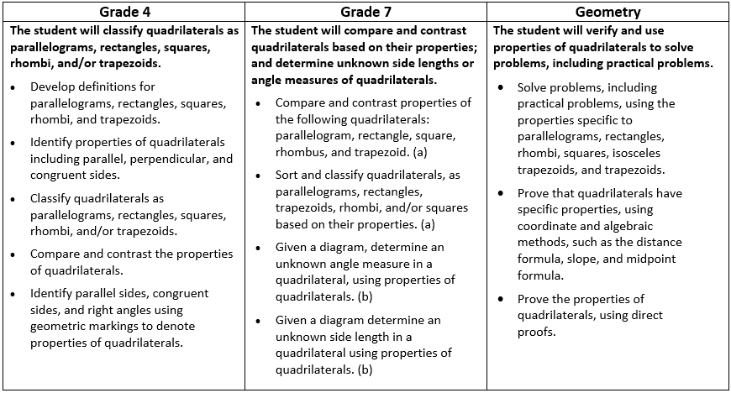
Quadrilateral Progression
Parallelogram
Rectangle
Square
Rhombus
Trapezoid
Parallelogram
Rectangle
Square
Rhombus
Trapezoid
Parallelogram
Rectangle
Square
Rhombus
Trapezoid
Isosceles Trapezoid
Identify
Parallel Sides
Perpendicular Sides Congruent Sides
Use
Prove
Parallel Sides
Perpendicular Sides Congruent Sides
Diagonals
Parallel Sides
Perpendicular Sides Congruent Sides
Diagonals
Right Angles
Opposite Angles
Consecutive Angles
Opposite Angles
Consecutive Angles
Diagonals and Angles

Slide 48
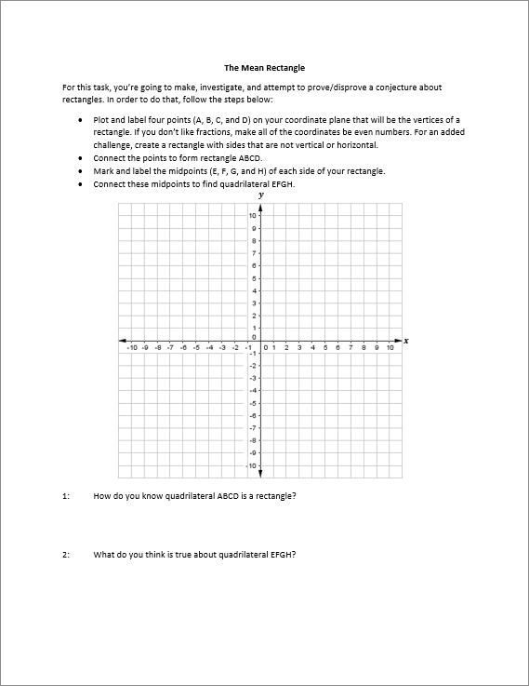
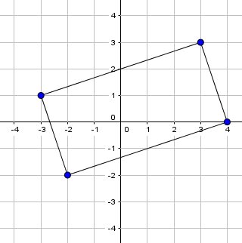
Rectangle Task
Complete the Mean Rectangle Task.

Slide 49
Quadrilateral Task
Dynamic Geometric software (e.g. Geogebra) can amplify the power of this task without sacrificing the mathematics.

Slide 50
Proofs
How is the concept of proof used in this task?
From the VDOE Curriculum Framework:
Deductive reasoning and logic are used in direct proofs. Direct proofs are presented in different formats (typically two-column or paragraph) and employ definitions, postulates, theorems, and algebraic justifications including coordinate methods.

Slide 51
NCTM Principles to Actions
Ensuring Mathematical Success for All
High Leverage Mathematics Teaching Practices
1. Establish mathematics goals to focus learning.
2. Implement tasks that promote reasoning and problem solving.
3. Use and connect mathematical representations.
4. Facilitate meaningful mathematical discourse.
5. Pose purposeful questions.
6. Build procedural fluency from conceptual understanding.
7. Support productive struggle in learning mathematics.
8. Elicit and use evidence of student thinking.
Adapted from Leinwand, S. et al. (2014) Principles to Actions – Ensuring Mathematical Success for All, National Council of Teachers of Mathematics. https://www.nctm.org/uploadedFiles/Standards_and_Positions/PtAExecutiveSummary.pdf

Slide 52
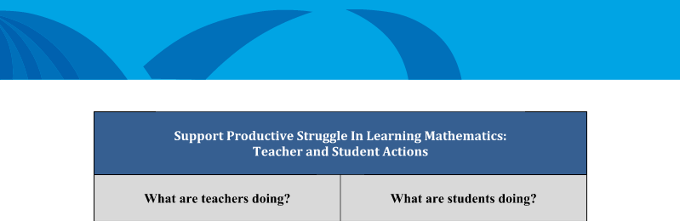
Support Productive Struggle
On page 52 of NCTM’s book Principles to Actions- Ensuring Mathematical Success for All, look at the list of student and teacher actions.
With your table group discuss the teacher and student actions that support productive struggle in learning mathematics.

Slide 53
Essential Questions Recap
What instructional strategies promote students’ understanding of quadrilaterals?
What is the role of proof in the Geometry curriculum?
Notes:
Lead: Revisit

Slide 54
II.d) Multiple Representations of Functions
Notes:
Lead

Slide 55
Essential Question
What instructional strategies promote students’ flexibility with multiple representations of functions?

Slide 56
Representations of Functions- Sorting
Sort the problems by the grade level in which you think they would be assessed.
Create sticky note headers; you will need nine sticky notes:
Elementary, Grade 6, Grade 7, Grade 8,
Algebra I, Geometry, Algebra II, Trigonometry, Mathematical Analysis

Slide 57
Multiple Representations of Functions
A.7 EKS: Investigate and analyze characteristics and multiple representations of functions with a graphing utility.
AII.7 EKS: Investigate and analyze characteristics and multiple representations of functions with a graphing utility.

Slide 58
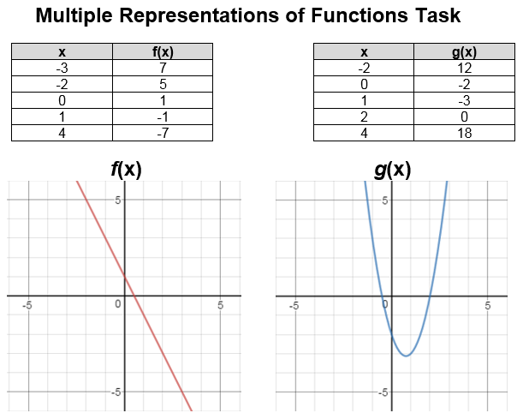
Multiple Representations of Functions
Complete the task with a partner.

Slide 59
Multiple Representations of Functions
How does the use of multiple representations in this task inform you of student understanding?
How does it demonstrate the need for multiple representations?
How can you modify these problems to change the cognitive demand?

Slide 60
NCTM Principles to Actions
Ensuring Mathematical Success for All
High Leverage Mathematics Teaching Practices
1. Establish mathematics goals to focus learning.
2. Implement tasks that promote reasoning and problem solving.
3. Use and connect mathematical representations.
4. Facilitate meaningful mathematical discourse.
5. Pose purposeful questions.
6. Build procedural fluency from conceptual understanding.
7. Support productive struggle in learning mathematics.
8. Elicit and use evidence of student thinking.
Adapted from Leinwand, S. et al. (2014) Principles to Actions – Ensuring Mathematical Success for All, National Council of Teachers of Mathematics. https://www.nctm.org/uploadedFiles/Standards_and_Positions/PtAExecutiveSummary.pdf
Notes:
Facilitator: Recall the eight teacher practices from earlier. This task hits on several, but we think it particularly draws on numbers 3 and 8:
3 – using and connecting representations obviously
8 – the representations students use tells us about their understanding of the concept and their preferred approach.
We are going to look closer at number 3.
Notice that we have discussed all 8 teaching practices.

Slide 61
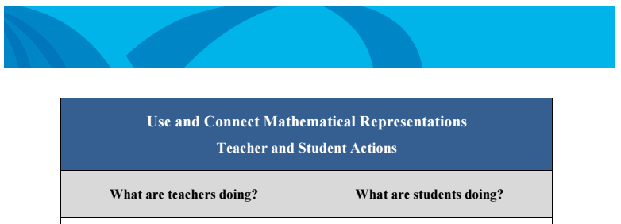
Use and Connect Multiple Representations
Look at the list of teacher actions.
With your table come up with possible student actions for your assigned teacher actions.

Slide 62
Essential Question Recap
What instructional strategies promote students’ flexibility with multiple representations of functions?

Slide 63
3. Support for Implementation

Slide 64
Essential Questions
What resources are available to help implement the 2016 Standards?
Where do we go from here?

Slide 65
Implementation Support Resources
2016 Mathematics Standards of Learning
2016 Mathematics Standards Curriculum Frameworks
2009 to 2016 Crosswalk (summary of revisions) documents
2016 Mathematics SOL Video Playlist (Overview, Vertical Progression & Support, Implementation and Resources)
Progressions for Selected Content Strands
Narrated 2016 SOL Summary PowerPoints
SOL Mathematics Institutes Professional Development Resources

Slide 66
Implementation Timeline
2016-2017 School Year – Curriculum Development VDOE staff provides a summary of the revisions to assist school divisions in incorporating the new standards into local written curricula for inclusion in the taught curricula during the 2017-2018 school year.
2017-2018 School Year – Crossover Year 2009 Mathematics Standards of Learning and 2016 Mathematics Standards of Learning are included in the written and taught curricula. Spring 2018 Standards of Learning assessments measure the 2009 Mathematics Standards of Learning and include field test items measuring the 2016 Mathematics Standards of Learning.
2018-2019 School Year – Full-Implementation Year Written and taught curricula reflect the 2016 Mathematics Standards of Learning. Standards of Learning assessments measure the 2016 Mathematics Standards of Learning.
Notes:
Lead

Slide 67
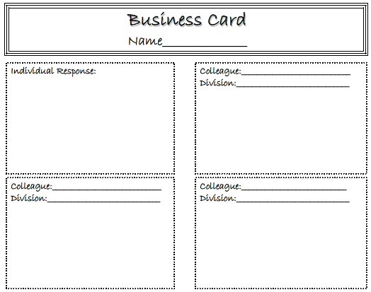
Reflection
What are your next steps?
Collect suggestions and contact information from 3 colleagues.

Slide 68
Please contact us!
The VDOE Mathematics Team at
Mathematics@doe.virginia.gov

