Slide 1
2017 Mathematics Institute
Grades 6 – 8 Session

Slide 2
Agenda
Revisions to Standards and Purpose
Emphasis on Specific Content
  Equations
  Inequalities
  Proportional Reasoning within the Algebra Strand
Support for Implementation

Slide 3
1. Revisions to Standards and Purpose

Slide 4
Focus of Revisions
Improve Vertical Progression
Improve Consistency of Math Language
Clarify Teaching & Learning Expectations
Increased Support for Teachers
Ensure Proficiency with Computational Skills
Ensure Developmental Appropriateness & Student Expectations
Notes:
Examples to follow

Slide 5
Improving Vertical Progression
If the ratio of number of chocolate candies to caramel candies purchased is 2:5 and each chocolate candy is $1.00 and each caramel candy is $0.75, which of the following could be the total cost of a bag of candies purchased?
$15.00
$17.25
$19.50
$27.90
SOL 6.1 -The student will represent relationships between quantities using ratios, and will use appropriate notations, such as , a to b, and a:b.
SOL 7.3 - The student will solve single-step and multistep practical problems, using proportional reasoning.
SOL 8.4 - The student will solve practical problems involving consumer applications.
Notes:
An example of how a concept taught in 6th grade (ratios), studied in 7th grade (proportional reasoning) is used in an 8th grade (multi-step consumer applications).
Multi-step:
Cost for 2 chocolate candies and for 5 caramel candies (2 * $1) and (5*$0.75)
Finding the total cost for 1 bag of the given ratio of candies, 2:5 ($2 + $3.75 = $5.75)
7th grade understanding of proportional relationships that the cost of 1 bag is $5.75 and determining which of the other total costs is proportional to this given ratio.
$\frac{1 bag}{\$5.75}=\frac{?complete bags}{cost choices given}$
Answer:
$17.25 divided by $5.75 is exactly 3 bags of candy with a ratio of 2 chocolate candies to 5 caramel candies.
$\frac{1 bag}{\$5.75}=\frac{3 bags}{\$17.25}$

Slide 6

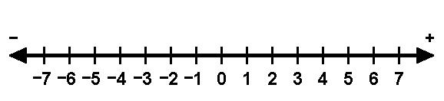
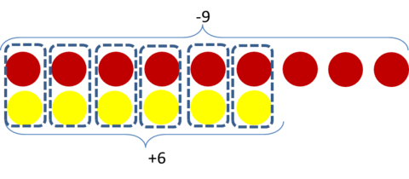
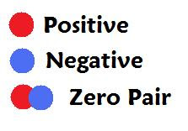

Developmental Appropriateness
SOL 6.6 The student will
a) add, subtract, multiply, and divide integers;
b) solve practical problems involving operations with
integers; and
c) simplify numerical expressions involving integers.
Negative
Positive
My cocoa was too hot to drink! To cool it off, I added an ice cube.

Slide 7

Five Strands Task –
Ensuring Student Expectations Grades 6 - 8
Number and Number Sense
Computation and Estimation
Measurement and Geometry
Probability and Statistics
Patterns, Functions, and Algebra
Notes:
Participants are encouraged to complete the Five Strands Task to explore the 6-8 strand introductions included in the Curriculum Framework documents.

Slide 8
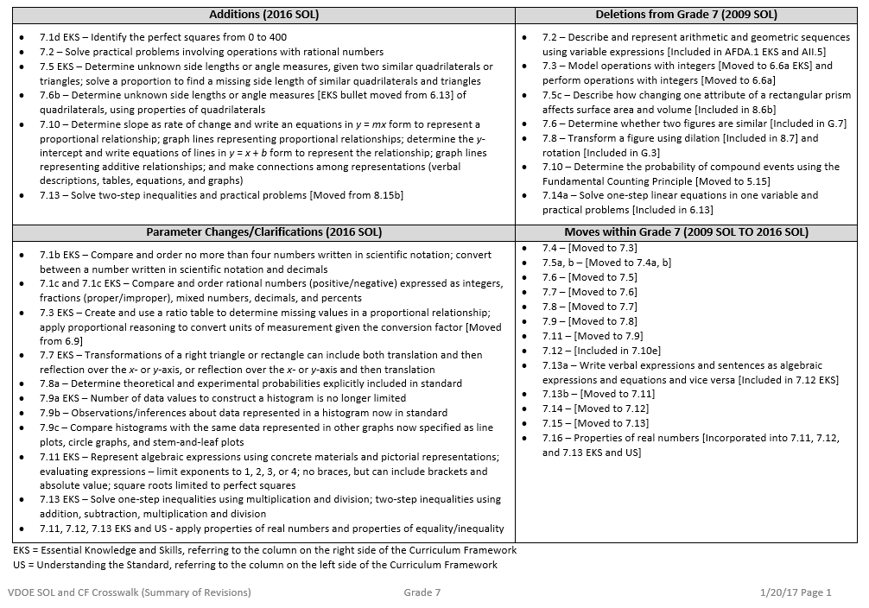
Grade 7– Crosswalk (Summary of Revisions): 2016 Mathematics Standards of Learning and Curriculum Framework

Slide 9

2016 Mathematics
Standards of Learning
Grade 7 Mathematics
Overview of Revisions - 2009 to 2016
Referenced documents available at VDOE Mathematics 2016
Notes:
Welcome to the Grade 7 Overview of Revisions to the Mathematics Standards of Learning from 2009 to 2016.
It would be helpful to have a copy of the Grade 7 – Crosswalk (Summary of Revisions) and a copy of the 2016 Grade 7 Curriculum Frameworks to reference during this presentation.
These documents are available electronically on the VDOE Mathematics 2016 webpage under Standards of Learning and Testing.

Slide 10
Purpose
Overview of the 2016 Mathematics Standards of Learning and the Curriculum Framework
Highlight information included in the Essential Knowledge and Skills and the Understanding the Standard sections of the Curriculum Framework
Notes:
Our purpose is to provide an overview of the revisions and to highlight information included in the Essential Knowledge and Skills and Understanding the Standards sections of the curriculum framework.
This presentation is a brief overview of revisions and not a comprehensive list of all revisions. Teachers should reference the curriculum framework if they have questions regarding the 2016 standards.

Slide 11
2009 SOL | 2016 SOL
7.14 The student will a) solve one- and two-step linear equations in one variable; and b) solve practical problems requiring the solution of one- and two-step linear equations. [One-step equations included in 6.13] | 7.12 The student will solve two-step linear equations in one variable, including practical problems that require the solution of a two-step linear equation in one variable.
Revisions:
One-step equations are included in 6.13
Coefficients and numeric terms will be rational
Apply properties of real numbers and properties of equality
EKS – Write verbal expressions and sentences as algebraic expressions and equations and vice versa [Moved from 7.13a]
Notes:
7.14 is now 7.12 in the 2016 standards.
Students are expected to represent and solve two-step equations in one variable and to solve practical problems that require the solution to a two-step equation.
Coefficients and numeric terms will be rational numbers.
Students are expected to apply the properties of real numbers when solving equations. This is a shift from the 2009 standards in that the focus is not to identify a specific property being used, but correctly apply the properties to solve equations. It is appropriate for teachers and students to use the names of the properties when being applied, but this should not be a focus of the assessment.
Students are expected to write verbal expressions and sentences as algebraic expressions and equations and vice versa. This was removed from 7.13a to the EKS in 7.12. See note in red on the screen.

Slide 12
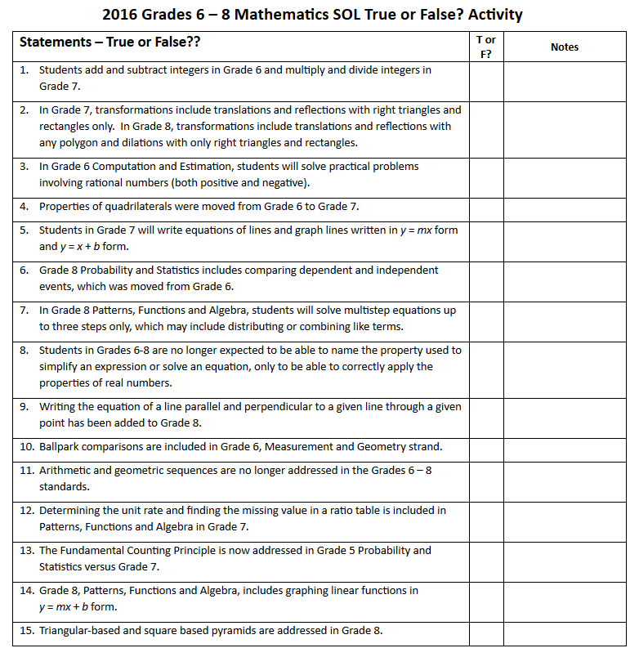

Slide 13
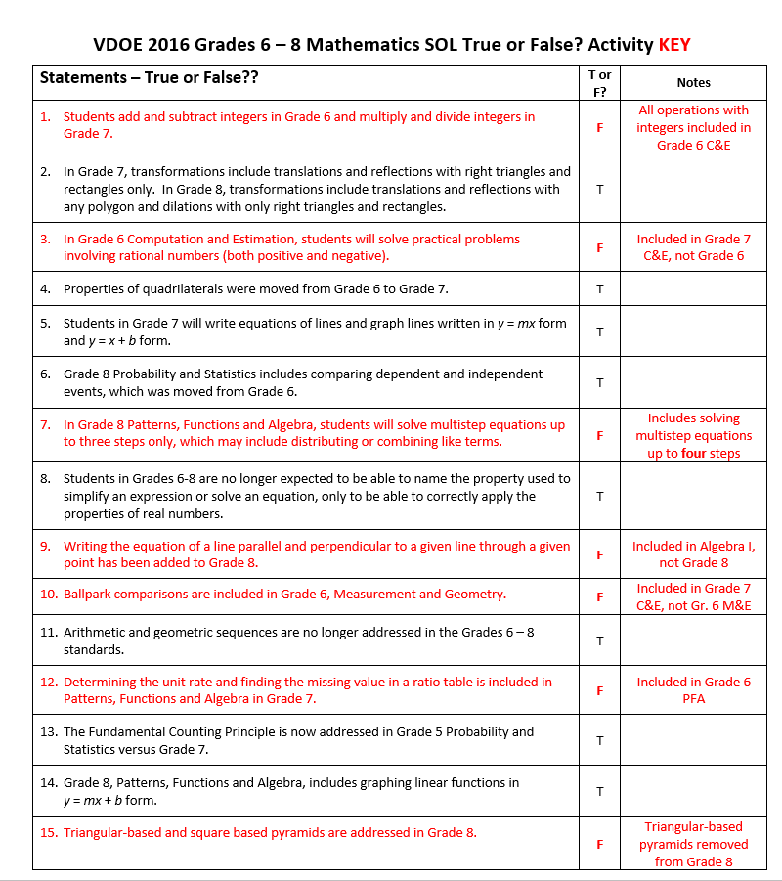

Slide 14
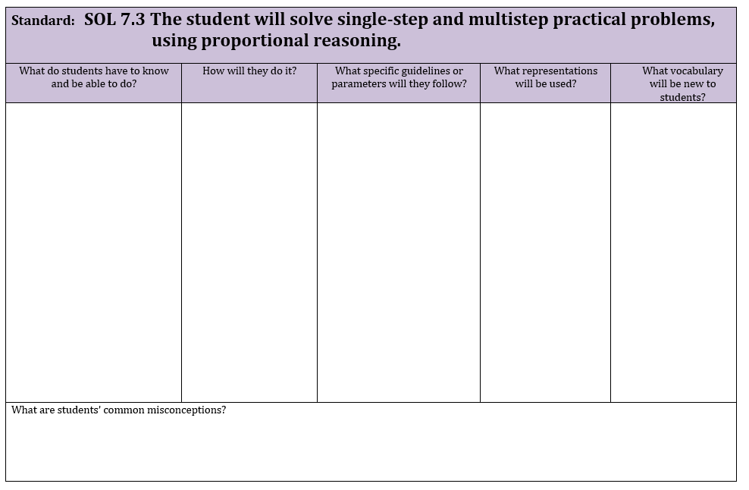

Clarify Teaching and Learning Expectations
Create & use Ratio Tables
Write and solve a proportion
Convert units of measurement within and between customary and metric
Solve practical problems
Compute 5%, 10%, 15%, 20% of a number
Compute 5%, 10%, 15%, 20% within a practical situation (tips, tax, and discounts)
Solve problems involving tips, tax, and discounts
3. Given conversion factor
4. Denominators $≤$ 12 for fraction scale factors. Decimals to tenths for decimal scale factors.
5 & 6. Using 10% as a benchmark
7. One percent computation per problem
Ratio Tables
4. scale drawings
Proportion
Multiplicatively
Scale drawing
Tax
Tip
Discounts
With Proportional REASONING using RATIO TABLES and Contextual Problems
It is intuitive for students to look for an additive relationship between ratios but proportions consist of a multiplicative relationship between ratios.
Students may view all ratios as fractions but many ratios do not consist of a part to whole relationship. A contextual fraction ratio is 3 boys to 10 total students. A non-fraction ratio would be 3 boys to 7 girls.

Slide 15
Mathematics Process Goals for Students
“The content of the mathematics standards is intended to support the five process goals for students”
- 2009 and 2016 Mathematics Standards of Learning
Communication
Connections
Representations
Problem Solving
Mathematical Understanding
Reasoning

Slide 16
NCTM Principles to Actions:
Ensuring Mathematical Success for All
High Leverage Mathematics Teaching Practices
1. Establish mathematics goals to focus learning.
2. Implement tasks that promote reasoning and problem solving.
3. Use and connect mathematical representations.
4. Facilitate meaningful mathematical discourse.
5. Pose purposeful questions.
6. Build procedural fluency from conceptual understanding.
7. Support productive struggle in learning mathematics.
8. Elicit and use evidence of student thinking.
Adapted from Leinwand, S. et al. (2014) Principles to Actions – Ensuring Mathematical Success for All, National Council of Teachers of Mathematics. https://www.nctm.org/uploadedFiles/Standards_and_Positions/PtAExecutiveSummary.pdf

Slide 17
2A. Equations

Slide 18
Equations Progression
SOL 6.13 | SOL 7.12 | SOL 8.17
Essential Knowledge and Skills | Essential Knowledge and Skills | Essential Knowledge and Skills
The student will use problem solving, mathematical communication, mathematical reasoning, connections and representation to Identify examples of the following algebraic vocabulary: equation, variable, expression, term, and coefficient. Represent and solve one-step linear equations in one variable, using a variety of concrete materials such as colored chips, algebra tiles, or weights on a balance scale. Apply properties of real numbers and properties of equality to solve a one-step equation in one variable. Coefficients are limited to integers and unit fractions. Numeric terms are limited to integers. Confirm solutions to one-step linear equations in one variable. Write verbal expressions and sentences as algebraic expressions and equations. Write algebraic expressions and equations as verbal expressions and sentences. Represent and solve a practical problem with a one-step linear equation in one variable. | The student will use problem solving, mathematical communication, mathematical reasoning, connections, and representations to Represent and solve two-step linear equations in one variable using a variety of concrete materials and pictorial representations. Apply properties of real numbers and properties of equality to solve two-step linear equations in one variable. Coefficients and numeric terms will be rational. Confirm algebraic solutions to linear equations in one variable. Write verbal expressions and sentences as algebraic expressions and equations. Write algebraic expressions and equations as verbal expressions and sentences. Solve practical problems that require the solution of a two-step linear equation. | The student will use problem solving, mathematical communication, mathematical reasoning, connections, and representations to Represent and solve multistep linear equations in one variable with the variable on one or both sides of the equation (up to four steps) using a variety of concrete materials and pictorial representations. Apply properties of real numbers and properties of equality to solve multistep linear equations in one variable (up to four steps). Coefficients and numeric terms will be rational. Equations may contain expressions that need to be expanded (using the distributive property) or require collecting like terms to solve. Write verbal expressions and sentences as algebraic expressions and equations. Write algebraic expressions and equations as verbal expressions and sentences. Solve practical problems that require the solution of a multistep linear equation. Confirm algebraic solutions to linear equations in one variable.

Slide 19
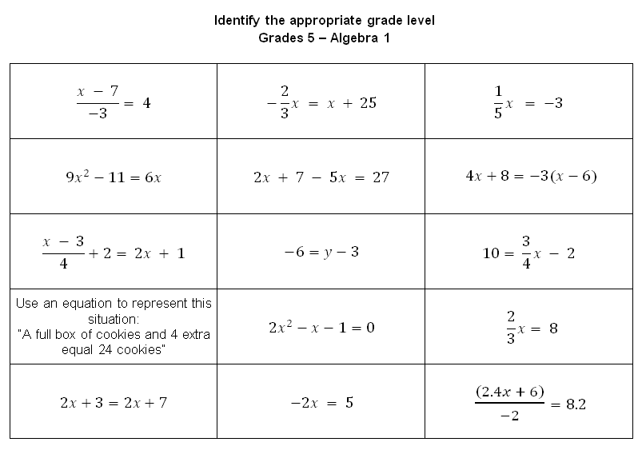
7
8
6
Alg
8
8
Alg
6
7
5
Alg
7
Alg
6
8

Slide 20
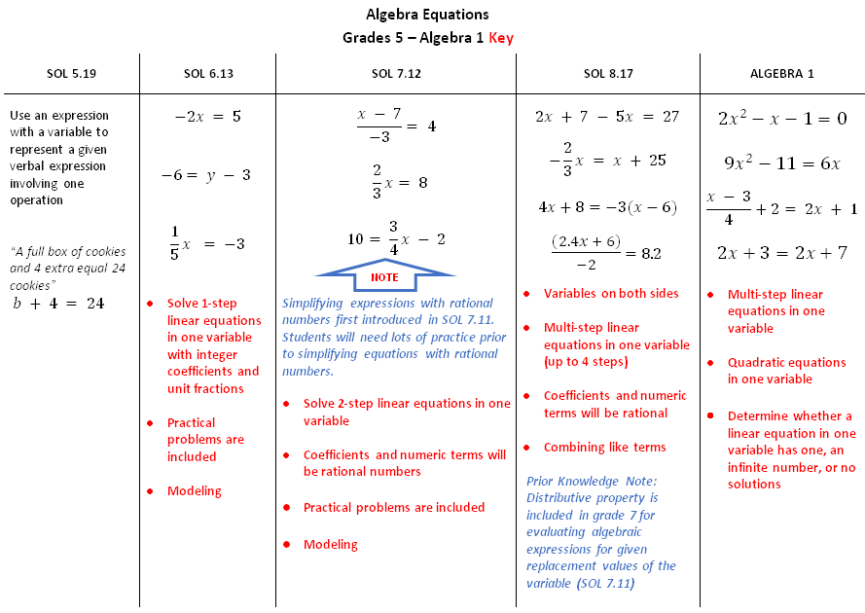

Slide 21
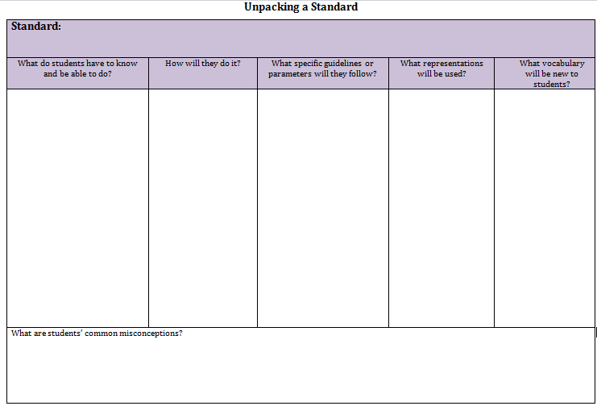

Connecting
the new standards

Slide 22
2B. Inequalities

Slide 23
Inequalities Progression
SOL 6.14 | SOL 7.13 | SOL 8.18
Essential Knowledge and Skills | Essential Knowledge and Skills | Essential Knowledge and Skills
The student will use problem solving, mathematical communication, mathematical reasoning, connections and representation to Given a verbal description, represent a practical situation with a one-variable linear inequality. (a) Apply properties of real numbers and the addition or subtraction property of inequality to solve a one-step linear inequality in one variable, and graph the solution on a number line. Numeric terms being added or subtracted from the variable are limited to integers. (b) Given the graph of a linear inequality with integers, represent the inequality two different ways (e.g., x < -5 or -5 > x) using symbols. (b) Identify a numerical value(s) that is part of the solution set of a given inequality. (a, b) | The student will use problem solving, mathematical communication, mathematical reasoning, connections, and representations to Apply properties of real numbers and the multiplication and division properties of inequality to solve one-step inequalities in one variable, and the addition, subtraction, multiplication, and division properties of inequality to solve two-step inequalities in one variable. Coefficients and numeric terms will be rational. Represent solutions to inequalities algebraically and graphically using a number line. Write verbal expressions and sentences as algebraic expressions and inequalities. Write algebraic expressions and inequalities as verbal expressions and sentences. Solve practical problems that require the solution of a one- or two-step inequality. Identify a numerical value(s) that is part of the solution set of a given inequality. | The student will use problem solving, mathematical communication, mathematical reasoning, connections, and representations to Apply properties of real numbers and properties of inequality to solve multistep linear inequalities (up to four steps) in one variable with the variable on one or both sides of the inequality. Coefficients and numeric terms will be rational. Inequalities may contain expressions that need to be expanded (using the distributive property) or require collecting like terms to solve. Graph solutions to multistep linear inequalities on a number line. Write verbal expressions and sentences as algebraic expressions and inequalities. Write algebraic expressions and inequalities as verbal expressions and sentences. Solve practical problems that require the solution of a multistep linear inequality in one variable. Identify a numerical value(s) that is part of the solution set of a given inequality.

Slide 24
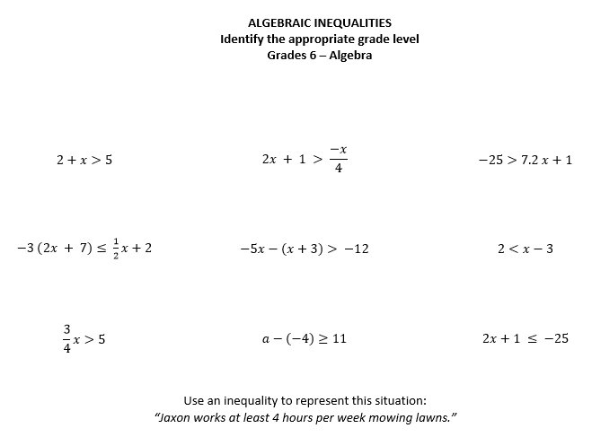
6
8
7
Alg
8
6
7
6
7
6

Slide 25
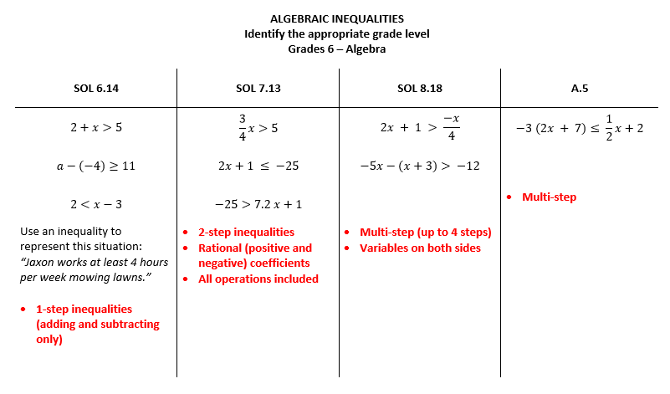

Slide 26
2C. Algebra (Proportional Reasoning)

Slide 27
Algebra (Proportional Reasoning) Progression
SOL 6.12 | SOL 7.10 | SOL 8.16
Essential Knowledge and Skills | Essential Knowledge and Skills | Essential Knowledge and Skills
The student will use problem solving, mathematical communication, mathematical reasoning, connections, and representations to Make a table of equivalent ratios to represent a proportional relationship between two quantities, when given a ratio. (a) Make a table of equivalent ratios to represent a proportional relationship between two quantities, when given a practical situation. (a) Identify the unit rate of a proportional relationship represented by a table of values or a verbal description, including those represented in a practical situation. Unit rates are limited to positive values. (b) Determine a missing value in a ratio table that represents a proportional relationship between two quantities using a unit rate. Unit rates are limited to positive values. (b) Determine whether a proportional relationship exists between two quantities, when given a table of values or a verbal description, including those represented in a practical situation. Unit rates are limited to positive values. (c) Determine whether a proportional relationship exists between two quantities given a graph of ordered pairs. Unit rates are limited to positive values. (c) Make connections between and among multiple representations of the same proportional relationship using verbal descriptions, ratio tables, and graphs. Unit rates are limited to positive values. (d) | The student will use problem solving, mathematical communication, mathematical reasoning, connections, and representations to Determine the slope, m, as rate of change in a proportional relationship between two quantities given a table of values or a verbal description, including those represented in a practical situation, and write an equation in the form y = mx to represent the relationship. Slope will be limited to positive values. (a) Graph a line representing a proportional relationship, between two quantities given an ordered pair on the line and the slope, m, as rate of change. Slope will be limited to positive values. (b) Graph a line representing a proportional relationship between two quantities given the equation of the line in the form y = mx, where m represents the slope as rate of change. Slope will be limited to positive values. (b) Determine the y-intercept, b, in an additive relationship between two quantities given a table of values or a verbal description, including those represented in a practical situation, and write an equation in the form y = x + b, b ≠ 0, to represent the relationship. (c) Graph a line representing an additive relationship (y = x + b, b ≠ 0) between two quantities, given an ordered pair on the line and the y-intercept (b). The y-intercept (b) is limited to integer values and slope is limited to 1. (d) Graph a line representing an additive relationship between two quantities, given the equation in the form y = x + b, b ≠ 0. The y-intercept (b) is limited to integer values and slope is limited to 1. (d) Make connections between and among representations of a proportional or additive relationship between two quantities using verbal descriptions, tables, equations, and graphs. (e) | The student will use problem solving, mathematical communication, mathematical reasoning, connections, and representations to Recognize and describe a line with a slope that is positive, negative, or zero (0). (a) Given a table of values for a linear function, identify the slope and y-intercept. The table will include the coordinate of the y-intercept. (b) Given a linear function in the form y = mx + b, identify the slope and y-intercept. (b) Given the graph of a linear function, identify the slope and y-intercept. The value of the y-intercept will be limited to integers. The coordinates of the ordered pairs shown in the graph will be limited to integers. (b) Identify the dependent and independent variable, given a practical situation modeled by a linear function. (c) Given the equation of a linear function in the form y = mx + b, graph the function. The value of the y-intercept will be limited to integers. (d) Write the equation of a linear function in the form y = mx + b given values for the slope, m, and the y-intercept or given a practical situation in which the slope, m, and y-intercept are described verbally. (e) Make connections between and among representations of a linear function using verbal descriptions, tables, equations, and graphs. (e).
PROPORTIONAL RELATIONSHIPS
NON-PROPORTIONAL,
ADDITIVE RELATIONSHIPS
LINEAR FUNCTIONS

Slide 28
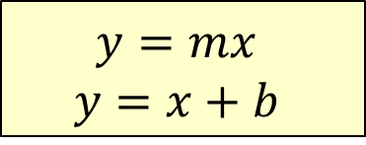

Algebra (Proportional Reasoning) Progression
SOL 6.12 | SOL 7.10 | SOL 8.16
Essential Knowledge and Skills | Essential Knowledge and Skills | Essential Knowledge and Skills
The student will use problem solving, mathematical communication, mathematical reasoning, connections, and representations to Make a table of equivalent ratios to represent a proportional relationship between two quantities, when given a ratio. (a) Make a table of equivalent ratios to represent a proportional relationship between two quantities, when given a practical situation. (a) Identify the unit rate of a proportional relationship represented by a table of values or a verbal description, including those represented in a practical situation. Unit rates are limited to positive values. (b) Determine a missing value in a ratio table that represents a proportional relationship between two quantities using a unit rate. Unit rates are limited to positive values. (b) Determine whether a proportional relationship exists between two quantities, when given a table of values or a verbal description, including those represented in a practical situation. Unit rates are limited to positive values. (c) Determine whether a proportional relationship exists between two quantities given a graph of ordered pairs. Unit rates are limited to positive values. (c) Make connections between and among multiple representations of the same proportional relationship using verbal descriptions, ratio tables, and graphs. Unit rates are limited to positive values. (d) | The student will use problem solving, mathematical communication, mathematical reasoning, connections, and representations to Determine the slope, m, as rate of change in a proportional relationship between two quantities given a table of values or a verbal description, including those represented in a practical situation, and write an equation in the form y = mx to represent the relationship. Slope will be limited to positive values. (a) Graph a line representing a proportional relationship, between two quantities given an ordered pair on the line and the slope, m, as rate of change. Slope will be limited to positive values. (b) Graph a line representing a proportional relationship between two quantities given the equation of the line in the form y = mx, where m represents the slope as rate of change. Slope will be limited to positive values. (b) Determine the y-intercept, b, in an additive relationship between two quantities given a table of values or a verbal description, including those represented in a practical situation, and write an equation in the form y = x + b, b ≠ 0, to represent the relationship. (c) Graph a line representing an additive relationship (y = x + b, b ≠ 0) between two quantities, given an ordered pair on the line and the y-intercept (b). The y-intercept (b) is limited to integer values and slope is limited to 1. (d) Graph a line representing an additive relationship between two quantities, given the equation in the form y = x + b, b ≠ 0. The y-intercept (b) is limited to integer values and slope is limited to 1. (d) Make connections between and among representations of a proportional or additive relationship between two quantities using verbal descriptions, tables, equations, and graphs. (e) | The student will use problem solving, mathematical communication, mathematical reasoning, connections, and representations to Recognize and describe a line with a slope that is positive, negative, or zero (0). (a) Given a table of values for a linear function, identify the slope and y-intercept. The table will include the coordinate of the y-intercept. (b) Given a linear function in the form y = mx + b, identify the slope and y-intercept. (b) Given the graph of a linear function, identify the slope and y-intercept. The value of the y-intercept will be limited to integers. The coordinates of the ordered pairs shown in the graph will be limited to integers. (b) Identify the dependent and independent variable, given a practical situation modeled by a linear function. (c) Given the equation of a linear function in the form y = mx + b, graph the function. The value of the y-intercept will be limited to integers. (d) Write the equation of a linear function in the form y = mx + b given values for the slope, m, and the y-intercept or given a practical situation in which the slope, m, and y-intercept are described verbally. (e) Make connections between and among representations of a linear function using verbal descriptions, tables, equations, and graphs. (e).
RATIO TABLES
UNIT RATES
SLOPE as RATE of CHANGE
SLOPE and y-INTERCEPT
$$y=mx$$
$$y=x+b$$
$$y=mx+b$$

Slide 29


Slide 30
2D. Proportional Reasoning & Unit Rates
Grade 6

Slide 31
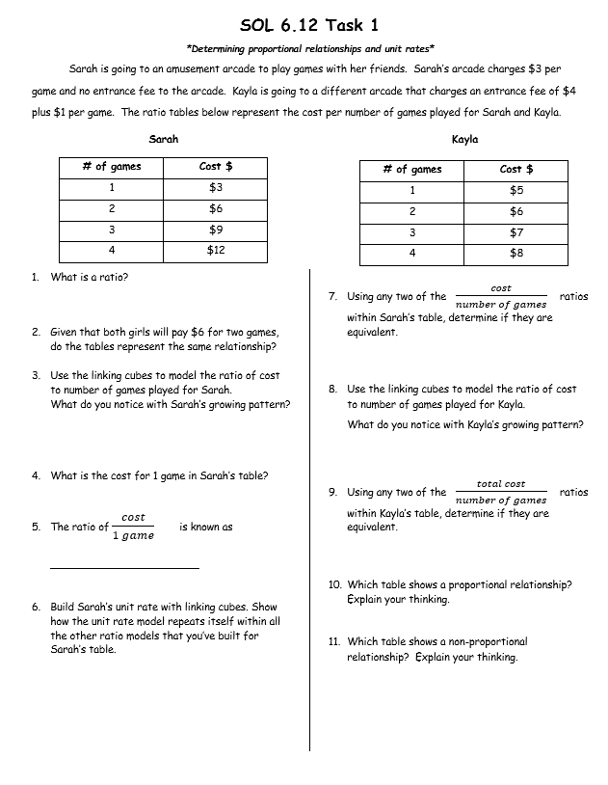
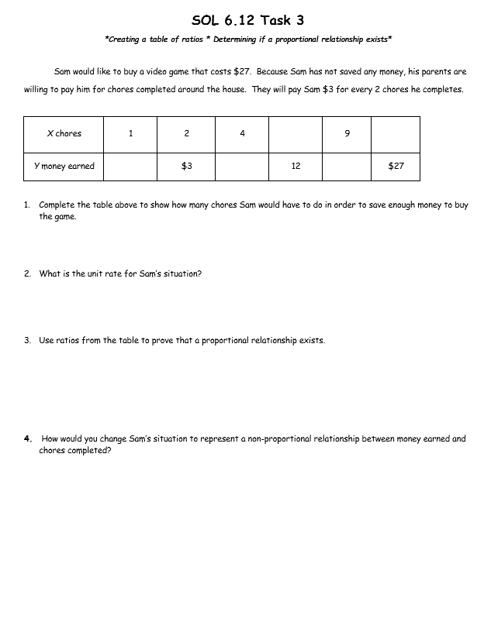
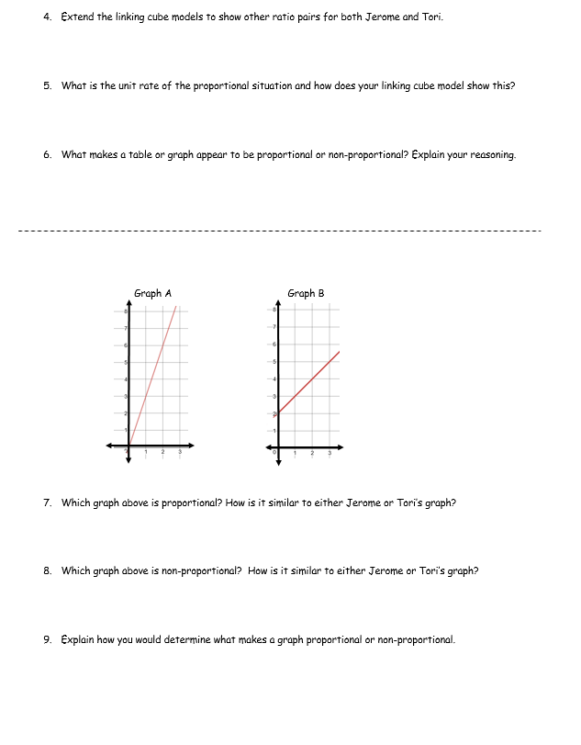
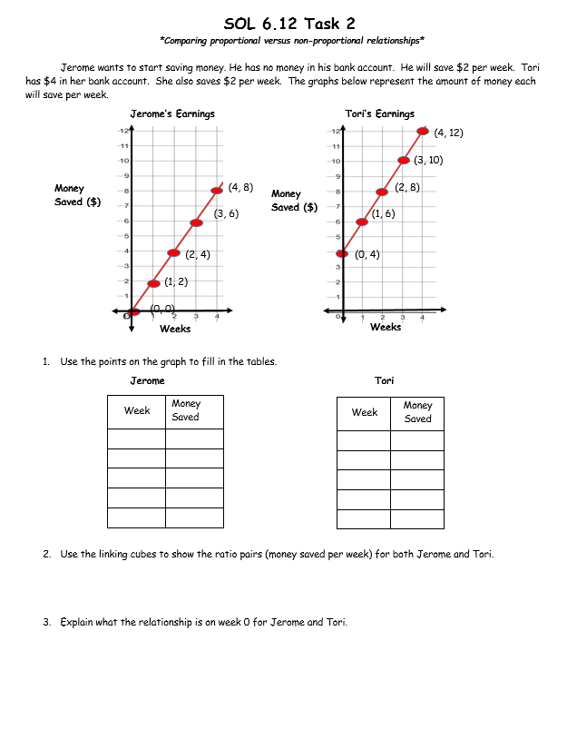

Slide 32
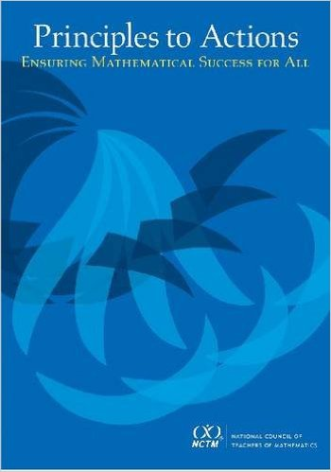
NCTM Principles to Actions
Ensuring Mathematical Success for All
TURN & TALK
Which practices were evident in the tasks?
High Leverage Mathematics Teaching Practices
1. Establish mathematics goals to focus learning.
2. Implement tasks that promote reasoning and problem solving.
3. Use and connect mathematical representations.
4. Facilitate meaningful mathematical discourse.
5. Pose purposeful questions.
6. Build procedural fluency from conceptual understanding.
7. Support productive struggle in learning mathematics.
8. Elicit and use evidence of student thinking.
Adapted from Leinwand, S. et al. (2014) Principles to Actions – Ensuring Mathematical Success for All, National Council of Teachers of Mathematics.

Slide 34
Lunch

Slide 35
2E. Slope as Rate of Change
Grade 7

Slide 36
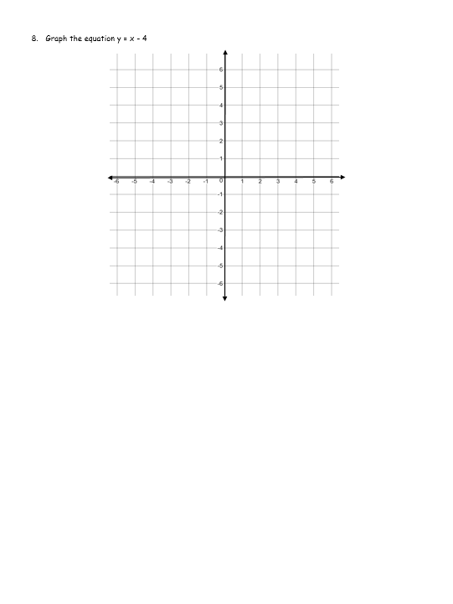
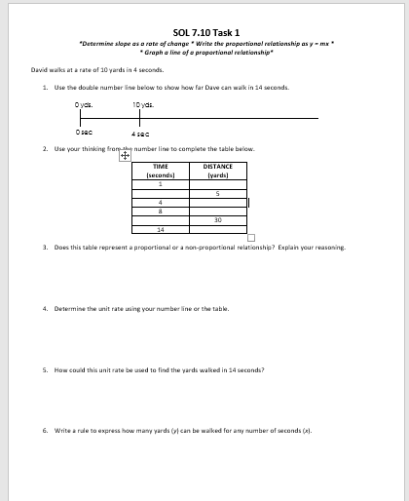
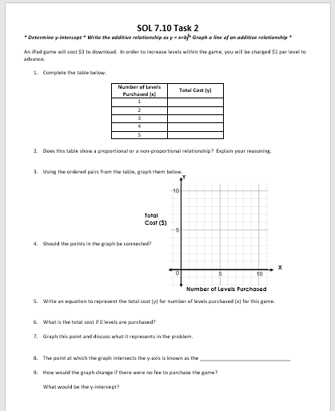
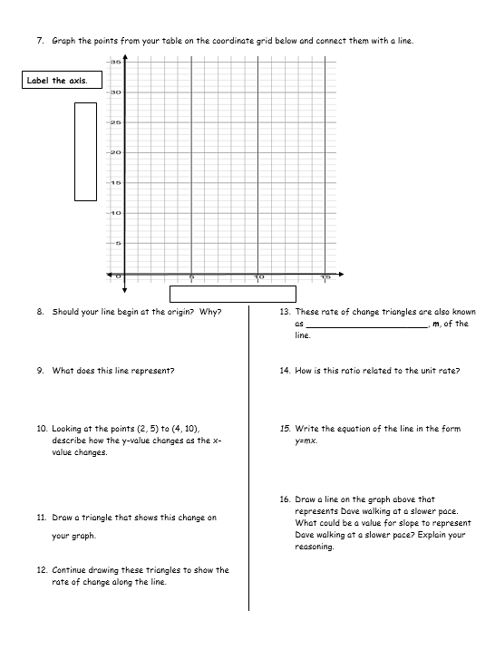
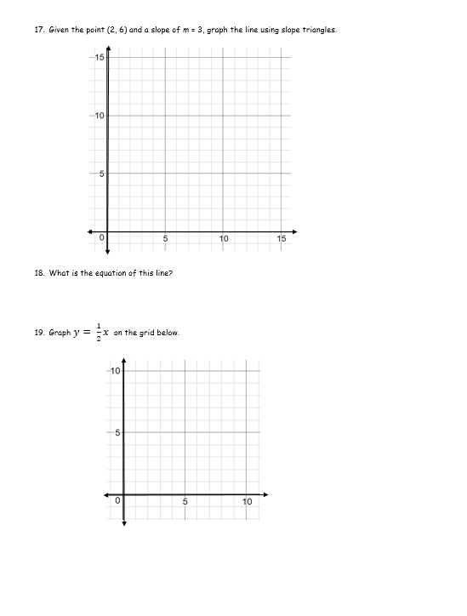

Slide 37
NCTM Principles to Actions
Ensuring Mathematical Success for All
TURN & TALK
Which practices were evident in the tasks?
High Leverage Mathematics Teaching Practices
1. Establish mathematics goals to focus learning.
2. Implement tasks that promote reasoning and problem solving.
3. Use and connect mathematical representations.
4. Facilitate meaningful mathematical discourse.
5. Pose purposeful questions.
6. Build procedural fluency from conceptual understanding.
7. Support productive struggle in learning mathematics.
8. Elicit and use evidence of student thinking.
Adapted from Leinwand, S. et al. (2014) Principles to Actions – Ensuring Mathematical Success for All, National Council of Teachers of Mathematics.
Notes:
.

Slide 39
2F. Linear Functions
Grade 8

Slide 40
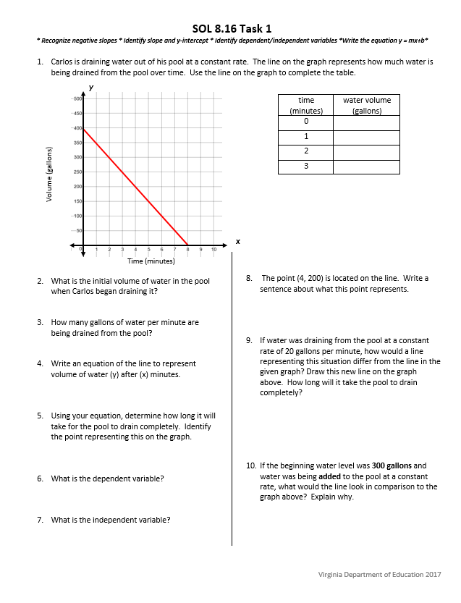
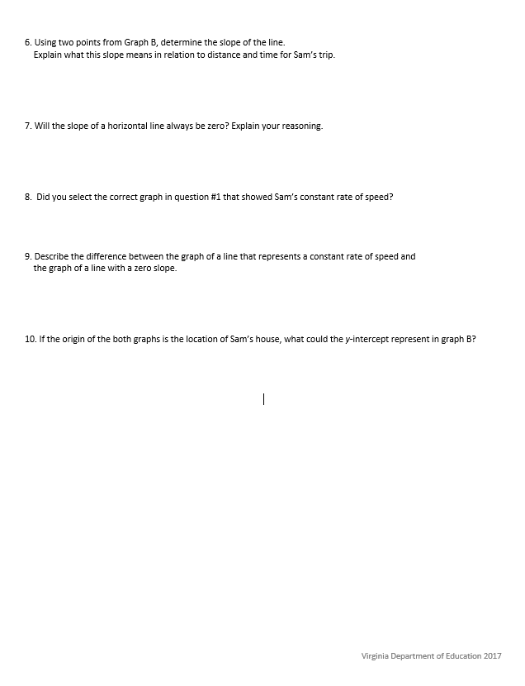
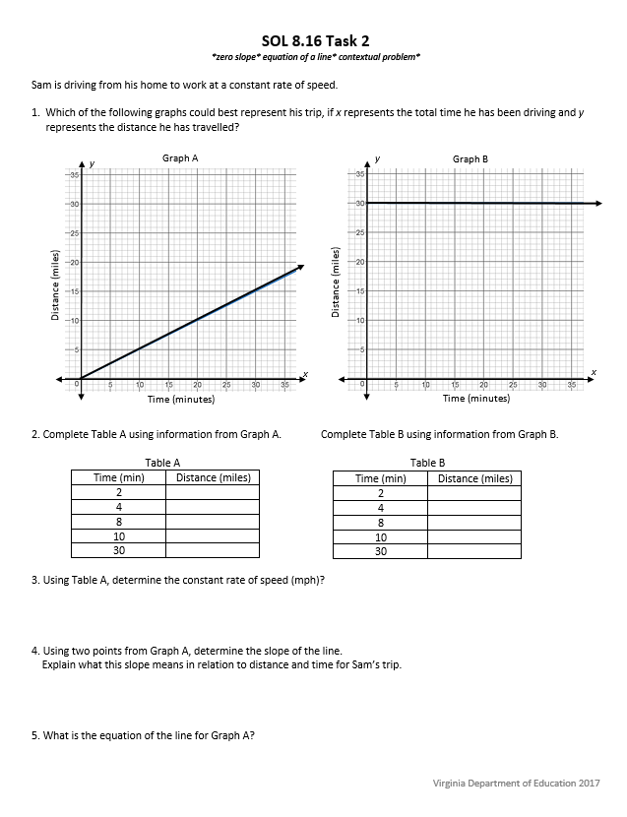

Slide 41
NCTM Principles to Actions
Ensuring Mathematical Success for All
TURN & TALK
Which practices were evident in the tasks?
High Leverage Mathematics Teaching Practices
1. Establish mathematics goals to focus learning.
2. Implement tasks that promote reasoning and problem solving.
3. Use and connect mathematical representations.
4. Facilitate meaningful mathematical discourse.
5. Pose purposeful questions.
6. Build procedural fluency from conceptual understanding.
7. Support productive struggle in learning mathematics.
8. Elicit and use evidence of student thinking.
Adapted from Leinwand, S. et al. (2014) Principles to Actions – Ensuring Mathematical Success for All, National Council of Teachers of Mathematics.

Slide 43
3. Support for Implementation

Slide 44
Implementation Support Resources
2016 Mathematics Standards of Learning
2016 Mathematics Standards Curriculum Frameworks
2009 to 2016 Crosswalk (summary of revisions) documents
2016 Mathematics SOL Video Playlist (Overview, Vertical Progression & Support, Implementation and Resources)
Progressions for Selected Content Strands
Narrated 2016 SOL Summary PowerPoints
SOL Mathematics Institutes Professional Development Resources

Slide 45
Implementation Timeline
2016-2017 School Year – Curriculum Development VDOE staff provides a summary of the revisions to assist school divisions in incorporating the new standards into local written curricula for inclusion in the taught curricula during the 2017-2018 school year.
2017-2018 School Year – Crossover Year 2009 Mathematics Standards of Learning and 2016 Mathematics Standards of Learning are included in the written and taught curricula. Spring 2018 Standards of Learning assessments measure the 2009 Mathematics Standards of Learning and include field test items measuring the 2016 Mathematics Standards of Learning.
2018-2019 School Year – Full-Implementation Year Written and taught curricula reflect the 2016 Mathematics Standards of Learning. Standards of Learning assessments measure the 2016 Mathematics Standards of Learning.

Slide 47

Closure and Participant Reflection
Exit Ticket – What Stuck?
On a Post-It Note –
This is what stuck with me today……..

Slide 48
Please contact us!
The VDOE Mathematics Team at
Mathematics@doe.virginia.gov

