Slide 1
VDOE Spring 2017 Mathematics Institute Grades 3-5 Session

Slide 2
Welcome and Introductions

Slide 3
Agenda
Revisions to standards and purpose
Emphasis on Specific Content
Number and Number Sense - Fractions
Computation and Estimation - Problem Types
Computation and Estimation – Computational Fluency
Support for Implementation

Slide 4
I. Revisions to Standards and Purpose
Notes:
30 minutes

Slide 5
Mathematics Process Goals for Students
“The content of the mathematics standards is intended to support the five process goals for students” - 2009 and 2016 Mathematics Standards of Learning
Mathematical Understanding
Problem Solving
Connections
Communication
Representations
Reasoning
Notes:
Emphasize that the process goals work together to mathematical understanding
Note that this is not new in the standards; it continues from previous years and is still important to highlight.

Slide 6
NCTM Principles to Actions Ensuring Mathematical Success for All
High Leverage Mathematics Teaching Practices
1. Establish mathematics goals to focus learning.
2. Implement tasks that promote reasoning and problem solving.
3. Use and connect mathematical representations.
4. Facilitate meaningful mathematical discourse.
5. Pose purposeful questions.
6. Build procedural fluency from conceptual understanding.
7. Support productive struggle in learning mathematics.
8. Elicit and use evidence of student thinking.
Adapted from Leinwand, S. et al. (2014) Principles to Actions – Ensuring Mathematical Success for All, National Council of Teachers of Mathematics.
Notes:
A resource for supporting these instructional practices is the book Principles to Actions from NCTM.
We’ll be spending more time throughout the presentation making connections to this work.

Slide 7
Format Changes to the Curriculum Framework
Reduction of columns from 3 to 2
consistency with other disciplines
consistency within mathematics levels
Indicators of SOL sub-bullet added to each bullet within the Essential Knowledge and Skills
Indicator of objectives measured without a calculator on state assessments
Reduction in number of standards – many levels
Notes:
You’ll notice in many grade levels that there appears to be a reduction of standards. The reduction in the number of standards does not mean there is less content to teach. It is a result of standards being combined. For example, in 5th grade classifying triangles and measuring angles are taught together because these skills are used together.

Slide 8
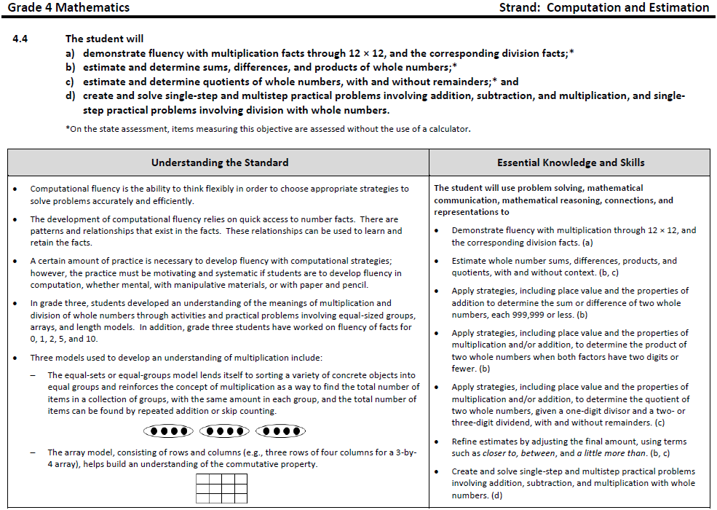
Notes:
This is one of the standards that has changed in grade 4. Now there are two columns. On the left are teacher notes on better understanding the content. On the right is more information about each essential standards, knowledge and skills. New this year is that each bullet is tied directly to the standards, knowledge and skills listed. If there is an asterisk, like here at A, B and C, that means that a calculator will not be allowed when this is tested on the SOL assessment. Because D does not have an asterisk, it would be tested in the calculator section of the SOL test.

Slide 9
Overview of Crosswalk Documents
By grade level/course
Includes:
Additions
Deletions
Parameter changes/
clarifications (2016 SOL)
Moves within the grade level
(2009 SOL to 2016 SOL)
Additions (2016) | Deletions (2009)
Parameter Changes (2016) | Moves (2009 to 2016)

Slide 10
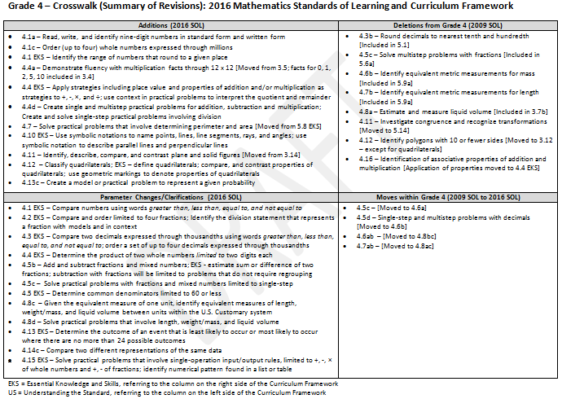
Grade Level Crosswalk
(Summary of Revisions)
Notes:
Review the overview of the crosswalk documents. This is just an overview of the changes and does not necessarily highlight every single change.
Here’s an example of what they look like. What questions might you have about the organization of the crosswalk document?

Slide 11
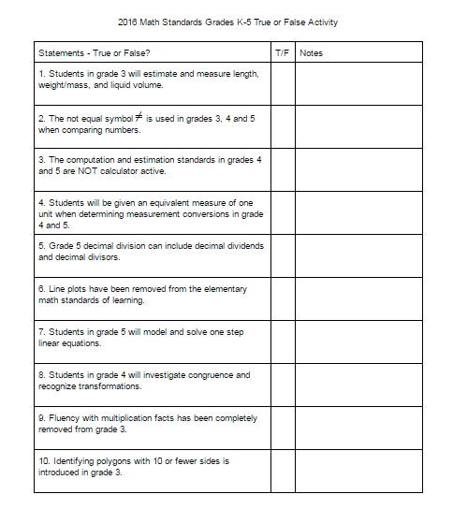
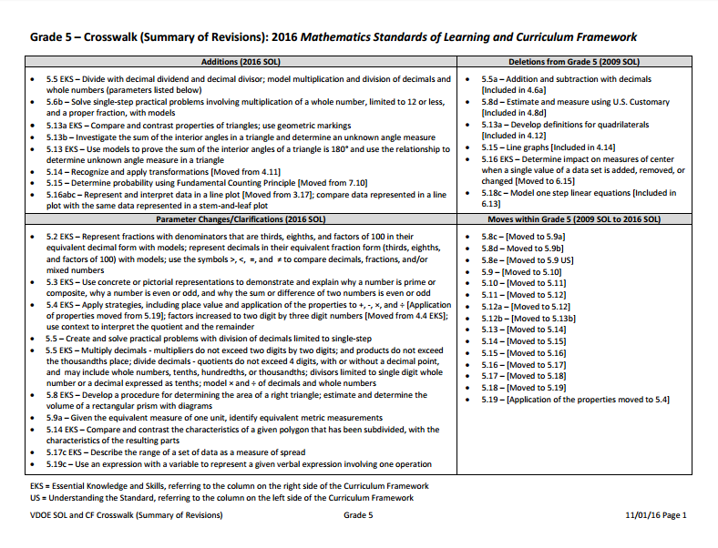
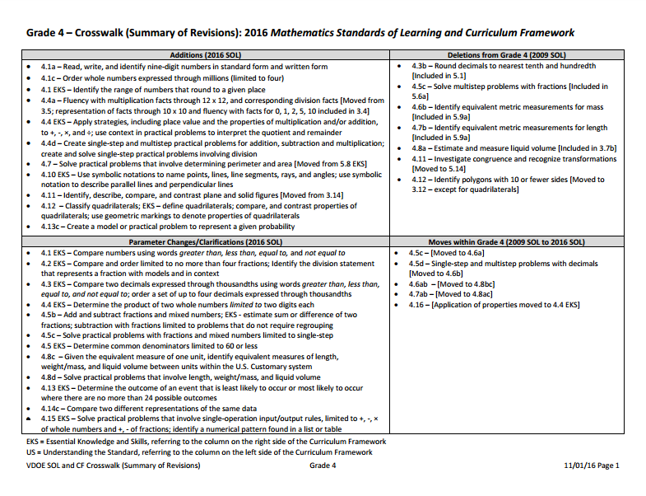
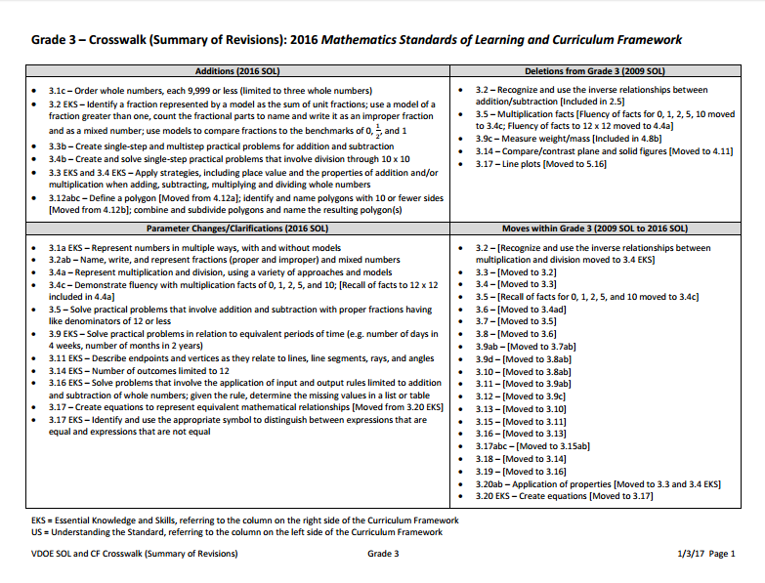
Scavenger Hunt
Notes:
9:36-9:45
To gain a better understanding of the changes to the standards, you will have an opportunity to read through the crosswalks and complete a scavenger hunt. The scavenger hunt is not grade level specific, so you’ll have to look through all three grade levels to determine if the statements are true or false. There is also a notes section to add your own notes about why statements are true or false.

Slide 12
Students in grade 3 will estimate and measure length, weight/mass, and liquid volume.
False
Notes:
Students in grade 3 will estimate and measure length and not the others.

Slide 13
The not equal symbol is used in grades 3, 4 and 5 when comparing numbers.
The not equal symbol is used in grades 3, 4 and 5 when comparing numbers.
True

Slide 14
The computation and estimation standards in grades 4 and 5 are NOT calculator active.
False
Notes:
Can use a calculator
4.4.d- create and solve single-step and multistep practical problems involving addition, subtraction, and multiplication, and single-step practical problems involving division with whole numbers
4.5 a determine common multiples and factors, including lcm and gcf
4.5.c solve single-step practical problems involving addition and subtraction with fractions and mixed numbers.
5.4 create and solve single-step and multistep practical problems involving addition, subtraction, multiplication, and division with whole numbers
5.5 create and solve single-step and multistep practical problems involving addition, subtraction, and multiplication of decimals, and create and solve single-step practical problems involving division of decimals
5.6.a solve single-step and multistep practical problems involving addition and subtraction with fractions and mixed numbers

Slide 15
Students will be given an equivalent measure of one unit when determining measurement conversions in grade 4 and 5.
True

Slide 16
Grade 5 decimal division can include decimal dividends and decimal divisors.
True

Slide 17
Line plots have been removed from the elementary math standards of learning.
False
Notes:
It has been moved to grade 5.16

Slide 18
Students in grade 5 will model and solve one step linear equations.
False
Notes:
Grade 6.13

Slide 19
Students in grade 4 will investigate congruence and recognize transformations.
False
Notes:
Grade 5.14

Slide 20
Fluency with multiplication facts has been completely removed from grade 3.
False
Notes:
Grade 3 0,1,2, 5,10
Grade 4 12 x12

Slide 21
Identifying polygons with 10 or fewer sides is introduced in grade 3.
True

Slide 22
Emphasis on Specific Content
Number and Number Sense of Fractions
Computation and Estimation – Problem Types
Computation and Estimation – Computational Fluency
Notes:
You may have noticed themes in the changes. Our content emphasis for today highlights these bigger changes which is in the areas of number and number sense, computation and estimate.

Slide 23
II. Emphasis on Specific Content

Slide 24
IIa. Number and Number Sense - Fractions
Notes:
120 minutes

Slide 25
Vertical Progression Number and Number Sense
3.2
4.2
5.2
Highlight
Models
Benchmarks
Compare and Order
Notes:
10 minutes
Vertical alignment highlighting for 3.2, 4.2, 5.2 (Models, benchmarks, compare/order)
A strategy you might use for vertical articulation is highlighting key ideas on a vertical progression. You have have an opportunity to experience.
Using your Vertical Progression for Number and Number Sense, highlight the models listed in yellow, highlight the benchmarks blue and highlight comparing and ordering in yellow. As you finish consider these guiding questions on the slide.

Slide 26
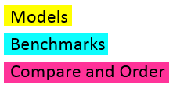
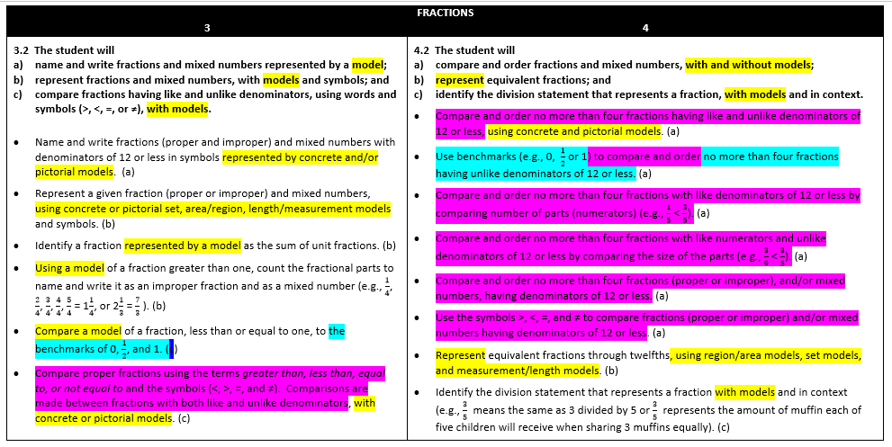
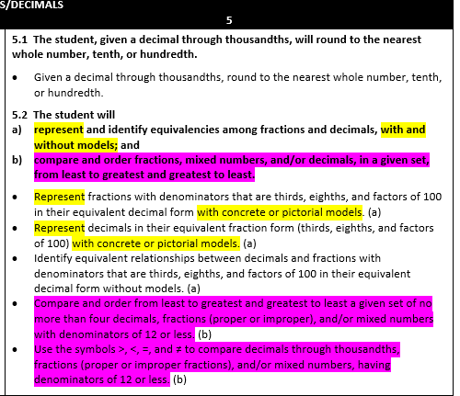
Vertical Progression Number and Number Sense
What do students need to know?
How do these standards connect?
How does the progression of these standards build number sense?
Notes:
Participants share their noticings from the three guiding questions

Slide 27
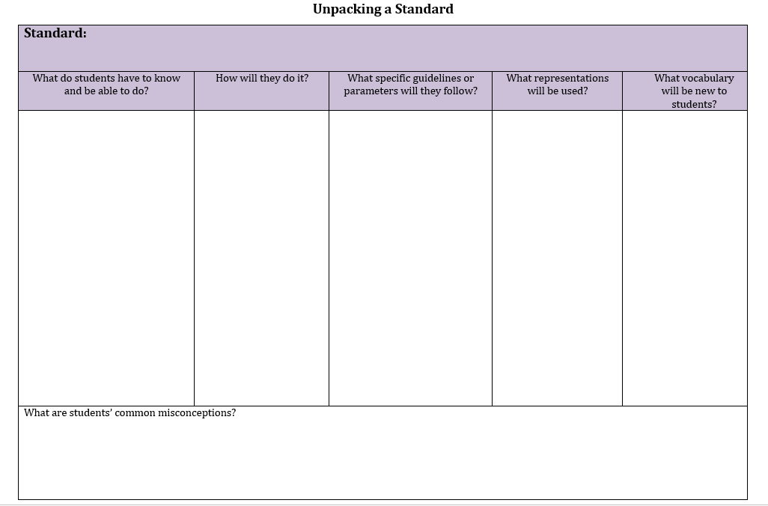
Unpacking Standard 3.2
Notes:
5 minutes
Unpacking standards now is very important with new standards. We recognize that this is being done in many of your districts and unpacking documents may already exist. We also recognize that “unpacking” may have a negative connotation. However, with new standards, this work is imperative.
Participants have an opportunity to use the unpacking document to unpack standard 3.2.

Slide 28
Think about…
What understandings do students demonstrate?
What types of experiences lead to this type of discussion?
Notes:
Invite participants to turn and talk about “What understandings did the students demonstrate?” and “What types of experiences do the students need to have to access this type of discussion?”

Slide 29
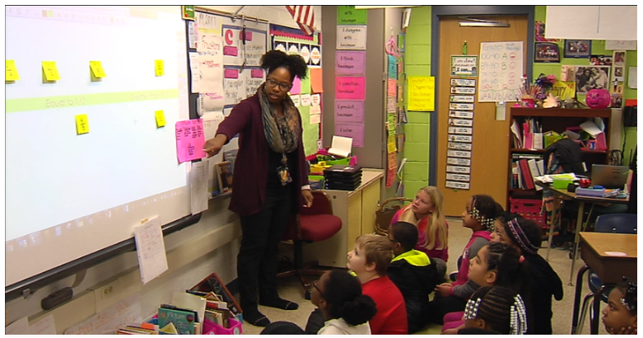
Benchmarking Video
Notes:
10 minutes
http://tvhcps.wpengine.com/2017/01/19/todays-classroom-johnson-elementary-school-2/
Guiding questions: What understandings do students demonstrate? What types of experiences lead to this type of discussion?
Thinking about the standard you just unpacked, this video highlights a way this might be taught. It takes place in a Virginia school that is Title 1. Let’s watch as the teacher introduces benchmarking to ½ to the class.
Stop video at 4:20

Slide 30
Turn and Talk
What understandings do students demonstrate?
What types of experiences lead to this type of discussion?
Notes:
Invite participants to turn and talk about “What understandings did the students demonstrate?” and “What types of experiences do the students need to have to access this type of discussion?”

Slide 31
NCTM Principles to Actions Ensuring Mathematical Success for All
High Leverage Mathematics Teaching Practices
1. Establish mathematics goals to focus learning.
2. Implement tasks that promote reasoning and problem solving.
3. Use and connect mathematical representations.
4. Facilitate meaningful mathematical discourse.
5. Pose purposeful questions.
6. Build procedural fluency from conceptual understanding.
7. Support productive struggle in learning mathematics.
8. Elicit and use evidence of student thinking.
Adapted from Leinwand, S. et al. (2014) Principles to Actions – Ensuring Mathematical Success for All, National Council of Teachers of Mathematics.
Notes:
Handout #2 –

Slide 32
NCTM Principles to Actions Ensuring Mathematical Success for All
High Leverage Mathematics Teaching Practices
1. Establish mathematics goals to focus learning.
2. Implement tasks that promote reasoning and problem solving.
3. Use and connect mathematical representations.
4. Facilitate meaningful mathematical discourse.
5. Pose purposeful questions.
6. Build procedural fluency from conceptual understanding.
7. Support productive struggle in learning mathematics.
8. Elicit and use evidence of student thinking.
Adapted from Leinwand, S. et al. (2014) Principles to Actions – Ensuring Mathematical Success for All, National Council of Teachers of Mathematics.
Notes:
Handout #2 –
We always want to be mindful of these high leverage teaching practices. You might have noticed some of these in the video.
As we continue to explore fractions, pay special attention to how we incorporate these three practices

Slide 33
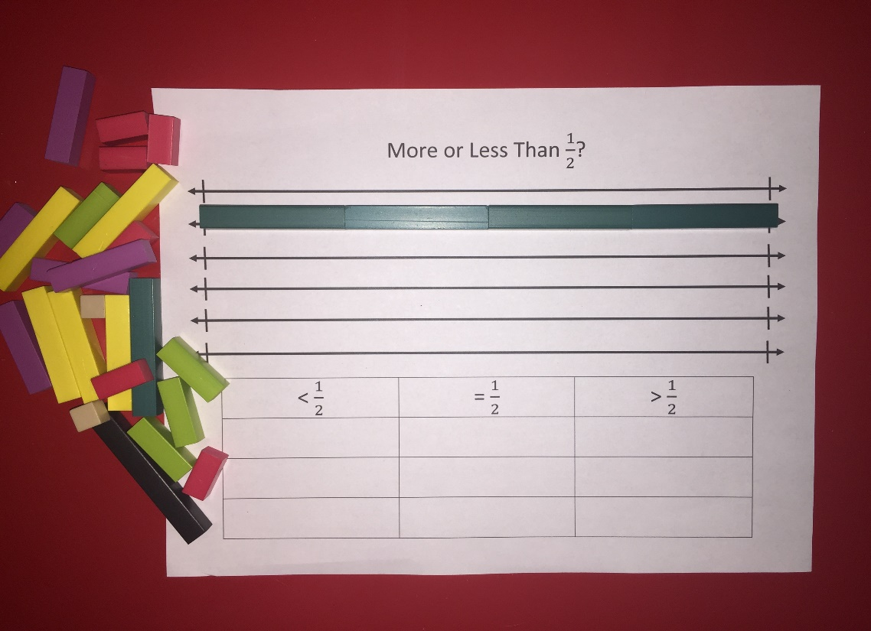
More or Less than Half
Find $\frac{1}{2}$ on the top number line using Cuisenaire Rods®.
Thirds
Fourths
Sixths
Eighths
Notes:
45 minutes for more tor less
Looking at your paper, find the top number line. Using your cuisinairre rods. Find ½. How do you know it’s one half? How can you prove it? Teacher share different ways they made ½. What are some reasons students might struggle with this activity?
Continue finding other fractions on your directions sheet.
With the group, discuss what’s less than a half, equal to or greater than one half. What do you notice about the fractions that are less than one half? What do you notice about the fractions that are greater than one half? What do you notice about the fractions that are equal to one half? How might this activity benefit students?

Slide 34
More or Less than Half
Why complete this activity with Cuisenaire Rods© instead of labeled fraction bars?
What are some reasons students might struggle with this activity?
Notes:
Turn and Talk then Whole Group Share: Why complete this activity with Cuisenaire Rods instead of labeled fraction bars?

Slide 35
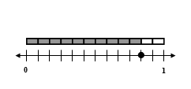
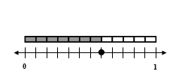
Close to 0, $\frac{1}{2}$, 1?
Sort fraction representations into three categories.
Label each card with a sticky note of the fraction it represents.
Sort each sticky note on the organizer
Notes:
30 minutes
Using the fraction cards on your table, describe what you see.
With a partner, sort the cards by what is closer to 0, which is closer to ½ and which is closer to 1?
Label each card with a sticky note of the fraction it represents.
With your table group, organize your fractions from your stickies that are close to 1, close to ½ and close to 1. Consider these questions: What do you notice about the fractions close to zero? Close to ½? Close to 1?
Check for understanding by asking where would 11/12 go? How do you know? Where would 2/8 go? How do you know?

Slide 36
Close to 0, $\frac{1}{2}$, 1?
How do these representations scaffold from the concrete models in the last activity?
Notes:
Invite participants to share how these representations scaffold the concrete models.

Slide 37
Fractions on a Number Line
0
Where would you place $\frac{1}{2}$ on the number line?
Notes:
Fractions on a Number Line-15 minutes
Looking at the number line, where would you place ½? Be sure to highlight the importance of an endpoint and how the beginning and endpoints impact the placement of the fraction.
Do set 2 and 3 only
First set:
1/6, 3/6, 4/6, 6/6.
Second set:
1/12, 1/8, ½, 1/6 – and then added in 0.25 to demonstrate that decimals are there too
Third set:
4/6, 4/10, 2/12, 3/5 - and then added in 9/6 a. Changed the endpoint from 1 to 3 and dialogue about how to adjust where all the numbers are to make it work.
Fourth set:
6/10, 7/12, 2/3, 4/7 and 3/7 – focus on benchmarking to the half
Fifth set:
¾, 7/8, 9/10, 11/12 – and then add 0.99 with this one too.

Slide 38
Fractions on a Number Line
0
$$\frac{4}{10}$$
1
What strategies did you use to find out where to stand?

Slide 39
Prompts to move students deeper in thinking:
How did you decide which benchmark the fractions are closest to?
What are you noticing about the relationship between the numerator and the denominator in each case?
How can we use benchmarks to help us order fractions?
Which fraction is larger? (Present students with two options.) How do you know?
What do you notice about the relationship between the numerator and the denominator when the fraction is close to 0?
What do you notice about the relationship between the numerator and the denominator when the fraction is close to $\frac{1}{2}$ ?
What do you notice about the relationship between the numerator and the denominator when the fraction is close to 1 whole?

Slide 40
NCTM Principles to Actions Ensuring Mathematical Success for All
High Leverage Mathematics Teaching Practices
1. Establish mathematics goals to focus learning.
2. Implement tasks that promote reasoning and problem solving.
3. Use and connect mathematical representations.
4. Facilitate meaningful mathematical discourse.
5. Pose purposeful questions.
6. Build procedural fluency from conceptual understanding.
7. Support productive struggle in learning mathematics.
8. Elicit and use evidence of student thinking.
Adapted from Leinwand, S. et al. (2014) Principles to Actions – Ensuring Mathematical Success for All, National Council of Teachers of Mathematics.
Notes:
5 minutes
Revisit the Principles to Actions. How were the high leverage mathematics teaching practices that we highlighted before the activities (3, 4, 5) made explicit throughout the activities?
Take a moment with a partner at your table and write down three questions that you plan to ask when you implement these activities with students.

Slide 41
IIb. Computation and Estimation –
Problem Types
Notes:
55 minutes

Slide 42
Write one story problem on each sticky note.
Addition
Subtraction
Notes:
Create problems 5 minute
Vertical Alignment
Create an addition word problem and a subtraction word problem. Record on separate sticky notes.
Give one minute for participants to write two word problems, one on each sticky note.
Once finished, participants should set the sticky notes to the side and we will come back to them.

Slide 43
NCTM Principles to Actions Ensuring Mathematical Success for All
High Leverage Mathematics Teaching Practices
1. Establish mathematics goals to focus learning.
2. Implement tasks that promote reasoning and problem solving.
3. Use and connect mathematical representations.
4. Facilitate meaningful mathematical discourse.
5. Pose purposeful questions.
6. Build procedural fluency from conceptual understanding.
7. Support productive struggle in learning mathematics.
8. Elicit and use evidence of student thinking.
Adapted from Leinwand, S. et al. (2014) Principles to Actions – Ensuring Mathematical Success for All, National Council of Teachers of Mathematics.

Slide 44
NCTM Principles to Actions Ensuring Mathematical Success for All
High Leverage Mathematics Teaching Practices
1. Establish mathematics goals to focus learning.
2. Implement tasks that promote reasoning and problem solving.
3. Use and connect mathematical representations.
4. Facilitate meaningful mathematical discourse.
5. Pose purposeful questions.
6. Build procedural fluency from conceptual understanding.
7. Support productive struggle in learning mathematics.
8. Elicit and use evidence of student thinking.
Adapted from Leinwand, S. et al. (2014) Principles to Actions – Ensuring Mathematical Success for All, National Council of Teachers of Mathematics.
Notes:
Handout #2 –

Slide 45
Vertical Progression - Computation and Estimation
3.3/3.4
4.4
5.4
What do students need to know?
How do these standards connect?
How does the progression of these standards support problem solving?
Notes:
Vertical alignment 3.3, 3.4, 4.4, 5.4
Revisiting the Principles to Action, we invite you to connect with these 3 throughout the afternoon.
While we’re not taking time to unpack these standards, these might be guiding questions you use during unpacking with your teachers. Within the vertical progression for computation and estimation, look for these key ideas and share with a partner.
What do students need to know?
How do these standards connect?
How does the progression of these standards support problem solving?
As you debrief these questions, highlight the importance of where fluency and the use of a calculator are noted in the progression if it does not come up in the discussion.

Slide 46
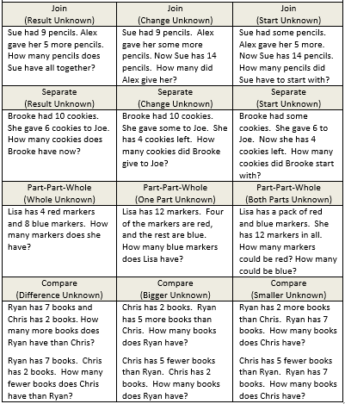
Modeling Activity Addition and Subtraction
Model each of these problem types.
Notes:
Explore Problem Types-20 minutes
Now that we have a clearer understanding of what students are expected to learn in these grade levels, let’s spend some time looking more closely at the different problem types.
Act out the different problem types and discuss the difference in what each of these look like.
Discuss which problem students might struggle with more.

Slide 47
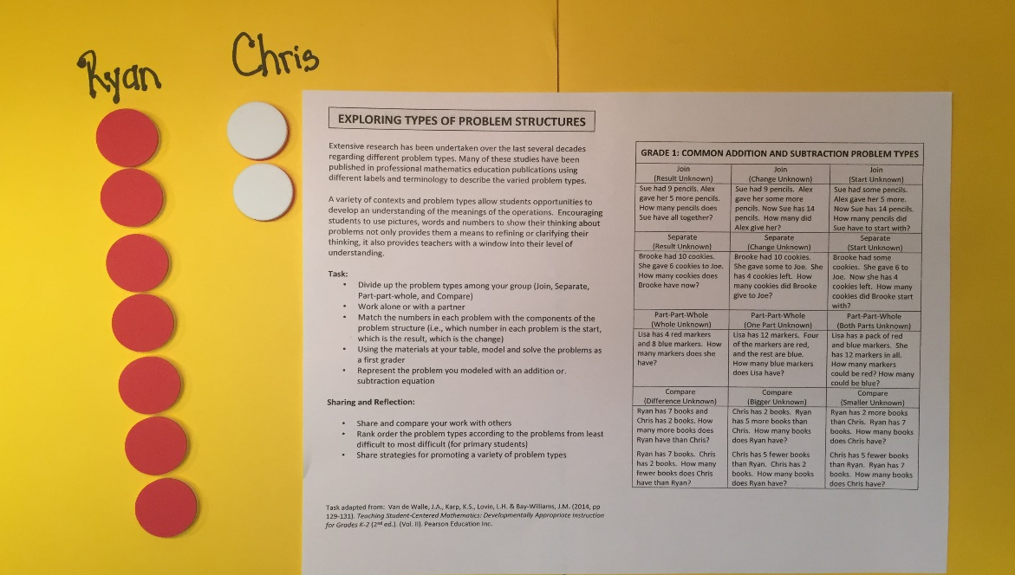
Modeling Activity Addition and Subtraction
How can these problem structures be adapted to your grade level?
What models would best be used to represent problems appropriate for your grade level?

Slide 48
Hang your sticky notes on the appropriate problem type posters.
Addition
Subtraction
Notes:
Revisit the addition/subtraction sticky notes previously written by participants.
Have them turn and talk to a partner about what type of story structure their problem represents and then have participants sort their problems onto the appropriate charts on the wall.
After all the sticky notes are placed ask-What do you notice? More than likely, most of the problems will fall into column one. Talk about how when we are asked to come up with problems we tend to create problems that are in column one. Teachers need to be strategic in providing students with the other story structures.

Slide 49
Sorting Activity Multiplication and Division
Use the chart and determine which problems fit with each description.
Notes:
About 10 minutes
Match the multiplication/division problem types to the chart (essentially creating the table of problem types)
Provide participants the blank multiplication and division problem type chart and cards with problems. Invite participants to match the problems with the descriptions on the chart.
Review the matches and clarify any questions or misconceptions.

Slide 50
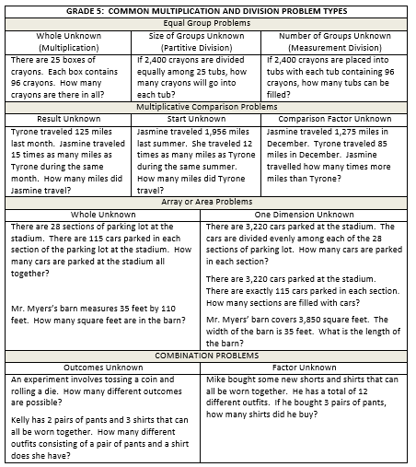
Sorting Activity Multiplication and Division
How does the work that you do with addition and subtraction problem types support learning in multiplication and division?
What models would best be used to represent problems appropriate for your grade level?
Notes:
Invite participants to reflect on on the connection between addition and subtraction and/or connections to models.
Ask-What squares with your thinking and what is still circling around in your head regarding story problem structures?

Slide 51
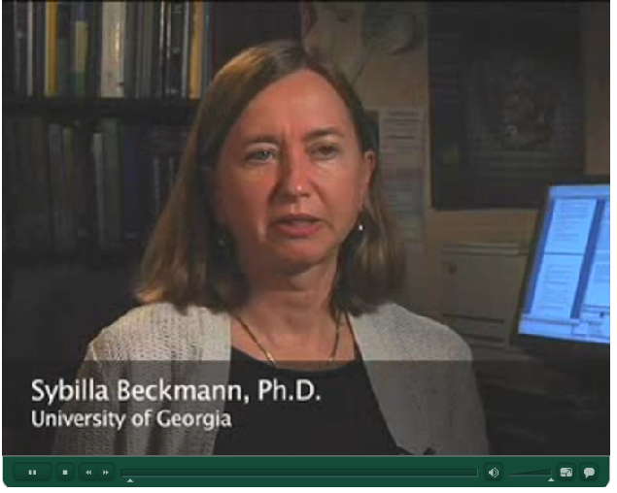
Video - Assisting Students Struggling with Mathematics: Response to Intervention (RtI) Recommendation #4
Gersten, R, et. Al. (2009) Assisting students struggling with mathematics: Response to intervention (RtI) for elementary and middle schools (NCEE 2009-4060). Washington, DC: USDOE.
Notes:
Next two slides about 10 minutes
Now we are going to watch a video that speaks to the importance of having students explore all the types of story structures.
Instruction should include solving word problems based on common underlying structures
Video - Assisting Students Struggling with Mathematics: Response to Intervention (RtI) Recommendation #4
To access video click See more under Recommendation #4.

Slide 52
In problem solving, emphasis should be placed on thinking and reasoning rather than on key words. Focusing on key words such as in all, altogether, difference, etc., encourages students to perform a particular operation rather than make sense of the context of the problem. A key-word focus prepares students to solve a limited set of problems and often leads to incorrect solutions as well as challenges in upcoming grades and courses.
VDOE 2016 Standards of Learning Curriculum Framework
Notes:
Show slide with the VDOE quote and ask participants to turn to a shoulder partner and reflect on the quote.
Revisit the addition and subtraction problems that were written on the sticky notes and placed on the charts on the wall. Ask - if a teacher were to focus solely on a keyword approach, what word might they include in a problem where they would like the students to add?
Point out examples of problems written on the sticky notes that use the words “altogether” or “in all”.
Ask - what word might teachers include in a problem where they would like the students to subtract if they are focusing on a keyword approach? Point out examples of problems written on sticky notes that use the word “left.”
Discuss where these problems fall in the problem types chart.

Slide 53
NCTM Principles to Actions Ensuring Mathematical Success for All
High Leverage Mathematics Teaching Practices
1. Establish mathematics goals to focus learning.
2. Implement tasks that promote reasoning and problem solving.
3. Use and connect mathematical representations.
4. Facilitate meaningful mathematical discourse.
5. Pose purposeful questions.
6. Build procedural fluency from conceptual understanding.
7. Support productive struggle in learning mathematics.
8. Elicit and use evidence of student thinking.
Adapted from Leinwand, S. et al. (2014) Principles to Actions – Ensuring Mathematical Success for All, National Council of Teachers of Mathematics.
Notes:
Revisiting these high leverage teaching practices, what connections did you make to 2, 7, and 8 through our work this afternoon?

Slide 54
IIc. Computation and Estimation – Computational Fluency
Notes:
30 minutes

Slide 55
Key Components of a Number Talk
Community
Discourse
Teacher’s Role
Mental Math
Purposeful Computation
Adapted from Parrish, S. (2010) Number Talks: Whole Number Computation, Grades K–5: A Multimedia Professional Learning Resource, Math Solutions.
Notes:
NEED to cite resource

Slide 56
Number Talk
12 x 15
Notes:
Number Talks are a quick way to promote computational fluency as well as reinforce basic fact strategies, place value, and properties.
How many people have heard of number talks?
Find someone who doesn’t know and explain it to them.
We are going to do a number talk together.
Model a number talk with 12x15.

Slide 57
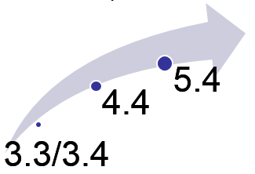
Connecting Back
Where do you see examples of the properties?
Where do you see extensions of basic fact strategies?
How does this support the Vertical Progression for Computation and Estimation?
Notes:
Now let’s talk about what took place. Where did you see the distributive property? Where did you see extensions of basic fact strategies? Place value? How does it support the vertical progression of computational fluency? How does the notation that the teacher uses allow properties or specific strategies to become explicit for students. Discuss the similarities and differences between the strategies shared.
How is thinking about the problem as (10 x 12) + (5 x 12) similar to (10 x 15) + (2 x 15)?
How is thinking about the problem as 3 x 4 x 15 different from (10 x 15) + (2 x 15)
Revisit the discussion of properties from general session. How do Number Talks support the use of properties?

Slide 58
III. Support for Implementation
Notes:
5 to 7 minutes

Slide 59
Implementation Support Resources
Currently Available
2016 Mathematics Standards of Learning
2016 Mathematics Standards Curriculum Frameworks
2009 to 2016 Crosswalk (summary of revisions) documents
2016 Mathematics SOL Video Playlist (Overview, Vertical Progression & Support, Implementation and Resources)
Coming Soon (April 2017)
Progressions for Selected Content Strands
Narrated 2016 SOL Summary PowerPoints
SOL Mathematics Institutes Professional Development Resources

Slide 60
NARRATED GRADE LEVEL-SPECIFIC POWERPOINTS –
Expected to be available early April
2016 Mathematics Standards of Learning
Grade 4
Overview of Revisions - 2009 to 2016
Referenced documents available at VDOE Mathematics 2016
Notes:
Welcome to the Grade 4 overview of revisions to the Mathematics Standards of Learning from 2009 to 2016.
It would be helpful to have a copy of the Grade 4 – Crosswalk (Summary of Revisions) and a copy of the 2016 Grade 4 Curriculum Framework to reference during this presentation.

Slide 61
Purpose
Overview of the 2016 Mathematics Standards of Learning and the Curriculum Framework
Highlight information included in the Essential Knowledge and Skills and the Understanding the Standard sections of the Curriculum Framework
Notes:
The purpose of this presentation is to provide an overview of the revisions and to highlight information included in the Essential Knowledge and Skills and Understanding the Standards sections of the curriculum framework. This presentation serves as a brief overview and is not a comprehensive list of all revisions. The curriculum framework should be referenced for additional information regarding the 2016 standards.

Slide 62
2009 SOL | 2016 SOL
4.4 The student will a) estimate sums, differences, products, and quotients of whole numbers;* b) add, subtract, and multiply whole numbers;* c) divide whole numbers, finding quotients with and without remainders;* and d) solve single-step and multistep addition, subtraction, and multiplication problems with whole numbers.* | 4.4 The student will a) demonstrate fluency with multiplication facts through 12 x 12, and the corresponding division facts;* [Moved from 3.5] b) estimate and determine sums, differences, and products of whole numbers;* c) estimate and determine quotients of whole numbers, with and without remainders;* and create and solve single-step and multistep practical problems involving addition, subtraction, and multiplication, and single-step practical problems involving division with whole numbers.
New
Revisions:
4.4a – Fluency with multiplication facts through 12 x 12, and corresponding division facts [Moved from 3.5; representation of facts through 10 x 10 and fluency with facts for 0, 1, 2, 5, 10 included in 3.4]
4.4b EKS – Determine the product of two whole numbers limited to two digits each
4.4b EKS – Apply strategies, including place value and the properties of multiplication and/or addition, to add, subtract, multiply and divide
4.4d – Create single-step and multistep practical problems for addition, subtraction, and multiplications; create and solve single-step practical problems involving division
4.4d EKS – Use context in practical problems to interpret the quotient and remainder
*On the state assessment, items measuring this objective are assessed without the use of a calculator.
Notes:
The contents of SOL 4.4a – demonstrate fluency with multiplication facts through 12 x 12, and the corresponding division facts is new to grade 4. Demonstrating fluency of facts in grade 3 is now limited to facts for 0, 1, 2, 5 and 10. It is important to note that students will continue to represent and use multiplication facts through 10 x 10 to create and solve practical problems that involve multiplication and division. It is recommended that fourth grade teachers collaborate with their third grade colleagues around instructional strategies focused on developing fluency.
Parameter changes were made to the EKS bullets for 4.4b -- when determining the products of two whole numbers both factors will be limited to two digits or fewer. In addition, students will apply strategies including the use of place value and the properties of multiplication and/or addition, to add, subtract, multiply and divide. This is a shift from the 2009 standards in that the focus is not to identify a specific property being used, but correctly apply the properties. It is, however, appropriate for teachers and students to use the names of the properties when being applied, but this should not be a focus of assessment. Teachers may reference the Understanding the Standard section of the Framework for additional information.
Additions to SOL 4.4d include creating single-step and multistep practical problems for addition, subtraction and multiplication AND creating and solving single-step practical problems involving division. In the EKS for 4.4d , students are expected to utilize the context as a tool for interpreting the quotient and remainder in division problems.
Please refer to the Understanding the Standard section of the Framework for additional teacher resources: 1) a chart that provides examples of the variety of problem types related to multiplication and division that grade 4 students should have experiences solving; and 2) a chart that provides examples of types of practical problems in which students must interpret the quotient and remainder based upon the context provided.

Slide 63
Implementation Timeline
2016-2017 School Year – Curriculum Development VDOE staff provides a summary of the revisions to assist school divisions in incorporating the new standards into local written curricula for inclusion in the taught curricula during the 2017-2018 school year.
2017-2018 School Year – Crossover Year 2009 Mathematics Standards of Learning and 2016 Mathematics Standards of Learning are included in the written and taught curricula. Spring 2018 Standards of Learning assessments measure the 2009 Mathematics Standards of Learning and include field test items measuring the 2016 Mathematics Standards of Learning.
2018-2019 School Year – Full-Implementation Year Written and taught curricula reflect the 2016 Mathematics Standards of Learning. Standards of Learning assessments measure the 2016 Mathematics Standards of Learning.

Slide 64
Questions?
Please contact the
VDOE Mathematics Team
Mathematics@doe.virginia.gov

Slide 65
3 – 2 – 1 Reflection
3 new things I learned today
2 things I want to try
1 question I still have
Notes:
3-2-1 Reflection
3 new things I learned today
2 things I want to try
1 question I still have

