Slide 1
2017 Mathematics Institute
K-2 Session

Slide 2
Agenda
Revisions to Standards and Purpose
Emphasis on Specific Content
    Decomposing and Composing Numbers
    Computation: Problem Types
    Fractions
Support for Implementation

Slide 3
1. Revisions to Standards and Purpose

Slide 4
Mathematics Process Goals for Students
“The content of the mathematics standards is intended to support the five process goals for students”
- 2009 and 2016 Mathematics Standards of Learning
Communication
Connections
Representations
Problem Solving
Mathematical Understanding
Reasoning

Slide 5
NCTM Principles to Actions
Ensuring Mathematical Success for All
High Leverage Mathematics Teaching Practices
1. Establish mathematics goals to focus learning.
2. Implement tasks that promote reasoning and problem solving.
3. Use and connect mathematical representations.
4. Facilitate meaningful mathematical discourse.
5. Pose purposeful questions.
6. Build procedural fluency from conceptual understanding.
7. Support productive struggle in learning mathematics.
8. Elicit and use evidence of student thinking.
Adapted from Leinwand, S. et al. (2014) Principles to Actions – Ensuring Mathematical Success for All, National Council of Teachers of Mathematics. https://www.nctm.org/uploadedFiles/Standards_and_Positions/PtAExecutiveSummary.pdf

Slide 6
Format Changes to the Grade Band Curriculum Framework
Reduction of columns from 3 to 2
  consistency with other disciplines
  consistency within mathematics levels
Indicators of SOL sub-bullet added to each bullet within the Essential Knowledge and Skills
Indicator of objectives measured without a calculator on state assessments
Reduction in number of standards – many levels

Slide 7
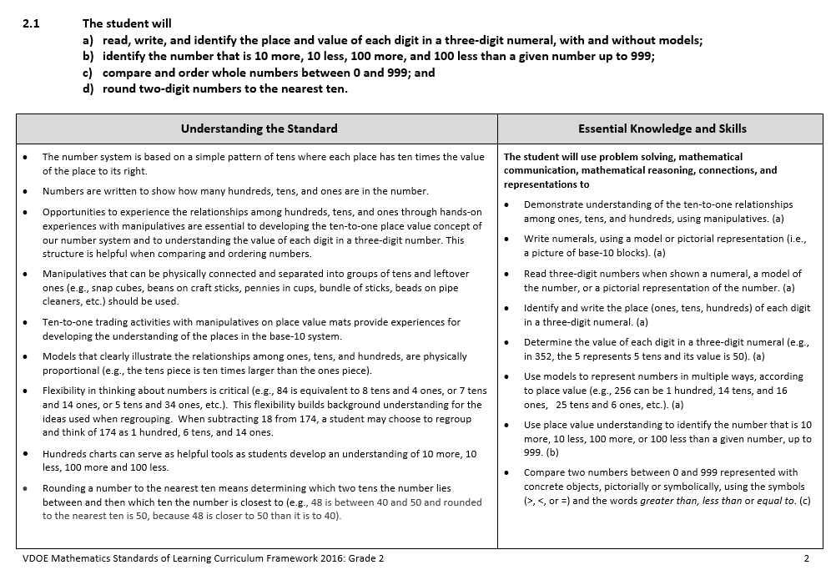

Slide 8
Overview of Crosswalk Documents
By grade level/course
Includes:
  Additions
  Deletions
  Parameter changes/
  clarifications (2016 SOL)
  Moves within the grade level
  (2009 SOL to 2016 SOL)
Additions (2016) | Deletions (2009)
Parameter Changes (2016) | Moves (2009 to 2016)

Slide 9
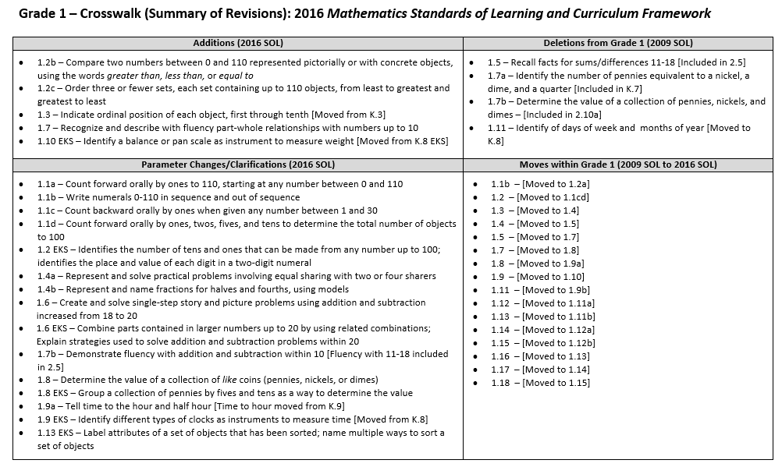
Grade Level Crosswalk
(Summary of Revisions)

Slide 10
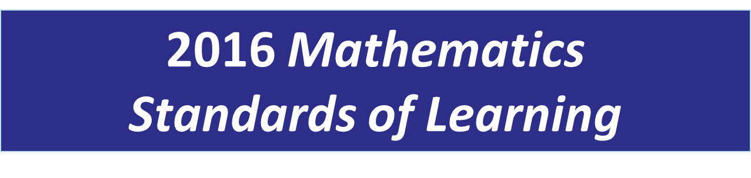

NARRATED GRADE LEVEL-SPECIFIC POWERPOINTS –
Expected to be available early April
Grade 2
Overview of Revisions from 2009 to 2016
Notes:
Welcome to the Grade Two Overview of Revisions to the Mathematics Standards of Learning from 2009 to 2016.
It would be helpful to have a copy of the Grade 2 – Crosswalk (Summary of Revisions) and a copy of the 2016 Grade 1 Curriculum Framework to reference during this presentation.

Slide 11
Purpose
Overview of the 2016 Mathematics Standards of Learning and the Curriculum Framework
Highlight information included in the Essential Knowledge and Skills and the Understanding the Standard sections of the Curriculum Framework
Notes:
The purpose of this presentation is to provide an overview of the changes and to highlight information included in the essential knowledge and skills and understanding the standards sections of the curriculum framework.

Slide 12
2009 SOL | 2016 SOL
 | 1.7 The student will a) recognize and describe with fluency part-whole relationships for numbers up to 10; and b) demonstrate fluency with addition and subtraction within 10. [Moved from 1.5]
New
Revisions:
1.7a – Recognize and describe with fluency part-whole relationships for numbers up to 10
1.7a EKS – Recognize and describe with fluency part-whole relationships for numbers up to 10 in a variety of configurations
1.7b – Demonstrate fluency for addition and subtraction limited to within 10 [Moved from 1.5]
Fluency for addition and subtraction for 11-18 already included in 2.5b
Notes:
SOL1.7a - recognize and describe with fluency part-whole relationships for numbers up to 10 is NEW content for grade one. The Essential Knowledge and Skills bullet states that students will recognize and describe part-whole relationships for numbers up to 10 in a variety of configurations.
SOL1.7b - demonstrate fluency for addition and subtraction is now limited to within 10. This content was moved from the 2009 SOL1.5; note that fluency with addition and subtraction for 11-18 has been removed from grade one but remains in grade two.
Additional information and examples of part-whole relationships and understandings, including examples of appropriate models can be found in the Understanding the Standards section of the Curriculum Framework.

Slide 13
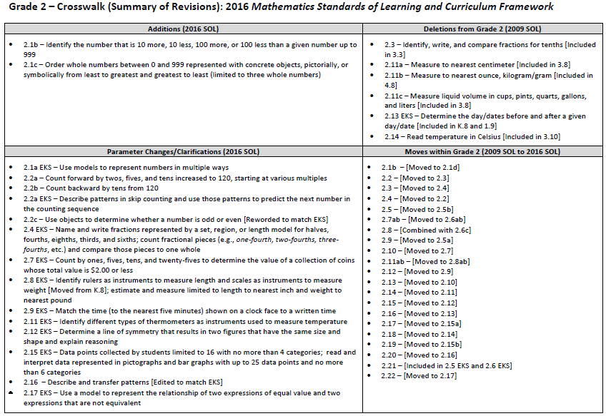
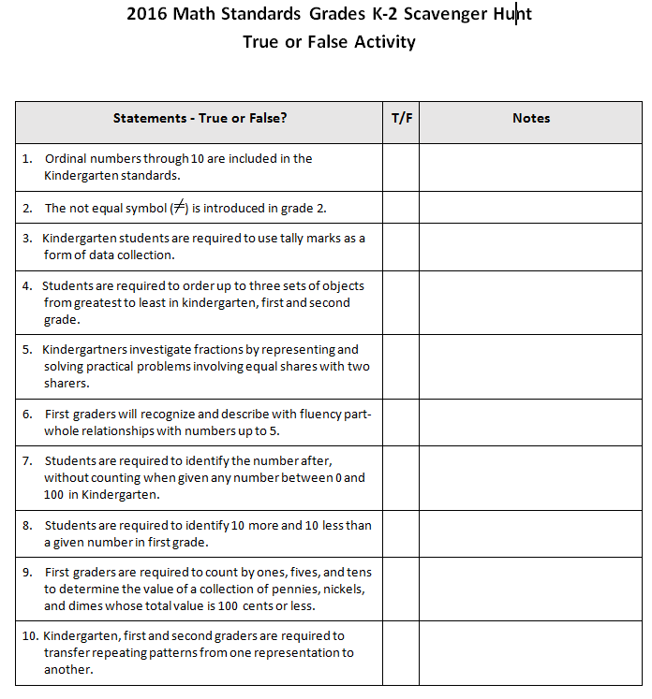
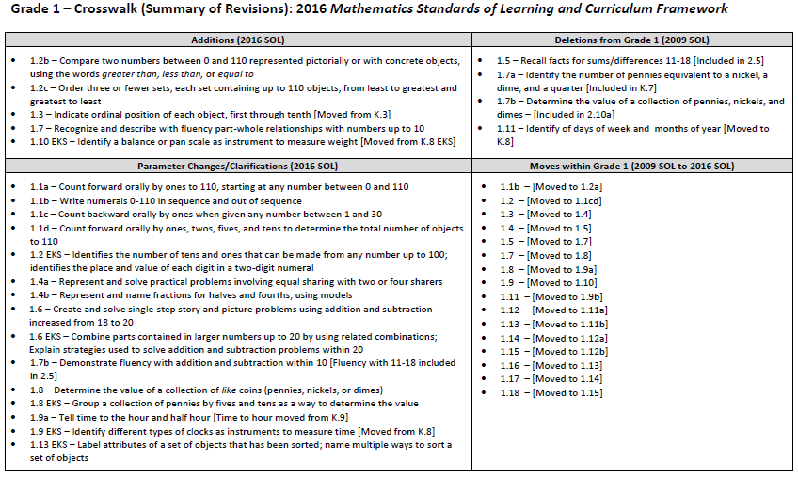
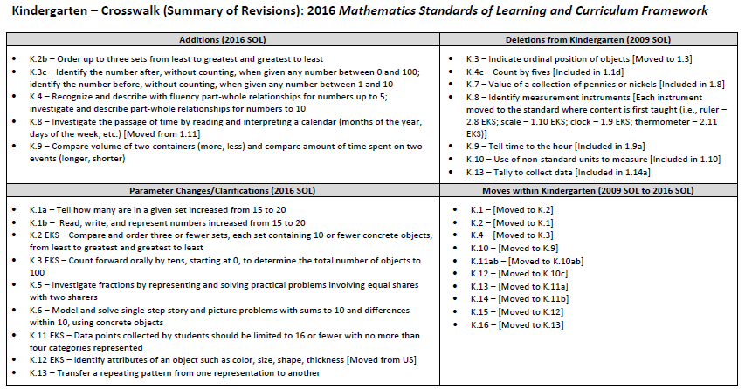
Scavenger Hunt
TRUE OR FALSE ACTIVITY
TRUE OR FALSE ACTIVITY

Slide 14
What Did You Notice?

Slide 15
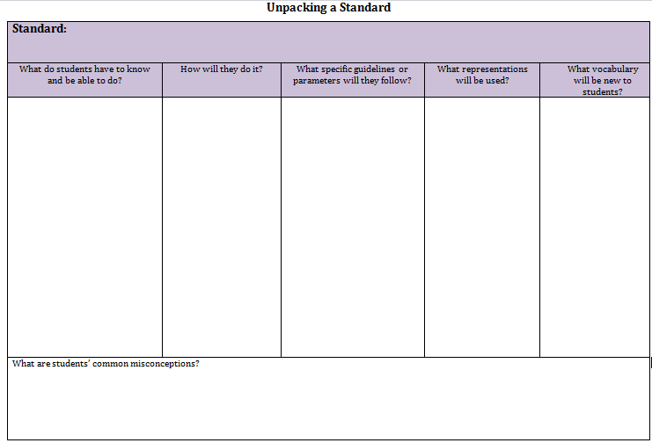
Unpacking Standards – Overview of Structure

Slide 16
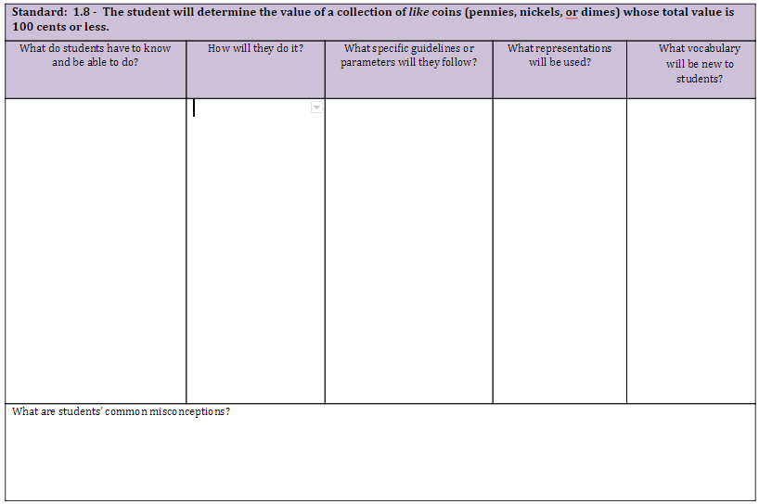
Unpacking Standard 1.8

Slide 17
Unpacking Standard 1.8
count a set of like coins
PK – ID coins
PK - ID value of coins
PK – sort coins
count by 1’s, 5’s, and 10’s

Slide 18
Unpacking Standard 1.8
count a set of like coins
PK – ID coins
PK - ID value of coins
PK – sort coins
count by 1’s, 5’s, and 10’s
coins are in sets of like sets, not mixed
100 cents or less
pennies, nickels, and dimes only
coins
pictures of coins
Frames (5 and 10)
Hundreds chart

Slide 19
Unpacking Standard 1.8
count a set of like coins
PK – ID coins
PK - ID value of coins
PK – sort coins
count by 1’s, 5’s, and 10’s
coins are in sets of like sets, not mixed
100 cents or less
pennies, nickels, and dimes only
coins
pictures of coins
Frames (5 and 10)
Hundreds chart
value
Students may still struggle with the concept that 1 coin represents more than 1 cent.

Slide 20

Reflection
How can you help to encourage unpacking
with your teams?

Slide 21
2. Emphasis on Specific Content

Slide 22
2a. Decomposing and Composing Numbers

Slide 23
NCTM Principles to Actions
Ensuring Mathematical Success for All
High Leverage Mathematics Teaching Practices
1. Establish mathematics goals to focus learning.
2. Implement tasks that promote reasoning and problem solving.
3. Use and connect mathematical representations.
4. Facilitate meaningful mathematical discourse.
5. Pose purposeful questions.
6. Build procedural fluency from conceptual understanding.
7. Support productive struggle in learning mathematics.
8. Elicit and use evidence of student thinking.
Adapted from Leinwand, S. et al. (2014) Principles to Actions – Ensuring Mathematical Success for All, National Council of Teachers of Mathematics. https://www.nctm.org/uploadedFiles/Standards_and_Positions/PtAExecutiveSummary.pdf

Slide 24
Computational Fluency
“Mathematics instruction must develop students’ conceptual understanding, computational fluency, and problem-solving skills. The development of related conceptual understanding and computational skills should be balanced and intertwined, each supporting the other and reinforcing learning. Computational fluency refers to having flexible, efficient and accurate methods for computing. Students exhibit computational fluency when they demonstrate strategic thinking and flexibility in the computational methods they choose, understand and can explain, and produce accurate answers efficiently.”
VDOE 2016 Mathematics Standards of Learning Curriculum Framework Introduction

Slide 25
Vertical Progression:
Computational Fluency
2.5
What do students need to know?
How do these standards connect?
How does the progression of these standards build number sense?
1.7
K.4

Slide 26

Recognizing Number as a Quantity
One-to-One Correspondence
Tagging
Synchrony
Rote Counting
Conservation of Number
Compensation
Cardinality
Subitizing
  Perceptual (instant recognition of number)
  Conceptual (recognize parts and whole)
Unitizing
Work with your table team to match
each vocabulary word to its definition.

Slide 27
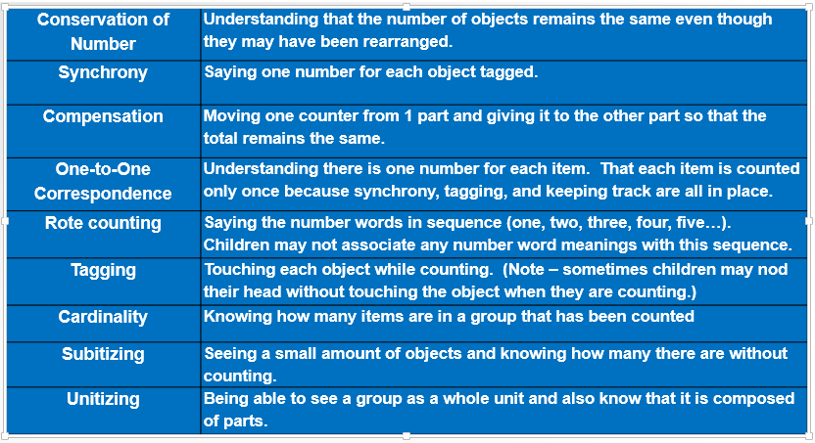
Recognizing Number as a Quantity

Slide 28
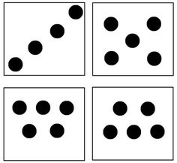
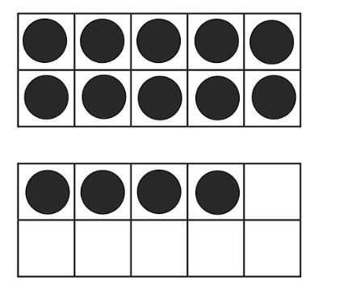
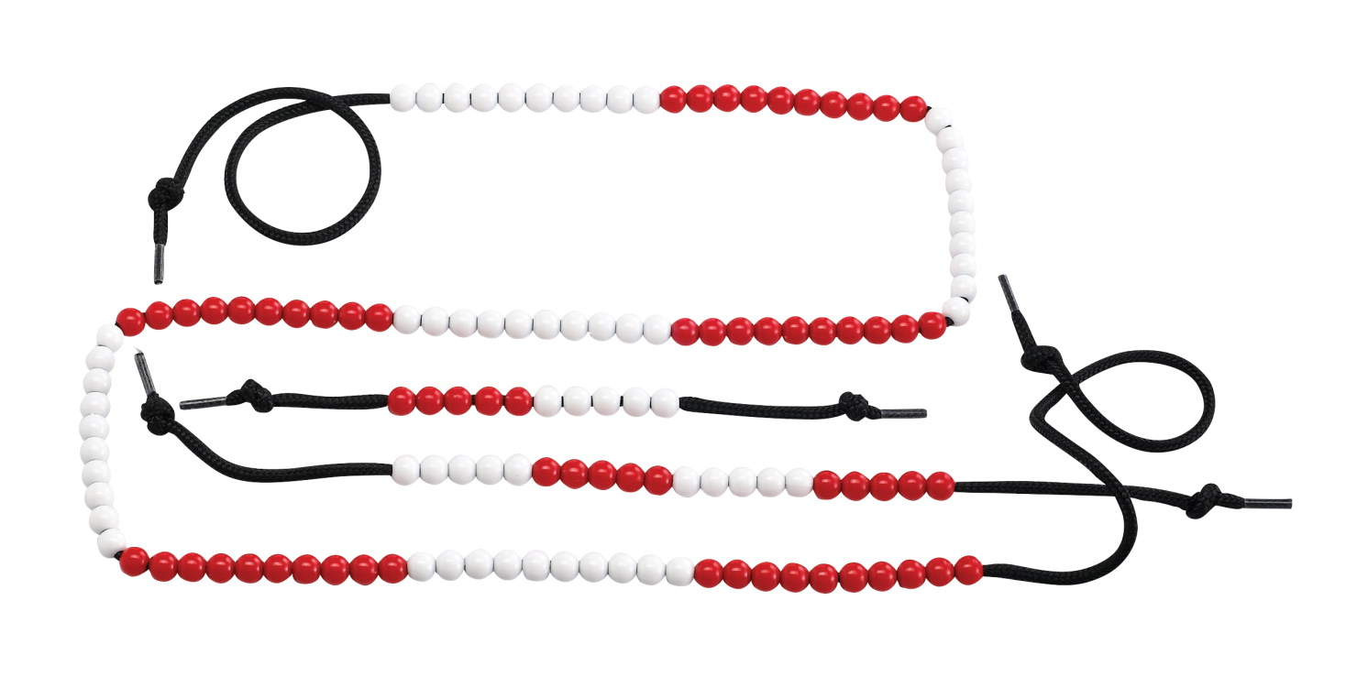

Tools To Support Understanding Parts of Numbers
Finger Patterns
String of Beads
Beaded Number Rack
Dot Cards
Five and Ten Frames

Slide 29
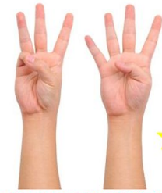

Finger Patterns

Slide 30


String of Beads

Slide 31
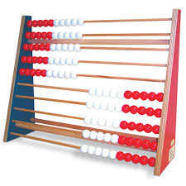
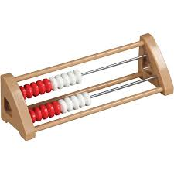
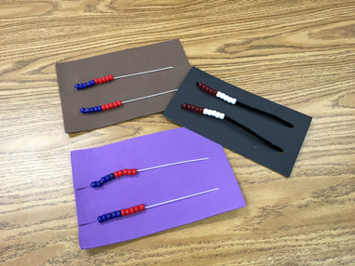
Beaded Number Rack

Slide 32
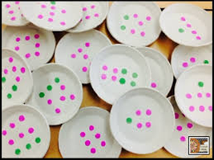
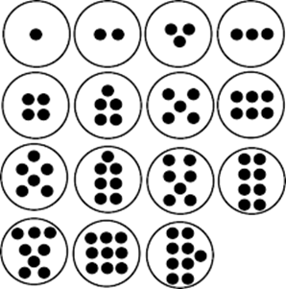
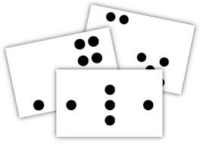
Dot Cards

Slide 33
Dot Images

Slide 34
Dot Images

Slide 35
Dot Images

Slide 36
Dot Images

Slide 37
Dot Images

Slide 38
Dot Images

Slide 39
Dot Images

Slide 40
Dot Images

Slide 41
Dot Images

Slide 42
Dot Images

Slide 43
Dot Images

Slide 44
Dot Images

Slide 45
Dot Cards

Slide 46
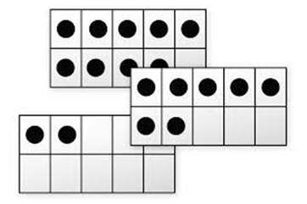
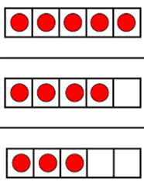
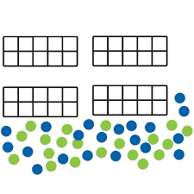
Five & Ten Frames

Slide 47
Time to Play
Make Ten Go Fish
Dot War
Dot Plate Flash
Or
Build numbers (using the tools in the bucket)

Slide 48

Reflection
How will these activities support computational fluency?

Slide 49
2b. Computation: Problem Types

Slide 50

Write Word Problems
On index cards, write two story problems that
you might give to your students –
one subtraction and one addition

Slide 51
NCTM Principles to Actions
Ensuring Mathematical Success for All
High Leverage Mathematics Teaching Practices
1. Establish mathematics goals to focus learning.
2. Implement tasks that promote reasoning and problem solving.
3. Use and connect mathematical representations.
4. Facilitate meaningful mathematical discourse.
5. Pose purposeful questions.
6. Build procedural fluency from conceptual understanding.
7. Support productive struggle in learning mathematics.
8. Elicit and use evidence of student thinking.
Adapted from Leinwand, S. et al. (2014) Principles to Actions – Ensuring Mathematical Success for All, National Council of Teachers of Mathematics. https://www.nctm.org/uploadedFiles/Standards_and_Positions/PtAExecutiveSummary.pdf

Slide 52

Solve & Sort
Using the graphic organizer to record your thinking, solve the story problems.
Once you and your group have solved the problems, sort these problems in any way you wish.
Notes:
need Connie and Juan problems to sort at table
Build the poster on the wall here after 10-15 minutes of sorting

Slide 53
Guiding Questions
Which of these problems might be the easiest for students to solve? Why?
Which of these problems might be the most difficult? Why?
Which of these problems are students most likely to see? Why?

Slide 54
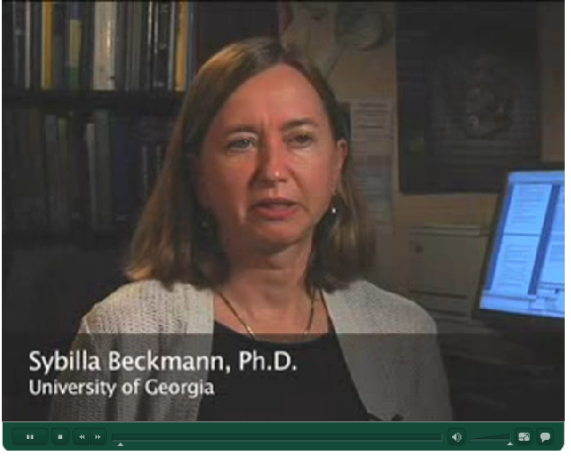
  Video - Assisting Students Struggling with Mathematics: Response to Intervention (RtI) Recommendation #4
Gersten, R, et. Al. (2009) Assisting students struggling with mathematics: Response to intervention (RtI) for elementary and middle schools (NCEE 2009-4060). Washington, DC: USDOE.
Notes:
Instruction should include solving word problems based on common underlying structures
Video - Assisting Students Struggling with Mathematics: Response to Intervention (RtI) Recommendation #4
To access video click See more under Recommendation #4.

Slide 55
Vertical Progression:
Solving Problems
2.6
What do students need to know?
How do these standards connect?
How does the progression of these standards support problem solving?
1.6
K.6

Slide 56
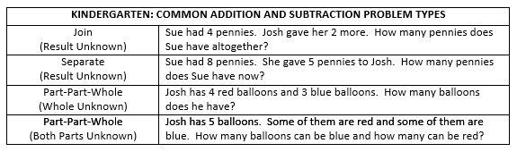
Problem Types - Kindergarten
Resource: VDOE 2016 Mathematics Standards of Learning Curriculum Framework: Kindergarten, p 10.

Slide 57
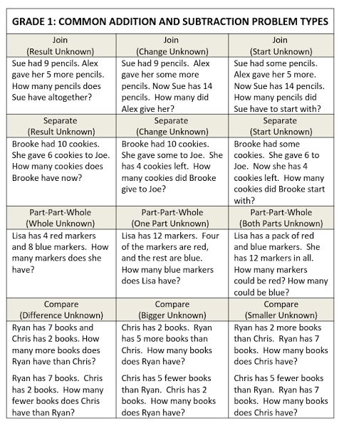
Problem
Types - Grade 1
Resource: VDOE 2016 Mathematics Standards of Learning Curriculum Framework: Grade One, p 12.

Slide 58
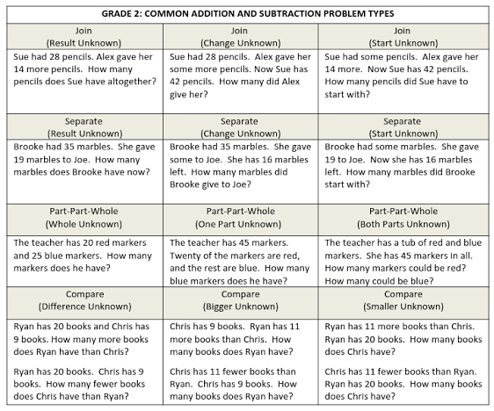
Problem
Types -
Grade 2
Resource: VDOE 2016 Mathematics Standards of Learning Curriculum Framework: Second Grade, p 14.

Slide 59
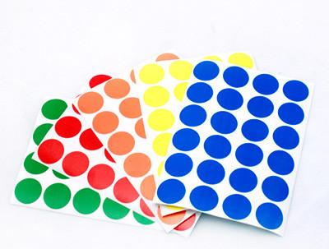
Reflection
Revisit the story problems you wrote. Consider, what problem type is represented in those problems?
Please use dot stickers to indicate on the poster what problem types you created.

Slide 60
Guiding Questions
What does the data tell us? Why do you think this is the case?
What is the benefit of doing this activity with a group?

Slide 61
IIc. Fractions

Slide 62
NCTM Principles to Actions
Ensuring Mathematical Success for All
High Leverage Mathematics Teaching Practices
1. Establish mathematics goals to focus learning.
2. Implement tasks that promote reasoning and problem solving.
3. Use and connect mathematical representations.
4. Facilitate meaningful mathematical discourse.
5. Pose purposeful questions.
6. Build procedural fluency from conceptual understanding.
7. Support productive struggle in learning mathematics.
8. Elicit and use evidence of student thinking.
Adapted from Leinwand, S. et al. (2014) Principles to Actions – Ensuring Mathematical Success for All, National Council of Teachers of Mathematics. https://www.nctm.org/uploadedFiles/Standards_and_Positions/PtAExecutiveSummary.pdf

Slide 63
Vertical Progression:
Fractional Sense
2.4
What do students need to know?
How do these standards connect?
How does the progression of these standards build understanding of fractions?
1.4
K.5

Slide 64
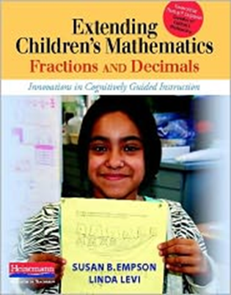
According to Empson & Levi (2011)
Children come to school with conceptually sound understandings of fractions, even before instruction
Research shows that the best way to build meaning for fractions is by solving and discussing word problems – starting with equal sharing problems.
Empson, S.B., and Levi, L. (2011). Extending children’s mathematics fractions and decimals: Innovations in cognitively guided instruction. Portsmouth, NH: Heinemann.

Slide 65
According to Empson & Levi (2011)
Children should first use pictures and words (e.g., one-half, two-fourths) to describe or represent fractions
Teachers should gradually incorporate the use of symbols and equations
Empson, S.B., and Levi, L. (2011). Extending children’s mathematics fractions and decimals: Innovations in cognitively guided instruction. Portsmouth, NH: Heinemann.

Slide 66

Equal Sharing
Division into equal groups is a process young children understand intuitively
Can be solved without direct instruction
Children do not need to know how to use fraction symbols or terminology to
solve these problems
Can begin as early as kindergarten

Slide 67

Activities To Support Fraction Understanding
Form groups: Kindergarten, First, and Second grade

Slide 68
Activities To Support Fraction Understanding
Form groups of four.
On chart paper, collaboratively solve your grade level problem.
Be mindful of the grade level parameters when solving.

Slide 69
Fraction Problems
Four children sharing five sandwiches
2
Four children sharing one piece of paper
1
Two children sharing six brownies
K

Slide 70

Gallery Walk

Slide 71

Reflection
How do equal sharing problems support understanding of fractions?
How might teachers choose purposeful numbers to promote greater understanding of fractions?

Slide 72
3. Support for Implementation

Slide 73
Implementation Support Resources
2016 Mathematics Standards of Learning
2016 Mathematics Standards Curriculum Frameworks
2009 to 2016 Crosswalk (summary of revisions) documents
2016 Mathematics SOL Video Playlist (Overview, Vertical Progression & Support, Implementation and Resources)
Progressions for Selected Content Strands
Narrated 2016 SOL Summary PowerPoints
SOL Mathematics Institutes Professional Development Resources

Slide 74
Implementation Timeline
2016-2017 School Year – Curriculum Development VDOE staff provides a summary of the revisions to assist school divisions in incorporating the new standards into local written curricula for inclusion in the taught curricula during the 2017-2018 school year.
2017-2018 School Year – Crossover Year 2009 Mathematics Standards of Learning and 2016 Mathematics Standards of Learning are included in the written and taught curricula. Spring 2018 Standards of Learning assessments measure the 2009 Mathematics Standards of Learning and include field test items measuring the 2016 Mathematics Standards of Learning.
2018-2019 School Year – Full-Implementation Year Written and taught curricula reflect the 2016 Mathematics Standards of Learning. Standards of Learning assessments measure the 2016 Mathematics Standards of Learning.

Slide 75
Questions?
Please contact the
VDOE Mathematics Team
Mathematics@doe.virginia.gov

