Slide 1
2017 Mathematics Institute
General Session
March 21, 2017 – Williamsburg
March 22, 2017 – Fredericksburg
April 4, 2017 – Wytheville
April 5, 2017 - Roanoke

Slide 2
VDOE General Session Agenda
Overview of 2016 Standards Adoption and Implementation
Revised Introductory Statements
Overview of Crosswalk Documents
Understanding the 2016 Standards of Learning Curriculum Framework
Mathematical Connections Across Grade Levels
Resources to Support 2016 Standards Implementation

Slide 3
Overview - 2016 Standards Adoption and Implementation

Slide 4
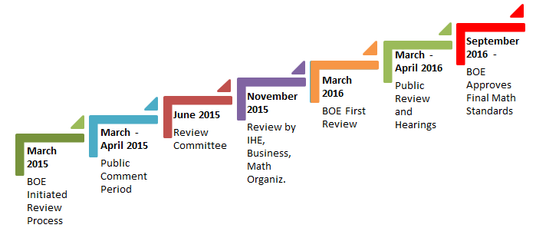
Mathematics SOL Revision Process
December 2016 – Final Versions of 2016 Mathematics Standards of Learning and Curriculum Frameworks posted to VDOE website.

Slide 5
2009 Curve of Change Implementation
Progress
Past Practice
Denial
Acceptance
Anger
Understanding
Fear
Depression

Slide 6
2016 Curve of Change Implementation
Progress
Past Practice
Denial
Anger
Acceptance
Fear
Understanding
Depression

Slide 7
Implementation Timeline
2016-2017 School Year – Curriculum Development VDOE staff provides a summary of the revisions to assist school divisions in incorporating the new standards into local written curricula for inclusion in the taught curricula during the 2017-2018 school year.
2017-2018 School Year – Crossover Year 2009 Mathematics Standards of Learning and 2016 Mathematics Standards of Learning are included in the written and taught curricula. Spring 2018 Standards of Learning assessments measure the 2009 Mathematics Standards of Learning and include field test items measuring the 2016 Mathematics Standards of Learning.
2018-2019 School Year – Full-Implementation Year Written and taught curricula reflect the 2016 Mathematics Standards of Learning. Standards of Learning assessments measure the 2016 Mathematics Standards of Learning.
Turn and Talk

Slide 8
Foci of Revisions
Improve Vertical Progression of Mathematical Content
Ensure Developmental Appropriateness of Student Expectations
Improve Precision and Consistency in Mathematical Language and Format
2016 REVISIONS
Increase Support for Teachers in Mathematics Content
Clarify Expectations for Teaching and Learning
Ensure Proficiency of Elementary Students in Computational Skills

Slide 9
Virginia’s Process Goals for Students in Mathematics
“The content of the mathematics standards is intended to support the five process goals for students”
- 2009 and 2016 Mathematics Standards of Learning
Mathematical Understanding
Problem Solving
Connections
Communication
Representations
Reasoning
Notes:
.

Slide 10
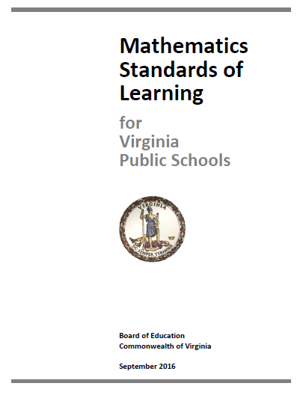
Mathematics Standards of Learning Revisions
K-12 Standards of Learning Documents
  Four New Introductory Statements
    Instructional Technology
    Computational Fluency
    Algebra Readiness
    Equity
  Revisions to Grade Level/Course Introductions
  Content Strand Revisions
  Standards Reworded/Revised/Combined/Moved

Slide 11
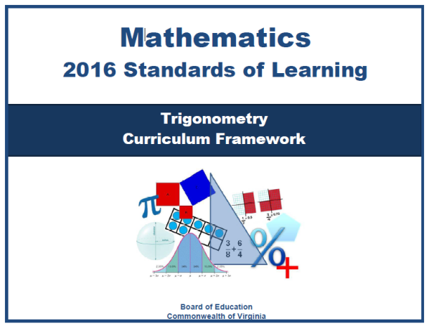
Mathematics Curriculum Framework Revisions
K-12 Curriculum Framework Documents
  New Introductory Statements included
  Revisions to Content Strand Introductions for grade bands
    K-2
    3-5
    6-8
  Standards Reworded/Revised/Combined/Moved
  Reference to Standards Assessed without a Calculator (Grades 3-7)
  Two columns only K-12
  Corresponding SOL and Essential Knowledge and Skills bullets are indicated

Slide 12
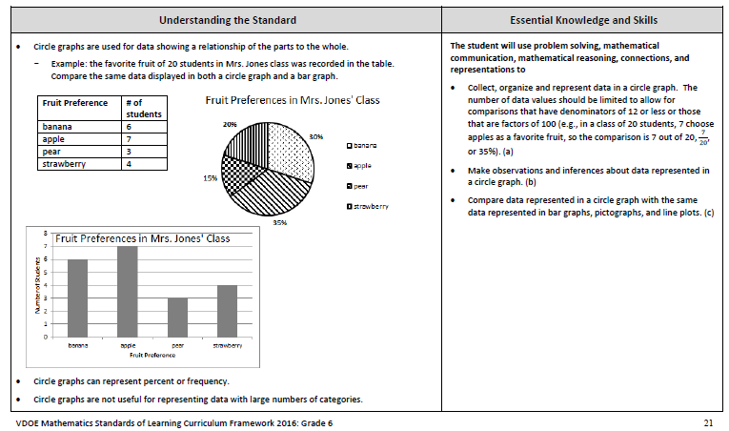
Mathematics Curriculum Framework Revisions
Understanding the Standard and Essential Knowledge and Skills
K-12 – only two columns
Understanding the Standard has more support for teachers:
Definitions
Explanations
Examples
Instructional Connections

Slide 13
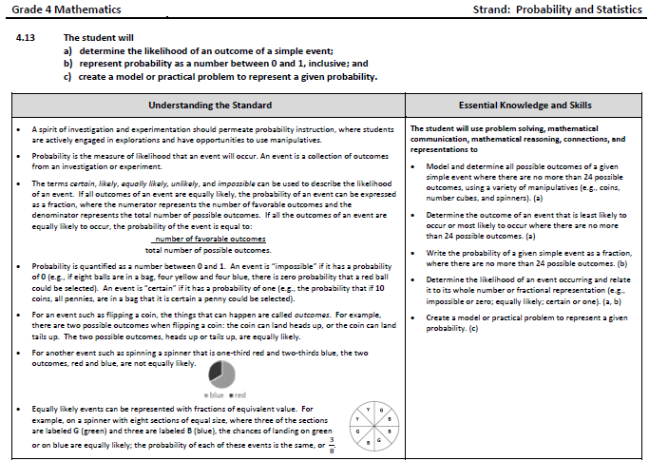
All 2016 K-12 Frameworks have the corresponding SOL and EKS bullets indicated

Slide 14
Vertical Progression of Mathematics Content
Overall reduction in the number of standards from 285 to 259
  Consolidation of related concepts and skills
  Reduction of repetition
  Improvement of the developmental progression
  Deletion of content

Slide 15
2016 Standards of Learning
Revised Introductory Statements

Slide 16

Introductory Statements - Jigsaw
Assign an Introductory statement to each group member
  Instructional Technology
  Computational Fluency
  Algebra Readiness
  Equity
Read the statement and underline or highlight important ideas that will help you to make meaning of the passage
In round robin format, each group member will summarize their assigned statement for group
As a small group, members will discuss each statement and the implications on mathematics instruction

Slide 17
Algebra Readiness
Introduction to the 2009 Grade 7 Mathematics SOL
  “Students who successfully complete the seventh-grade standards should be prepared to study Algebra I in grade eight.”
Replaced with an introductory paragraph
  ““Algebra readiness” describes the mastery of, and the ability to apply, the Mathematics Standards of Learning, including the Mathematical Process Goals for Students, for kindergarten through grade 8.”
REMOVED

Slide 18
Overview of 2016 Crosswalk
(Summary of Revisions) Documents

Slide 19
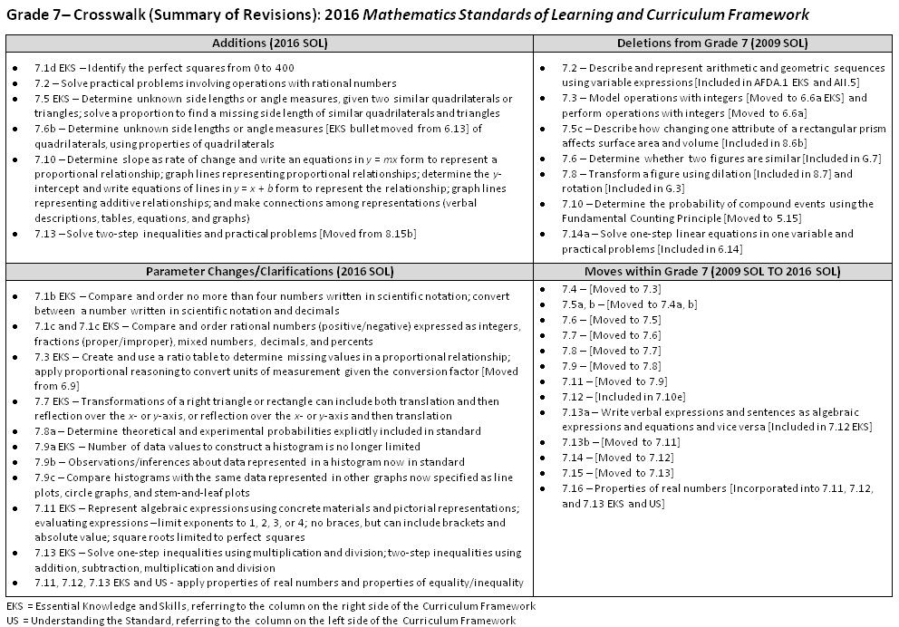
2009
2016
Grade Level Crosswalk
(Summary of Revisions)

Slide 20
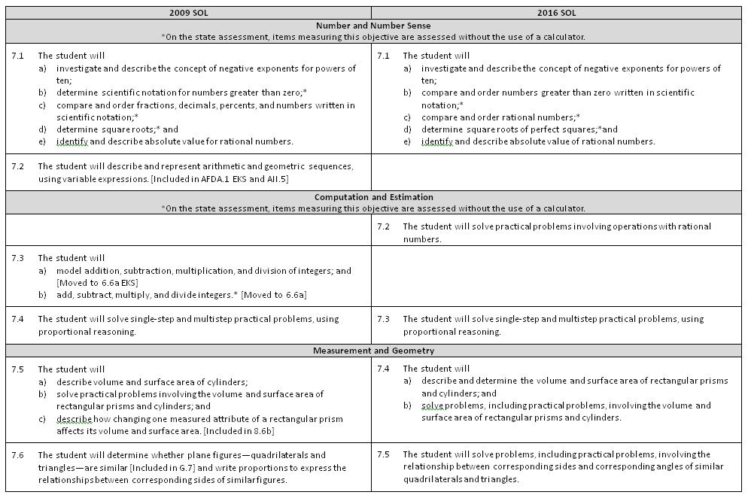

Slide 21
Understanding the 2016 Standards of Learning Curriculum Framework

Slide 22
Understanding the Standards
Unpacking…..
What do students need to know and be able to do?
“How” will students be expected to learn these concepts?
What content parameters exist?
What representations will students use to make sense of the concepts?
What new vocabulary will students encounter?
What are some common student misconceptions?

Slide 23
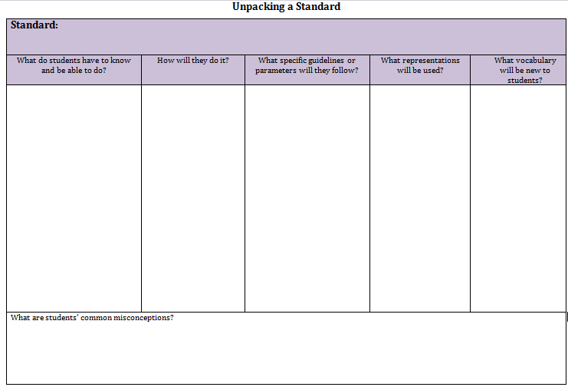
Unpacking Standards – Overview of Structure

Slide 24
Understanding the Standards
Making other connections…..
What prerequisite knowledge will students need to be ready to learn?
How does this standard connect to other standards (in the same grade/course? in other grades/courses?)
What conceptual understanding does this standard require? What procedures will need to be connected to these concepts? What opportunities exist to apply the mathematics?
What mathematical process goals can be accessed through this content?

Slide 25
Mathematical Connections
Across Grade Levels

Slide 26
Mathematical Connections Across Grade Levels
Mathematical Understanding
Problem Solving
Connections
Communication
Representations
Reasoning

Slide 27

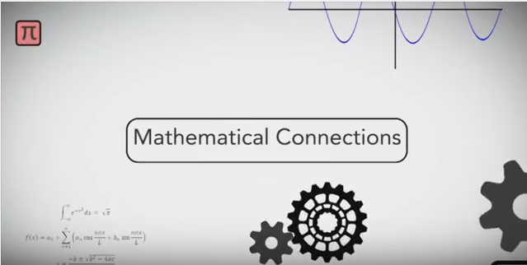

Mathematical Connections Across Grade Levels https://www.youcubed.org/tour-of-mathematical-connections/
Dr. Jo Boaler,
Stanford University
From Jo Boaler, Mathematical Connections, youcubed (Stanford University), 2016. Permission granted for use by VDOE.

Slide 28
Computational Fluency in K-5
4.4 Demonstrate fluency with multiplication facts through 12 × 12, and the corresponding division facts
Computational fluency refers to having flexible, efficient, and accurate methods for computing. Students exhibit computational fluency when they demonstrate strategic thinking and flexibility in the computational methods they choose, understand, and can explain, and produce accurate answers efficiently.
3.4c Demonstrate fluency with multiplication facts of 0, 1, 2, 5, and 10
2.5b Demonstrate fluency with addition and subtraction within 20
1.7a Recognize and describe with fluency part-whole relationships for numbers up to 10
1.7b Demonstrate fluency with addition and subtraction within 10
K.4a Recognize and describe with fluency part-whole relationships for numbers up to 5

Slide 29
Application vs. Identification of Properties
Apply Properties of Real Numbers
  SOL 3.3, SOL 3.4, 4.4, 5.4 Apply properties to perform operations
  SOL 6.6c Simplify numerical expressions with integers
  SOL 7.11 Evaluate algebraic expressions
  SOL 8.14a, b Evaluate/simplify algebraic expressions
Identification of properties is NOT
a focus of assessment.

Slide 30
Application vs. Identification of Properties
Apply Properties of Equality and Inequality
    SOL 6.13/6.14 Solve one-step linear equations/one-step linear inequalities (add/subtract)
    SOL 7.12/7.13 Solve two-step linear equations/one- and two-step linear inequalities (+/−/×/÷)
    SOL 8.17/8.18 Solve multi-step linear equations/inequalities
    SOL A.4/A.5 Solve equations (linear, linear systems, literal, quadratic)/inequalities (linear, linear systems)
Identification of properties is NOT
a focus of assessment.

Slide 31


Multiple Representations or Models Across K-12
Kindergarten
Grade 3
Grade 5
Grade 7
Algebra I

Slide 32
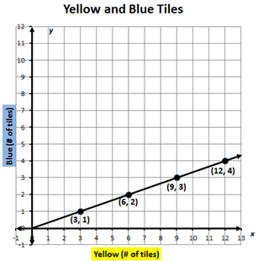
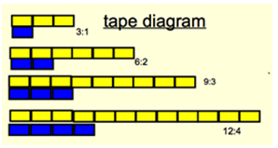
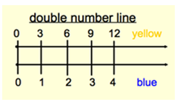
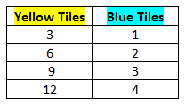
Make connections between and among multiple representations of functions
verbal
The ratio of yellow tiles to blue tiles is 3:1.
graph
diagram
number lines
table

Slide 33
Principles to Actions:
Ensuring Mathematical Success for All

Slide 34
“Effective teaching is the non-negotiable core that ensures that all students learn mathematics at high levels.”
NCTM, Principles to Action Executive Summary, 2014

Slide 35
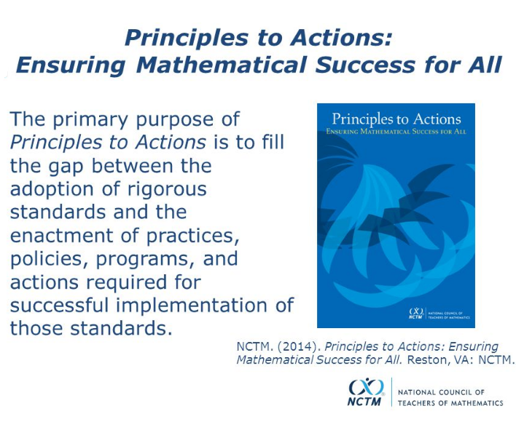

Slide 36
NCTM Principles to Actions
Ensuring Mathematical Success for All
High Leverage Mathematics Teaching Practices
1. Establish mathematics goals to focus learning.
2. Implement tasks that promote reasoning and problem solving.
3. Use and connect mathematical representations.
4. Facilitate meaningful mathematical discourse.
5. Pose purposeful questions.
6. Build procedural fluency from conceptual understanding.
7. Support productive struggle in learning mathematics.
8. Elicit and use evidence of student thinking.
Adapted from Leinwand, S. et al. (2014) Principles to Actions – Ensuring Mathematical Success for All, National Council of Teachers of Mathematics. https://www.nctm.org/uploadedFiles/Standards_and_Positions/PtAExecutiveSummary.pdf

Slide 37
Resources to Support
2016 Mathematics Standards Implementation

Slide 38
Implementation Support Resources
2016 Mathematics Standards of Learning
2016 Mathematics Standards Curriculum Frameworks
2009 to 2016 Crosswalk (summary of revisions) documents
2016 Mathematics SOL Video Playlist (Overview, Vertical Progression & Support, Implementation and Resources)
Progressions for Selected Content Strands
Narrated 2016 SOL Summary PowerPoints
SOL Mathematics Institutes Professional Development Resources

Slide 39
K-12 Mathematics Textbook Approval and Review Committees
March –May 2017 Publisher Submission Process
June – August 2017 Review Committee Work
October – November 2017 Consensus Evaluations Shared with Publishers
January 2018 BOE First Review of Proposed Textbook List
February 2018 – Public Comment Period
March 2018 – BOE Final Approval of Textbook List

Slide 40
Please contact us!
The VDOE Mathematics Team at
Mathematics@doe.virginia.gov

