Slide 1
VDOE 2018 Mathematics Institute 6-8 Session

Slide 2
Agenda
Welcome and Introductions
Facilitate Meaningful Discourse
Mathematical Community
Pose Purposeful Questions and Elicit and Use Evidence of Student Thinking
Lemonade Task
Lunch
Support Productive Struggle and Use and Connect Representations
Telling the Tale Task
Taking Action – Next Steps
Notes:
Facilitator: Read through the general plan for the day - focusing on the 4 mathematical teaching practices. Explain no breaks other than lunch so take as needed independently. Ask that phones be put on silent or vibrate.

Slide 3
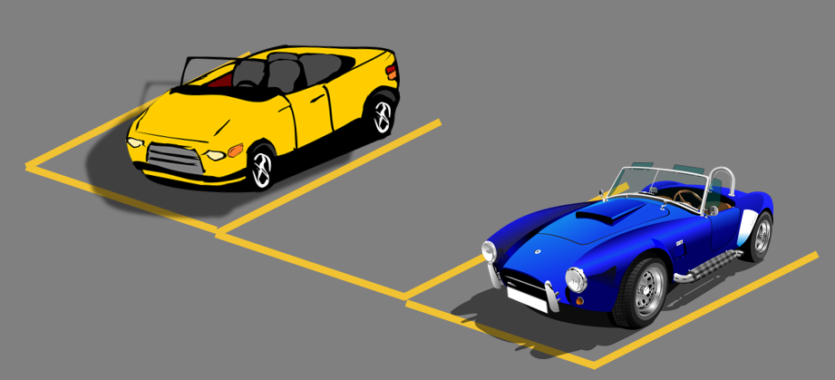
Parking Lot
Notes:
Facilitator: Explain there is a “parking lot” hanging in the room for participant questions. Just write the question/concern on a sticky note and add it to the parking lot at any time during the presentation. Or utilize a padlet link that the facilitator creates to send your questions.

Slide 4
Which one doesn’t belong?
Notes:
Facilitator: Ask participants to individually decide which doesn’t belong and introduce yourselves to your tablemates with your name as you state why you picked which superhero.

Slide 5
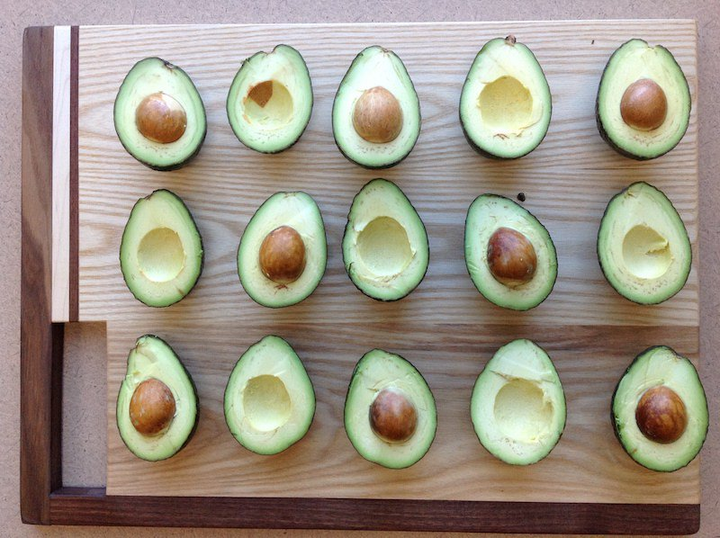
How many?
Notes:
Facilitator: Ask participants to individually decide how many then remind the group of your name, tell everyone what you do for a job in mathematics, and how many you see in the slide.

Slide 6
Resources for initiating student engagement:
Which one doesn't belong
Dot images
Table Talk Math
Real World Images
Would you rather math
Estimation 180
101 Questions
Notes:
Facilitator: Explain to participants that getting students to talk in math class in middle school is tough so sometimes need to use sites that don’t begin with math or begin with math that is easier than they are learning in class. Here are some options of sites to use to begin working with students.

Slide 7
I. Teaching Practice: Facilitate Meaningful Discourse

Slide 8
Essential Question
What elements must be in place to support meaningful mathematical discourse?
Notes:
Facilitator: Draw attention to the essential question for Module 1.

Slide 9
Eight Teaching Practices
Notes:
Facilitator: Explain how the book “Taking Action” is set up
chapter 1 is an overview and chapter 10 is a summary
the 8 mathematical teaching practices are chapters 2 - 9
Ask participants to take a minute to look at page 5 and read the brief descriptions of the practices
Explain that today we will be looking at those discourse teaching practices explained in chapters 5 – 9
(Participants may want to use sticky notes to mark pages that we refer to in the book.)

Slide 10
Mathematics Process Goals for Students
“The content of the mathematics standards is intended to support the five process goals for students” - 2009 and 2016 Mathematics Standards of Learning
Communication
Connections
Representations
Problem Solving
Mathematical Understanding
Reasoning
Notes:
Facilitator: Explain that these are the process goals from your standards (right column of each curriculum framework). They have been a focus of VA and written in the standards since 2001.

Slide 11
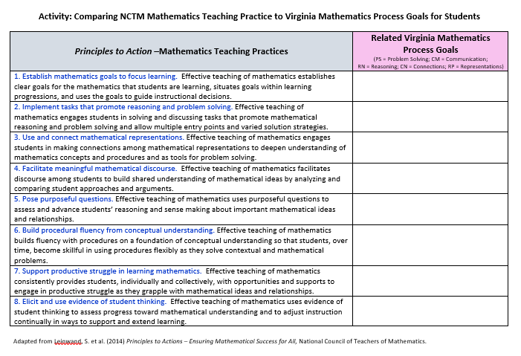
Teaching Practices- Process Goals
Notes:
Facilitator: Distribute paper copies of “Activity: Comparing NCTM Mathematics Teaching Practice to Virginia Mathematics Process Goals for Students”.
Assign each table one process goal.
Direct the participants at the table to determine which of the Mathematical teaching practices align with their assigned process goal.
Mark in the “Related Virginia Mathematics Process Goals” column the abbreviation for your process goal next to the Teaching Practice.
When you’ve decided which teaching practice aligns to your process goal, write the initials of your process goal on a sticky note and place it on the poster on the wall.
(Poster has 5 columns to the right for the process standards. Sticky notes matched the columns, so color-coding was an option. Remind participants to add sticky notes as they are completed to avoid a back-up at the last minute.)

Slide 12
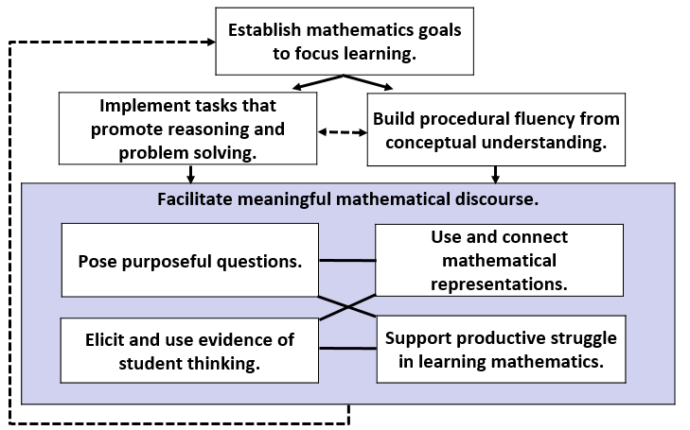
Teaching Framework for Mathematics
Adapted from Smith, M. et al. (2017) Taking Action – Implementing Effective Mathematics Teaching Practices Series, National Council of Teachers of Mathematics.
Notes:
Facilitator: This graphic can be found on page 194 and the gray box is where we are focusing today but all teaching practices are connected and can’t exist without the others

Slide 13
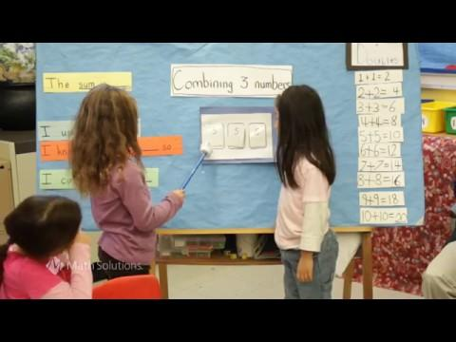
Video Reflection
Notes:
Facilitator: Ask participants to put 5 sticky notes in front of them.
As you watch the video put ONE thing that sticks out to you on each sticky note.
It is a 2 and a half minute video – write quickly
Reflect at table what stood out to you individually and then have a whole group discussion.
The next slide is what stood out for the authors.

Slide 14
Video Reflection
student voices
collaboration between students promotes learning
teacher gathers more information about student understandings
talk moves (turn and talk, restate, repeat)
promote reasoning
equity - encourages students who are hesitant to participate
justify
Notes:
Facilitator: These are the points that stuck out watching the video for the authors. Be sure the whole group discussion from the previous slide hits these points.

Slide 15
In Our Classroom We…
need our students to be comfortable talking about mathematics.
want middle school students participating in number talks.
will make use of mathematics vocabulary.
see student talk dominating discussions.
see students who are supportive and accepting of support.

Slide 16
Mathematics Community
What it is NOT: | What it is:
Teachers doing most of the math | Students doing most of the math
Assigned tasks | Student choice
Teachers showing the procedure and talking about the steps to follow | Students talking about their mathematical thinking and reasoning
Teachers as holders of knowledge | Teachers acting as facilitators – asking good questions
Students working in isolation; sharing answers or strategies is cheating | Students working collaboratively and learning from one another
Teachers rescuing students | Students struggling with challenging mathematics and learning from errors
Teachers presenting to the whole class | Teacher working with small groups
Focused on procedural skill | Focused on conceptual understanding
Notes:
Facilitator: Participants read this table for a minute. What is it that you see in “what it is” – STUDENTS!!

Slide 17
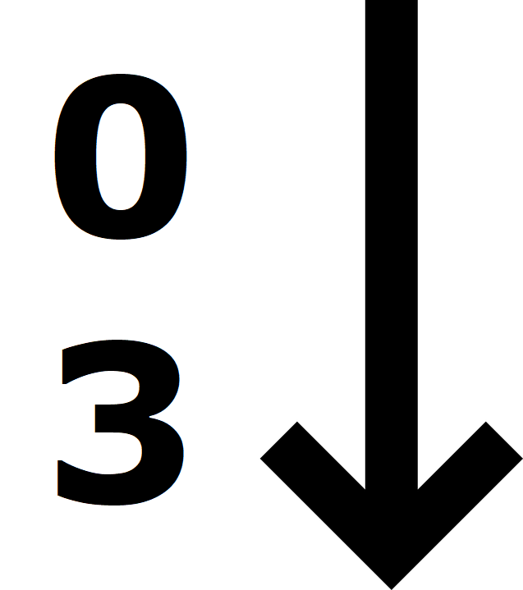
Levels of Classroom Discourse
Rich classroom discourse is a necessity. This rubric lets you consider where your classroom is on the continuum.
Sort the two columns so that “0” is the least and “3” is most advanced.
Use the LIGHT GREEN papers for the “Teacher Role” column and the GRAY papers for the “Building Student Responsibility Within the Community” column.
Notes:
Facilitator:
Introduce the sort is about levels of classroom discourse.
Model … Pull the light green and gray papers from the envelope on the table. Place those vertically, 0 on top, on the dark green sorting papers. (Teacher role sort, Building student responsibility within the community sort)
Discuss placement of these in the rubric and then consider where your classroom is and how to move it along the continuum.
You will get a copy of the completed rubric at the end of the day.

Slide 18
Components and Levels of a Math Talk Learning Community
 | Teacher role
Level 0 | Teacher is at the front of the room and dominates the conversation.
Level 1 | Teacher encourages the sharing of math ideas and directs speaker to talk to the class, not to the teacher only.
Level 2 | Teacher facilitates conversation between students and encourages students to ask questions to one another.
Level 3 | Students carry the conversations themselves. Teacher only guides from the periphery of the conversation. Teacher waits for students to clarify thinking of others.
Notes:
Facilitator: This is the teacher role placement of light green papers. Participants should reflect on their self-perceived level as well as the level of their colleagues.

Slide 19
Components and Levels of a Math Talk Learning Community
 | Building student responsibility within the community
Level 0 | Culture supports students keeping ideas to themselves or just providing answers when asked.
Level 1 | Students believe that their ideas are accepted by the classroom community. They begin to listen to one another supportively and to restate in their own words what another student has said.
Level 2 | Students believe that they are math learners and that their ideas and the ideas of their classmates are important. They listen actively so that they can contribute significantly.
Level 3 | Students believe that they are math leaders and can help shape the thinking of others. They help shape others’ math thinking in supportive, collegial ways and accept the same support from others.
Notes:
Facilitator: This is the building student responsibility within the community gray paper placement.

Slide 20
Reflect on the Essential Question
What elements must be in place to support meaningful mathematical discourse?
Notes:
Facilitator: This is a reminder of what we wanted to get at during module 1.

Slide 21
Time to Reflect
Complete Module 1 section of reflection document
What elements must be in place to support meaningful mathematical discourse?
Notes:
Facilitator: Explain that after each module you will be asked to reflect on your personal classroom changes and how you will share this information in professional development when you return to your division. Distribute the “reflection document” and provide time to reflect on Module 1. (Allow participants to share reflections or big “aha’s with the group.)

Slide 22
II. Teaching Practices: Pose Purposeful Questions Elicit and Use Evidence of Student Thinking
Notes:
Facilitator: We begin Module 2 where we focus primarily on the teaching practice Posing Purposeful Questions which is supported by the teaching practice Elicit and Use Evidence of Student Thinking.

Slide 23
Teaching Framework for Mathematics
Adapted from Smith, M. et al. (2017) Taking Action – Implementing Effective Mathematics Teaching Practices Series, National Council of Teachers of Mathematics.
Notes:
Facilitator: remind participants of how interconnected the mathematical teaching practices are and that the gray box is our focus today but they couldn’t exist without all the others.

Slide 24
Essential Questions
How does posing purposeful questions promote equitable learning opportunities for all students?
How does eliciting and using evidence of student thinking support efforts to pose purposeful questions?
Notes:
Facilitator: Take a moment to read the essential questions Module 2.

Slide 25
Pose Purposeful Questions
Carefully planning questions before teaching the lesson is essential.
Questions should reveal student understanding.
Questions should foster discussion.
Questions are intended to focus and clarify student thinking.
Notes:
Facilitator: The teaching practice of posing purposeful questions involves many things - the next two slides provide information on that.

Slide 26
Five Types of Questions
Taking Action book – page 81
Question Type | Purpose
Gathering Information | Ask students to recall facts, definitions, or procedures.
Probing thinking | Ask students to explain, elaborate, or clarify their thinking, including articulating the steps in solution methods or completion of a task.
Making the mathematics visible | Ask students to discuss mathematical structures and make connections among mathematical ideas and relationships.
Encouraging reflection and justification | Reveal deeper insight into student reasoning and actions, including asking students to argue for the validity of their work.
Engaging with the reasoning of others | Help students to develop an understanding of each other’s solution paths and thinking, and lead to the co-construction of mathematical ideas.
Notes:
Facilitator: Share that page 81 in Taking Action provides more information on these five types of questions

Slide 27
Classifying Questions
Taking Action book – page 92-93
Assessing Questions Are based closely on the work that the student has produced. Clarify what the student has done and understands about what s/he has done. Gives the teacher information about what the student understands Teacher stays to hear the answer to the question. | Advancing Questions Use what students have produced as a basis for making progress toward the target goal of the lesson. Move students beyond their current thinking by pressing students to extend what they know to a new situation. Press students to think about something they are not currently thinking about. Teacher walks away, leaving students to figure out how to proceed.
Notes:
Facilitator: Of great importance throughout the book and in classrooms are these two types of questions. For further reference, see page 86 and pages 92-93 of Taking Action.

Slide 28
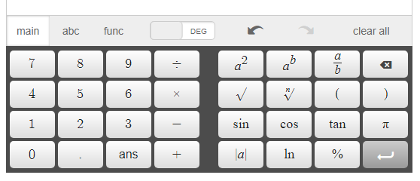
Desmos Scientific Calculator
Virginia Scientific Calculator
Notes:
Facilitator: Explain that this is the calculator students will have access to when they take the SOL test in Spring, 2019 when handhelds are still allowed. Then, after Spring, 2019, only this calculator will be used. Explore it right now.
From desmos.com, go to testing at the bottom of the page and find Virginia and get the version of each – show this to participants.
Mention that TestNav Practice Items now have the Desmos calculator connected for use.
Also VDOE has a page dedicated to Desmos now: http://www.doe.virginia.gov/testing/sol/standards_docs/mathematics/calculators/desmos/index.shtml
Discuss the need for professional development in use of this calculator for staff and determining how each classroom is going to use it with students.
Also note that the desmos scientific calculator has an APP, that while not the Virginia version, will allow students to use it for practice without internet connection.

Slide 29
The Lemonade Stand Task
Notes:
Facilitator: This slide just lets participants know we are about to begin a task.

Slide 30
Vertical Progression:
8.1
Ratio
Rational numbers
Real numbers
7.1
6.1
Notes:
Facilitator: Curriculum framework pages are available on the tables. Discuss the specifics of both columns of the framework. Really make sure participants are aware of the framework and are prepared to use it for their planning.

Slide 31
Vertical Progression:
8.16
Proportional Relationships
7.10
6.12
Notes:
Facilitator: Curriculum framework pages are available on the tables. Discuss the specifics of both columns of the framework. Really make sure participants are aware of the framework and are prepared to use it for their planning.

Slide 32
Lemonade Stand Task Launch
Video Launch
Notes:
Facilitator: Share video and explain that a launch can be a CATCH for students or can be an activity to retrieve prior knowledge.

Slide 33
The Lemonade Stand Task
Work on the task individually for 3 minutes.
Have each person share their strategy with the table.
Pick 2 to 3 different strategies that your table would like to share with the whole group.
Display those strategies on chart paper.
Notes:
Facilitator: Distribute copies of “The Lemonade Task”. Leave the slide up while participants work for directions. Facilitators watch groups work and select and sequence groups to share out whole group.

Slide 34
Posing Purposeful Questions
Questions that Foster Discussion
Question Stems
Notes:
Facilitator: Remind participants that the task was a way to get at the teaching practice of posing purposeful questions.
Distribute copies of both pages to participants and share that in the next jigsaw activity these pages may be helpful.
Discuss the papers once the participants receive them.
Refer to sentence starters hanging around the room

Slide 35
The Lemonade Stand Task
Pick up a letter card (A-H) from the center of the table.
Rearrange to meet with others who have chosen the same letter.
After you have received a sample of student work, brainstorm purposeful questions that you might ask to focus student thinking.
Notes:
Facilitator: Explain the jigsaw activity that is described in this slide and the next.
Each participant takes a card A – H
Participants move to large groups of just their letter. Mark these locations in the morning.
Facilitators give copies of student work correlating to the letter to each group.

Slide 36
The Lemonade Stand Task
Return to your original table.
Partner with tablemates who recorded questions for the same student (A/E, B/F, C/G, and D/H)
Share the student work and the questions that your group created.
Notes:
Facilitator: After a suitable amount of time on the previous slide, bring the group back to original tables and explain the rest of the jigsaw.
Return to your table and partner with the assigned letters (sit next to one another . . . can return to original seats after sharing out)
Discuss the student work that was reviewed and the questions participants created

Slide 37
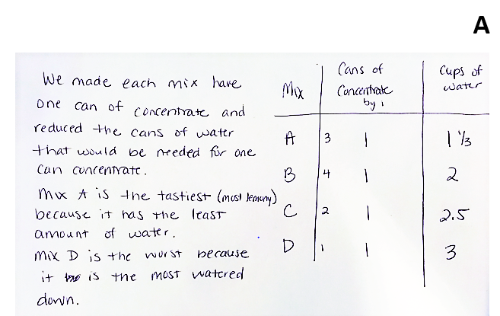
Student Work
Notes:
Facilitator: Show this work while the participants who had cards A and E discuss questions they wrote to focus student thinking.

Slide 38
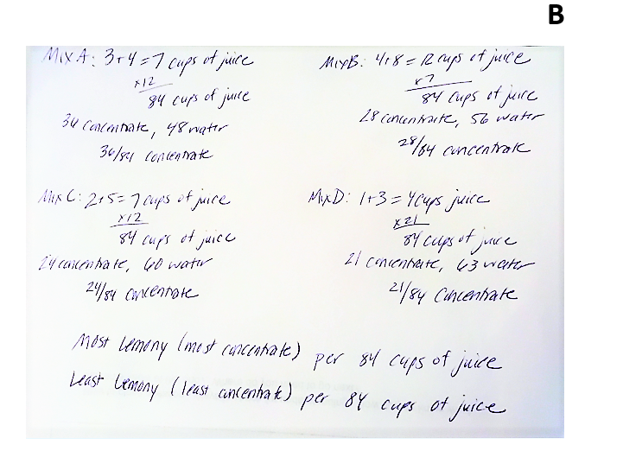
Student Work
Notes:
Facilitator: Show this work while the participants who had cards B and F discuss questions they wrote to focus student thinking.

Slide 39
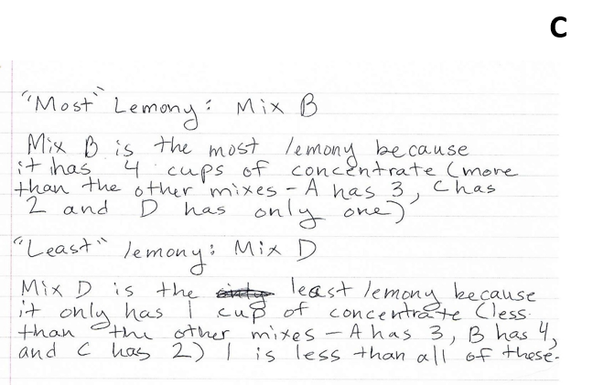
Student Work
Notes:
Facilitator: Show this work while the participants who had cards C and G discuss questions they wrote to focus student thinking.

Slide 40
Student Work
Notes:
Facilitator: Show this work while the participants who had cards D and H discuss questions they wrote to focus student thinking.

Slide 41
The Lemonade Stand Task
 | Assessing Questions | Advancing Questions
Gathering Information Ask students to recall facts, definitions, or procedures.
Probing Thinking Ask students to explain, elaborate, or clarify their thinking, including articulating the steps in solution methods or completion of a task.
Making the mathematics visible Ask students to discuss mathematical structures and make connections among mathematical ideas and relationships.
Encouraging reflection and justification Reveal deeper insight into student reasoning and actions, including asking students to argue for the validity of their work.
Engaging with the reasoning of others Help students to develop an understanding of each other’s solution paths and thinking, and lead to the co-construction of mathematical ideas.
Notes:
Facilitator: During the jigsaw, fill in this document as you observe. You don’t have to fill the entire table but share with whole group where facilitator asked these questions. It might be helpful to write some questions ahead of time to be prepared with which to ask the groups. (bringing back the 5 types of questions from slide 26 and the 2 types of questions from slide 27)

Slide 42
Posing Purposeful Questions - Research
Many classrooms follow the traditional I-R-E (Initiate-Response-Evaluate) format, rather we should “engage students in constructing knowledge and in collaborative problem-solving.” (Mehan 1979a)
“…teachers in the United States pose fewer high-level questions in middle school mathematics classrooms than teachers in other countries.” Stigler and Hiebert (1999)
Notes:
Facilitator: For each teaching practice in the book there is research to support its importance. These are the points the authors liked best.

Slide 43
Posing Purposeful Questions - Promoting Equity
Positioning the way students are “entitled, expected, and obligated to interact with one another as they work on content together” (Gresalfi and Cobb 2006, p 51)
Considerations:
Are all students’ ideas and questions heard, valued and pursued?
Who does the teacher call on?
Whose ideas does the class examine and discuss?
Whose thinking does the teacher select for further inquiry and whose thinking does the teacher disregard?
Notes:
Facilitator: For each teaching practice in the book there is a section on promoting equity with that practice. These are the points the authors found most important.

Slide 44
Elicit and Use Evidence of Student Thinking - Research
“Teachers who consistently elicit student thinking during a lesson can use that evidence to adapt their instruction to better meet their students’ needs (Leahy et al. 2005).”
“If teachers wait until the end of the week or the end of a unit to elicit and use evidence of student thinking, they have little clear information on which to base immediate instructional decisions in the lessons leading up to that assessment (William 2007).”
Notes:
Facilitator: For each teaching practice in the book there is research to support its importance. These are the points the authors liked best.

Slide 45
Elicit and Use Evidence of Student Thinking - Promoting Equity
“This move can strengthen students’ identities as knowers and doers of mathematics, in addition to giving teachers a more nuanced view of their own students as learners (Crespo 2000).”
Invite broader participation by explicitly asking other students to comment on the work, promoting diversity of views and strategies in the classroom.
Notes:
Facilitator: For each teaching practice in the book there is a section on promoting equity with that practice. These are the points the authors found most important.

Slide 46
Levels of Classroom Discourse
Return to the sort.
This time sort and consider where your classroom is in terms of the “Questioning” column (LIGHT YELLOW) and the “Explaining Mathematical Thinking” column (BLUE).
Notes:
Facilitator: Participants should take the light yellow and blue cards out of the envelope on the table. Sort Questioning (on light yellow paper) and Explaining mathematical thinking (on blue paper) as we did earlier.

Slide 47
Components and Levels of a Math Talk Learning Community
 | Questioning
Level 0 | Teacher is only questioner. Questions serve to keep students listening to teacher. Students give short answers and respond to teacher only.
Level 1 | Teacher questions begin to focus on student thinking and less on answers. Only teachers ask questions.
Level 2 | Teacher asks probing questions and facilitates some student-to-student talk. Students ask questions of one another with prompting from teacher.
Level 3 | Student-to-student talk is student initiated. Students ask questions and listen to responses. Many questions ask “why” and call for justification. Teacher questions may still guide discourse.
Notes:
Facilitator: This is the sort in correct order for Questioning. Participants should reflect on their self-perceived level as well as the level of their colleagues. Share and discuss.

Slide 48
Components and Levels of a Math Talk Learning Community
 | Explaining mathematical thinking
Level 0 | Teacher questions focus on correctness. Students provide short answer-focused responses. Teacher may give answers.
Level 1 | Teacher probes student thinking somewhat. One or two strategies may be elicited. Teacher may fill in an explanation. Students provide brief description of their thinking in response to teacher probing.
Level 2 | Teacher probes more deeply to learn about student thinking. Teacher elicits multiple strategies. Students respond to teacher probing and volunteer their thinking. Students begin to defend their answers.
Level 3 | Teacher follows student explanations closely. Teacher asks students to contrast strategies. Students defend and justify their answers with little prompting from the teacher.
Notes:
Facilitator: This is the sort in correct order for Explaining Mathematical Thinking. Share and discuss.

Slide 49
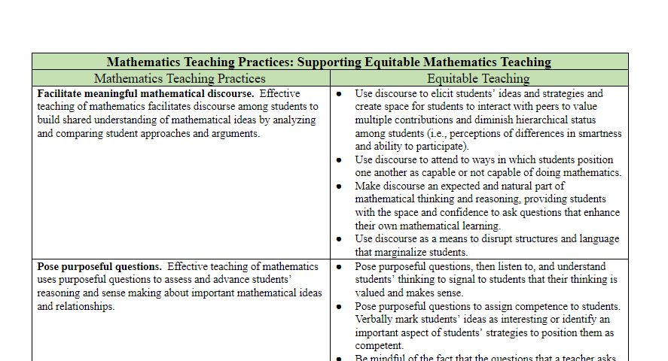
Supporting Equitable Mathematics Teaching
Notes:
Facilitators: Draw attention to the Mathematics Teaching Practices: Supporting Equitable Mathematics Teaching document (2-sided) that was in their folder when they arrived. Ask participants to refer to as we proceed to a reflection period.

Slide 50
Reflect on Essential Questions
How does posing purposeful questions promote equitable learning opportunities for all students?
How does eliciting and using evidence of student thinking support efforts to pose purposeful questions?
Notes:
Facilitator: Share that this is what we hoped to get to during this module - consider if we did

Slide 51
Time to Reflect
Complete Module 2 section of reflection document
How does posing purposeful questions promote equitable learning opportunities for all students?
How does eliciting and using evidence of student thinking support efforts to pose purposeful questions?
Notes:
Facilitator: Direct participants to return to the reflection document and write thoughts on individual classroom change and how to provide professional development on the topics from Module 2. Provide an opportunity for participants to share out reflections.

Slide 52
Desmos – go to student.desmos.com
Log in with the Class Code
JR7GGE
Interact with others as your screen describes
Notes:
Facilitator: As participants return from lunch, have them log into desmos as students and experiment with the point activity.
Explain there are many like this that allow students to interact with each other.

Slide 53
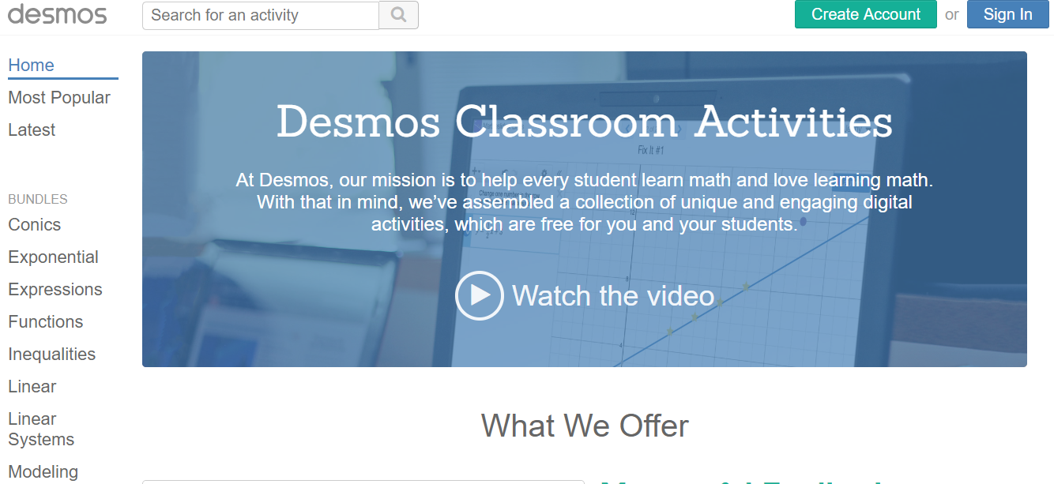
Teacher.desmos.com
Notes:
Facilitator: Click on the image to access teacher.desmos.com. Show participants how to get codes, find activities, etc. Take time here to return to Desmos to discuss how to find teacher activities, that using the graphing calculator in instruction is ok even if the tested calculator is the scientific.

Slide 54
Proportional Reasoning
Lesh, Post and Behr (1988, p.93) call proportional reasoning “the capstone of children's elementary arithmetic” and
“the cornerstone of all that is to follow”
Notes:
Facilitator: Allow participants to read this to remind them that we continue to focus on proportional relationships in the afternoon as well. Stress the theme that we are the cornerstone to build a strong foundation for higher level mathematics.

Slide 55
III. Teaching Practices: Support Productive Struggle Use and Connect Mathematical Representations
Notes:
Facilitator: We begin Module 3 where we focus primarily on the teaching practice Supporting Productive Struggle which is supported by the teaching practice Use and Connect Mathematical Representations.

Slide 56
Teaching Framework for Mathematics
Adapted from Smith, M. et al. (2017) Taking Action – Implementing Effective Mathematics Teaching Practices Series, National Council of Teachers of Mathematics.
Notes:
Facilitator: Remind participants of this graphic from the book and the connections of the 8 teaching practices – specifically the 4 we are discussing regarding discourse today.

Slide 57
Essential Questions
How does supporting productive struggle promote equity, student agency, and identity?
How does using and connecting mathematical representations improve efforts to support productive struggle?
Notes:
Facilitator: Take a moment to read the essential questions for this Module.

Slide 58
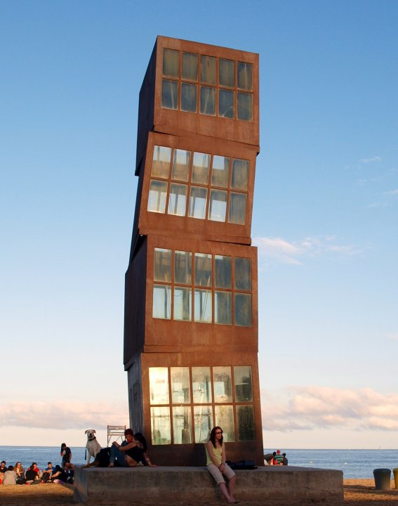
Telling the Tale Task
Notes:
Facilitator: This slide just lets participants know we are about to begin a task.

Slide 59
Vertical Progression:
8.16
Proportional Relationships
7.10
6.12
Notes:
Facilitator: Participants already have the curriculum framework pages from the Lemonade Stand Task. Really make sure participants are aware of the framework and prepared to use it for their planning.

Slide 60
Telling the Tale Task - Launch
Video launch

Slide 61
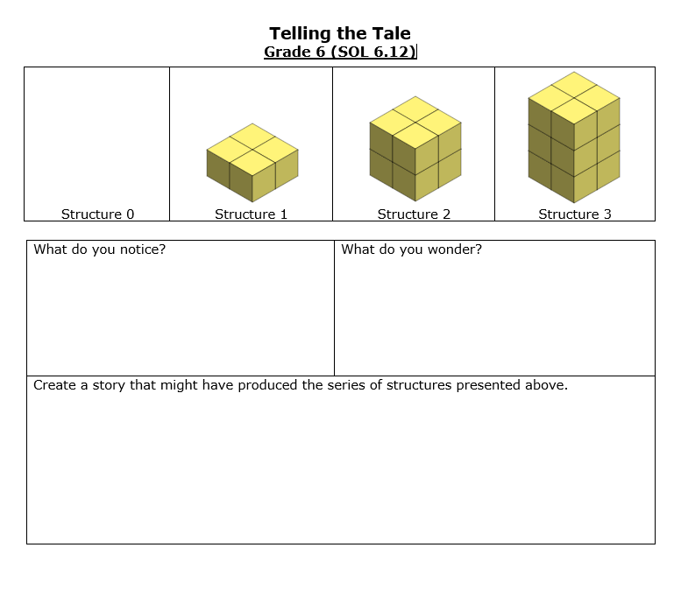
Telling the Tale Task: SOL 6.12
Notes:
Facilitator: Distribute the 6th grade, 7th grade and 8th grade tasks. We will begin with the 6th grade task. Stress that these tasks are scaffolded. Educators can edit, as appropriate, to make them more open-ended. Direct participants to work on the task as shown on the slide. While participants work, circulate and share thoughts and hear theirs.

Slide 62
Telling the Tale Task
Independently: Explore the task and begin solving for 5 minutes
Partner or Group: continue work for 10 minutes
Notes:
Facilitator: Direct participants to work on the task as shown on the slide. While participants work, facilitators circulate to listen to thoughts and pick someone to share answers to the final two questions. Facilitators may need to DRAW a double number line to share with participants.

Slide 63
Supporting Productive Struggle
Four types of teacher responses to struggle (Warshauer, 2015b, p.387):
Telling
Directed Guidance
Probing Guidance
Affordance
Notes:
Facilitator: Share the four types of teacher responses to this specific task:
Telling – to be a proportional relationship you must divide the numbers in the table and get the same result each time
Directed Guidance - if you would divide the numbers in the table, you would be able to determine the unit rate.
Probing Guidance - tell me how you got the numbers in your table, I’m wondering if you could expand your table to structures that aren’t in the picture or asked for (offered an idea based on student thinking)
Affordance - tell me what you have here, so how can this help you use the unit rate

Slide 64
Supporting Productive Struggle
Supporting students who can’t get started:
Select a task that has multiple entry points.
Make sure your launch has specifics regarding expectations and/or background knowledge.
Ask questions to determine what the students understand.
Notes:
Facilitator: Tell participants they can refer to pp 185-187 in Taking Action. Explain the bullets with specific attention to the third:
third bullet ask questions to determine what students understand - teacher might ask: “What is an unrealistic number of cubes in a structure?” “what is happening in each structure?” What do you know about the structures we can’t see yet?” “can you build it with cubes?”

Slide 65
Supporting Productive Struggle
Four strategies for supporting productive struggle (Warshauer, 2015a, p. 392):
question
encourage
give time
acknowledge
Notes:
Facilitator: Explain the four strategies with this information:
Questioning makes student thinking public
Encourage students to reflect, reconsider or revise thinking
Give time to work without hovering to send the message that the teacher has the confidence the students can do the work without her assistance
Acknowledge the effort and ability to work through the problem.

Slide 66
Telling the Tale Task: SOL 7.10
Notes:
Facilitator: Direct participants to review 7th grade Telling the Tale Task. Part I series is the series the 6th grade task investigated for proportional relationships. Part II includes the series that investigates additive relationships to follow along with the vertical alignment to 7th grade SOL 7.10.

Slide 67
Telling the Tale Task: SOL 7.10
6th
7th

Slide 68
Telling the Tale Task
Independently: Explore the task and begin solving Part II of the 7th grade task for 5 minutes
Partner or Group: continue work on Part II for 5 minutes
Notes:
Facilitator: Share directions for working on 7th grade so they can see how it grows on the 6th grade

Slide 69
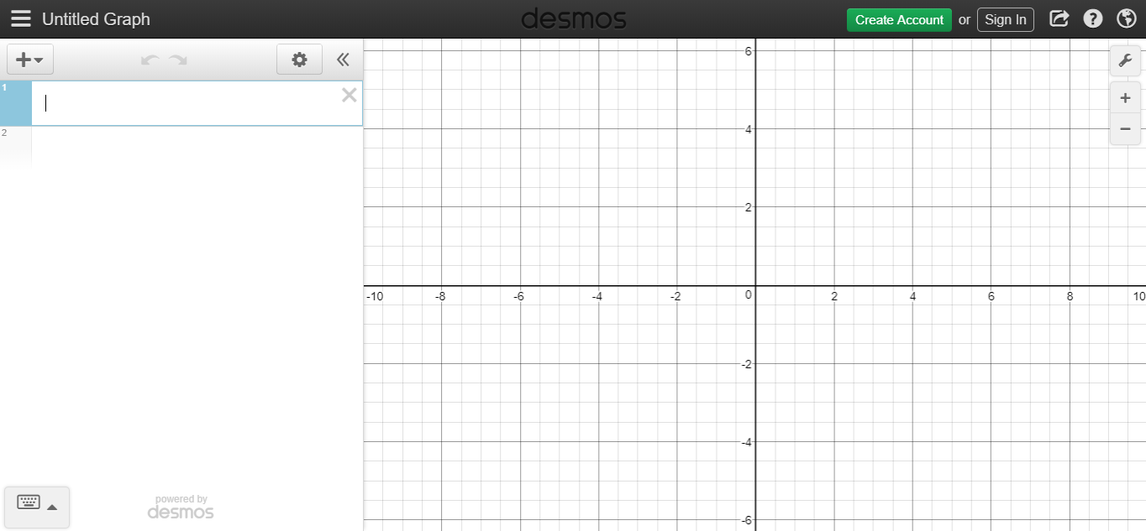
Telling the Tale Task
Notes:
Facilitator: Click on the image to link to www.desmos.com. As participants set up an account or login, distribute the “Desmos to Make Connections” document and work through together on computers.

Slide 70
Telling the Tale Task
Lesson Planning PRIOR
Notes:
Facilitator: Ask participants to share in the way the facilitator decided using the Telling the tale 6th grade select sequence connect guide and explain the process of “select, sequence, and connecting” as you have them present. Distribute “Telling the Tale Lesson Plan” that we prepared ahead of time so that we would have questions to ask you and a place to record what you saw in the groups

Slide 71
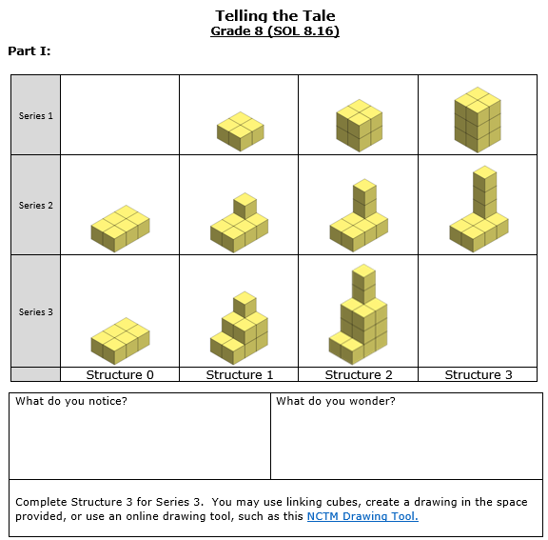
Telling the Tale Task: SOL 8.16
Notes:
Facilitator: Direct participants to review 8th grade Telling the Tale Task. The NCTM Isometric Drawing Tool is attached if you click on the area where you see NCTM Drawing Tool. May want to open up and build some of series 3 together.

Slide 72
Telling the Tale Task
Independently: Explore the task and begin solving the 8th grade task for 5 minutes
Partner or Group: continue work on the 8th grade task for 10 minutes
Notes:
Facilitator: Share directions for working on 8th grade so they can see how it grows on the 7th grade

Slide 73
Telling the Tale Task
Notes:
Facilitator: Share 8th grade on desmos . . . Click on the image to connect to https://www.desmos.com/calculator/b6vkob4nla.

Slide 74
Connecting to the Curriculum Framework
8.16
7.10
6.12
Notes:
Facilitator: Discuss the Essential Knowledge and Skills for each grade level and how they were covered in the tasks. Highlight the boundaries that should be upheld to develop this content for students.

Slide 75
Support Productive Struggle - Research
Count off by 5’s
Rearrange to meet with a group of colleagues that share your number.
Each number group receives one “new expectation for students”
Brainstorm two things:
teacher actions consistent with expectations
indicators of success
Pick a group member to share
Notes:
Facilitator: Prepare “new expectations for students” (printed front to back so the front has the student expectations and back has space to write the teacher actions and indicators of success to distribute as you explain “new expectations for students” on individual papers to hand to the groups
Have participants count off by 5s. Once in groups by number (labelled in the morning) ask them to consider answers to TWO QUESTIONS
Now that we expect these things from students - 1. What will you do as the teacher to make this happen? and 2. How will you know you’ve done it?
About 10 participants/group . . . Need a recorder and presenter
The next 5 slides prompt whole group sharing.
pg 189 in Taking Action provides more information

Slide 76
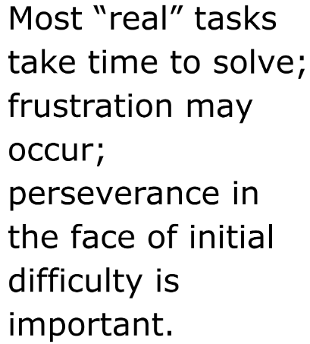
New Expectations for Students

Slide 77
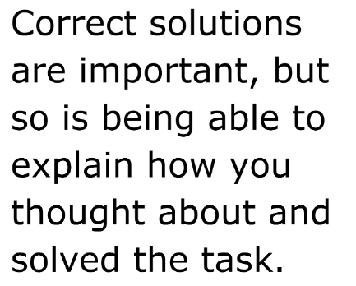
New Expectations for Students

Slide 78
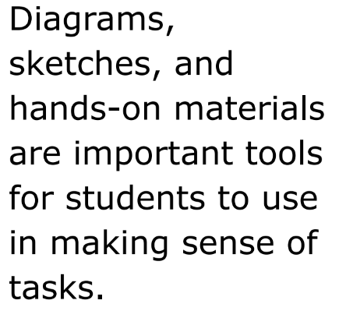
New Expectations for Students

Slide 79
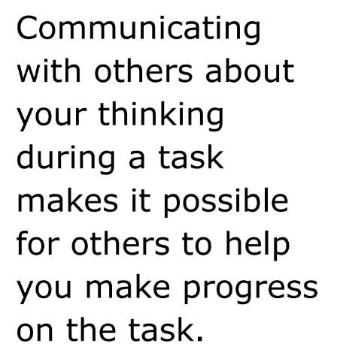
New Expectations for Students

Slide 80
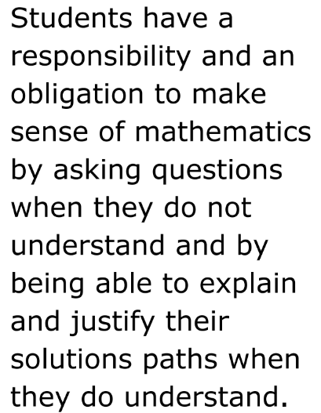
New Expectations for Students

Slide 81
Support Productive Struggle - Promoting Equity
ensure each student has access to challenging mathematical work
teachers believe that all students can learn mathematics
reasonable and appropriate accommodations are made as needed
Notes:
Facilitator: For each teaching practice in the book there is a section on promoting equity with that practice. These are the points the authors found most important.

Slide 82
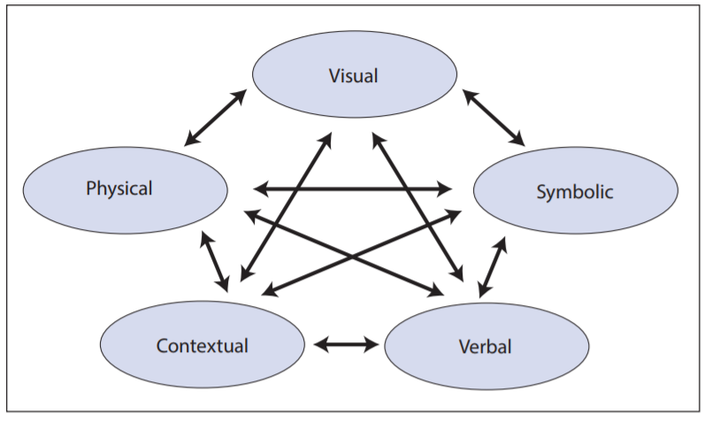
Use and Connect Mathematical Representations
Adapted from NCTM 2014, p. 25
Notes:
Facilitator: Share this visual as a reminder of how to use and connect mathematical representations.

Slide 83
Use and Connect Mathematical Representations - Research
pg 119 “...early and consistent work moving across multiple representations, including context through the use of meaningful contextual tasks, helps students better understand why mathematics works and how to deploy mathematical tools effectively and efficiently.”
“The use of manipulatives and pictures should not fade in the middle grades but should continue alongside the development of more mathematically specific representations like symbolic expressions and equations, tables, and graphs (Tripathi 2008).”
Notes:
Facilitator: For each teaching practice in the book there is research to support its importance. These are the points the authors liked best.

Slide 84
Use and Connect Mathematical Representations - Promoting Equity
Allowing entry at different levels - such as building with manipulatives, drawing pictures, or creating tables - can help students engage in the mathematical ideas in ways that make sense to them.
“...allows students to draw on multiple resources of knowledge, one of the five equity-based practices (Aguirre, Mayfield-Ingram, and Martin 2013).”
teachers must explicitly value and encourage multiple mathematical representations...
Notes:
Facilitator: For each teaching practice in the book there is a section on promoting equity with that practice. These are the points the authors found most important.

Slide 85
Levels of Classroom Discourse
Finally explore where your classroom is with the “Mathematical Representations” column as you sort the remaining GOLD/ORANGE papers.
Notes:
Facilitator: Get the gold/orange papers from your folder and sort them from 0-3 on the dark green sorting page.

Slide 86
Components and Levels of a Math Talk Learning Community
 | Mathematical representations
Level 0 | Representations are missing, or teacher shows them to students.
Level 1 | Students learn to create math drawings to depict their mathematical thinking.
Level 2 | Students label their math drawings so that others are able to follow their mathematical thinking.
Level 3 | Students follow and help shape the descriptions of others’ math thinking through math drawings and may suggest edits in others’ math drawings.
Notes:
Facilitator: Participants reflect on their self-perceived level as well as the levels of their colleagues. Distribute the completed version of our sorts.

Slide 87
Reflect on Essential Questions
How does supporting productive struggle promote equity, student agency, and identity?
How does using and connecting mathematical representations improve efforts to support productive struggle?
Notes:
Facilitator: Take a moment to read the essential questions for this Module.

Slide 88
Time to Reflect
Complete Module III section of reflection document
How does supporting productive struggle promote equity, student agency, and identity?
How does using and connecting mathematical representations improve efforts to support productive struggle?
Notes:
Facilitator: Direct participants to return to the reflection document and write thoughts on individual classroom change and how to provide professional development on the topics from Module 3. Provide time for participants to share reflections.

Slide 89
IV. Taking Action – Next Steps
Notes:
Facilitator: This final Module is bringing it all together and deciding how you will take action!

Slide 90
Essential Questions
How will the teaching practices shared today (Supporting Productive Struggle, Posing Purposeful Questions, Using and Connecting Mathematical Representations, and Eliciting and Using Evidence of Student Thinking) facilitate meaningful mathematical discourse?
How does facilitating meaningful mathematical discourse promote equity?
Notes:
Facilitator: Take a moment to read the essential questions for this Module.

Slide 91
Summarizing
Climate
Process goals connected to 8 mathematical practices
Technology - including Desmos
Equity
Thoughtful and thorough lesson planning
Reflection is deliberate
Notes:
Facilitator: Share this quick summary on what we have discussed during the day.

Slide 92
Teaching Framework for Mathematics
Adapted from Smith, M. et al. (2017) Taking Action – Implementing Effective Mathematics Teaching Practices Series, National Council of Teachers of Mathematics.
Notes:
Facilitator: Remind participants that they saw this slide at the beginning of the presentation and how interrelated the 8 teaching practices are. We focused on the gray box 4 practices to facilitate meaningful mathematical discourse.

Slide 93
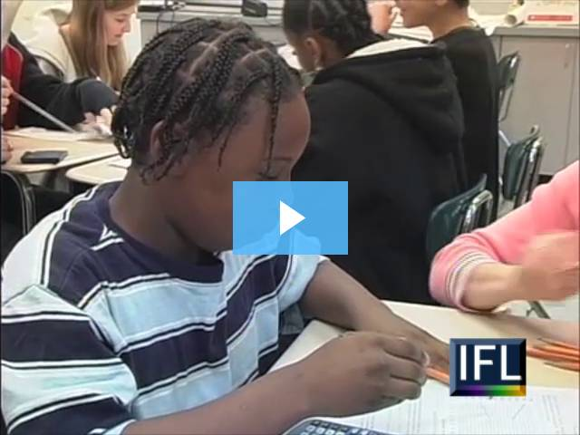
List evidence of all four practices in the video of Elizabeth Brovey’s classroom.
Notes:
Facilitator: Share with participants that in Taking Action on page 151 the task is presented if you want a quick look at it
Distribute Video Reflection sheet and ask participants to watch the video clip and record evidence of the four practices (posing purposeful questions, eliciting and using evidence of student thinking, supporting productive struggle, using and connecting mathematical representations).

Slide 94
2016 Mathematics Standards of Learning - Instructional Resources
Currently Available
2016 Mathematics Standards of Learning and Curriculum Frameworks
2009 to 2016 Crosswalk (summary of revisions) documents
Narrated Crosswalk Presentations
Test Blueprints for SOL Assessments
2017 SOL Mathematics Institutes PD Resources – includes progressions for select 2016 content
Sample K-3 Mathematics Achievement Records
Vocabulary Word Wall Cards – 2016 SOL
Mathematics Instructional Plans (formerly Enhanced Scope and Sequence) correlated to 2016 SOL
Co-teaching Mathematics Instructional Plans 2016 SOL
Resources – Tentatively Scheduled to be Available Fall 2018
Mathematics Instructional Videos
Notes:
Facilitator: Remind participants of materials provided on VDOE site UPDATE BEFORE PRESENTING

Slide 95
Reflect on Essential Questions
How will the teaching practices shared today facilitate meaningful mathematical discourse?
How does facilitating meaningful mathematical discourse promote equity?
Notes:
Facilitator: Take a moment to read the essential question for this Module. Give participants time for reflection on an individual basis.

Slide 96
Time to Reflect
Based on all
module reflections,
how will you provide professional development on these teaching practices?
Notes:
Facilitator: Direct participants to use the final portion of the reflection sheet to merge all thoughts from the day into an actionable plan. Provide an opportunity for participants to share their thoughts regarding how they will share today’s information with others in their district.

Slide 97
Please contact us
The VDOE Mathematics Team at
Mathematics@doe.virginia.gov

