Slide 1
2018 Mathematics Institute
3-5 Session

Slide 2
Welcome and Introductions

Slide 3

That’s Me!
Notes:
https://www.freeimages.com/search/that-me/3

Slide 4
Stand up if this is refers to you…
Summer is your favorite season
Traveled more than an hour to get here today
Addicted to a show on Netflix
Read for fun last night
Thought today was Friday
If you teach or support grade 3
If you teach or support grade 4
If you teach or support grade 5
If you teach or support something else
If you love mathematics
If you love working with children

Slide 5
Agenda
Welcome and Introductions
Facilitate Meaningful Discourse
  Mathematical Community
Pose Purposeful Questions
  Fractions
  Geometry - Polygons
Elicit and Use Evidence of Student Thinking
  Computational Fluency
Taking Action – Next Steps

Slide 6
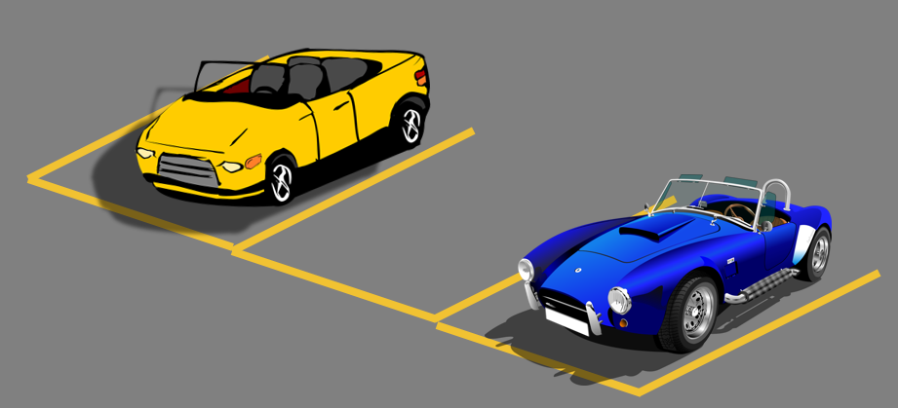
Parking Lot

Slide 7
Today’s Goals and Outcomes
Be able to plan to implement tasks to facilitate meaningful mathematical discourse by:
  Posing purposeful questions
  Eliciting and using evidence of student thinking

Slide 8
Mathematics Process Goals for Students
“The content of the mathematics standards is intended to support the five process goals for students”
- 2009 and 2016 Mathematics Standards of Learning
Communication
Connections
Representations
Problem Solving
Mathematical Understanding
Reasoning

Slide 9
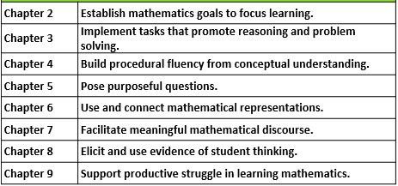

Eight Effective Mathematics Teaching Practices
Adapted from Leinwand, S. et al. (2014) Principles to Actions – Ensuring Mathematical Success for All, National Council of Teachers of Mathematics.
Adapted from Leinwand, S. et al. (2014) Principles to Actions – Ensuring Mathematical Success for All, National Council of Teachers of Mathematics.

Slide 10
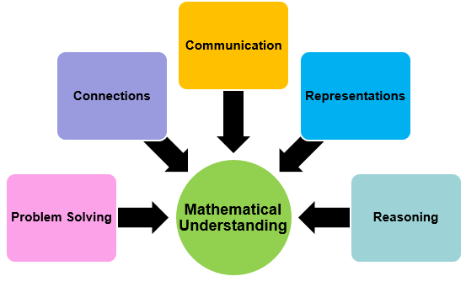
What’s the connection?
Eight Effective Mathematics Teaching Practices
Establish mathematics goals to focus learning.
Implement tasks that promote reasoning and problem solving.
Build procedural fluency from conceptual understanding.
Pose purposeful questions.
Use and connect mathematical representations.
Facilitate meaningful mathematical discourse.
Elicit and use evidence of student thinking.
Support productive struggle in learning mathematics.
3
2
4
1
5
Making the Connection
Count off 1-5.
Go to the labeled place in the room for 1-5.
Discuss your assigned process goal and practice.
Note ways that this goal connects to the 8 Practices on the matrix.
Notes:
Change out slide

Slide 11
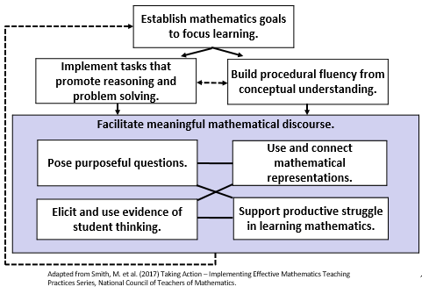
Teaching Framework for Mathematics
Taking Action
page 245

Slide 12
I. Teaching Practice:
Facilitate Meaningful Discourse

Slide 13
Teaching Framework for Mathematics

Slide 14

Essential Question
What elements must be in place to support meaningful mathematical discourse?
On your Own:
Jot down a few ideas on your reflection sheet. We will share and compare later.
Notes:
2 minutes

Slide 15

Which One Doesn’t Belong? Why?

Slide 16
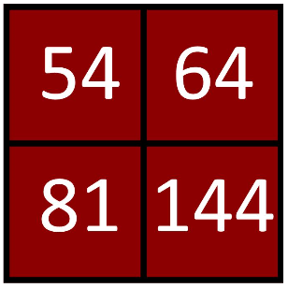
Sense Making Routine
Which One Doesn’t Belong? Why?

Slide 17
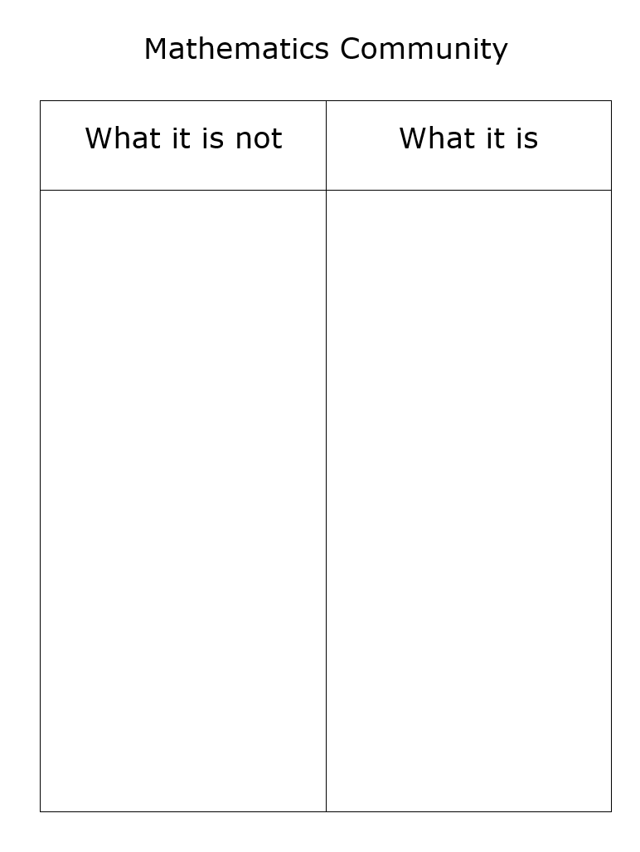
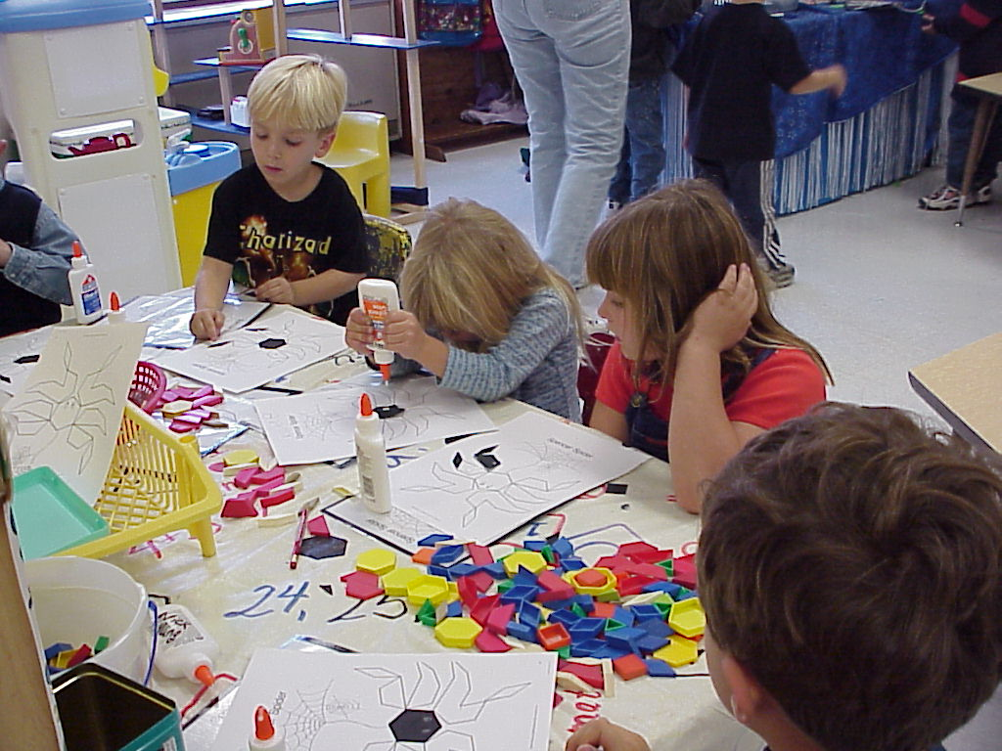
Establishing a Mathematics Community

Slide 18
Mathematics Community
What it is NOT: | What it is:
Teachers doing most of the math | Students doing most of the math
Assigned tasks | Student choice
Teachers showing the procedure and talking about the steps to follow | Students talking about their mathematical thinking and reasoning
Teachers as holders of knowledge | Teachers acting as facilitators – asking good questions
Students working in isolation; sharing answers or strategies is cheating | Students working collaboratively and learning from one another
Teachers rescuing students | Students struggling with challenging mathematics and learning from errors
Teachers presenting to the whole class | Teacher working with small groups
Focused on procedural skill | Focused on conceptual understanding

Slide 19
Sentence Frames for Students
I agree with ____________ because …
I respectfully disagree with that because …
I still have questions about …
I’m confused by…
I have a different perspective because …
I connected with what ____ said because
I chose this method because _________
I would like to defend the answer ________
Could you say more?
I was wondering?
I have a question about ____________?
I like how you explained this because _____________.
I would like to revise my thinking.
I would like to defend my thinking.
Taking Action book – page 105
Adapted from Smith, M. S., et al. (2017). Taking Action: Implementing Effective Mathematics Teaching Practices, p. 105, National Council of Teachers of Mathematics.

Slide 20
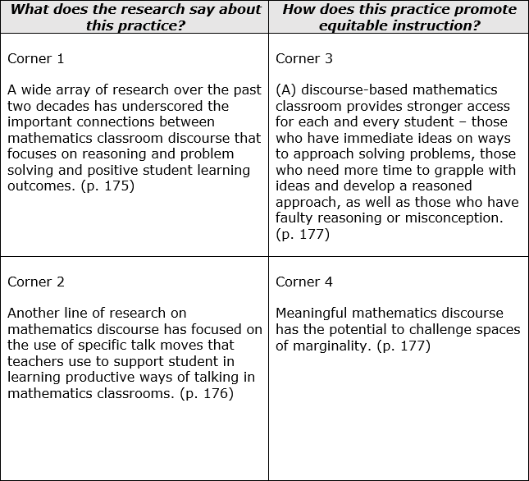
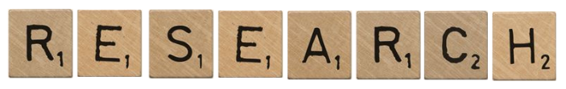
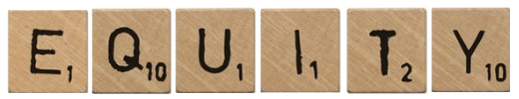
Research and Equity

Slide 21
Reflection -
Essential Questions
What elements must be in place to support meaningful mathematical discourse?
How does promoting meaningful mathematical discourse promote equity in the classroom?

Slide 22
II. Teaching Practice:
Pose Purposeful Questions

Slide 23
Teaching Framework for Mathematics

Slide 24
Essential Questions
How can posing purposeful questions be used to inform instruction and assess student understanding?
How does posing purposeful questions promote equitable learning opportunities for all students?

Slide 25
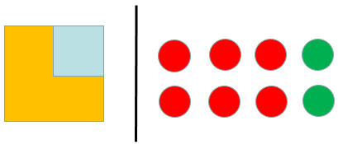
Sense Making Routine
How are these representations alike?
How are they different?
McCoy, Barnett and Combs (2013). High Yield Routines, p. 21, National Council of Teachers of Mathematics.

Slide 26
Vertical Progression:
Fraction Sense
5.2
4.2
3.2
What do students need to know?
How do these standards connect?
How does the progression of these standards build fraction sense?

Slide 27
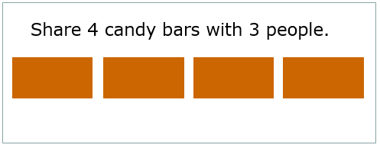
Examining Questions
Reference: Mathematics Instructional Plan: Candy Bar Fractions, Grade 3, VDOE, 2018.

Slide 28
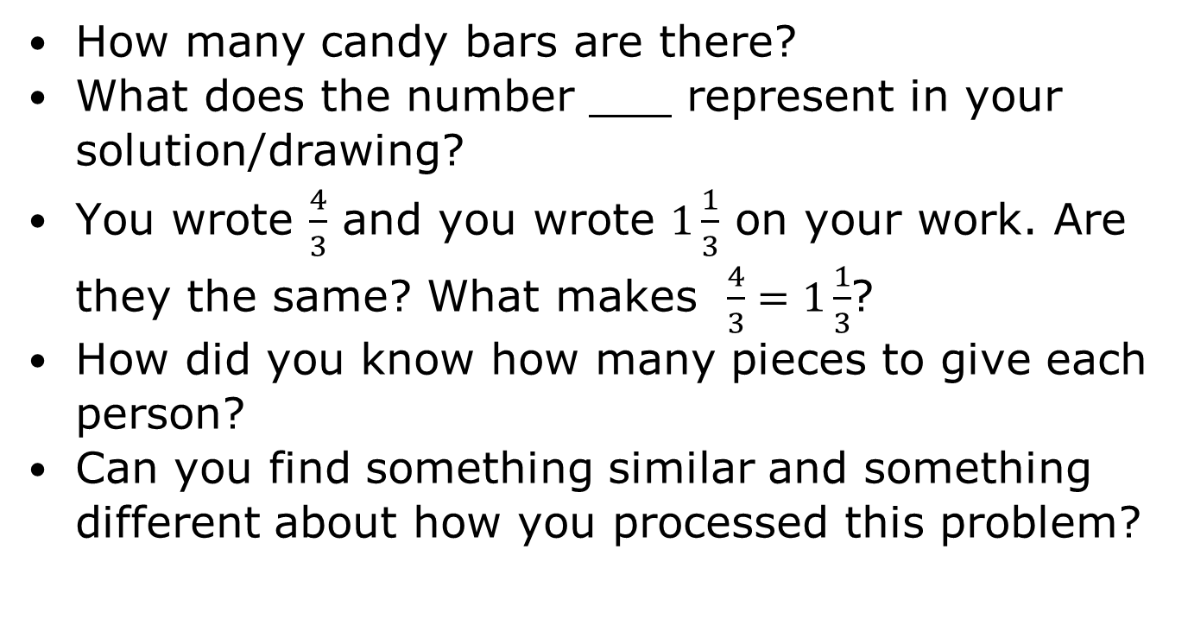
Teacher Asked Questions

Slide 29
Reflect on the Questions
What do you notice about the questions the teacher asked?
What purpose did each question appear to serve?
Which questions reveal insights into students’ understanding and strategies?
Which questions orient students to each other’s reasoning?

Slide 30
Five Types of Questions
READ: Taking Action book – page 102
Question Type | Purpose
Gathering Information | Ask students to recall facts, definitions, or procedures.
Probing thinking | Ask students to explain, elaborate, or clarify their thinking, including articulating the steps in solution methods or completion of a task.
Making the mathematics visible | Ask students to discuss mathematical structures and make connections among mathematical ideas and relationships.
Encouraging reflection and justification | Reveal deeper insight into student reasoning and actions, including asking students to argue for the validity of their work.
Engaging with the reasoning of others | Help students to develop an understanding of each other’s solution paths and thinking, and lead to the co-construction of mathematical ideas.
Adapted from Smith, M. S., et al. (2017). Taking Action: Implementing Effective Mathematics Teaching Practices, p. 102, National Council of Teachers of Mathematics.

Slide 31
Question Stems for Teachers
That seems really important, who can say that another way?
Who can say that back in your own words?
What does she mean when she says …?
Who can add on to that explanation…?
Do you agree or disagree with …? Why?
Turn and talk to a partner about … Who can tell the class what your partner said?
Let’s all try using __________’s method for this new problem.
Who has a similar way of looking at that?
Who has a different way?
Let’s take a look at these two approaches. How are they similar? How are they different?
Taking Action – page 105
Adapted from Smith, M. S., et al. (2017). Taking Action: Implementing Effective Mathematics Teaching Practices, p. 105, National Council of Teachers of Mathematics.
Notes:
SpencerCreate handout and table to add to this slide from page 105

Slide 32
Vertical Progression:
Geometry - Polygons
5.12
5.13
What do students need to know?
How do these standards connect?
How does the progression of these standards build mathematical relationships?
4.11
4.12
3.12
Notes:
Lynne
Meet up with a different vertical group

Slide 33
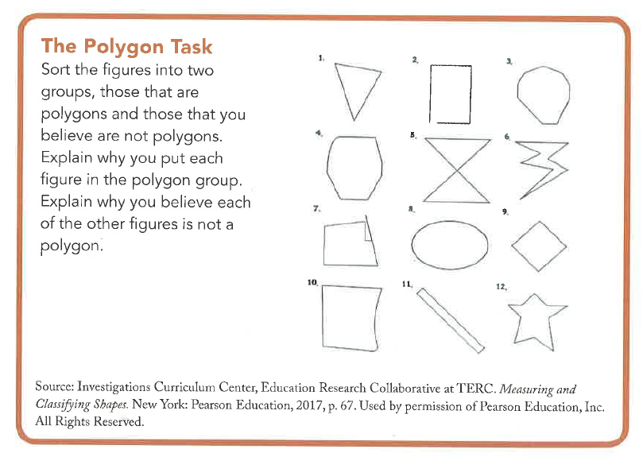
The Polygon Task
Now it’s your turn!
Familiarize yourself with the Polygon Task.
Collaborate to create different types of questions that you would ask students as they work this task.
Question Type | Examples of Questions
Gathering Information
Probing thinking
Making the mathematics visible
Encouraging reflection and justification
Engaging with the reasoning of others
Notes:
Task on page 25

Slide 34
Essential Questions
How can posing purposeful questions be used to inform instruction and assess student understanding?
How does posing purposeful questions promote equitable learning opportunities for all students?

Slide 35
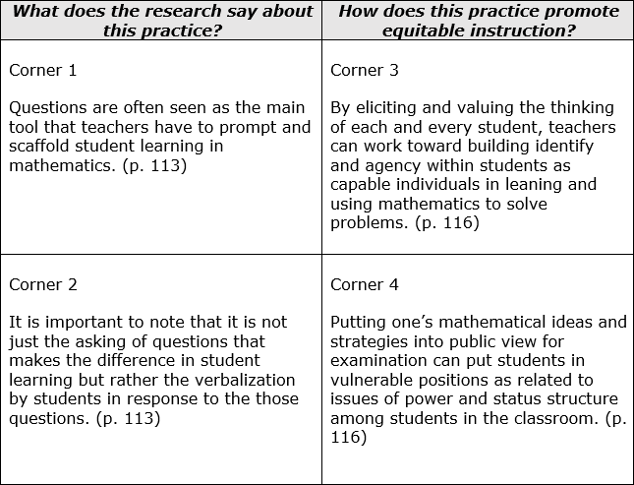
Research and Equity

Slide 36
Pose Purposeful Questions - Promoting Equity
Positioning the way students are “entitled, expected, and obligated to interact with one another as they work on content together” (Gresalfi and Cobb 2006, p 51)
Considerations:
  Are all students ideas and questions heard, valued and pursued?
  Who does the teacher call on?
  Whose ideas does the class examine and discuss?
  Whose thinking does the teacher select for further inquiry and whose thinking does the teacher disregard?

Slide 37
III. Teaching Practice: Elicit and Use Evidence of Student Thinking

Slide 38
Teaching Framework for Mathematics

Slide 39
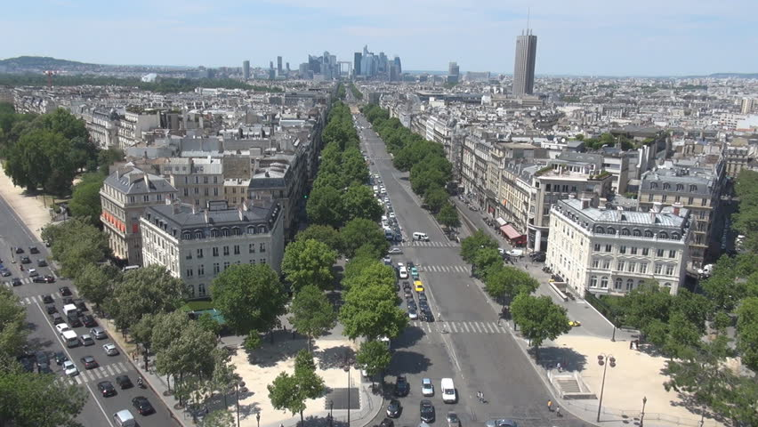

Sense Making Routine
Would you rather:
Spend one week in the city or in the mountains?

Slide 40

Sense Making Routine
Would you rather:
Read a book or go to the movies?

Slide 41
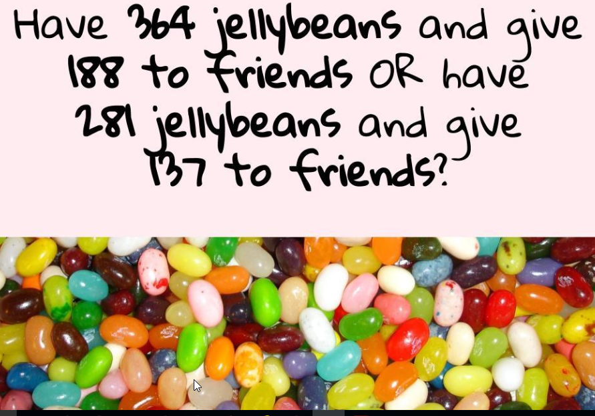
Sense Making Routine
Would you rather:

Slide 42
Essential Questions
How can eliciting and using evidence of student thinking be used to inform instruction and assess student understanding?
How does eliciting and using evidence of student thinking promote equity in the mathematics classroom?

Slide 43
Ambitious Teaching
Ambitious mathematics teaching involves skilled ways of eliciting and responding to each and every student in the class so that they learn worthwhile mathematics and come to view themselves as competent mathematicians.
Smith, M. S., et al. (2017). Taking Action: Implementing Effective Mathematics Teaching Practices, p. 4, National Council of Teachers of Mathematics.

Slide 44
Ambitious Teaching
The goal of ambitious teaching is to ensure that each and every student succeeds in doing meaningful, high-quality work, not simply executing procedures with speed and accuracy.
Smith, M. S., et al. (2017). Taking Action: Implementing Effective Mathematics Teaching Practices, p. 4, National Council of Teachers of Mathematics.

Slide 45
Assessing or Advancing Questions
Assessing Questions | Advancing Questions
Based closely on the student’s current work and approach. Clarify aspects of the student work and approach and what the student understands about that work or approach. Provide information to the teacher about what the student understands about the mathematical ideas and relationships. Teacher STAYS to hear the answer to the question. | Use student work as a basis for making progress toward the target goal. Move student beyond their current thinking by pressing students to extend what they know to a new situation. Prompt students to think about a mathematical idea they are not currently considering. Teacher WALKS AWAY, leaving students to figure out how to proceed.
Smith, M. S., et al. (2017). Taking Action: Implementing Effective Mathematics Teaching Practices, p. 110, National Council of Teachers of Mathematics.

Slide 46
Intentional advance planning
Intentional advance planning is the key to effective teaching. Intentional planning shoulders much of the burden of teaching by replacing on-the-fly decision making during a lesson with careful investigation into the what and how of instruction before the lesson is taught.
Stigler, James W. and James Hiebert. (1999), p. 156, The Teaching Gap: Best Ideas from the World’s Teachers for Improving Education in the Classroom. New York:Simon and Schuster.
Notes:
Page 248
Cite original quote
connect back to question stems and highlight being intentional in planning

Slide 47
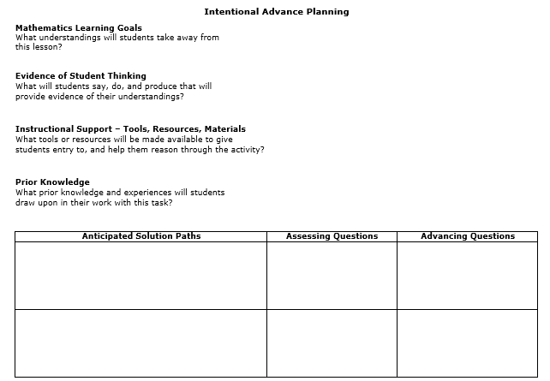
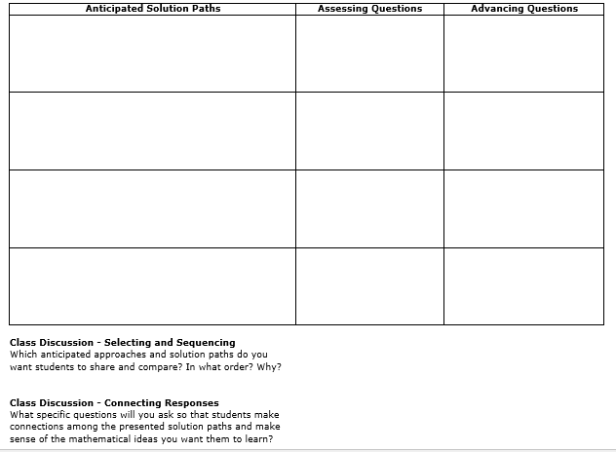
Questions to Ask for Thoughtful and Intentional Advance Planning
Adapted from Smith, M. S., et al. (2017). Taking Action: Implementing Effective Mathematics Teaching Practices, National Council of Teachers of Mathematics.

Slide 48
Vertical Progression:
Computational Fluency
5.4
What do students need to know?
How do these standards connect?
How does the progression of these standards build mathematical relationships?
4.4
3.3
3.4

Slide 49
Using Intentional Advance Planning
Adapted from Smith, M. S., et al. (2017). Taking Action: Implementing Effective Mathematics Teaching Practices, National Council of Teachers of Mathematics.

Slide 50
Grade Level Tasks
Grade | Task
3 | If 30 markers are placed into school boxes with each box containing 6 markers, how many school boxes can be filled?
4 | Timmy has a jar of 725 small candies. If he eats 20 candies a day, how many days will the candies last?
5 | Ben and Maria order flyers to advertise their yard sale. Flyers cost $8.75 for the first 40, and $1.50 for each additional 20. The bill was $19.25. How many flyers did they order?
Reference: Curriculum Framework, Essential Understanding for Standards for 3.4, 4.4 and 5.4 VDOE, 2018.

Slide 51
Essential Questions
How can eliciting and using evidence of student thinking be used to inform instruction and assess student understanding?
How does eliciting and using evidence of student thinking promote equity in the mathematics classroom?

Slide 52
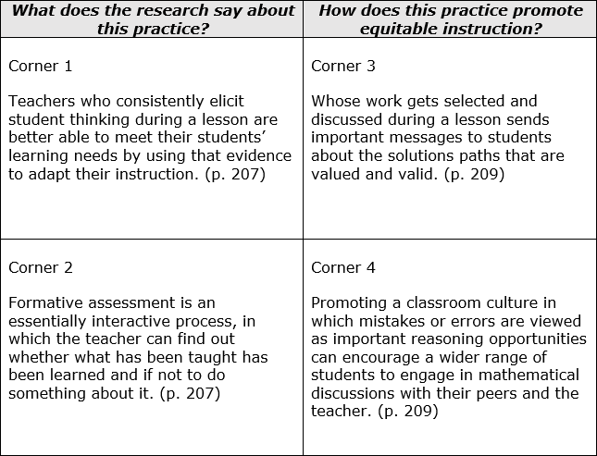
Research and Equity

Slide 53
IV. Taking Action – Next Steps

Slide 54
Essential Questions
How will you plan to implement tasks to facilitate meaningful mathematical discourse?
How will you share this information with others?

Slide 55
Putting it All Together
“Identifying a set of practices that aims at complex outcomes for all students is a first step toward strengthening the teaching profession. These practices could provide a common foundation for teacher education, a common professional language, and a framework for appraising and improving teaching.”
Smith, M. S., et al. (2017). Taking Action: Implementing Effective Mathematics Teaching Practices, p. 243, National Council of Teachers of Mathematics.

Slide 56
Components of a Math Talk Learning Community
Teacher role
Questioning
Explaining mathematical thinking
Mathematical representations
Building student responsibility within the community
Smith, M. S., et al. (2017). Taking Action: Implementing Effective Mathematics Teaching Practices, National Council of Teachers of Mathematics.

Slide 57
Components and Levels of a Math Talk Learning Community
 | Teacher role | Questioning | Explaining mathematical thinking | Mathematical representations | Building student responsibility within the community
Level 0
Level 1
Level 2
Level 3

Slide 58
Components and Levels of a Math Talk Learning Community
 | Teacher role
Level 0 | Teacher is at the front of the room and dominates the conversation.
Level 1 | Teacher encourages the sharing of math ideas and directs speaker to talk to the class, not to the teacher only.
Level 2 | Teacher facilitates conversation between students and encourages students to ask questions to one another.
Level 3 | Students carry the conversations themselves. Teacher only guides from the periphery of the conversation. Teacher waits for students to clarify thinking of others.
 | Teacher role
Level 0
Level 1
Level 2
Level 3

Slide 59
Components and Levels of a Math Talk Learning Community
 | Questioning
Level 0
Level 1
Level 2
Level 3
 | Questioning
Level 0 | Teacher is only questioner. Questions serve to keep students listening to teacher. Students give short answers and respond to teacher only.
Level 1 | Teacher questions begin to focus on student thinking and less on answers. Only teachers ask questions.
Level 2 | Teacher asks probing questions and facilitates some student-to-student talk. Students ask questions of one another with prompting from teacher.
Level 3 | Student-to-student talk is student initiated. Students ask questions and listen to responses. Many questions ask “why” and call for justification. Teacher questions may still guide discourse.

Slide 60
Components and Levels of a Math Talk Learning Community
 | Explaining mathematical thinking
Level 0 | Teacher questions focus on correctness. Students provide short answer-focused responses. Teacher may give answers.
Level 1 | Teacher probes student thinking somewhat. One or two strategies may be elicited. Teacher may fill in an explanation. Students provide brief description of their thinking in response to teacher probing.
Level 2 | Teacher probes more deeply to learn about student thinking. Teacher elicits multiple strategies. Students respond to teacher probing and volunteer their thinking. Students begin to defend their answers.
Level 3 | Teacher follows student explanations closely. Teacher asks students to contrast strategies. Students defend and justify their answers with little prompting from the teacher.
 | Explaining mathematical thinking
Level 0
Level 1
Level 2
Level 3

Slide 61
Components and Levels of a Math Talk Learning Community
 | Mathematical representations
Level 0
Level 1
Level 2
Level 3
 | Mathematical representations
Level 0 | Representations are missing, or teacher shows them to students.
Level 1 | Students learn to create math drawings to depict their mathematical thinking.
Level 2 | Students label their math drawings so that others are able to follow their mathematical thinking.
Level 3 | Students follow and help shape the descriptions of others’ math thinking through math drawings and may suggest edits in others’ math drawings.

Slide 62
Components and Levels of a Math Talk Learning Community
 | Building student responsibility within the community
Level 0 | Culture supports students keeping ideas to themselves or just providing answers when asked.
Level 1 | Students believe that their ideas are accepted by the classroom community. They begin to listen to one another supportively and to restate in their own words what another student has said.
Level 2 | Students believe that they are math learners and that their ideas and the ideas of their classmates are important. They listen actively so that they can contribute significantly.
Level 3 | Students believe that they are math leaders and can help shape the thinking of others. They help shape others’ math thinking in supportive, collegial ways and accept the same support from others.
 | Building student responsibility within the community
Level 0
Level 1
Level 2
Level 3

Slide 63
2016 Mathematics Standards of Learning - Instructional Resources
Currently Available
2016 Mathematics Standards of Learning and Curriculum Frameworks
2009 to 2016 Crosswalk (summary of revisions) documents
Narrated Crosswalk Presentations
Test Blueprints for SOL Assessments
2017 SOL Mathematics Institutes PD Resources – includes progressions for select 2016 content
Sample K-3 Mathematics Achievement Records
Vocabulary Word Wall Cards – 2016 SOL
Mathematics Instructional Plans – 2016
Resources – Anticipated in Fall 2018
Mathematics Instructional Videos
NEW

Slide 64
Resources for initiating student engagement:
Which one doesn't belong
Dot images
Table Talk Math
Real World Images
Would you rather math
Estimation 180
101 Questions

Slide 65
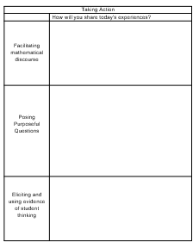
Essential Questions
How will you plan to implement tasks to facilitate meaningful mathematical discourse?
How will you share this information with others?

Slide 66
Contact the VDOE Mathematics Team at mathematics@doe.virginia.gov

