Slide 1
2018 Mathematics SOL Institute General Session
October 4, 2018 – Wytheville
October 5, 2018 – Roanoke
October 15, 2018 – Fredericksburg
October 16, 2018 – Virginia Beach
October 17, 2018 - Richmond

Slide 2
VDOE General Session Agenda
Education in Virginia - Update
Mathematics Institute – Defining the Focus
Effective Mathematics Teaching Practices
Access and Equity in Mathematics Teaching
Implementation of the 2016 Mathematics Standards of Learning
Assessing the 2016 Mathematics SOL

Slide 3
Education in Virginia - Update

Slide 4
Virginia Board of Education’s Comprehensive Plan 2018-2023
Priority 1: Provide high-quality, effective learning environments for all students
Priority 2: Advance policies that increase the number of candidates entering the teaching profession and encourage and support the recruitment, development, and retention of well-prepared and skilled teachers and school leaders
Priority 3: Ensure successful implementation of the Profile of a Virginia Graduate and the accountability system for school quality as embodied in the revisions to the Standards of Accreditation
Virginia Board of Education’s Comprehensive Plan

Slide 5
VDOE Mathematics Vision Statement
The vision for K-12 mathematics education in the Commonwealth of Virginia is that all students have access to high-quality, equitable, and engaging mathematics instruction. Students participate in relevant learning opportunities that develop both conceptual and procedural understanding. Teachers develop classroom communities that promote student ownership of learning through the use of mathematical discourse, problem solving, and rich tasks. Students and teachers exemplify resilience and a growth mindset, believing that all students can learn mathematics at high levels.

Slide 6
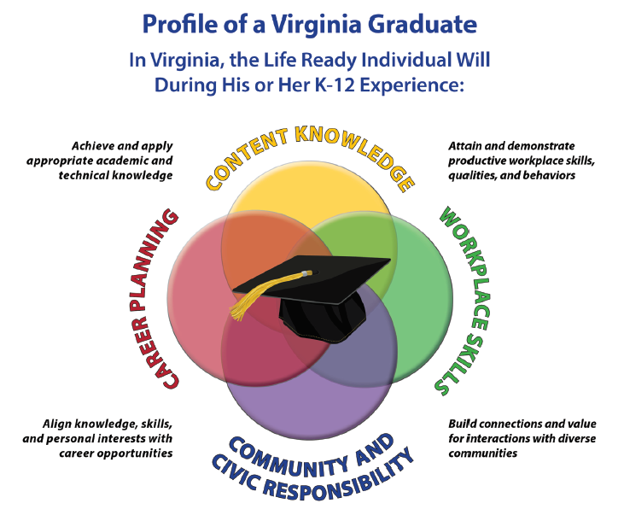
Profile of a Virginia Graduate

Slide 7
Mathematics Process Goals for Students
“The content of the mathematics standards is intended to support the five process goals for students” - 2009 and 2016 Mathematics Standards of Learning
Mathematical Understanding
Problem Solving
Connections
Communication
Representations
Reasoning

Slide 8
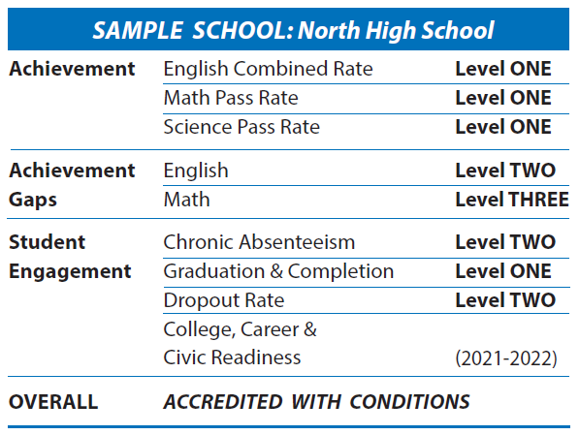
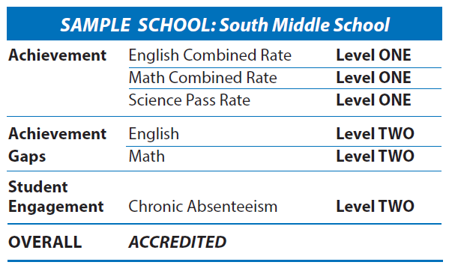
Virginia’s School Accreditation

Slide 9
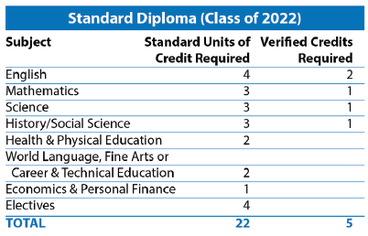
Graduation Requirements

Slide 10
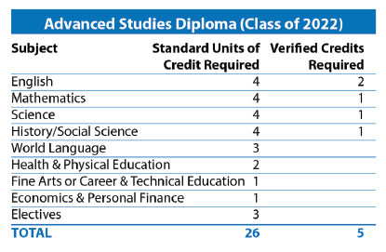
Graduation Requirements

Slide 11
Locally Awarded Verified Credit
Superintendent’s Memo #130-18
Students that entered the ninth grade prior to the 2018-2019 school year - may be awarded a total of three locally-awarded verified credits in English, mathematics, science and history/social science (effective May 9, 2018)
Students who enter the ninth grade for the first time in the 2018-2019 school year or thereafter will be able to earn no more than one locally-awarded verified credit in English, mathematics, laboratory science, or history and social science
Revised Guidance Governing the Use of Locally-Awarded Verified Credits is now available

Slide 12
Mathematics Institute – Defining the Focus

Slide 13
Purpose of 2018 Mathematics Institutes
The 2018 Mathematics Institute will provide teachers with professional development grounded in the implementation of the 2016 Mathematics Standards of Learning to:
Strengthen the teaching and learning of mathematics through facilitating meaningful mathematical discourse;
Support equitable learning opportunities for all students; and
Provide training materials for divisions and teachers for use as a local professional development tool.

Slide 14
Principles to Actions: Ensuring Mathematical Success for All
Eight Effective Mathematics Teaching Practices
Establish mathematics goals to focus learning.
Implement tasks that promote reasoning and problem solving.
Build procedural fluency from conceptual understanding.
Pose purposeful questions.
Use and connect mathematical representations.
Facilitate meaningful mathematical discourse.
Elicit and use evidence of student thinking.
Support productive struggle in learning mathematics.
Adapted from Leinwand, S. et al. (2014) Principles to Actions – Ensuring Mathematical Success for All, NCTM

Slide 15
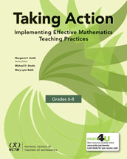
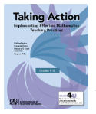
Taking Action Implementing Effective Mathematics Teaching Practices
This resource provides:
An overview, specific examples, and activities that focus on each of the practices
Activities for analyzing teaching and learning (includes specific artifacts of classroom practice)
Extensive research supporting each practice
Specific examples of how each practice promotes equitable instruction for all students
Suggestions for exploration of the individual practices by classroom teachers

Slide 16
Teaching Framework for Mathematics
Adapted from Smith, M. et al. (2017) Taking Action – Implementing Effective Mathematics Teaching Practices Series, National Council of Teachers of Mathematics.

Slide 17
Beliefs About Teaching and Learning Mathematics
Unproductive Beliefs vs. Productive Beliefs
Mathematics learning should focus on practicing procedures and memorizing basic number combinations.
Mathematics learning should focus on concepts and procedures through problem solving, reasoning, and discourse.
Students need only to learn and use the same standard computational algorithms and the same prescribed methods to solve algebraic problems.
All students need to have a range of strategies and approaches from which to choose in solving problems (including algorithms & procedures).
Adapted from Leinwand, S. et al. (2014) Principles to Actions – Ensuring Mathematical Success for All, NCTM

Slide 18
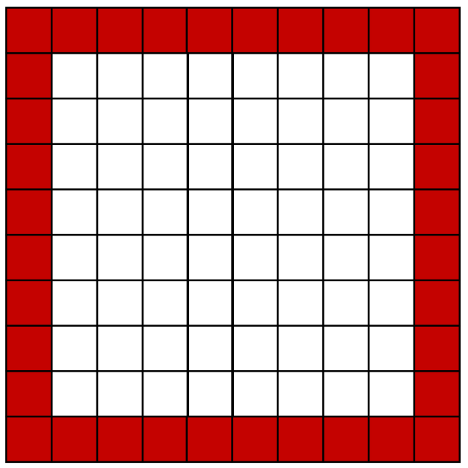
How many squares create the border?
You Cubed

Slide 19
How many squares create the border?
You Cubed

Slide 20
Quote
Children have real understanding
only of that which they invent
themselves, and each time that we
try to teach them too quickly we
keep them from reinventing it
themselves.
- Piaget

Slide 21
Principles to Actions: Ensuring Mathematical Success for All
Access and Equity
Curriculum
Tools and Technology
Assessment
Professionalism

Slide 22
Dr. James Lane
Notes:
https://www.youtube.com/watch?v=QACux-wIxYI

Slide 23
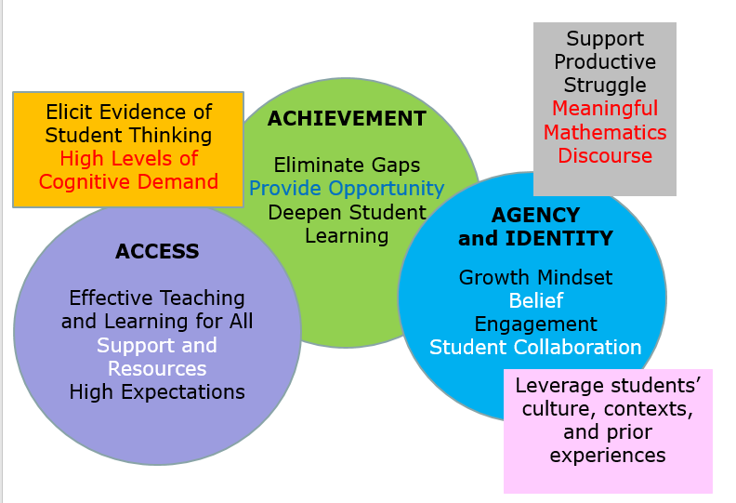
The Lens of Equity in Mathematics

Slide 24
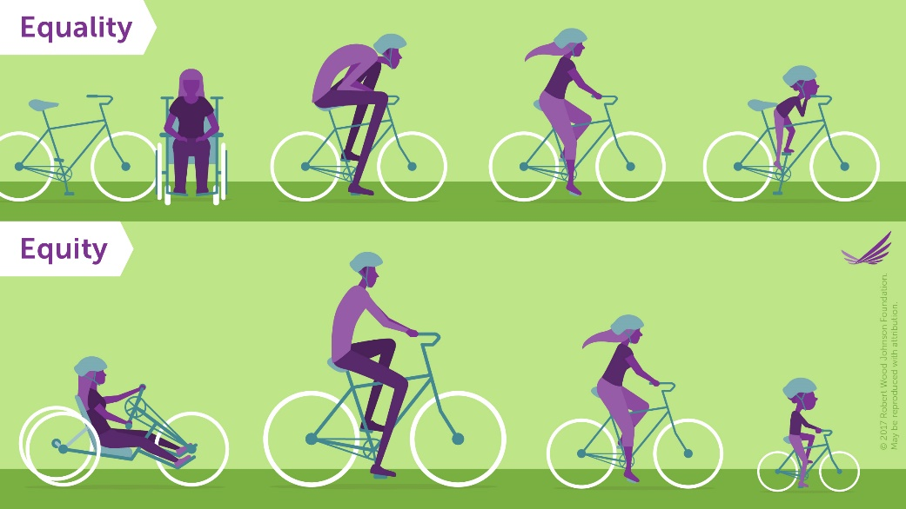
Equality ≠ Equity

Slide 25
Access and Equity Principle
An excellent mathematics program requires that all students have access to a high-quality mathematics curriculum, effective teaching and learning, high expectations, and the support and resources needed to maximize their learning potential.”
Adapted from Leinwand, S. et al. (2014) Principles to Actions – Ensuring Mathematical Success for All, NCTM

Slide 26
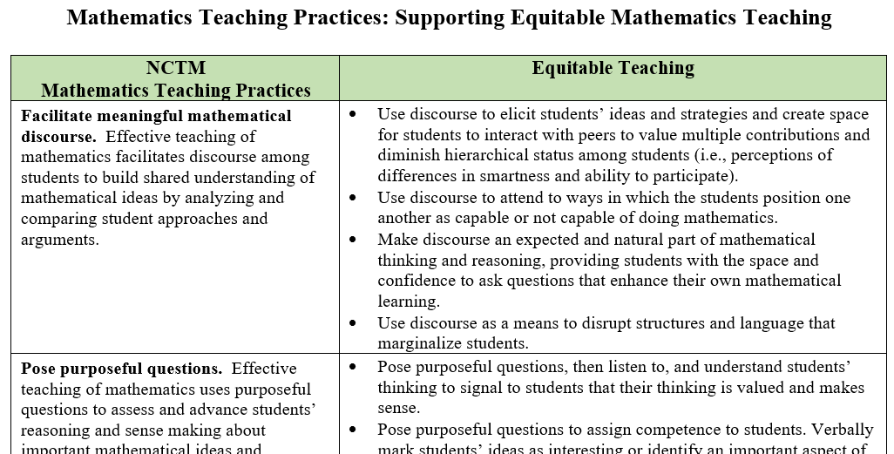
Supporting Equitable Mathematics Teaching
Adapted from: National Council of Teachers of Mathematics (2018) Catalyzing Change in High School Mathematics – Initiating Critical Conversations. Reston, VA.

Slide 27
Taking Action
Leaders and Policymakers
Principals, Coaches, & Specialist
Teachers

Slide 28
Implementation of the 2016 Mathematics SOL

Slide 29
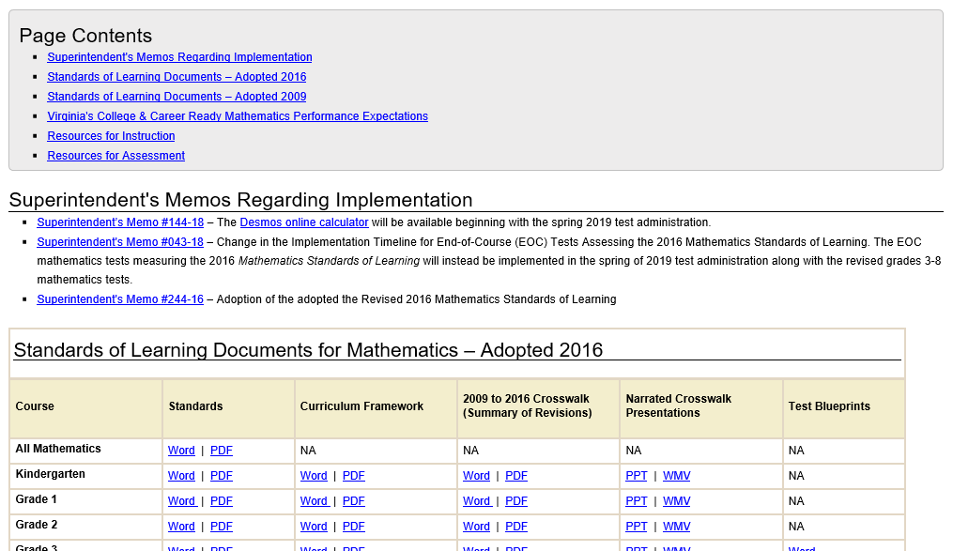
Mathematics Instructional Resources
Webpage Flip (2009 2016)
Standards of Learning and Testing webpage updated so 2016 Mathematics SOL are forward facing
Instruction webpage has been updated - 2016 Instructional Resources are now featured

Slide 30
2016 Mathematics Standards of Learning - Instructional Resources
Currently Available
2016 Mathematics Standards of Learning
2016 Mathematics Standards Curriculum Frameworks
2009 to 2016 Crosswalk (summary of revisions) documents
Narrated Crosswalk Presentations
Test Blueprints for SOL Assessments based on 2016 Standards
2017 SOL Mathematics Institutes PD Resources – includes progressions for select 2016 content

Slide 31
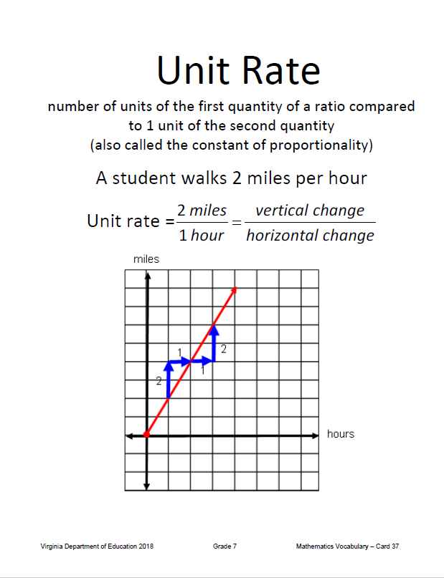
Mathematics Vocabulary Word Wall Cards

Slide 32
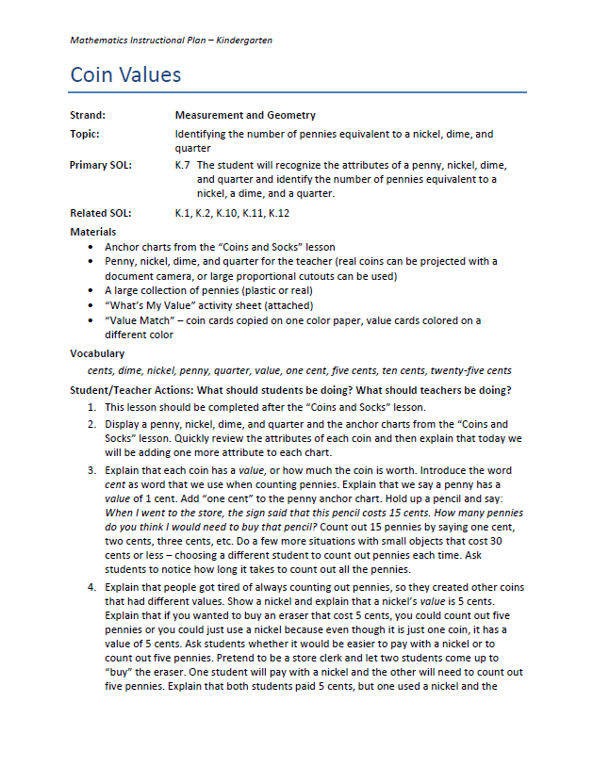
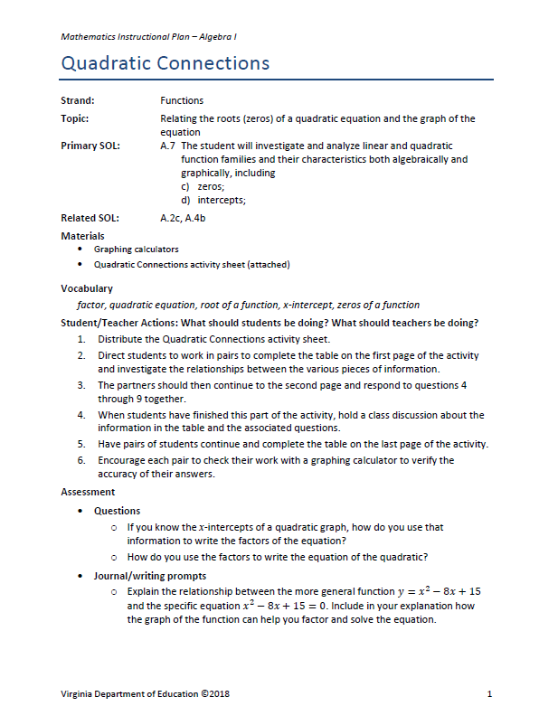
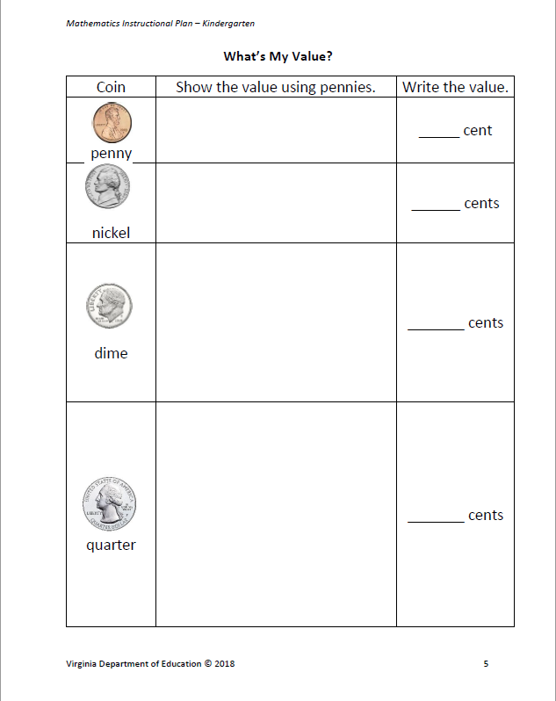
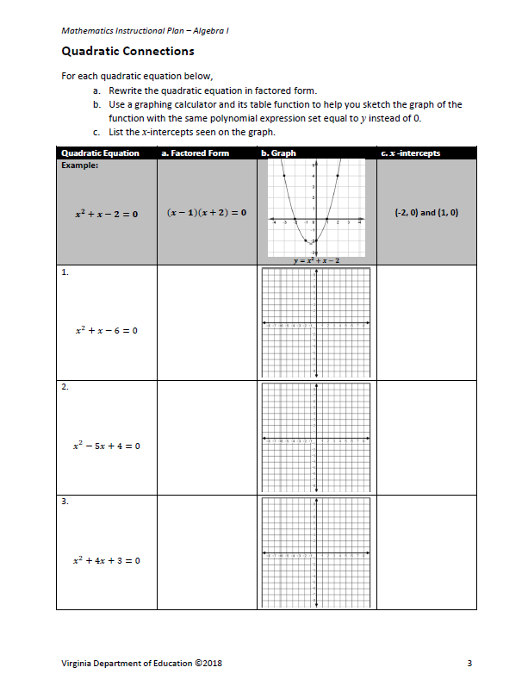
Mathematics Instructional Plans (MIPs)

Slide 33
Mathematics Assessment in Virginia

Slide 34
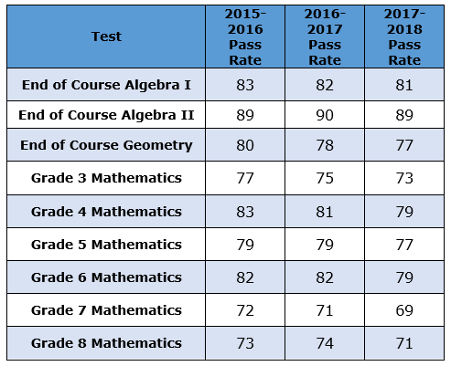
VDOE Mathematics Pass Rates
VDOE Mathematics Pass Rates
Notes:
Crosswalk year - tough

Slide 35
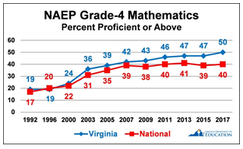
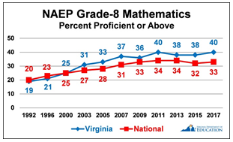
2017 National Assessment of Educational Progress (NAEP)
VDOE News Release April 2017

Slide 36
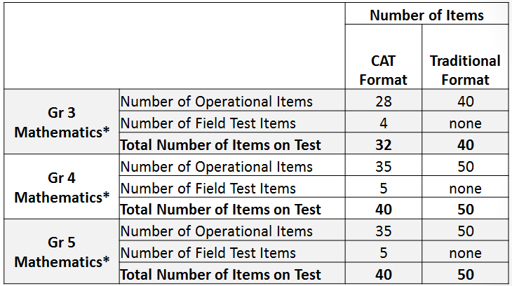
2016 Mathematics SOL Test Blueprints: Grades 3-5*
*For assessments based on 2016 Mathematics SOL only
For assessments based on 2009 Mathematics SOL:
Gr 3: 32 (CAT) & 50 (Traditional)
Gr 4 & 5: 39 (CAT) & 60 (Traditional)

Slide 37
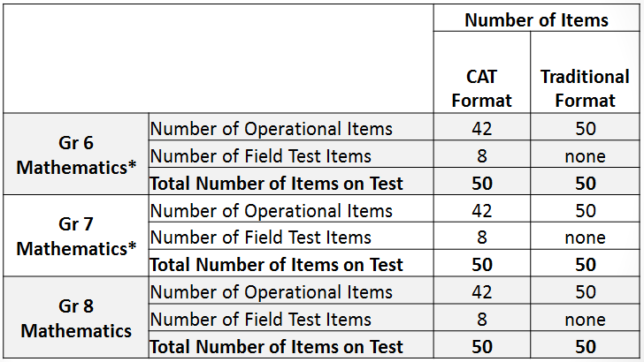
2016 Mathematics SOL Test Blueprints: Grades 6-8*
*For assessments based on 2016 Mathematics SOL only
For assessments based on 2009 SOL:
CAT: 45 operational + 8 field test = 53 Total
Traditional: 50 operational + 10 field test = 60 Total

Slide 38
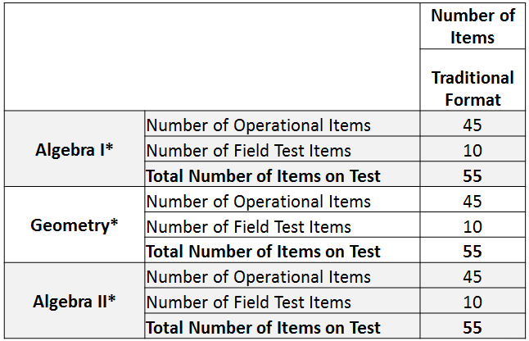
2016 Mathematics SOL Test Blueprints: End-of-Course*
*For assessments based on 2016 Mathematics SOL only
For assessments based on 2009 SOL:
50 operational + 10 field test = 60 Total

Slide 39
TestNav 8 Tools
The assessments measuring the 2016 Mathematics Standards of Learning will have:
Updated Protractor- ability to measure to the nearest degree
Straightedge Tool- this tool will appear on the tool bar and will be functional on all item types.
Both of these new tools appear in the 2016 Mathematics Practice Item Sets.

Slide 40
Ancillary Materials 2016 Mathematics Standards
New formula sheets have been developed for Grades 6 through 8 and EOC Mathematics tests.
These formula sheets will first be used for all Mathematics tests administered spring 2019.
There has been no change to the EOC Algebra II Standard Normal Probabilities table (z-table).

Slide 41
Plain English Mathematics SOL Tests
Beginning with the implementation of the SOL tests assessing the 2016 Mathematics standards, all test items that will be used on Mathematics SOL tests will meet the criteria for Universal Design (UD).
UD requires that language not specific to the content area be simplified so test questions are accessible by all populations of students.
Separate Plain English Mathematics test forms will no longer be administered.

Slide 42
Desmos Online Calculators
Spring 2019
Mathematics Standards of Learning tests (assessing the 2016 Mathematics SOL) administered online will include access to an online calculator from Desmos within TestNav 8
Students may use Desmos and one of the hand-held calculators on the List of Approved Calculators
2018-2019 School Year – Transition period for school division staff and students to become more familiar with Desmos

Slide 43
Desmos Online Calculators
2019-2020 School Year – Students taking the Mathematics SOL tests administered online expected to use only the Virginia Desmos online calculator
Mathematics Practice Items in TestNav –2016 items include Virginia Desmos online
calculator where applicable
Superintendent’s Memo 144-18

Slide 44
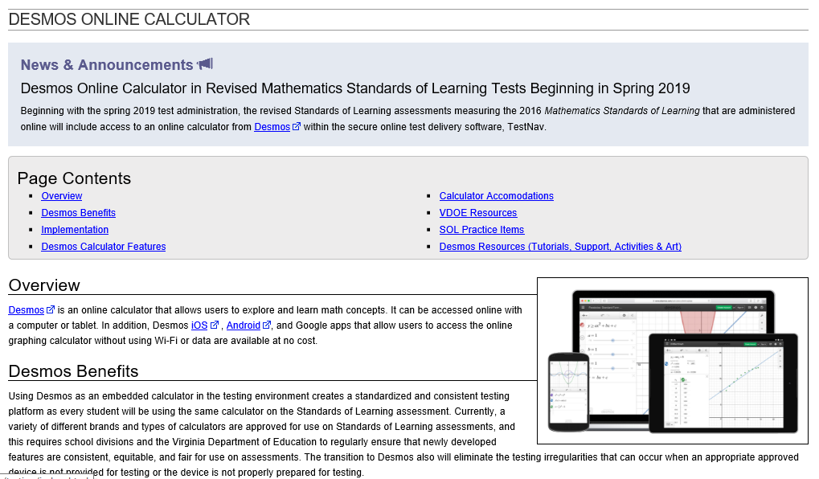
Desmos Online Calculators

Slide 45
Desmos Online Calculators
Desmos Tutorials and Learning Hub
Desmos Classroom Activities
Student Classroom Hub
Desmos Art

Slide 46
Please Contact Us!
The VDOE Mathematics Team
at
Mathematics@doe.virginia.gov

