Slide 1
Developing Deeper Learning through Rich Mathematical Tasks
2019 Mathematics Institute
EOC Session

Slide 2
Welcome and Introductions

Slide 3

Opening Video Message from VDOE

Slide 4
Focus of 2019 Mathematics Institutes
Establish mathematics goals to focus learning.
Implement tasks that promote reasoning and problem solving.
Build procedural fluency from conceptual understanding.
Facilitate meaningful mathematical discourse.
Pose purposeful questions.
Use and connect mathematical representations.
Elicit and use evidence of student thinking.
Support productive struggle in learning mathematics.
Adapted from Smith, M. et al. (2017) Taking Action – Implementing Effective Mathematics Teaching Practices Series, National Council of Teachers of Mathematics.

Slide 5
Logistics
Parking Lot
Restroom Locations
Breaks
Strategy Catcher
Charging Devices
Wi-Fi Access
Notes:
Parking Lot- chart paper or Padlet
Restrooms – no need to wait for a formal break
Breaks – Lunch and afternoon snack

Slide 6

Community Builder
Stand up if:

Slide 7

Just Like Me
Stand up if you are a pet owner

Slide 8
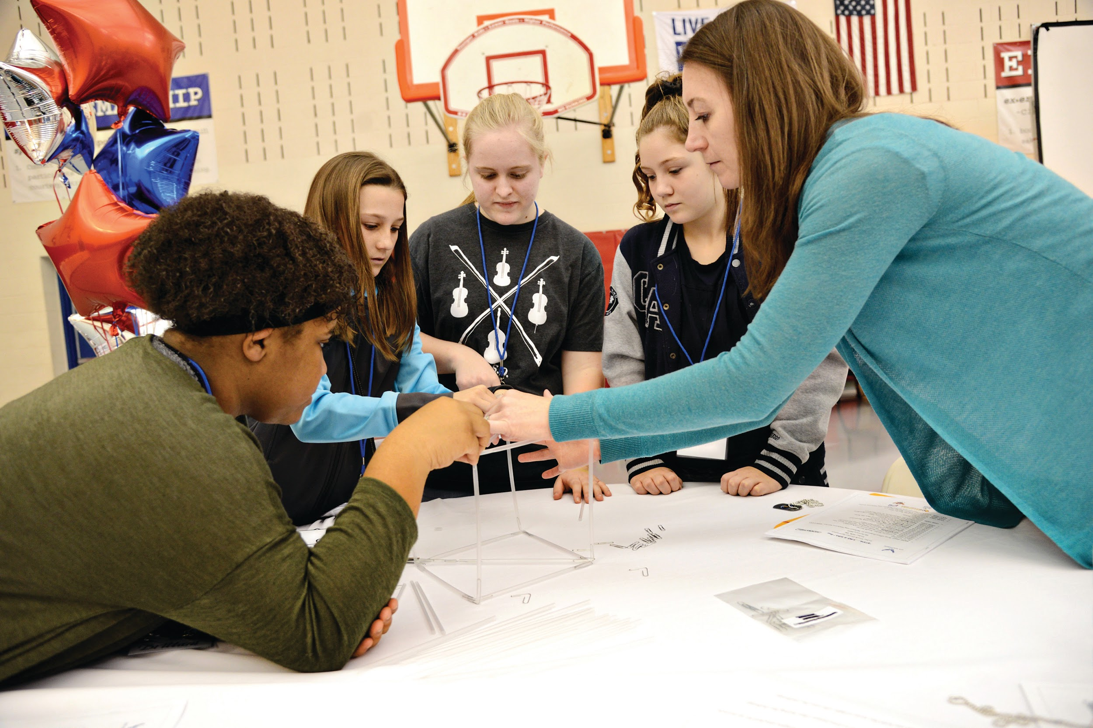
Just Like Me
Stand up if you have used tasks in your classroom

Slide 9
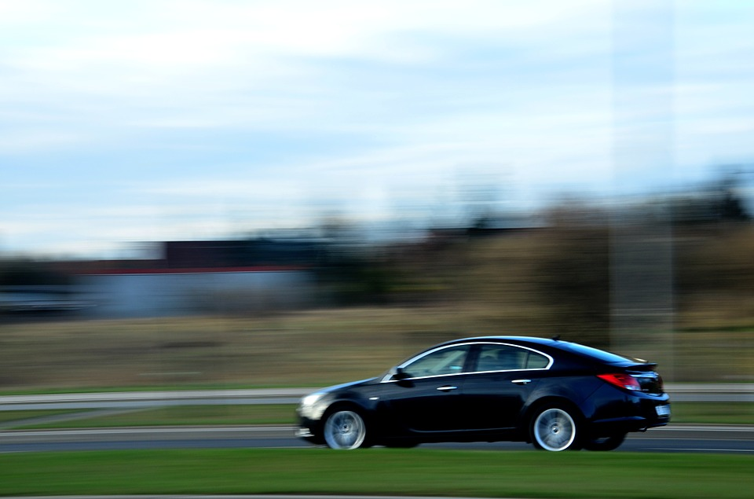
Just Like Me
Stand up if you drove over an hour to get here today.

Slide 10
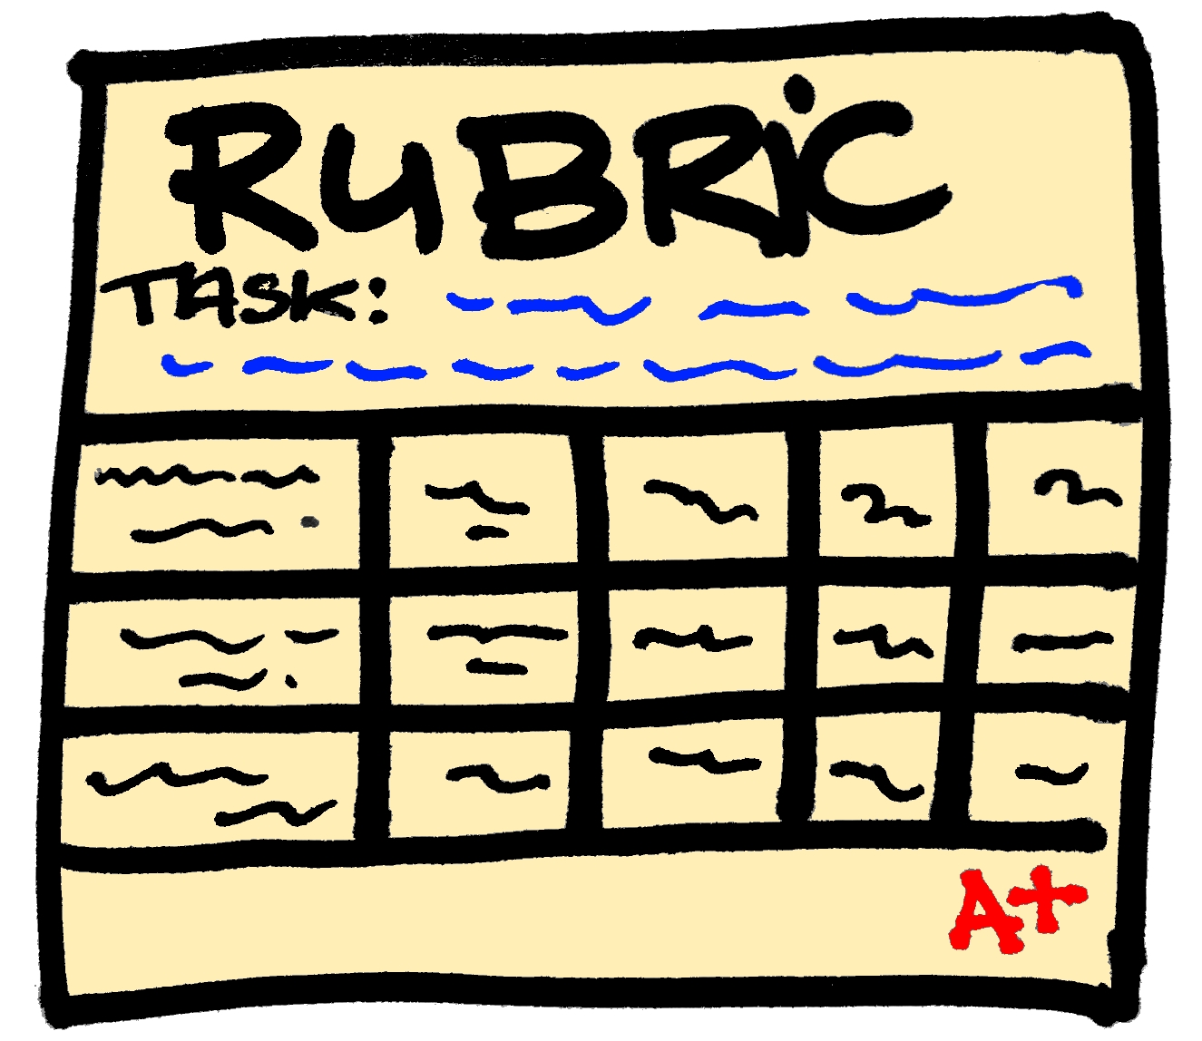
Just Like Me
Stand up if you have scored student work with a rubric before.

Slide 11

Just Like Me
Stand up if you have been teaching less than five years.

Slide 12

Just Like Me
Stand up if you have an administrative role.

Slide 13

Just Like Me
Stand up if you have heard of visible learning.

Slide 14

Just Like Me
Stand up if you believe you have an impact on student learning.

Slide 15
Agenda
Morning Session
Module I: Overview – Visible Learning, Equity, and Identity (includes VDOE Video Overview)
Module II: Task Implementation (Before)
Afternoon Session
Module III: Task Implementation (During/After)
Module IV: Assessing Student Understanding
Reflection and Closure

Slide 16
Session Learning Intentions
Content:
I am learning about strategies and approaches that make teaching and learning more visible.
Language:
I am learning to use the language of a visible learning mathematics classroom.
Social:
I am learning how to listen and respond to my colleagues’ ideas in ways that move everyone forward as learners.

Slide 17
Module I
Overview – Visible Learning, Equity, and Identity

Slide 18
Module I: Success Criteria
I can recognize strategies in teaching and learning that have high impacts (effect size) on student achievement.
I can recognize and support equitable learning opportunities for all students that promote positive student mathematical identity and agency.
I can describe how to create a classroom environment that supports the development of assessment-capable mathematics learners.

Slide 19

Anticipation Reaction Guide
Before the video…
  Answer True (T) or False (F)
Watch the Video
During/After the video…
  Adjust Answer True (T) or False (F)
  Rewrite False Statements
Notes:
Complete guide, watch video, complete 2nd column, then show answer key on next slide
2/3 of guides will be regular with 1/3 differentiated.

Slide 20
Anticipation Reaction Guide Key
1. True 6. True
2. False 7. True
3. True 8. False
4. False 9. True
5. True 10. False
Share corrections to false statements.
Notes:
Presenter will remind participants that there were two different versions – one is differentiated to show that there would be 4 False answerers. When reviewing the answers, call on the participants to see how they made corrections to the false statements.

Slide 21
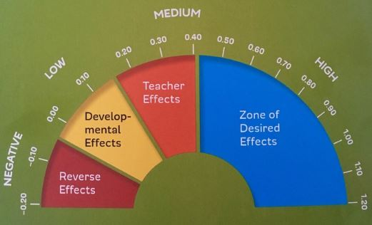
Barometer of Influence and Effect Size
Adapted from Hattie, J. (2009) Visible Learning: A Synthesis of Over 800 Meta-analyses Relating to Achievement. New York, NY: Routledge.

Slide 22
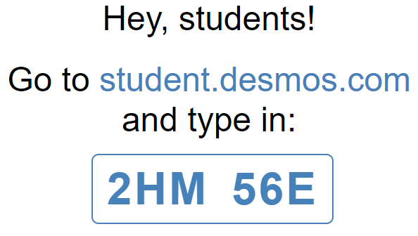
Effect Size Sort
Notes:
Presenters should have already created class codes. At this point, limit participants to the first 3 slides.
https://teacher.desmos.com/activitybuilder/custom/5cffc3e35a559b0bfa5173d5

Slide 23

Math Identity and Equity

Slide 24
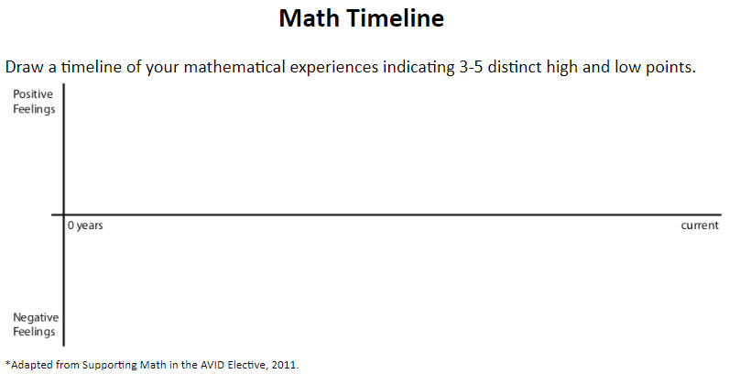
Math Timeline
Notes:
After participants complete the activity, turn and talk through with a neighbor the questions at the bottom of the timeline.
Pass out books during Turn & Talk.

Slide 25
The Five Equity-Based Mathematics Teaching Practices
Go deep with mathematics (Deeper Learning)
Leverage multiple mathematical competencies
Affirm mathematics learners’ identities
Challenge spaces of marginality
Draw on multiple resources of knowledge
Resource: Smith, M. et al. (2017) Taking Action – Implementing Effective Mathematics Teaching Practices Series, National Council of Teachers of Mathematics.
Notes:
Presenter will discuss how and why it is important for us as math educators to explicitly teach a growth mindset and create a classroom culture where all students have the ability to identify as a “math person”.

Slide 26


A Visible Learning Classroom is...
Teachers
Learners
Predict:
What does visible teaching look like in a classroom?
What does visible learning look like in a classroom?
Notes:
Strategy: Predictions charted as a group by presenters on T-table on chart paper

Slide 27
Comparing Visible Teaching & Learning
Visible Teaching
Visible Learning
Visible Learning Book
Page 20
Clearly communicates
the learning intention
Identifies challenging success criteria
Utilizes a range of
learning strategies
Continually monitors student learning
Provides feedback to learners
So that learners understand the intention of the learning experience.
So that learners know what success looks like.
So that learners develop a range of learning strategies.
So that learners know when they are not progressing and can make adjustments.
So that learners can seek feedback about their learning.
Source: John Almarode, Douglas Fisher, Joseph Assof, John Hattie, and Nancy Frey (2019)
Notes:
http://resources.corwin.com/sites/default/files/almarode_web_figure_1.1.pdf

Slide 28
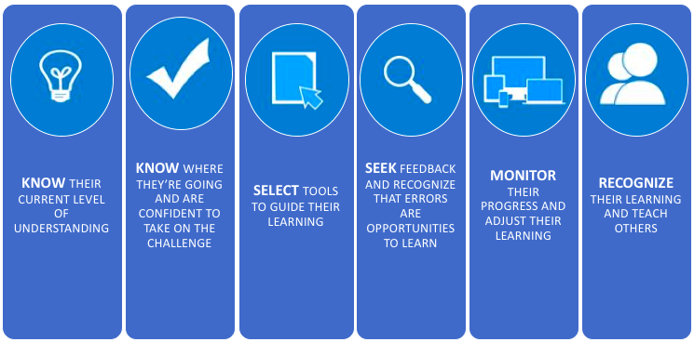
Assessment-Capable Visible Learner
Visible Learning Book
Page 12

Slide 29
Mistake-Friendly Classroom
Mistakes are not only opportunities for learning, as students consider the mistakes, but also times when our brains grow.
Understanding the power of mistakes is critical, as children and adults everywhere often feel terrible when they make a mistake in math.
They think it means they are not a math person, because they have been brought up in a performance culture (see Boaler, 2014) in which mistakes are not valued—or worse, they are punished.
You cubed

Slide 30
Jigsaw Reading
Visible Learning Book
Page 21-35
Form groups of 3 and number off.
Read the pages based on your number, starting with the following section titles:
    1. Surface, Deep, and Transfer Learning (pgs. 21-25)
2. Moving Learners Through the Phases of Learning (pgs. 26-31)
3. Differentiating Tasks for Complexity and Difficulty (pgs. 31-35)
Come back together and discuss common themes from the sections you read.

Slide 31
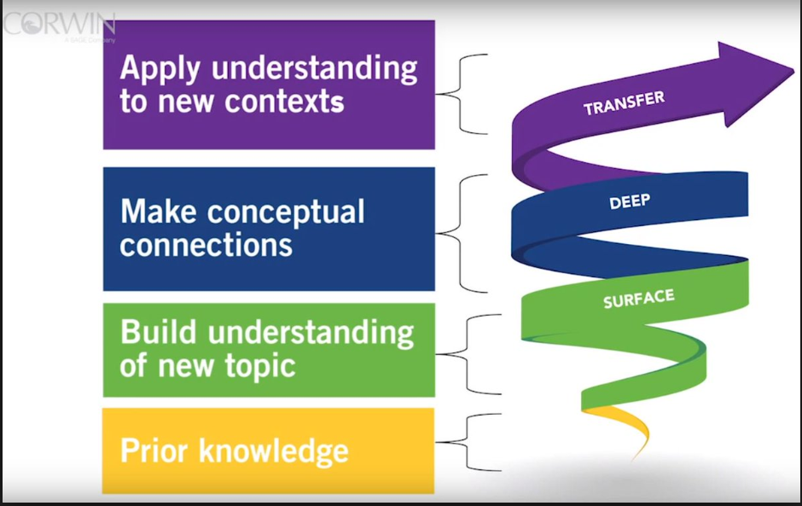
Surface, Deep, and Transfer Learning in Math
Visible Learning Book
Page 22
Ongoing assessments inform teachers that students are in various places along this path, and sometimes will move interchangeably between these phases of learning. It is the teacher’s goal to provide interventions and strategies students need at the right time for the right reason.

Slide 32
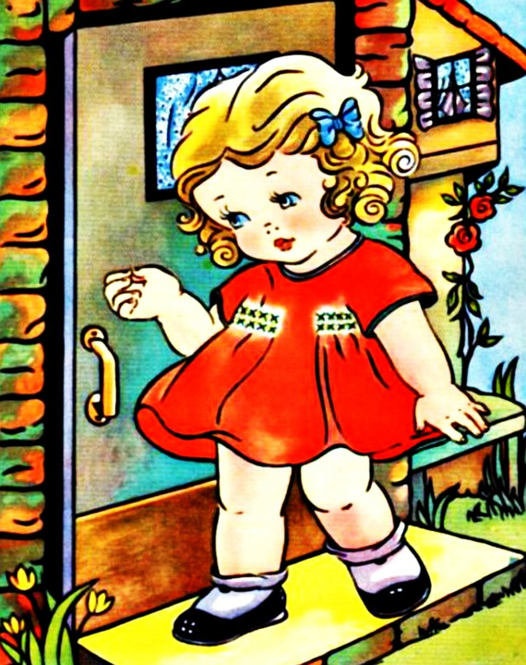
The “Goldilocks” Effect
A Visible Learning classroom uses…
the right strategy at the right time,
for the right level of thinking,
with the right level of challenge.

Slide 33



Square, Circle, Triangle Reflection
Based on Module I...
What is one idea that squared with your thinking?
What is a question circling in your mind?
What point(s) would you like to remember, that might impact your work?

Slide 34
Module II
Task Implementation (Before)

Slide 35
Module II: Success Criteria
I can identify how teacher clarity about learning intentions and success criteria contributes to student success.
I can distinguish between tasks that will engage students in higher levels of cognitive demand versus lower levels of cognitive demand.
I can describe the factors associated with the decline or maintenance of the cognitive level of a rich mathematical task.
I can anticipate student solution strategies and misconceptions associated with the implementation of a mathematical task.

Slide 36
Learning Intentions and Success Criteria
Visible Learning Book
Pages 48 - 50
Learning intentions - describe what teachers want students to learn from the lesson.
  Content: “What is the math I am supposed to use and learn today?”
  Language: “How should I communicate my mathematical thinking today?”
  Social: “How should I interact with my learning community today?”
Success criteria is meant to describe what success looks like when a student has reached the learning goal.
Clear Learning Intentions
Rich Mathematical Tasks
Progress Toward Mastery
Notes:
Learning Intentions - Students need to not only know what they are supposed to learn but also how they will know if they have learned it and how they might access themselves along the way.
Success criteria are specific, concrete, measurable statements that describe what success looks like when the learning goal has been reached. Hattie, et al., share that students are more motivated to work toward success criteria when those criteria are specific. In addition, the more specific the learning intentions and the criteria for reaching those intentions, the more likely it is that student will achieve them

Slide 37

Grouping Activity –
How Many Fingers?
(No more than 4 to a group)
Algebra I - Hold up 1 finger and find a group member with the same number
Algebra II - Hold up 2 fingers and and find a group member with the same number
Geometry - Hold up 3 fingers and and find a group member with the same number
Notes:
Learning Intentions - Students need to not only know what they are supposed to learn but also how they will know if they have learned it and how they might access themselves along the way.
Success criteria are specific, concrete, measurable statements that describe what success looks like when the learning goal has been reached. Hattie, et al., share that students are more motivated to work toward success criteria when those criteria are specific. In addition, the more specific the learning intentions and the criteria for reaching those intentions, the more likely it is that student will achieve them

Slide 38
Create Learning Intentions
and Success Criteria for a Task...
Algebra I - Solving a system of linear equations
Algebra II - Characteristics of functions with a focus on quadratics and modeling
Geometry - Applications of right triangles
Clear Learning Intentions
Rich Mathematical Tasks
Progress Toward Mastery
Notes:
Participants need paper to write their intentions and success criteria.
Learning Intentions - Students need to not only know what they are supposed to learn but also how they will know if they have learned it and how they might access themselves along the way.
Success criteria are specific, concrete, measurable statements that describe what success looks like when the learning goal has been reached. Hattie, et al., share that students are more motivated to work toward success criteria when those criteria are specific. In addition, the more specific the learning intentions and the criteria for reaching those intentions, the more likely it is that student will achieve them

Slide 39
Does the Task Match?
Read the task for your content and compare to the Learning Intentions and Success Criteria your group created.
Does the task satisfy your Learning Intentions?
Clear Learning Intentions
Rich Mathematical Tasks
Progress Toward Mastery
Notes:
Learning Intentions - Students need to not only know what they are supposed to learn but also how they will know if they have learned it and how they might access themselves along the way.
Success criteria are specific, concrete, measurable statements that describe what success looks like when the learning goal has been reached. Hattie, et al., share that students are more motivated to work toward success criteria when those criteria are specific. In addition, the more specific the learning intentions and the criteria for reaching those intentions, the more likely it is that student will achieve them

Slide 40
How do tasks and their implementation impact mathematics learning?
Student learning is greatest in classrooms where the tasks consistently encourage high‐ level student thinking and reasoning and least in classrooms where the tasks are routinely procedural in nature.
  Boaler and Staples 2009; Hieber and Wearne 1993;
  Stein and Lane 1996
Clear Learning Intentions
Rich Mathematical Tasks
Progress Toward Mastery
Notes:
Not all tasks provide the same opportunity for student thinking

Slide 41
Rich Mathematical Tasks - Definition
Rich mathematical tasks engage students in sense-making through deeper learning that require high levels of thinking, reasoning, and problem solving.
Clear Learning Intentions
Rich Mathematical Tasks
Progress Toward Mastery
Notes:
Turn and talk – what might be the characteristics of a rich task?
Participants put their ideas on a post-it note and add them to a poster, grouping their ideas with any similar ones already on the poster.

Slide 42
Characteristics of Rich Tasks
Promote high levels of cognitive demand
Allow multiple entry points to students with a wide range of skills and abilities
Allow for multiple solution pathways
Promote reasoning and sense making
Encourage the use of varied representations
Require justification or explanation
Encourage connections among ideas
Are authentic, relevant, or problem-based
Clear Learning Intentions
Rich Mathematical Tasks
Progress Toward Mastery
Notes:
Characteristics were developed by the RMT committee through research.
Facilitators will compare characteristics from the RMT committee with those generated by the participants.

Slide 43
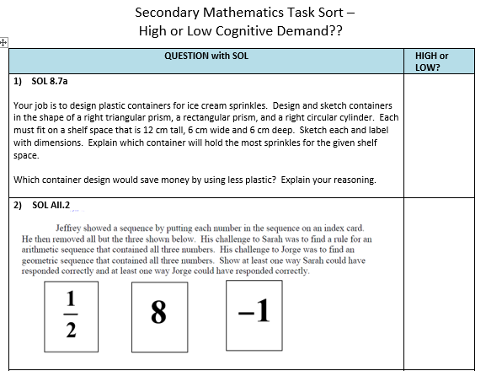
Cognitive Demand
Notes:
Handouts – if participants finish “high or low” early, they can fill in the characteristics on the last page of the document.
Have Kahoot ready before session begins.
Link to Kahoot: https://create.kahoot.it/share/high-low-task-sort/fd2db8c0-a385-402d-94a6-f056d1ff970b

Slide 44
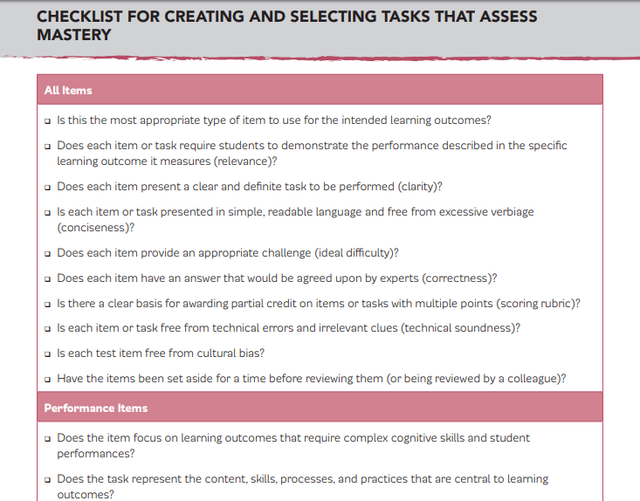
Checklist
Visible Learning Book
Page 197
Source: Adapted from Linn and Gronlund (2000)
Notes:
https://resources.corwin.com/sites/default/files/almarode_web_figure_5.6.pdf

Slide 45
Does the Task Match?
With your group, make adjustments to the task and/or implementation ideas to make it match your Learning Intentions and Success Criteria.
Clear Learning Intentions
Rich Mathematical Tasks
Progress Toward Mastery
Notes:
Trios make adjustment to task or implementation ideas to align with their learning intentions and success criteria.
Many task resources exist, this activity shows that often edits and adjustments must be made to suit the teacher’s needs.

Slide 46
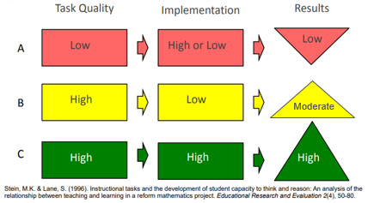
It’s not just about the task…
Notes:
It’s not just about the task. Implementation of the task is very important. A task requiring a high level of cognitive demand may have been chosen; however, implementation of the task will determine whether the level of the task is maintained. High results require both a high cognitive demand task and high levels of implementation.

Slide 47
Factors Associated with the Decline and Maintenance of High Level Tasks
Decline | Maintenance
Problematic aspects of the task become routinized Emphasis is shifted to correctness or completeness Not enough time is provided Classroom management problems prevent engagement Inappropriate task Lack of accountability for high-level products | Scaffolding Students provided way to monitor their progress High-level of performance is modeled Sustained justification, meaning, questioning, comments, and feedback Tasks build on prior knowledge Frequent conceptual connections Sufficient time to explore
Resource: Smith, M. et al. (2017) Taking Action – Implementing Effective Mathematics Teaching Practices Series, National Council of Teachers of Mathematics.
Notes:
Review components of Teaching Mathematics in the Visible Learning Classroom

Slide 48
Anticipating Solutions and Misconceptions
With your group, review the Planning for Mathematical Discourse document from the Task Template
Notes:
Pass out Planning for Mathematical Discourse documents.
Read something/say something within group
This was the focus of the 2018 Institute, so limited time on this area.

Slide 49
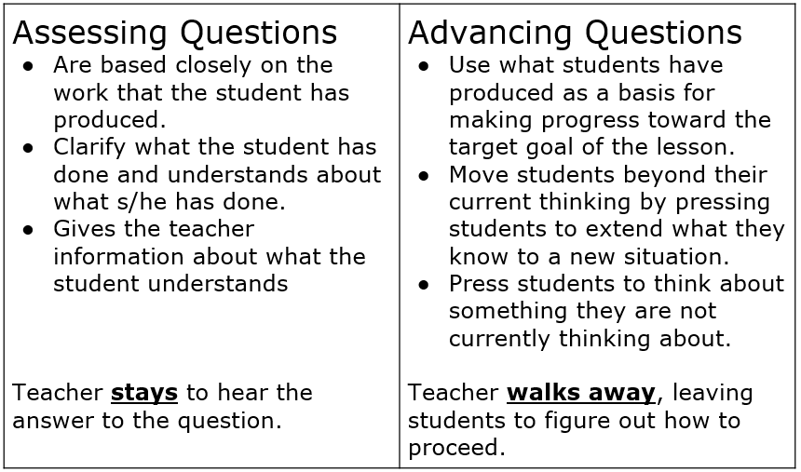
Planning Questions
2018 SOL Institute Topic
Notes:
Facilitator: This is part of the planning stage, but was covered at the 2018 SOL Institute. Also covered in the task planning guides.

Slide 50
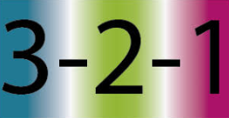
3 - 2 - 1 Reflection
Based on Module II…
3 things I have learned are...
Two questions I have are...
One thing I want the presenter to know is...
Notes:
Participants return to their original seats to complete the reflection.

Slide 51
Module III
Task Implementation (During/After)

Slide 52
Module III: Success Criteria
I can implement a rich mathematical task to support deeper learning for all students.
Notes:
Note: Participants will complete this module as a “student”.

Slide 53
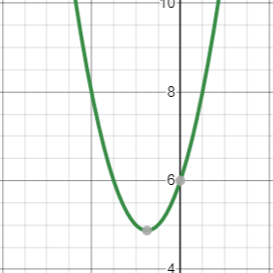
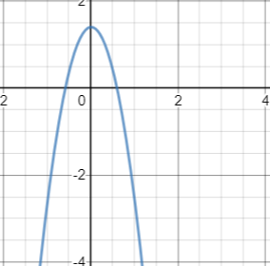
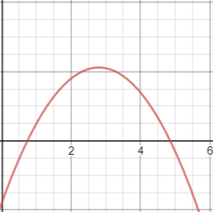
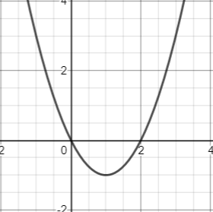
Which One Doesn’t Belong?
A
B
C
D
Notes:
Strategy: Four corners, tell partner why you chose, discuss with group to see if all reasons are the same, then have spokesperson from each corner share 1 of their reasons.

Slide 54

The Soccer Competition Task
Learning Intentions
Content: To Investigate and analyze quadratic functions algebraically and/or graphically through a real world situation.
Language: To justify decisions using supporting evidence from algebraic and/or graphical methods.
Social: To communicate and share with peers the reasoning process to support my decision.
Notes:
Participants are acting as students at this point.

Slide 55
The Soccer Competition Task
Success Criteria
I can identify the zeros and intercepts of a function presented algebraically or graphically;
I can determine f(x) for any value, x, in the domain of f.
I can represent functions using tables, equations, and graph.
Given one representation, I can model the
function algebraically or graphically.
I can investigate and analyze characteristics and multiple representations of functions with a graphing utility.

Slide 56
The Soccer Competition Task
Do the math
Solve the task
Try solving it more than one way
Share the math
Listen to the various solutions of your colleagues
Think about how your method was the same and different
Notes:
Monitor the room and select a sample of “student work” - Ask 4-5 people to put their work on posters to share out in the order we select, at the end of the work time

Slide 57
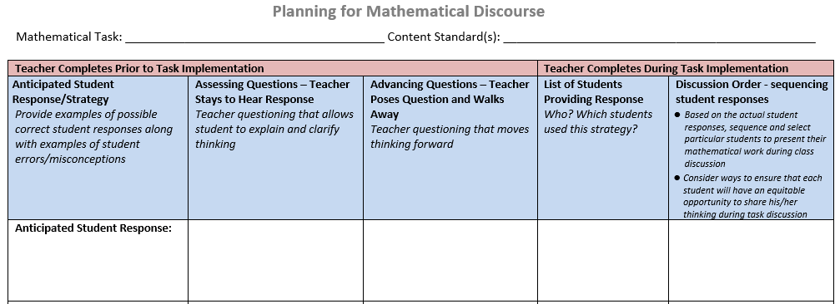
Selecting & Sequencing Student Work
Notes:
Share how we selected and sequenced the “student work”. Participants have a copy of the Planning for Mathematical Discourse document from the previous module. Point out the Math Workshop connection to Task & Share structure.

Slide 58
Task Closure
Self-Reflecting on the Learning Intentions
Please be prepared to answer one of the following questions:
How has my understanding increased as a result of today’s task?
What questions do I still have about the math I learned today?
What do I still need to work on? How do I know?
If I could do this task over again, what would I do differently?
What advice would I have for another student who was about to start this same task?
Random Number Generator:
Look at your table number
Number off 1-8 within your table
Notes:
Table numbers
Random number generator for table and person to answer question of their choosing. https://www.google.com/search?q=random+number
Facilitator should point out that teachers could also give an option of having groups discuss their ideas before calling on students so they could share either their answer or one of their tablemate’s answers.

Slide 59
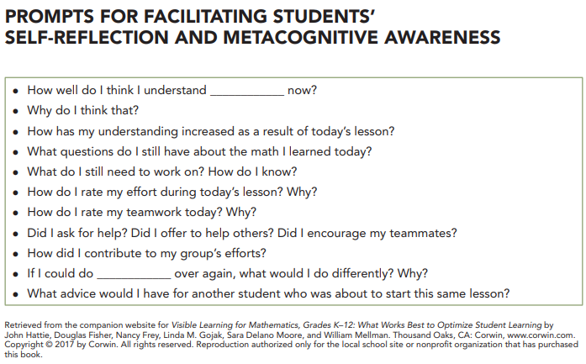
Task Closure
Self-Reflecting on the Learning Intentions
Notes:
From the Green Book: Visible Learning for Mathematics http://resources.corwin.com/VL-mathematics
Figure 6.3 http://resources.corwin.com/sites/default/files/Figure_6.3.pdf

Slide 60
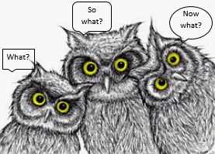
3 W’s Reflection
Based on Module III…
What did we learn today?
So What? (Why is this useful or important?)
Now What? (How does this fit into the unit, affect their thinking, or can they predict what comes next.)

Slide 61
Module IV
Assessing Student Understanding

Slide 62
Module IV: Success Criteria
I can use a rubric to score student work samples and work collaboratively to calibrate my scores.
I can use success criteria to provide effective feedback to students to deepen student learning.
I can analyze student work to identify what students know and are able to do in order to plan instruction that moves all students forward as learners.

Slide 63

Scoring the Soccer Competition Task
Now that you have done the math through the lens of a student, we will now look at the Soccer Task through the lens of a teacher.
We will use some sample student work and a team protocol for looking at that work.

Slide 64
Calibration Protocol Purpose
Provides a process whereby groups can discuss student work in order to reach consensus about how to score the work based on a rubric or scoring criteria.
Ensures equity in how each scorers contributions are considered
Provides a structure that makes it safe to challenge and question one another
Makes the most of time set aside for examining student work
Increases inter-rater reliability (providing for fair and consistent scoring of student work)
Notes:
The main reasons for using a calibration protocol is to …..

Slide 65
Calibration Protocol
See Handout
Examination – work through task (individual)
Discussion of proficient responses (small group)
Read and place in groups (individual)
Score student work (individual)
Score Sharing (small group)
Discussion (small group)
Debrief Discussion (small group)
Notes:
...and the protocol looks like this overall.
Pass out the Calibration Protocol

Slide 66
Mathematics Process Goals for Students
“The content of the mathematics standards is intended to support the five process goals for students”
- 2009 and 2016 Mathematics Standards of Learning
Communication
Connections
Representations
Problem Solving
Mathematical Understanding
Reasoning
Notes:
Talk about connections between the process goals and the mathematics practice (e.g., Facilitating Discourse)

Slide 67
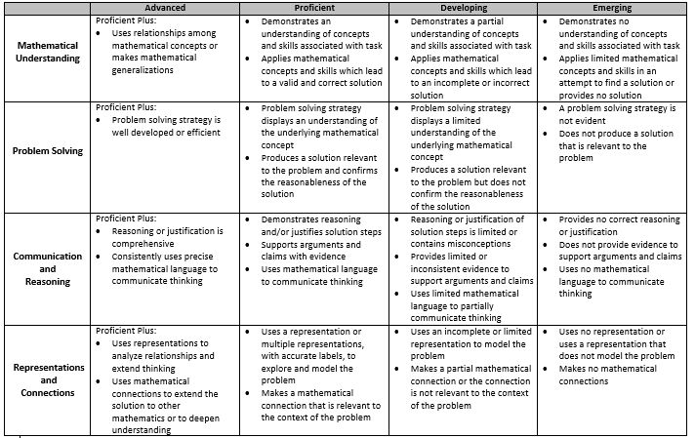
Rich Mathematical Task Rubric
Notes:
Pass out Rich Mathematical Task Rubric

Slide 68
Group Roles
Identify the following roles within your group:
Recorder
Facilitator
Speaker
Time keeper
Notes:
Strategy

Slide 69
Preparing to Score Student Work
1. Examination – done in the previous Module
2. Discuss proficient response (group) - 10 minutes
Discuss at your table what is expected in a proficient student
response in holistic terms.
Use the Rich Mathematical Task Rubric as a guide.
Notes:
Since we have already worked this task, we can move on to step #2
Pass out student work

Slide 70
Scoring Student Work
3. Read and place in groups (individually) - 10 minutes
Sort student work into 3 piles - low, med, high based on overall impression.
4. Score student work (individually) - 10 minutes
Score each student work sample.
Record your scores on the Individual Scoring Notes sheet.
Use evidence from the work and the rubric to support your scores.
Notes:
Participants will have to cut student work pages in half in order to sort the work.
Individual work

Slide 71
Sharing and Discussing Student Work
5. Score sharing without explanation (collaboratively) - 2 minutes
One at a time, team members share their score for each of the rubric criteria while a recorder completes the group’s score sheet.
6. Discussion (collaboratively) - 15 minutes
Use evidence from the work and the rubric to support your scores.
7. Debrief (collaboratively) - 5 minutes
Discuss the questions found on the handout.
Notes:
Group Work

Slide 72
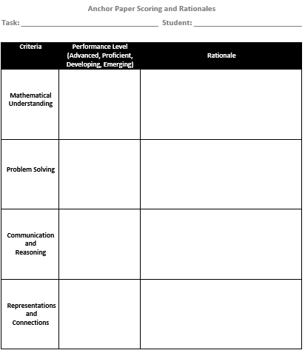
Anchor Paper Scoring and Rationales
Resources for all tasks used today.
VDOE Rich Mathematical Tasks
Notes:
Show from link, we are not handing this out.

Slide 73
Elements of Effective Feedback
Visible Learning Book
Page 210
Effective Feedback
Where am I going? How am I going? Where to next?
Each question works at four levels
Task Level
How well are the tasks understood/ performed?
Process Level
The main process needed to understand/ perform tasks
Self-Regulation Level
Self-monitoring directing, and regulating of actions
Self Level
Personal evaluations and effect (usually positive) about the learner
Source: Hattie &
Timperly (2007).
Clear Learning Intentions
Rich Mathematical Tasks
Progress Toward Mastery
Notes:
We spent time doing this in last year’s SOL Institute. You can refer back to those materials, however, time does not permit us to do this today.

Slide 74

Graffiti Reflection
Based on Module IV, graffiti a thought about one of the following:
Rubric
Calibration Protocol
Feedback
Notes:
Need multiple posters per topic to spread participants out.

Slide 75
Session Closure and Reflection

Slide 76
Learning Intentions
Content:
I am learning about strategies and approaches that make teaching and learning more visible.
Language:
I am learning to use the language of a visible learning mathematics classroom.
Social:
I am learning how to listen and respond to my peers’ ideas in ways that move everyone forward as learners.
Notes:
Strategy: Thumbs up or down - where might you be in your progress towards these learning intentions.

Slide 77
Effect Size Sort - Solutions
Go back to Desmos sort,
you may now complete the activity.

Slide 78
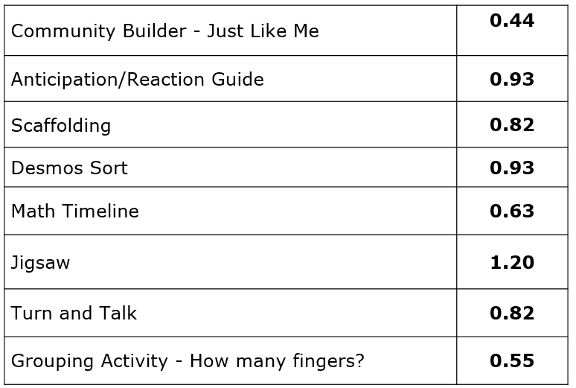
Strategy Catcher
Notes:
Community Builder – Strong Classroom Cohesion
Anti/React – Strat to integrate with prior knowledge
Desmos – Strat to integrate with prior knowledge
Math Timeline - Deep motivation and approach
Jigsaw – Jigsaw Method
Turn and Talk – Classroom Discussion
Grouping Activity - How many fingers? – Cooperative vs. individualistic learning

Slide 79
Strategy Catcher
Clear Goal Intentions | 0.48
Success Criteria | 1.13
Kahoot practice | 0.79
Checklist | 1.29
Which One Doesn’t Belong? | 0.44
Task | 0.68/1.33
Self-Reflection | 0.75
Discourse | 0.82
Notes:
Clear Goal Intentions – Clear Goal Intentions/Learning Intentions/Success Criteria
Self-Reflection – Evaluation and Reflection
Discourse - Classroom Discussion
Kahoot practice – Deliberate Practice
Checklist – Cognitive Task Analysis
Which One Doesn’t Belong – Inductive Thinking (Critical Thinking wasn’t on the list in the book.)
Task – Problem Solving/Assessment Capable Learners

Slide 80
Quote
Give yourself “permission to spend more time developing student’s deep understanding of mathematics as a well-rounded discipline.”
-Teaching Mathematics In the Visible
Learning Classroom: High School

Slide 81

Traffic Light Exit Ticket
Based on today’s presentation…
One thing I could stop doing is...
One thing I could continue doing is...
One thing I could start doing is...
Notes:
Use Verdana
Titles should be 36 point
Body text should be 20

Slide 82
2016 Mathematics Standards of Learning - Instructional Resources
Standards of Learning and Curriculum Frameworks
Test Blue Prints
Practice Items
Mathematics Instructional Plans
Co-Teaching Mathematics Instructional Plans
Algebra Readiness Initiative Materials
  Mathematics Vertical Articulation Tool
    Static Versions and Dynamic Versions
  Remediation Plans
  Formative Assessments
2018 Mathematics SOL Institutes Materials
Mathematics Vocabulary Word Wall Cards
Desmos Resources
Rich Mathematical Tasks

Slide 83
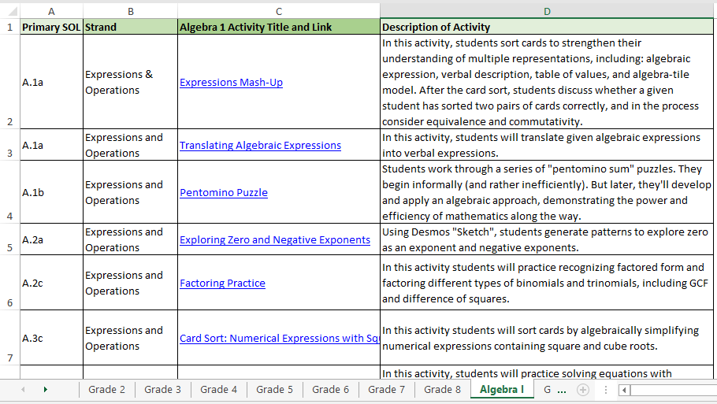
Desmos Classroom Activities Log (NEW)
Notes:
Desmos Classroom Activities – digital mathematics activities
Aligned to 2016 Virginia Mathematics Standards of Learning
- Includes activities that were:
Not modified (already align to 2016 SOL)
Modified to align to 2016 SOL
Newly designed to align to 2016 SOL
Logs created to provide links and descriptions of activities sorted by 2016 SOL

Slide 84
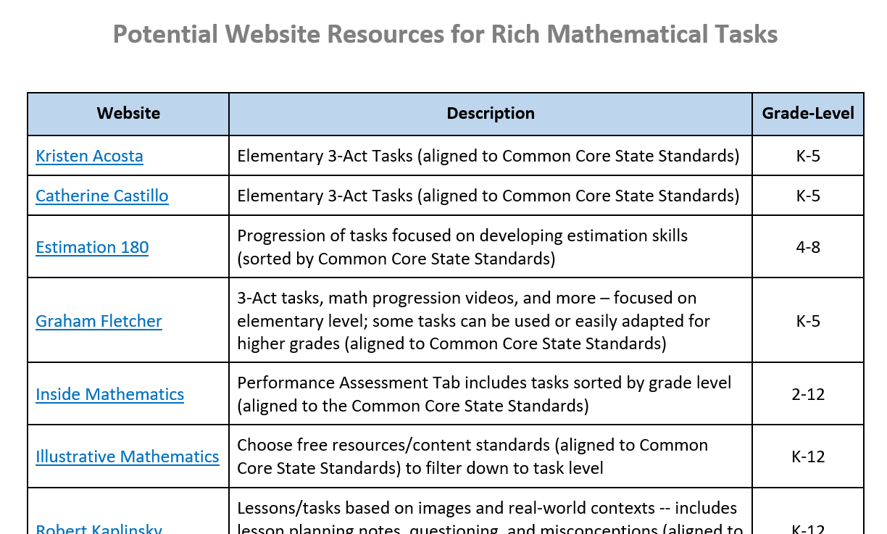
Potential Website Resources
Notes:
Provide participants a list of resources to find tasks (bit.ly site), including VDOE work on writing tasks.

Slide 85
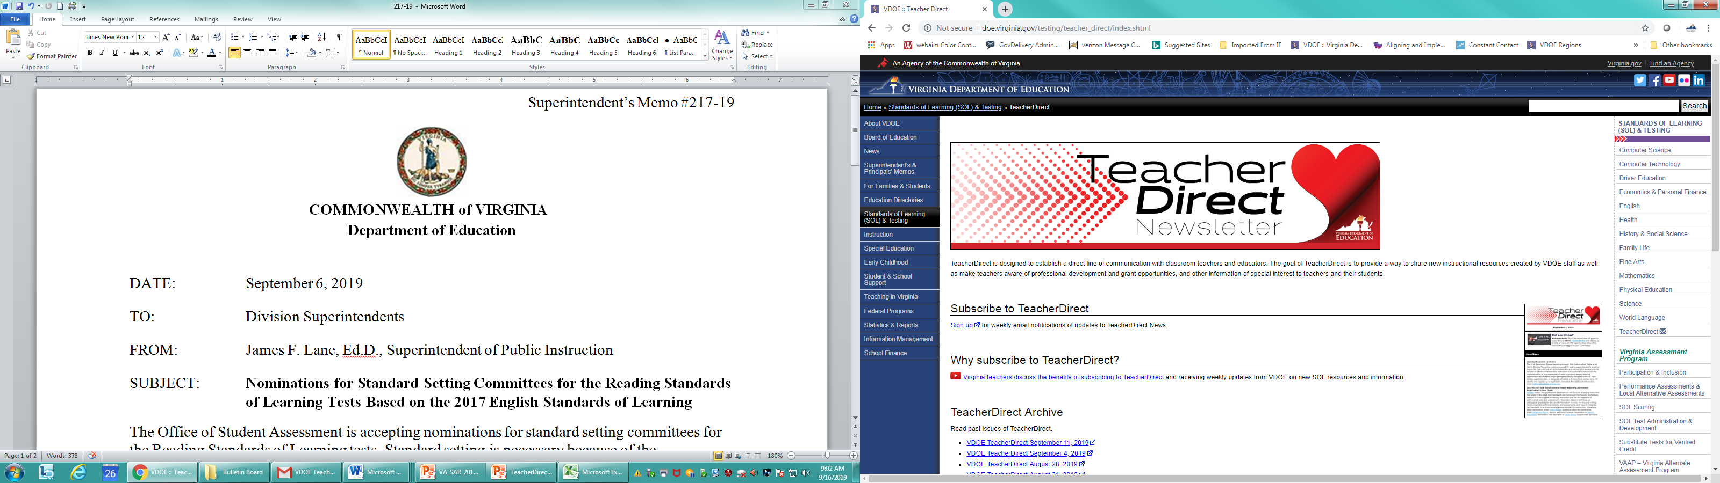
Teacher Direct
Access TeacherDirect from “Instruction” Link on the left side of the VDOE home page
Sign-up Link

Slide 86
Please Contact Us
The VDOE Mathematics Team at
Mathematics@doe.virginia.gov

