Slide 1
Developing Deeper Learning through Rich Mathematical Tasks 2019 Mathematics Institute 6-8 Session

Slide 2
Welcome and Introductions

Slide 3
Community Builder
Stand up if:

Slide 4
Just Like Me
Stand up if you are a pet owner

Slide 5
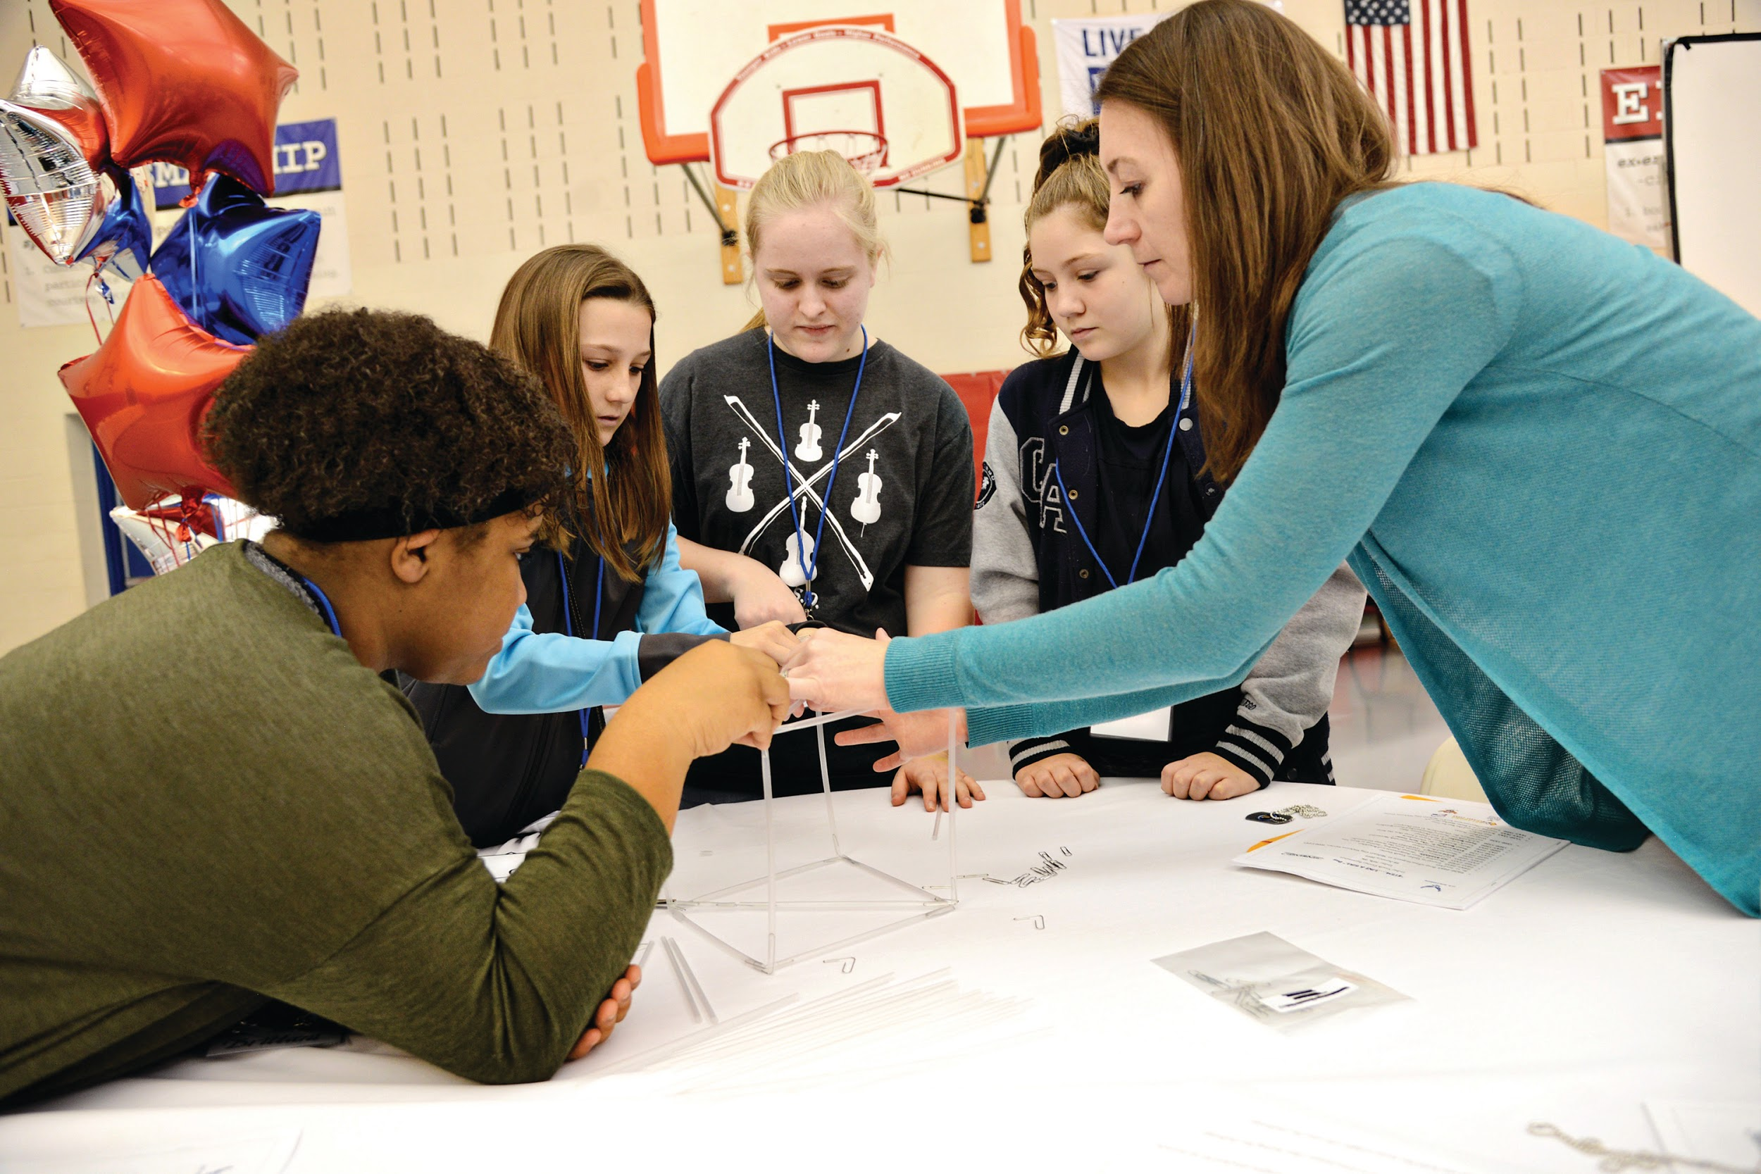
Just Like Me
Stand up if you have used tasks in your classroom

Slide 6
Just Like Me
Stand up if you drove over an hour to get here today.

Slide 7
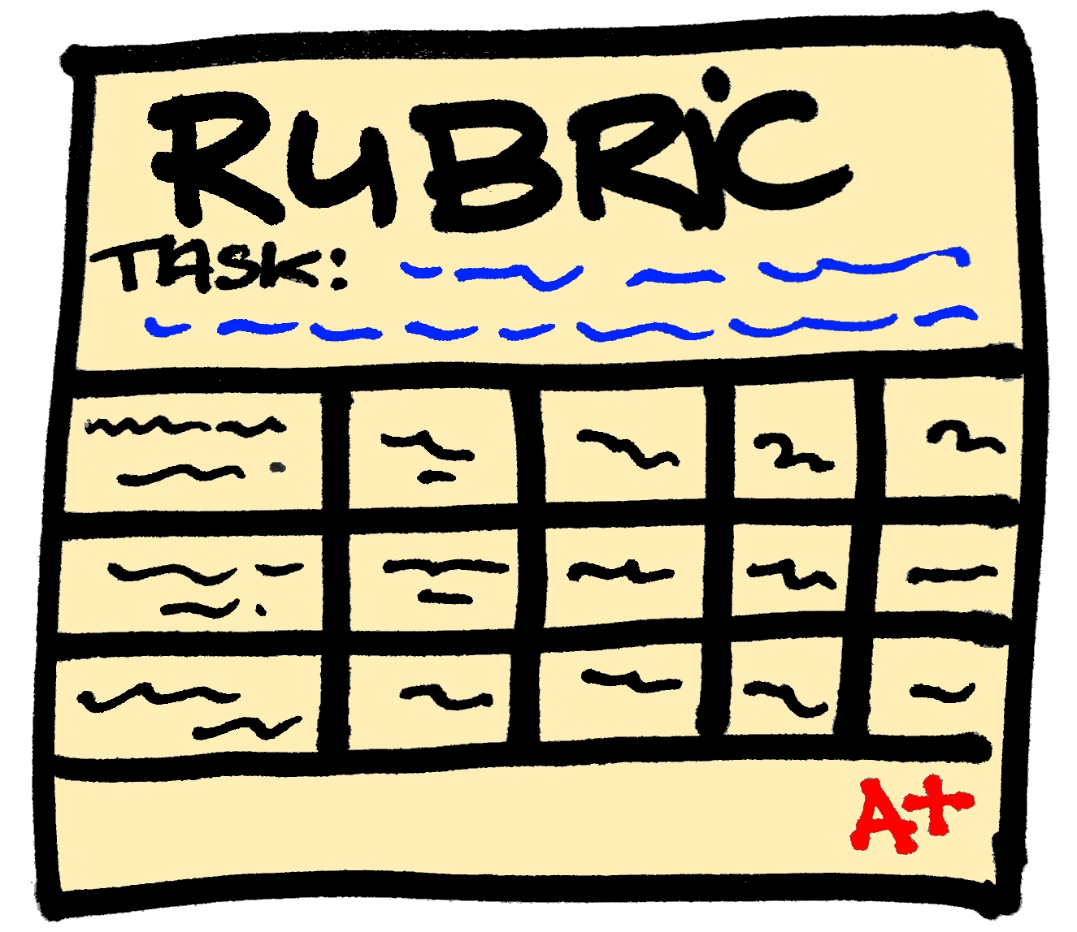
Just Like Me
Stand up if you have scored student work with a rubric before.

Slide 8
Just Like Me
Stand up if you have been teaching less than five years.

Slide 9
Just Like Me
Stand up if you have an administrative role.

Slide 10
Just Like Me
Stand up if you have heard of visible learning.

Slide 11
Just Like Me
Stand up if you you believe you have an impact on student learning.

Slide 12
Turn and Talk
How might you use this activity in your classroom to build community?
What is the importance of building a classroom community?
What additional ways do you foster a classroom community?

Slide 13
Agenda
Morning Session
Module 1: Overview – Visible Learning, Equity, and Identity
Module 2: Task Implementation (Before)
LUNCH
Afternoon Session
Module 3: Task Implementation (During/After)
Module 4: Assessing Student Understanding
Reflection and Closure

Slide 14
Opening Video Message from VDOE

Slide 15
Learning Intentions
Content:
I am learning about strategies and approaches that make teaching and learning more visible.
Language:
I am learning to use the language of a visible learning
mathematics classroom.
Social:
I am learning how to listen and respond to my colleagues’ ideas in ways that move everyone forward as learners.

Slide 16
Module I Overview – Visible Learning, Equity, and Identity

Slide 17
Success Criteria
I can recognize strategies in teaching and learning that have high impacts (effect size) on student achievement.
I can recognize and support equitable learning opportunities for all students that promote positive student mathematical identity and agency.
I can describe how to create a classroom environment that supports the development of assessment-capable mathematics learners.

Slide 18
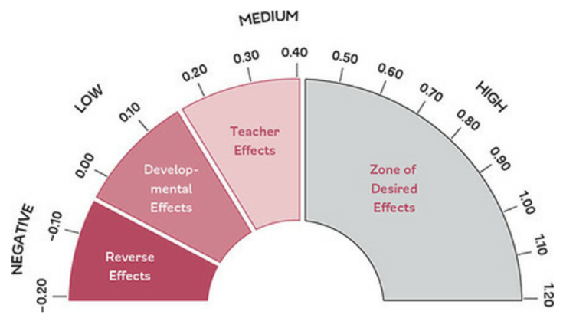
Barometer of Influence and Effect Size
Visible Learning Book
Page 5
Adapted from Hattie, J. (2009) Visible Learning: A Synthesis of Over 800 Meta-analyses Relating to Achievement. New York, NY: Routledge.

Slide 19
The Barometer of Influence
Reverse Effects – Have reverse consequences on learning
Developmental Effects – Students could achieve to this level on their own.
Teacher Effects – The effect that “any teacher” can produce
Zone of Desired Effects – Will have greater than average influence on achievement

Slide 20
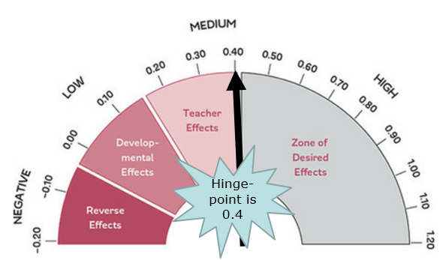
Hinge Point

Slide 21
Desmos Barometer Sort
Go to Student.Desmos.com
Enter the code:
Complete the sort
When you are finished – please stand

Slide 22
Desmos Barometer Sort Pair Up
Find an eye contact partner
Answer the following prompts:
My name is …
I am from…
My familiarity with Hattie’s research is…
My reaction to the sort is…

Slide 23
Effect Sizes of NCTM’s Mathematical Teaching Practices

Slide 24
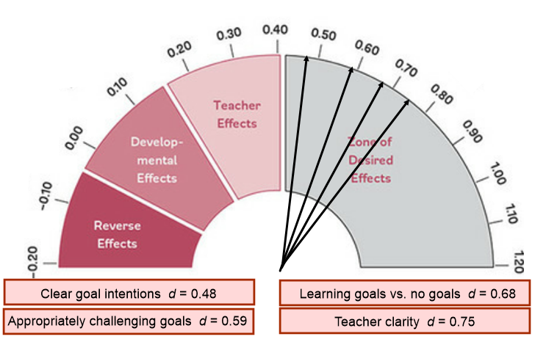
Establish mathematics goals to focus learning.

Slide 25
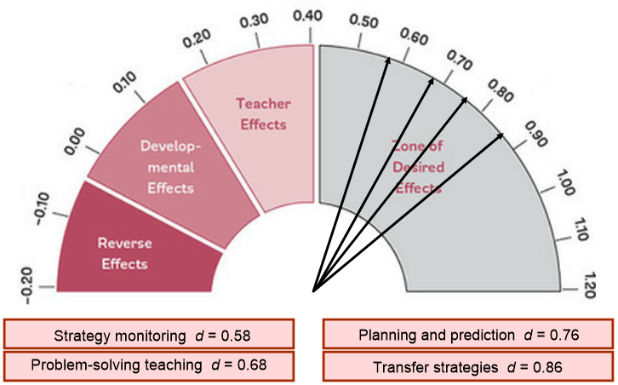
Implement tasks that promote reasoning and problem solving.

Slide 26
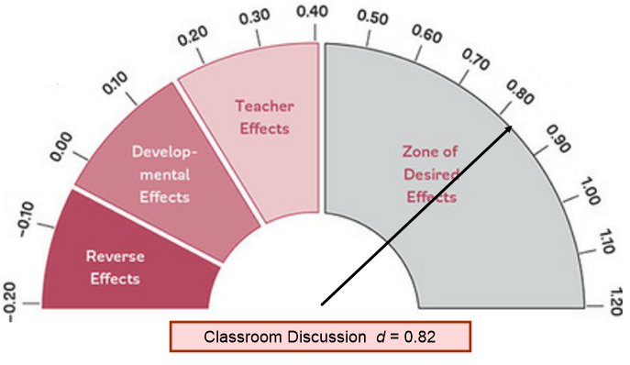
Facilitate meaningful mathematical discourse.

Slide 27
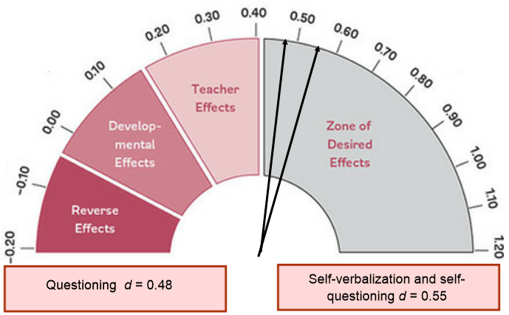
Pose Purposeful Questions

Slide 28
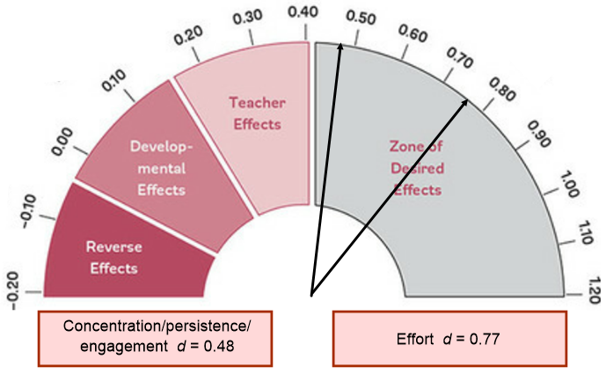
Support productive struggle in learning mathematics.

Slide 29
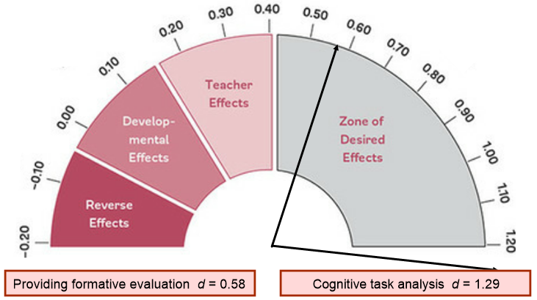
Elicit and use evidence of student thinking.

Slide 30
“We should not hold any influence, instructional strategy, action, or approach to teaching and learning in higher esteem than students’ learning. Using the right approach at the right time increases our impact on student learning in the mathematics classroom.” -Teaching Mathematics in the Visible Learning Classroom: Grades 6-8

Slide 31
Math Identity, Agency, and Equity

Slide 32
Mathematics Identity Graph
See Handout
Draw a timeline of your mathematical experiences indicating 3-5 distinct high and low points.

Slide 33
Teacher Mindframes
Visible Learning Book
Page 1
The teacher has the capacity to select and implement various teaching and learning strategies that enhance their adolescent learners in mathematics.
The decisions the teacher makes about their teaching have an impact on their students’ learning.
Each and every student can learn mathematics and the teacher takes responsibility to teach all learners in their middle school mathematics class.
The teacher must continuously question and monitor the impact of their teaching on student learning.
How do the belief statements you wrote in last question from the Math Identity Graph handout connect to these mindframes?

Slide 34
Positive Mathematical Identity
Empowering students to see themselves as capable of participating in and being doers of mathematics – developed in a classroom where students:
Are active participants;
Engage in reasoning and sense making;
Strive to make their thinking visible and intelligible to others;
Use multiple forms of discourse; and
Critique their world through using mathematics.
Adapted from Catalyzing Change in High School Mathematics – Initiating Critical Conversations. Reston, VA: NCTM, 2018.

Slide 35
Supporting Equitable Learning
Mathematical identity – dispositions and deeply held belies that individuals develop about their ability to participate and perform effectively in mathematical contexts and to use mathematics to change the conditions of their lives. (Martin, 2012, p. 57-58)
Mathematical agency – students capacity and willingness to engage mathematically (Schoenfeld, 2014, p. 407)

Slide 36
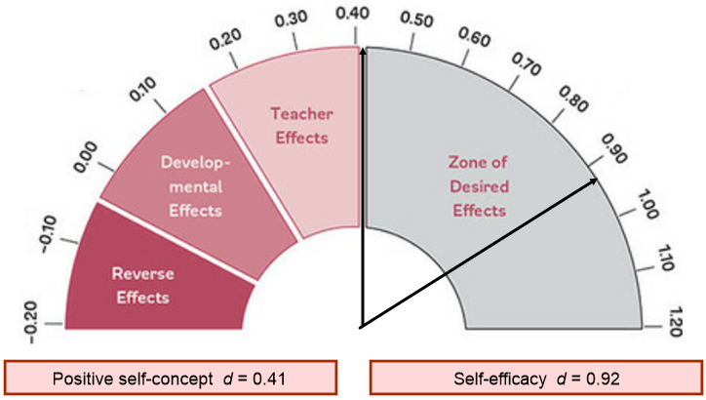
Identity and Agency

Slide 37
A Visible Learning Classroom is...
Teachers
Learners
Predict:
What do you think visible teaching looks like?
What do you think visible learning looks like?

Slide 38
Creating Assessment-Capable Visible Learners

Slide 39
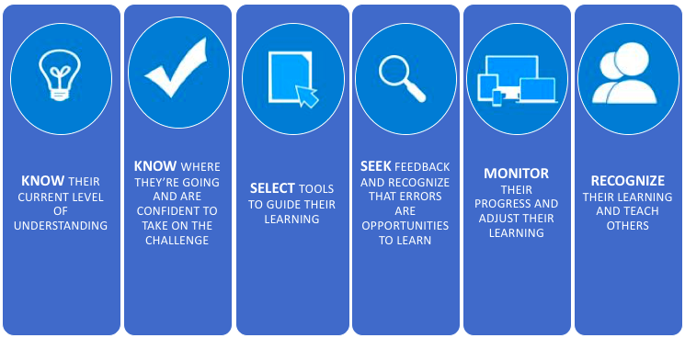
Assessment-Capable Visible Learner
Visible Learning Book
Page 10
Adapted from Teaching Mathematics in the Visible Learning Classroom: Grade 6-8

Slide 40
Impact of Visible Teaching
Visible Teaching
Visible Learning Book
Page 20
Visible Learning
Clearly communicates the learning intention
Identifies challenging success criteria
Utilizes a range of learning strategies
Continually monitors student learning
Provides feedback to learners
So that learners understand the intention of the learning experience.
So that learners know what success looks like.
So that learners develop a range of learning strategies.
So that learners know when they are not progressing and can make adjustments.
So that learners can seek feedback about their learning.
arrow
Source: Teaching Mathematics in the Visible Learning Classroom:
https://us.corwin.com/en-us/sam/teaching-mathematics-in-the-visible-learning-classroom-grades-6-8

Slide 41
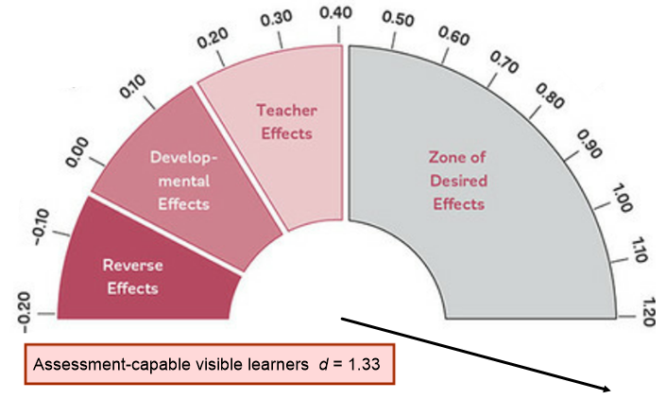
Assessment-Capable Visible Learners
Wow!

Slide 42
Mistake-Friendly Classroom
Mistakes are not only opportunities for learning, as students consider the mistakes, but also times when our brains grow.
Understanding the power of mistakes is critical, as children and adults everywhere often feel terrible when they make a mistake in math.
They think it means they are not a math person, because they have been brought up in a performance culture (see Boaler, 2014) in which mistakes are not valued—or worse, they are punished.
You cubed

Slide 43
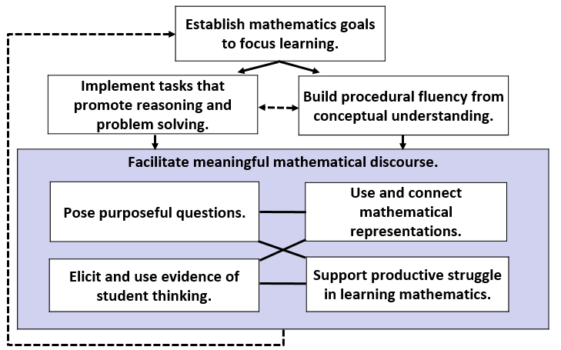
Focus of 2018 Mathematics Institutes
Adapted from Smith, M. et al. (2017) Taking Action – Implementing Effective Mathematics Teaching Practices Series, National Council of Teachers of Mathematics.

Slide 44
Focus of 2019 Mathematics Institutes
Establish mathematics goals to focus learning.
Implement tasks that promote reasoning and problem solving.
Build procedural fluency from conceptual understanding.
Facilitate meaningful mathematical discourse.
Pose purposeful questions.
Use and connect mathematical representations.
Elicit and use evidence of student thinking.
Support productive struggle in learning mathematics.
Adapted from Smith, M. et al. (2017) Taking Action – Implementing Effective Mathematics Teaching Practices Series, National Council of Teachers of Mathematics.

Slide 45
Reflection on Success Criteria
I can recognize strategies in teaching and learning that have high impacts (effect size) on student achievement.
I can recognize and support equitable learning opportunities for all students that promote positive student mathematical identity and agency.
I can describe how to create a classroom environment that supports the development of assessment-capable mathematics learners.

Slide 46
Square, Circle, Triangle Reflection
See Reflection Sheet
Based on Module I...
What is one idea that squared with your thinking?
What is a question circling in your mind?
What point(s) would you like to remember, that might impact your work?

Slide 47
Module II Task Implementation (Before)

Slide 48
Success Criteria
I can identify how teacher clarity about learning intentions and success criteria contributes to student success.
I can identify strategies, methods or approaches to meet the learning needs of individual students.
I can distinguish between tasks that will engage students in higher levels of cognitive demand versus lower levels of cognitive demand.
I can describe the factors associated with the decline or maintenance of the cognitive level of a rich mathematical task.
I can anticipate student solution strategies and misconceptions associated with the implementation of a mathematical task.

Slide 49
Ingredients for Progress Toward Mastery

Slide 50
Clear Learning Intentions
Clear Learning Intentions
Rich Mathematical Tasks
Progress Toward Mastery
Visible Learning Book
Page 47-48
“Dividing learning intentions into content, language, and social varieties can provide teachers and students alike a clearer sense of the day’s expectations.”
-Teaching Mathematics in the Visible Learning Classroom: Grades 6-8
Content
What is the math I am supposed to use and learn today?
Language
How should I communicate my mathematical thinking today?
Social
How should I interact with my learning community today?

Slide 51
Writing Clear Learning Intentions
Clear Learning Intentions
Rich Mathematical Tasks
Progress Toward Mastery
SOL 6.6b The student will solve practical problems involving operations with integers.
Content
Language
How should I communicate my mathematical thinking today?
Social
How should I interact with my learning community today?
What is the math I am supposed to use and learn today?

Slide 52
Writing Clear Learning Intentions
Clear Learning Intentions
Rich Mathematical Tasks
Progress Toward Mastery
Visible Learning Book
Page 80-81
SOL 6.6b The student will solve practical problems involving operations with integers.
Content
I am learning to use my understanding of integer addition and subtraction to solve problems about temperature comparisons or changes.
Language
I am learning to explain my problem-solving approach verbally and in writing.
Social
I am learning to explain my problem-solving thinking clearly to my peers.

Slide 53
What Does Success Look Like?
Clear Learning Intentions
Rich Mathematical Tasks
Progress Toward Mastery
Success Criteria:
I can find and explain temperature relationships among the cities in the task.
I can compute missing values accurately.
I can explain the process used to figure out missing values.

Slide 54
Establish mathematics goals to focus learning.

Slide 55
How do tasks and their implementation impact mathematics learning?
Student learning is greatest in classrooms where the tasks consistently encourage high‐ level student thinking and reasoning and least in classrooms where the tasks are routinely procedural in nature.
(Boaler and Staples 2009; Hieber and Wearne 1993;
Stein and Lane 1996)

Slide 56
Rich Mathematical Tasks - Definition
Rich mathematical tasks engage students in sense-making through deeper learning that require high levels of thinking, reasoning, and problem solving.

Slide 57
Characteristics of Rich Tasks
Promote high levels of cognitive demand
Allow multiple entry points to students with a wide range of skills and abilities
Allow for multiple solution pathways
Promote reasoning and sense making
Encourage the use of varied representations
Require justification or explanation
Encourage connections among ideas
Are authentic, relevant, or problem-based

Slide 58
Implement tasks that promote reasoning and problem solving.

Slide 59
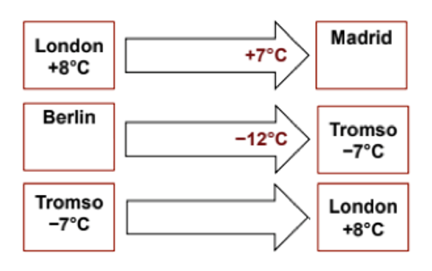
Task Launch
Source: Adapted from 2015 MARS, Shell Center, University of Nottingham

Slide 60
The Task
See Cards on Table
Place all cards face up on the table.
When it is your turn, connect two City Temperature cards using a Changes in Temperature arrow card.
Figure out any missing temperatures.
Explain your calculations verbally to your group.
If others in your group disagree, they should explain why. Then as a group, figure out the answer together.
When you have reached an agreement, record your strategy on the poster paper and write your solution in the box on the card.
Source: Adapted from 2015 MARS, Shell Center, University of Nottingham

Slide 61
Stop and Reflect
Why is it important to experience the task prior to implementing in class?
What is the benefit of experiencing the task in a collaborative learning team?
How could this task be scaffolded to support differing student needs?
See Reflection Sheet

Slide 62
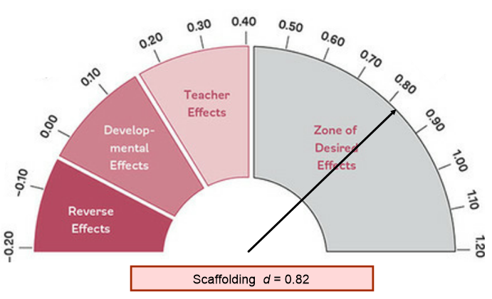
Scaffolding

Slide 63
Effective Task Implementation Jigsaw
Complete the sort for your group.
Identify key characteristics of the vocabulary assigned to your group.
Be prepared to share your findings!
See Handouts
Clear Learning Intentions
Rich Mathematical Tasks
Progress Toward Mastery

Slide 64
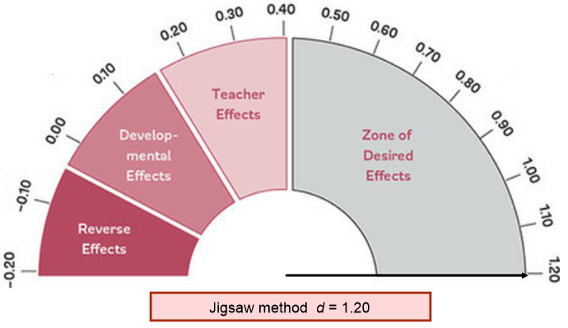
Jigsaw

Slide 65
Surface, Deep, and Transfer Learning in Mathematics
Ongoing assessments inform teachers that students are in various places along this path, and sometimes will move interchangeably between these phases of learning. It is the teacher’s goal to provide interventions and strategies students need at the right time for the right reason.
Hattie, J. , Fisher, D., Frey, N. (2017) Visible Learning for Mathematics: What Works Best to Optimize Student Learning. Thousand Oaks, CA: Corwin.
Corwin Website

Slide 66
It’s not just about the task…..
Moderate

Slide 67
Factors Associated with the Decline and Maintenance of High Level Tasks
Decline | Maintenance
Problematic aspects of the task become routinized Emphasis is shifted to correctness or completeness Not enough time is provided Classroom management problems prevent engagement Inappropriate task Lack of accountability for high-level products | Scaffolding Students provided way to monitor their progress High-level of performance is modeled Sustained justification, meaning, questioning, comments, and feedback Tasks build on prior knowledge Frequent conceptual connections Sufficient time to explore
Resource: Smith, M. et al. (2017) Taking Action – Implementing Effective Mathematics Teaching Practices Series, National Council of Teachers of Mathematics.

Slide 68
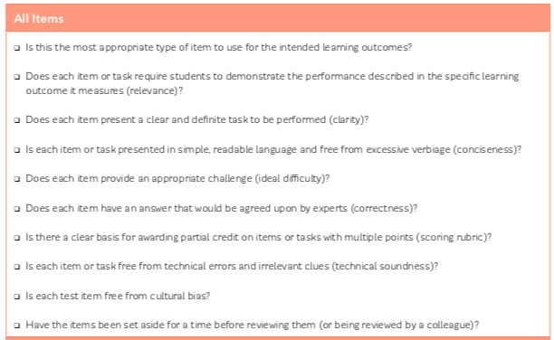
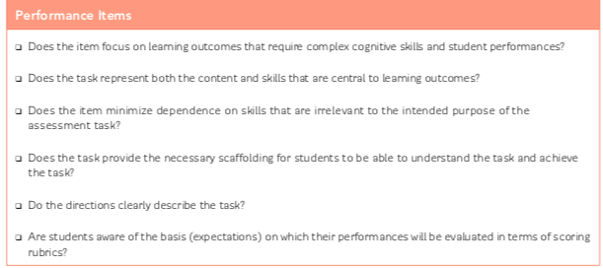
Checklist for Creating or Selecting Tasks that Promote Mastery
Visible Learning Book
Page 197
See Handout

Slide 69
Goldilocks Challenge
“… the task is challenging enough to provide a productive struggle for every student in the class. Learners who are still mastering the content may not complete the entire task, but their reasoning and problem-solving skills are challenged by the parts of the task they complete. Learners who are more advanced will progress further into the task and identify some of the more complex missing value calculations.”
-Teaching in the Visible Learning
Classroom: Grades 6-8, pg. 85

Slide 70
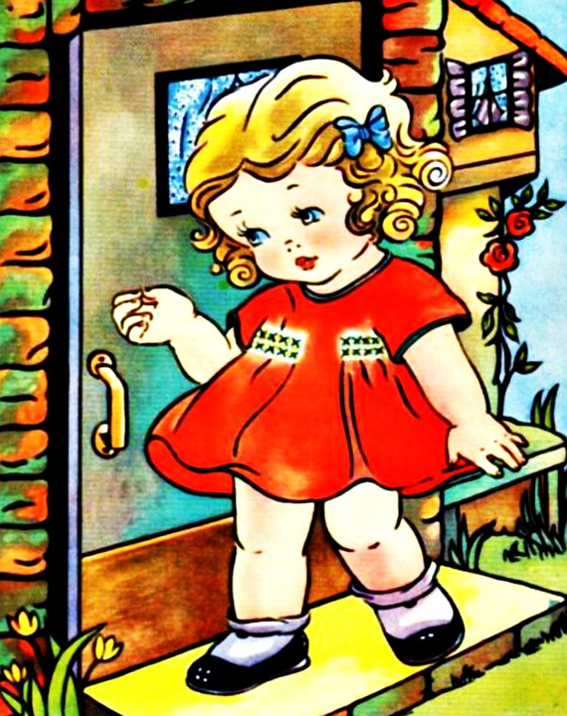
The “Goldilocks” effect
A Visible Learning classroom uses…
the right strategy at the right time,
for the right level of thinking,
with the right level of challenge.

Slide 71
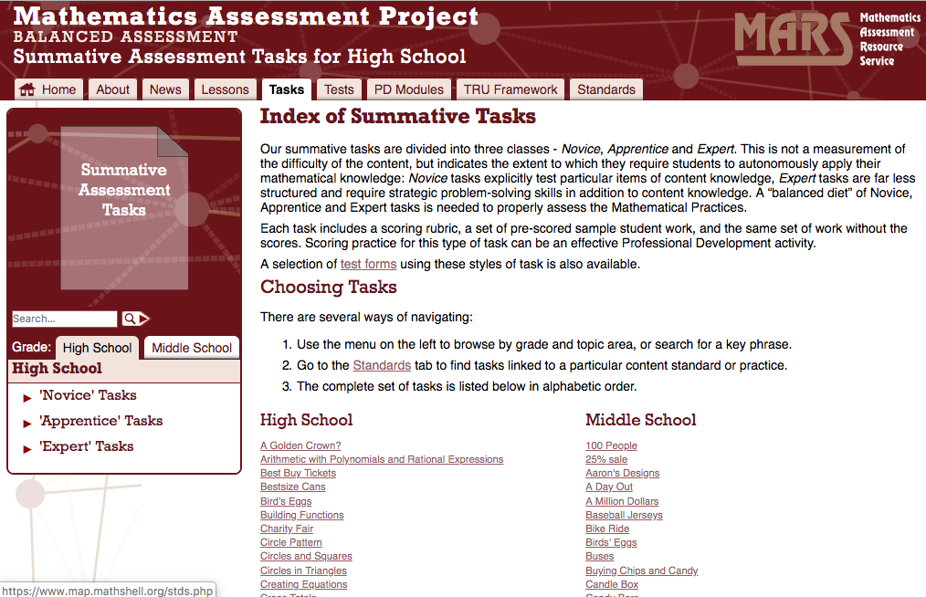
Mathematics Assessment Project

Slide 72
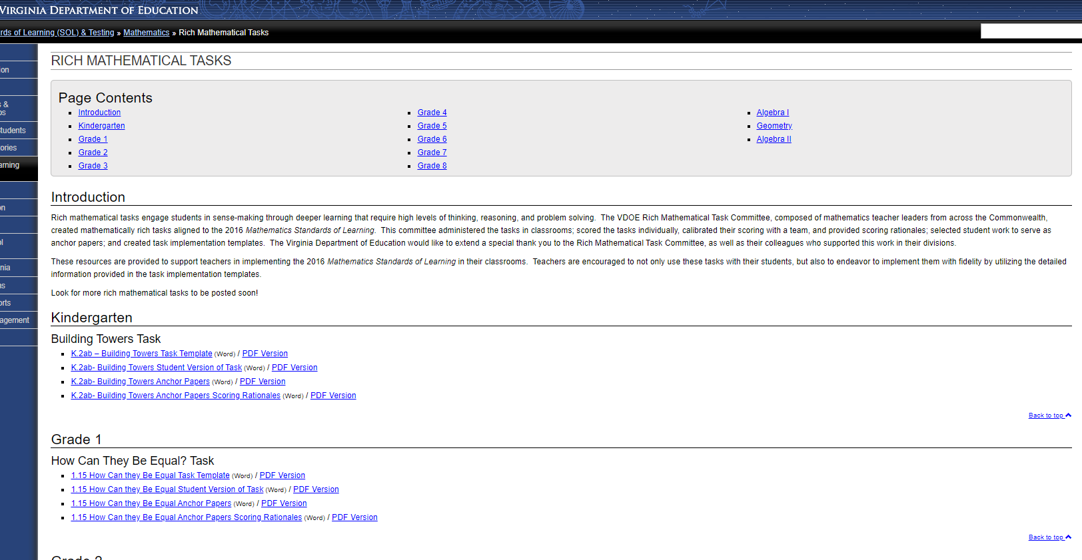
VDOE Rich Mathematical Tasks

Slide 73
Anticipating Student Responses
See Handout
“As math students ourselves, we are often trained to become more efficient and begin pruning what feel like unnecessary steps and computational deadweight. The trouble with this path to efficiency is that these trimmings become expert blind spots when we run a classroom of our own. Many of us have lived through educational experiences in which we were taught to seek the right answers as quickly as possible. With a core shift to viewing mathematics as a process rather than a collection of products, it is important for us as educators to investigate our own problem-solving process and regrow any trimmed blind spots. It helps to think about mathematics itself as an explanation, in which each individual step comes with purpose and justifiable legitimacy.”
-Teaching Mathematics in the Visible
Learning Classroom: High School
Source: Adapted from Teaching Mathematics in the Visible Learning Classroom

Slide 74
Planning for Mathematical Discourse Chart

Slide 75
Classifying Questions
Assessing Questions Are based closely on the work that the student has produced. Clarify what the student has done and understands about what s/he has done. Gives the teacher information about what the student understands Teacher stays to hear the answer to the question. | Advancing Questions Use what students have produced as a basis for making progress toward the target goal of the lesson. Move students beyond their current thinking by pressing students to extend what they know to a new situation. Press students to think about something they are not currently thinking about. Teacher walks away, leaving students to figure out how to proceed.
Source: Taking Action: Implementing Effective Mathematics Teaching Practices

Slide 76
Pose Purposeful Questions

Slide 77
Reflection on Success Criteria
I can identify how teacher clarity about learning intentions and success criteria contributes to student success.
I can identify strategies, methods or approaches to meet the learning needs of individual students.
I can distinguish between tasks that will engage students in higher levels of cognitive demand versus lower levels of cognitive demand.
I can describe the factors associated with the decline or maintenance of the cognitive level of a rich mathematical task.
I can anticipate student solution strategies and misconceptions associated with the implementation of a mathematical task.

Slide 78
Stop and Reflect
What was the most important point you would like to hold on to?
What is something you are most excited to share with your colleagues?
See Reflection Sheet

Slide 79
Module III Task Implementation (During/After)

Slide 80
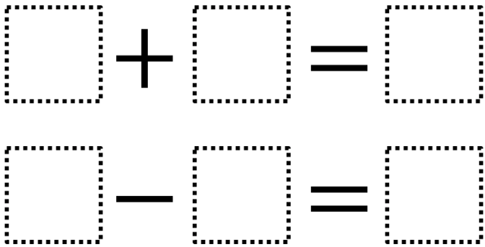
Welcome Back!
Cut out the cards on your table.
In groups, work to find two true equations.
Each card may only be used once.
One integer card will not be used.
Source: https://www.openmiddle.com/integer-sums-and-differences/

Slide 81
Synectics
Rich Tasks are like ______ because _______.

Slide 82
Success Criteria
I can implement a rich mathematical task to support deeper learning for all students.

Slide 83
Which One Doesn’t Belong?

Slide 84
Learning Intentions & Success Criteria
Learning Intention(s):
Content– I am learning about the relationship between area and perimeter of rectangles and the area and circumference of circles.
Language- I am learning how to communicate about the relationships and patterns of area, perimeter, and circumference.
Social – I am learning how to explain my strategy and work to others so I can refine my strategies for problem solving.

Slide 85
Learning Intentions & Success Criteria
Success Criteria:
I can determine the area and perimeter of rectangles and the area and circumference of circles in a practical problem.
I can justify the relationships between area and perimeter using appropriate math language.
I can make suggestions and utilize suggestions made by my peers to make revisions to my work and thinking.

Slide 86
Planning a Dog Park
See Handout
Your parents have asked you to design an enclosed area in your backyard for your dog.
The enclosed area can be in the shape of a square or a rectangle.
The area will be enclosed with a fence that cannot be attached to another structure (i.e., the house, shed, etc.).
There is 72 yards of fencing available.
The dimensions of your rectangular backyard is 30 yards by 35 yards.
What is the largest area in your backyard that can be enclosed for your dog? What are the dimensions of this enclosed area? Justify how you know that your design provides the largest area.
Sequel: What is the largest area in your backyard for your dog if the enclosure can be a circle? How does this change your answer?

Slide 87
Debrief
What did you notice the facilitators were doing during the task?
What scaffolds may you provide so that all students can meet success with this task?

Slide 88
Scaffolding

Slide 89
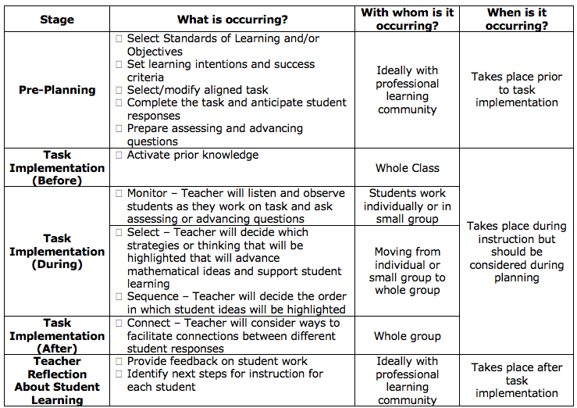
Task Implementation Checklist
See Handout
Adapted from: The 5 Practices in Practice:
Successfully Orchestrating Mathematics Discussion in Your Middle School Classroom.

Slide 90
Mathematics Process Goals in Action
See Handout
Communication
Connections
Representations
Problem Solving
Mathematical Understanding
Reasoning

Slide 91
Reflect on Success Criteria
I can use effective questioning strategies to assess and advance student thinking.

Slide 92
Stop and Reflect
What are the benefits of monitoring, selecting, sequencing, and connecting?
How does anticipating help you to monitor, select, sequence, and connect during task implementation?
See Reflection Sheet

Slide 93
Module IV Assessing Student Understanding

Slide 94
Success Criteria
I can use success criteria to provide effective feedback to students to deepen student learning.
I can use a rubric to score student work samples and work collaboratively to calibrate my scores.
I can analyze student work to identify what students know and are able to do in order to plan instruction that moves all students forward as learners.

Slide 95
Calibration Protocol Purpose
Provides a process whereby groups can discuss student work in order to reach consensus about how to score the work based on a rubric or scoring criteria.
Ensures equity in how each scorers contributions are considered
Provides a structure that makes it safe to challenge and question one another
Makes the most of time set aside for examining student work
Increases inter-rater reliability (providing for fair and consistent scoring of student work)

Slide 96
Calibration Protocol
See Handout
Examination – work through task (individual)
Discussion of proficient responses (small group)
Read and place in groups (individual)
Score student work (individual)
Score Sharing (small group)
Discussion (small group)
Debrief Discussion (small group)

Slide 97
Group Roles
1. Identify the following roles within your group:
Recorder
Facilitator
Speaker
Time Keeper

Slide 98
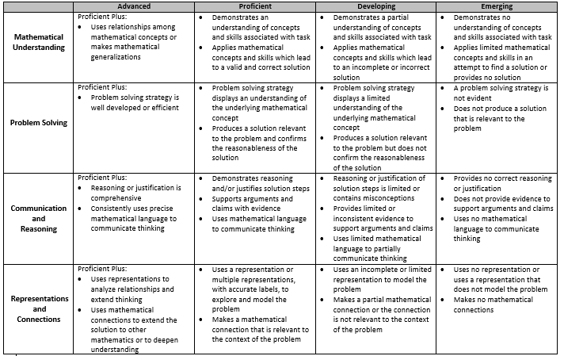
Preparing to Score Student Work
2. Discuss proficient response (group) - 10 min.
Discuss at your table what is expected for a proficient student response in holistic terms.
Use the Rich Mathematical Task Rubric as a guide.
See Handout

Slide 99
Scoring Student Work
See Handout
3. Read and place in groups (individually) - 10 min
Sort student work into 3 piles - low, med, high based on overall impression.
4. Score student work (individually) - 10 min.
Score each student work sample.
Record your scores on the Individual Scoring Notes sheet.
Use evidence from the work and the rubric to support your scores.

Slide 100
Sharing & Discussing Student Work
5. Score sharing without explanation (collaboratively) - 2 min
One at a time, team members share their score for each of the rubric criteria while a recorder completes the group’s score sheet.
6. Discussion (collaboratively) - 15 min
Score each student work sample. Record your scores on the Individual Scoring Notes sheet.
Use evidence from the work and the rubric to support your scores.
7. Debrief (collaboratively) - 5 min
Discuss the questions found on the handout.

Slide 101
Think – Pair – Share
What are the benefits of the calibration process?

Slide 102
Benefits of Calibration
Provides opportunity to deepen educators’ understanding or expectations of student work and the standards of learning
Strengthens educators’ ability to teach and assess in alignment with a rubric
Process provides opportunity to identify areas where rubric could be made clearer or better align to expectations and standards
Calibration can lead to
Greater insight into instructional practices and curriculum
Identification of student strengths and weaknesses at each level of the rubric
Reliable identification of students in need of instructional supports or extensions

Slide 103
Elicit and use evidence of student thinking.

Slide 104
Elements of Effective Feedback
Clear Learning Intentions
Rich Mathematical Tasks
Progress Toward Mastery
Effective Feedback
Where am I going? How am I going? Where to next?
Each question works at four levels
Task Level
How well are the tasks understood/ performed?
Process Level
The main process needed to understand/ perform tasks
Self-Regulation Level
Self-monitoring directing, and regulating of actions
Self Level
Personal evaluations and affect (usually positive) about the learner
Source: Hattie & Timperly (2007).

Slide 105
Feedback
Clear Learning Intentions
Rich Mathematical Tasks
Progress Toward Mastery
As a table pick one student work sample and discuss the following questions:
What misconceptions, if any, does the student have?
What feedback would you give the student?
What are the next instructional steps for the student?

Slide 106
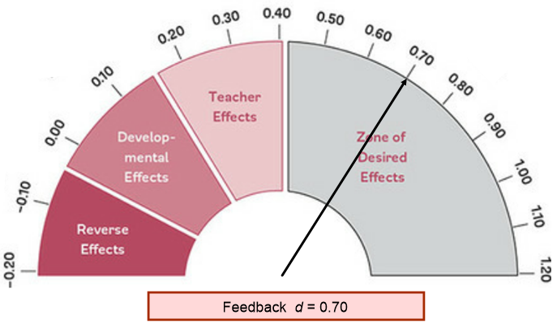
Feedback

Slide 107
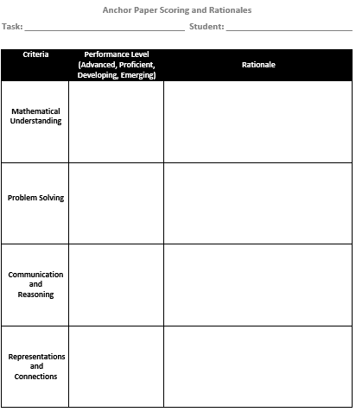
Anchor Paper Scoring and Rationales
Task developers collected comments from scoring sheets to assist in creating final anchor paper rationales
Following scoring calibration, developers deliberately selected 4-6 student work samples to serve as anchor papers
See Handout

Slide 108
Identified Anchor Papers …
Serve as examples of student work at varying levels of performance that, along with rubrics, guide formative and summative assessments
Include a scoring rationale for each criteria explaining why the work is assessed at a specific performance level
Identify where students are in terms of mathematical understanding
Can be examined as a way to understand the learning opportunities we are, and are not, giving our students
Can be used to evaluate how accurately and consistently teachers are assessing students

Slide 109
Reflect on Success Criteria
I can use success criteria to provide effective feedback to students to deepen student learning.
I can use a rubric to score student work samples and work collaboratively to calibrate my scores.
I can analyze student work to identify what students know and are able to do in order to plan instruction that moves all students forward as learners.

Slide 110
Stop and Reflect
What are the benefits of discussing student work with a collaborative learning team?
See Reflection Sheet

Slide 111
Session Closure and Reflection

Slide 112
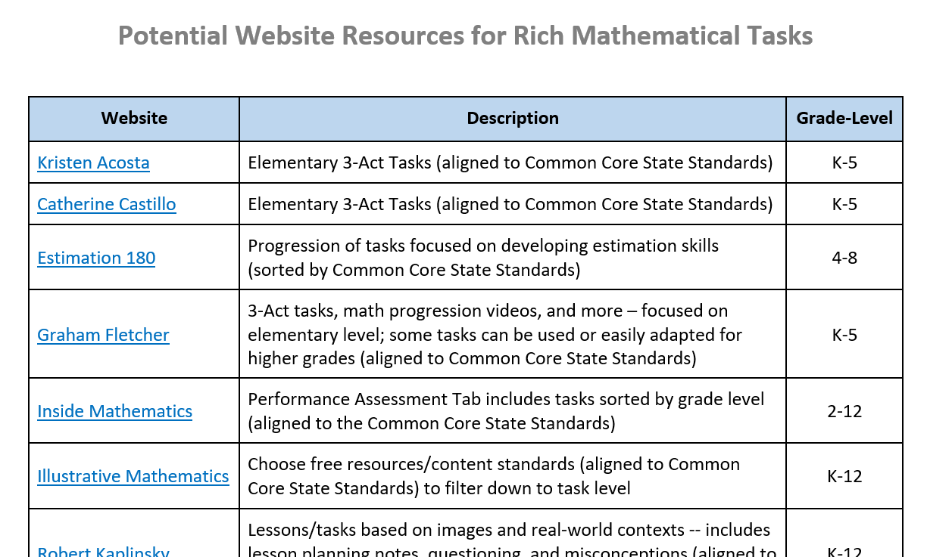
Potential Website Resources

Slide 113
Strategy Catcher
Community Builders Strong Classroom Cohesion(0.44)
Math Timeline Positive Self-Concept (0.41)
Jigsaw (1.20)
Questioning (0.48)
Strategy Monitoring (0.58)
Planning and Prediction (0.76)
Checklist Setting Standards for Self Judgement (0.62)
Scaffolding (0.82)
Feedback (0.70)
Cooperative Learning (0.40)
Reflection Evaluation and Reflection (0.75)
Sentence Frames Teaching Communication Skills & Strategies (0.43)

Slide 114
Assessment-Capable Visible Learner
Adapted from Teaching Mathematics in the Visible Learning Classroom: Grade 6-8

Slide 115
2016 Mathematics Standards of Learning - Instructional Resources
Standards of Learning and Curriculum Frameworks
Test Blue Prints
Practice Items
Mathematics Instructional Plans
Co-Teaching Mathematics Instructional Plans
Algebra Readiness Initiative Materials
Mathematics Vertical Articulation Tool
Static Versions and Dynamic Versions
Remediation Plans
Formative Assessments
2018 Mathematics SOL Institutes Materials
Mathematics Vocabulary Word Wall Cards
Desmos Resources
Rich Mathematical Tasks

Slide 116
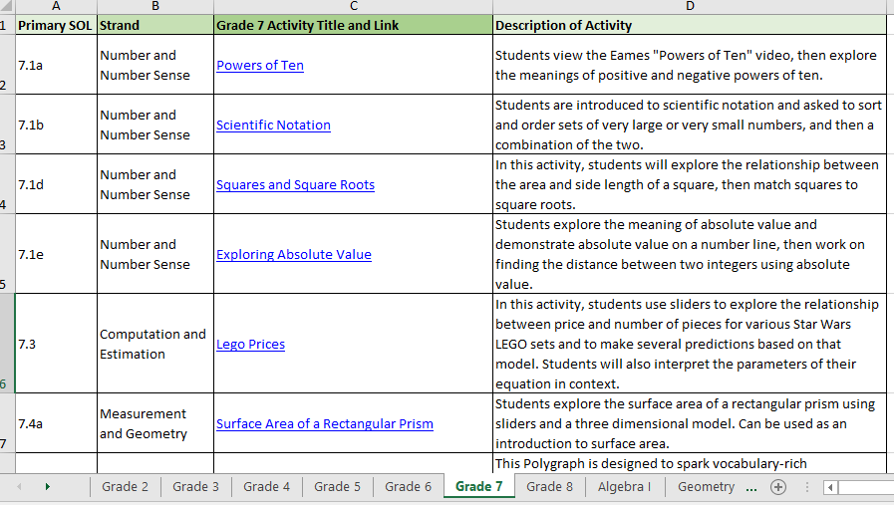
Desmos Classroom Activities Log (NEW)
116

Slide 117
Teacher Direct
Access TeacherDirect from “Instruction” Link on the left side of the VDOE home page
Sign-up Link

Slide 118
Math Information Email
Teachers, administrators and mathematics coordinators are encouraged to send an email to mathematics@doe.virginia.gov to receive the VDOE Mathematics Update distributed by the mathematics office.

Slide 119
Learning Intentions
Content: I am learning about strategies and approaches that make teaching and learning more visible.
Language: I am learning to use the language of a visible learning mathematics classroom.
Social: I am learning how to listen and respond to my peers’ ideas in ways that move everyone forward as learners.

Slide 120
Traffic Light Exit Ticket
Based on today’s presentation…
One thing I could stop doing is...
One thing I could continue doing is...
One thing I could start doing is...

Slide 121
Give yourself “permission to spend more time developing student’s deep understanding of mathematics as a well-rounded discipline.” -Teaching Mathematics In the Visible Learning Classroom: Grades 6-8

Slide 122
Please Contact Us
The VDOE Mathematics Team at
Mathematics@doe.virginia.gov

