Slide 1
Developing Deeper Learning through Rich Mathematical Tasks
2019 Mathematics Institute
K-2 Session

Slide 2
Welcome and Introductions

Slide 3

Just Like Me
Stand up if… you are a pet owner.

Slide 4
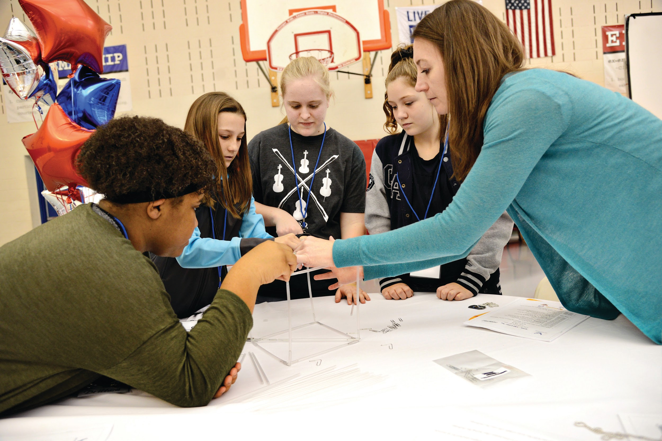
Just Like Me
Stand up if… you have used rich mathematical tasks in your classroom.

Slide 5

Just Like Me
Stand up if… you drove over an hour to get here today.

Slide 6
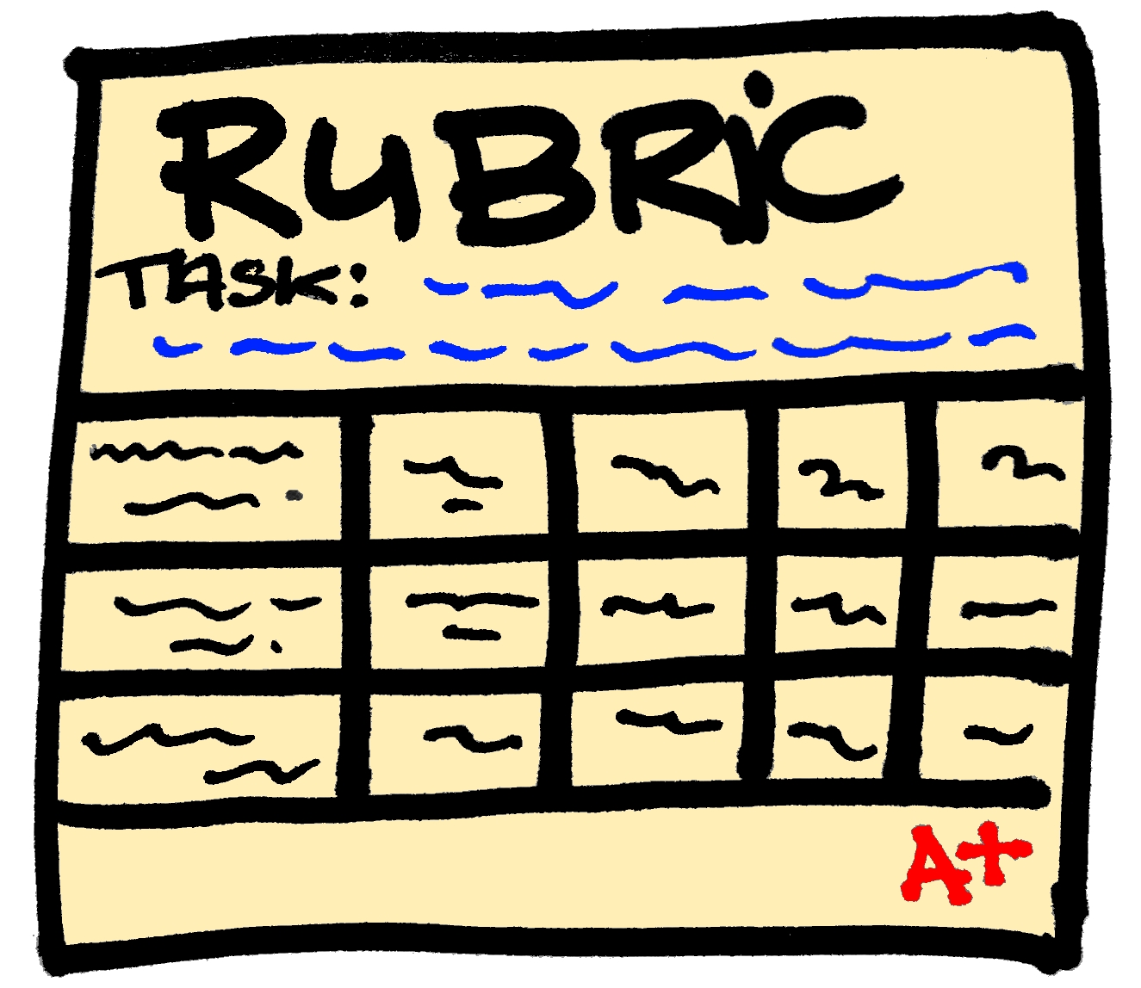
Just Like Me
Stand up if… you have scored student work with a rubric before.

Slide 7

Just Like Me
Stand up if… you have been teaching for
  less than 5 years
  6-10 years
  more than 10 years

Slide 8

Just Like Me
Stand up if… you are in a role as
  an administrator
  a math specialist/coach
  a classroom teacher
  other resource teacher

Slide 9

Just Like Me
Stand up if… you have heard of Visible Learning.

Slide 10

Just Like Me
Stand up if… you believe you have an impact on student learning.

Slide 11
Agenda
Morning Session
Module 1: Overview – Visible Learning, Equity, and Identity
Module 2: Task Implementation (Before)
Afternoon Session
Module 3: Task Implementation (During/After)
Module 4: Assessing Student Understanding
Reflection and Closure

Slide 12

Opening Video Message from VDOE

Slide 13
Session Learning Intentions
Content:
I am learning about strategies and approaches that make teaching and learning more visible.
Language:
I am learning to use the language of a visible learning
mathematics classroom.
Social:
I am learning how to listen and respond to my colleagues’ ideas in ways that move everyone forward as learners.

Slide 14
I. Overview – Visible Learning, Equity, and Identity

Slide 15
Module I - Success Criteria
I can recognize strategies in teaching and learning that have high impacts (effect size) on student achievement.
I can recognize and support equitable learning opportunities for all students that promote positive student mathematical identity and agency.
I can describe how to create a classroom environment that supports the development of assessment-capable mathematics learners.

Slide 16

Math Identity, Agency, and Equity

Slide 17
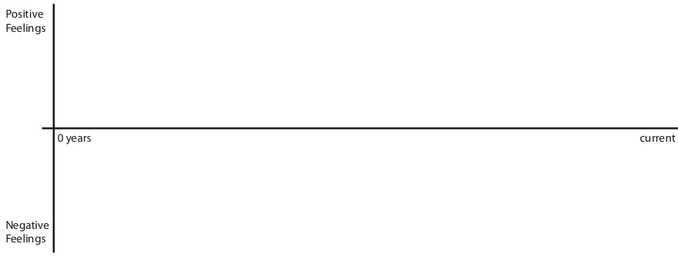
What’s Your Math Story?
Mathematics Identity Graph
  Create a timeline of your mathematical experiences
  indicating 3-5 distinct high and low points.
Consider the following questions:
Briefly describe one of your low points. What made this a negative mathematical experience?
Briefly describe one of your high points. What made this a positive mathematical experience?

Slide 18

Turn and Talk
What is the leverage point for a mathematical experience to be positive or negative?
Thinking about your classroom, what beliefs do you hold that promote positive mathematical experiences for students?

Slide 19

Supporting Equitable Learning
Mathematical Identity
Mathematical Agency
Dispositions and deeply held beliefs that individuals develop about their ability to participate and perform effectively in mathematical contexts and to use mathematics to change the conditions of their lives.
(Martin, 2012, p. 57-58)
Students’ capacity and willingness to engage mathematically.
(Schoenfeld, 2014, p. 407)
MATH

Slide 20
Positive Mathematical Identity
Empowering students to see themselves as capable of participating in and being doers of mathematics developed in a classroom where students:
  Are active participants;
  Engage in reasoning and sense making;
  Strive to make their thinking visible and intelligible to others;
  Use multiple forms of discourse; and
  Critique their world through using mathematics.
Adapted from Catalyzing Change in High School Mathematics – Initiating Critical Conversations. Reston, VA: NCTM, 2018.

Slide 21
Equity in Math
“Addressing equity and access includes both ensuring that all students attain mathematics proficiency and increasing the numbers of students from all racial, ethnic, linguistic, gender, and socioeconomic groups who attain the highest levels of mathematics achievement.” (NCTM)
– Found on VDOE Website,
Mathematics Standards of Learning Preface, p. VI

Slide 22
Equity Quotes 4 Corners Activity
1. Read the Equity Quotes handout.
2. Decide which quote resonates with you.
3. Go to corner that corresponds to your quote’s letter.
4. Discuss why you chose this quote with others in your corner. Prepare to share out with the whole group.

Slide 23
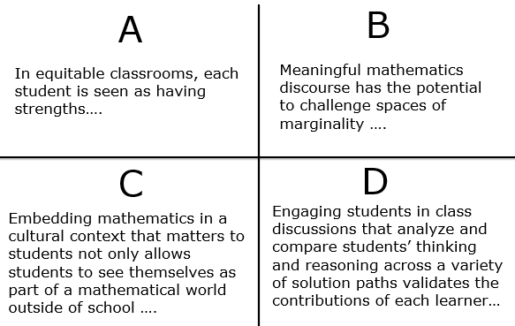
Equity Quotes 4 Corners Activity

Slide 24
The Five Equity-Based Mathematics Teaching Practices
Go deep with mathematics
Leverage multiple mathematical competencies
Affirm mathematics learners’ identities
Challenge spaces of marginality
Draw on multiple resources of knowledge
Resource: Smith, M. et al. (2017) Taking Action – Implementing Effective Mathematics Teaching Practices Series, National Council of Teachers of Mathematics.

Slide 25


A Visible Learning Classroom is...
Teachers
Learners
Predict: What does visible teaching look like in a classroom?
What does visible learning look like in a classroom?

Slide 26
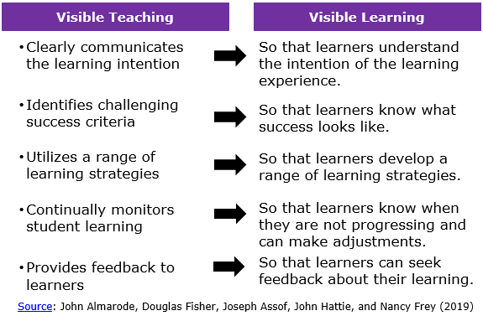
Comparing Visible Teaching & Learning

Slide 27

Assessment-Capable Visible Learners
Reflective Questions:
What are characteristics of an assessment-capable learner?
How would you create a classroom environment that supports the development of assessment-capable mathematics learners?

Slide 28
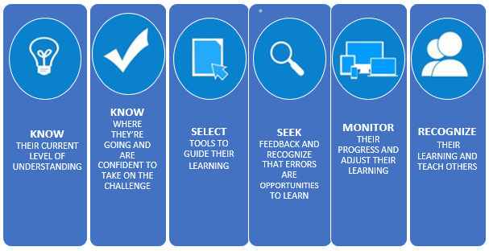
Assessment-Capable Visible Learners

Slide 29
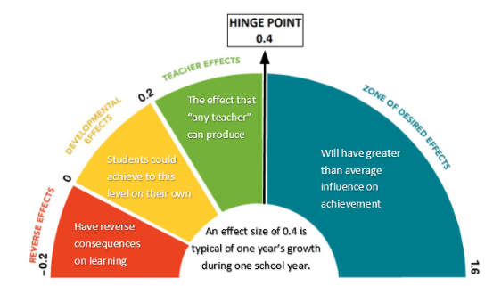
Barometer of Influence and Effect Size
Adapted from Hattie, J. (2009) Visible Learning: A Synthesis of Over 800 Meta-analyses Relating to Achievement. New York, NY: Routledge.

Slide 30
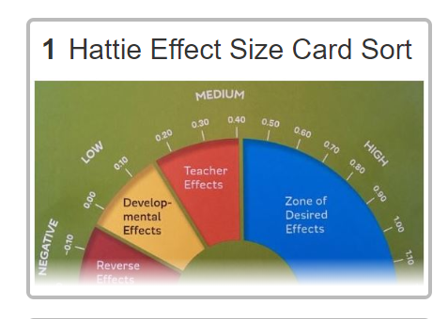
Effect Size Sort

Slide 31
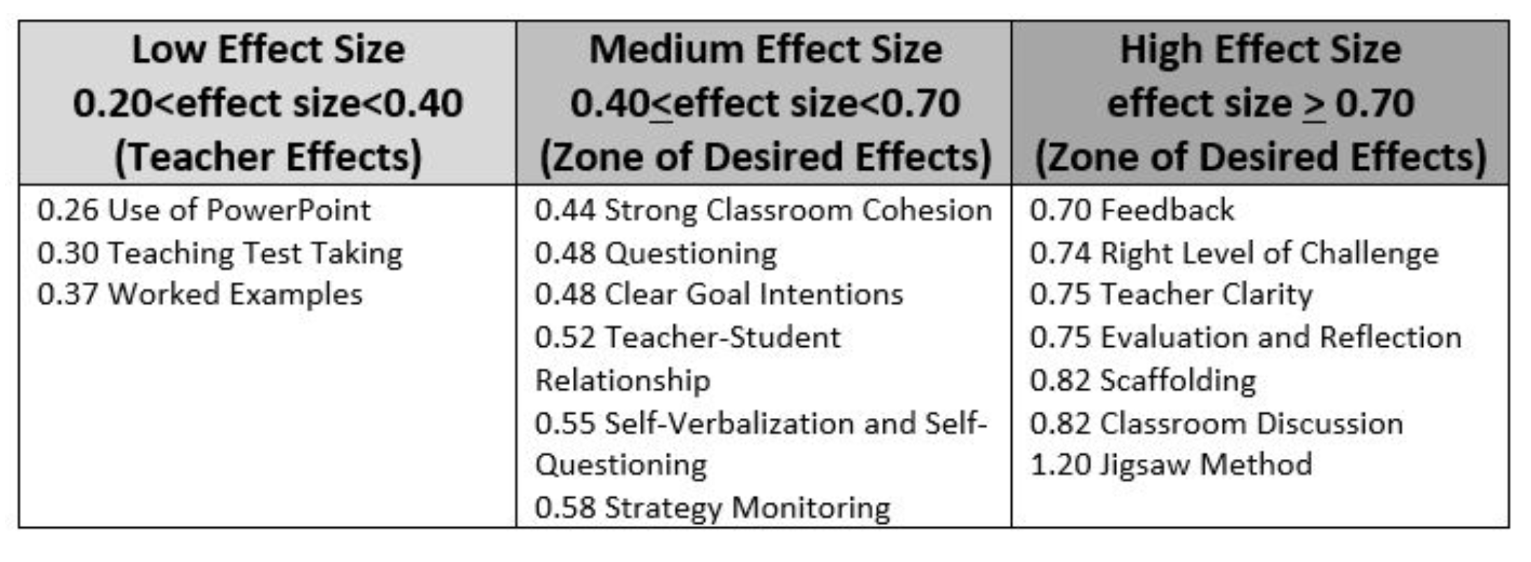
Effect Size Sort Solutions
Think back to the sort you completed this morning.
Visible Learning Book Pages 245-249

Slide 32
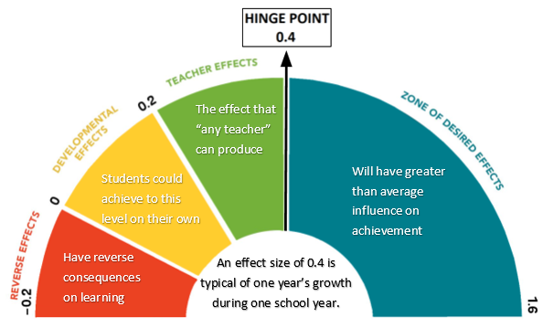
Effect Size of Strategies Used
So far today, we have used…
Strategy to Integrate with Prior Knowledge 0.93
Learning Intentions 0.68
Vocabulary Instruction 0.62
Strong Classroom Cohesion 0.44
Success Criteria 1.13
Discussion 0.82
Discussion
0.82

Slide 33
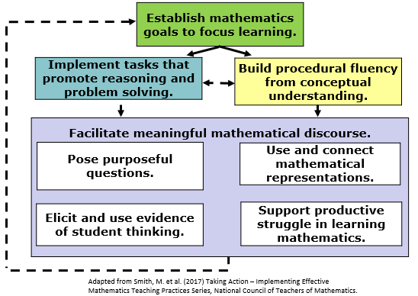
Focus of 2018 and 2019 Mathematics Institutes

Slide 34
Mathematics Process Goals for Students
“The content of the mathematics standards is intended to support the five process goals for students”
- 2009 and 2016 Mathematics Standards of Learning
Communication
Connections
Representations
Problem Solving
Mathematical Understanding
Reasoning

Slide 35
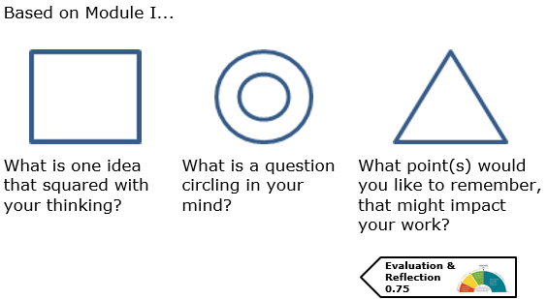
Square, Circle, Triangle Reflection

Slide 36
II. Task Implementation (Before)

Slide 37
Focus of 2019 Mathematics Institutes

Slide 38
Module II - Success Criteria
Success Criteria
1.13
I can identify how teacher clarity about learning intentions and success criteria contributes to student success.
I can identify strategies, methods or approaches to meet the learning needs of individual students.
I can distinguish between tasks that will engage students in higher levels of cognitive demand versus lower levels of cognitive demand.
I can describe the factors associated with the decline or maintenance of the cognitive level of a rich mathematical task.
I can anticipate student solution strategies and misconceptions associated with the implementation of a mathematical task.

Slide 39
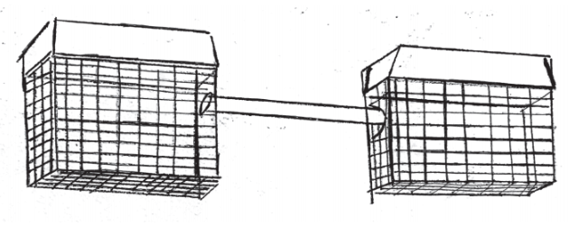
The Hamster Cage Task

Slide 40
Learning Intentions and Success Criteria
Visible Learning Book
Pages 53-56
Learning intentions - describe what teachers want students to learn from the lesson.
  Content: “What is the math I am supposed to use and learn today?”
  Language: “How should I communicate my mathematical thinking today?”
  Social: “How should I interact with my learning community today?”
Success criteria is meant to describe what success looks like when a student has reached the learning goal.
Learning Intentions
0.68
Success Criteria
1.13

Slide 41

Say Something!
Refer to pages 53-56 in Teaching Mathematics in the Visible Learning Classroom.
With a partner, determine places to stop and reflect.
Discussion 0.82

Slide 42
Task Implementation Guide
Determine Learning Intentions
Select Rich Task
Do the Math/Anticipate Strategies
Monitor
Select
Sequence
Connect

Slide 43
Task Implementation Guide
Determine Learning Intentions
Select Rich Task
Do the Math/Anticipate Strategies
Monitor
Select
Sequence
Connect

Slide 44
o
Student learning is greatest in classrooms where the tasks consistently encourage high‐ level student thinking and reasoning and least in classrooms where the tasks are routinely procedural in nature.
(Boaler and Staples 2009; Hiebert and Wearne 1993;
Stein and Lane 1996)

Slide 45
o
Student learning is greatest in classrooms where the tasks consistently encourage high‐ level student thinking and reasoning and least in classrooms where the tasks are routinely procedural in nature.
(Boaler and Staples 2009; Hiebert and Wearne 1993;
Stein and Lane 1996)

Slide 46
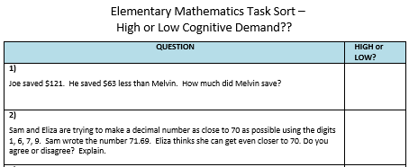
Cognitive Demand
Teacher
Clarity
0.75

Slide 47
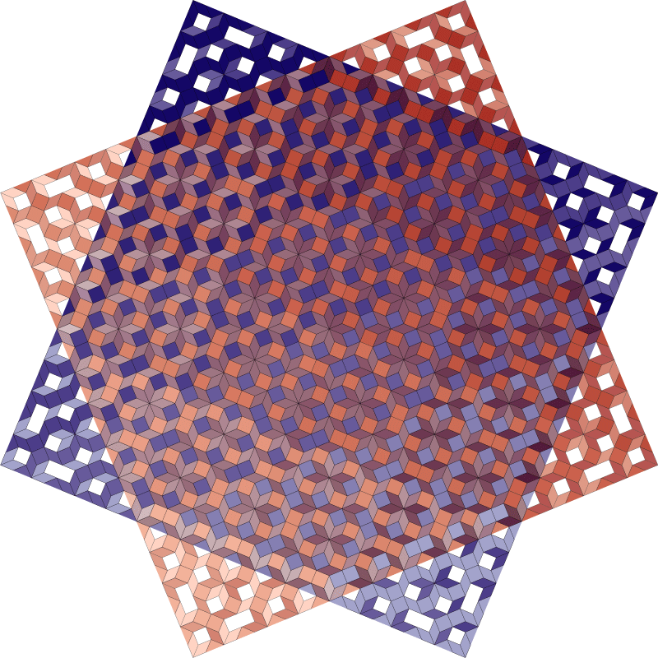
Think-Pair- Square
Discussion 0.82
Think as you name the tasks High/Low on your own.
Pair with an elbow partner to compare answers.
Square with another pair to further compare answers.

Slide 48

Cognitive Demand Characteristics: Group Consensus Chart
Elaboration & Organization 0.75
In your square group:
  Identify trends of your High Demand Tasks.
Complete the chart on the back of the sort to list the “Characteristics of a High and Low Cognitive Demand Tasks.”
High Demand
Task

Slide 49
Rich Mathematical Tasks - Definition
Rich mathematical tasks engage students in sense-making through deeper learning that require high levels of thinking, reasoning, and problem solving.
Vocabulary Instruction 0.62

Slide 50
Characteristics of Rich Tasks
Similarities & Differences
1.32
Promote high levels of cognitive demand
Allow multiple entry points to students with a wide range of skills and abilities
Allow for multiple solution pathways
Promote reasoning and sense making
Encourage the use of varied representations
Require justification or explanation
Encourage connections among ideas
Are authentic, relevant, or problem-based

Slide 51
The Hamster Cage Task
Notes:
Let’s look back to the hamster cage problem. Was this a high demand task? Why or why not?
Revisit the Hamster Cage Task. Based on the criteria the teams created, does the task require high cognitive demand? Why or why not? Share out. (Slide 52)

Slide 52
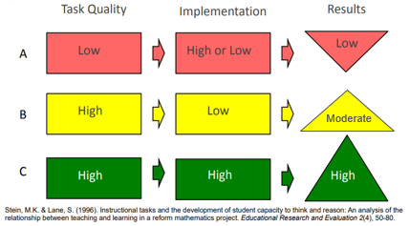
It’s not just about the task…

Slide 53
Factors Associated with the Decline and Maintenance of High-Level Tasks
Decline | Maintenance
Problematic aspects of the task become routinized Emphasis is shifted to correctness or completeness Not enough time is provided Classroom management problems prevent engagement Inappropriate task Lack of accountability for high-level products | Scaffolding Students provided way to monitor their progress High-level of performance is modeled Sustained justification, meaning, questioning, comments, and feedback Tasks build on prior knowledge Frequent conceptual connections Sufficient time to explore
Scaffolding 0.82
Feedback 0.70
Resource: Smith, M. et al. (2017) Taking Action – Implementing Effective Mathematics Teaching Practices Series (p. 38), National Council of Teachers of Mathematics.

Slide 54
Task Implementation Guide
Determine Learning Intentions
Select Rich Task
Do the Math/Anticipate Strategies
Monitor
Select
Sequence
Connect

Slide 55

Activate Prior Knowledge
Prior Knowledge
0.93
Visible Learning Book Pages 56-58

Slide 56
Reflection
Evaluation & Reflection
0.75
Based on your reading what are some teaching takeaways you might consider when activating prior knowledge?

Slide 57
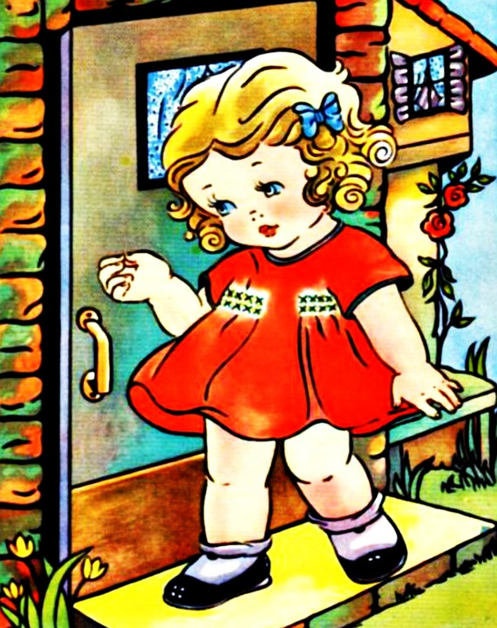
The “Goldilocks” Effect
Right Level of
Challenge
0.74
A Visible Learning classroom uses…
the right strategy at the right time,
for the right level of thinking,
with the right level of challenge.
Visible Learning Book
Page 38

Slide 58
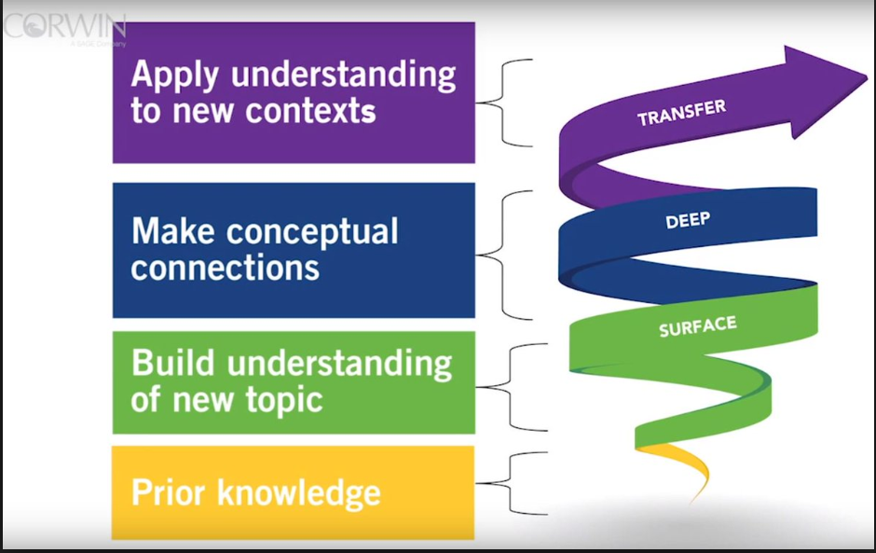
Surface, Deep, and Transfer Learning in Math
Visible Learning Book
Page 28-30
Ongoing assessments inform teachers that students are in various places along this path, and sometimes will move interchangeably between these phases of learning. It is the teacher’s goal to provide interventions and strategies students need at the right time for the right reason.

Slide 59
Intentional Planning
Determine Learning Intentions
Select the Task
Do the Math/Anticipate solutions
Plan advancing/assessing questions
Monitor
Select
Sequence
Connect

Slide 60
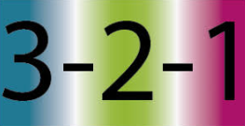
3 - 2 - 1 Reflection
Evaluation & Reflection 0.75
3 things I have learned are… 2 questions I have are… 1 thing I intend to implement is…

Slide 61
III. Task Implementation (During/After)

Slide 62
Focus of 2019 Mathematics Institutes

Slide 63
Success Criteria
Success Criteria
1.13
I can implement a rich mathematical task to support deeper learning for all students.

Slide 64
Task Implementation Guide
Determine Learning Intentions
Select Rich Task
Do the Math/Anticipate Strategies
Monitor
Select
Sequence
Connect

Slide 65
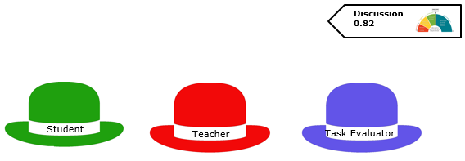
Talking Hats

Slide 66

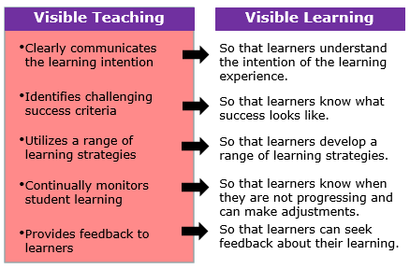
Impact of Visible Teaching
Teacher

Slide 67

Characteristics of Rich Tasks
Promote high levels of cognitive demand
Allow multiple entry points to students with a wide range of skills and abilities
Allow for multiple solution pathways
Promote reasoning and sense making
Encourage the use of varied representations
Require justification or explanation
Encourage connections among ideas
Are authentic, relevant, or problem-based

Slide 68

Assessment-Capable Visible Learners
Student

Slide 69
Before we get started…

Slide 70
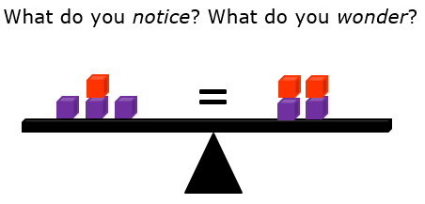
Task Launch

Slide 71
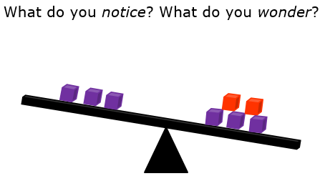
Task Launch

Slide 72
Success Criteria
I can describe equality.
I can use the equal symbol, numbers, objects and words to represent equivalent values.
I can justify my thinking and explain my solution to classmates when creating balanced equations.

Slide 73
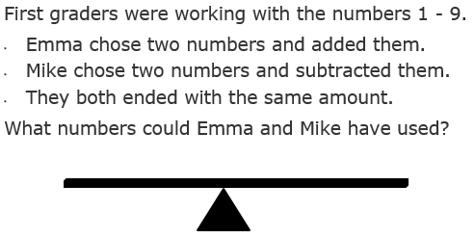
Do the Task

Slide 74
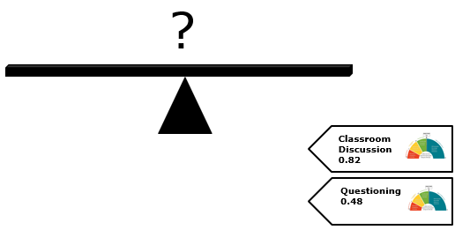
Task Share

Slide 75
Task Closure
Did you meet today’s success criteria?
I can describe equality.
I can use the equal symbol, numbers, objects and words to represent equivalent values.
I can justify my thinking and explain my solution to classmates when creating balanced equations.
Evaluation & Reflection 0.75

Slide 76
Reflection
Talking Hats
  Pick a colored tile from the table.
  Mix and mingle.
  Create a trio representing all 3 roles.

Slide 77

Talking Hat Reflection
How did this task engage the student as an assessment-capable learner?
What teacher moves were evident to promote visible learning?
What characteristics of a rich mathematical task were evident?
Student
Teacher
Task Evaluator
Evaluation & Reflection 0.75

Slide 78

Whole Group Reflection

Slide 79
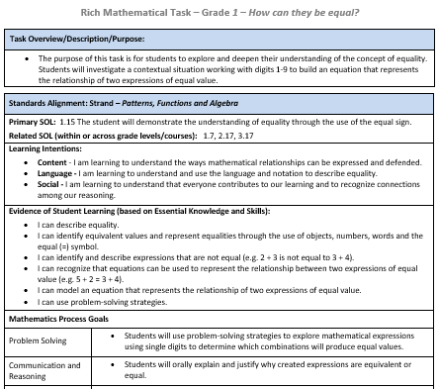
  Rich Mathematical Task Template
See Handout

Slide 80

Scavenger Hunt
Given the task template, work with a partner to find:
  Learning intentions and success criteria
  Connected process goals
  Tips for task implementation
  (before, during, after)
  Anticipated student response section
  Rich Mathematical Task Rubric
Cooperative Learning 0.40

Slide 81
Reflection on Resource
What did you find most useful about this resource?
How will you utilize this resource?

Slide 82
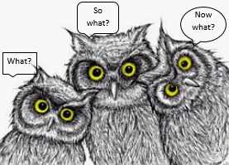
3 W’s Reflection
Based on Module III…
What? (What did you learn?)
So What? (Why is this useful or important?)
Now What? (How does this support you with implementing tasks?)
Evaluation & Reflection 0.75

Slide 83
IV. Assessing Student Understanding

Slide 84
Module IV - Success Criteria
Success
Criteria
1.13
I can use a rubric to score student work samples and work collaboratively to calibrate my scores.
I can use success criteria to provide effective feedback to students to deepen student learning.
I can analyze student work to identify what students know and are able to do in order to plan instruction that moves all students forward as learners.

Slide 85

Scoring Equality Task
?

Slide 86
Calibration Protocol Purpose
Discussion 0.82
  Provides a process whereby groups can discuss student work in order to reach consensus about how to score the work based on a rubric or scoring criteria.
  Ensures equity in how each scorer’s contributions are considered
  Provides a structure that makes it safe to challenge and question one another
  Makes the most of time set aside for examining student work
  Increases inter-rater reliability (providing for fair and consistent scoring of student work)

Slide 87
Calibration Protocol
Explicit Teaching Strategies 0.57
  Examination – work through task (individual)
  Discussion of proficient responses (small group)
  Read and place in groups (individual)
  Score student work (individual)
  Score sharing (small group)
  Discussion (small group)
See Handout

Slide 88
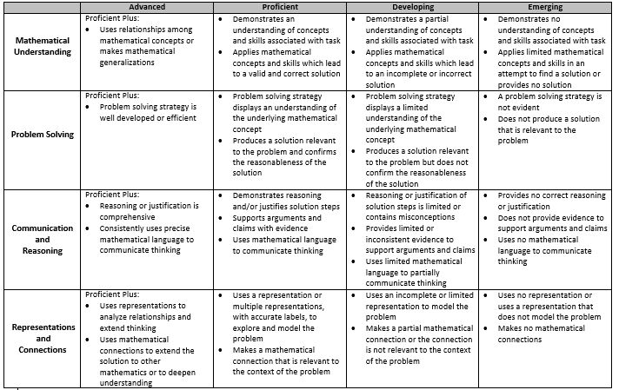
Preparing to Score Student Work
2. Discuss proficient response (group)
Discuss at your table what is expected in a proficient student response in holistic terms.
Use the Rich Mathematical Task Rubric as a guide.
See Task Template Handout
Discussion
0.82

Slide 89
Mathematics Process Goals for Students
“The content of the mathematics standards is intended to support the five process goals for students”
- 2009 and 2016 Mathematics Standards of Learning
Communication
Connections
Representations
Problem Solving
Mathematical Understanding
Reasoning

Slide 90
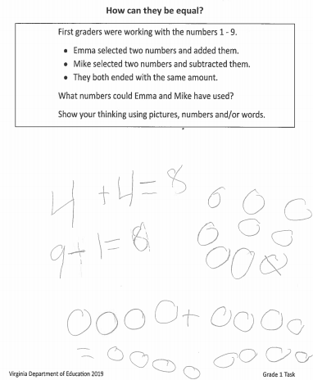
Sorting Student Work
3. Read and place in groups (individually)
Sort student work into 3 piles - low, med, high based on overall impression.

Slide 91
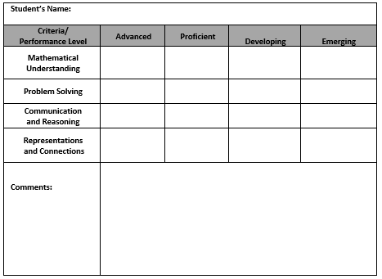
Scoring Student Work
Formative Evaluation 0.48
4. Score student work (individually)
Score each student work sample using the rubric.
Record your scores on the Individual Scoring Notes sheet.
Use evidence from the work and the rubric to support your scores.

Slide 92
Sharing and Discussing Student Work
5. Score sharing without explanation (collaboratively)
One at a time, team members share their score for each of the rubric criteria while a recorder completes the group’s score sheet.

Slide 93
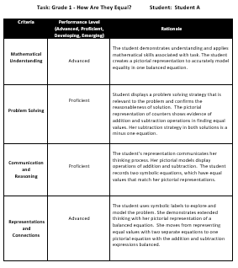
Sharing & Discussing Student Work
Discussion
0.82
6. Discussion (collaboratively)
Use evidence from the work and the rubric to support your scores.

Slide 94
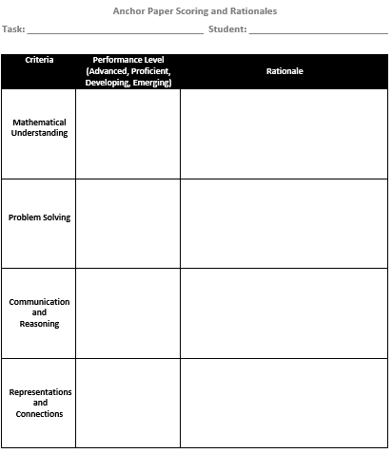
  Anchor Paper Scoring and Rationales
Task developers collected comments from scoring sheets to assist in creating final anchor paper rationales.
Following scoring calibration, developers deliberately selected 4-6 student work samples to serve as anchor papers.
See Completed Handout
Similarities & Differences 1.32

Slide 95
Purpose of Anchor Papers
Guide formative and summative assessments
Explain why the work is assessed at a specific performance level
Identify current level of student understanding
Examine to understand the learning opportunities we are, and are not, giving our students
Provide consistency in assessing students

Slide 96
Reflecting on the Calibration Protocol
  Examination – work through task (individual)
  Discussion of proficient responses (small group)
  Read and place in groups (individual)
  Score student work (individual)
  Score Sharing (small group)
  Discussion (small group)
See Handout
Evaluation & Reflection 0.75
Turn and Talk:
What is the value of participating in a calibration protocol?
How does this protocol promote greater equity?

Slide 97
Elements of Effective Feedback
Feedback
0.70
Effective Feedback
Where am I going? How am I going? Where to next?
Each question works at four levels
Task Level
How well are the tasks understood/ performed?
Process Level
The main process needed to understand/ perform tasks
Self-Regulation Level
Self-monitoring directing, and regulating of actions
Self Level
Personal evaluations and affect (usually positive) about the learner
Source: Hattie & Timperly (2007).

Slide 98

Planning Next Steps
Evaluation & Reflection
0.75
Find your assigned student work poster and Graffiti either an idea for feedback OR an idea for next steps.
What misconceptions, if any, does the student have?
What feedback would you give the student?
What would be your focus for next steps with the student?

Slide 99

Jot Thoughts Reflection
Topic: Think about the Rubric, the Calibration Protocol and Feedback from this module.
How would you use these in your classroom?
How would you use these in PD?

Slide 100
Session Closure and Reflection

Slide 101
Strategy Catcher
Similarities and Differences 1.32
Success Criteria 1.13
Prior Ability 0.94
Prior Knowledge 0.93
Scaffolding 0.82
Discussion 0.82
Summarizing 0.79
Evaluation & Reflection 0.75
Teacher Clarity 0.75

Slide 102
Strategy Catcher
Elaboration & Organization 0.75
Right Level of Challenge 0.74
Feedback 0.70
Learning Intentions 0.68
Vocabulary Instruction 0.62
Explicitly Teaching Strategies 0.57
Teacher Student Relationship 0.52
Questioning 0.48
Formative Evaluation 0.48
Strong Classroom Cohesion 0.44
Cooperative Learning 0.40

Slide 103

o
Give yourself “permission to spend more time developing students’ deep understanding of mathematics as a well-rounding discipline.”
-Teaching Mathematics in the
Visible Learning Classroom: High School

Slide 104
Session Learning Intentions
Content:
I am learning about strategies and approaches that make teaching and learning more visible.
Language:
I am learning to use the language of a visible learning mathematics classroom.
Social:
I am learning how to listen and respond to my colleagues’ ideas in ways that move everyone forward as learners.

Slide 105

Traffic Light Exit Ticket
Based on today’s presentation…
One thing I could stop doing is...
One thing I could continue doing is...
One thing I could start doing is...

Slide 106
2016 Mathematics Standards of Learning - Instructional Resources
Standards of Learning and Curriculum Frameworks
Test Blue Prints
Practice Items
Mathematics Instructional Plans
Co-Teaching Mathematics Instructional Plans
Algebra Readiness Initiative Materials
  Mathematics Vertical Articulation Tool
    Static Versions and Dynamic Versions
  Remediation Plans
  Formative Assessments
2018 Mathematics SOL Institutes Materials
Mathematics Vocabulary Word Wall Cards
Desmos Resources
Rich Mathematical Tasks

Slide 107
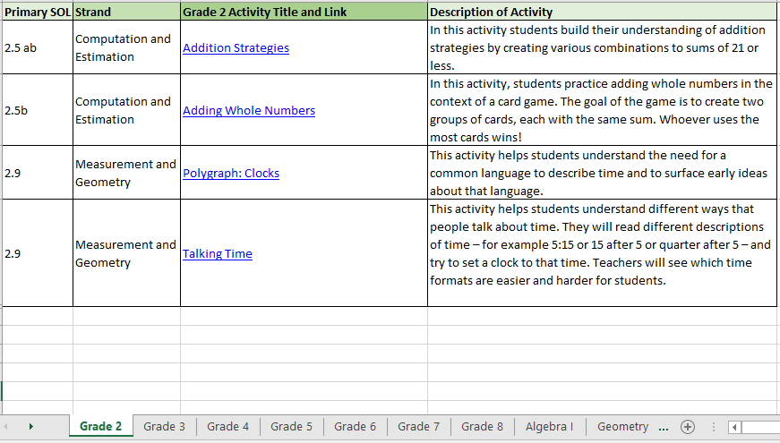
Desmos Classroom Activities Log (NEW)

Slide 108
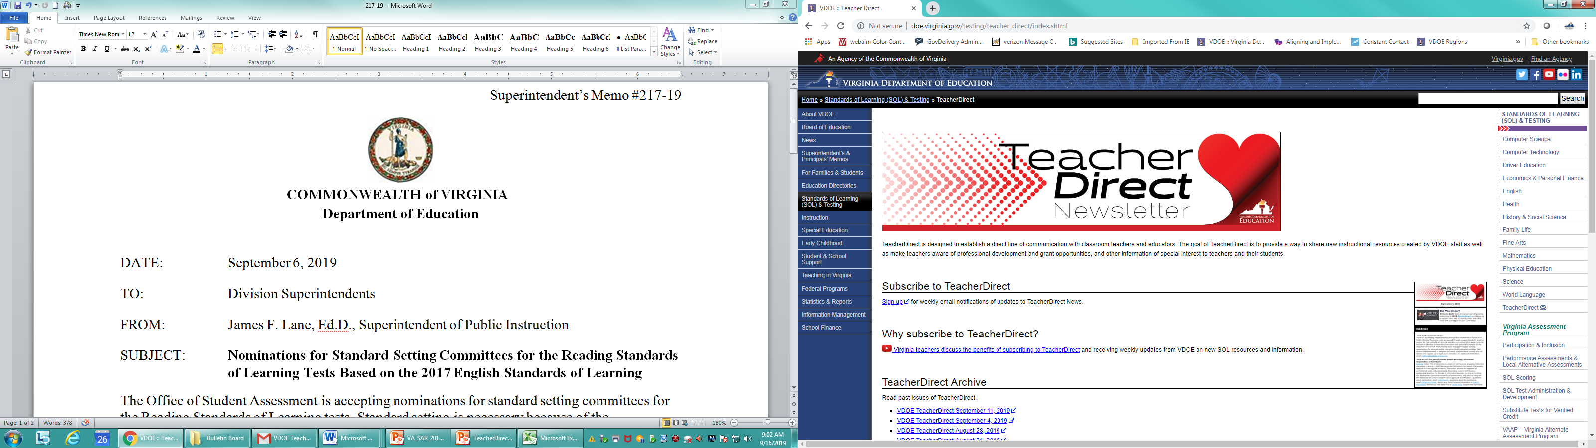
Access TeacherDirect from “Instruction” Link on the left side of the VDOE home page

Slide 109
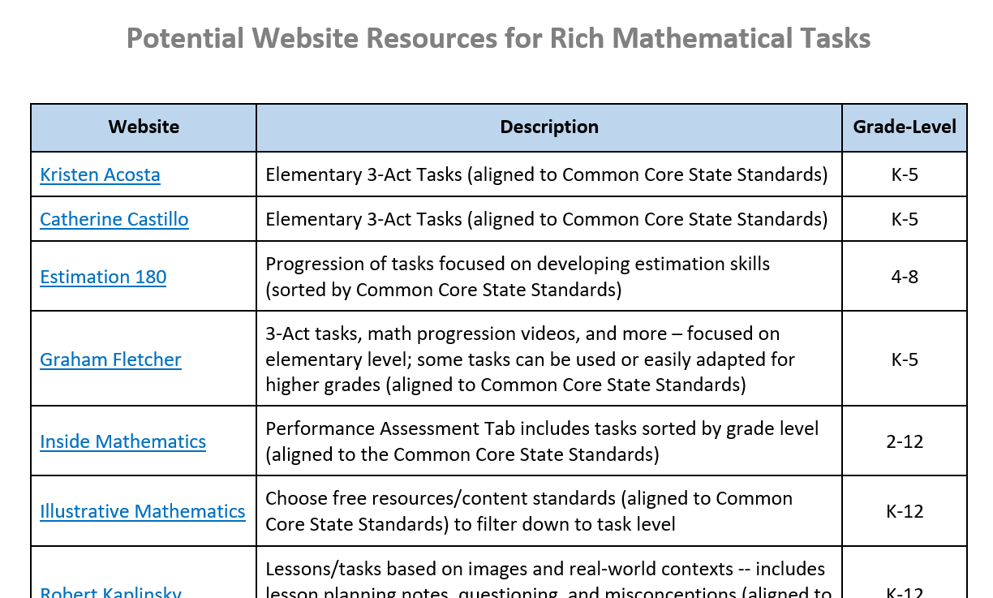
Potential Website Resources
See
bit.ly/math-institute-k-2

Slide 110
0
Please contact
The VDOE Mathematics Team at
Mathematics@doe.virginia.gov

