Slide 1




Assessment Supports for 2020-2021
(End-of-Course)

Slide 2
Questions During the Webinar
Use the chat feature to pose any questions to the group that arise during the webinar.
Please send your questions to “All Attendees.”

Slide 3
Recover. Redesign. Restart. 2020 (1 of 2)
On June 9, 2020, Governor Northam announced a phased reopening plan for Virginia schools. During this press conference, Dr. Lane, Superintendent of Schools, shared the guidance document Recover, Redesign, Restart 2020.

Slide 4
Recover. Redesign. Restart. 2020 (2 of 2)
Teachers should seek to design and implement authentic learning experiences. Authentic learning is a term used to describe instructional strategies that are designed to connect the subjects students are taught in school to the real world. Authentic learning can: prepare students for the real world; help students make informed career choices; bridge skill gaps; enhance critical thinking; improve creativity; increase engagement; motivate students; boost retention of information; provide multiple perspectives on issues; and help build 21st Century skills.

Slide 5
Background (1 of 3)
In order to support instruction of the 2017 English Standards of Learning (SOL), this PowerPoint presentation has been developed to provide specific examples of SOL content and the progression of reading skills.
Some of the information in this PowerPoint originated from interviews with schools that maintained or went up in their 2018-2019 Standards of Learning (SOL) Reading data. Please refer to these webinar materials: Sharing With School Divisions Lessons Learned from Divisions on Best Instructional Practices.

Slide 6
Background (2 of 3)
It should be noted that the assessment questions in this presentation are not meant to mimic SOL test questions. Instead, they are intended to provide reading educators with further insight into the 2017 English Standards of Learning.

Slide 7
Background (3 of 3)
It is important to keep the content of this presentation in perspective. The information provided here should be used as supplemental information to support the implementation of the 2017 English Standards of Learning.
Instructional focus should remain on the standards as a whole, and the selection of authentic text should be used to support the introduction and review of skills.

Slide 8
Reading Instruction (1 of 3)
As noted in the 2017 English Standards of Learning Curriculum Framework, “The concepts, skills, and content in English Language Arts spiral. Teachers should note each grade level builds skills that carry to the following grades.” This presentation will support the spiraling, scaffolding, and progression of skills embedded in authentic text.

Slide 9
Reading Instruction (2 of 3)
  Step One: Select Authentic Text
    Ensure the passage(s) are grade-level appropriate, provide instructional scaffolding to introduce and review skills, and provide opportunities for formative and summative review.
  Step Two: Examine the Content and Progression of Standards
    Review the SOL in the grades before and after to ensure scaffolding of the targeted skills.

Slide 10
Reading Instruction (3 of 3)
  Step Three: Sample Question Starters
    Questions asked before, during, and after instruction should bring students back to the text and align with the progression of the skill, therefore supporting student mastery. These questions could be exemplified by having students write about what was read, answering questions, etc.
  Step Four: Exploring Instructional Resources
    Select additional grade-level text that is engaging and varying in genre. Introduce new skills and spiral previously taught skills.

Slide 11
Step 1: Select Authentic Text (1 of 7)
When selecting a text, it is important to:
  Review to ensure it supports the identified purpose for reading the passage.
    Setting the purpose will focus on either:
      Identifying the skills that will be introduced or reviewed for reading comprehension and then ensuring the passage supports the identified skills.
      Selecting a passage and then determining the skills that could be introduced or reviewed throughout the reading.
  Read to locate examples of the skills that support the purpose identified.

Slide 12
Step 1: Select Authentic Text (2 of 7)
If the passage supports the identified purpose and includes examples that focus on the desired skills, the passage should be used for instruction.
  If other reading comprehension skills are found within the passage, apart from the determined purpose, teachers should use these skills to support instruction and reading comprehension.
  It is important to ensure the passage supports the use of guiding questions to provide the necessary background information to support student comprehension, engagement, and application of skills.

Slide 13
Step 1: Select Authentic Text (3 of 7)
If examples of the introduction or review of skills are not found:
  A new passage should be selected to support the determined purpose, or
  New skills should be identified to support a new purpose.

Slide 14
Step 1: Select Authentic Text (4 of 7)
Throughout the provided grade-level authentic passages, annotations (a note of commentary or explanation) that include discussion points and guiding questions have been provided to support the introduction and review of skills.

Slide 15
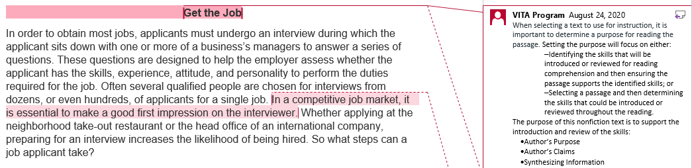
Step 1: Select Authentic Text (5 of 7)
Notes:
The annotations were created by Virginia Department of Education staff from the Office of Humanities and the Office of Student Assessment. VITA Program (Virginia Information Technologies Agency) is the author of the annotations.

Slide 16
Step 1: Select Authentic Text (6 of 7)
Technical Text: “Get the Job”
This technical text example will be used to demonstrate how the selection of authentic text supports the introduction and review of specific skills.
Please see the annotated Word document for additional support.

Slide 17
Step 1: Select Authentic Text (7 of 7)
The selected technical text, “Get the Job”*, supports the introduction and review of:
  Author’s Purpose
  Author’s Claims
  Synthesizing Information
  *Please see the annotated Word document for additional support.

Slide 18
Step 2: Examine the Content and Progression of Standards
  Please note, based on the 2017 End-of-Course Blueprint, “All SOL listed in the blueprint are eligible for inclusion on each version of an SOL test. Some reading skills are repeated across grades 9, 10, and 11. Those SOL should be taught across all grades and will be assessed at the highest appropriate standard.”

Slide 19
Step 2: Examine the Content and Progression of Standards for SOL 11.5A
9.5D- Recognize an author’s intended purpose for writing and identify the main idea.
10.5B- Recognize an author’s intended audience and purpose for writing.
11.5A- Apply information from texts to clarify understanding of concepts.

Slide 20
Step 2: Examine the Content and Progression of Standards for SOL 10.5G
9.5G- Identify a position/argument to be confirmed, disproved, or modified.
10.5G- Analyze and synthesize information in order to solve problems, answer questions, and generate new knowledge.

Slide 21
Step 2: Examine the Content and Progression of Standards for SOL 11.5I
9.5I- Analyze, organize, and synthesize information in order to solve problems, answer questions, complete a task, or create a product.
10.5G- Analyze and synthesize information in order to solve problems, answer questions, and generate new knowledge.
11.5I- Generate and respond logically to literal, inferential, evaluative, synthesizing, and critical thinking questions about the text(s).

Slide 22
Step 3: Sample Question Starters for SOL 11.5A
How does the development of the main idea support the author’s purpose of this selection?
The author’s purpose for writing this selection is most likely to [insert author’s purpose] the reader about-
The author’s purpose for writing this selection is most likely to-
Which sentence best expresses the main purpose of this selection?
Identify the main purpose of this selection. Include specific details from the selection to justify your answer.

Slide 23
Step 3: Sample Question Starters for SOL 10.5G (1 of 2)
What argument about [insert information] could be made based on this selection?
The information in [insert location of selection] suggests that [insert claim, problem to solve, question to answer, etc.]
Which phrase from [insert title of selection] best reveals the main argument of the selection?

Slide 24
Step 3: Sample Question Starters for SOL 10.5G (2 of 2)
Which statement(s) best explain [insert claim, problem to solve, question to answer, etc.]?
Which [insert claim, problem to solve, question to answer, etc.] is NOT supported by the selection?
Identify the main [insert desired skill focus] of the selection. Include specific details from the selection to support your answer.

Slide 25
Step 3: Sample Question Starters for SOL 11.5I (1 of 2)
Which question about [insert detail] is NOT answered in the selection?
Which of these would be the best source of information for a [insert another format, i.e. report, presentation, visual aid, etc.] about [insert detail]? [insert book titles, websites, etc. sources]
Based on the selection, it is clear that [insert detail] because-

Slide 26
Step 3: Sample Question Starters for SOL 11.5I (2 of 2)
What is the main reason [insert detail]?
Based on information from the selection, what is the importance of [insert detail]?
What does this selection suggest about [insert detail]? Include specific details from the selection to support your answer.

Slide 27
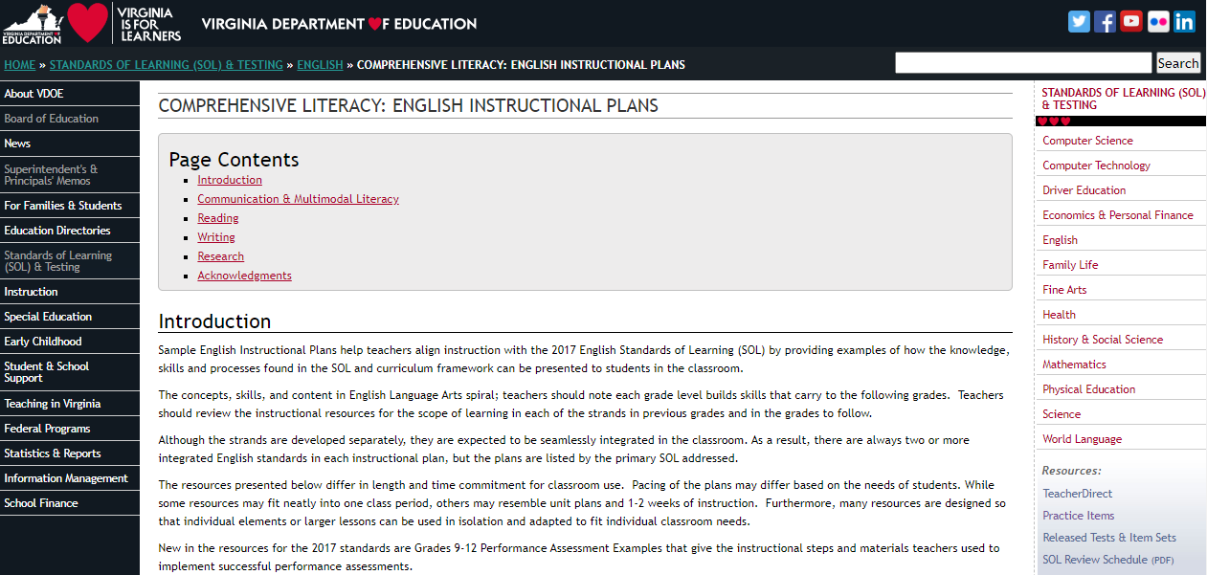
Step 4: Exploring Instructional Resources (1 of 5)
Comprehensive Literacy: English Instructional Plans

Slide 28
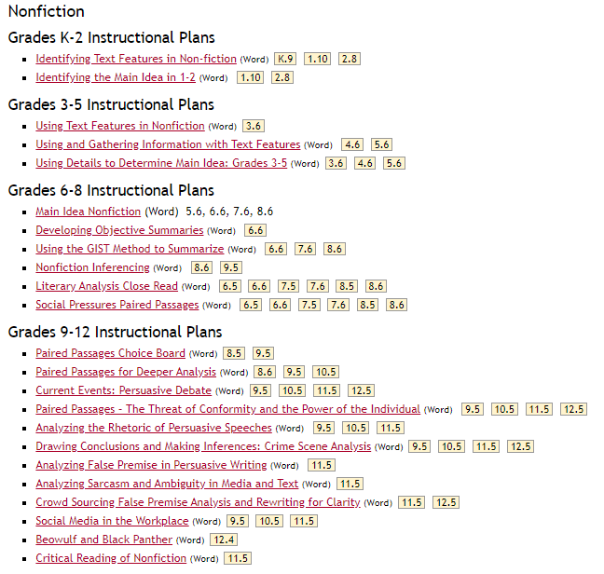
Step 4: Exploring Instructional Resources (2 of 5)

Slide 29
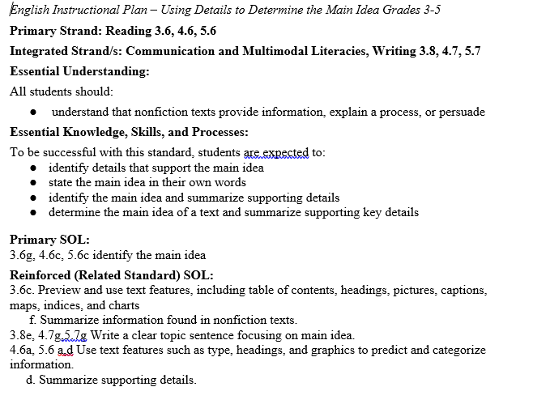
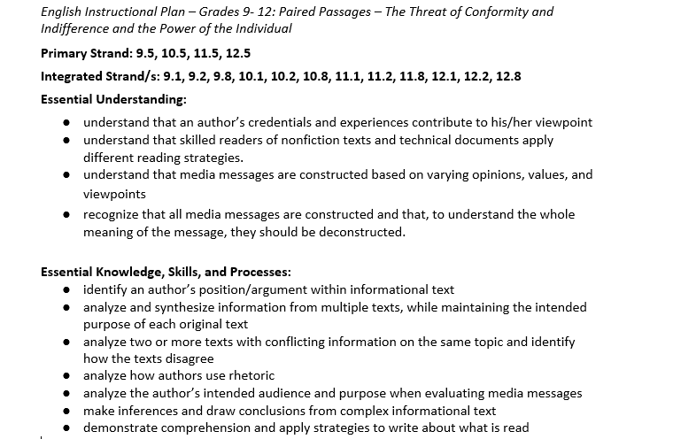
Step 4: Exploring Instructional Resources (3 of 5)

Slide 30
Step 4: Exploring Instructional Resources (4 of 5)
Comprehensive Literacy: English Instructional Plans
  Paired Passages- The Threat of Conformity and the Power of the Individual (11.5A)
This instructional plan was created by Virginia teachers to model how the skill can be introduced or reviewed.
    Please note: text examples within the instructional plans can be changed based on grade level, genre, etc.
    This plan models using paired passages to determine purpose; however, if the text supports the spiraling of additional skills, they should be implemented to support reading comprehension and skill application.

Slide 31
Step 4: Exploring Instructional Resources (5 of 5)
Comprehensive Literacy: English Instructional Plans
  Critical Reading of Nonfiction (11.5I)
This instructional plan was created by Virginia teachers to model how the skill can be introduced or reviewed.
    Please note: text examples within the instructional plans can be changed based on grade level, genre, etc.
    This plan models critical reading of nonfiction with a focus on synthesizing information; however, if the text supports the spiraling of additional skills, they should be implemented to support reading comprehension and skill application.

Slide 32
Step 1: Select Authentic Text (1 of 2)
Technical Text: “Lease Agreement For Room Use”
This technical text example will be used to demonstrate how the selection of authentic text supports the introduction and review of specific skills.
Please see the annotated Word document for additional support.

Slide 33
Step 1: Select Authentic Text (2 of 2)
The selected technical text, “Lease Agreement for Room Use”*, supports the introduction and review of:
  Vocabulary in Context
  Characteristics of Technical Text
  Skimming Text for Information
  *Please see the annotated Word document for additional support.

Slide 34
Step 2: Examine the Content and Progression of Standards for SOL 11.3B
9.3B- Use context, structure, and connotations to determine meanings of words and phrases.
10.3B- Use context, structure, and connotations to determine meanings of words and phrases.
11.3B- Use context, structure, and connotations to determine meanings of words and phrases.

Slide 35
Step 2: Examine the Content and Progression of Standards for SOL 11.5C
9.5F- Identify characteristics of expository, technical, and persuasive texts.
10.5D- Compare and contrast informational texts for intent and content.
11.5C- Analyze technical writing for clarity.

Slide 36
Step 2: Examine the Content and Progression of Standards for SOL 11.5D
9.5H- Evaluate clarity and accuracy of information.
10.5C- Skim materials to develop an overview and locate information.
11.5D- Paraphrase and synthesize ideas within and between texts.

Slide 37
Step 2: Examine the Content and Progression of Standards
  Please note, based on the 2017 End-of-Course Blueprint, “All SOL listed in the blueprint are eligible for inclusion on each version of an SOL test. Some reading skills are repeated across grades 9, 10, and 11. Those SOL should be taught across all grades and will be assessed at the highest appropriate standard.”

Slide 38
Step 3: Sample Question Starters for SOL 11.3B
In [insert location], [insert word] means-
Which word means the same as [insert word] as it is used in [insert location]?
What is the meaning of [insert word] as it is used in [insert location]?
Which definition of [insert word] is used in [insert location]?
Use the context of the selection to determine the meaning of [insert word(s)]. Include specific details from the selection to support your answer.

Slide 39
Step 3: Sample Question Starters for SOL 11.5C (1 of 2)
Identify characteristics of technical texts.
Which characteristic most clearly identifies this selection as a technical text?
The reader can best describe this selection as technical text because-

Slide 40
Step 3: Sample Question Starters for SOL 11.5C (2 of 2)
This selection is considered technical text because it includes all of these EXCEPT-
The reader can tell this selection is NOT [insert persuasive, expository, etc.] because-
Why is this selection considered a technical text? Include specific details from the selection to support your answer.

Slide 41
Step 3: Sample Question Starters for SOL 11.5D
According to the selection, what is the primary reason [insert detail]?
According to [insert title or location in selection], how/why did [insert detail]?
According to the selection, what is [insert detail]?
Which sentence from the selection would be easiest to verify as a fact?
According to the selection why [insert detail]? Include specific details from the selection to support your answer.

Slide 42
Step 4: Exploring Instructional Resources
Comprehensive Literacy: English Instructional Plans
  Vocabulary and Author’s Tone (11.3B)
This instructional plan was created by Virginia teachers to model how a skill can be introduced or reviewed.
    Please note: text examples within the instructional plans can be changed based on grade level, genre, etc.
    This plan models using context to determine meaning of unfamiliar words; however, if the text supports the spiraling of additional skills they should be implemented to support reading comprehension and skill application.

Slide 43
Resources (1 of 3)
Virginia Department of Education: English
  Grade 3 Reading Blueprint
  Grade 4 Reading Blueprint
  Grade 5 Reading Blueprint
  Grade 6 Reading Blueprint
  Grade 7 Reading Blueprint
  Grade 8 Reading Blueprint
  End-of-Course Reading Blueprint

Slide 44
Resources (2 of 3)
Reading Progression Charts
2017 Curriculum Framework
2017 Standards of Learning
Computer Adaptive Testing
Comparison of a Passage-Based CAT and a Traditional Test
Assessment Supports for 2020-2021 Literacy Webinar Series
Recover, Redesign, Restart 2020

Slide 45
Resources (3 of 3)
Frequently Asked Questions about Passage-Based CAT Testing
SOL Practice Items in TestNav 8
2019 English Deeper Learning Conferences
2018 English Standards of Learning (SOL) Institutes
Comprehensive Literacy: English Instructional Plans
Superintendent’s Memo 249-20: Update on New Standards of Learning Tests in Reading and History and Social Science

Slide 46
Stay Connected
Office of Student Assessment
  student_assessment@doe.virginia.gov
  (804) 225-2102
Department of Learning and Innovation
  Jill Nogueras, K-12 English Coordinator,
  jill.nogueras@doe.virginia.gov
  Carmen Kurek, Elementary English Specialist,
  carmen.kurek@doe.virginia.gov
  Colleen Cassada, Middle School English Specialist,
  colleen.cassada@doe.virginia.gov

Slide 47
Disclaimer
Reference within this presentation to any specific commercial or non-commercial product, process, or service by trade name, trademark, manufacturer or otherwise does not constitute or imply an endorsement, recommendation, or favoring by the Virginia Department of Education.

Slide 48
Copyright ©2020 by the Commonwealth of Virginia, Department of Education, P.O. Box 2120, Richmond, Virginia 23218-2120. All rights reserved. Except as permitted by law, this material may not be reproduced or used in any form or by any means, electronic or mechanical, including photocopying or recording, or by any information storage or retrieval system, without written permission from the copyright owner. Commonwealth of Virginia public school educators may reproduce any portion of these items for non-commercial educational purposes without requesting permission. All others should direct their written requests to the Virginia Department of Education at the above address or by e-mail to Student_Assessment@doe.virginia.gov.

