Slide 1




Assessment Supports for 2020-2021

Slide 2
Questions During the Webinar
Use the chat feature to pose any questions to the group that arise during the webinar.
Please send your questions to “All Attendees.”

Slide 3
Recover. Redesign. Restart. 2020 (1 of 2)
On June 9, 2020, Governor Northam announced a phased reopening plan for Virginia schools. During this press conference, Dr. Lane, Superintendent of Schools, shared the guidance document Recover, Redesign, Restart 2020.

Slide 4
Recover. Redesign. Restart. 2020 (2 of 2)
Teachers should seek to design and implement authentic learning experiences. Authentic learning is a term used to describe instructional strategies that are designed to connect the subjects students are taught in school to the real world. Authentic learning can: prepare students for the real world; help students make informed career choices; bridge skill gaps; enhance critical thinking; improve creativity; increase engagement; motivate students; boost retention of information; provide multiple perspectives on issues; and help build 21st Century skills.

Slide 5
Background (1 of 3)
In order to support instruction of the 2017 English Standards of Learning (SOL), this PowerPoint presentation has been developed to provide specific examples of SOL content and the progression of reading skills.
Some of the information in this PowerPoint originated from interviews with schools that maintained or went up in their 2018-2019 Standards of Learning (SOL) Reading data. Please refer to these webinar materials: Sharing With School Divisions Lessons Learned from Divisions on Best Instructional Practices.

Slide 6
Background (2 of 3)
It should be noted that the assessment questions in this presentation are not meant to mimic SOL test questions. Instead, they are intended to provide reading educators with further insight into the 2017 English Standards of Learning.

Slide 7
Background (3 of 3)
It is important to keep the content of this presentation in perspective. The information provided here should be used as supplemental information to support the implementation of the 2017 English Standards of Learning.
Instructional focus should remain on the standards as a whole, and the selection of authentic text should be used to support the introduction and review of skills.

Slide 8
Reading Instruction (1 of 3)
As noted in the 2017 English Standards of Learning Curriculum Framework, “The concepts, skills, and content in English Language Arts spiral. Teachers should note each grade level builds skills that carry to the following grades.” This presentation will support the spiraling, scaffolding, and progression of skills embedded in authentic text.

Slide 9
Reading Instruction (2 of 3)
  Step One: Select Authentic Text
    Ensure the passage(s) are grade-level appropriate, provide instructional scaffolding to introduce and review skills, and provide opportunities for formative and summative review.
  Step Two: Examine the Content and Progression of Standards
    Review the SOL in the grades before and after to ensure scaffolding of the targeted skills.

Slide 10
Reading Instruction (3 of 3)
  Step Three: Sample Question Starters
    Questions asked before, during, and after instruction should bring students back to the text and align with the progression of the skill, therefore supporting student mastery. These questions could be exemplified by having students write about what was read, answering questions, etc.
  Step Four: Exploring Instructional Resources
    Select additional grade-level text that is engaging and varying in genre. Introduce new skills and spiral previously taught skills.

Slide 11
Step 1: Select Authentic Text (1 of 7)
When selecting a text, it is important to:
  Review to ensure it supports the identified purpose for reading the passage.
    Setting the purpose will focus on either:
      Identifying the skills that will be introduced or reviewed for reading comprehension and then ensuring the passage supports the identified skills.
      Selecting a passage and then determining the skills that could be introduced or reviewed throughout the reading.
  Read to locate examples of the skills that support the purpose identified.

Slide 12
Step 1: Select Authentic Text (2 of 7)
If the passage supports the identified purpose and includes examples that focus on the desired skills, the passage should be used for instruction.
  If other reading comprehension skills are found within the passage, apart from the determined purpose, teachers should use these skills to support instruction and reading comprehension.
  It is important to ensure the passage supports the use of guiding questions to provide the necessary background information to support student comprehension, engagement, and application of skills.

Slide 13
Step 1: Select Authentic Text (3 of 7)
If examples of the introduction or review of skills are not found:
  A new passage should be selected to support the determined purpose, or
  New skills should be identified to support a new purpose.

Slide 14
Step 1: Select Authentic Text (4 of 7)
Throughout the provided grade-level authentic passages, annotations (a note of commentary or explanation) that include discussion points and guiding questions have been provided to support the introduction and review of skills.

Slide 15
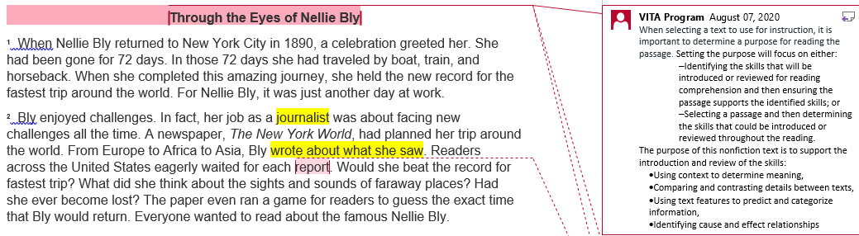
Step 1: Select Authentic Text (5 of 7)
Notes:
The annotations were created by Virginia Department of Education staff from the Office of Humanities and the Office of Student Assessment. VITA Program (Virginia Information Technologies Agency) is the author of the annotations.

Slide 16
Step 1: Select Authentic Text (6 of 7)
Article: “Through the Eyes of Nellie Bly”
paired with
Poem: “Around the World in 72 Days”
This paired passage example will be used to demonstrate how the selection of authentic text supports the introduction and review of specific skills.
Please see the annotated Word document for additional support.

Slide 17
Step 1: Select Authentic Text (7 of 7)
The selected article and poem about Nellie Bly* support the introduction and review of:
  Using context to determine meaning,
  Comparing and contrasting details between texts,
  Using text features to predict and categorize information,
  Identifying cause and effect relationships
  *Please see the annotated Word document for additional support.

Slide 18
Step 2: Examine the Content and Progression of Standards for SOL 5.4A
4.4A- Use context to clarify meanings of unfamiliar words.
5.4A- Use context to clarify meaning of unfamiliar words and phrases.
6.4C- Use context and sentence structure to determine meanings and differentiate among multiple meanings of words.

Slide 19
Step 2: Examine the Content and Progression of Standards for SOL 5.5L
4.5I- Compare/contrast details in literary and informational nonfiction texts.
5.5L- Compare/contrast details in literary and informational nonfiction texts.
6.5I- Compare/contrast details in literary and informational nonfiction texts.

Slide 20
Step 2: Examine the Content and Progression of Standards for SOL 5.6A
4.6A- Use text features such as type, headings, and graphics, to predict and categorize information.
5.6A- Use text features such as type, headings, and graphics to predict and categorize information.
6.6A- Skim materials using text features such as type, headings, and graphics to predict and categorize information.

Slide 21
Step 2: Examine the Content and Progression of Standards for SOL 5.6H
4.6F- Distinguish between cause and effect.
5.6H- Identify cause and effect relationships.
6.6I- Identify cause and effect relationships.

Slide 22
Step 3: Sample Question Starters for SOL 5.4A
(1 of 2)
Identify [insert number of words] unfamiliar words from the passage.
What does [insert word from the text] mean?
Which word or phrase from [insert location from the text] helps to define [insert word from the text]?
In [insert location from the text], [insert word from the text] means--

Slide 23
Step 3: Sample Question Starters for SOL 5.4A (2 of 2)
Which meaning of [insert word from the text] is used in [insert location from the text]?
What context clues support the definition of [insert word] from [insert location from the text]? Use specific details from the text to support your answer.
Create an original sentence for each unfamiliar word using the word correctly in context.

Slide 24
Step 3: Sample Question Starters for SOL 5.5L (1 of 2)
Complete a diagram comparing or contrasting [insert name, person, event, etc. from the text] from [name of passage or genre of passage].
Complete a diagram comparing and contrasting both passages.
Which statement best describes how the [insert genres] are related? [insert statements]

Slide 25
Step 3: Sample Question Starters for SOL 5.5L (2 of 2)
With which idea would the author of the article and the speaker of the poem NOT agree? [insert statements]
Which [insert literary element] is used in both the [insert appropriate genres of the texts]?
Write a response explaining how the word choice from [insert genres or titles of text] impacts [insert name, person, event, etc. from the text]. Use specific details from the text to support your answer.

Slide 26
Step 3: Sample Question Starters for SOL 5.6A (1 of 2)
Identify the text feature(s) in [insert genre or title of text].
What is the purpose of the [insert text feature] from [insert appropriate genre or location from the text]?
What text feature does the author use to help categorize [insert name, person, event, etc. from the text]?

Slide 27
Step 3: Sample Question Starters for SOL 5.6A (2 of 2)
How does the author use [insert text feature(s)] to categorize [insert name, person, event, etc. from the text]?
Which additional [insert text feature] could the author include to support [insert name, person, event, etc. from the text]? Use specific details from the text to support your answer.

Slide 28
Step 3: Sample Question Starters for SOL 5.6H
(1 of 2)
Define cause and effect.
Identify a cause from [insert genre or title of text].
Identify an effect from [insert genre or title of text].
According to [insert location from text], what was one effect of [insert event from the text]?

Slide 29
Step 3: Sample Question Starters for SOL 5.6H
(2 of 2)
Based on the article, what was an effect of [insert event from the text] on [insert name of person, event, etc. from the text]?
What caused [insert idea from the text] to happen in the text?
Using [insert genre(s) or titles of text], write a response discussing the cause-and-effect relationships that [insert name, person, event, etc. from the text]. Use specific details from the text to support your answer.

Slide 30
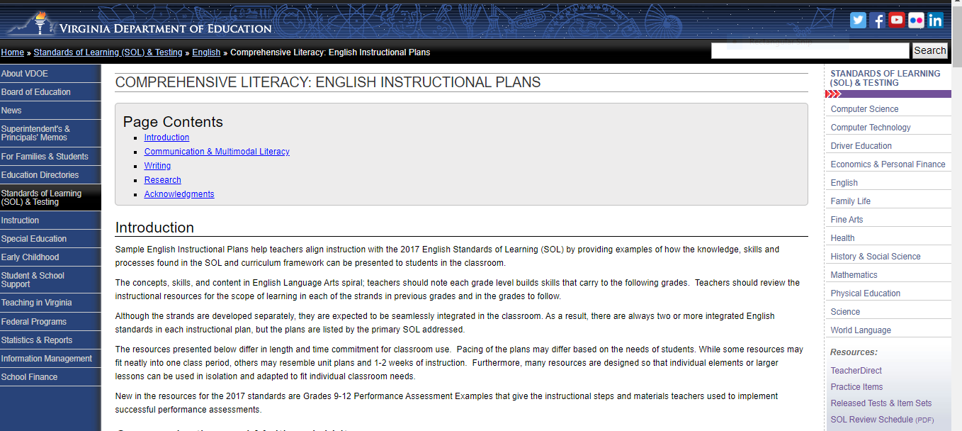
Step 4: Exploring Instructional Resources (1 of 7)
Comprehensive Literacy: English Instructional Plans

Slide 31
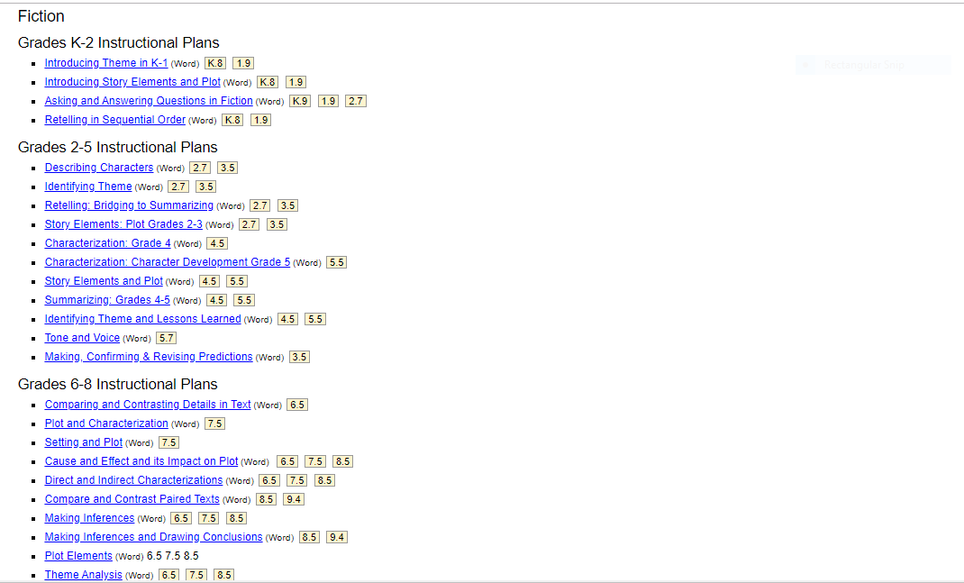
Step 4: Exploring Instructional Resources (2 of 7)

Slide 32
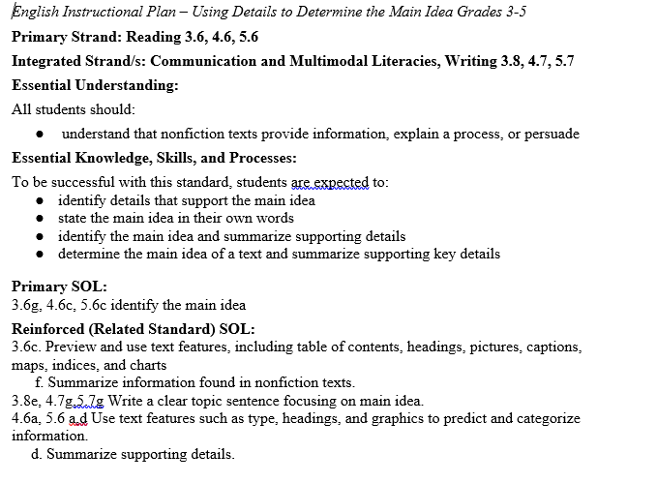
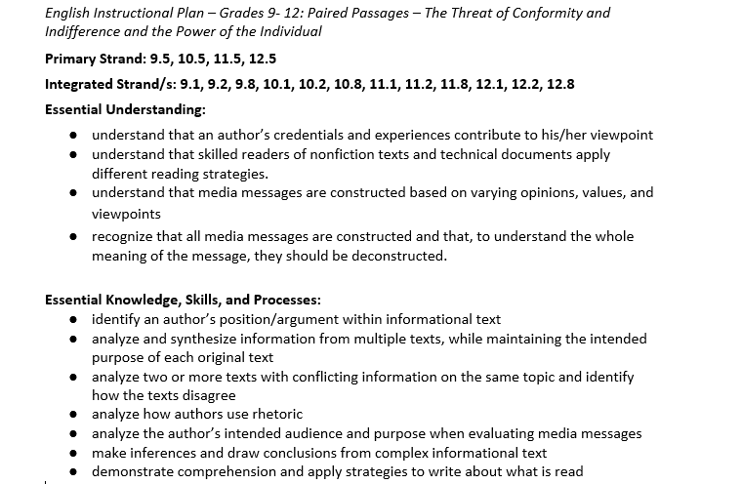
Step 4: Exploring Instructional Resources (3 of 7)

Slide 33
Step 4: Exploring Instructional Resources (4 of 7)
Comprehensive Literacy: English Instructional Plans
  Using Context to Determine Meaning of Unfamiliar Words (5.4A)
This instructional plan was created by Virginia teachers to model how a skill can be introduced or reviewed.
    Please note: text examples within the instructional plans can be changed based on grade level, genre, etc.
    This plan models using context to determine meaning of unfamiliar words; however, if the text supports the spiraling of additional skills they should be implemented to support reading comprehension and skill application.

Slide 34
Step 4: Exploring Instructional Resources (5 of 7)
Comprehensive Literacy: English Instructional Plans
  Comparing and Contrasting Details in Text (5.5L)
This instructional plan was created by Virginia teachers to model how the skill can be introduced or reviewed.
    Please note: text examples within the instructional plans can be changed based on grade level, genre, etc.
    This plan models comparing and contrasting details; however, if the text supports the spiraling of additional skills, they should be implemented to support reading comprehension and skill application.

Slide 35
Step 4: Exploring Instructional Resources (6 of 7)
Comprehensive Literacy: English Instructional Plans
  Using and Gathering Information with Text Features (5.6A)
This instructional plan was created by Virginia teachers to model how the skill can be introduced or reviewed.
    Please note: text examples within the instructional plans can be changed based on grade level, genre, etc.
    This plan models text features; however, if the text supports the spiraling of additional skills, they should be implemented to support reading comprehension and skill application.

Slide 36
Step 4: Exploring Instructional Resources (7 of 7)
Comprehensive Literacy: English Instructional Plans
  Cause and Effect and its Impact on Plot (5.6H)
This instructional plan was created by Virginia teachers to model how the skill can be introduced or reviewed.
    Please note: text examples within the instructional plans can be changed based on grade level, genre, etc.
    This plan models cause and effect; however, if the text supports the spiraling of additional skills, they should be implemented to support reading comprehension and skill application.

Slide 37
Resources (1 of 3)
Virginia Department of Education: English
  Grade 3 Reading Blueprint
  Grade 4 Reading Blueprint
  Grade 5 Reading Blueprint
  Grade 6 Reading Blueprint
  Grade 7 Reading Blueprint
  Grade 8 Reading Blueprint
  End-of-Course Reading Blueprint

Slide 38
Resources (2 of 3)
Reading Progression Charts
2017 Curriculum Framework
2017 Standards of Learning
Computer Adaptive Testing
Comparison of a Passage-Based CAT and a Traditional Test
Assessment Supports for 2020-2021 Literacy Webinar Series
Recover, Redesign, Restart 2020

Slide 39
Resources (3 of 3)
Frequently Asked Questions about Passage-Based CAT Testing
SOL Practice Items in TestNav 8
2019 English Deeper Learning Conferences
2018 English Standards of Learning (SOL) Institutes
Comprehensive Literary: English Instructional Plans
Superintendent’s Memo 249-20: Update on New Standards of Learning Tests in Reading and History and Social Science

Slide 40
Stay Connected
Office of Student Assessment
  student_assessment@doe.virginia.gov
  (804) 225-2102
Department of Learning and Innovation
  Jill Nogueras, K-12 English Coordinator,
  jill.nogueras@doe.virginia.gov
  Carmen Kurek, Elementary English Specialist,
  carmen.kurek@doe.virginia.gov
  Colleen Cassada, Middle School English Specialist,
  colleen.cassada@doe.virginia.gov

Slide 41
Disclaimer
Reference within this presentation to any specific commercial or non-commercial product, process, or service by trade name, trademark, manufacturer or otherwise does not constitute or imply an endorsement, recommendation, or favoring by the Virginia Department of Education.

Slide 42
Copyright ©2020 by the Commonwealth of Virginia, Department of Education, P.O. Box 2120, Richmond, Virginia 23218-2120. All rights reserved. Except as permitted by law, this material may not be reproduced or used in any form or by any means, electronic or mechanical, including photocopying or recording, or by any information storage or retrieval system, without written permission from the copyright owner. Commonwealth of Virginia public school educators may reproduce any portion of these items for non-commercial educational purposes without requesting permission. All others should direct their written requests to the Virginia Department of Education at the above address or by e-mail to Student_Assessment@doe.virginia.gov.

