Slide 1




Assessment Supports for 2020-2021

Slide 2
Questions During the Webinar
Use the chat feature to pose any questions to the group that arise during the webinar.
Please send your questions to “All Attendees.”

Slide 3
Recover. Redesign. Restart. 2020 (1 of 2)
On June 9, 2020, Governor Northam announced a phased reopening plan for Virginia schools. During this press conference, Dr. Lane, Superintendent of Schools, shared the guidance document Recover, Redesign, Restart 2020.

Slide 4
Recover. Redesign. Restart. 2020 (2 of 2)
Teachers should seek to design and implement authentic learning experiences. Authentic learning is a term used to describe instructional strategies that are designed to connect the subjects students are taught in school to the real world. Authentic learning can: prepare students for the real world; help students make informed career choices; bridge skill gaps; enhance critical thinking; improve creativity; increase engagement; motivate students; boost retention of information; provide multiple perspectives on issues; and help build 21st Century skills.

Slide 5
Background (1 of 3)
In order to support instruction of the 2017 English Standards of Learning (SOL), this PowerPoint presentation has been developed to provide specific examples of SOL content and the progression of reading skills.
Some of the information in this PowerPoint originated from interviews with schools that maintained or went up in their 2018-2019 Standards of Learning (SOL) Reading data. Please refer to these webinar materials: Sharing With School Divisions Lessons Learned from Divisions on Best Instructional Practices.

Slide 6
Background (2 of 3)
It should be noted that the assessment questions in this presentation are not meant to mimic SOL test questions. Instead, they are intended to provide reading educators with further insight into the 2017 English Standards of Learning.

Slide 7
Background (3 of 3)
It is important to keep the content of this presentation in perspective. The information provided here should be used as supplemental information to support the implementation of the 2017 English Standards of Learning.
Instructional focus should remain on the standards as a whole, and the selection of authentic text should be used to support the introduction and review of skills.

Slide 8
Reading Instruction (1 of 3)
As noted in the 2017 English Standards of Learning Curriculum Framework, “The concepts, skills, and content in English Language Arts spiral. Teachers should note each grade level builds skills that carry to the following grades.” This presentation will support the spiraling, scaffolding, and progression of skills embedded in authentic text.

Slide 9
Reading Instruction (2 of 3)
  Step One: Select Authentic Text
    Ensure the passage(s) are grade-level appropriate, provide instructional scaffolding to introduce and review skills, and provide opportunities for formative and summative review.
  Step Two: Examine the Content and Progression of Standards
    Review the SOL in the grades before and after to ensure scaffolding of the targeted skills.

Slide 10
Reading Instruction (3 of 3)
  Step Three: Sample Question Starters
    Questions asked before, during, and after instruction should bring students back to the text and align with the progression of the skill, therefore supporting student mastery. These questions could be exemplified by having students write about what was read, answering questions, etc.
  Step Four: Exploring Instructional Resources
    Select additional grade-level text that is engaging and varying in genre. Introduce new skills and spiral previously taught skills.

Slide 11
Step 1: Select Authentic Text (1 of 7)
When selecting a text, it is important to:
  Review to ensure it supports the identified purpose for reading the passage.
    Setting the purpose will focus on either:
      Identifying the skills that will be introduced or reviewed for reading comprehension and then ensuring the passage supports the identified skills.
      Selecting a passage and then determining the skills that could be introduced or reviewed throughout the reading.
  Read to locate examples of the skills that support the purpose identified.

Slide 12
Step 1: Select Authentic Text (2 of 7)
If the passage supports the identified purpose and includes examples that focus on the desired skills, the passage should be used for instruction.
  If other reading comprehension skills are found within the passage, apart from the determined purpose, teachers should use these skills to support instruction and reading comprehension.
  It is important to ensure the passage supports the use of guiding questions to provide the necessary background information to support student comprehension, engagement, and application of skills.

Slide 13
Step 1: Select Authentic Text (3 of 7)
If examples of the introduction or review of skills are not found:
  A new passage should be selected to support the determined purpose, or
  New skills should be identified to support a new purpose.

Slide 14
Step 1: Select Authentic Text (4 of 7)
Throughout the provided grade-level authentic passages, annotations (a note of commentary or explanation) that include discussion points and guiding questions have been provided to support the introduction and review of skills.

Slide 15
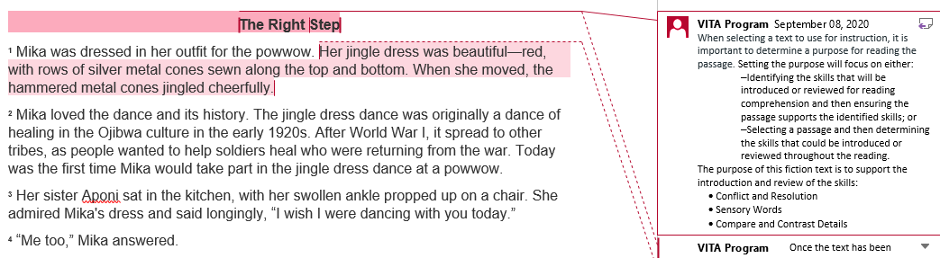
Step 1: Select Authentic Text (5 of 7)
Notes:
The annotations were created by Virginia Department of Education staff from the Office of Humanities and the Office of Student Assessment. VITA Program (Virginia Information Technologies Agency) is the author of the annotations.

Slide 16
Step 1: Select Authentic Text (6 of 7)
Passage: The Right Step
This fiction passage example will be used to demonstrate how the selection of authentic text supports the introduction and review of specific skills.
Please see the annotated Word document for additional support.

Slide 17
Step 1: Select Authentic Text (7 of 7)
The selected fiction passage, “The Right Step”*, supports the introduction and review of:
  Conflict and Resolution
  Sensory Words
  Compare and Contrast Details
  *Please see the annotated Word document for additional support.

Slide 18
Step 2: Examine the Content and Progression of Standards for SOL 4.5F
3.5I- Identify the conflict and resolution.
4.5F- Identify the conflict and resolution.
5.5E- Explain the resolution of conflicts.

Slide 19
Step 2: Examine the Content and Progression of Standards for SOL 4.5G
Grade 3 – Introduced in Grade 4
4.5G- Identify sensory words.
5.5I - Explain how an author’s choice of vocabulary contributes to the author’s style.

Slide 20
Step 2: Examine the Content and Progression of Standards for SOL 4.5I
Grade 3 – Introduced in Grade 4
4.5I - Compare/contrast details in literary and informational nonfiction texts.
5.5L- Compare/contrast details in literary and informational nonfiction texts.

Slide 21
Step 3: Sample Question Starters for SOL 4.5F
What is a conflict?
What is another word for when the conflict is solved?
Identify the conflict from [insert title of text].
Identify the resolution from [insert title of text].
What is the main conflict in [insert location or title of text]?
Which paragraph shows the conflict has been resolved?
Identify and explain the conflict and resolution from [insert title of text]. Include specific details from the text to support your answer.

Slide 22
Step 3: Sample Question Starters for SOL 4.5G
What are sensory words?
What are some words/phrases that appeal to your senses?
Explain why sensory words are used.
Identify the sensory words from [insert title or location of text ].
Why are sensory words used in [insert title or location of the text]?
Which paragraph(s) use sensory words in [insert title of the text]?
Explain how sensory words help the reader understand [insert statement from the text]. Use specific details from the text to support your answer.

Slide 23
Step 3: Sample Question Starters for SOL 4.5I
What does it mean to compare and contrast details?
How are [insert character name] and [insert character name] the same?
One difference between [insert character name] and [insert character name] is that-- [insert statements]
[Insert location from text] and [insert location from text] both suggest that-- [insert statements]
Explain why [insert character name] would agree or disagree with [insert statement from the text]. Use specific details from the text to support your answer.

Slide 24
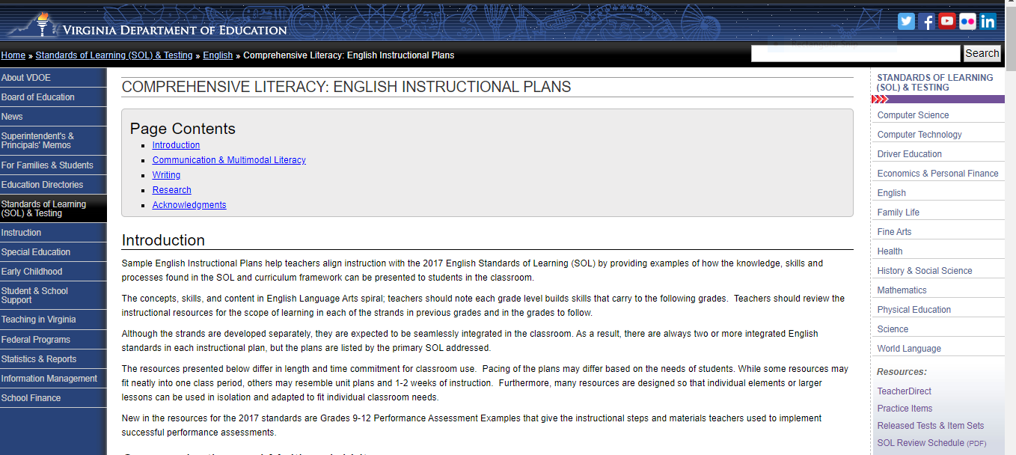
Step 4: Exploring Instructional Resources (1 of 4)
Comprehensive Literacy: English Instructional Plans

Slide 25
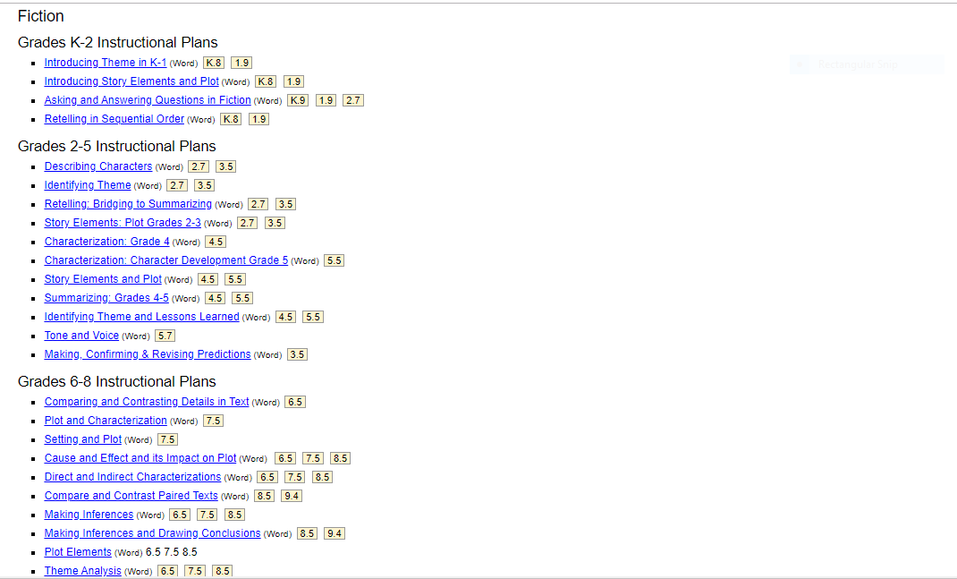
Step 4: Exploring Instructional Resources (2 of 4)

Slide 26
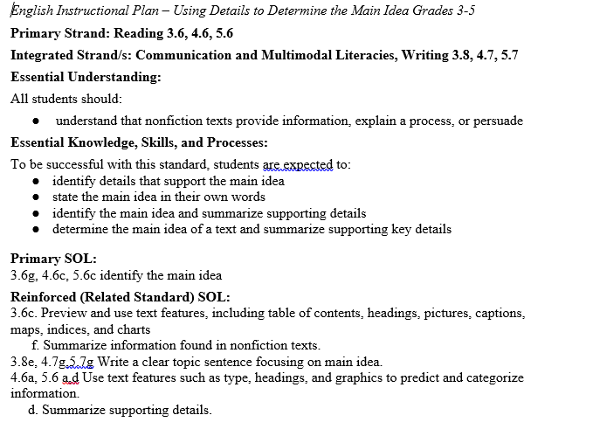
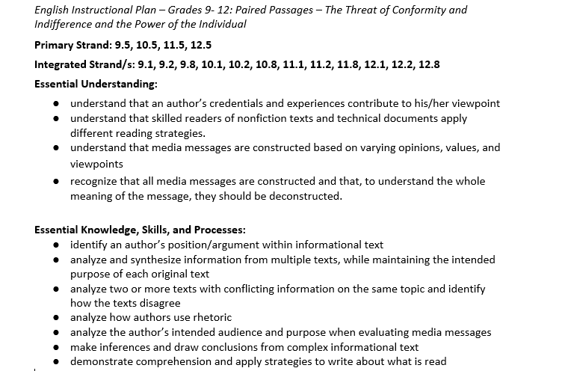
Step 4: Exploring Instructional Resources (3 of 4)

Slide 27
Step 4: Exploring Instructional Resources (4 of 4)
Comprehensive Literacy: English Instructional Plans
  Story Elements and Plot (4.5F)
This instructional plan was created by Virginia teachers to model how a skill can be introduced or reviewed.
  Please note: text examples within the instructional plans can be changed based on grade level, genre, etc.
  This plan models story elements including conflict and resolution; however, if the text supports the spiraling of additional skills they should be implemented to support reading comprehension and skill application.

Slide 28
Step 1: Select Authentic Text (1 of 2)
Informational: Coconut Crabs
This nonfiction passage example will be used to demonstrate how the selection of authentic text supports the introduction and review of specific skills.
Please see the annotated Word document for additional support.

Slide 29
Step 1: Select Authentic Text (2 of 2)
The selected article, “Coconut Crabs”*, supports the introduction and review of:
  Author’s Purpose
  Summarize Supporting Details
  Fact and Opinion
  *Please see the annotated Word document for additional support.

Slide 30
Step 2: Examine the Content and Progression of Standards for SOL 4.6 B
3.6A- Identify the author’s purpose.
4.6B- Explain the author’s purpose.
5.6G- Locate information from the text to support opinions, inferences, and conclusions.

Slide 31
Step 2: Examine the Content and Progression of Standards for SOL 4.6D
3.6F- Summarize information found in nonfiction texts.
4.6D- Summarize supporting details.
5.6D- Summarize supporting details.

Slide 32
Step 2: Examine the Content and Progression of Standards for SOL 4.6 G
Grade 3 – Introduced in grade 4.
4.6G- Distinguish between fact and opinion.
5.6I – Differentiate between fact and opinion.

Slide 33
Step 3: Sample Question Starters for SOL 4.6B (1 of 2)
What does the author want us to know about the text?
The author wrote [insert title of text] most likely to-- [insert statements]
The main purpose of [insert title or location from text] is to--
Why did the author include [insert location from text]?

Slide 34
Step 3: Sample Question Starters for SOL 4.6B (2 of 2)
The author [insert technique used i.e., question asked, descriptive language, figurative language, etc.] in [insert location from text] to--
The author’s use of [insert word or phrase] suggests that-- [insert statements]
Explain the main purpose of [insert title of text]. Use specific details from the text to support your answer.

Slide 35
Step 3: Sample Question Starters for SOL 4.6D
Which question is answered in [insert location or title of text]?
Which of these details should NOT be included in a summary of [insert location or title of text]?
Which paragraph answers [insert question]?
The author included [insert detail from text] to --
Explain why adding [insert new detail] supports [insert location or title of text]. Use specific details from the text to support your answer.

Slide 36
Step 3: Sample Question Starters for SOL 4.6G
How are facts and opinions different?
Which sentence from [insert location or title of text] is a fact? [insert statements from text]
Which word makes this sentence an opinion? [insert sentence]
Which statement about [insert name, person, event, etc. from the text] is a fact?
[Insert two sentences, one fact and one opinion, from the text]. Identify and explain which sentence is a fact and which is an opinion. Use specific details from the text to support your answer.

Slide 37
Step 4: Exploring Instructional Resources
Comprehensive Literacy: English Instructional Plans
  Using Details to Determine Main Idea: Grades 3-5 (4.6D)
This instructional plan was created by Virginia teachers to model how a skill can be introduced or reviewed.
  Please note: text examples within the instructional plans can be changed based on grade level, genre, etc.
  This plan models using details to arrive at the main idea; however, if the text supports the spiraling of additional skills they should be implemented to support reading comprehension and skill application.

Slide 38
Resources (1 of 2)
Virginia Department of Education: English
  Grade 3 Reading Blueprint
  Grade 4 Reading Blueprint
  Grade 5 Reading Blueprint
  Grade 6 Reading Blueprint
  Grade 7 Reading Blueprint
  Grade 8 Reading Blueprint
  End-of-Course Reading Blueprint

Slide 39
Resources (2 of 2)
Reading Progression Charts
2017 Curriculum Framework
2017 Standards of Learning
Computer Adaptive Testing
Comparison of a Passage-Based CAT and a Traditional Test
Assessment Supports for 2020-2021 Literacy Webinar Series
Recover, Redesign, Restart 2020

Slide 40
Resources (3 of 3)
Frequently Asked Questions about Passage-Based CAT Testing
SOL Practice Items in TestNav 8
2019 English Deeper Learning Conferences
2018 English Standards of Learning (SOL) Institutes
Comprehensive Literary: English Instructional Plans
Superintendent’s Memo 249-20: Update on New Standards of Learning Tests in Reading and History and Social Science

Slide 41
Stay Connected
Office of Student Assessment
  student_assessment@doe.virginia.gov
  (804) 225-2102
Department of Learning and Innovation
  Jill Nogueras, K-12 English Coordinator,
  jill.nogueras@doe.virginia.gov
  Carmen Kurek, Elementary English Specialist,
  carmen.kurek@doe.virginia.gov
  Colleen Cassada, Middle School English Specialist,
  colleen.cassada@doe.virginia.gov

Slide 42
Disclaimer
Reference within this presentation to any specific commercial or non-commercial product, process, or service by trade name, trademark, manufacturer or otherwise does not constitute or imply an endorsement, recommendation, or favoring by the Virginia Department of Education.

Slide 43
Copyright ©2020 by the Commonwealth of Virginia, Department of Education, P.O. Box 2120, Richmond, Virginia 23218-2120. All rights reserved. Except as permitted by law, this material may not be reproduced or used in any form or by any means, electronic or mechanical, including photocopying or recording, or by any information storage or retrieval system, without written permission from the copyright owner. Commonwealth of Virginia public school educators may reproduce any portion of these items for non-commercial educational purposes without requesting permission. All others should direct their written requests to the Virginia Department of Education at the above address or by e-mail to Student_Assessment@doe.virginia.gov.

